Slide 1
Analysis of Graphs for Digital Preservation Suitability
Charles L. Cartledge
Michael L. Nelson
Old Dominion University
Department of Computer Science
Norfolk, VA 23529 USA

Slide 2
Overview
Why the problem is of interest
Picking apart the title
  Preservation
  Graph
  Suitability
A game
Results
Conclusion
2

Slide 3
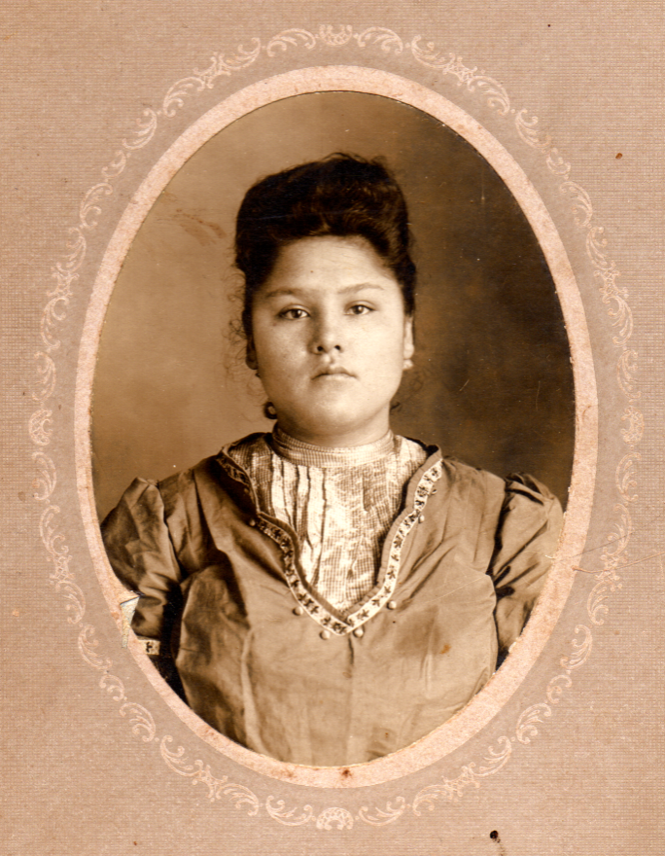
A Preservation Scenario
In 2007, Bob received a photograph from an analog age
Bob wants to preserve the photograph into a digital age
3

Slide 4
Bob Creates a Web Object (WO)
{
Scanned image of the photograph
Metadata
  Name
  Date
  Image type
  etc.
Data
{
dc.name = “Josie McClure”
dc.date = “28 Feb 1907”
dc.type = “image/tiff”
…
Other data: TBD
Metadata

Slide 5








Trials and Tribulations of Bob’s Attempts at Digital Preservation
+
=

Slide 6


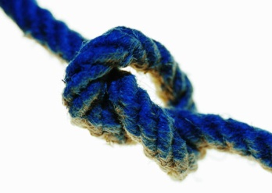


Options and Threats to Bob’s Other Digital Preservation Plan
dc.name = “Josie McClure”
dc.date = “28 Feb 1907”
dc.type = “image/tiff”
…
Other data: TBD
6

Slide 7
Change the Perspective and Revisit the Problem
Can web objects (WO) be constructed to act in an autonomous manner to create a network of WOs that live on the web architecture and can be expected to outlive the people and institutions that created them?
7

Slide 8
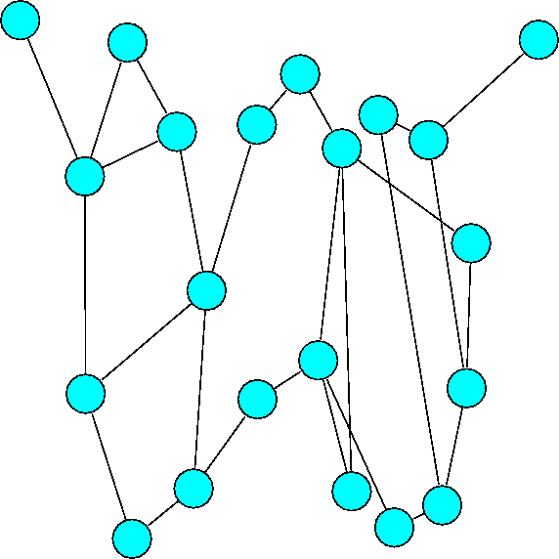
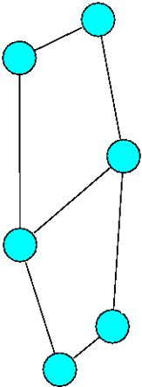
A Change in Notation and Size

Slide 9
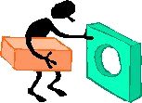
Now on to Suitability
Title: Analysis of Graphs for Digital Preservation Suitability
Repurpose one thing to do something else
To revisit how something works and utilize it in a new and novel way
“To bravely go where no one …”
9

Slide 10
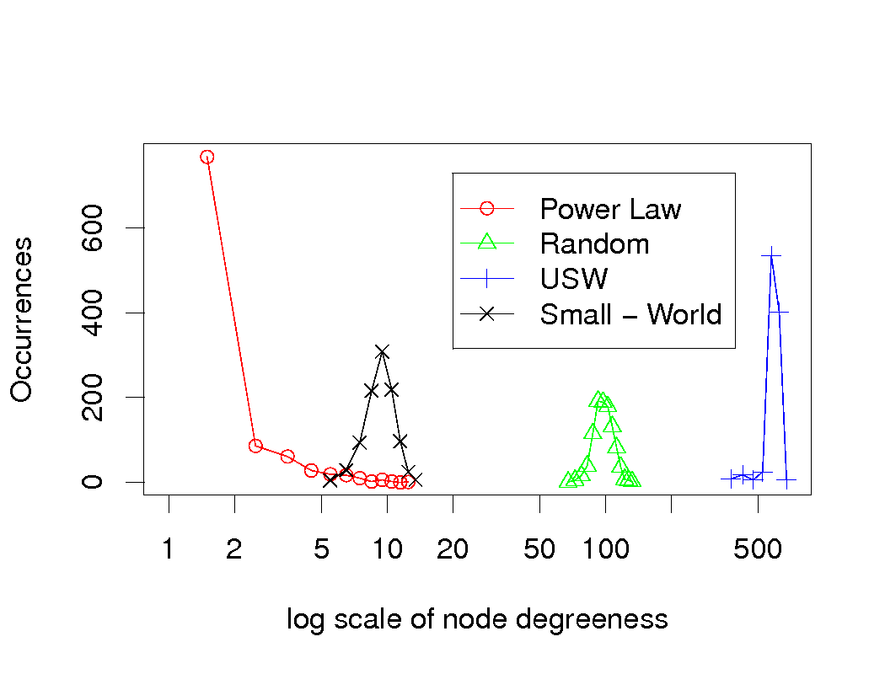
Types of Graphs Based on “Degreeness”
Title: Analysis of Graphs for Digital Preservation Suitability
Random – global construction
Power Law – global construction
Small World – global construction
Unsupervised Small World (USW) – local construction
“The number of systems of terminology presently used in graph theory is equal, to a close approximation, to the number of graph theorists.”
Enumerative Combinatorics, 1986
10

Slide 11
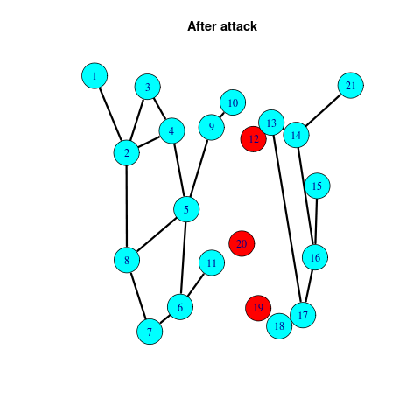
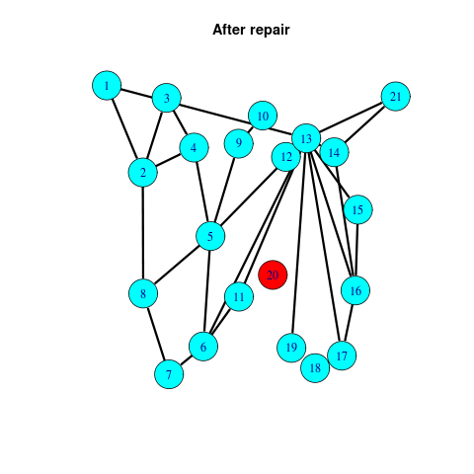
Intuitive Thoughts about the Robustness and Resilience in a Graph
Robustness – a complex network is robust if it keeps is basic functionality even under failure of some of its components
Resilience – is how a network responds against repeated component failure
Brandes, “Network Analysis,
Methodological Foundations”, 2005
11

Slide 12
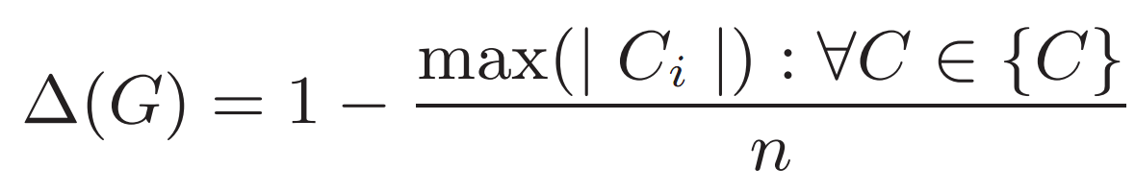
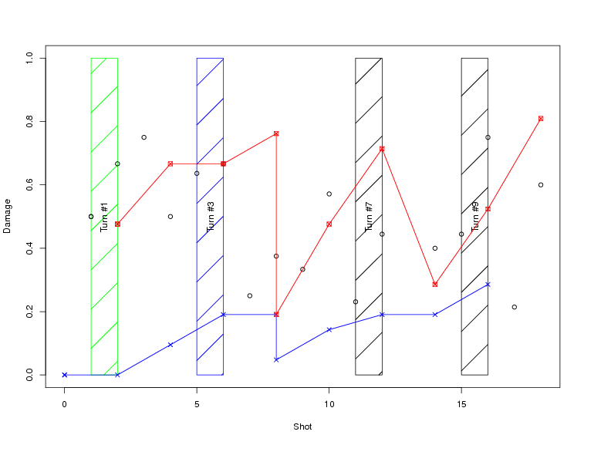
How to Quantify a Graph’s Robustness and Resilience
There are lots of ways to quantify the characteristics of a graph
This equation captures our intuition of damage to a graph based on its structure

Slide 13
The Centrality Concept
Centrality “denotes an order of importance on the vertices or edges of a graph by assigning real values to them.”
A centrality index “is only depending on the structure of the graph.”
Brandes, “Network Analysis,
Methodological Foundations”, 2005

Slide 14
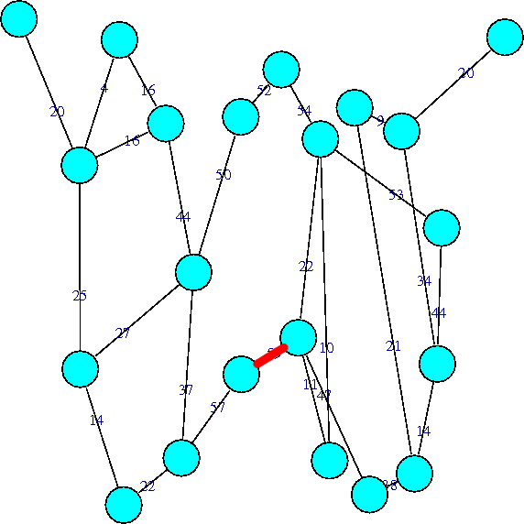


Edge Betweenness Centrality
The number of shortest paths between all nodes that go through an edge
Highest = 57 (more than one)
Lowest = 4

Slide 15
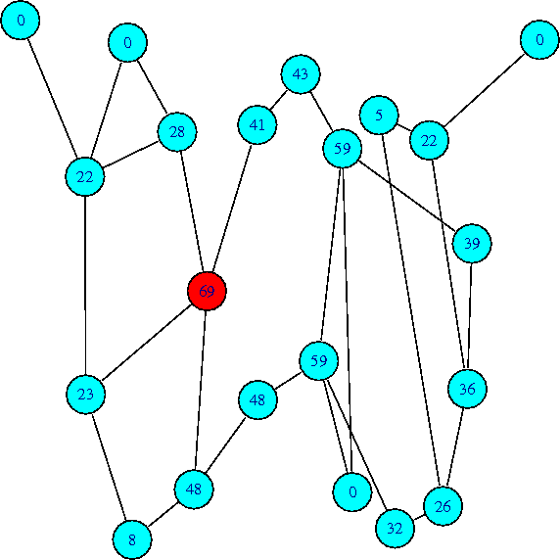
Vertex Betweenness Centrality
The number of shortest paths that go through a vertex
Highest = 69
Lowest = 0 (more than one)

Slide 16
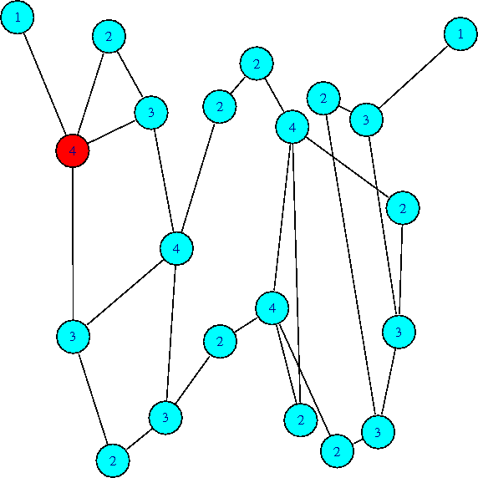
Degree Betweenness Centrality
The number of edges incident to a vertex
Highest = 4 (more than one)
Lowest = 1 (more than one)

Slide 17
How Different Centrality Measures Can Affect the Game Space
An attack profile uses a centrality measurement to decide which graph component to eliminate
Mallory will use an attack profile during the game
Attack profile | # of unique graphs | Max. depth | Min. depth | Mean depth | St. dev. Depth
D-V-L | 428,580 | 20 | 4 | 15.57 | 3.65
D-V-H | 8 | 2 | 1 | 1.87 | 0.35
B-E-L | 7 | 6 | 6 | 6 | 0.00
B-E-H | 2 | 2 | 2 | 2 | 0.00
B-V-L | 53,155 | 20 | 15 | 19.56 | 0.82
B-V-H | 1 | 2 | 2 | 2 | n/a
17

Slide 18
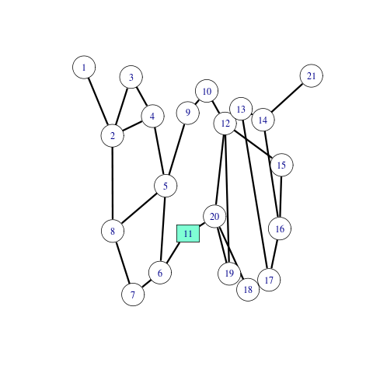
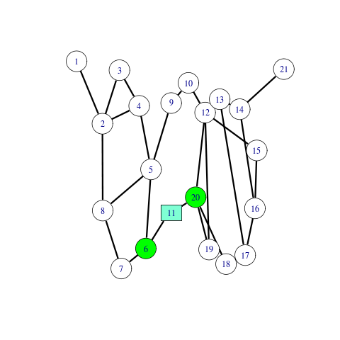
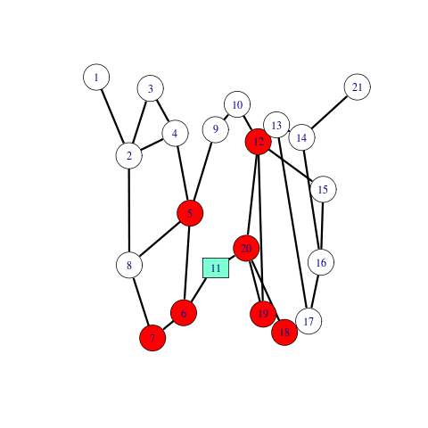
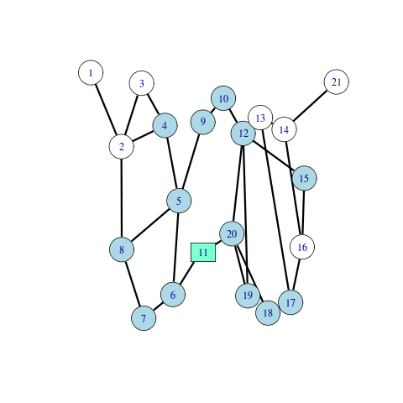
Local vs. Global Graph Knowledge
As the path length grows, graph knowledge grows from Local to Global

Slide 19
A Game Between Mallory and Bob’s Graph
Mallory’s goal - destroy the graph, or give up
Bob’s graph’s goal - survive
Rules of the game
  Alternating turns
  Mallory has to maintain the same attack profile through out
  Mallory has local knowledge only
  Mallory can only remove/destroy a maximum number of edges or vertices per turn
  Bob’s graph can only attempt to recreate a fixed percentage of the graph per turn
19

Slide 20
Let the Game Begin!
Sample graph
  20 vertices
  24 edges
  Random degree distribution
Attack parameters
  Attack profile: B-V-H
  Malory has 2 shots per turn
  Path length: 2 edges
20

Slide 21
Results from a Larger Game
Graph has 1,000 nodes
Attack parameters
  Attack profile: B-V-H
  Attacker has 100 shots per turn
  Path length: 10 edges
Resilience parameters
  Graph repair: 4% of nodes selected for potential reconstruction
  Same repair parameters as creation
Game ends at 10 turns or when the graph is disconnected
Results
  Power law graph – 1 vertex
  Random graph – 100 vertices
  Small world graph 140 vertices
  USW – 170 vertices
21

Slide 22

How the Graph Would be Used for Preservation
Title: Analysis of Graphs for Digital Preservation Suitability
WO contains digital data to be preserved
WO contains links to copies of itself and to other WOs
When WO is accessed, it checks the availability of its own copies and connections to “neighboring” WOs
If copies are lost, then initiate reconstruction processes
Others
Self
Reconstruct
Accessed
22

Slide 23
Conclusion
A USW graph is more robust than small-world, random or power law graphs
USW has shown to have better preservation potential than other tested graphs
Analysis of Graphs for Digital Preservation Suitability
Charles L. Cartledge
Michael L. Nelson
Old Dominion University
Department of Computer Science
Norfolk, VA 23529 USA
This work was funded in part by the National Science Foundation.

