Slide 1
2D Oculomotor Plant Mechanical Model
By
Sampath Jayarathna, B.S.
Supervising Professor: Dr. Oleg V. Komogortsev
Graduate Thesis Defense
Department of Computer Science
Texas State University – San Marcos

Slide 2
Our Approach
The goal of the model is to simulate eye positional signal on a two dimensional plane with characteristics resembling normal humans.
These characteristics are represented by,
The difference between simulated and the actual position of the eye movement signal
The relationship between the amplitude and the duration of the saccade and
The properties of the main-sequence relationship

Slide 3
Objectives
The OP, driven by the neuronal control signal, exhibits six eye movement types: fixations, saccades, smooth pursuits, optokinetic reflex, vestibulo-ocular reflex, and vergence.
The goal of the model is to provide an accurate eye position trace during saccades with the duration and main sequence relationships within the physiological capabilities of a normal human.

Slide 4
Background
There are two categories of the OP models that have been presented to the scientific community so far.
The first category - 1D OP Models
Westheimer [Westheimer 1954],
Robinson [Robinson 1973],
Clark and Stark [Clark and Stark 1974],
Bahill [Bahill 1980],
Komogortsev & Khan [Komogortsev and Khan 2009],
Martin and Schovanec [Martin and Schovanec 1998].

Slide 5
Background – 1D Models
Westheimer - a linear two-order OP system.
Robinson – a four-order OP system
Both models - main sequence relationship not supported
Bahill - a sixth-order linear homeomorphic OP model, with velocity output close to the physiological recordings of normal humans.
Only rightward saccades from the primary eye position.

Slide 6
Background
Komogortsev & Khan - modified Bahill’s model providing both rightward and leftward horizontal saccades from any angular position.
Martin and Schovanec – a non-linear tenth order system,
Anatomically accurate hill-type individual extraocular muscle model with a passive elasticity component modeled in a non linear fashion.

Slide 7
Background – 3D OP Models
The second category – 3D OP models
Models without considering the force output or anatomical properties of the individual extraocular muscles
Rapahn [Raphan 1998]
Tweed[Tweed 1997].
A non-linear models with most accurate representations for the anatomical components such as individual properties of the EOP and pulley mechanics.
Polpitiya [Polpitiya et al. 2002]
Lockwood-Cooke [Lockwood-Cooke et al. 1999].

Slide 8
Background – 2DOPMM
The 2DOPMM incorporates a realistic pulse-step properties of the neuronal control signal.
Each extraocular muscle is modeled individually, allowing maintaining physiological agonist-antagonist nature of the extraocular movement dynamics.
The model of each muscle encapsulates elastic, viscous, active state tension, length tension and force velocity relationships properties by creating a linear mathematical representation of each component.

Slide 9
Background – 2DOPMM
The strength of the proposed model is its linear and homeomorphic design that keeps it simple enough to allow its implementation in the real-time eye gaze aware systems.
We hypothesize that the 2D model will allow to investigate novel schemes of Human Computer Interaction as in [Komogortsev et al. 2009 ] and improving the robustness of the biometrics systems as presented in [Komogortsev et al. 2010]

Slide 10
Background – 2DOPMM
The model is verified via RMSE and R² provides an accurate eye position trace during saccades with the duration and main sequence relationships within the physiological capabilities of a normal human.
The accuracy of the model is verified against two types of independent eye movement recordings, employing various setups and eye tracker equipment, and 49 subject records.

Slide 11
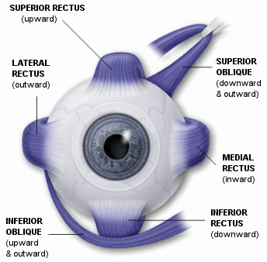
Human Visual System
The eye globe rotates in its socket through the use of six muscles,
lateral/medial recti
superior/inferior recti
superior/inferior oblique

Slide 12
Human Visual System….
The brain sends a neuronal control signal to each muscle to direct the muscle to perform its work.
A neuronal control signal is anatomically implemented as a neuronal discharge that is sent through a nerve to a designated muscle from the brain.
The neuronal control signal for the horizontal and vertical components is generated by different parts of the brain.

Slide 13
2DOPMM Overview
Our 2D OPMM is driven by the neuronal control signal innervating four extraocular muscles (EOM) lateral, medial, superior, and inferior recti that induce eye globe movements.

Slide 14
2DOPMM Overview
Evoked by muscle movements, an eye can move in 8 different directions: Right Horizontal, Left Horizontal, Top Vertical, Bottom Vertical, Right Upward, Left Upward, Right Downward, and Left Downward.
Each muscle plays the role of the agonist or the antagonist.
The agonist muscle contracts and pulls the eye globe in the required direction and the antagonist muscle stretches and resists the pull.

Slide 15
Right Upward eye movement
Lateral Rectus - AG
Medial Rectus - ANT
Superior Rectus - AG
Inferior Rectus - ANT

Slide 16
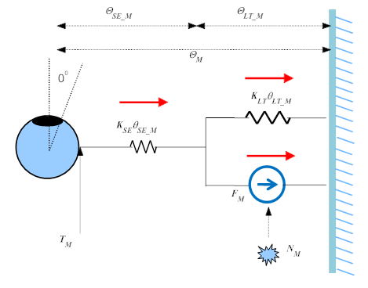
Stationary MEOM of the agonist muscle

Slide 17
Stationary MEOM of the agonist muscle
Neuronal control signal N_{M} creates active tension force that works in parallel with the length-tension force .
Altogether they produce tension that is propagated through the series elasticity components to the eye globe.

Slide 18
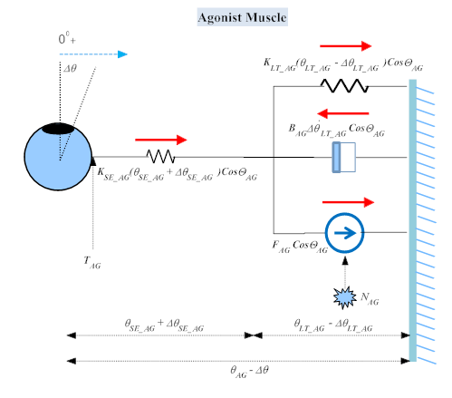
Agonist EOM Model

Slide 19
MMM Scalar Values
Length tension force of agonist is,
where θ_{LT_AG} is the displacement of the spring in the horizontal direction and K_{LT_AG} is the spring’s coefficient
The force propagated by the series elasticity component is,
where θ_{SE_AG} is the displacement of the spring and K_{SE_AG} is the spring’s coefficient.

Slide 20
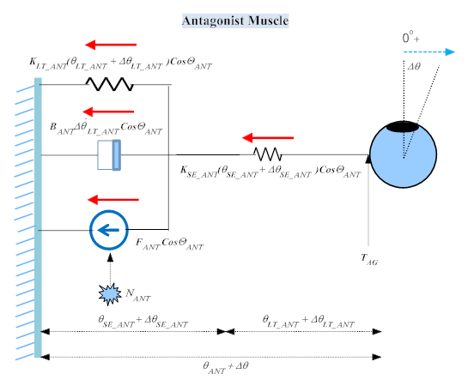
Antagonist EOM Model

Slide 21
1DOPMM
The equations for the one dimensional case, e.g. horizontal movement, are created by considering all forces that contribute to the rotation of the eye globe.
The agonist force dynamics can be described by combining equations on agonist MEOM,
The antagonist dynamics is derived by combining equations on antagonist MEOM,

Slide 22
1DOPMM
Newton’s second law is applied to receive the equation connecting the acceleration of the eye globe and inertia to all forces acting on the eye globe,

Slide 23
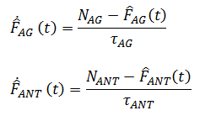
1DOPMM
Two equations describe the dynamics of the active state tension,
The last equation connects the derivative of position to the velocity of the movement signal.

Slide 24
1DOPMM
Two equations describe the dynamics of the active state tension,
The last equation connects the derivative of position to the velocity of the movement signal.

Slide 25
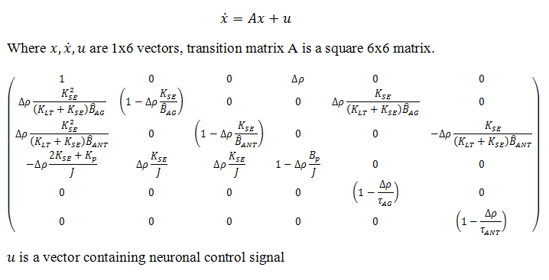
1DOPMM
By writing previous 6 differential equations in matrix form we can obtain the following equation which completely describes the Oculomotor Plant mechanical model during 1D saccades.

Slide 26
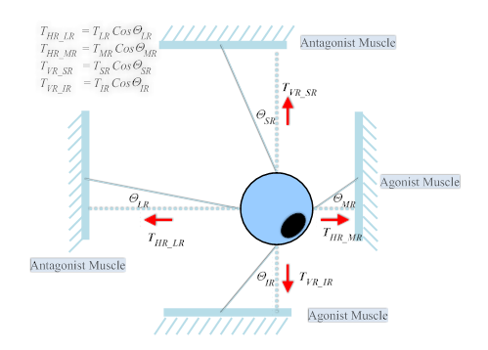
2DOPMM
In a 2D case EOM movement dynamics and roles remain essentially the same as in 1D case, i.e., the agonist muscles contract and pull the eye globe in the required direction and the antagonist muscles stretch and resist the pull.

Slide 27
2DOPMM
Twelve differential equations describe the 2DOPMM.
Two equations are created as a result of the application of the Newton’s second law to the vertical and the horizontal component of the eye movement.
Four equations describe the dynamics of the EOM forces that move the eye globe.
Four equations describe the transformation of the neuronal control signal in each EOM to the active state tension
Two equations connect the velocity of the eye movement to the position of the eye in the vertical and horizontal plane.

Slide 28
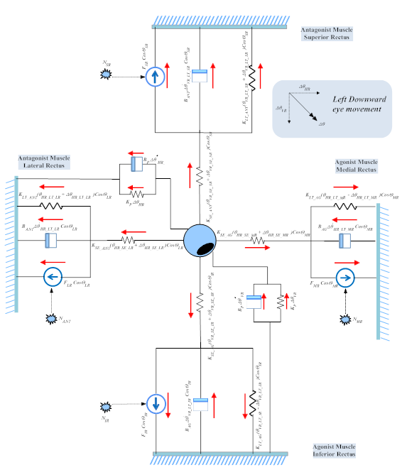
2DOPMM – Left Downward rotation

Slide 29
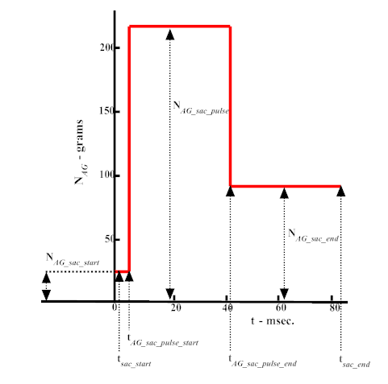
Neuronal Control Signal
The neuronal control signal during saccades is a pulse-step function. The step part of the signal is created by positional command (angular eye position prior to and after a saccade) and pulse part of the signal is created by the velocity command, which is determined by the amplitude of the programmed saccade.

Slide 30
Neuronal Control Models
The choice of the specific neuronal control signal model during a saccade is an area of active research.
This research study presents two existing models that were developed for the horizontal saccades, and a new model essentially adhering to the main-sequence relationship.
Main sequence properties are defined by the following formula:

Slide 31
Neuronal Control Models
Model I
Model II
Model III

Slide 32
Methodology
Apparatus
Tobii x120 eye tracker,
Standalone unit connected to a 19 inch flat panel screen with resolution of 1280x1024.
The eye tracker performs binocular tracking with the following characteristics:
accuracy 0.5°,
spatial resolution 0.2°,
drift 0.3°, and
eye position sampling frequency of 120Hz.

Slide 33
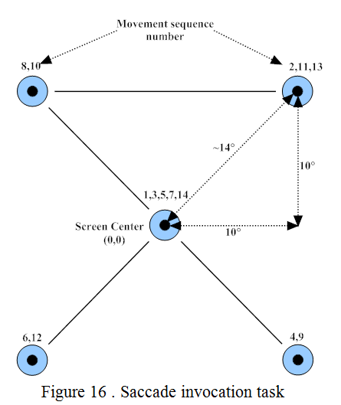
Methodology
Saccade Invocation Task
14 points invoking 13 stimuli saccades.
After each subsequent jump the point remained stationary for 1.5s before the next jump.
The size of the point was approximately 1° of the visual angle with center marked as a black dot.

Slide 34
Methodology
Participants & Quality of the Recorded Data
A total of 68 participants (24 males/ 44 females),
18 – 25 (mean 21.2) years old.
All participants had normal or corrected-to-normal vision.
Only 49 participant records passed the validation criteria resulting in the average calibration error of 1.21º ± 0.49 and valid data percentage of 96.12% ± 3.89.

Slide 35
Methodology
Auxiliary Data Set – DOVES
The DOVES consists of eye positional recordings collected from 29 human observers as they viewed 101 natural calibrated images.
Recordings were done using a high precision dual-Purkinje eye tracker with accuracy of <10 min of arc, precision of about 1 min of arc, a response time of <1 ms, and sampling frequency of 200Hz.

Slide 36
Methodology
Model Validation Metrics
The Root Mean Squared Error (RMSE) computed by the equation was employed to indicate a magnitude of error between the simulated and actual signal.
R² statistic was employed to indicate the goodness of fit for horizontal and vertical components of movement

Slide 37
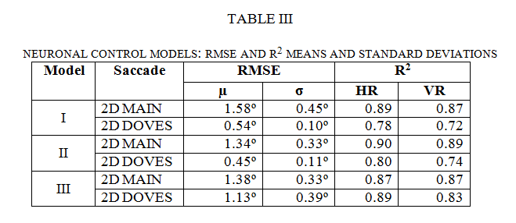
Results – Model Validation
The resulting RMSE for the main database for all models was at least 0.5º as small than the computed distance between the left and right eyes (mean 2.01º±0.73).

Slide 38
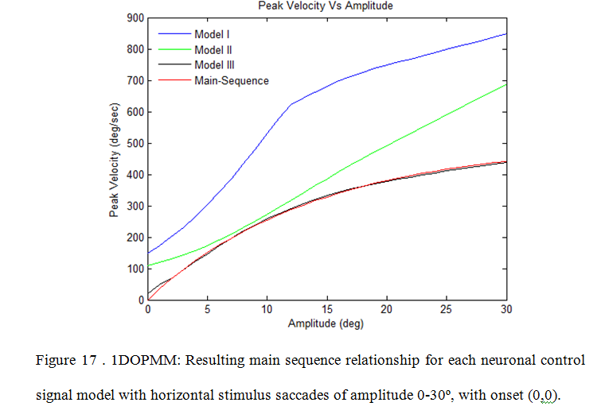
Results – Main Sequence Relationship

Slide 39
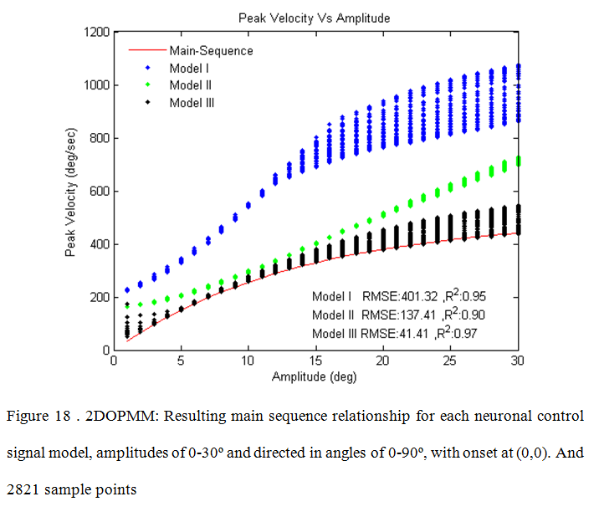
Results – Main Sequence Relationship

Slide 40
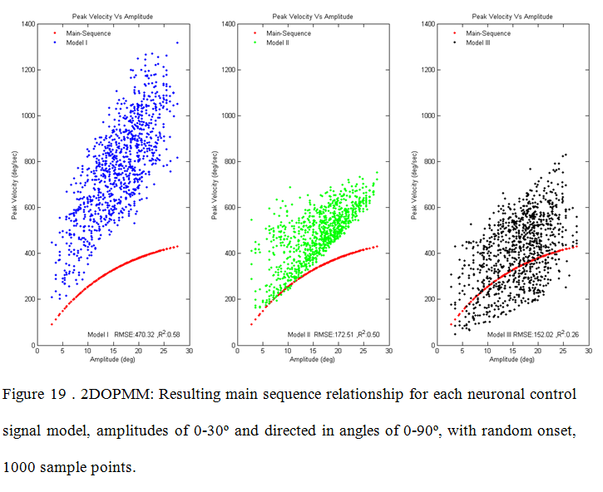
Results – Main Sequence Relationship

Slide 41
Conclusion
Eye mathematical modeling can be used to advance such fast growing areas of research as medicine, HCI, and software usability.
Our model, 2DOPMM is capable of generating eye movement trajectories with both vertical and horizontal components during fast eye movements (saccades) given the coordinates of the onset point, the direction of movement, and the value of the saccade amplitude.
The important contribution of the proposed model to the field of bio engineering is the ability to compute individual extraocular muscle forces during a saccade

Slide 42
Conclusion – Future Work
The fit to the main sequence relationship was adequate, but with large velocity errors, indicating the need for the development of the new models of the neuronal control for the random eye movements.
In the future the 2DOPMM can be applied to the novel Human Computer Interaction techniques and biometric systems as conducted with 1DOPMM model.

Slide 43
List of Publications
_{Refereed Journal Publications}
Sampath Jayarathna and Oleg Komogortsev. " Two Dimensional Oculomotor Plant Mathematical Model (2DOPMM)". IEEE Transactions on Systems, Man, and Cybernetics-Part A: Systems and Humans. (In Review)
Oleg Komogortsev, Denise Gobert, Sampath Jayarathna, Do Hyong Koh and Sandeep Gowda. " Standardization of Automated Analysis of Oculomotor Fixation and Saccadic Behaviors ". IEEE Transactions on Biomedical Engineering. (In Review)
Refereed Conference Publications
Oleg Komogortsev, Sampath Jayarathna, Cecilia Aragon, and Mahmouod Mechehoul. "Biometric Identification via an Oculomotor Plant Mathematical Model". Proceedings of the 2010 Symposium on Eye-Tracking Research & Applications (ETRA'10), Austin, Texas, March 22-24, 2010, ISBN: 978-1-60558-994-7
Oleg Komogortsev, Sampath Jayarathna, Do Hyong Koh, and Sandeep Gowda, . "Qualitative and Quantitative Scoring and Evaluation of the Eye Movement Classification Algorithms". Proceedings of the 2010 Symposium on Eye-Tracking Research & Applications (ETRA'10), Austin, Texas, March 22-24, 2010, ISBN: 978-1-60558-994-7
Oleg Komogortsev and Sampath Jayarathna, "2D Oculomotor Plant Mathematical Model for Eye Movement Simulation". In proceedings of the 8th International Conference on Bioinformatics and Bioengineering (BIBE08), Athens, Greece, Oct 8-10, 2008, ISBN:978-1-4244-2845-8, pp.103
_{Posters and other papers}
Sampath Jayarathna, Oleg Komogortsev, Cecilia Aragon, and Mahmouod Mechehoul. "Oculomotor Plant Biometric: Person Specific Features in Eye Movements". 2009 Sigma Xi International Research Conference, The Woodlands, Texas, Nov 12-15, 2009. [poster session paper]
Sampath Jayarathna, Oleg Komogortsev, Cecilia Aragon, and Mahmouod Mechehoul. "Oculomotor Plant Biometric Identification". International Research Conference for Graduate Students, Texas State University, San Marcos, Texas, Nov 4-5, 2009. [oral presentation]

Slide 44
Acknowledgement
Supervising Professor: Dr. Oleg Komogortsev
Thesis Committee:
Dr. Xiao Chen
Dr. Carl Mueller
Dr. Denise Gobert (Texas State Physical Therapy)
Dr. Cecilia Aragon (Lawrence Berkeley National Lab)
Do Hyong Koh
Sandeep Gowda
Nirmala Karunarathna
This research is partially supported by Sigma Xi : The Scientific Research Society Grant-In-Aid of Research program grants G200810150639, G2009102034, and Texas State University – San Marcos.

Slide 45
Questions?

