Slide 1
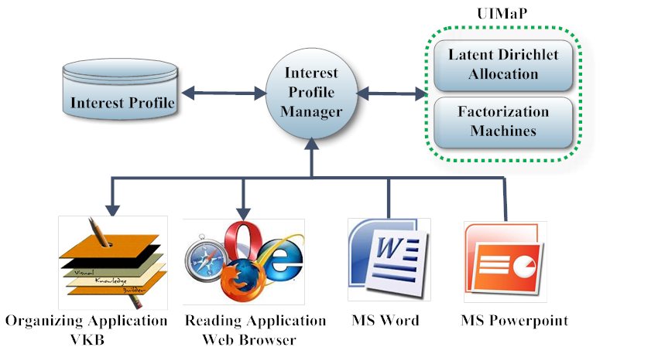
UIMaP: Mining Short-Term User Interest from Personalized Triage Tasks Sampath Jayarathna, Atish Patra and Frank Shipman
Computer Science & Engineering, Texas A&M University – College Station
ABSTRACT
USER INTEREST MINING
SEARCH AND RECOMMENDATIONS
We are interested about open-ended information gathering tasks—document triage tasks in particular—in which people collect Web documents for interpretation and synthesis.
User interests are usually distributed in different systems during a triage tasks. Traditional user interest modeling methods are not designed for integrating and analyzing interests from multiple sources, hence, they are not very effective for obtaining comparatively complete description of user interests in a multi-application environment.
We propose UIMaP -User Interest Management and Personalization, to detect triage task sessions and group them according to common task or intent.
Figure 1. Multi-Application Short-term Interest Modeling
Even with the best search engine and the most effective query formulation, “triage tasks” require people to work through long lists of documents to synthesize the information they need; there is usually no single document containing one right answer. In fact, as people skim early documents, they may determine additional information needs that suggest further queries and results in even more documents to process.
Problem Statement: Our task is, given a sequence of document triage tasks, predict whether the user will continue on the same triage session or switch to a new one.
WebAnnotate - During information task, useful documents may be long, and cover multiple subtopics; users may read some segments and ignore others. In order to record which portion(s) of the document pique the user’s interests, an explicit interest expressions (e.g. annotations using WebAnnotate) capturing tool is used .
Figure 2. Triage Session Segmentation
Latent Dirichlet Allocation (LDA) -LDA performs unsupervised identification of hidden topics in a document triage task using a generative probabilistic model, so that each triage task can be seen as a mixture of words (bag of words) over these topics
The resultant LDA output consists of a topic probability distribution per triage task and word probability distribution per topic.
The topic probability distribution provides list of triage tasks and their corresponding topics with the given topic probability distribution. By using a simple heuristics (topic with the highest probability), it is possible to obtain a triage task clusters or the tasks associated with each of the topics.
Normally, users perform triage tasks using multiple applications in concert: a search engine interface presents lists of potentially relevant documents; a document reader displays their contents; and a third tool—a text editor or personal information management application—is used to record notes and assessments (MS Word and MS PowerPoint).
An Interest Profile Manager infers users' interests from their interactions with the multi-applications, coupled with the characteristics of the interest modeling techniques. The resulting interest profile is used to generate visualizations that direct users' attention to documents or parts of documents that match their inferred interests.
We present preliminary investigation of predicting, in real time, weather a user is about to switch interest - that is, weather the user is about to finish the current triage task and switch to another triage task.
CONCLUSION & FUTURE WORK
Our major contributions in this work can be summarized as:
A novel application to perform short-term interest mining based on evidence coming from multiple applications and segmenting triage tasks using topic modeling.
In the future we plan on creating a weighting schema to identify the importance of evidence coming from multiple applications like VKB, Web Browser, Word and PowerPoint.
REFERENCES
Bae, S., Hsieh, H., Kim, D., Marshall, C.C., Meintanis, K., Moore, J.M., Zacchi, A. and Shipman, F.M. Supporting document triage via annotation-based visualizations. American Society for Information Science and Technology, 45 (1). 1-16.
Blei, David M., Andrew Y. Ng, and Michael I. Jordan. "Latent dirichlet allocation." the Journal of machine Learning research 3 (2003): 993-1022.
Guo, Qi, and Eugene Agichtein. "Beyond session segmentation: predicting changes in search intent with client-side user interactions." Proceedings of the 32nd international ACM SIGIR conference on Research and development in information retrieval. ACM, 2009.
Tolomei, G., Orlando, S. and Silvestri, F., Towards a task-based search and recommender systems. in In Proceedings of ICDE Workshops, (2010), 333-336.
Acknowledgements : This research is supported by NSF grant 0938074

