Slide 1
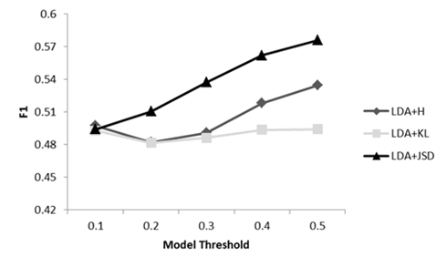
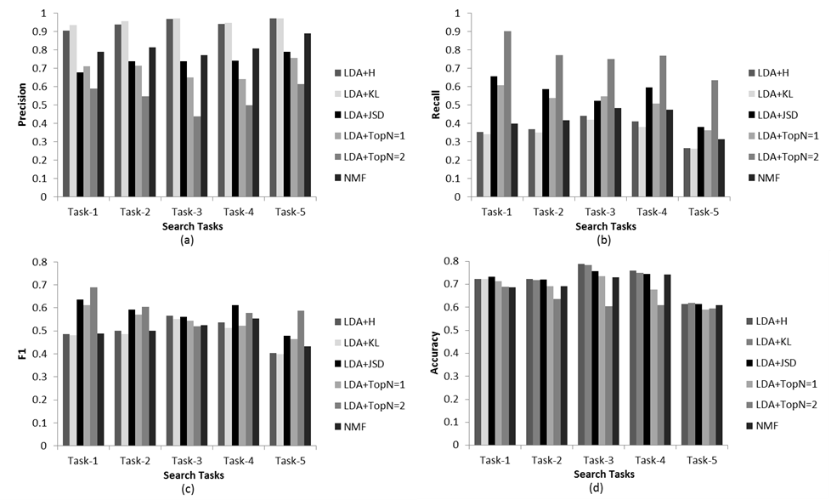
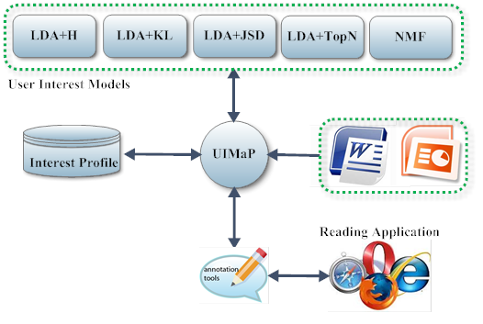
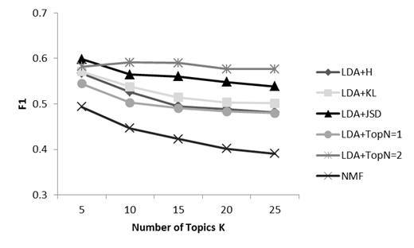
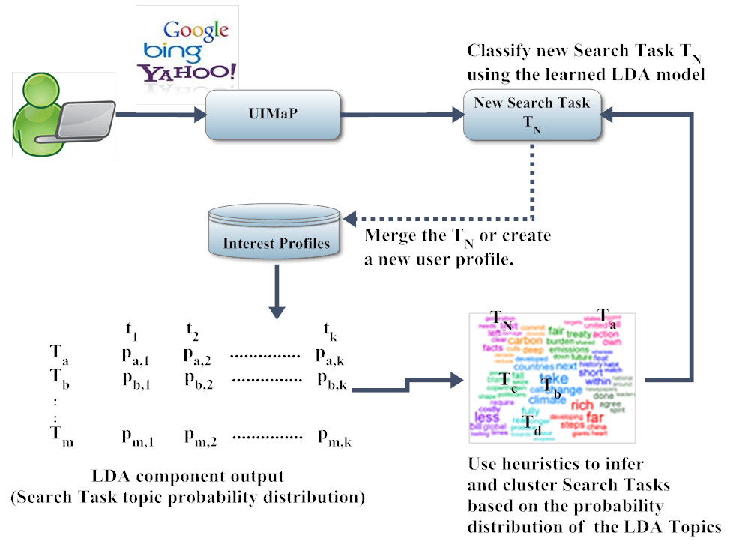
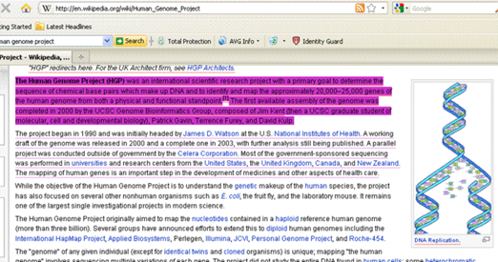
Mining Explicit Feedback for Multi-Application User Interest Modeling Sampath Jayarathna, Atish Patra and Frank Shipman
Computer Science & Engineering, Texas A&M University
PROBLEM STATEMENT
DATA SET AND RESULTS
“Compare alternative approaches to recommending a combination of documents and document components based on implicit and explicit feedback across multiple applications”
Figure 1. UIMaP: Overview and System Components
We explore recommendations of documents to support users to best match their interests during an open-ended information gathering task
A user often interacts with multiple applications while working on a search task
Our work helps in building a multi-application environment by inferring user profiles based on users’ aggregated interactions with multiple applications, coupled with an analysis of the characteristics and content of the documents they are interacting with
Figure 2. User Annotations and System Visualizations
MOTIVATION
Figure 4. Impact of UIMaP System Parameters Figure 5. Performance Comparisons of Different Topic Models
TOPIC MODELING
CONCLUSION & FUTURE WORK
Our major contributions in this work can be summarized as:
Topic model based study of the effectiveness of user interest modeling using explicit feedback indicators
Tensor factorization based study of the implicit feedback data as an expression of interest to enrich the explicit feedback based user model
Modeling of user-interest drift over time using the learned user interest model
REFERENCES
Jayarathna, S., A. Patra, and F. Shipman, Mining User Interest from Search Tasks and Annotations in Twenty-Second ACM International Conference on Information and Knowledge Management2013: San Francisco, CA, USA
Bae, S., Hsieh, H., Kim, D., Marshall, C.C., Meintanis, K., Moore, J.M., Zacchi, A. and Shipman, F.M. Supporting document triage via annotation-based visualizations. American Society for Information Science and Technology, 45 (1). 1-16.
Blei, David M., Andrew Y. Ng, and Michael I. Jordan. "Latent dirichlet allocation." the Journal of machine Learning research 3 (2003): 993-1022.
Tolomei, G., Orlando, S. and Silvestri, F., Towards a task-based search and recommender systems. in In Proceedings of ICDE Workshops, (2010), 333-336.
Figure 3. Topic Modeling based Search Task Clustering
Acknowledgements : This research is supported in part by National Science Foundation grant DUE-0938074

