Slide 1

Multi-Application User Interest Modeling
Sampath Jayarathna
Center for the Study of Digital Libraries
Computer Science & Engineering
Texas A&M University

Slide 2
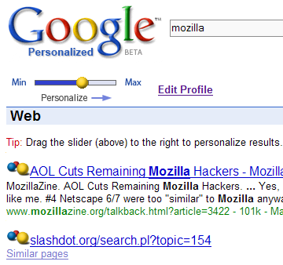
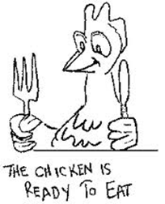
Motivation
Personalized Information Delivery
  Customize search results based on the
  inferred interest of the user
User Interest Model
  Query input
    Most direct evidence
    short and imprecise queries
    (natural language is inherently ambiguous)
  Explicit feedback
    Users reluctant to make frequent ratings
    Rate fewer documents than they read

Slide 3
Motivation
Two key challenges in Personalized Information Delivery
Identifying the interests of users in
semi-persistent user profiles
Given the user preferences recorded
in a user profile, alter the presentation
of search results to reflect those preferences
how can we build more valuable models of a user’s interests based on their prior activities?

Slide 4
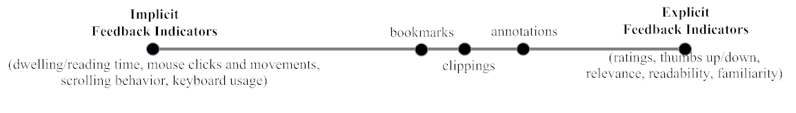
Motivation
Annotation and clipping behavior provide more direct evidence of user interest
Browsing and reading behaviors, such as dwelling time, mouse clicks, mouse movements and scrolling provide more indirect evidence of user interest

Slide 5

Goals
For User Interest Modeling
  A unified user interest model combining implicit and semi-explicit feedback (unified model)
  User model based on multiple everyday-applications
  A model to predict ratings from the estimated unified feedback
  A model to detect user interest shift

Slide 6
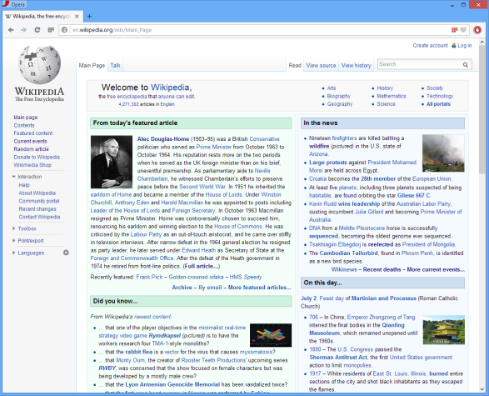
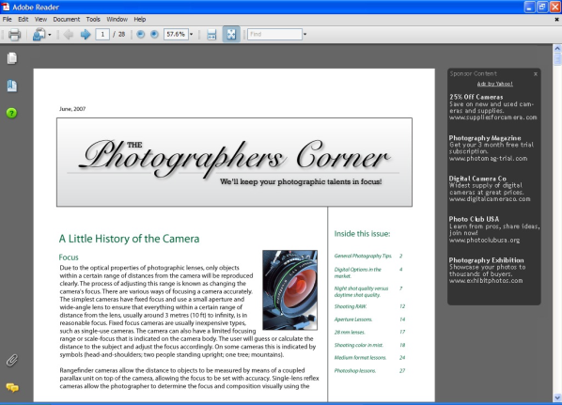
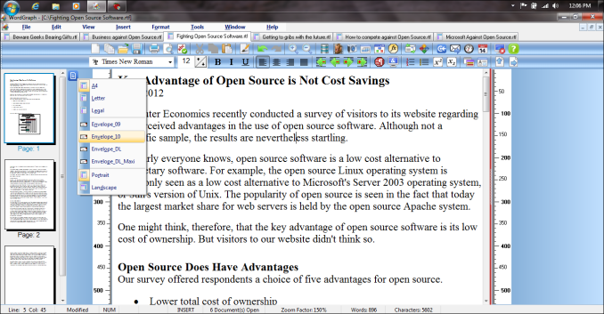
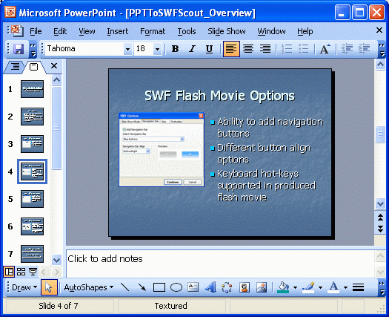
System Architecture
Two types of applications
  Consumption Applications,
  For dealing with reading or
  skimming web documents
  and/or PDF documents
  Production Applications,
  For organizing the content for consumption such as word processors and presentation applications

Slide 7
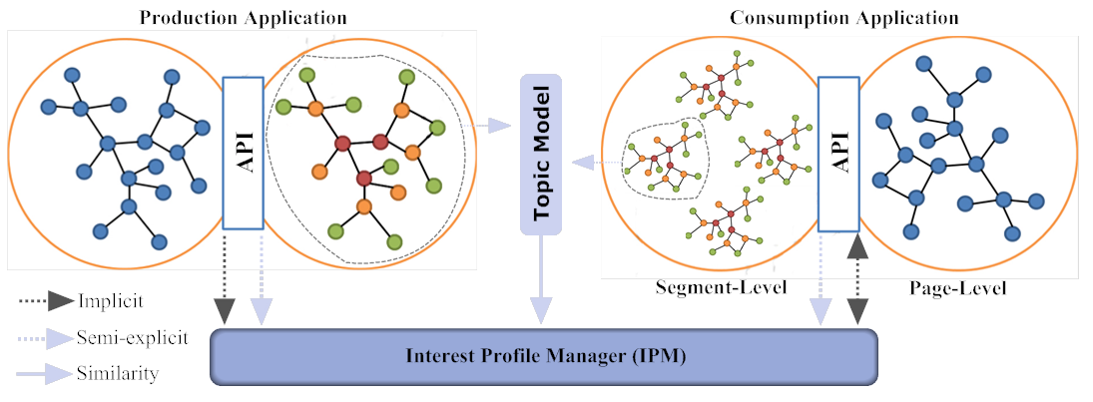
System Architecture

Slide 8
Relevance Feedback Types
Web Browser (Firefox) / PDF Reader
Document Attributes | User Events
Number of links, number of images, number of characters, paragraph information, title, url | Time Spent, mouse usage (mouse click, number of scrolls, scroll offset, number of scrolling direction changes, total number of scrolling groups, time moving, scroll bar clicks) , keyboard usage (arrow key and page up-down clicks/time), text selection, highlight, note, number of document accesses, focus in/out, bookmark,
Word / PowerPoint
Document Attributes | User Events
Name of the Document, size, number of characters, content, title | Time (idle, formatting, typing), focus in/out, Quote, Cut & Paste,
Explicit Feedback
page readability, page relevance, paragraph relevance, user annotations (semi-explicit)
Explicit feedback: users explicitly mark relevant and irrelevant documents
Implicit feedback: system attempts to infer user intentions based on observable behavior

Slide 9
Topic Models - LDA
Latent Dirichlet Allocation’s view of a document

Slide 10
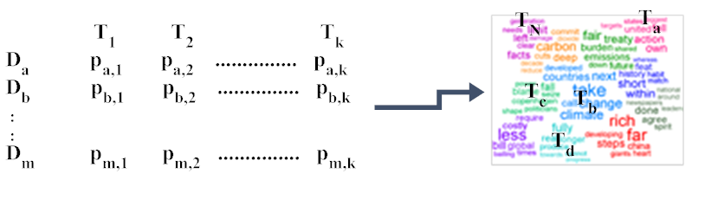
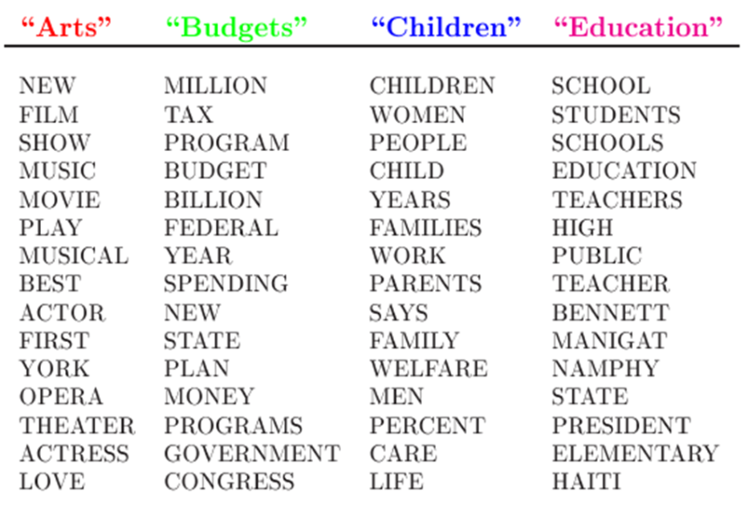
Topic Models - LDA
Document-Topic Distribution
Topic-Word Distribution

Slide 11
User Interest Models
Baseline-LDA Model
  Text edited from Production applications
Semi-Explicit Model
  Text edited from Production applications + text annotated from Consumption applications
Unified Model
  Text edited + Text annotated + implicit feedback

Slide 12
How to Evaluate these models?
Evaluation is key to building effective and efficient user models
  usually carried out in controlled experiments
  online testing can also be done
Effectiveness and efficiency are related
  High efficiency may be obtained at the price of effectiveness

Slide 13
Evaluation Metrics: Classification View
Action
Retrieved
Not Retrieved
Doc
Relevant
Relevant Retrieved
Relevant Rejected
Not relevant
Irrelevant Retrieved
Irrelevant Rejected

Slide 14
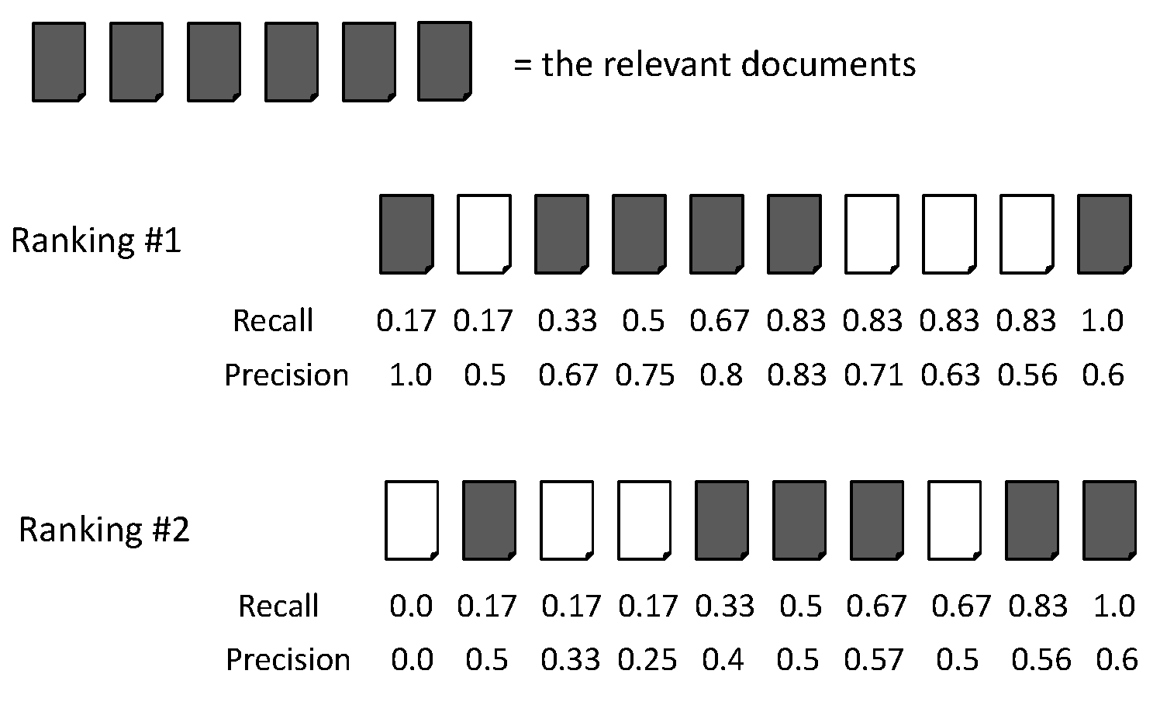
Evaluation Metrics: Example
Recall = 2/6 = 0.33
Precision = 2/3 = 0.67

Slide 15
Evaluation Metrics: Example
Recall = 5/6 = 0.83
Precision = 5/6 = 0.83

Slide 16
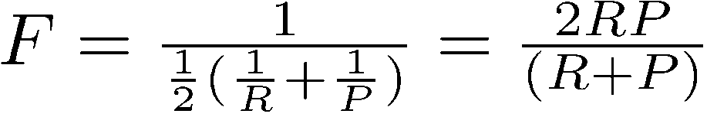
F Measure
Harmonic mean of recall and precision
  Why harmonic mean?
  harmonic mean emphasizes the importance of small values, whereas the arithmetic mean is affected more by outliers that are unusually large

Slide 17
Evaluation Metrics: Example
Recall = 2/6 = 0.33
Precision = 2/3 = 0.67
F = 2*Recall*Precision/(Recall + Precision)
= 2*0.33*0.67/(0.33 + 0.67) = 0.22

Slide 18
Evaluation Metrics: Example
Recall = 5/6 = 0.83
Precision = 5/6 = 0.83
F = 2*Recall*Precision/(Recall + Precision)
= 2*0.83*0.83/(0.83 + 0.83) = 0.83

Slide 19
Evaluation for Ranking
Average precision
  Averaging the precision values from the rank positions where a relevant document was retrieved
  Set precision values to be zero for the not retrieved documents

Slide 20
Average Precision: Example

Slide 21
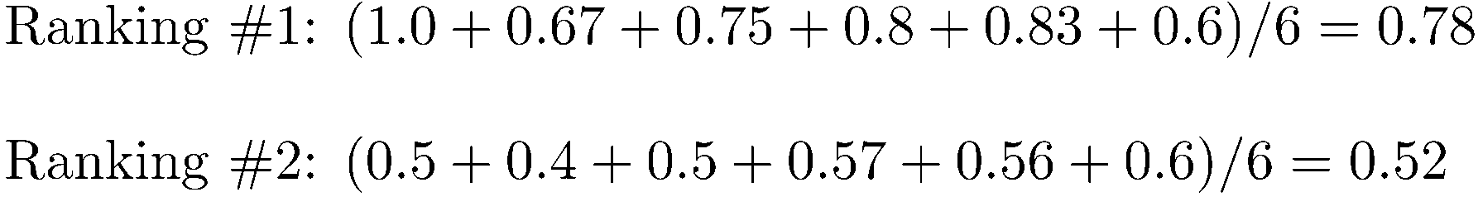
Average Precision: Example

Slide 22
Average Precision: Example

Slide 23
Mean Average Precision (MAP)
Summarize rankings from multiple algorithms by averaging average precision
Most commonly used measure in research papers
Assumes user is interested in finding many relevant documents for each algorithm

Slide 24
Significance Tests
Given the results from a number of algorithms, how can we conclude that algorithm A is better than algorithm B?
A significance test
  null hypothesis: no difference between A and B
  alternative hypothesis: B is better than A
  the power of a test is the probability that the test will reject the null hypothesis correctly

Slide 25
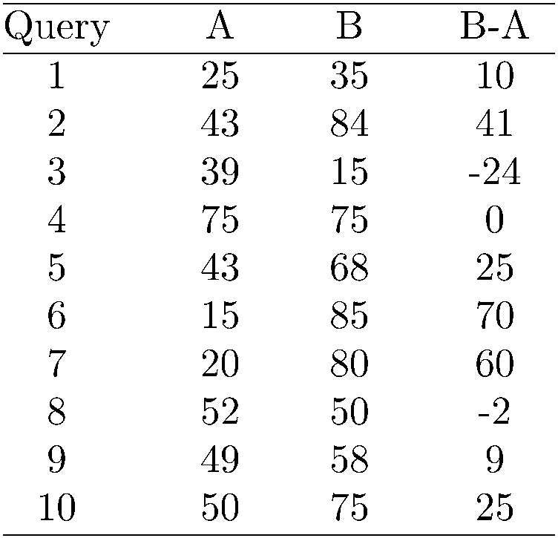
Example Experimental Results
Significance level: α = 0.05
Probability for B=A

Slide 26
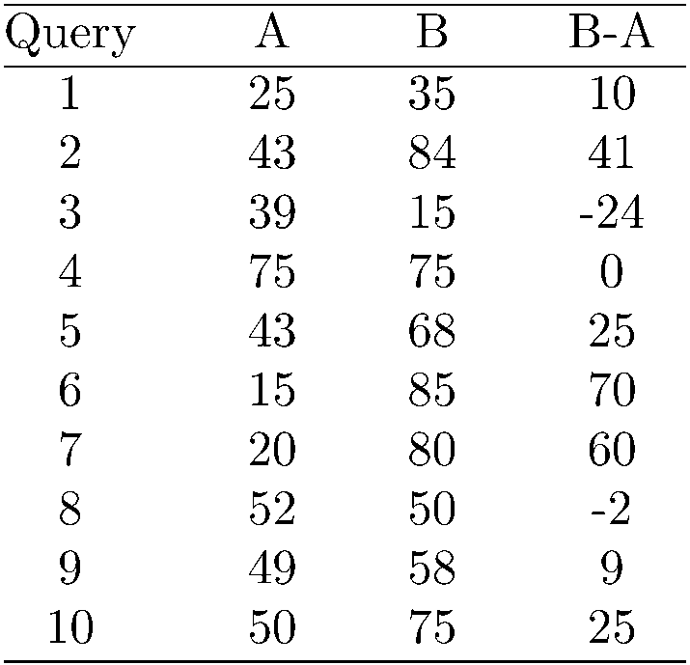
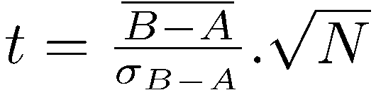
Example Experimental Results
t-test
t = 2.33 p-value = 0.02
Probability for B=A is 0.02
→ B is better than A
Avg 41.1 62.5
Significance level: α = 0.05
Probability for B=A

Slide 27
Evaluation Plan
User Study
  Ground-truth dataset, 31 Students
  Simulated search tasks environment
  Multiple everyday applications (MS Word, MS PowerPoint, Mozilla Browser)
  Implicit feedback, semi-explicit feedback (annotations), explicit feedback (paragraph relevance score, page relevance score, page readability score),

Slide 28
Evaluation Plan
User Study
  Read 8 web pages per each task, assign page relevance score, and readability score, and paragraph level (segment) relevance per each page.
  Create a summery in Word and PowerPoint.
Task No | Task Name | Relevance score
1 | How does Google Glass work? | 3.55 ± 0.96
2 | What is mars one project? | 3.23 ± 1.11
3 | How to improve your credit score? | 3.53 ± 0.98
4 | What are the rules of American football? | 3.52 ± 1.01

Slide 29
Results – Page Level
 | Page-Level RMSE
 | Task-1 | Task-2 | Task-3 | Task-4
baseline-LDA | 1.1799 | 1.3145 | 1.2387 | 1.5147
semi-Explicit | 1.1259 | 1.3258 | 1.2583 | 1.4628
unified | 1.0966 | 1.1979 | 1.1617 | 1.3881
  Baseline-LDA vs. Semi-explicit, p=0.414
  Baseline-LDA vs. Unified, p=0.0037
  Semi-Explicit vs. Unified, p=0.0287

Slide 30
Results – Segment Level

Slide 31
For more information
Dr. Shipman, shipman@cse.tamu.edu
Or me
  sampath@cse.tamu.edu
  http://students.cse.tamu.edu/sampath/
Our lab
  Shipman Lab, HRBB 232

