Slide 1
Undergraduate Degree Program
Computer Science
2015
Dr. Ravi Mukkamala, Department Chair
Ms. Janet Brunelle, Chief Departmental Advisor

Slide 2
Agenda
Computer Science Degree Requirements
Computer Science Courses
Math Courses
Computer Science Electives
General Education
Advising Block
Popular Minors

Slide 3
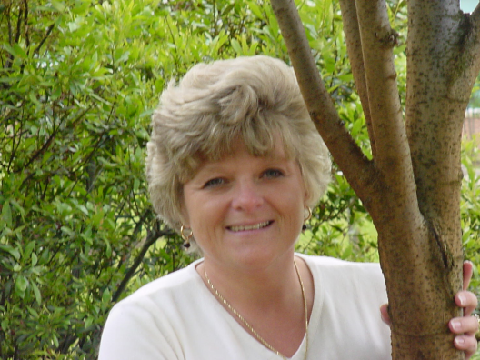
Who is your Advisor?
Janet Brunelle
Chief Departmental Advisor
Assistant Chair
Undergraduate Curriculum Committee Chair
Teaching faculty
CS 410
CS 411W
Advising Awards:
Advisor of the Year, College of Sciences 2000, 2005, 2012 & 2015
NACADA Mid-Atlantic Region Outstanding Faculty Academic Advising Award 2007
NACADA National Award for Outstanding Faculty Advising; 2007 certificate of Merit.

Slide 4
How do you contact an Advisor?
Janet Brunelle
Email: brunelle@cs.odu.edu
Make an appointment online:
https://odu.agilegrad.com/center/
NOTE: You must create your computer science Account
Posted Office hours:
http://www.cs.odu.edu/~brunelle
Engineering & Computational Sciences Bldg; room 3210
Phone: 683-7714
Peer Advisors:
Dontavus Riddick Daniel Dang
driddic@cs.odu.edu ddang@cs.odu.edu
757-683-7805
Dragas 1103A

Slide 5
Email Etiquette
Keep it short
Expect a reply within 48 hours
Use a signature with your contact info:
Best regards,
Tim Holmes
Peer Advisor
UIN: 00899309
Phone: 757-683-7805
Email: tholmes@cs.odu.edu
Office: Dragas 1103A

Slide 6
Navigating to DegreeWorks
Open a browser (Chrome preferred)
Go to my.odu.edu:
This will not work:

Slide 7
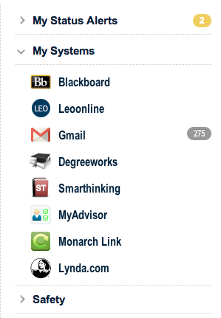
Navigating to DegreeWorks
Once you log in to My ODU, select DegreeWorks on the right side of the screen.
Here →

Slide 8
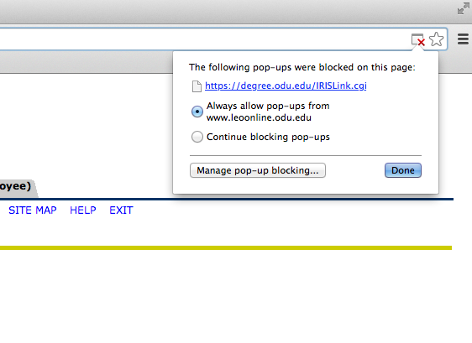
Navigating to DegreeWorks
Clicking the link will take you to a blank page. Allow pop-ups and refresh the page.

Slide 9
Degree Requirements
Computer Science required courses
49 credits
Computer Science elective courses
9 credits
Mathematics/Statistics
14 credits
Technical electives
6 to 8 credits
Additional requirements
Upper Division General Education requirements
Lower Division General Education requirements
Examinations

Slide 10
Prerequisite Structure - Mathematics
Math 103 SAT 449 and Below
College Algebra with Recitation
Math 102 SAT 450-550 ACT Any Score
College Algebra
Math 162 SAT 550-650 ACT 30-36
Pre Calculus I
Math 163 SAT 650-700 ACT requires Compass Math Test
Pre Calculus II
Math 211 SAT 700+ ACT requires Compass Math Test
Calculus I
Math 212
Calculus II
Transfer/
AP Credit
or
Academic
Placement
Based upon Math
SAT Score or Compass Exam
If you need to brush up on math before you take the Compass Math Test try Khan Academy
https://www.khanacademy.org/

Slide 11
Required Math Courses
Math 211
Calculus I
Math 212
Calculus II
Math 316
Linear Algebra
Stat 330
Introduction to Statistics
With Calculus as prerequisite

Slide 12
Required Computer Science Courses
CS 333
Fast Track
Programming
CS 150
Problem Solving and Programming I
CS 250
Problem Solving and Programming II
CS 252
Introduction to Unix for programmers
CS 361
Advanced Data Structures and Algorithms
CS 330
Object Oriented Programming and Design
CS 350
Introduction to Software Engineering
CS 355
Principles of Programming Languages
CS 410
Professional Workforce Development I
CS 411W (Writing Intensive)
Professional Workforce Development II

Slide 13
Architecture Courses
Operating Systems
Operating Systems
CS 170
Introduction to Computer Architecture I
CS 270
Introduction to Computer Architecture II
CS 471
Operating Systems
CS 334
Fast Track

Slide 14
CS 333 and CS 334
Created for Second Degree Students or
Students with adequate prior programming knowledge and experience
Fast track courses
Internet based course
Requires:
Prior knowledge of programming language
Considerable maturity of student
Independent responsibility on the student

Slide 15
Required CS Math Courses
CS 381
Introduction to Discrete Structures
CS 390
Introduction to Theoretical Computer Science
CS 417
Computational Methods and Software

Slide 16
Applied Technology CS Courses
CS 300T
Computers in Society and Ethics

Slide 17
Lower Division General Education Requirements
Interpreting the Past (H)
Hist 101H, Hist 102H,
Hist 103H, Hish 104H, Hist 105H
Information Literacy & Research:
CS 121G
English
Composition:
110C
231C (or 211C)
Literature: (L)
112L, 144L, Flet 100L
Oral Communication ( R)
Comm 101R (103R, 112R)
Philosophy and Ethics (P or E)
110P, 120P, 140P, 230E, 250E, 303E, 344E, 345E, 441E, 442E
Human Creativity (A)
Art 121A, Art 122A, Musc 264A, Dance 185A, Thea 241A, Thea 270A
Human Behavior (S)
Antr 110S, Comm 200S, Crjs 200S, Econ 200S, Econ 201S, Econ 202S, Fin 210S, Geog 100S, Geog 101S, Pols 100S, Pols 101S, Pols 102S, Psyc 101S, Psyc 201S, Psyc 203S, Soc 201S Wmst 201S

Slide 18
Science Courses
Natural Sciences – Full Year (2 sequential Semesters)
Physics 101-102; 111-112; 231-232
Chemistry 105-106; 107-108
Biology 121-122; 123-124
Geology OEAS 110; 111 or 112
Oceanography OEAS 106-108
Accounting (Acct 201, Acct 202, …)
Any other technical in nature – Approval from Advisor
Not to include:
Biology 105N, 106N, 108N, 109N, 110N, 111N, 112N, 113N, 117N, 118N, 122N, 123N (Life Science)
Physics 103N – 104N (Astronomy)
Technical Electives: any Two additional Science Courses

Slide 19
Co-op/Internships
Up to 6 credits for upper level CS Electives
Approval by CS Department and Career Management Center (CMC)
Pass/Fail Grading
Short duration of career development
Academic requirements may differ
Requires
Contracts
Reports

Slide 20
CS Electives – Database Track
CS 450
Database Concepts
CS 452
Database Software Development Methodology
CS 456
Database Administration I
CS 457
Database Administration II

Slide 21
CS Electives – Networking
CS 455
Introduction to Networks and Communications
CS 472
Network and Security
CS 487
Applied Parallel Computing
CS 486
Introduction to Parallel Computing

Slide 22
CS Electives – Systems Programming
CS 476
Systems Programming
CS 477
Systems Programming in Windows Operating Systems
CS 454
Network Management
CS 472
Network and Security

Slide 23
CS Electives – Web Programming
CS 312
Internet Concepts
CS 418
Web Programming
CS 431
Web Server Design
CS 432
Web Science
CS 441
App Development for Smart Devices

Slide 24
CS Electives – Game Development
CS 460
Computer Graphics
CS 480
Introduction to Artificial Intelligence

Slide 25
CS Electives – Cybersecurity
CS 462
Cybersecurity Fundamentals
CS 463
Cryptography for Cybersecurity
CS 464
Networked Systems Security
CS 465
Information Assurance

Slide 26
CS Electives - Miscellaneous
CS 478
Computational Geometry, Methods and Applications
CS 488
Principles of Compiler Construction

Slide 27
Advisor Block
http://www.cs.odu.edu
Sign up for registration advising (Immediately after midterm)
Plan a tentative schedule
Based upon Degree Evaluation
Worksheets
Prerequisite structure charts
Attend advising session or email to finalize
Advisor will remove block

Slide 28
Popular Minors
Mathematics – 2-3 Math/Stat classes
Computer Engineering – 2 ECE classes
Modeling and Simulation – 3 ECE classes
Information Technology – 4 IT classes
Electrical Engineering Technology – 4 EET classes
Military Leadership
Any two courses 300 level or higher outside COS
Can share one course
Required Exams
CS EXIT Exams
Senior Survey

Slide 29
Five Year Program – BS and MS in Computer Science
Up to 12 credits of graduate coursework toward both their undergraduate and masters degrees in Computer Science
Contact CDA, Janet Brunelle
Declare a CS undergraduate major
Draft a schedule of graduate courses to be taken as an undergraduate requirements
During senior year, apply to the Office of Admission to M.S. in CS program
http://www.cs.odu.edu/advising/program_5year_bsmscs_info.shtml

Slide 30
Conclusion
Information found online
http://www.cs.odu.edu under “Undergraduate” section
Call for an appointment or schedule it online https://www4.cs.odu.edu/advise/
Advising hours are available at
http://www.cs.odu.edu/advise_info_ug.shtml
GOOD LUCK!

Slide 31
Annual STEM jobs through 2020

Slide 34
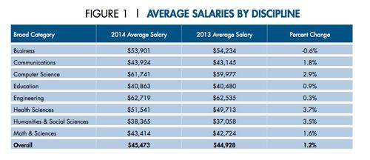
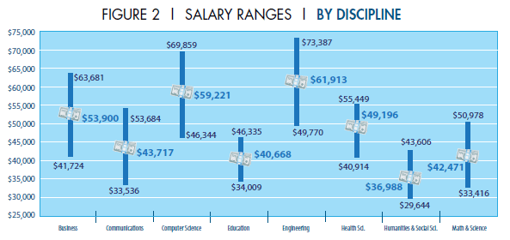
Salaries by Discipline

Slide 35
Association for Computing Machinery
Old Dominion University ACM
acm@cs.odu.edu

Slide 36
What is the ACM?
A professional organization focused on the educational and scientific computing society.
Membership include –
Access to digital library
Conferences
CACM and XRDS publications

Slide 37
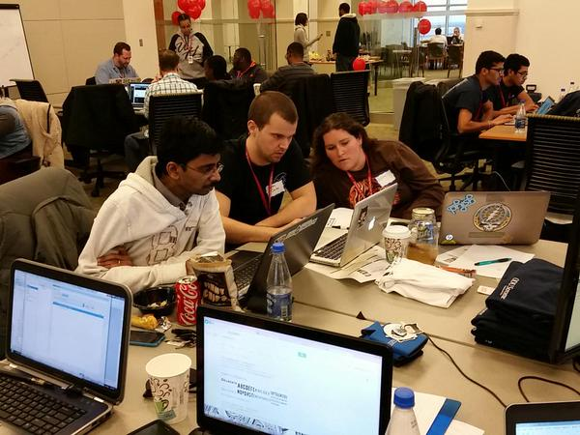
What do we do?
An idea of what we do:
Hackathons
Company tours
Speakers
And other CS related activities

Slide 38
Why should you join?
Experience
Learn a language: C++ & Java, Javascript, PHP, HTML & CSS
Projects in your field: big data, artificial intelligence, mobile, web, software engineer, OS, database
Research!
Networking
Meet faculty & peers
Professionals in the field
FUN!!!

Slide 39
ACM@cs.odu.edu
www.cs.odu.edu/~acm

Slide 40
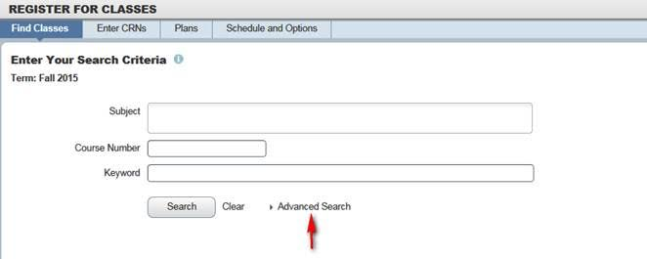
Registration Tips

Slide 41
Linked Courses
CS 150 has lectures,
labs, and recitations.
Sciences have
lectures and labs.
ADD THEN SUBMIT

