Slide 1
Scheduling Academic Groundwork Assistance

Slide 2
Outline
Organizational Chart of Team
Societal Problem
Objectives
Current Process Flow for ODU’s System
Issues with Current System
What is Needed to Solve it?
Solution
Major Functional Component Diagram
Software
Improved Process Flow
Competition
Risks
What’s in the Box?
What’s not in the Box?
Conclusion

Slide 3
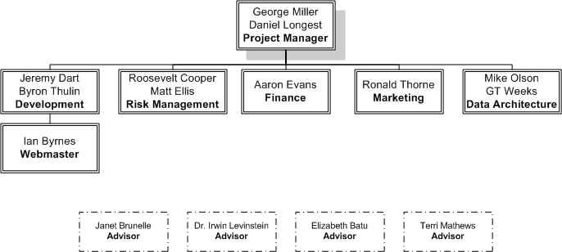
Organizational Chart

Slide 4
As a University Scheduler
Are you..
Wasting time keying in the same course schedules semester after semester?
Having trouble scheduling the right number of course sessions for a semester?
Graduation rates suffering due to course availability?

Slide 5
Higher Education in the US
5,758 higher education institutions in the United States, the second largest number in the world
19,764,000 students are currently enrolled in these institutions
66 public and private universities in Virginia
United States Census Bureau img: americanancestors.info

Slide 6
Ineffective Utilization of Resources
Rooms
Faculty
Course Offerings
Student
Poor seat allocation
Disjoint faculty input
Not meeting student needs
No current input

Slide 7
Societal Problem
The lack of an effective scheduling software results in many universities:
Requiring faculty and staff spending undue amounts of time on the scheduling process
Developing a negative image among potential students
Creates an unhappy student body
Having less than optimal graduation rates
(Average of five years for graduation)
Five Year Graduation

Slide 8
Solution: Build SAGA
Provide this scheduling software suite which:
Includes a predictive scheduling engine
Allows for efficient management of room ownership
Considers faculty preference and needs
Considers student preference and needs
Digitally automates the collection of faculty and student preferences

Slide 9
Case Study: ODU – Computer Science
Old Dominion University’s Computer Science department represents a stable case that demonstrates problems that similar universities have with scheduling and utilization of resources

Slide 10
Utilization of Large Rooms* by Department
Optimum range
*rooms with 50 or more seats
Retrieved from BANNER by Assistant Dean Terri Mathews(Fall 2010)

Slide 11
Improving Freshman Retention
Schools | Rate
Eastern Michigan University | 71%
Old Dominion University | 80%
Florida International University | 81%
Georgia State University | 82%
Oakland University | 72%
Universities similar to ODU will benefit the most from SAGA.
carnegiefoundation.org

Slide 12
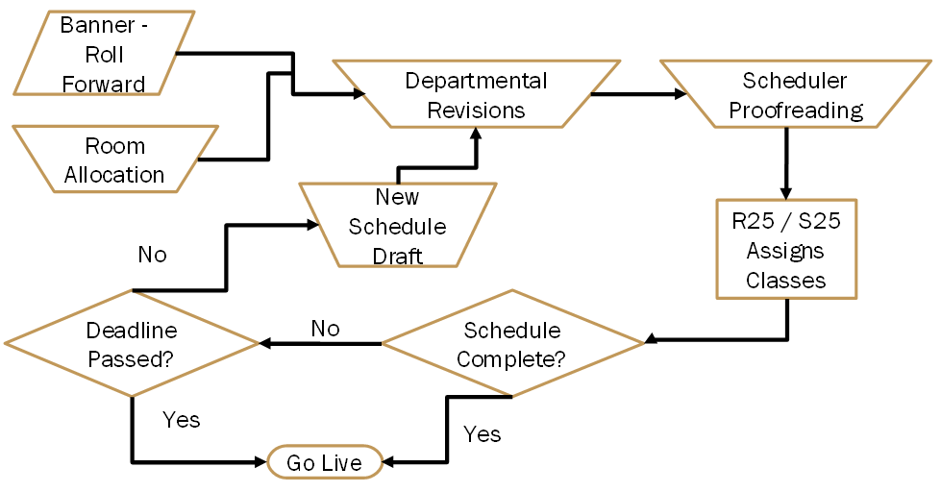
Current Registrar Process

Slide 13
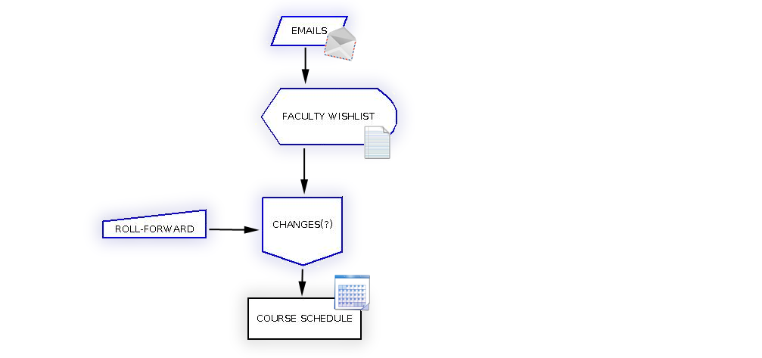
Current Department Process

Slide 14
Issues With Current Scheduling System
Labor intensive
Error prone
Inefficient
Lack of student contributions
Inconsistent use of tools

Slide 15
SAGA’s Improved Utilization
Optimize
Rooms
Faculty
Input
Course Offerings
Student
Input

Slide 16
What is Needed to Solve it?
A system that will find the right set of courses based upon
Student pre-requisite structure
Student interests
Faculty preferences
Efficient use of classroom space
A system that will check for common mistakes and auto correct

Slide 17
The SAGA Solution
SAGA is a customizable, intuitive, scheduling software suite that can be integrated into any existing university infrastructure.
SAGA will support student input, faculty preferences, prediction, report generation, and efficient classroom utilization on a semester by semester basis.

Slide 18
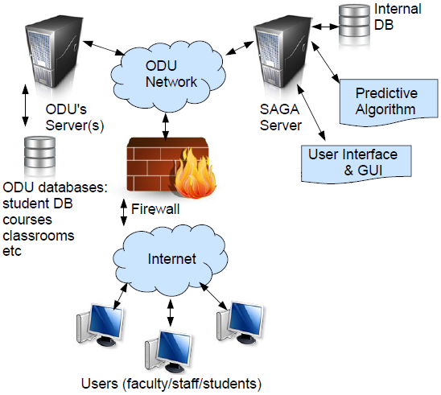
Major Functional Component Diagram

Slide 19
Software Objectives
Capture Faculty & Student wants and needs
Provide a schedule management tool for the department
Offer customized interface for use with current tools
Provide a predictive engine that utilizes historical data

Slide 20
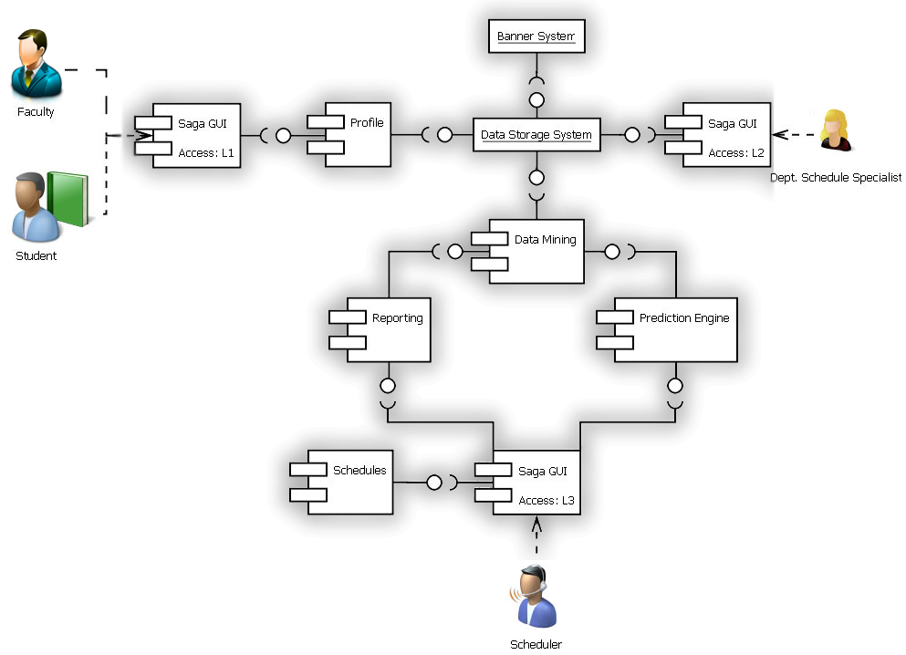
Software

Slide 21
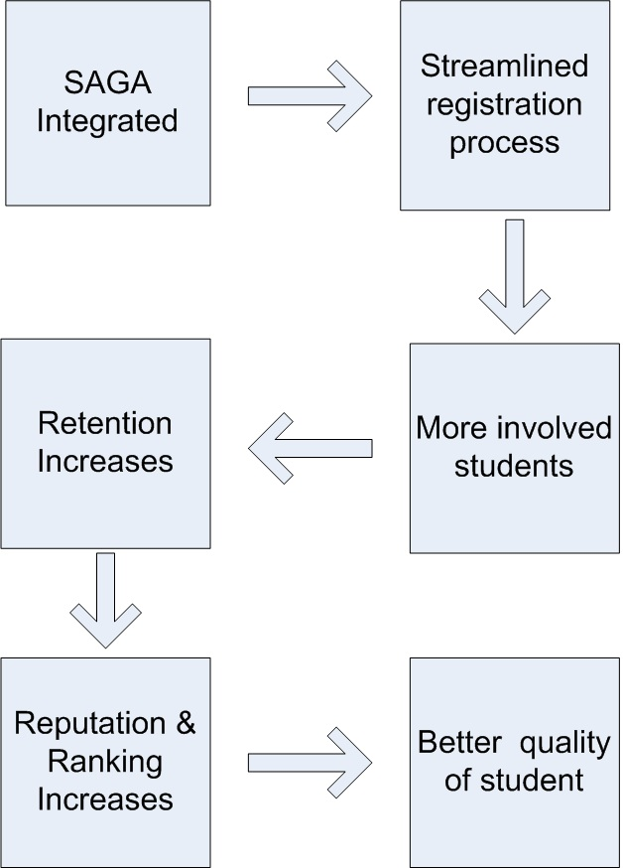
Return On Investment

Slide 22
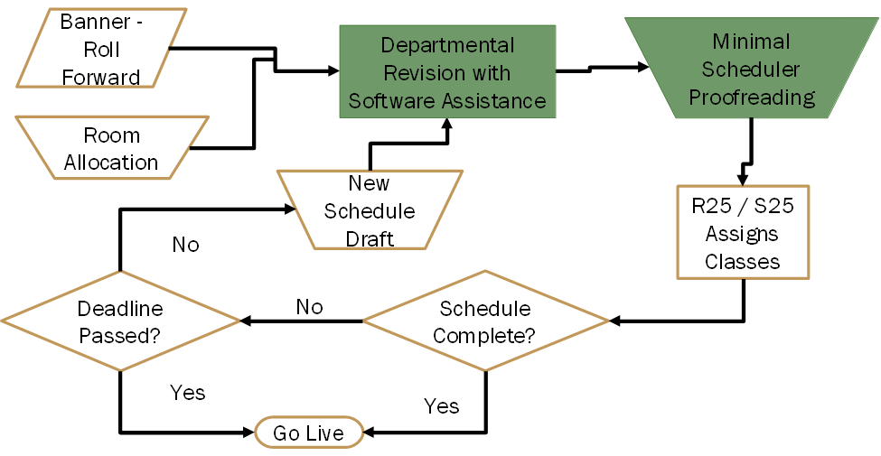
Improved Registrar Process

Slide 23
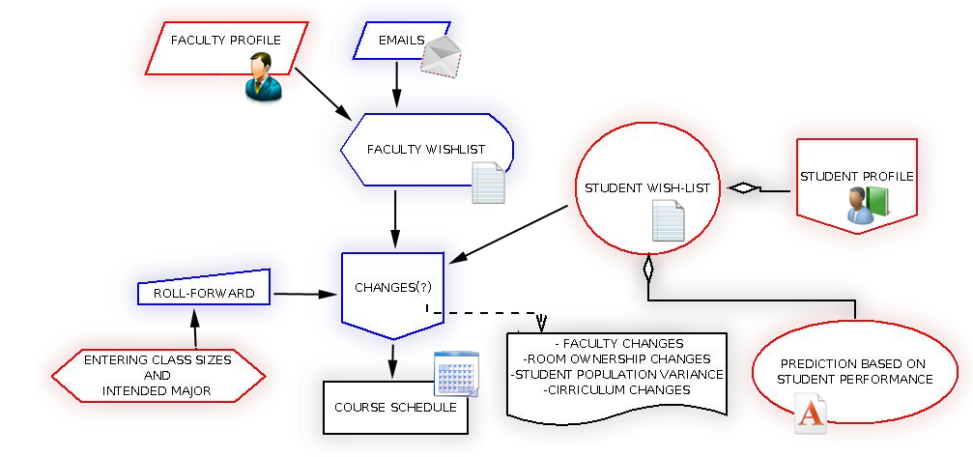
Improved Department Process

Slide 24
Competition - Preferences
 | SAGA | Schedule Whiz | Schedule 25 | IQ.Session | Scheduling Studio 7
Faculty
Student
Room
Room Ownership
Preference Priority
Course Dependencies
Student Curriculum Track
Competition Data

Slide 25
Competition – Scheduling Features
 | SAGA | Schedule Whiz | Schedule 25 | IQ.Session | Scheduling Studio 7
Prediction Engine
Dept to University
Optimizer
Multi-Term Forecaster
3rd Party Integration
Competition Data

Slide 26
Financial Risks
F1: Cost of development too high
F2: Final cost of product too high
F3: Unable to fund project

Slide 27
Technical Risks
T1: Getting enough student data
T2: Getting enough faculty data
T3: Getting the right student data
T4: Getting the right faculty data
T5: The various ODU systems do not integrate well
T6: Historical data exists in a difficult form to collect and manage

Slide 28
Customer Risks
C1: University politics (Institutional Inertia)
C2: Unable to force students to create a profile
C3: Unable to force faculty to create a profile

Slide 29
Schedule Risks
S1T6: Historical data difficult to collect and manage
S2C1: University unwilling to modify existing process

Slide 30
Impact and Probability of Risks

Slide 31
What’s in the Box?
Predictive Engine
Custom Software and GUI’s
Maintenance, Training, & Support
Data Mining Engine

Slide 32
What’s Not In The Box
Will not replace current tools
Will not change university politics
Will not automate the schedule

Slide 33
Conclusion
The ultimate purpose of SAGA is to ease the burden of those involved with the scheduling process while simultaneously catering to student and faculty needs and interests which will lead to increased tuition dollars.
SAGA improves the course making process by providing collaborative input from students, faculty, and historical trends to assist in predicting demand for the future.

Slide 34
Works Cited
Mathews, Terri (Fall 2010) – Mathews, Terri. (2011). Fall 2010 Room Utilization By Priority Rooms
Cost of Students - http://www.collegemeasures.org/reporting/Institution/Scorecard/232982.aspx
Retention Rate - The Carnegie Foundation for the Advancement of Teaching. (2011, March 30). Carnegie classifications. Retrieved from http://classifications.carnegiefoundation.org
Competition Data – www.thoughtitmus.com , corp.collegenet.com , www.comquip.com , www.collegescheduler.com , www.lantiv.com
Fiver Year Graduation -http://www.collegeparents.org/members/resources/articles/reasons-why-your-college-student-might-not-graduate-four-years

