Slide 1
SAGA
Schedule Academic
Groundwork Assistance

Slide 2
Outline
Organizational Chart of Team
Societal Problem
SAGA Solution
Case Study
Process Flow for ODU’s System
Issues with Current System
What is Needed to Solve it?
Software Diagrams
Improved Process Flow
Milestones
Schemas
Competition
Risks
What’s in the Box?

Slide 3
Team Organization
Byron Thulin
Resource Manager
Software Developer
Matt Ellis
Risk Management Specialist
George Miller
Co-Project
Manager
GT Weeks
Database and Development Specialist
Daniel Longest
Co-Project
Manager
Ian Byrnes
Web Master
Software Developer
Jeremy Dart
Security Expert
Software Developer
Mike Olson
Math Expert
Documentation Specialist
Ronald Thorne
Marketing Specialist
Software Developer
Aaron Evans
Database Expert
GUI Expert
Roosevelt Cooper
Risk Management
Specialist
Report Expert

Slide 4
Domain Experts
Irwin Levinstein
Department Scheduler and Database Expert
Janet Brunelle
Computer Science Advisor
Elizabeth Batu
Registrar Scheduler
Terri Mathews
Assistant Dean for the College of Science

Slide 5
Higher Education in the U.S.
5,758 higher education institutions in the United States, the second largest number in the world
19,764,000 students are currently enrolled in these institutions
Roughly 100,000,000 academic courses must be scheduled each semester nation wide
U.S. Census Bureau

Slide 6
Groundwork Involved in the Scheduling Process
Rooms
Faculty
Student
Course Offerings

Slide 7
Constraints on Resources
Limited
  Seats
  Options
  Ownership
  Access
Rooms
Faculty
Student
Course Offerings

Slide 8
Constraints on Resources
Rooms
Faculty
Student
Course Offerings
Teaching levels (ugrad, grad, Phd)
Times available
Subject area knowledge

Slide 9
Constraints on Resources
Rooms
Faculty
Student
Course Offerings
Times available
Work schedule
Interest
Major requirements
Prerequisites
Minimum credit hours

Slide 10
Constraints on Resources
Rooms
Faculty
Student
Course Offerings
Deadline to go live
Declared major
General Education Requirements

Slide 11
Effects of the Constraints
Due to the current constraints on resources, universities experience:
  An unhappy student body
  A reduction in retention rates
  Less than optimal graduation rates
  (Average of five years for graduation)
College Parents Organization

Slide 12
Solution: Build SAGA
Schedule Academic Groundwork Assistance
Software suite which:
  Collects and manage information about complete set of constraints
  Collect and utilize preferences and needs
  Allows for customized integration to the current university infrastructure
  Automation of current manual/difficult processes

Slide 13

Case Study: ODU – Computer Science
Old Dominion University’s Computer Science Department represents a stable case that demonstrates problems that similar universities have with scheduling and utilization of resources

Slide 14
Utilization of Large Rooms* by Department at ODU
(37)
Optimum range
*rooms with 50 or more seats
Banner - ODU

Slide 15
Graduation Rates – ODU & Peer Schools
School | Four-year Graduation Rate | Five-year Graduation Rate | Six-year Graduation Rate
Eastern Michigan University | 11% | 26% | 37%
Old Dominion University | 22% | 42% | 49%
Florida International University | 20% | 40% | 49%
Georgia State University | 17% | 36% | 44%
Oakland University | 14% | 34% | 44%
College Results Carnegie Classifications

Slide 16
The Goal for SAGA
SAGA will provide a customizable and intuitive scheduling software suite that can be integrated into any existing university infrastructure.
SAGA will support student input, faculty preferences, report generation, and trending analysis on historical data.

Slide 17
SAGA Objectives
Capture Faculty & Student wants and needs
Provide a schedule management tool for the university department
Offer a per-customer customized interface for use with current tools
Provide a predictive engine that utilizes historical data

Slide 18
What’s in the Box?
Predictive Engine
Custom Software
and Interfaces
Maintenance, Training, & Support
Data Mining Engine

Slide 19
What’s not in the Box?
Will not replace current tools
Will not change university politics
Will not automate the schedule

Slide 20
SAGA’s Improved Utilization
Rooms
Faculty
Input
Student Input
Course Offerings

Slide 21
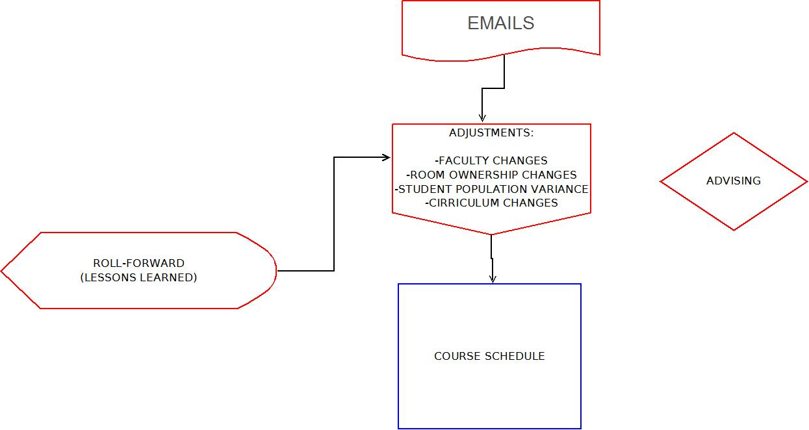
Current ODU CS
Department Process

Slide 22
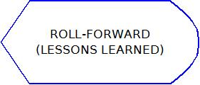
Current Roll Forward

Slide 23
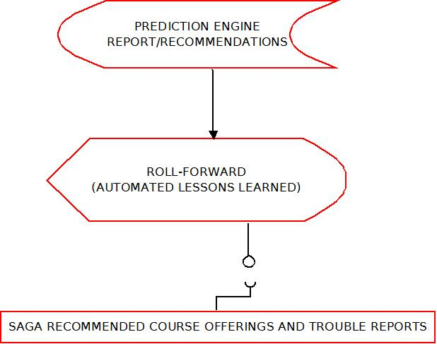
SAGA Roll Forward

Slide 24
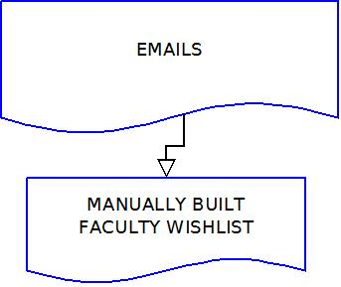
Current Faculty Email Process

Slide 25
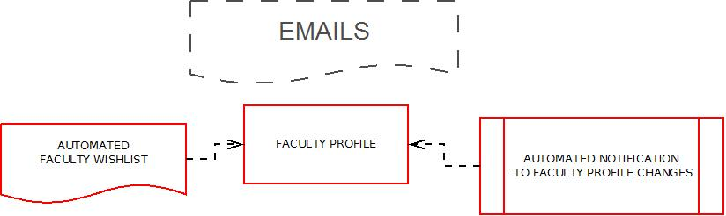
SAGA Faculty Process

Slide 26
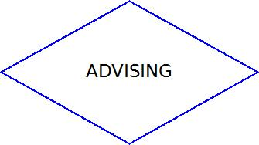
Current Advising Process

Slide 27
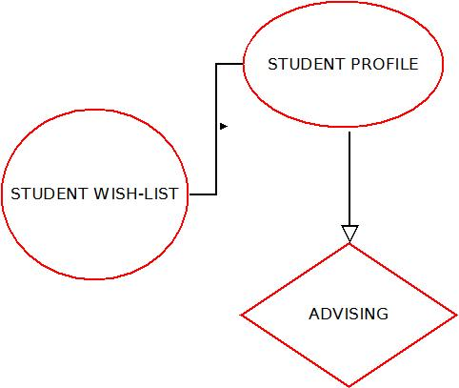
Improved Advising Process

Slide 28
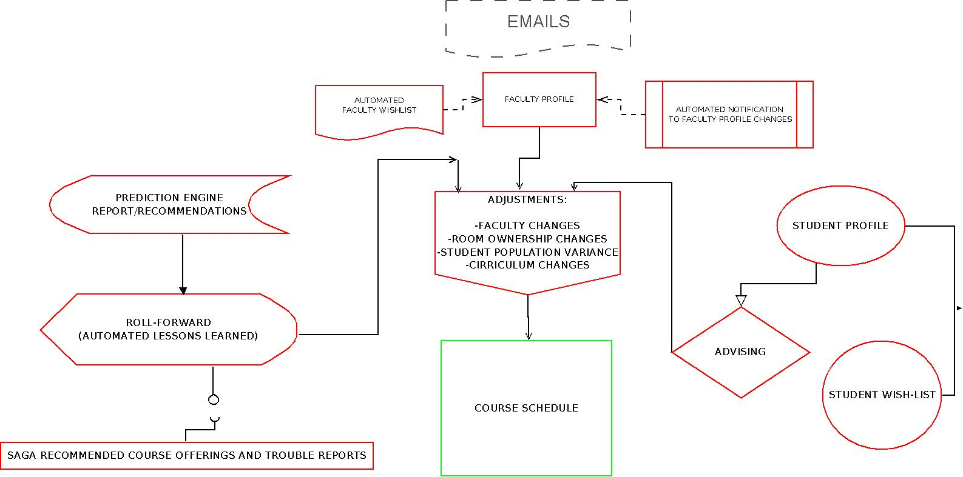
Improved ODU CS
Department Process

Slide 29
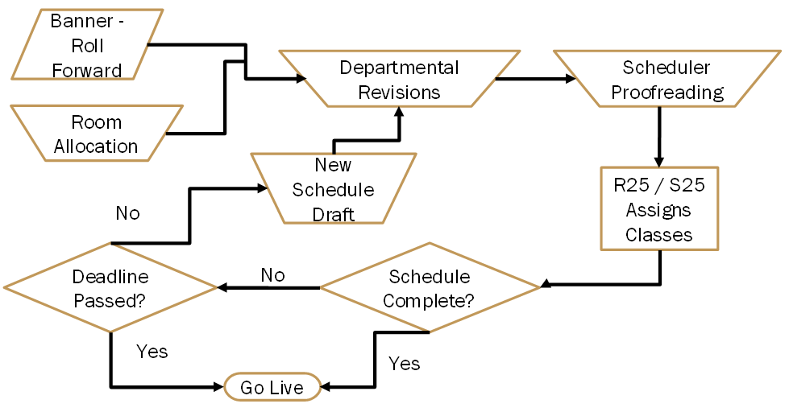
Current Registrar Process

Slide 30
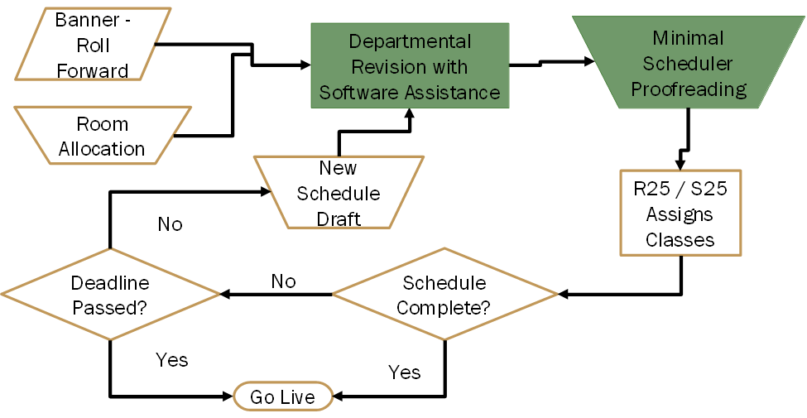
Improved Registrar Process

Slide 31
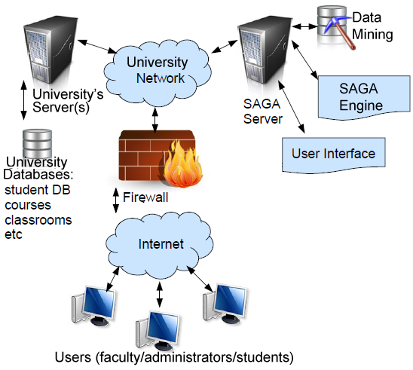
MFCD

Slide 32
Software Milestones
Saga
Databases
Data Miner
Interfaces
Prediction Engine
Testing

Slide 33
Interfaces
Saga
Database
Data Miner
Interfaces
Prediction Engine
Testing
Registrar & Department tool pages
Student & Faculty profiles
Admin maintenance

Slide 34
Data Miner
Saga
Database
Data Miner
Interfaces
Prediction Engine
Testing
Populates the SAGA DB
Processes into SAGA
Builds a report

Slide 35
Database
Saga
Database
Data Miner
Interfaces
Prediction Engine
Testing
Student Profile
Faculty Profile
Extracted Historical Data

Slide 36
Prediction Engine
Saga
Database
Data Miner
Interfaces
Prediction Engine
Testing
Schedule Assistance Algorithm
Evaluates data trends
Manages data history

Slide 37
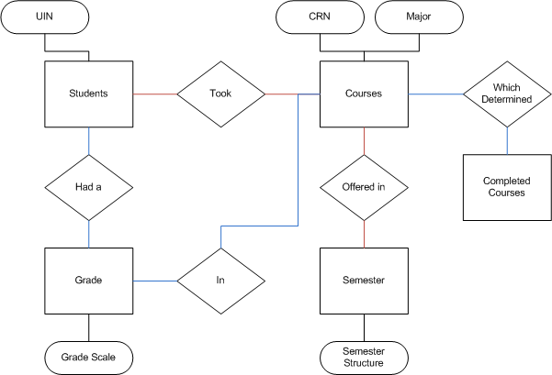
Historical Database ERD

Slide 38
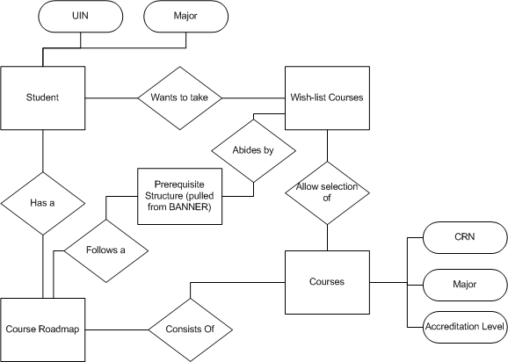
Student Database ERD

Slide 39
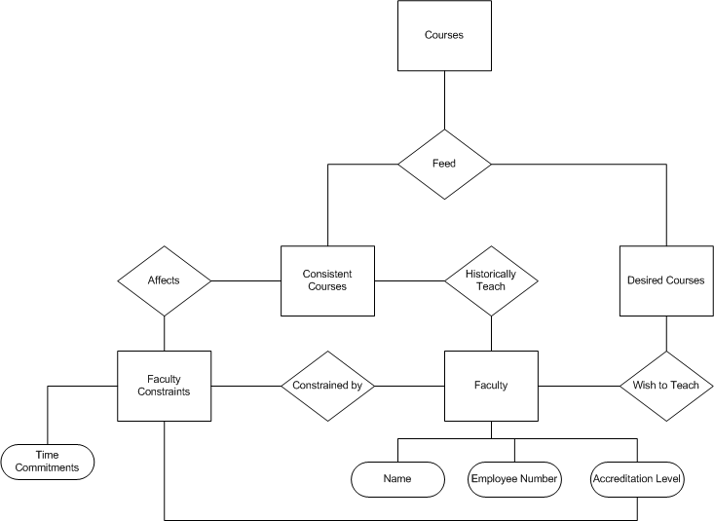
Faculty Database ERD

Slide 40
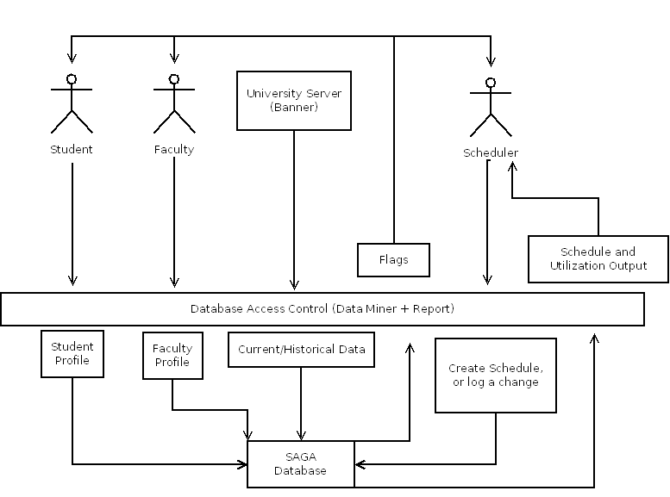
Data Miner and Report

Slide 41
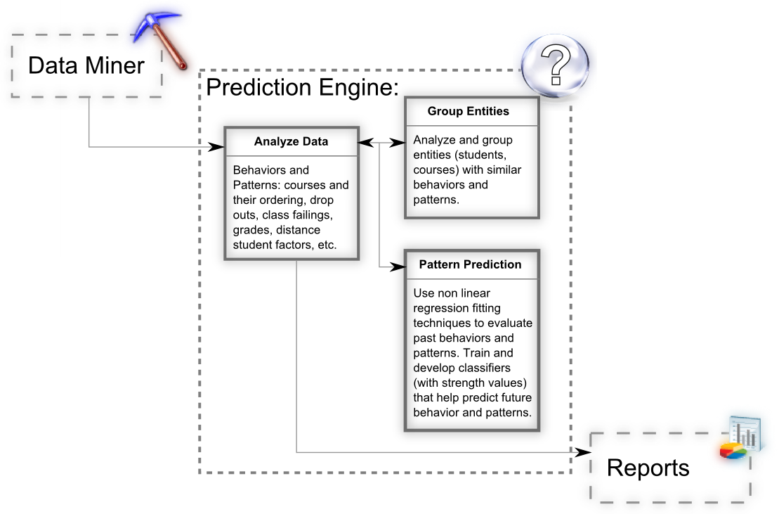
Prediction Engine

Slide 42
Reporting Interface
Displays warnings for:
  Course capacity
  Missing desired courses
Displays flags for conflicts with:
  Among candidate courses
  Faculty
  Course Times
  Rooms

Slide 43
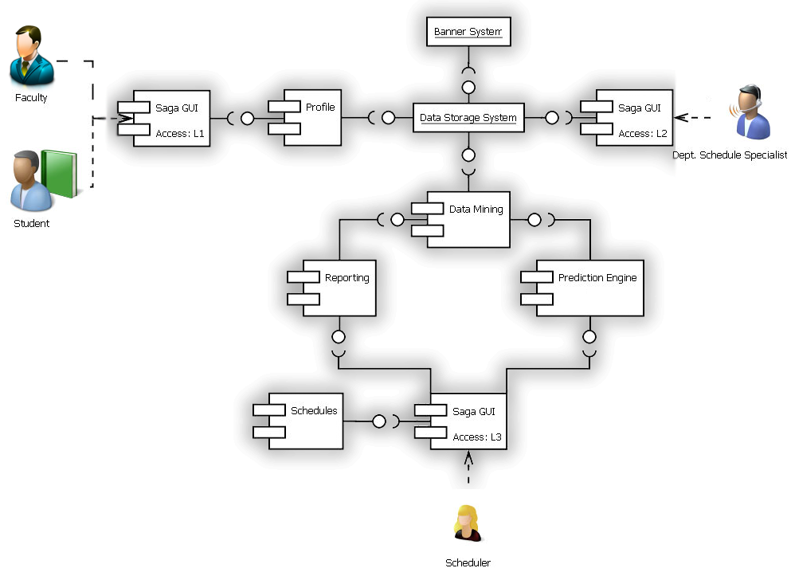
SAGA Software

Slide 44
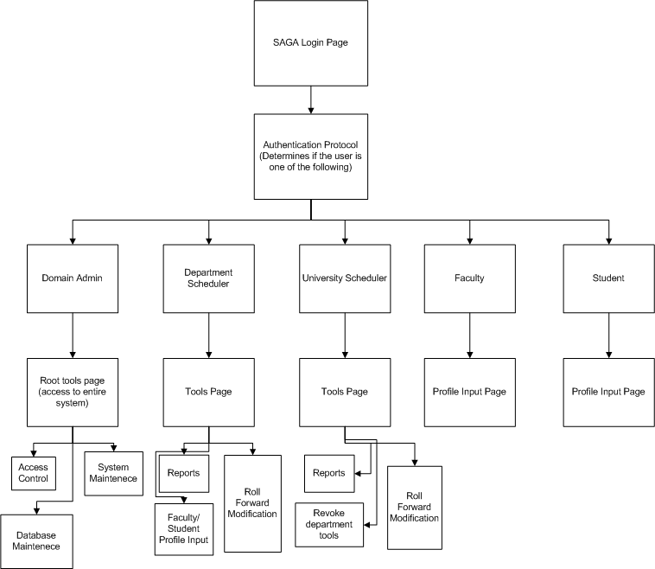
GUI Site Map

Slide 45
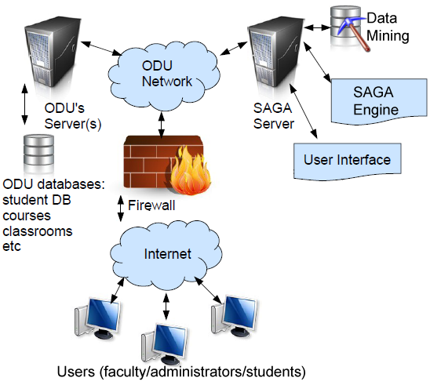
Prototype Major Functional
Component Diagram

Slide 46
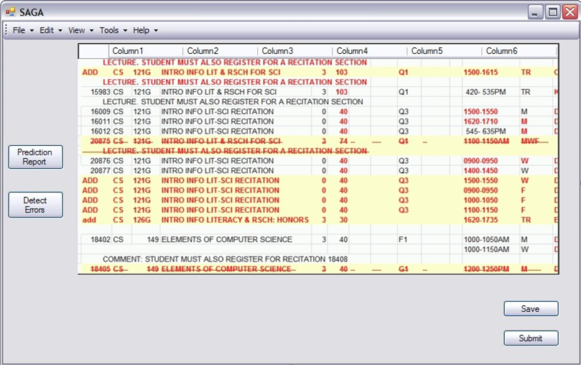
Prototype Department Interface

Slide 47
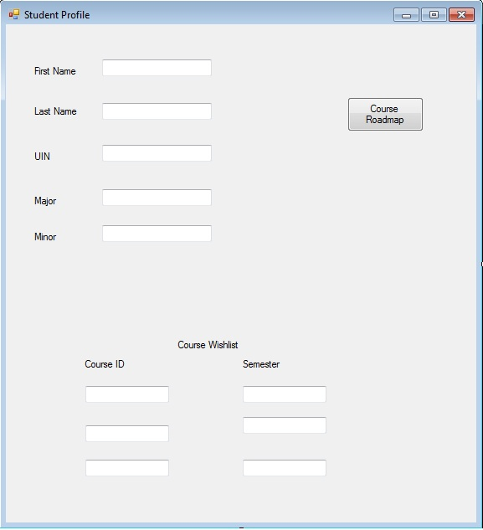
Prototype Student Profile

Slide 48
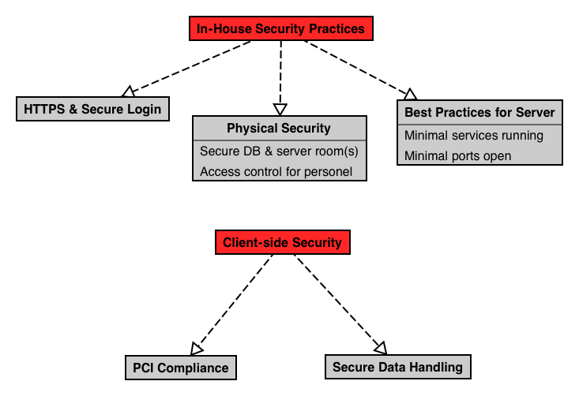
Security

Slide 49
Risks

Slide 50
Financial Risks
F1: Development Cost:
  Impact – 4, Probability – 2
  Mitigation: Secure stable funding, efficient use of funding.
F2: Product Price
  Impact 4, Probability - 1
  Mitigation: Set product cost to be competitive with the existing market.
F3: Unable to fund project
  Impact – 4, Probability -2
  Mitigation: Secure development grants/investors to move project forward.

Slide 51
Technical Risks
T5: The various ODU systems do not integrate well
  Impact – 3, Probability – 3
  Mitigation: Beta Testing

Slide 52
Customer Risks
C1: University politics (Institutional Inertia)
  Impact – 4, Probability – 3
  Mitigation: Work with the university to resolve any issues.
C2: Unable to force students to create a profile
  Impact – 4, Probability -4
  Mitigation: Make it a requirement to remove advising hold.
C3: Unable to force faculty to create a profile
  Impact – 4, Probability -4
  Mitigation: Faculty teaches previous semester courses unless profile is updated.

Slide 53
Schedule Risks
S2,C1: University Politics
  Impact – 4, Probability – 3
  Mitigation: Work with the university to resolve any issues.

Slide 54
Security Risks
SEC1: PCI Compliance
  Impact – 3, Probability – 2
  Mitigation: Use of best practices.
SEC2: Secure Handling of Data
  Impact – 3, Probability -2
  Mitigation: Use of best practices.

Slide 55
Phase 1 Organization
Project Manager
Database Expert
Predictive Algorithm Expert
Software Engineer(3)
Database Developer
Web Developer

Slide 56
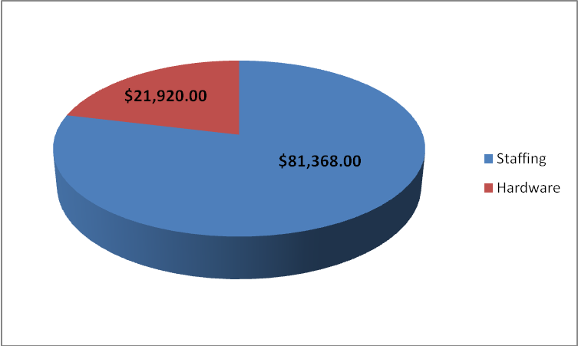
Phase 1 Funding
SBIR grant from the National Science Foundation extends up to $100,000
In this phase, all employees are paid as student interns
Costs over SBIR budget covered by $3,000 loan.

Slide 57
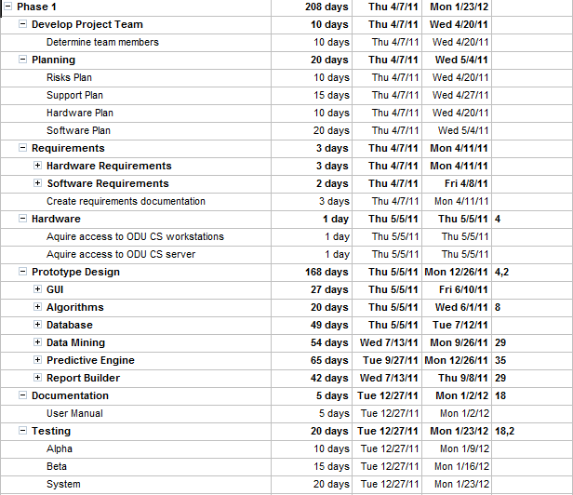
Phase 1 WBS

Slide 58
Phase 1 Staffing
Position | Number of Employees | Hourly Rate | Hours | Cost
Project Manager | 1 | $15 | 800 | $12,000
Software Developer | 3 | $15 | 1344 | $20,160
Database Developer | 1 | $15 | 664 | $9,960
Web Developer | 1 | $15 | 400 | $6,000
Database Expert | 1 | $100 | 50 | $5,000
Predictive Algorithm Expert | 1 | $100 | 50 | $5,000
Salary Cost |  |  |  | $58,120
40% Overhead |  |  |  | $23,248
Total Cost |  |  |  | $81,368

Slide 59
Phase 1 Resources

Slide 60
Phase 2 Organization
Project Manager
Software
Engineer(3)
Database
Developer
Web Developer
Math Expert

Slide 61
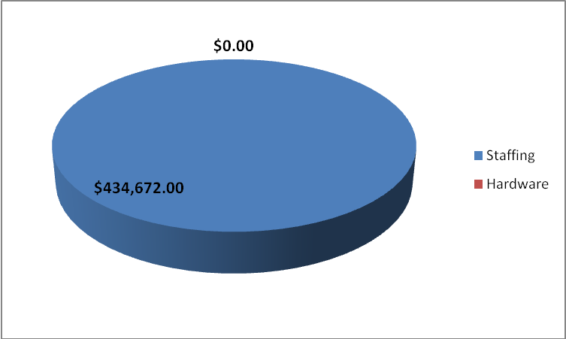
Phase 2 Funding
National Science Foundation helps by granting money up to $750,000
Anticipated Costs: $434,672
Resources carried over from Phase 1

Slide 62
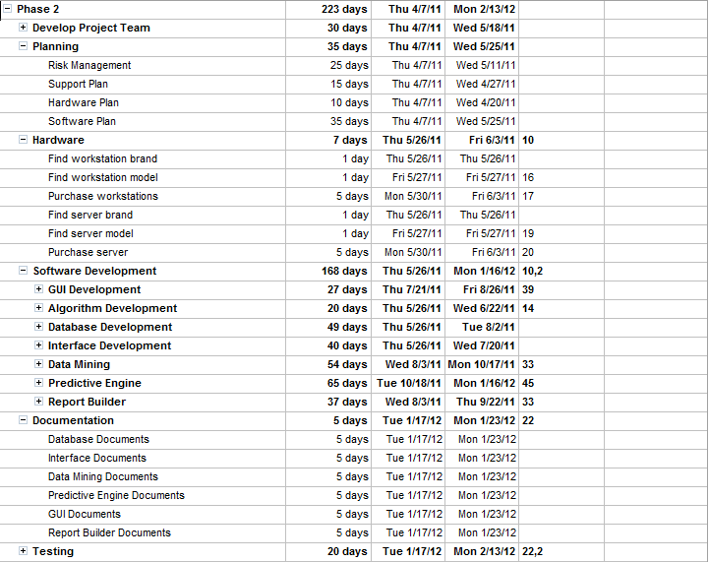
Phase 2 WBS

Slide 63
Phase 2 Staffing
Position | Number of Employees | Hourly Rate | Cost
Project Manager | 1 | $45 | $80,280
Software Engineer | 3 | $35 | $124,880
Webmaster | 1 | $25 | $22,300
Database Developer | 1 | $35 | $51,800
Math Expert | 1 | $35 | $31,220
Salary Cost |  |  | $310,480
40% Overhead |  |  | $124,192
Total Cost |  |  | $434,672

Slide 64
Phase 2 Resources
* Resources carried over from Phase 1

Slide 65
Phase 3 Organization
Project Manager
Software
Engineer
Database
Administrator
Webmaster

Slide 66
Phase 3 Funding
Small business loan or angel investors

Slide 67
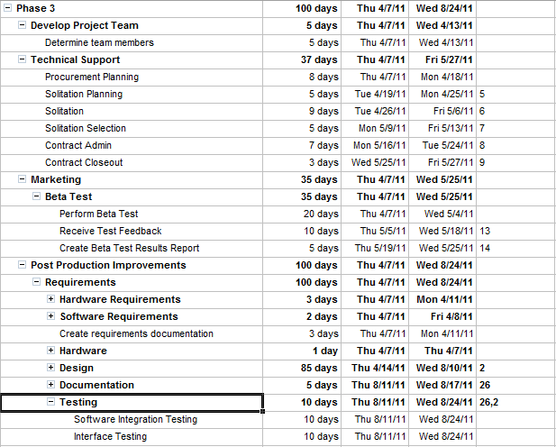
Phase 3 WBS

Slide 68
Phase 3 Staffing
Position | Number of Employees | Hourly Rate | Cost
Project Manager | 1 | $45 | $36,000
Software Engineer | 1 | $35 | $28,000
Webmaster | 1 | $25 | $5,000
Database Administrator | 1 | $35 | $14,000
Additional Salaries |  |  | $84,000
Salary Cost |  |  | $167,000
40% Overhead |  |  | $66,800
Total Cost |  |  | $234,000

Slide 69
Phase 3 Resources
* Resources carried over from Phase 1

Slide 70
Potential Market
State | Grad. Rate (%) | 1st Year Ret. (%) | State | Grad. Rate (%) | 1st Year Ret. (%)
Alabama | 47.4 | 76.4 | Montana | 41.1 | 69.3
Alaska | 25.0 | 70.7 | Nebraska | 54.3 | 77.1
Arizona | 54.7 | 77.7 | Nevada | 43.1 | 75.1
Arkansas | 41.2 | 69.6 | New Hampshire | 65.4 | 83.9
California | 62.0 | 84.3 | New Jersey | 63.6 | 84.7
Colorado | 53.4 | 76.3 | New Mexico | 41.0 | 71.3
Connecticut | 56.2 | 83.7 | New York | 56.8 | 82.5
Delaware | 70.7 | 85.1 | North Carolina | 58.8 | 81.2
Florida | 59.2 | 85.6 | North Dakota | 47.0 | 77.0
Georgia | 51.0 | 80.8 | Ohio | 56.1 | 79.2
Hawaii | 50.9 | 75.1 | Oklahoma | 46.1 | 70.6
Idaho | 32.7 | 63.5 | Oregon | 54.1 | 76.7
Illinois | 59.5 | 80.2 | Pennsylvania | 61.7 | 81.1
Indiana | 52.5 | 77.1 | Rhode Island | 53.6 | 79.2
Iowa | 65.7 | 83.3 | South Carolina | 59.5 | 78.8
Kansas | 54.8 | 74.9 | South Dakota | 46.4 | 73.9
Kentucky | 46.3 | 72.3 | Tennessee | 44.2 | 72.0
Louisiana | 39.8 | 71.5 | Texas | 48.9 | 74.4
Maine | 50.6 | 72.4 | Utah | 47.7 | 73.4
Maryland | 63.0 | 82.3 | Vermont | 71.6 | 86.0
Massachusetts | 52.7 | 79.0 | Virginia | 67.3 | 86.1
Michigan | 59.1 | 80.3 | Washington | 66.4 | 83.5
Minnesota | 53.2 | 78.5 | West Virginia | 45.1 | 72.3
Mississippi | 49.3 | 75.2 | Wisconsin | 58.6 | 79.3
Missouri | 53.8 | 76.0 | Wyoming | 56.9 | 72.5

Slide 71
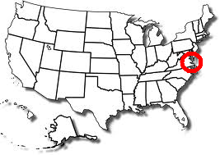
Old Dominion
Old Dominion University

Slide 72
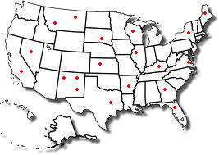
Year One

Slide 73
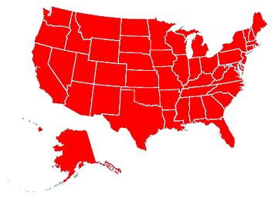
Beyond Year One

Slide 74

Competition: Preferences
Preferences | SAGA | Schedule Whiz | Schedule 25 | IQ.Session | Scheduling Studio 7
Faculty
Student
Room
Room Ownership
Preference Priority
Course Dependencies
Student Curriculum Track

Slide 75
Competition:
Scheduling Features
Scheduling | SAGA | Schedule Whiz | Schedule 25 | IQ.Session | Scheduling Studio 7
Prediction Engine
Dept to University
Optimizer
Multi-Term Forecaster
3rd Party Integration

Slide 76
Price Point
Each unit of SAGA will cost $4,700
An optional $1,000 per year for a support/training plan will also be available

Slide 77
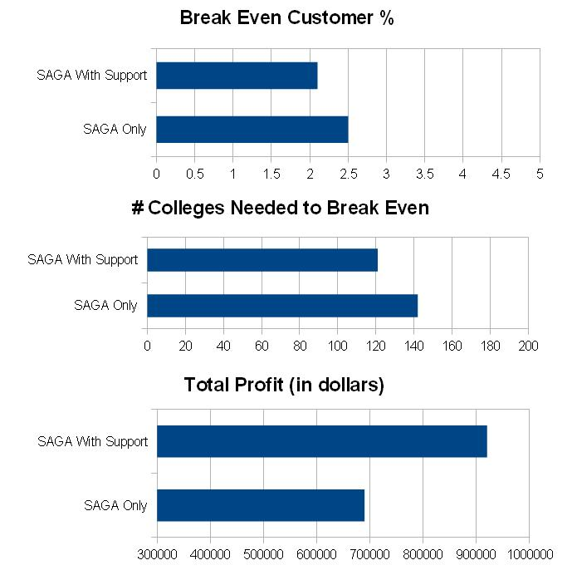
Break Even Analysis

Slide 78
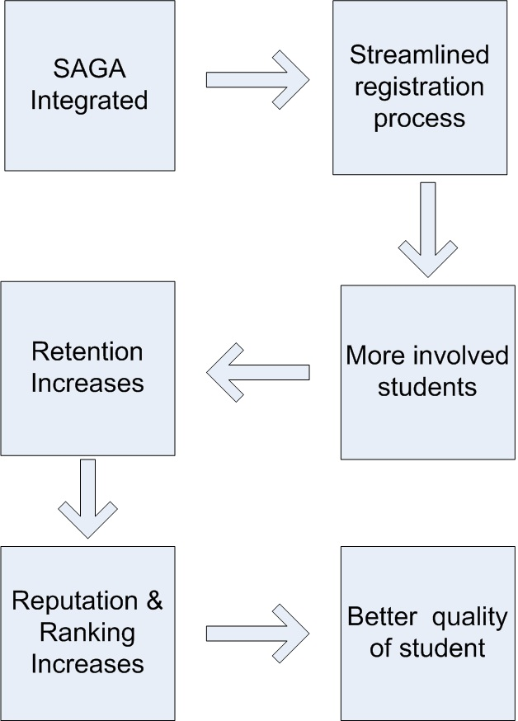
Return on Investment

Slide 79
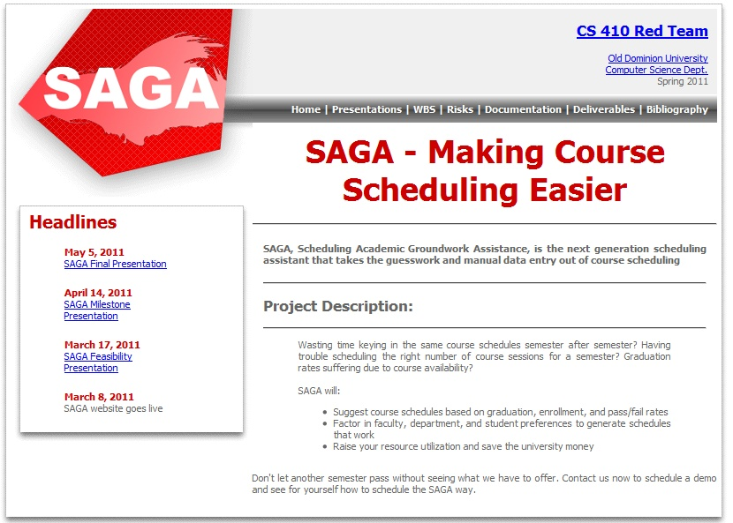
SAGA Website

Slide 80
Schedule Academic Software Assistance
The ultimate purpose of SAGA is to ease the burden of those involved with the scheduling process while simultaneously catering to student and faculty needs and interests.
SAGA improves the course making process by providing collaborative input from students, faculty, and historical trends to assist in predicting demand for the future.

Slide 81
Resources
Mathews, Terri (Fall 2010) – Mathews, Terri. (2011). Fall 2010 Room Utilization By Priority Rooms from BANNER
Cost of Students - http://www.collegemeasures.org/reporting/Institution/Scorecard/232982.aspx
Retention Rate - The Carnegie Foundation for the Advancement of Teaching. (2011, March 30). Carnegie classifications. Retrieved from http://classifications.carnegiefoundation.org
Competition Data – www.thoughtitmus.com , corp.collegenet.com , www.comquip.com , www.collegescheduler.com , www.lantiv.com
Fiver Year Graduation -http://www.collegeparents.org/members/resources/articles/reasons-why-your-college-student-might-not-graduate-four-years

