Slide 1
COmputeR ScienCe wAitlist Milestone Presentation
CS410 Red Team

Slide 2
Team Corsica
Anthony Baron
Web Master
Patrick DeBerry
Reporting & Analyses
Latimer Gerle
Database &
Project Manager
Nicholas LoGioco
Algorithms
Bitaseme Mboe
Interface
Lookmai Rattana
Front End Developer & User Interface

Slide 3
Outline
Identification and Analysis of Societal Problem
Identification and Analysis of Customer
Current Process Flow
Current Process with Proposed Improvements
Solution Design
Major Functional Components Identified
Hardware Requirements Identified
Software Requirements Identified
Software Development Described
Software Details & Logic Approach
Technical Risks
Customer Risks

Slide 4
What is Corsica?
It is an improved waitlist management and enrollment system
For the Computer Science Department

Slide 5
The Issue
Current system causes confusion
Time consuming
Insufficient and Unfair

Slide 6
The current class enrollment system is insufficient for handling course overflows

Slide 7
Who it affects
Administration
Advisors
Faculty
Students

Slide 8
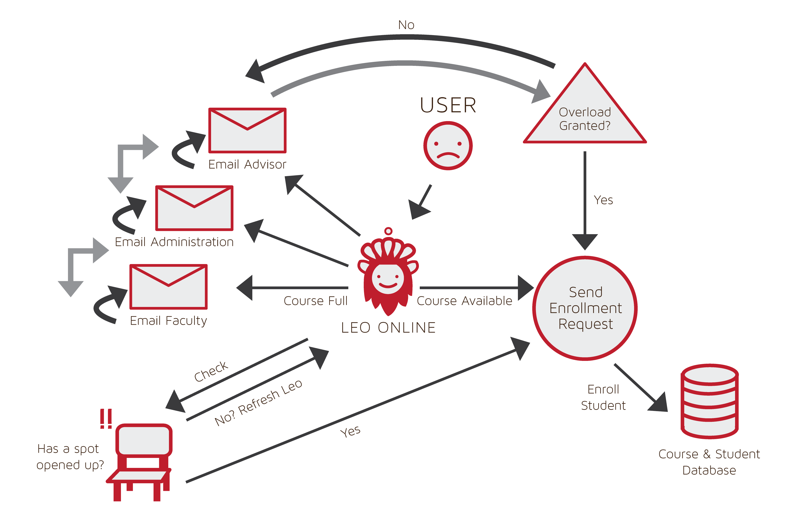
Current Process

Slide 9
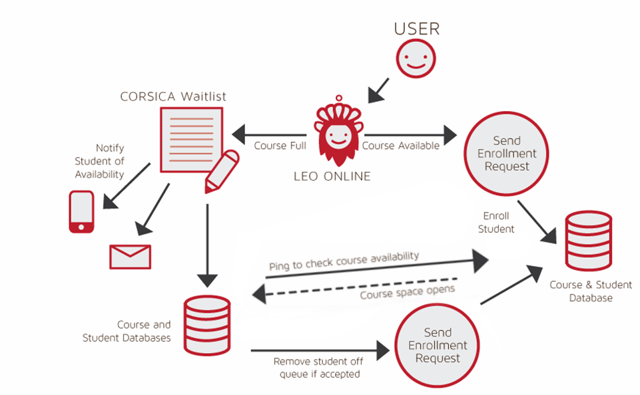
New Process Flow

Slide 10
Mission
Corsica will cause the enrollment process to become more efficient and streamlined by
Improve course waitlist system
To handle course fill ups during enrollment process
Improve the communication system
Let students know a course has an open seat by email and/or text message
Notes:
In order to solve the overflow problem we will implement a waitlist system that manages student sign ups during the enrollment process, if of course that course is full. We’ve elected to include a communication system in order to reach students when a course opens up. They will be notified via: email or text; (if number given) giving them an opportunity to sign up for their desired course.
But how will the system really work?
The waitlist will contain X amount of students on the list (which will be determined at a later date.) The students on the waitlist will receive messages when a spot becomes available, with the option of receiving a phone call, as well. The message will notify the student of their position on the waitlist, let them know when there is an opening in the class, and tell them that they are not guaranteed a seat in the course (as this depends on their spot in the list and I will explain what I mean by this shortly).
If the message arrives via email or text, it will contain a link to the appropriate website; if it is a phone call, the call system will tell the student what the website is.
The waitlist program will function in accordance to strict guidelines and they are as follows:
- If a seat opens up the system will send out a message to all the students on the waitlist.
- If student 1 on the waitlist responds within 24 hours and that response is a “YES” they will be enrolled into the class.
- If student 1 on the waitlist responds within 24 hours and that response is a “NO” they will not be enrolled into the class and each student on the waitlist will go down by 1 position ( I.E. student 2’s place is now in student’s 1 place.)
If student 1 on the waitlist does not respond within 24 hours each spot on the waitlist will go down by 1 position.
If student 1, student 2 (and so on, until someone says “YES”) says “NO” the student who said “YES” will be enrolled into that class.
- If student 1 says “NO” and student 2 does not respond but student 3 says “YES” this does not mean that student 3 gets the seat. Student 2 never responded so they still have the chance to enroll into the class, provided their 24 hour window is still active.
Next slide please….

Slide 11
Solution Goals
Provide automated system through which:
Faculty and students can be notified of available seats
Reserves the available seats for student on waitlist
Ensures fair process
Triggers alerts for enrollment aspects
Notes:
The automated portions of our waitlist enrollment system will include the: notification process (where the students are notified of the available space), the checking of course availability, alert system (where student will be updated of progress [i.e. seat is available for course X, you have enrolled in course X, you have been dropped from waitlist, etc.)]
Seat opens etc

Slide 12
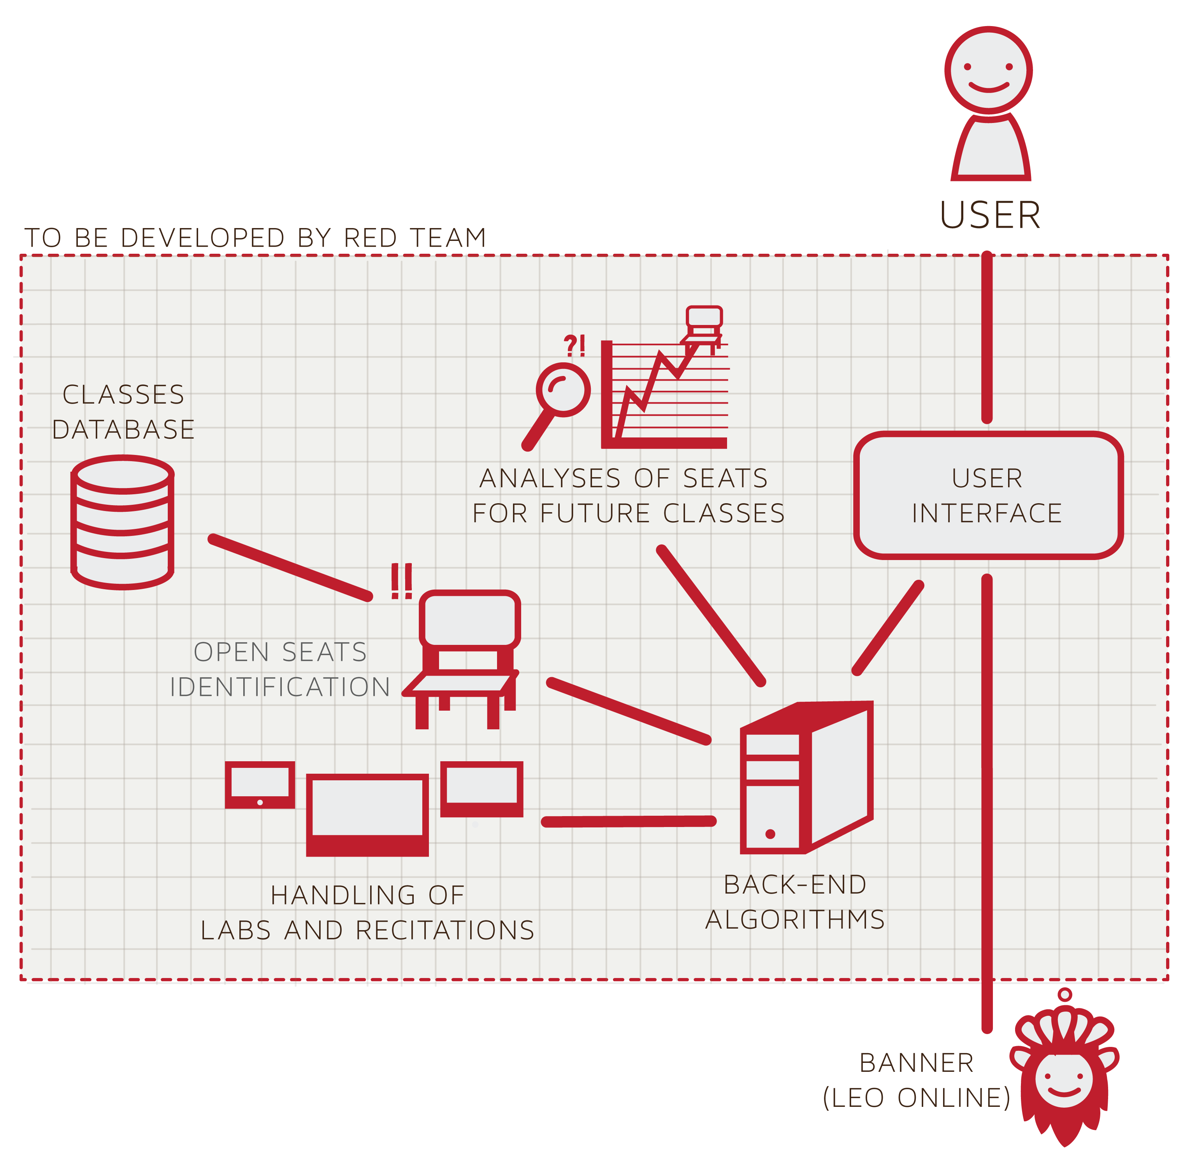
Major Functional Component Diagram
Notes:
She liked this slide

Slide 13
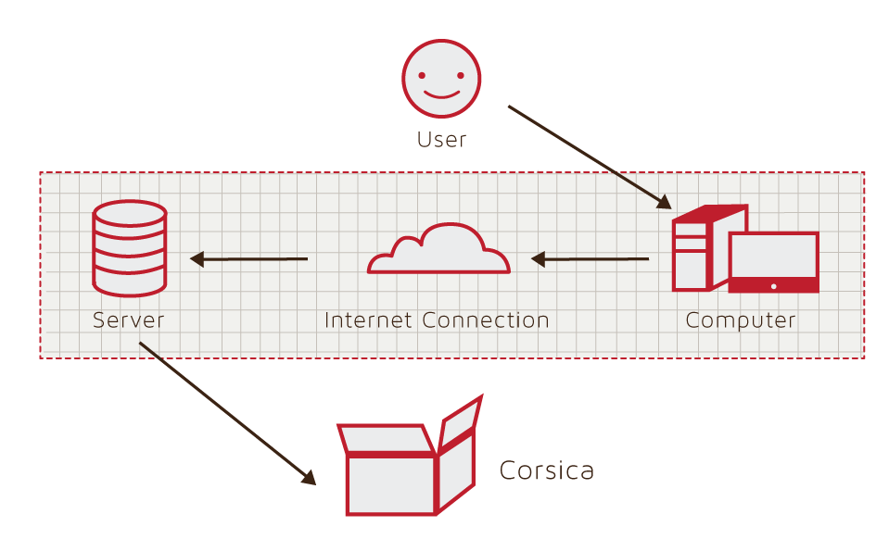
Hardware Requirements Identified

Slide 14
Software Requirements Identified
Database
Essential information
Algorithms
The workhorse behind CORSICA
Interfaces
Variety of views
Notification System
Notify students of an open seat
Test Case
Test the capability of CORSICA

Slide 15
Software Development Described
Algorithm:
C++
Database:
MySQL
GUI:
HTML
CSS
Javascript

Slide 16
Software Details & Logic Approach
Algorithm
Database
GUI
Notification System

Slide 17
Software Details & Logic Approach

Slide 18
Software Details & Logic Approach

Slide 19
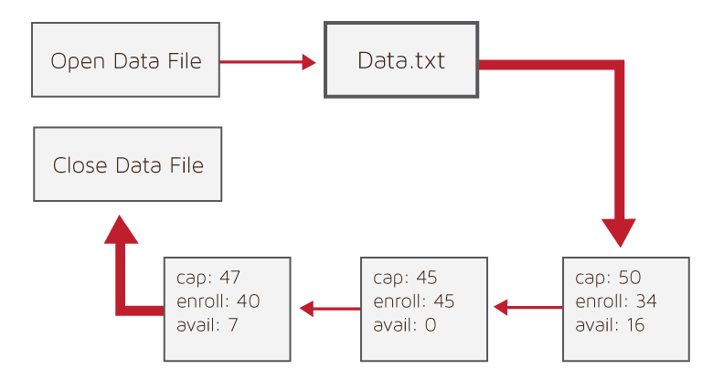
Algorithm: Load Enrollment Data Files
Purpose: Load Corsica with course information
Procedure:
Open data file
Copy data file information into Corsica
Close data file upon completion
Data File Contents:
Course capacity
Course enrollments
Available seats
Notes:
To the right you will see a diagram showing how our load data algorithm will work. It is rather simple. We will have data files that consist of a course’s name, its capacity, amount of students enrolled, and the number of available seats. For demonstration purposes, each SQUARE in the diagram represents a different course. However, we will also be loading data for different sections of the same course (not depicted).

Slide 20
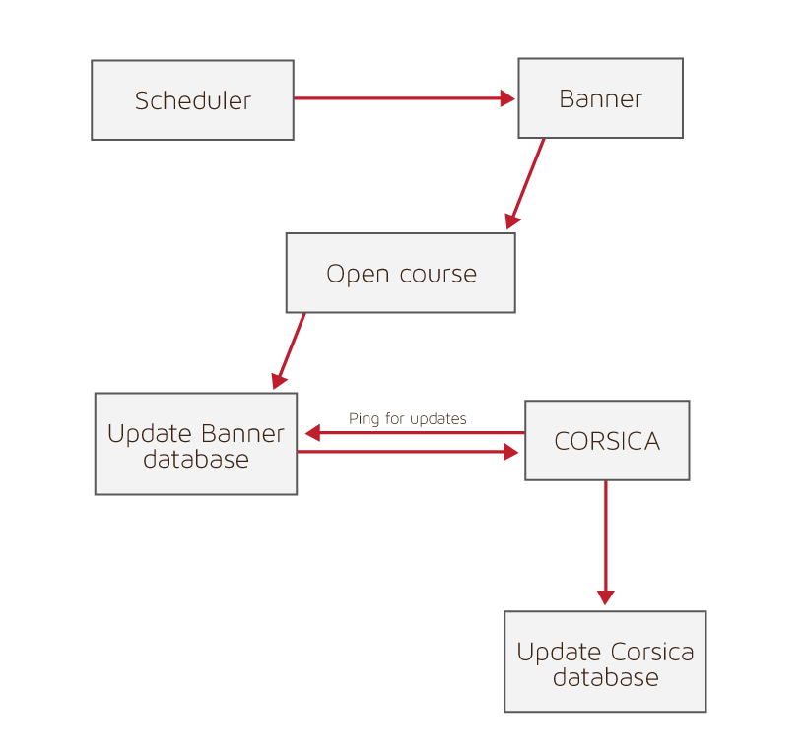
Algorithm: Open Course
Purpose: Add course as waitlist option
Procedure:
Scheduler locates course in Banner
Scheduler adds the course as available option
Banner database is updated
Corsica is notified of change
Corsica database is updated

Slide 21
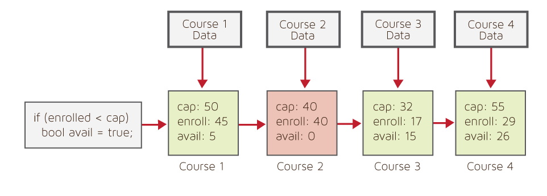
Algorithm: Check for Open Seats
Purpose: Corsica functionality
Procedure:
Pull course information
Check if there are available seats
Return a Boolean value
Move to next course
Notes:
A major part of Corsica will be its ability to determine if a course has an available seat or not. To the right you will see a diagram giving a sample run through of how this algorithm will function. Again, each square represents a different course. Our algorithm will perform a simple test once course data is pulled. If the amount of enrolled students is less than the course capacity, then there are available seats. As you can see, Course 1 passes this test and is marked true (shaded green). However, upon reaching Course 2, we have a fail case. There are no available seats and it is marked false (shaded red). Courses 3 and 4 are carried on in the same fashion.
While simple, this is a critical test to determine if a student will be notified of an available seat for a course they have been waitlisted on.

Slide 22
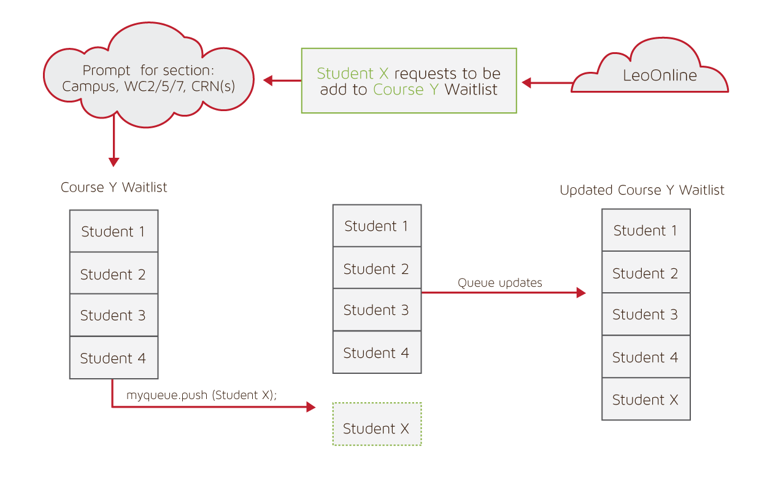
Algorithm: Add Student to Waitlist
Purpose: Allow student to be placed on waitlist
Procedure:
Student X wishes to be on Course Y waitlist
Student is prompted for section
Course Y waitlist is pulled up by Corsica
Student is placed at end of queue
Course Y waitlist updates
Notes:
With a high level of abstraction, our diagram depicts a scenario in which Student X wishes to be placed on the waitlist for Course Y and how this algorithm will flow. The student will be prompted for a specific section(s) prior to being placed on that particular waitlist. After they have chosen a single or multiple sections, Corsica will pull that specific waitlist and add Student X to the queue. Once the student is placed, the waitlist for Course Y is updated.

Slide 23
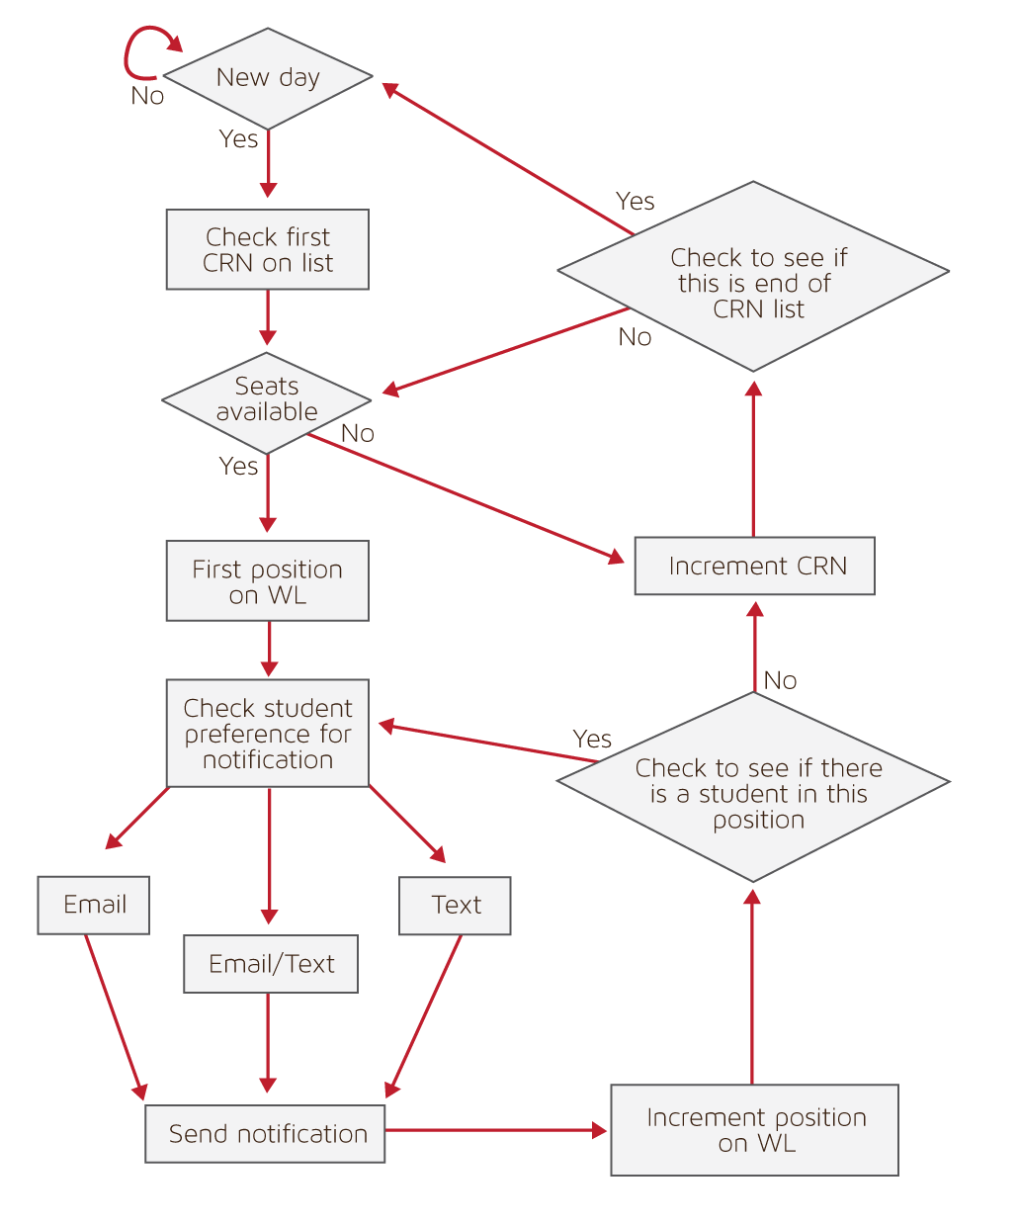
Algorithm: Notification
Purpose: Notify students on waitlist of an open seat
Procedure:
Pull course information
Return Boolean value
If true
Check notification preference for students
Notify students via email and/or text
If false
Increment course

Slide 24
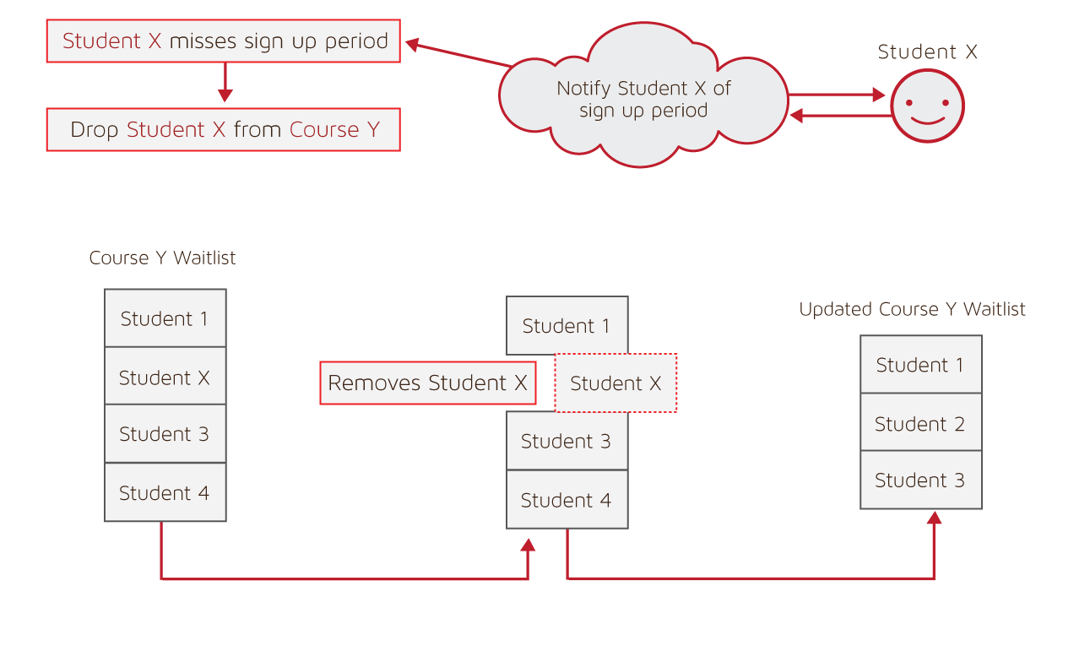
Algorithm: Drop Student from Waitlist
Purpose: Remove student from waitlist
Procedure:
Student X either misses window or signs up for Course Y
Course Y waitlist is pulled up
Student X is located in queue
Student X is removed form queue
Course Y waitlist updates
Notes:
The purpose of this algorithm is to handle a situation in which either: The student is notified of an opening for a course and they miss their 24 hour window or if they successfully enroll in a course during their time window. The diagram shows how the algorithm will flow. Student X is notified of an available seat for Course Y and the 24 hour window begins. Now, either the student has missed their window or they have successfully signed up for Course Y. Both scenarios lead to Corsica finding Course Y’s waitlist and locating Student X on the queue. Once found, the student is removed from the queue. The waitlist for Course Y is now updated.

Slide 25
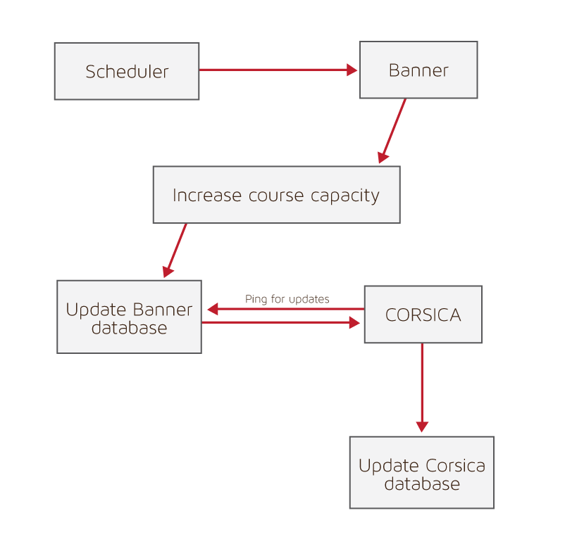
Algorithm: Increase Course Capacity
Purpose: Increase a course's capacity
Procedure:
Scheduler locates course in Banner
Scheduler increases capacity
Banner database is updated
Corsica is notified of change
Corsica database is updated

Slide 26
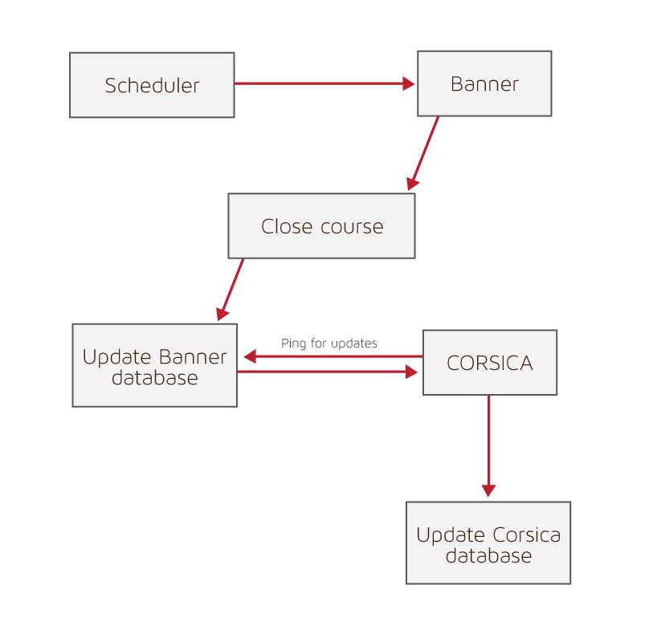
Algorithm: Close Course
Purpose: Remove course as waitlist option
Procedure:
Admin Locates Course in Banner
Admin removes the course as available option
Banner Database is updated
Corsica is notified of change
Corsica Database is updated
Notes:
This algorithm is necessary to handle a situation in which ODU has decided to no longer provide a specific course or course section. An Admin will log into Banner and locate the course in question. They will remove the course or course section as an available option for students to enroll in and the Banner database will be updated to reflect this change. Corsica will be notified about this change and will then update its own database and no longer allow students to be placed on that course’s waitlist.

Slide 27
Software Details & Logic Approach

Slide 28
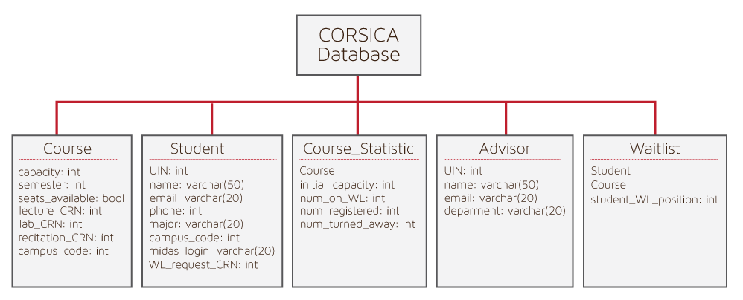
Database Schema
Notes:
As you can see, our database will consist of five tables, namely: Course, Student, Course Statistics, Advisor, and Waitlist. The Course table will contain all the relevant course information, such as capacity, whether or not there are any seat available, and the campus code. Like the Course table, the student table will contain the relevant student information, like the student’s UIN, name, and the Course Registration Number of the course section for which they would like to be waitlisted. The Course Statistics table would consist of an instance of a Course, as well as the final registration numbers; this would be used for future analyses regarding seating capacities. The Advisor table would house information about the student’s advisor, such as name and department. And finally, each Waitlist table would represent an actual waitlist; thus, it would contain a Student class, a Course class, and the student’s position on the waitlist.

Slide 29
Database: Student
Notes:
Here we have an entity relationship diagram between our waitlist, advisor, and student tables. The waitlist lists students; one waitlist can list numerous students, and multiple students can be on a waitlist. Meanwhile, the advisor advises the students; like the waitlist, one advisor can advise multiple students.

Slide 30
Database: Course
Notes:
And this is the entity relationship diagram between our waitlist, course, and course statistics. The waitlist has a course; there is one waitlist for a course, and one course corresponds to a waitlist. Course statistics are gathered from courses. This is also a one-to-one relationship; one course provides a set of course statistics, and a set of course statistics is gathered from a course.

Slide 31
Software Details & Logic Approach

Slide 32
Software Details & Logic Approach

Slide 33
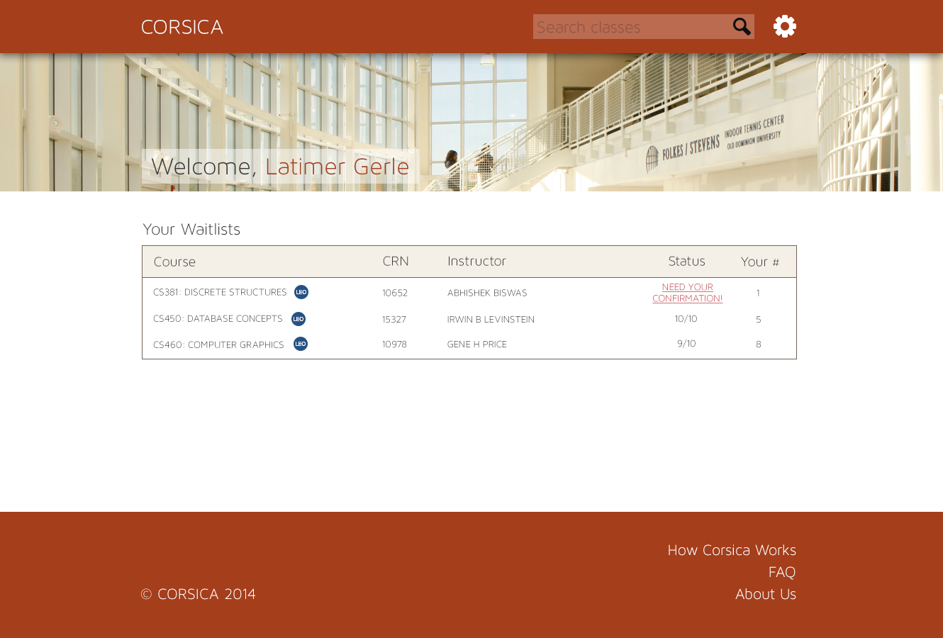

Slide 34
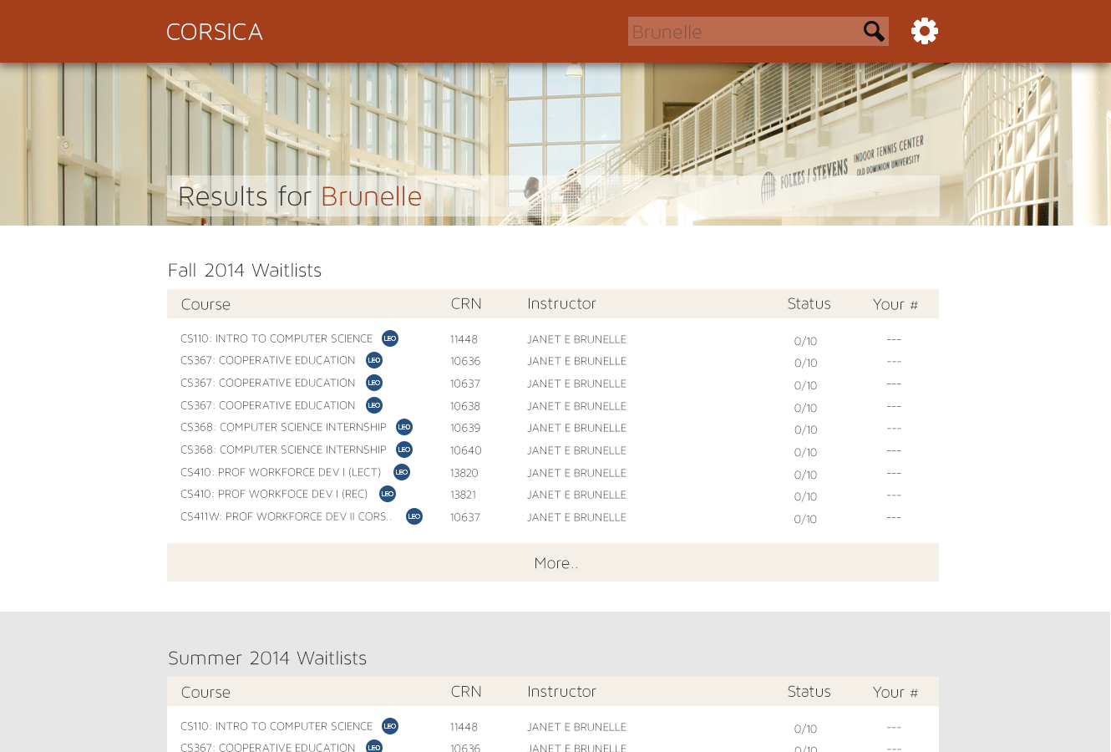

Slide 35
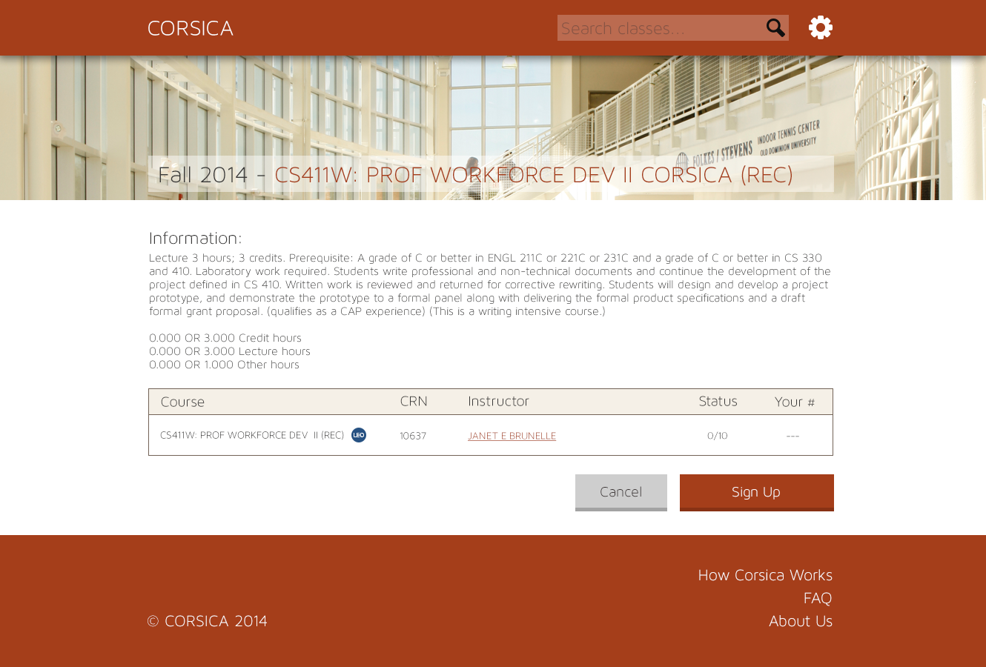

Slide 36
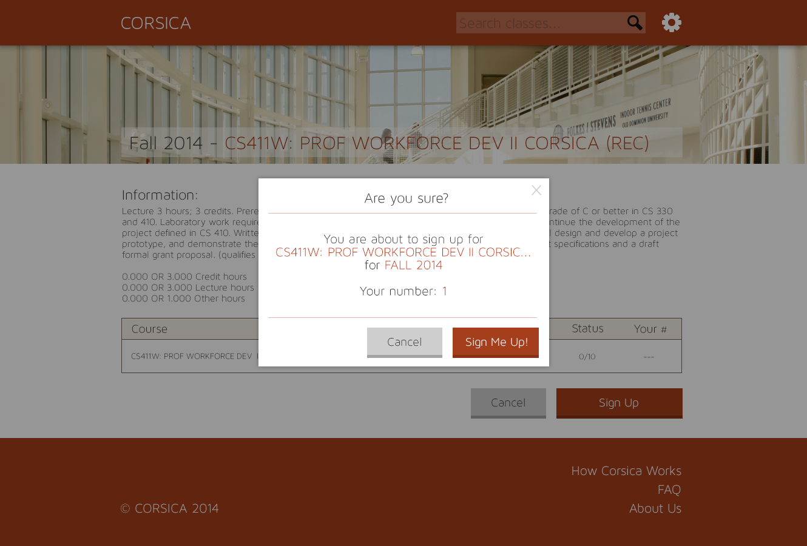

Slide 37
Software Details & Logic Approach

Slide 38
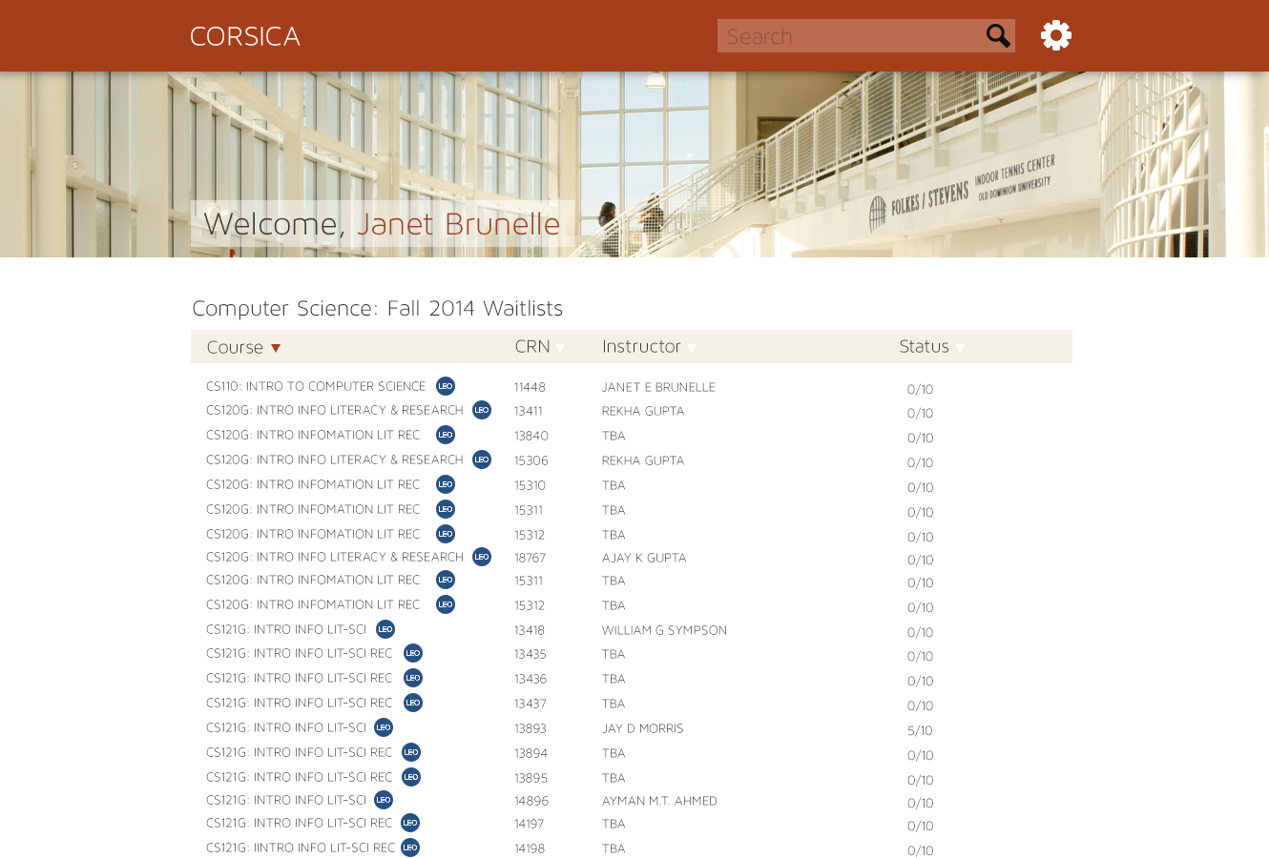
Notes:
Home Screen – displays the active semester waitlists list (lol). The user can filter the list by course name, crn, instructor’s names, or by the status

Slide 39
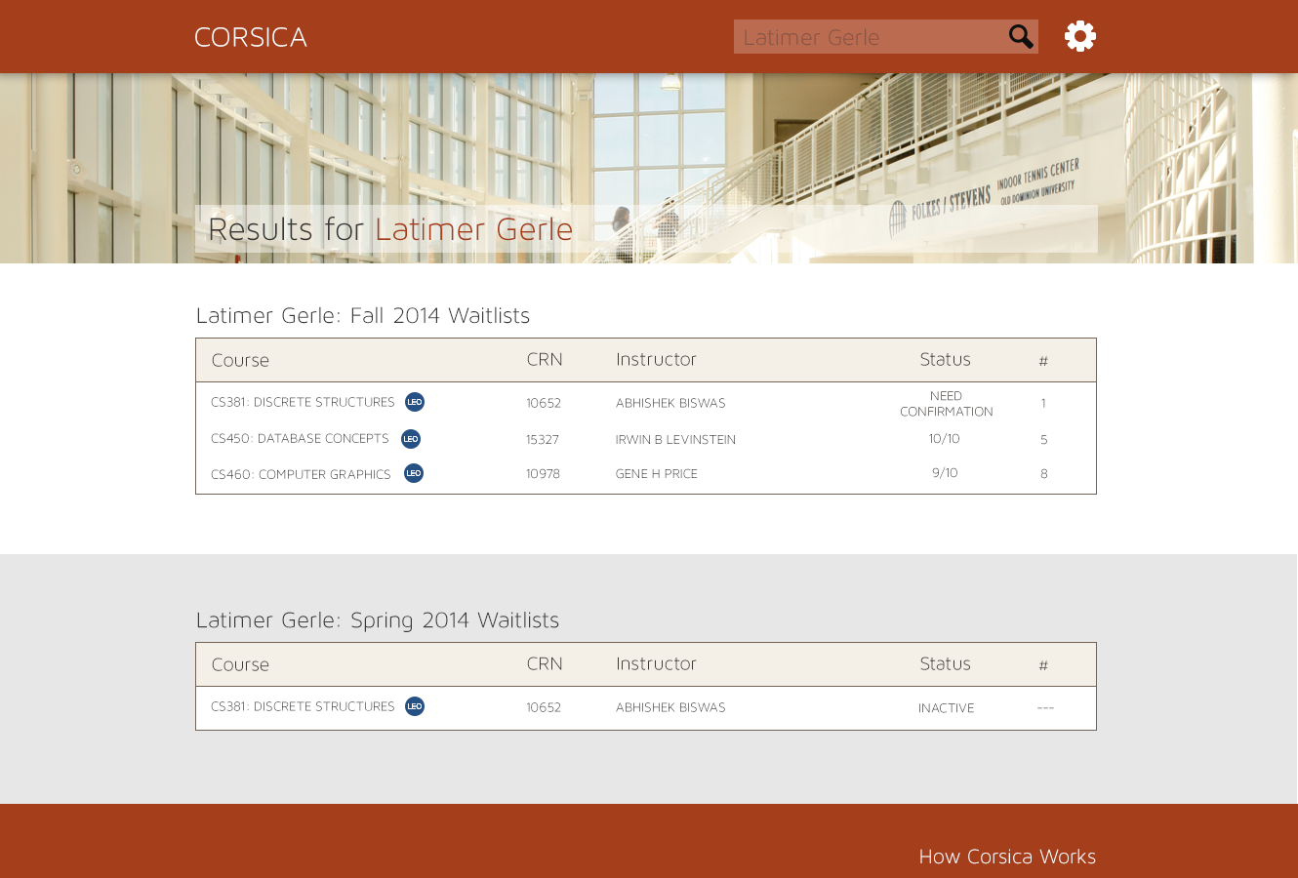

Slide 40
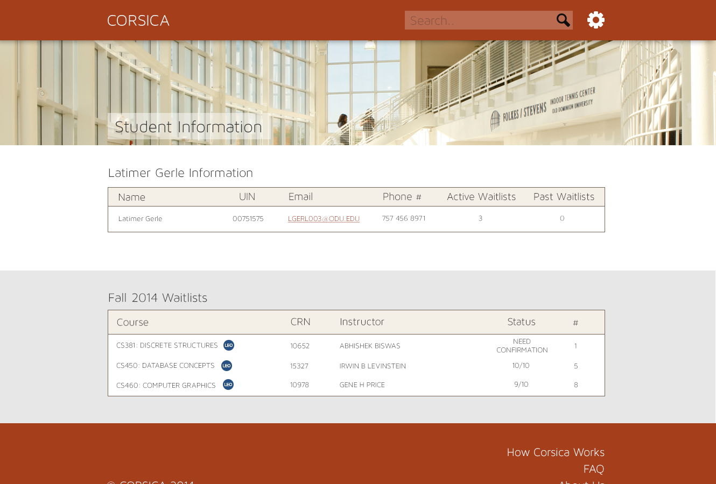

Slide 41
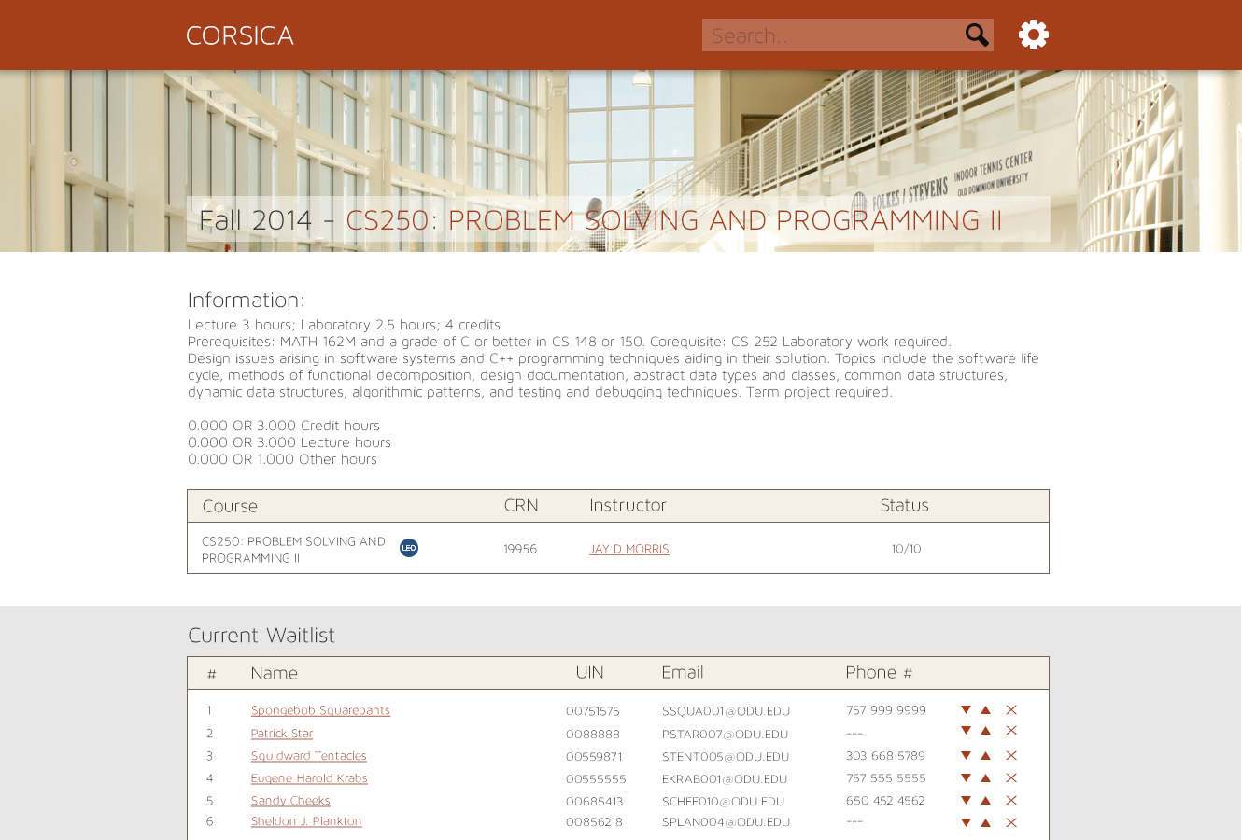

Slide 42
Software Details & Logic Approach

Slide 44
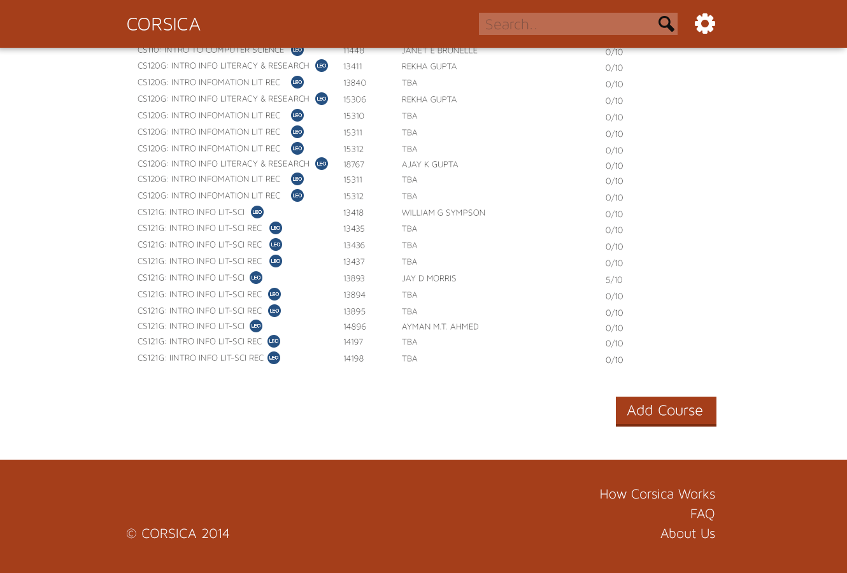

Slide 45
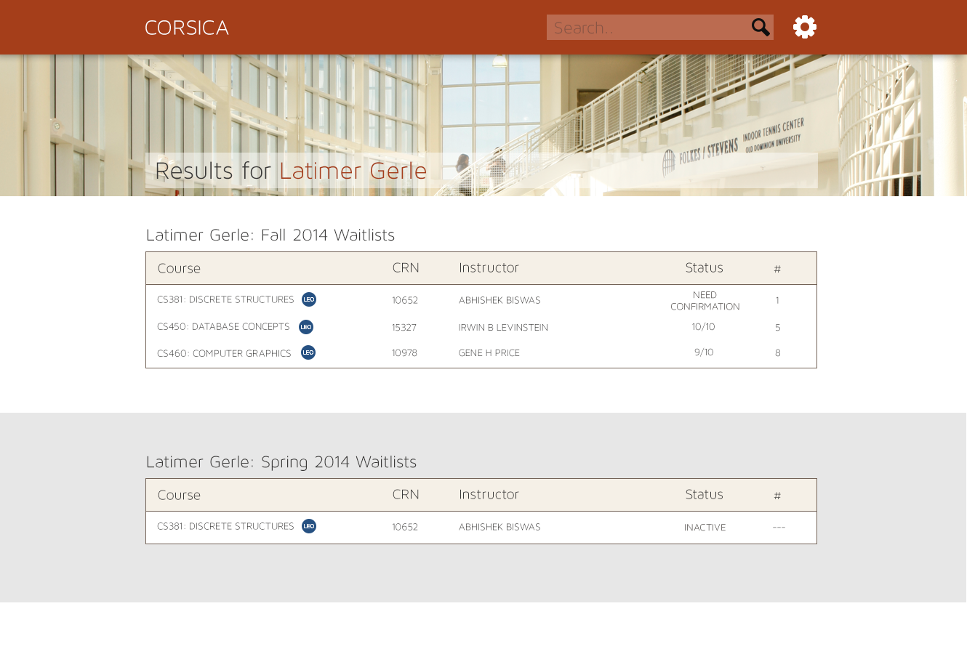

Slide 47
Software Details & Logic Approach

Slide 48
Administrator
Administrator will have the same accessibility as the scheduler

Slide 49
Guest (Non Logged In) Person
Guest will have the ability to see static pages such as:
Home Page
How Corsica Works
Condensed and easy to read version of the current site’s Overview and Deliverables
About Us
Contact Us
FAQ

Slide 50
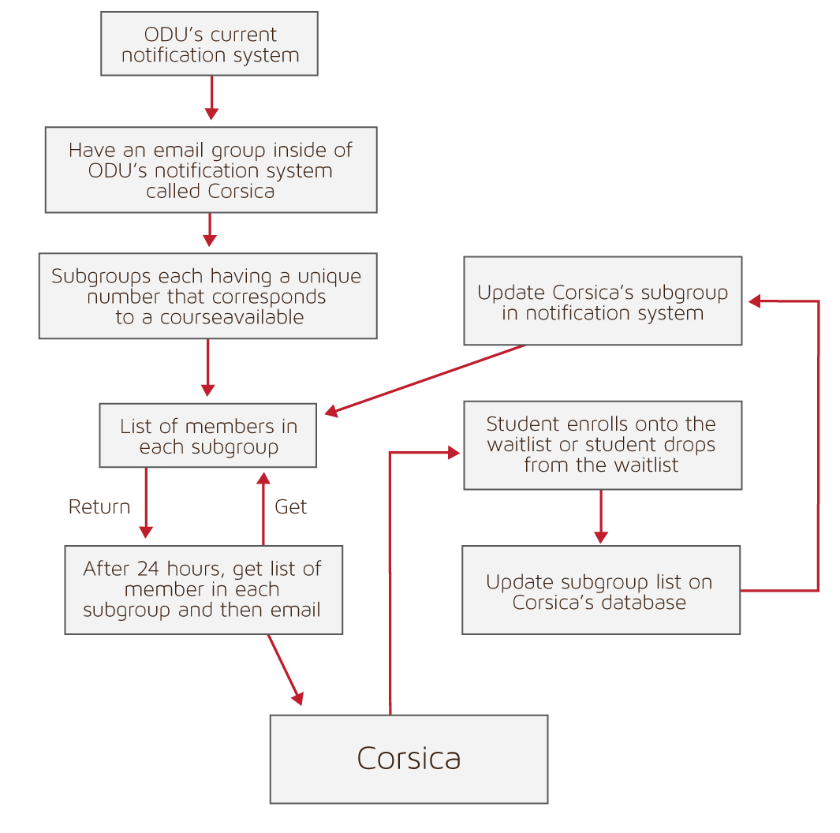
Notification System

Slide 51
Risk Management Plan

Slide 52
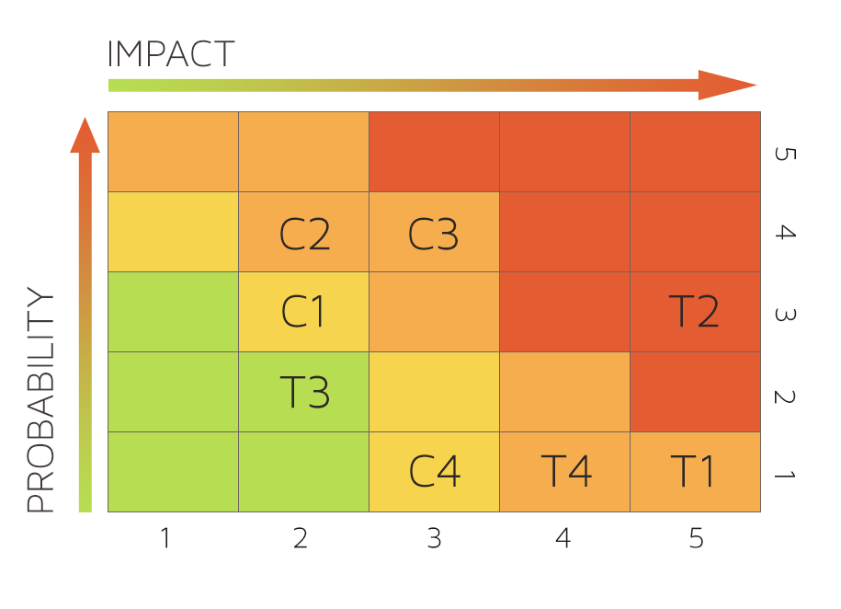
Risk Matrix
Customer Risks | Technical Risks
C1: Department Use Rejection | T1: Ability to Integrate with Banner
C2: Transition to New GUI | T2: Software Upgrades
C3: Cost of Product | T3: Availability of Server Storage
C4: Product Interest | T4: Security Vulnerability

Slide 53
Customer Risks
C1: Department Use Rejection
Impact: 2
Probability: 3
Mitigation: Corsica aims to solve the waitlist issues of the department at an affordable price.
C2: Transition to a New GUI
Impact: 2
Probability: 4
Mitigation: Corsica will strive provide its users with a simple interface.

Slide 54
Customer Risks
C3: Cost of Product
Impact: 3
Probability: 4
Mitigation: Corsica will take into account the past and future annual incomes in a 2 year time-span and price the product accordingly. Also we aim to use cost-effective components in our product.
C4: Product Interest
Impact: 3
Probability: 1
Mitigation: Since there is a need for an efficient waitlist feature, Corsica will be solution to that problem.

Slide 55
Technical Risks
T1: Ability to Integrate with Banner
Impact: 5
Probability: 1
Mitigation: Corsica will be designed to work with the Banner. Any incompatibilities should be insignificant to the overall operation and can be mitigated with software updates.
T2: Software Updates
Impact: 5
Probability: 3
Mitigation: Technology is constantly evolving. This means it is up to the developers of Corsica to be aware of any updates to University Software in order to provide updates to the Corsica software to maintain compatibility with the University Software.

Slide 56
Technical Risks
T3: Availability of Server Storage
Impact: 2
Probability: 2
Mitigation: Corsica creates event logs and data files that it keeps on a server. In the event that server storage space is low, there is a feature to back up all logs and files to another cloud storage or to download the file to the computer.
T4: Security Vulnerability
Impact: 4
Probability: 1
Mitigation: Corsica runs through the secure servers of the University. This means that the data that is being transferred is encrypted, preventing anyone from hacking into the system to view files.

