Slide 1
Voice Over Internet Protocol
Nelson Kattula Computer Science, Masters

Slide 2
Outline
Define VoIP
Protocols
Advantages / Disadvantages
Current Research

Slide 3
What is it?
VoIP allows you to make telephone calls using a computer network, over a data network like the Internet.
Also referred to as IP Telephony
Voice conversations are turned into digitized data and packetized for transmission across a network.

Slide 4
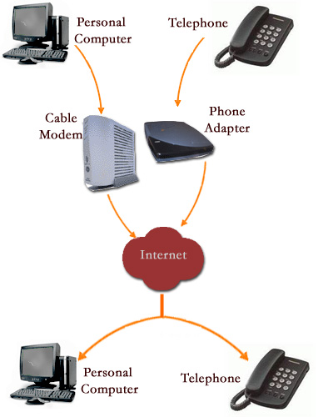

Slide 5
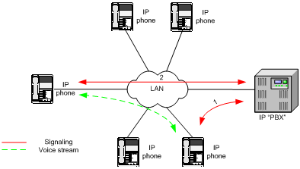
VoIP Architecture
Multimedia stream
End-to-end
IP Phone to Host machine
Host Machine to IP Phone
Signals
Administered by server
PBX-Private Branch Exchange

Slide 6
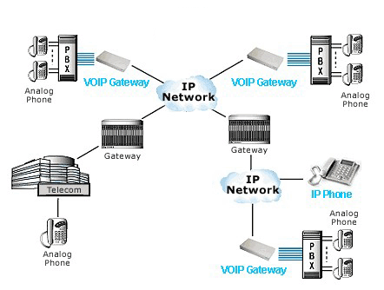
Working Model
VoIP Gateway
transform IP to PSTN traffic
Vice-versa
Gateway
Connect hosts
Connect IP Phone

Slide 7
IP address to Phone Number
VoIP look for IP address
Translate Phone numbers to IP addresses
The central call processor is a piece of hardware running a specialized database/mapping program called a soft switch.
Soft switches know:
Where the endpoint is on the network
What phone number is associated with that endpoint
The current IP address assigned to that endpoint
If soft switch does not have the information, the request is handled by another soft switch.

Slide 8
Protocols
Used to connect different pieces of hardware.
H.323
Most widely used protocol
provides specifications for real-time, interactive videoconferencing, data sharing and audio applications (VoIP)
SIP
More streamlined protocol
Developed specifically for VoIP
Lack of a standard protocol is a problem. Not always compatible.

Slide 9
VoIP VS PSTN
PSTN = Public Switched Telephone Network
VoIP uses Packet Switching which is more efficient than a dedicated line
Also compression can be used
Can transmit data (video)

Slide 10
Advantages
Cost
Free VoIP to VoIP
Low cost VoIP to Public Switch Telephone Network (PSTN)
Less bandwidth requirements
Low cost / no cost software and hardware
Mobility
Any internet connection
Growing number of wireless broadband locations

Slide 11
Drawbacks
Quality
High quality PSTN
Variable VoIP dependent on connection
Dependent on wall power
Lost or delayed packets cause drop-out in voice
Emergency Calls
Hard to find geographic location
Security
Most VoIP services do not support encryption

Slide 12
Results
Many paths performed poorly for VoIP traffic due to long delays and large delay variability
Playback buffer schemes – tradeoff between data loss and increased delay in the buffer
Overall rated VoIP as poor
Mark voice traffic and give it preferential treatment
Choose playback buffer scheme to match delay pattern

Slide 13
Fast computer network and dependable telephones are fundamental to every successful work environment
Questions?

