Slide 1
Content Distribution Networks
Presented by
Sajna Rejinath

Slide 2
Introduction
Today, many internet video companies such as YouTube, Netflix etc. , are distributing multi-Mbps streams to users around the world everyday.
The most straightforward approach is:
Build a single massive data center
Store all of its videos in the center
Stream the videos directly from the center to clients worldwide.

Slide 3
Drawback Of This Approach
Three major problems:
Freezing Delays
Waste of bandwidth
Single point of failure
To meet the challenge of distributing massive amount of video data to users around the world, all major video-streaming companies make use of Content Distribution Networks(CDNs).

Slide 4
What is Content distribution network?
Also known as content delivery network.
A CDN manages servers in a multiple geographically distributed locations, stores copies of the videos (and other types of Web content, including documents, images, and audio) in its servers, and attempts to direct each user request to a CDN location that will provide the best user experience.

Slide 5
Types of CDNs
Private CDN
Owned by contend provider itself. Ex Google’s CDN distributes YouTube videos and other types of content.
Third-party CDN
CDN that distributes content on behalf of multiple content providers. Ex Akamai’s CDN distributes Netflix and Hulu content.

Slide 6
Server Placement Philosophies
CDNs typically adopt one of the two different server placement philosophies :
Enter Deep.
Pioneered by Akamai
Enter deep into the access networks of Internet Service Provider, by deploying server clusters in access ISPs all over the world.
Goal : To get close to end users, thereby improving user-perceived delay and throughput by decreasing the number of links and routers between the end user and the CDN cluster from which it receives content.

Slide 7
Bring Home.
This philosophy, taken by Limelight and many other CDN companies
Build large clusters at a smaller number (for example, tens) of key locations and connecting these clusters using a private high-speed network.
CDNs typically place each cluster at a location that is simultaneously near the PoPs of many tier-1 ISPs, for example, within a few miles of both AT&T and Verizon PoPs in a major city.
Compared with the enter-deep design philosophy, the bring-home design typically results in lower maintenance and management overhead, possibly at the expense of higher delay and lower throughput to end users
.

Slide 8
CDN Operation
Most CDNs take advantage of DNS to intercept and redirect requests.
Let’s consider an example to illustrate how DNS is typically involved. Suppose a content provider, NetCinema, employs the third-party CDN company, KingCDN, to distribute its videos to its customers. On the NetCinema Web pages, each of its videos is assigned a URL that includes the string “video” and a unique identifier for the video itself;
For example, Transformers 7 might be assigned http://video.netcinema.com/6Y7B23V

Slide 9
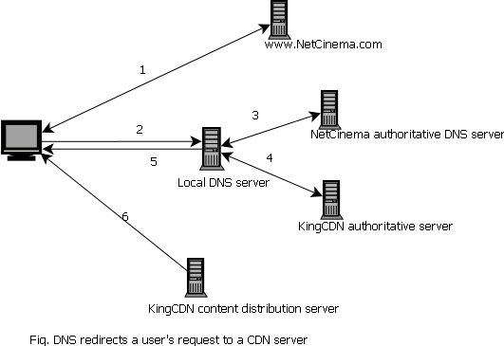
.

Slide 10
Six steps then occur
The user visits the Web page at NetCinema.
When the user clicks on the link http://video.netcinema.com/6Y7B23V, the user’s host sends a DNS query for video.netcinema.com
The user’s Local DNS Server (LDNS) relays the DNS query to an authoritative DNS server for NetCinema, which observes the string “video” in the hostname video.netcinema.com. To “hand over” the DNS query to KingCDN, instead of returning an IP address, the NetCinema authoritative DNS server returns to the LDNS a hostname in the KingCDN’s domain, for example,a1105.kingcdn.com.

Slide 11
From this point on, the DNS query enters into KingCDN’s private DNS infrastructure. The user’s LDNS then sends a second query, now for a1105.kingcdn.com, and KingCDN’s DNS system eventually returns the IP addresses of a KingCDN content server to the LDNS. It is thus here, within the KingCDN’s DNS system, that the CDN server from which the client will receive its content is specified.
The LDNS forwards the IP address of the content-serving CDN node to the user’s host.
Once the client receives the IP address for a KingCDN content server, it establishes a direct TCP connection with the server at that IP address and issues an HTTP GET request for the video.

Slide 12
Cluster Selection Strategies
Mechanism for dynamically directing clients to a server cluster or a data center within the CDN.
Geographically closest
Assign the client to the cluster that is geographically closest.
This may not work for some client since the geographically closest cluster may not be the closest cluster along the network path.
Real-time measurement of delay
CDN performs periodic real-time measurement of delay and loss performance between their clusters and clients

Slide 13
IP anycast
The routers in the Internet route the client’s packets to the “closest” cluster, as determined by BGP.
Load on the clusters
Clients should not be directed to overloaded clusters.
ISP delivery cost
The clusters may be chosen so that specific ISPs are used to carry CDN-to-client traffic, taking into account the different cost structures in the contractual relationships between ISPs and cluster operators.

Slide 14
Notable Content Delivery Service Providers
Free CDNs
BootstrapCDN
CloudFlare
Instart Logic
Traditional commercial CDNs
Akamai Technologies
Amazon CloudFront
Azure CDN
HP Cloud Services

Slide 15
Reference
Computer Networking A Top-Down Approach by James F. Kurose

