Slide 1
Principals of Mobility Management
Krasnolobova Kristina CS555

Slide 2
What is Mobile Node?
A mobile node is an Internet-connected device whose location and point of attachment to the Internet may frequently be changed. (Rouse,n.d)

Slide 3
Mobility from the
Network Layer’s Standpoint
User moves between
access networks
While maintaining
ongoing connection
User moves only within
same wireless
access network
No mobility
High mobility
User moves between
access networks,
shutting down while
moving between networks

Slide 4
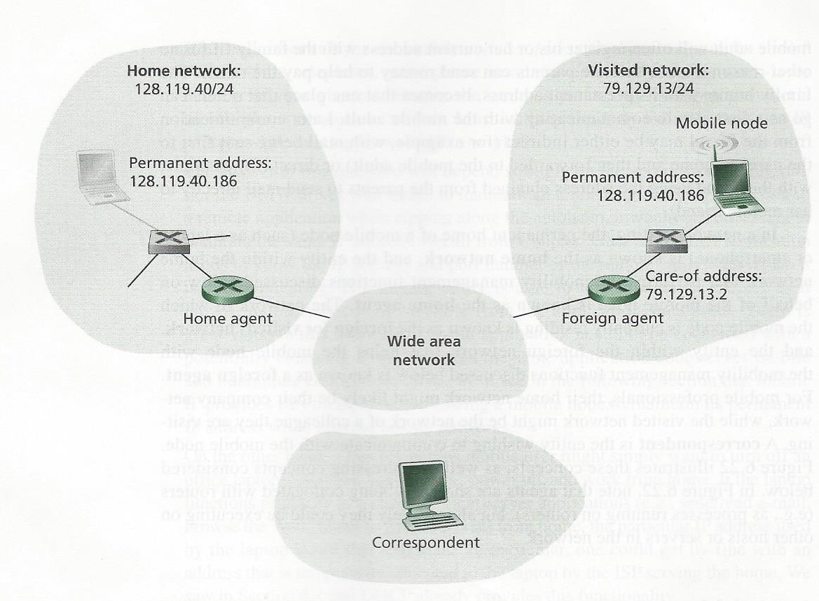
Initial elements of mobile network architecture
Network in which mobile node currently residing
Permanent home of mobile node(such as a laptop or smartphone)
Entity within the home network that performs mobility management functions on behalf of the mobile node
Entity within the foreign network that helps mobile node with the mobility management functions
Entity wishing to communicate with the mobile node
(Kurose, & Ross, 2013, p. 558)

Slide 5
Addressing
Approach #1
Steps:
Advertise to neighbors that
It has specific rout to mobile’s
Node permanent address
2. Neighbors will propagate
this information
3. When mobile node leaves,
new network will advertise a new
route to the mobile node
Drawback: scalability
(Kurose, & Ross, 2013, p. 558)

Slide 6
Addressing
Approach #2
Mobiles node home network
will track the foreign network in
which the mobile node resides
(Kurose, & Ross, 2013, p. 558)

Slide 7

Foreign agent
Permanent address;
foreign address
Create care-of address (COA) –
foreign address
2. Inform home agent that the mobile
Node is resident in its network and
given COA
(Kurose, & Ross, 2013, p. 558)

Slide 8
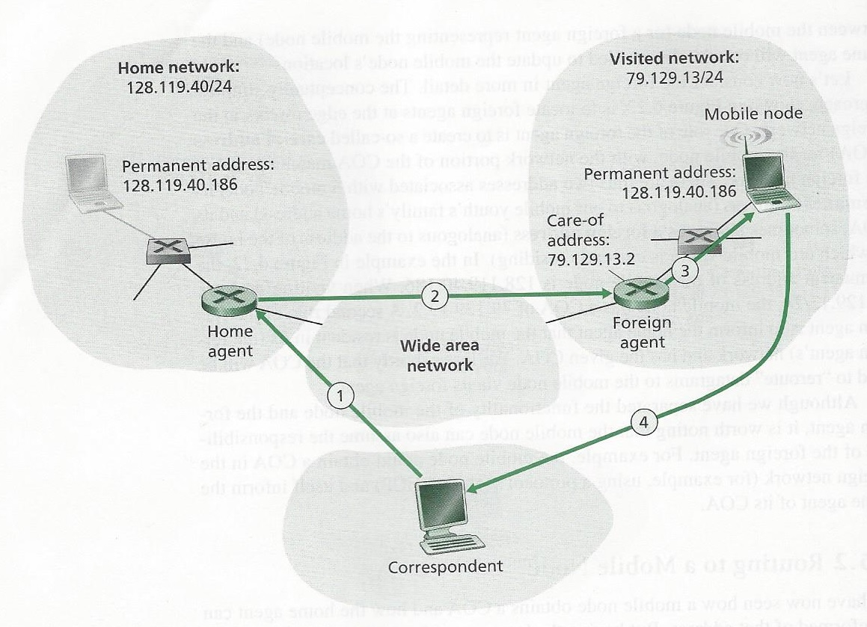
Indirect Routing to a mobile node
1.Track mobile node’s COA
2. Be on lookout for arriving
datagrams address to node
Drawback: triangle routing problem – datagrams routed to home agent, then foreign network.
(Kurose, & Ross, 2013, p. 560)

Slide 9
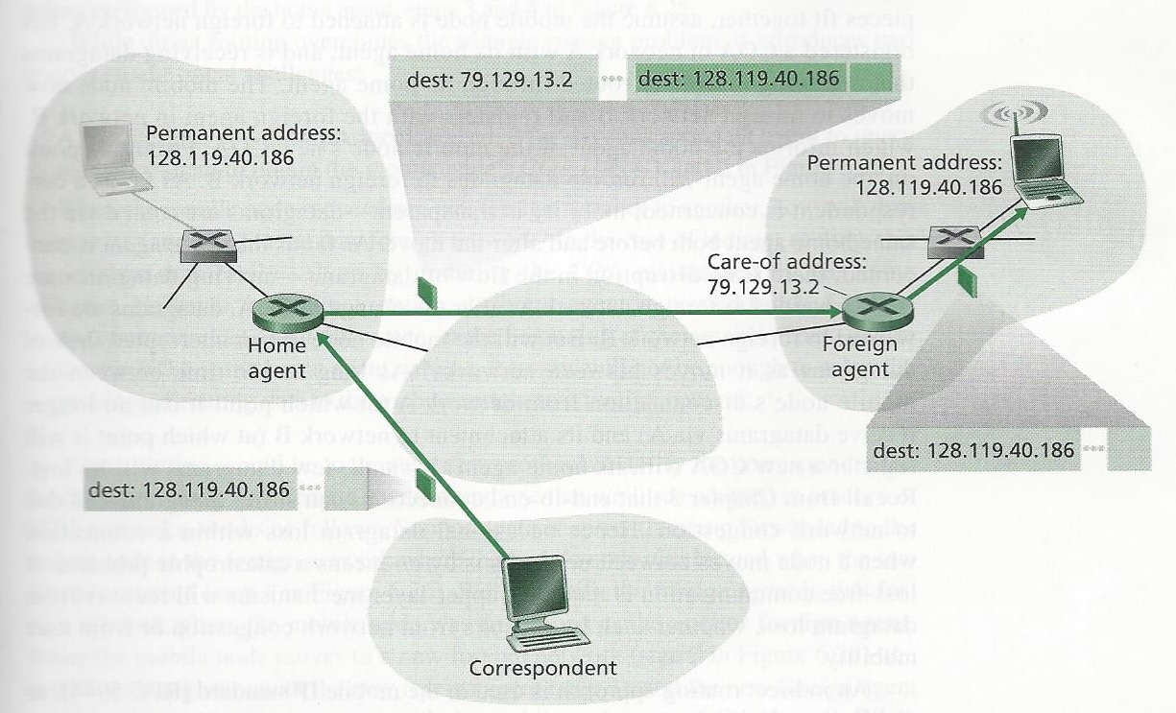


Encapsulation and decapsulation
3
2
1
(Kurose, & Ross, 2013, p. 561)

Slide 10
New network layer functionality required to support mobility
A mobile-node-to-foreign-agent protocol.
A foreign-agent-to-home-agent registration protocol
A home-agent datagram encapsulation protocol
A foreign-agent decapsulation protocol

Slide 11
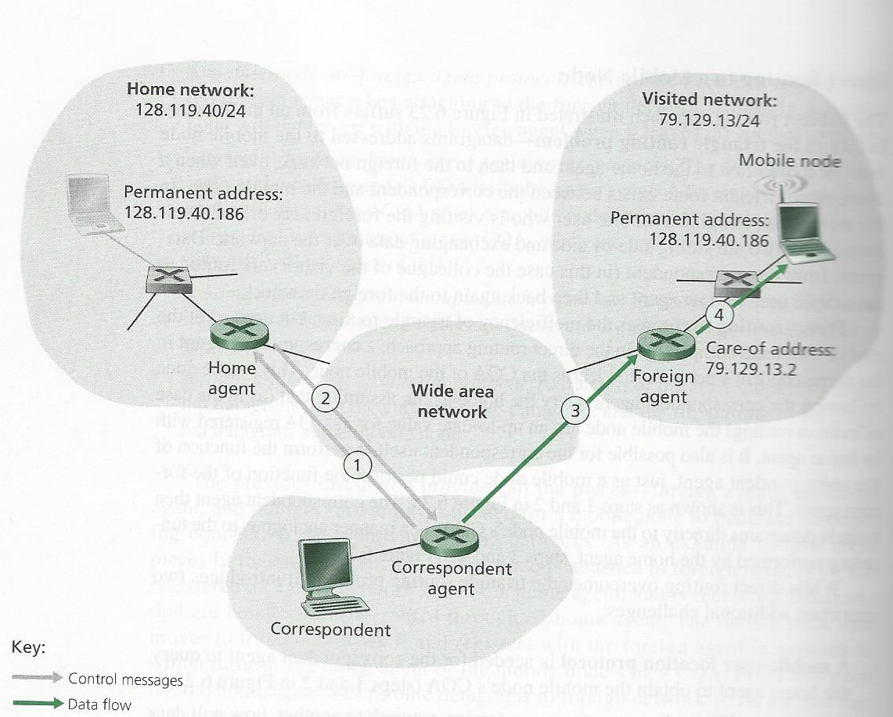

Direct Routing to a mobile node
Steps:
1,2. Correspondent agent learns COA
3,4. Correspondent tunnels datagrams
directly to the mobile node’s COA
Challenges with direct routing:
Mobile-user location protocol
is needed
2. Updating information about COA
(Kurose, & Ross, 2013, p. 564)

Slide 12
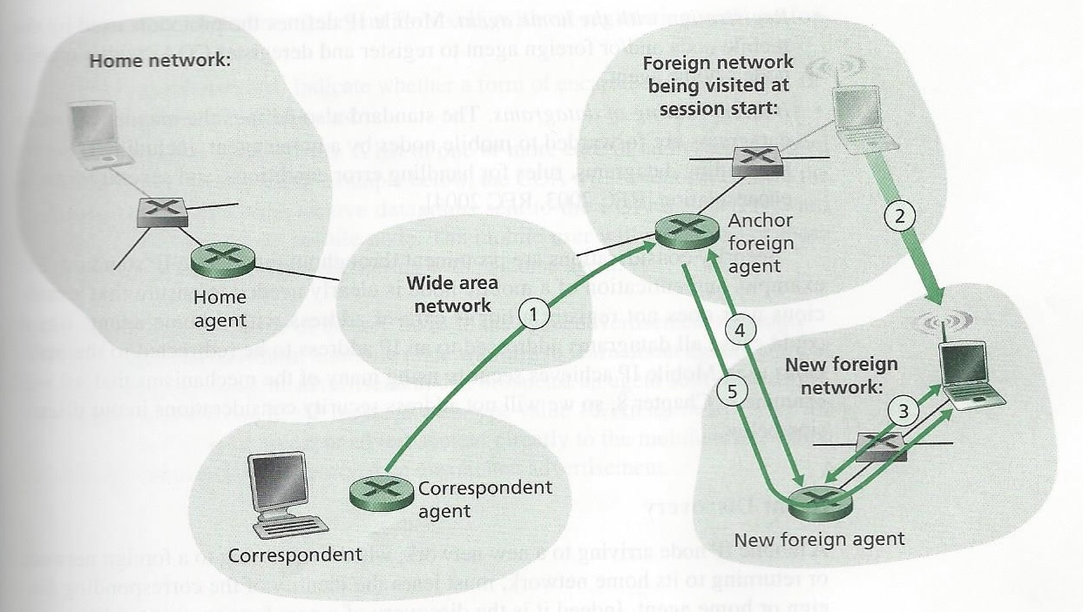
Mobile transfer between networks with direct routing
Steps:
Data forwarded to
mobile node in foreign network
2. Mobile node moves to new
Network
3. Registers with new foreign agent
4. New foreign agent provides anchor
agent with new COA
5. Re-encapsulate arrived datagram
and forward it to mobile node
(Kurose, & Ross, 2013, p. 565)

Slide 13
Bibliography
Rouse, M. (n.d). “Definition Mobile Node,” retrieved April 15, 2016, from http://searchmobilecomputing.techtarget.com/definition/mobile-node
Image courtesy of Digitalar, zirconicusso, cuteimage, Master isolated images at FreeDigitalPhotos.net
Kurose, J. F., & Ross, K. W. (2013). Computer Networking A Top-Down Approach (6th ed.) Boston, MA: Pearson

Slide 14
Thank you

