Slide 1
Congestion Control Evaluation in Dynamic Network
By
Bhavani manthena

Slide 2
What is Congestion?
Congestion is a situation in Communication Networks in which too many packets are present in a part of the subnet, performance degrades.
Congestion in a network may occur when the load on the network is greater than the capacity of the network

Slide 3
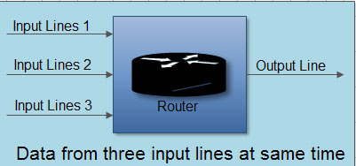
Causes of Congestion
The input traffic rate exceeds the capacity of the output lines
The routers are too slow to perform bookkeeping tasks
The routers' buffer is too limited
if the processors are slow and also because of the slow links.
Source: http://ecomputernotes.com/images/Data-from-three-input-lines-at-same-time.jpg

Slide 4
Types of Congestion ControL
Prevents the congestion from happening (Open Loop)
Removes congestion after it has taken place(Closed Loop).

Slide 5
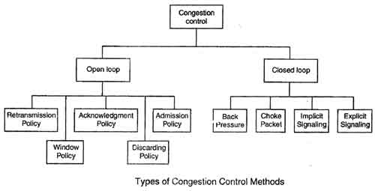
Source : http://ecomputernotes.com/images/Types-of-Congestion-Control-Methods.jpg

Slide 6
Open Loop
Retransmission Policy: The sender retransmits a packet, if it feels that the packet it has sent is lost or corrupted.
Window Policy: selective reject window method is used for congestion control.
Acknowledgement Policy: The acknowledgement policy imposed by the receiver may also affect congestion.
Discarding Policy: A router may discard less sensitive packets when congestion is likely to happen.
Admission Policy: is a quality-of-service mechanism, can also prevent congestion in virtual circuit networks

Slide 7
Closed Loop
Backpressure: is a node-to-node congestion control that starts with a node and propagates, in the opposite direction of data flow.
Choke Packet: congested router or node sends a special type of packet called choke packet to the source to inform it about the congestion.
Implicit Signaling: there is no communication between the congested node or nodes and the source.
Explicit Signaling: the congested nodes explicitly send a signal to the source or destination to inform about the congestion.

Slide 8
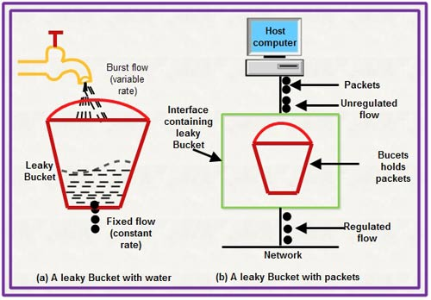
Algorithms for congestion Control
Leaky Bucket Algorithm: It is a traffic shaping mechanism that controls the amount and the rate of the traffic sent to the network.
Source: http://ecomputernotes.com/images/Leaky-Bucket.jpg

Slide 9
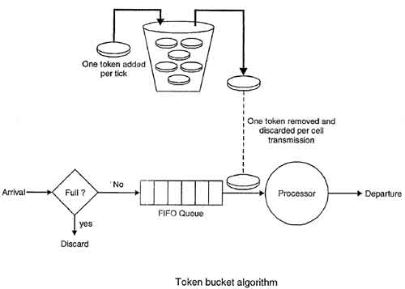
Token bucket Algorithm: The leaky bucket algorithm allows only an average (constant) rate of data flow. Its major problem is that it cannot deal with bursty data.
Source: http://ecomputernotes.com/images/Token-bucket-Algorithm.jpg

Slide 10
References
http://ecomputernotes.com/computernetworkingnotes/communication-networks/what-is-congestion-control-describe-the-congestion-control-algorithm-commonly-used
https://en.wikipedia.org/wiki/Network_congestion

Slide 11
Thank You

