Slide 1
Network Function Virtualization(NFV)
CS555 SPRING 2016
Presented by Rithika Reddy Madugula
Date: April 21st, 2016

Slide 2
History
In October 2012, a group of network service providers, published a white paper at a conference in Germany at the software-defined network (SDN) and OpenFlow World Congress.
The group, part of the European Telecommunications Standards Institute (ETSI), was made up of representatives from the telecommunication industry from Europe and beyond.

Slide 3
NFV
NFV is a new way to design, deploy and manage networking services.
It is a complementary approach to software-defined networking (SDN).
NFV decouples the network functions, such as firewall, encryption from dedicated hardware and moves them to virtual functions.
Reduces equipment and operational costs.

Slide 4
NFV platform
The NFV platform must combine virtualization and cloud technologies to fulfill the following requirements:
Distributed cloud infrastructure
Automated cloud nodes
Automated application lifecycle management
Network automation
An open and multivendor environment

Slide 5
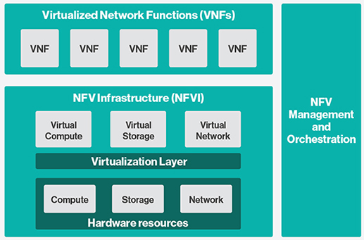
NFV framework
Source: http://www.etsi.org/deliver/etsi_gs/nfv/001_099/002/01.01.01_60/gs_nfv002v010101p.pdf

Slide 6
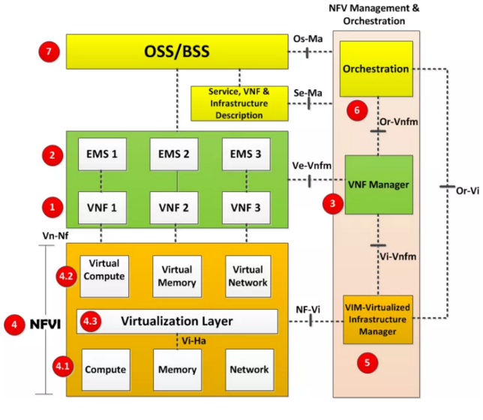
NFV architecture
Source: http://www.etsi.org/deliver/etsi_gs/nfv/001_099/002/01.01.01_60/gs_nfv002v010101p.pdf

Slide 7
Benefits of NFV
Reduce CapEx
Reduce OpEX
Accelerate Time-to-Market
Deliver Agility and Flexibility

Slide 8
Thank you

