Slide 1
5G
What made us thinking of achieving it?
Sai Srinivasa Bharath Poduri
Computer Science, Masters

Slide 2
Contents
Introduction
Evolution of G
What is 5G?
How fast is 5G?
What are the challenges?
What will 5G enable?
Who’s in the game?
Conclusion

Slide 3
What does G stand for ?
'G' stands for Generation , which means the networking has been improving with every generation.
While many parts of the world have yet to experience 4G, governments, industry associations, mobile operators and equipment vendors globally are all working to create the foundations for 5G.

Slide 4
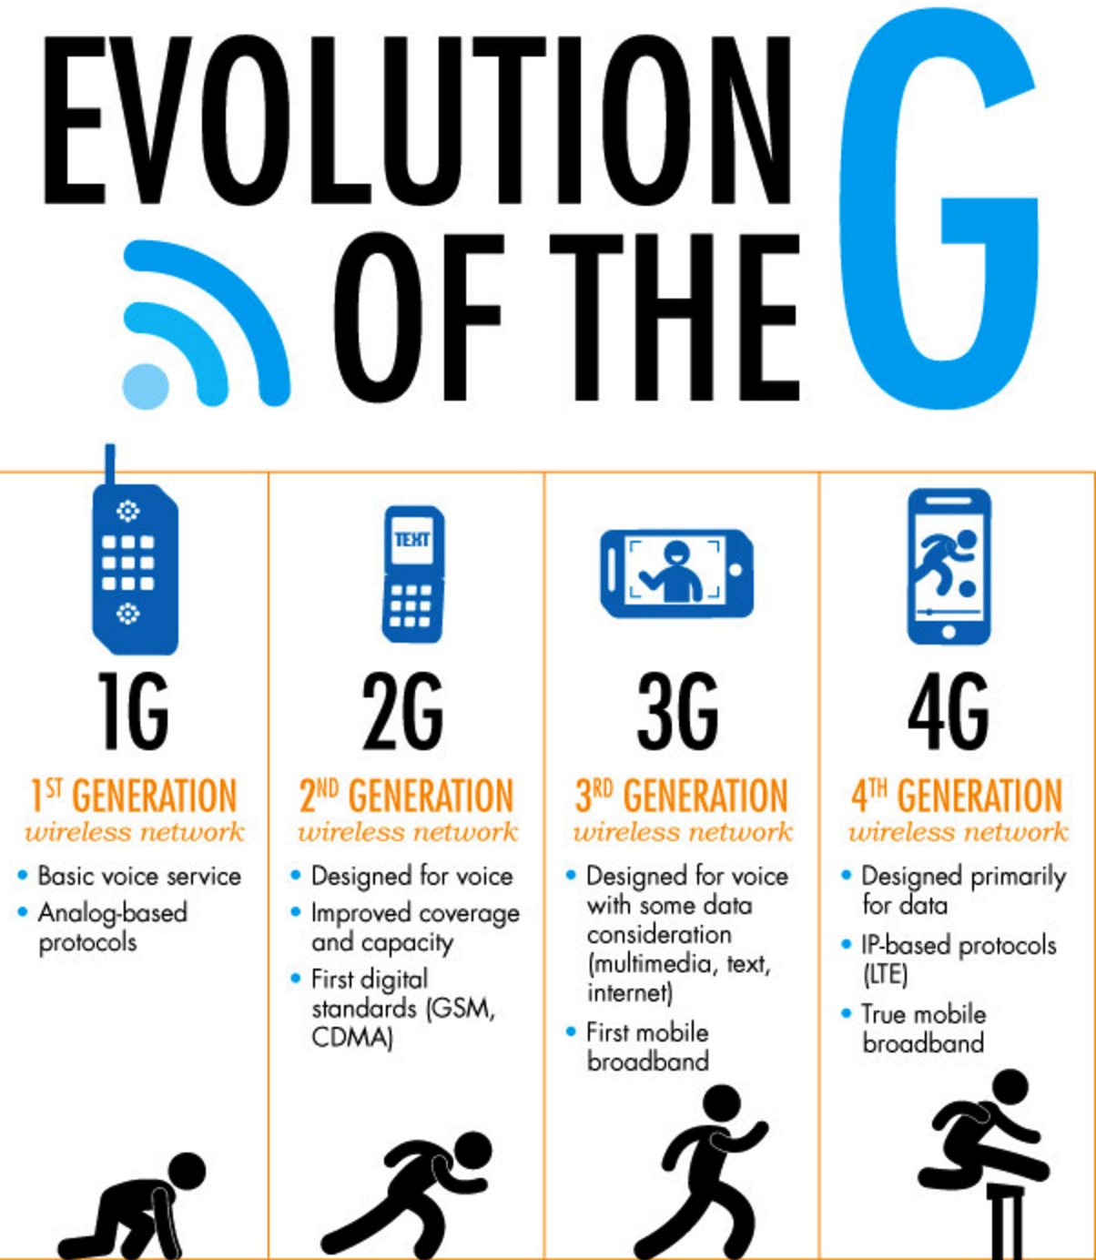

Slide 5
What is 5G?
5G is the fifth generation of mobile networks.
Despite the huge interest, 5G development is in the very early stages and there are as yet no standards or specifications. Until standards are formalized, any attempt to come up with a definition of 5G would be meaningless.
Notes:
Vvvvvvvjhhkhkjhkjhj
Lkk

Slide 6
Cont.
In December 2014 the GSMA outlined five criteria for 5G. A network connection should meet a majority of the five in order to qualify as 5G:
1-10Gbps connections to end points in the field (i.e. not theoretical maximum)
1 millisecond end-to-end round trip delay (latency)
10-100x number of connected devices
90% reduction in network energy usage
Up to 10 year battery life for low power, machine-type devices

Slide 7
So, What do all these numbers mean?
Speed: 5G will be much, much faster than previous generations. A full HD movie will be able to be downloaded in under 10 seconds, compared with a similar number of minutes over 4G.
Latency: The response time will be significantly better, at 1 millisecond compared with the current rate of around 50 with 4G.
User experience: Because of the substantial improvements to speed and latency, the user will have the perception of limitless bandwidth and continuous availability, wherever they are.
Capacity: 5G will provide the bandwidth that will be needed to enable the billions of devices that will be connected to the internet to communicate with each other.
Energy: 5G will need to be cost effective for users and operators, hence the need to achieve significant reductions in energy usage.

Slide 8
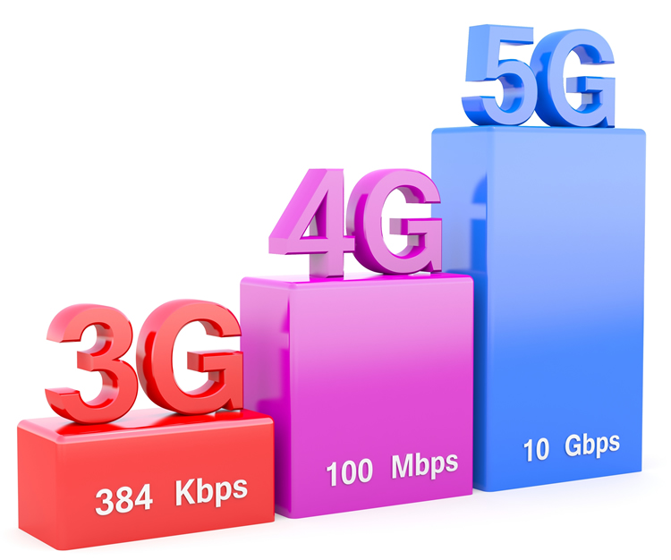
How fast is 5G?
5G is set to transform the mobile landscape with blazing fast speeds, but just how fast are we talking?
The exact speeds are yet to be finalized, but early tests are already achieving remarkable speeds and these give us a good idea of what we can expect when 5G finally launches.

Slide 9
Cont.
DOWNLOAD SPEEDS
Some sources, such as The Korea Times, even reckon 5G will networks be capable of transmitting data at up to 20Gbps.
Already 5G trials are taking place, with Verizon in the US for example showing that its technology can achieve download speeds of 30-50 times faster than 4G. That would enable you to download a full movie in around 15 seconds, versus around 6 minutes on 4G.
UPLOAD SPEEDS
Estimates of upload speeds are so far vaguer than those for 5G download speeds, but the consensus is that you’ll be able to upload data at many gigabits per second, possibly up to 10Gbps.

Slide 10
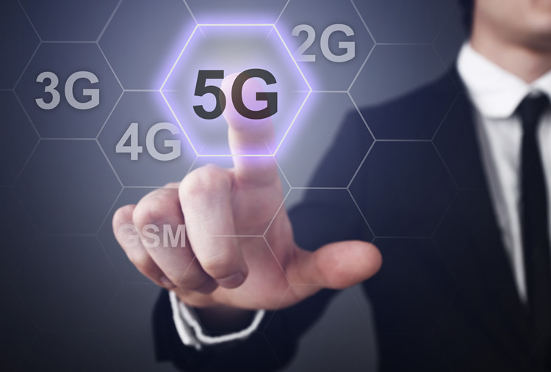
What are the challenges?
Beyond the obvious technological challenges, there are two main hurdles that 5G players will need to overcome.
Spectrum availability
Radio frequencies used for 3G and 4G are already overcrowded, so new spectrum will be required, and it will need to be in high frequency bands in order to deliver the envisaged data speeds.
Cost is a big consideration
Until the technology is developed, no-one knows how much it will cost. But if the full benefits of 5G are to be realized, the price of 5G capable handsets and 5G services must not be prohibitive. Just because I can download more data, faster, does not mean that I will be prepared to pay a huge bill every month.

Slide 11
What will 5G enable?
5G will enable a fully mobile and connected society. As end-users, we tend to think about faster data transfer and lower latency in terms of our own usage: downloading a movie more quickly, at any time or anywhere, statically or on the move, and with little or no lag. This will obviously be the case, but 5G will enable much more.

Slide 12
Who’s in the game?
Every operator and equipment vendor in the world wants to be at the forefront of 5G development.
2013: The governments of China, Japan and South Korea began working independently on defining 5G requirements. Japan set a target of commercial 5G availability in time for the 2020 Olympic Games in Tokyo.
2014: Ericsson demonstrated a 5Gbit/s throughput speed in the 15GHz frequency in laboratory trials.
February 2016: Verizon announced it had begun limited trials in three US states, while AT&T said it would begin testing 5G in its own labs.

Slide 13
THE FUTURE IS 5G
2020 is the widely talked about date for commercial availability of 5G and, while that target looks achievable, it will certainly not be the start of mass rollout. Like 4G and other generations before it, 5G will be rolled out in stages and will complement existing technologies.

Slide 14
Conclusion
Excited yet? You should be! 5G might be a way off but dozens of organizations around the world are kicking into gear, collaborating and making 5G breakthroughs. It’s an exciting period, one which will lead to a whole new technological era.

Slide 15
References
https://www.qualcomm.com/
http://www.telecomabc.com/n/nmt.html
SK Telecom 5g Whitepaper
https://5g.co.uk/guides/what-is-5g/
Quora, Accessed 2016

Slide 16
Questions?

