Slide 1
Security In Virtual Private Networks
Presented By : Nishant Suresh

Slide 2
Contents
INRODUCTION
VPN BASIC ARCHITECTURE
VPN ENCAPSULATION OF PACKETS
PROTOCOLS USED IN VPN
TYPES OF IMPLEMENTATIONS
VPN TUNNELING
VPN SECURITY
ADVANTAGES
DIS ADVANTAGES

Slide 3
INTRODUCTION
What is a VPN?
Virtual Private Network is a type of private network that uses public telecommunication, such as the Internet, instead of leased lines to communicate.
In a virtual private network (VPN), "virtual" implies that there is no physical network infrastructure dedicated to the private network. Instead, a single physical network infrastructure is shared among various logical networks.

Slide 4
INTRODUCTION
Why VPNs?
Separate private networking solutions are expensive and cannot be updated quickly to adapt to changes in business requirements.
The Internet is inexpensive but does not by itself ensure privacy.
Who uses VPNs?
VPN’s can be found in homes, workplaces, or anywhere else as long as an ISP (Internet Service Provider) is available.
VPN’s allow company employees who travel often or who are outside their company headquarters to safely and securely connect to their company’s Intranet.

Slide 5
INTRODUCTION
Four Critical Functions of VPN:
Authentication – validates that the data was sent from the sender.
Access control – limiting unauthorized users from accessing the network.
Confidentiality – preventing the data to be read or copied as the data is being transported.
Data Integrity – ensuring that the data has not been altered.

Slide 6
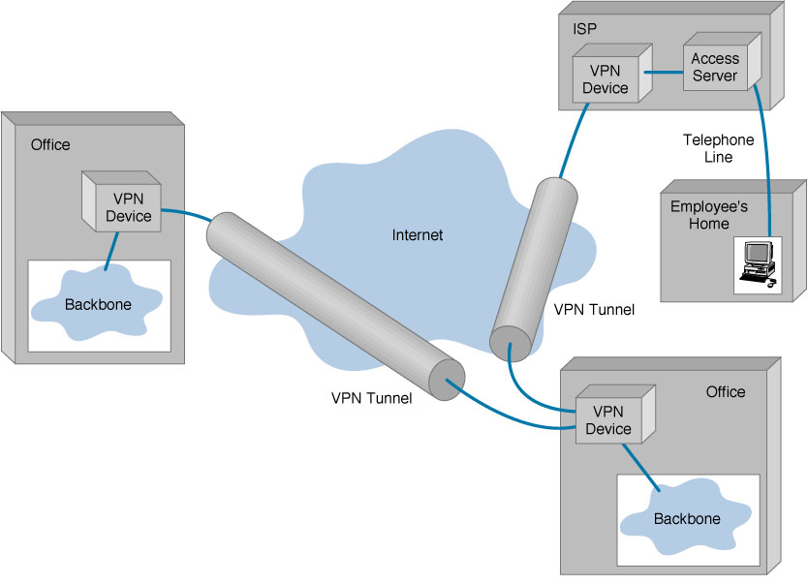
VPN BASIC ARCHITECTURE

Slide 7
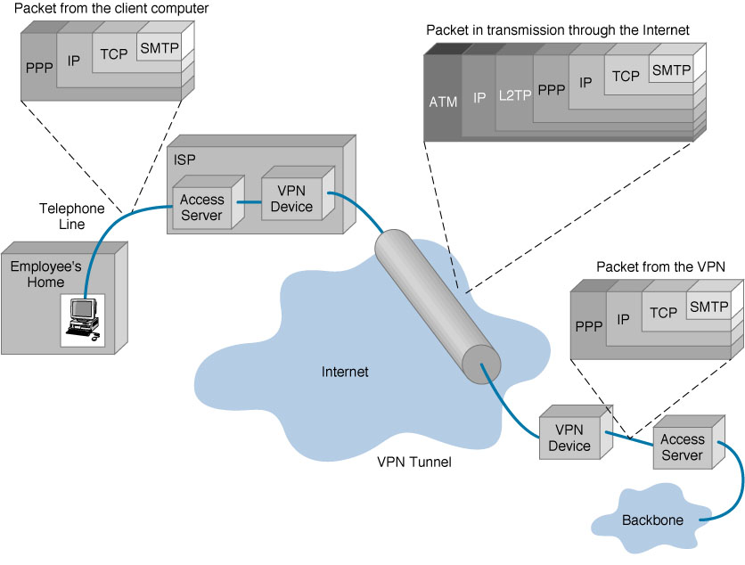
VPN ENCAPSULATION OF PACKETS

Slide 8
PROTOCOLS USED IN VPN
PPTP - Point-to-Point Tunneling Protocol
L2TP - Layer 2 Tunneling Protocol
IPsec - Internet Protocol Security
SOCKS – Is not used very frequently

Slide 9
TYPES OF IMPLEMENTATIONS
Remote-Access VPN
Site-to-Site VPN (Intranet-based)
Site-to-Site VPN (Extranet-based)

Slide 10
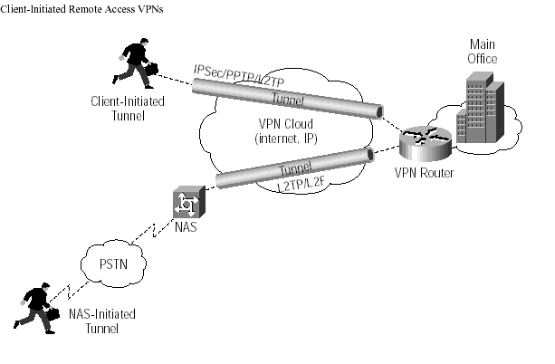
Remote-Access VPN

Slide 11
Remote-Access VPN
Remote-access, also called a virtual private dial-up network (VPDN), is a user-to-LAN connection used by a company that has employees who need to connect to the private network from various remote locations.
A good example of a company that needs a remote-access VPN would be a large firm with hundreds of sales people in the field.
Remote-access VPNs permit secure, encrypted connections between a company's private network and remote users through a third-party service provider.

Slide 12
Applications : Remote-Access VPN
Encrypted connections between mobile or remote users and their corporate networks
Remote user can make a local call to an ISP, as opposed to a long distance call to the corporate remote access server.
Ideal for a telecommuter or mobile sales people.
VPN allows mobile workers & telecommuters to take advantage of broadband connectivity i.e. DSL, Cable.

Slide 13
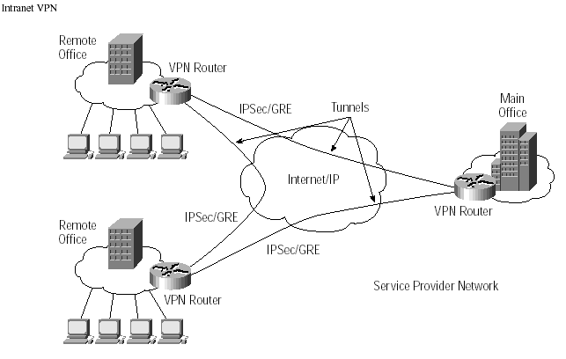
Site-to-Site VPN (Intranet-based)

Slide 14
Site-to-Site VPN (Intranet-based)
If a company has one or more remote locations that they wish to join in a single private network, they can create an intranet VPN to connect LAN to LAN.

Slide 15
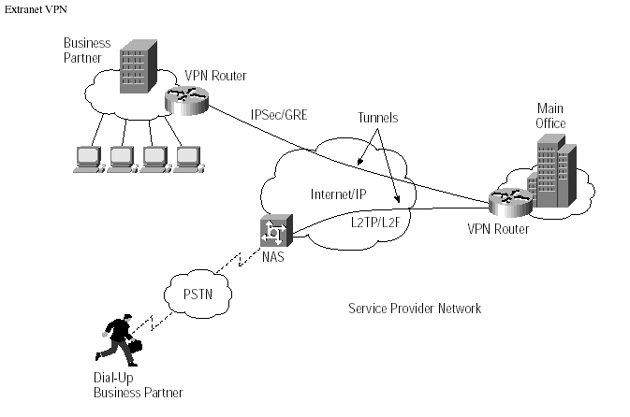
Site-to-Site VPN (Extranet-based)

Slide 16
Site-to-Site VPN (Extranet-based)
When a company has a close relationship with another company (for example, a partner, supplier or customer), they can build an extranet VPN that connects LAN to LAN, and that allows all of the various companies to work in a shared environment.

Slide 17
Applications : Site-to-Site VPN
Large-scale encryption between multiple fixed sites such as remote offices and central offices .
Network traffic is sent over the branch office Internet connection.
This saves the company hardware and management expenses.

Slide 18
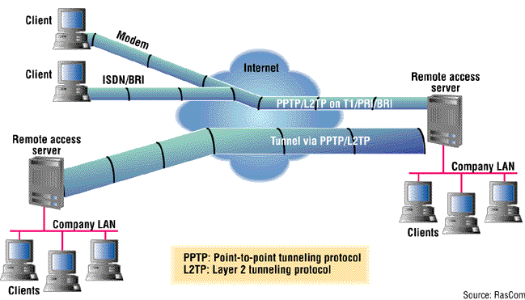
VPN Tunneling

Slide 19
TUNNELING
Most VPNs rely on tunneling to create a private network that reaches across the Internet. Essentially, tunneling is the process of placing an entire packet within another packet and sending it over a network.
Tunneling requires three different protocols:
Passenger protocol - The original data (IPX, IP) being carried
Encapsulating protocol - The protocol (GRE, IPSec, L2F, PPTP, L2TP) that is wrapped around the original data
Carrier protocol - The protocol used by the network that the information is traveling over

Slide 20
VPN SECURITY
A well-designed VPN uses several methods for keeping the connection and data secure:
Firewalls
Encryption
IPSec
AAA Server
You can set firewalls to restrict the number of open ports, what type of packets are passed through and which protocols are allowed through.

Slide 21
VPN : ADVANTAGES
Greater Scalability
Mobility
Security
Easy to add/remove users
Reduced long-distance telecommunications cost

Slide 22
VPN : DIS ADVANTAGES
Unpredictable Internet traffic
Lack of standards
Understanding of security issues
Difficult to accommodate products from different vendors

Slide 23
References
https://technet.microsoft.com/en-us/library/cc779919(v=ws.10).aspx

Slide 24
Thank You !

