Slide 1
Lecture 8 Object Oriented Programming (OOP)
CS 128
Introduction to C++
Sampath Jayarathna
Cal Poly Pomona
Based on slides created by Bjarne Stroustrup & Tony Gaddis

Slide 2
Procedural and Object-Oriented Programming
Procedural programming focuses on the process/actions that occur in a program
C, Fortran, Pascal, Ada, Basic, Go
Object-Oriented programming is based on the data and the functions that operate on it. Objects are instances of Abstract Data Types (ADT) that represent the data and its functions
Java, C++, C#, Python, Objective-C, Swift, Ruby, Perl

Slide 3
Limitations of Procedural Programming
If the data structures change, many functions must also be changed
Programs that are based on complex function hierarchies are:
difficult to understand and maintain
difficult to modify and extend
easy to break

Slide 4
Object-Oriented Programming Terminology
The main purpose of C++ programming is to add object orientation to the C programming language and classes are the central feature of C++ that supports object-oriented programming and are often called user-defined types.
class: (allows bundling of related variables). When you define a class, you define a blueprint for a data type.
object: an instance of a class

Slide 5
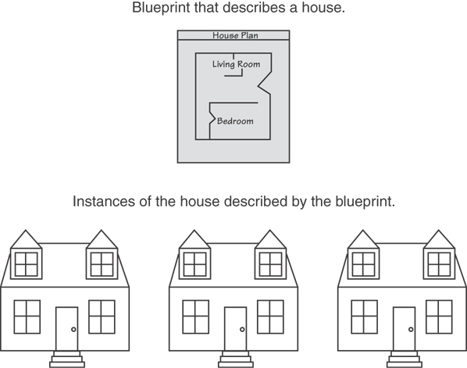
Classes and Objects
A Class is like a blueprint and objects are like houses built from the blueprint

Slide 6
Object-Oriented Programming Terminology
attributes: members of a class
methods or behaviors: member functions of a class

Slide 7
Introduction to Classes
Objects are created from a class
Format:
class ClassName
{
declaration;
declaration;
};

Slide 8
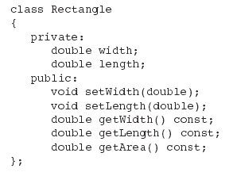
Class Example

Slide 9
Access Specifiers
Used to control access to members of the class
public: can be accessed by functions outside of the class
private: can only be called by or accessed by functions that are members of the class

Slide 10
More on Objects
data hiding: restricting access to certain members of an object
public interface: members of an object that are available outside of the object. This allows the object to provide access to some data and functions without sharing its internal details and design, and provides some protection from data corruption

Slide 11
Class Example
Private Members
Public Members

Slide 12
More on Access Specifiers
Can be listed in any order in a class
Can appear multiple times in a class
If not specified, the default is private

Slide 13
Using const With Member Functions
const appearing after the parentheses in a member function declaration specifies that the function will not change any data in the calling object.

Slide 14
Code Organization
As programs grow larger, it becomes inconvenient and frequently inefficient for all code to reside in a single file.
Frequently, functions are moved into one or more "library" files.
It can also be inconvenient to have all functions in a single library.
So logically separate functions into groups and put each group in its own "library." Note that each library will consist of a header file (.h or .hpp) and a source file (.cpp).

Slide 15
Creating Header file for Declarations : Rectangle.h
#ifndef RECTANGLE_H
#define RECTANGLE_H
class Rectangle
{
private:
double width;
double length;
public:
void setWidth(double);
void setLength(double);
double getWidth()const;
double getLength()const;
double getArea()const;
};
#endif

Slide 16
Code Organization : Header Guards
The result of preprocessing one implementation (".cpp") file is a translation unit (TU).
Headers can include other headers, so a header may be indirectly included multiple times within the same TU.
Definitions can only occur at most once per TU. (Some definitions must also not be in multiple Tus
The problem include guards solve is preventing multiple definition errors when a given header is included more than once within one TU.
Include guards work by "wrapping" the contents of the header in such a way that the second and subsequent includes are no-ops.
The #ifndef and #define directives should be the first two lines of the file, and #endif should be the last.
Include guards are only used in headers.

Slide 17
Separating Specification from Implementation
Place class declaration in a header file that serves as the class specification file. Name the file ClassName.h, for example, Rectangle.h
Place member function definitions in ClassName.cpp, for example, Rectangle.cpp File should #include the class specification file
Programs that use the class must #include the class specification file, and be compiled and linked with the member function definitions

Slide 18
Defining a Member Function
When defining a member function:
Put prototype in class declaration (header file)
Define function using class name and scope resolution operator (::) in the relevant .cpp file
Example: Rectangle.cpp
#include <iostream>
#include "Rectangle.h"
using namespace std;
void Rectangle::setWidth(double w)
{
width = w;
}

Slide 19
Accessors and Mutators
Mutator: a member function that stores a value in a private member variable, or changes its value in some way
Accessor: function that retrieves a value from a private member variable. Accessors do not change an object's data, so they should be marked const.

Slide 20
Defining an Instance of a Class
An object is an instance of a class
Defined like structure variables:
Rectangle r;
Access members using dot operator:
r.setWidth(5.2);
cout << r.getWidth();
Compiler error if attempt to access private member using dot operator

Slide 21
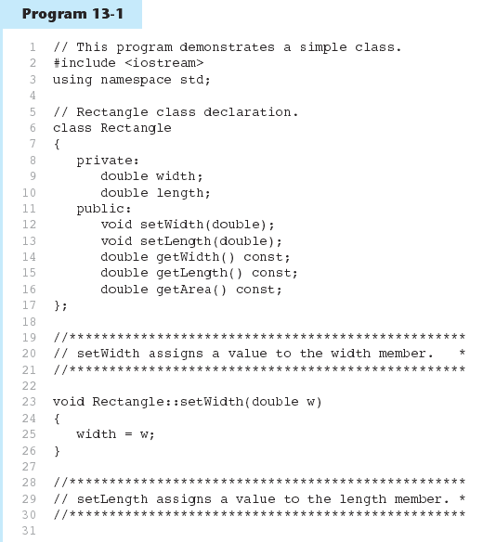

Slide 22
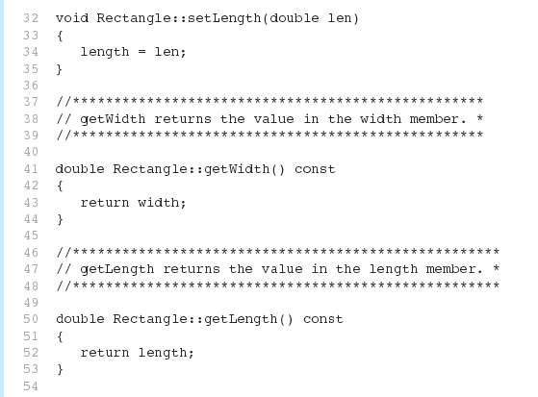
Program 13-1 (Continued)

Slide 23
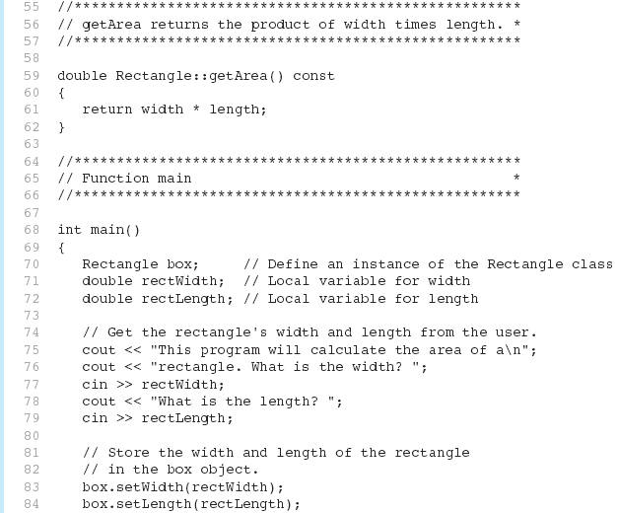
Program 13-1 (Continued)

Slide 24
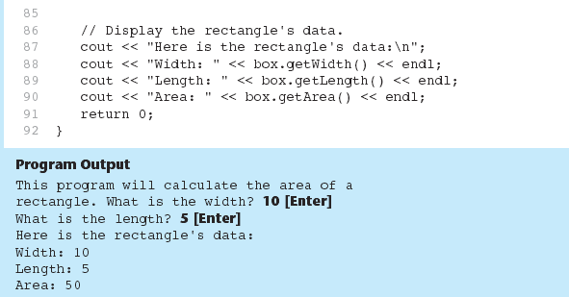
Program 13-1 (Continued)

Slide 25
Why Have Private Members?
Making data members private provides data protection
Data can be accessed only through public functions
Public functions define the class’s public interface

Slide 26
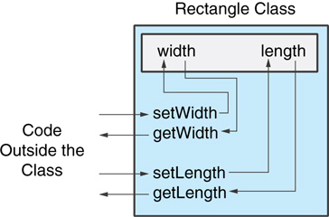
Code outside the class must use the class's public member functions to interact with the object.

Slide 27
Inline Member Functions
Member functions can be defined
inline: in class declaration
after the class declaration
Inline appropriate for short function bodies:
int getWidth() const { return width; }

Slide 28
Rectangle Class with Inline Member Functions
1 // Specification file for the Rectangle class 2 // This version uses some inline member functions. 3 #ifndef RECTANGLE_H 4 #define RECTANGLE_H 5 6 class Rectangle 7 { 8 private: 9 double width; 10 double length; 11 public: 12 void setWidth(double); 13 void setLength(double); 14 15 double getWidth() const 16 { return width; } 17 18 double getLength() const 19 { return length; } 20 21 double getArea() const 22 { return width * length; } 23 }; 24 #endif

Slide 29
Tradeoffs – Inline vs. Regular Member Functions
Regular functions – when called, compiler stores return address of call, allocates memory for local variables, etc.
Code for an inline function is copied into program in place of call – larger executable program, but no function call overhead, hence faster execution

Slide 30
Constructors
Member function that is automatically called when an object is created
Purpose is to construct an object
Constructor function name is class name
Has no return type

Slide 31
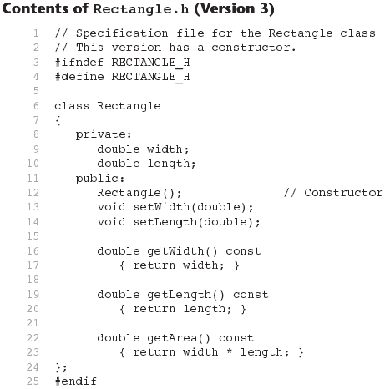

Slide 32
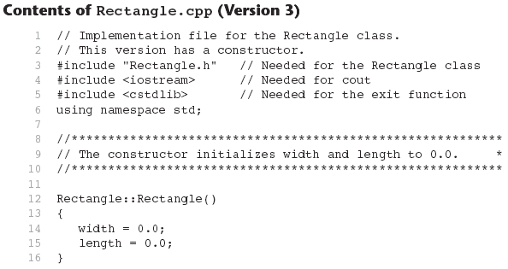
Continues...

Slide 33
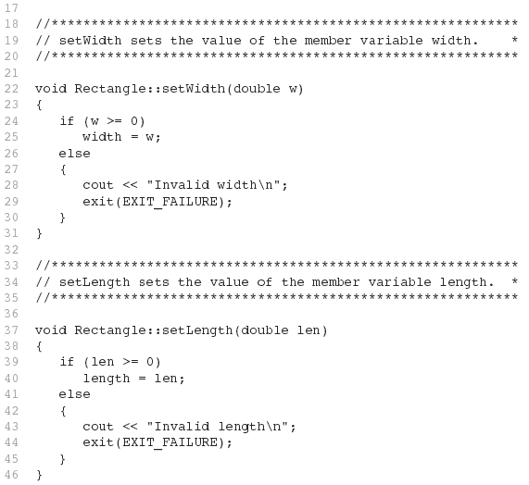
Contents of Rectangle.ccp Version3
(continued)

Slide 34
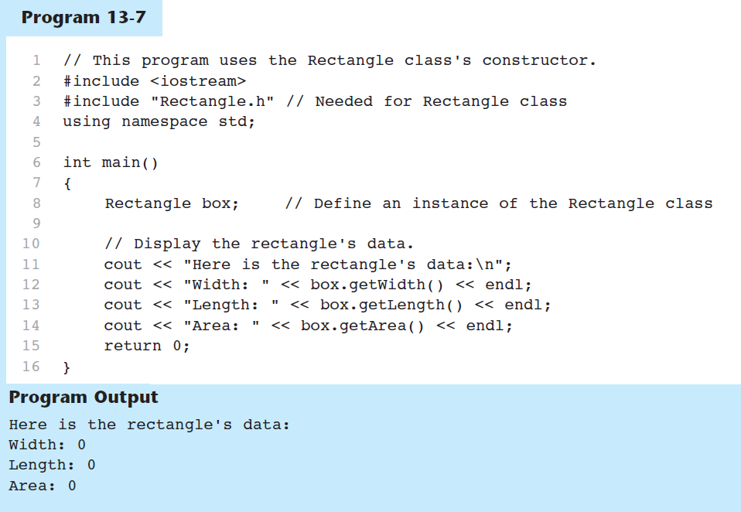

Slide 35
Default Constructors
A default constructor is a constructor that takes no arguments.
If you write a class with no constructor at all, C++ will write a default constructor for you, one that does nothing.
A simple instantiation of a class (with no arguments) calls the default constructor:
Rectangle r;

Slide 36
Passing Arguments to Constructors
To create a constructor that takes arguments:
indicate parameters in prototype: Rectangle(double, double);
Use parameters in the definition: Rectangle::Rectangle(double w, double len) { width = w; length = len; }

Slide 37
Passing Arguments to Constructors
You can pass arguments to the constructor when you create an object:
Rectangle r(10, 5);

Slide 38
More About Default Constructors
If all of a constructor's parameters have default arguments, then it is a default constructor. For example:
Rectangle(double = 0, double = 0);
Creating an object and passing no arguments will cause this constructor to execute: Rectangle r;

Slide 39
Classes with No Default Constructor
When all of a class's constructors require arguments, then the class has NO default constructor.
When this is the case, you must pass the required arguments to the constructor when creating an object.

Slide 40
Destructors
Member function automatically called when an object is destroyed
Destructor name is ~classname, e.g., ~Rectangle
Has no return type; takes no arguments
Only one destructor per class, i.e., it cannot be overloaded
If constructor allocates dynamic memory, destructor should release it

Slide 41
Overloading Constructors
A class can have more than one constructor
Overloaded constructors in a class must have different parameter lists:
Rectangle(); Rectangle(double);
Rectangle(double, double);

Slide 42
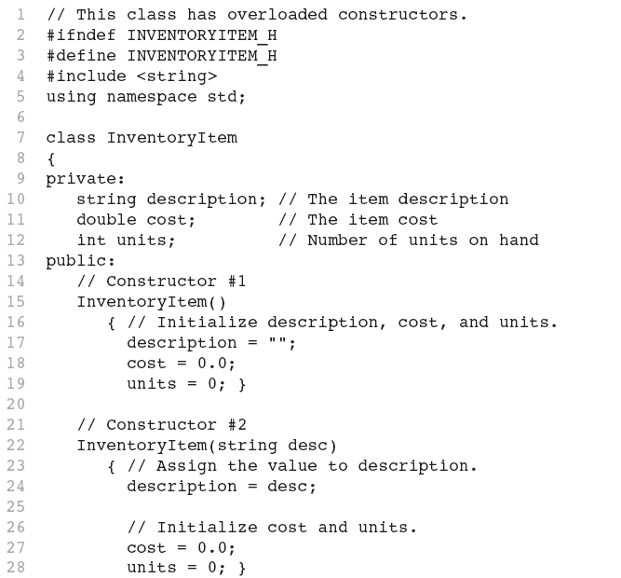
Continues...

Slide 43
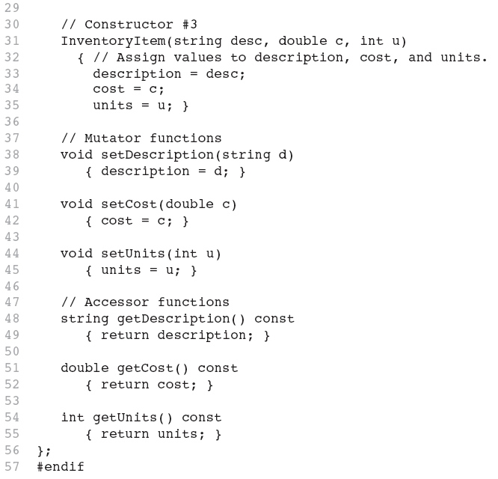

Slide 44
Using Private Member Functions
A private member function can only be called by another member function
It is used for internal processing by the class, not for use outside of the class

