Slide 1
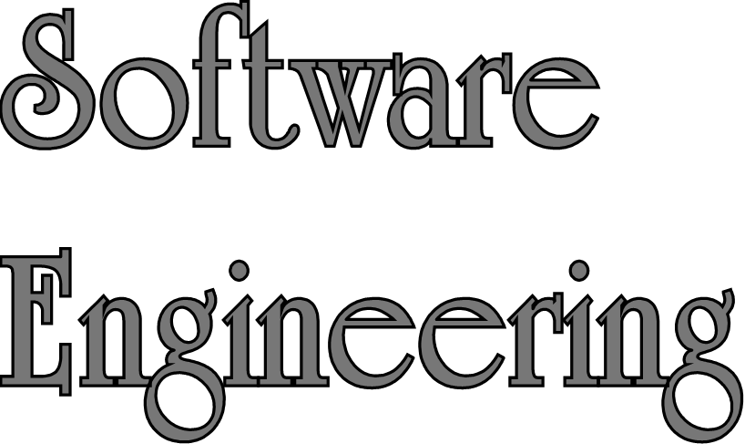
Lecture 2 Supplement - Prototyping
Sampath Jayarathna
Cal Poly Pomona
Based on slides created by Preece (Interaction Design)

Slide 2
Prototyping
What is a prototype?
Why prototype?
Different kinds of prototyping
- Low fidelity
- High fidelity
Compromises in prototyping
- Vertical
- Horizontal
Final product needs to be engineered

Slide 3
What is a prototype?
a series of screen sketches
a storyboard, i.e. a cartoon-like series of scenes
a PowerPoint slide show
a video simulating the use of a system
a lump of wood (e.g. PalmPilot)
a cardboard mock-up
a piece of software with limited functionality written in the target language or in another language

Slide 4
What to prototype?
Technical issues
Work flow, task design
Screen layouts and information display
Difficult, controversial, critical areas

Slide 5
Low-fidelity Prototyping
Uses a medium which is unlike the final medium, e.g. paper, cardboard
Is quick, cheap and easily changed
Examples:
sketches of screens, task sequences, etc
‘post-it’ notes
storyboards
‘Wizard-of-Oz’

Slide 6
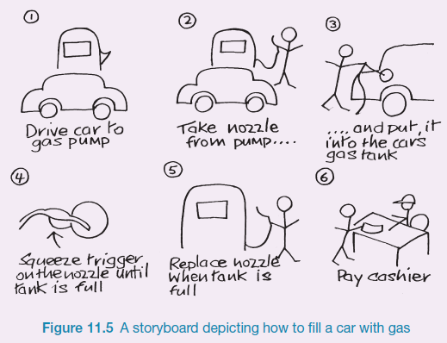
Sketching
Sketching is important to low-fidelity prototyping
Don’t be inhibited about drawing ability. Practice simple symbols
14

Slide 7
Storyboards
Often used with scenarios, bringing more detail, and a chance to role play
It is a series of sketches showing how a user might progress through a task using the device
Used early in design

Slide 8
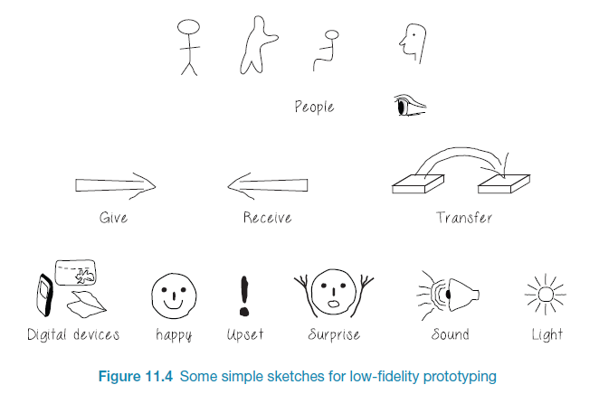
Generate storyboard from scenario
25

Slide 9
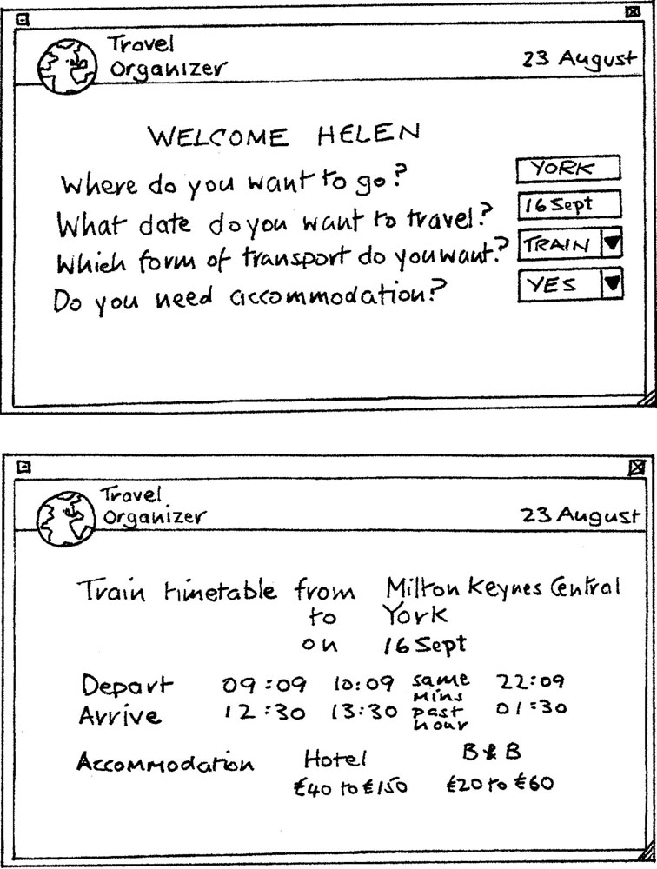
Card-based prototypes
Index cards (3 X 5 inches)
Each card represents one screen or part of screen
Often used in website development
15

Slide 10
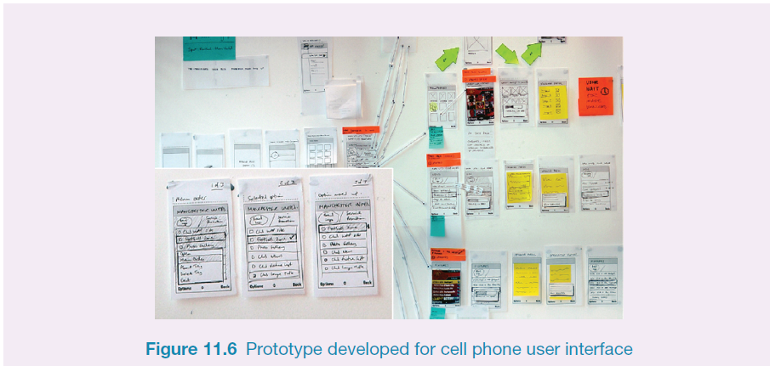
Card-based prototype from use case
26

Slide 11
‘Wizard-of-Oz’ prototyping
The user thinks they are interacting with a computer, but a developer is responding to output rather than the system.
Usually done early in design to understand users’ expectations
What is ‘wrong’ with this approach?
User
>Blurb blurb
>Do this
>Why?

Slide 12
High-fidelity prototyping
Uses materials that you would expect to be in the final product
Prototype looks more like the final system than a low-fidelity version
High-fidelity prototypes can be developed by integrating existing hardware and software components
Danger that users think they have a complete system…….see compromises

Slide 13
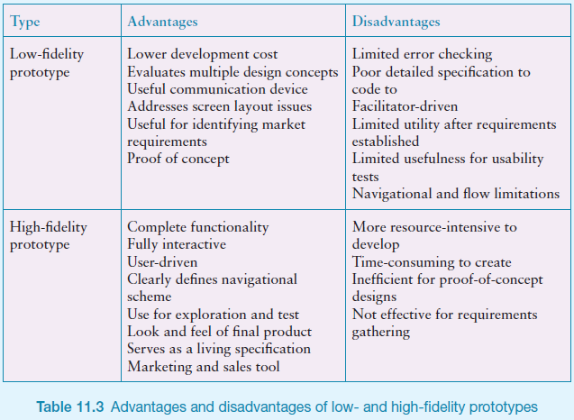
Low-fidelity vs High-fidelity Prototypes

Slide 14
Compromises in prototyping
All prototypes involve compromises
For software-based prototyping maybe there is a slow response? sketchy icons? limited functionality?
Two common types of compromise
horizontal: provide a wide range of functions, but with little detail
vertical: provide a lot of detail for only a few functions
Compromises in prototypes mustn't be ignored. Product needs engineering

Slide 15
Explore the user’s experience
Use personas, card-based prototypes or stickie's to model the user experience
Visual representation called:
design map
customer/user journey map
experience map
Two common representations
wheel
timeline
27

Slide 16
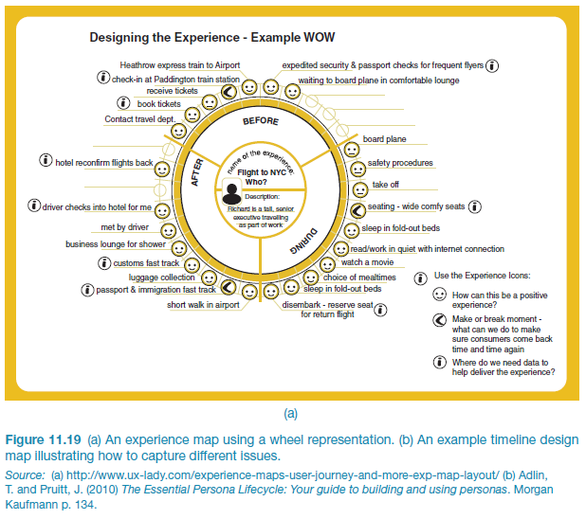
An experience map drawn as a wheel
28

Slide 17
An experience map drawn as a timeline
29

Slide 18
Construction: physical computing
Build and code prototypes using electronics
Toolkits available include
Arduino
LilyPad (for fabrics)
Senseboard
MaKey MaKey
Designed for use by wide range of people
30

Slide 19
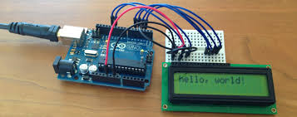
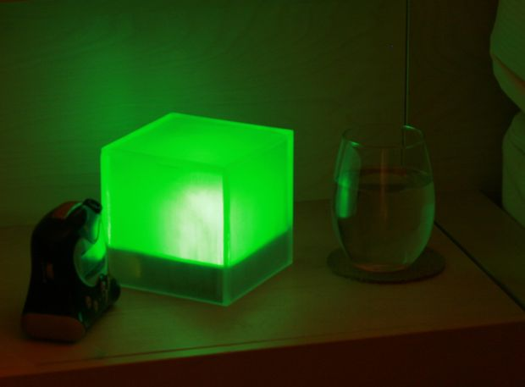
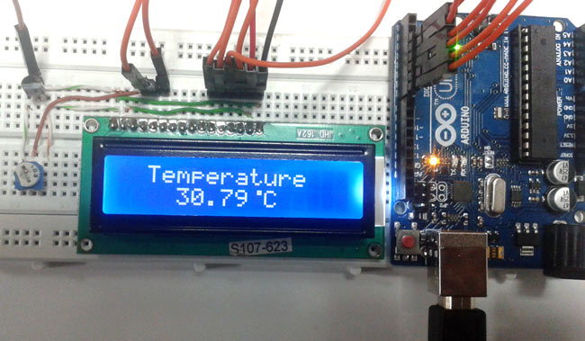
Physical computing kits
31

Slide 20
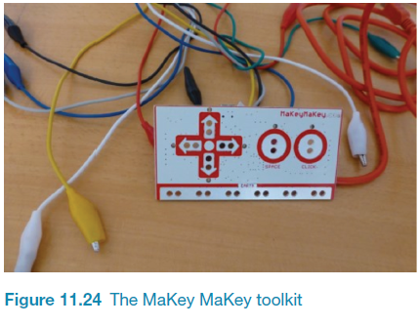
Physical computing kits
32

Slide 21
Physical computing kits
33

Slide 22
Summary
Different kinds of prototyping are used for different purposes and at different stages
Prototypes answer questions
The final product must be engineered appropriately
Storyboards can be generated from scenarios
Card-based prototypes can be generated from use cases
Physical computing kits and SDKs facilitate transition from design to construction

