Slide 1
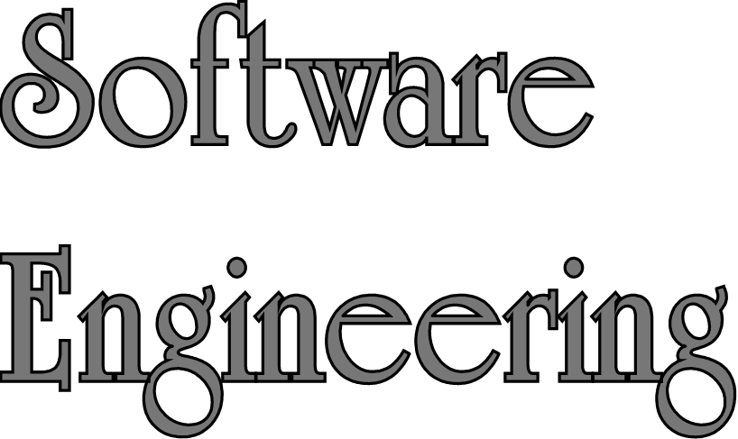
Lecture 5 – System Modeling
Sampath Jayarathna
Cal Poly Pomona
Based on slides created by Ian Sommerville & Gary Kimura

Slide 2
Topics covered
Context models
Interaction models
Structural models
Behavioral models
Model-driven engineering

Slide 3
System modeling
System modeling is the process of developing abstract models of a system, with each model presenting a different view or perspective of that system.
Using some kind of graphical notation, which is now almost always based on notations in the Unified Modeling Language (UML)
System modelling helps the analyst,
To understand the functionality of the system
These models are used to communicate with customers.

Slide 4
Existing and planned system models
Models of the existing system are used during requirements engineering.
They help clarify what the existing system does and can be used as a basis for discussing its strengths and weaknesses. These then lead to requirements for the new system.
Models of the new system are used during requirements engineering.
Engineers use these models to discuss design proposals and to document the system for implementation and to help explain the proposed requirements to other system stakeholders
In a model-driven engineering process, it is possible to generate a complete or partial system implementation from the system model.

Slide 5
System perspectives
An external perspective, where you model the context or environment of the system.
An interaction perspective, where you model the interactions between a system and its environment, or between the components of a system.
A structural perspective, where you model the organization of a system or the structure of the data that is processed by the system.
A behavioral perspective, where you model the dynamic behavior of the system and how it responds to events.

Slide 6
UML diagram types
Activity diagrams, which show the activities involved in a process or in data processing .
Use case diagrams, which show the interactions between a system and its environment.
Sequence diagrams, which show interactions between actors and the system and between system components.
Class diagrams, which show the object classes in the system and the associations between these classes.
State diagrams, which show how the system reacts to internal and external events.

Slide 7
UML Model Building tools/products
IBM Rational Rose/RSA. $$$ Free trial 90 days
http://www-03.ibm.com/software/products/en/rational-software-designer-architect-fam
ArgoUML. Free
Visual Paradigm, $$$ free community version, limited
Visio $$$
Sparx $$$
Altova, fully functional 30 trial
GenMyModel. $$
SmartDraw (drawing) $$$

Slide 8
Use of graphical models
As a means of facilitating discussion about an existing or proposed system
Incomplete and incorrect models are OK as their role is to support discussion.
As a way of documenting an existing system
Models should be an accurate representation of the system but need not be complete.
As a detailed system description that can be used to generate a system implementation
Models have to be both correct and complete.

Slide 9
Context models
Context models are used to illustrate the operational context of a system - they show what lies outside the system boundaries.
Social and organisational concerns may affect the decision on where to position system boundaries.
Architectural models show the system and its relationship with other systems.

Slide 10
System boundaries
System boundaries are established to define what is inside and what is outside the system.
They show other systems that are used or depend on the system being developed.
The position of the system boundary has a profound effect on the system requirements.
Defining a system boundary is a political judgment
There may be pressures to develop system boundaries that increase / decrease the influence or workload of different parts of an organization.

Slide 11
The context of the Mentcare system

Slide 12
Process perspective
Context models simply show the other systems in the environment, not how the system being developed is used in that environment.
Process models reveal how the system being developed is used in broader business processes.
UML activity diagrams may be used to define business process models.

Slide 13
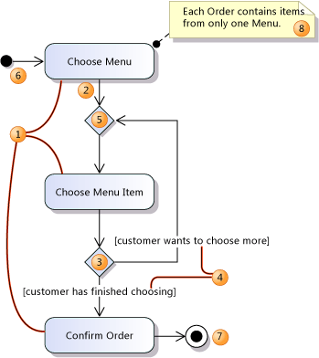
Activity Diagram Basics
Create an Action (1)
for each major task that is performed by a user, the system, or both in collaboration.
Link the actions in sequence with Connectors (2)
Use a Decision Node (3)
to indicate a point where the outcome of a decision dictates the next step. You can draw as many outgoing paths as you want.
You should define the guards (4)
so that it is clear when each path should be taken.
Use a Merge Node (5)
to bring together two or more alternative flows that branched at a Decision Node.
Initial Node (6)
Use an Activity Final Node (7)
to indicate the end of an activity.

Slide 14
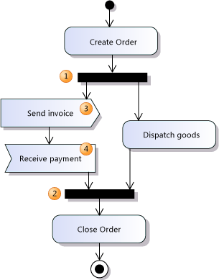
Activity Diagram – Concurrent flows
The effect of the Fork Node (1) is
to divide the thread of control into two or more threads. When the previous action ends, all the actions on the output side of the fork can start.
A Join Node (2)
brings concurrent threads together. The action after the Join Node may not start until all the actions leading to the Join Node are complete.
Use a Send Signal Action (3)
to indicate that a signal or message of some kind is sent to other activities or processes.

Slide 15
Process model of involuntary detention

Slide 16
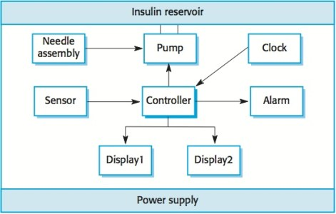
Case Study: Insulin Pump
The level of blood sugar depends on what the system user has eaten, the speed of their digestive processes and the effectiveness of their body in metabolizing blood sugar. Therefore, there is not a simple relationship between a blood sugar measurement and the amount of insulin to be injected. Rather, the control system has to make several measurements and assess the rate of change of blood sugar. Based on the current level and the rate and direction of change, the incremental amount of insulin to be injected is computed and injected using the micro-pump in the system.

Slide 17
Relationship to other diagrams
If you draw an activity diagram to describe a business process, or a way in which users use your system, you can draw a use case diagram to show a different view of the same information.
In the use case diagram, you draw actions as use cases.
Give the use cases the same names as the corresponding actions.

Slide 18
Interaction models
Modeling user interaction is important as it helps to identify user requirements.
Modeling system-to-system interaction highlights the communication problems that may arise.
Modeling component interaction helps us understand if a proposed system structure is likely to deliver the required system performance and dependability.
Use case diagrams and sequence diagrams may be used for interaction modelling.

Slide 19
Use case modeling
Use cases were developed originally to support requirements elicitation and now incorporated into the UML.
Each use case represents a discrete task that involves external interaction with a system.
Actors in a use case may be people or other systems.
Represented diagrammatically to provide an overview of the use case and in a more detailed textual form.

Slide 20
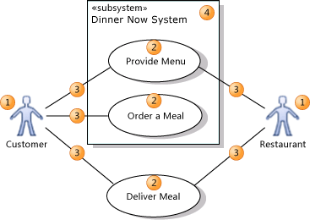
Use case modeling basics
An actor (1) is
a class of person, organization, device, or external software component that interacts with your system. Example actors are Customer, Restaurant, Temperature Sensor, Credit Card Authorizer.
A use case (2)
represents the actions that are performed by one or more actors in the pursuit of a particular goal. Example use cases are Order Meal, Update Menu, Process Payment.
On a use case diagram, use cases are associated (3) with the actors that perform them.
Your system (4) is
whatever you are developing. It might be a small software component, whose actors are just other software components; or it might be a complete application; or it might be a large distributed suite of applications deployed over many computers and devices. Example subsystems are Meal Ordering Website, Meal Delivery Business, Website Version 2.
A use case diagram can show which use cases are supported by your system or its subsystems.

Slide 21
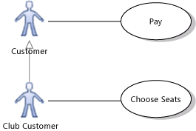
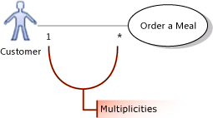
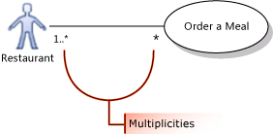
Use case modeling basics
You can draw a Generalization link between Actors.
The specialized actor, such as Club Customer in the example, inherits the use cases of the generalized actor, such as Customer.
The association between an actor and a use case can show a multiplicity at each end.
1 to state that exactly one instance of this role participates in each link.
1..* to state that one or more instance of this role participate in each link.
0..1 to state that participation is optional.
* to state that zero or more instances of this role participate in the link.
In the illustration, one or more restaurants can take part in fulfilling the same meal order.

Slide 22
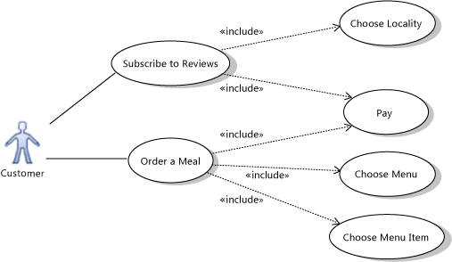
Use case modeling basics
Use an Include relation to show that one use case describes some of the detail of another. In the illustration, Order a Meal includes Pay, Choose Menu, and Choose Menu Item. Each of the included, more detailed use cases is a step that the actor or actors might have to perform to achieve the overall goal of the including use case. The arrow should point at the more detailed, included use case.

Slide 23
Use case modeling basics
Use an Extend link to show that one use case may add functionality to another use case under certain circumstances. The arrow should point at the main, extended use case.
For example, the Login use case of a typical Web site can include Register New User - but only when the user does not already have an account.

Slide 24
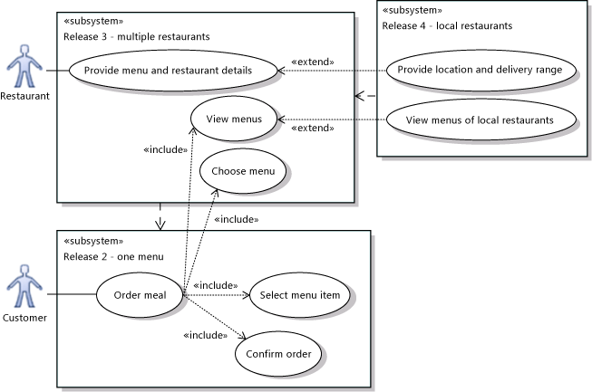
Use case modeling basics
You can use different subsystem boundaries to illustrate different versions of the system.
Use Dependency relations to link subsystems representing different versions or variants.

Slide 25
Case Study: Scenario for travel organizer
“The Thomson family enjoy outdoor activities and want to try their hand at sailing this year. There are four family members: Sky (10 years old), Eamonn (15 years old), Claire (35), and Will (40). One evening after dinner they decide to start exploring the possibilities. They all gather around the travel organizer and enter their initial set of requirements – a sailing trip for four novices in the Mediterranean. The console is designed so that all members of the family can interact easily and comfortably with it. The system’s initial suggestion is a flotilla, where several crews (with various levels of experience) sail together on separate boats. Sky and Eamonn aren’t very happy at the idea of going on vacation with a group of other people, even though the Thomsons would have their own boat. The travel organizer shows them descriptions of flotillas from other children their ages and they are all very positive, so eventually, everyone agrees to explore flotilla opportunities. Will confirms this recommendation and asks for detailed options. As it’s getting late, he asks for the details to be saved so everyone can consider them tomorrow. The travel organizer emails them a summary of the different options available.”

Slide 26
Use case for travel organizer
1. The system displays options for investigating visa and vaccination requirements.
2. The user chooses the option to find out about visa requirements.
3. The system prompts user for the name of the destination country.
4. The user enters the country’s name.
5. The system checks that the country is valid.
6. The system prompts the user for her nationality.
7. The user enters her nationality.
8. The system checks the visa requirements of the entered country for a passport holder of her nationality.
9. The system displays the visa requirements.
10. The system displays the option to print out the visa requirements.
11. The user chooses to print the requirements.

Slide 27
Alternative courses for travel organizer
Some alternative courses:
6. If the country name is invalid:
6.1 The system displays an error message.
6.2 The system returns to step 3.
8. If the nationality is invalid:
8.1 The system displays an error message.
8.2 The system returns to step 6.
9. If no information about visa requirements is found:
9.1 The system displays a suitable message.
9.2 The system returns to step 1.

Slide 28
Use case relationship to other diagrams
A use case represents a user's goal, together with a sequence of steps for achieving the goal.
The sequence of steps can be described in several ways.
One option is to draw a sequence diagram that shows the interactions between the users and the system's major components.

Slide 29
Sequence diagrams
Sequence diagrams are part of the UML and are used to model the interactions between the actors and the objects within a system.
A sequence diagram shows the sequence of interactions that take place during a particular use case or use case instance.
The objects and actors involved are listed along the top of the diagram, with a dotted line drawn vertically from these.
Interactions between objects are indicated by annotated arrows.

Slide 30
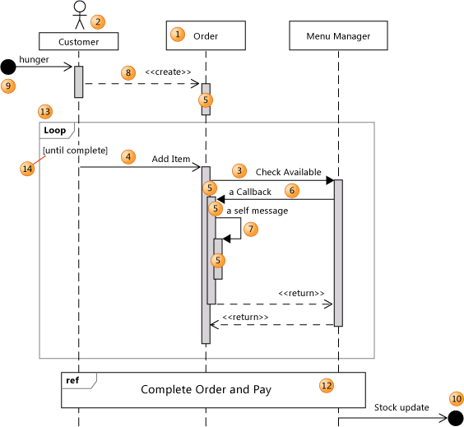
Sequence diagram basics
Drag Lifelines (1) diagram to
represent instances of classes, components, actors, or devices.
To create a message (3, 4, 6, 7),
click a sending lifeline at the point where you want the message to start, and then click the receiving lifeline.
An execution occurrence (5) appears at the receiving lifeline.
The execution occurrence represents a period of time during which the instance is executing a method.
To show a message that comes from an unknown event source (9), or broadcasts to unknown recipients (10),
draw an asynchronous message from or to blank space on the diagram.

Slide 31
Sequence diagram – types of message
Use the Synchronous tool to describe an interaction in which the sender waits for the receiver to return a response (3).
A <<return>> arrow will be shown at the end of the execution occurrence. It indicates return of control to the sender.
Use the Asynchronous tool to describe an interaction in which the sender can continue immediately without waiting for the receiver (4).
Use the Create tool to describe an interaction in which the sender creates the receiver (8).
A create message should be the first message that the receiver receives.

Slide 32
Sequence relationship to other diagrams
The lifelines you draw in a sequence diagram can represent typical instances of the components or classes in your system.
You can create lifelines from types, and types from lifelines, and show the types on UML class diagrams and UML component diagrams.

Slide 33
Class diagrams
Class diagrams are used when developing an object-oriented system model to show the classes in a system and the associations between these classes.
An object class can be thought of as a general definition of one kind of system object.
An association is a link between classes that indicates that there is some relationship between these classes.
When you are developing models during the early stages of the software engineering process, objects represent something in the real world, such as a patient, a prescription, doctor, etc.

Slide 34
UML classes and association

Slide 35
Classes and associations in the MHC-PMS

Slide 36
Classes and associations in the Mentcare

Slide 37
The Consultation class

Slide 38
Generalization
Generalization is an everyday technique that we use to manage complexity.
Rather than learn the detailed characteristics of every entity that we experience,
we place these entities in more general classes (animals, cars, houses, etc.) and
learn the characteristics of these classes.
This allows us to infer that different members of these classes have some common characteristics e.g. squirrels and rats are rodents.

Slide 39
Generalization
In modeling systems, it is often useful to examine the classes in a system to see if there is scope for generalization. If changes are proposed, then you do not have to look at all classes in the system to see if they are affected by the change.
In object-oriented languages, such as Java, generalization is implemented using the class inheritance mechanisms built into the language.
In a generalization, the attributes and operations associated with higher-level classes are also associated with the lower-level classes.
The lower-level classes are subclasses inherit the attributes and operations from their superclasses. These lower-level classes then add more specific attributes and operations.

Slide 40
A generalization hierarchy

Slide 41
A generalization hierarchy with added detail

Slide 42
Object class aggregation models
An aggregation model shows how classes that are collections are composed of other classes.
Aggregation models are similar to the part-of relationship in semantic data models.

Slide 43
The aggregation association

Slide 44
Behavioral models
Behavioral models are models of the dynamic behavior of a system as it is executing. They show what happens or what is supposed to happen when a system responds to a stimulus from its environment.
You can think of these stimuli as being of two types:
Data Some data arrives that has to be processed by the system.
Events Some event happens that triggers system processing. Events may have associated data, although this is not always the case.

Slide 45
Data-driven modeling
Many business systems are data-processing systems that are primarily driven by data. They are controlled by the data input to the system, with relatively little external event processing.
Data-driven models show the sequence of actions involved in processing input data and generating an associated output.
They are particularly useful during the analysis of requirements as they can be used to show end-to-end processing in a system.

Slide 46
An activity model of the insulin pump’s operation – (Data flow diagram)

Slide 47
Event-driven modeling
Real-time systems are often event-driven, with minimal data processing. For example, a landline phone switching system responds to events such as ‘receiver off hook’ by generating a dial tone.
Event-driven modeling shows how a system responds to external and internal events.
It is based on the assumption that a system has a finite number of states and that events (stimuli) may cause a transition from one state to another.

Slide 48
State machine models
These model the behaviour of the system in response to external and internal events.
They show the system’s responses to stimuli so are often used for modelling real-time systems.
State machine models show system states as nodes and events as arcs between these nodes. When an event occurs, the system moves from one state to another.
State charts are an integral part of the UML and are used to represent state machine models.

Slide 49
State diagram of a microwave oven

Slide 50
Microwave oven operation

Slide 51
Model-driven engineering
Model-driven engineering (MDE) is an approach to software development where models rather than programs are the principal outputs of the development process.
The programs that execute on a hardware/software platform are then generated automatically from the models.
Proponents of MDE argue that this raises the level of abstraction in software engineering so that engineers no longer have to be concerned with programming language details or the specifics of execution platforms.

Slide 52
Usage of model-driven engineering
Model-driven engineering is still at an early stage of development, and it is unclear whether or not it will have a significant effect on software engineering practice.
Pros
Allows systems to be considered at higher levels of abstraction
Generating code automatically means that it is cheaper to adapt systems to new platforms.
Cons
Models for abstraction and not necessarily right for implementation.
Savings from generating code may be outweighed by the costs of developing translators for new platforms.

Slide 53
Key points
A model is an abstract view of a system that ignores system details. Complementary system models can be developed to show the system’s context, interactions, structure and behaviour.
Context models show how a system that is being modeled is positioned in an environment with other systems and processes.
Use case diagrams and sequence diagrams are used to describe the interactions between users and systems in the system being designed. Use cases describe interactions between a system and external actors; sequence diagrams add more information to these by showing interactions between system objects.
Structural models show the organization and architecture of a system. Class diagrams are used to define the static structure of classes in a system and their associations.

Slide 54
Key points
Behavioral models are used to describe the dynamic behavior of an executing system. This behavior can be modeled from the perspective of the data processed by the system, or by the events that stimulate responses from a system.
Activity diagrams may be used to model the processing of data, where each activity represents one process step.
State diagrams are used to model a system’s behavior in response to internal or external events.
Model-driven engineering is an approach to software development in which a system is represented as a set of models that can be automatically transformed to executable code.

