Slide 1
Lecture 5 Supplement – ER Model & Mapping to Relational Model
Sampath Jayarathna
Cal Poly Pomona
Based on slides created by Ian Sommerville & Gary Kimura

Slide 2
Overview of Database Design
Requirements Analysis: Understand what data will be stored in the database, and the operations it will be subject to.
Conceptual Design: (ER Model is used at this stage.)
What are the entities and relationships in the enterprise?
What information about these entities and relationships should we store in the database?
What are the integrity constraints or business rules that hold?
A database `schema’ in the ER Model can be represented pictorially (ER diagrams).
Can map an ER diagram into a relational schema.
Logical Design: Convert the conceptual database design into the data model underlying the DBMS chosen for the application.
Notes:
2

Slide 3
Overview of Database Design (cont.)
Schema Refinement: (Normalization) Check relational schema for redundancies and anomalies.
Physical Database Design and Tuning: Consider typical workloads and further refinement of the database design (v.g. build indices).
Application and Security Design: Consider aspects of the application beyond data. Methodologies like UML often used for addressing the complete software development cycle.
Notes:
2

Slide 4
ER Model Basics - Notations
Notes:
3

Slide 5
ER Model Basics - Notations
Notes:
3

Slide 6
ER Model Basics
Entity: Real-world object distinguishable from other objects. An entity is described using a set of attributes.
Entity Set: A collection of entities of the same kind. E.g., all employees.
All entities in an entity set have the same set of attributes.
Each entity set has a key(a set of attributes uniquely identifying an entity).
Each attribute has a domain.
name
ssn
lot
Employees
Notes:
3

Slide 7
Keys
A super key of an entity set is a set of one or more attributes whose values uniquely determine each entity.
A candidate key of an entity set is a minimal super key
Although several candidate keys may exist, one of the candidate keys are selected to be the primary key.
Note: foreign key term used in relational databases (but not in the E-R model) for an attribute that is the primary key of another table and is used to establish a relationship with that table where it appears as an attribute also.

Slide 8
Key Examples
Suggest super keys for the following entity?
What are the candidate keys?
Primary key?
author
name
death
birthday
description

Slide 9
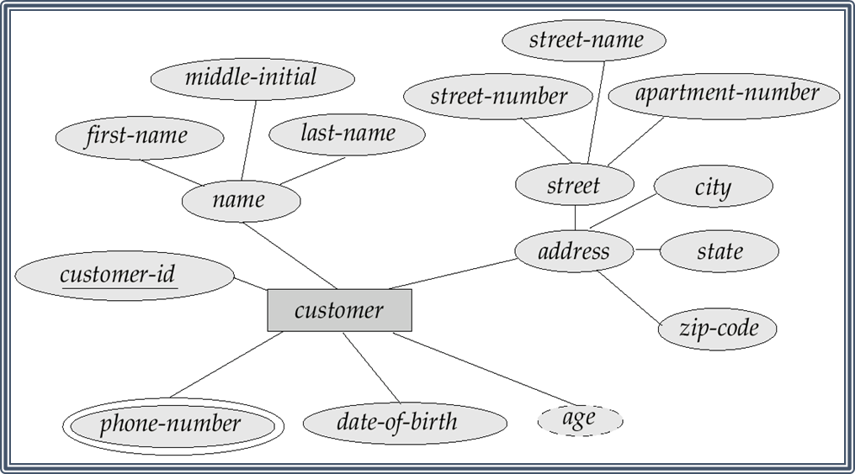
Attributes
Both entity sets and relationships can have attributes
Attributes may be
Composite
Multi-valued (double ellipse)
Derive (dashed ellipse)

Slide 10
ER Model Basics (Contd.)
since
name
dname
ssn
lot
did
budget
Employees
Works_In
Departments
Relationship: Association among two or more entities. E.g., Peter works in Pharmacy department.
Relationship Set: Collection of similar relationships.
Relationship sets can also have descriptive attributes (e.g., the since attribute of Works_In). A relationship is uniquely identified by participating entities without reference to descriptive attributes.
Notes:
4

Slide 11
Key Constraints (a.k.a. Cardinality)
Consider Works_In (in previous slide): An employee can work in many departments; a dept can have many employees.
In contrast, each dept has at most one manager, according to the key constraint on Manages.
since
name
dname
ssn
lot
did
budget
Employees
Manages
Departments
1-to-1
1-to Many
Many-to-1
Many-to-Many
Constraints are IMPORTANT because they must be ENFORCED
when IMPLEMENTING the database
Notes:
6

Slide 12
Key Constraints (ternary relationships)
name
Each employee can work at
most in one department at
a single location
Location
name
dname
ssn
lot
did
budget
Employees
works_In
Departments
12-233
D10
12-354
D12
12-243
D13
12-299
Rome
London
Paris
Notes:
6

Slide 13
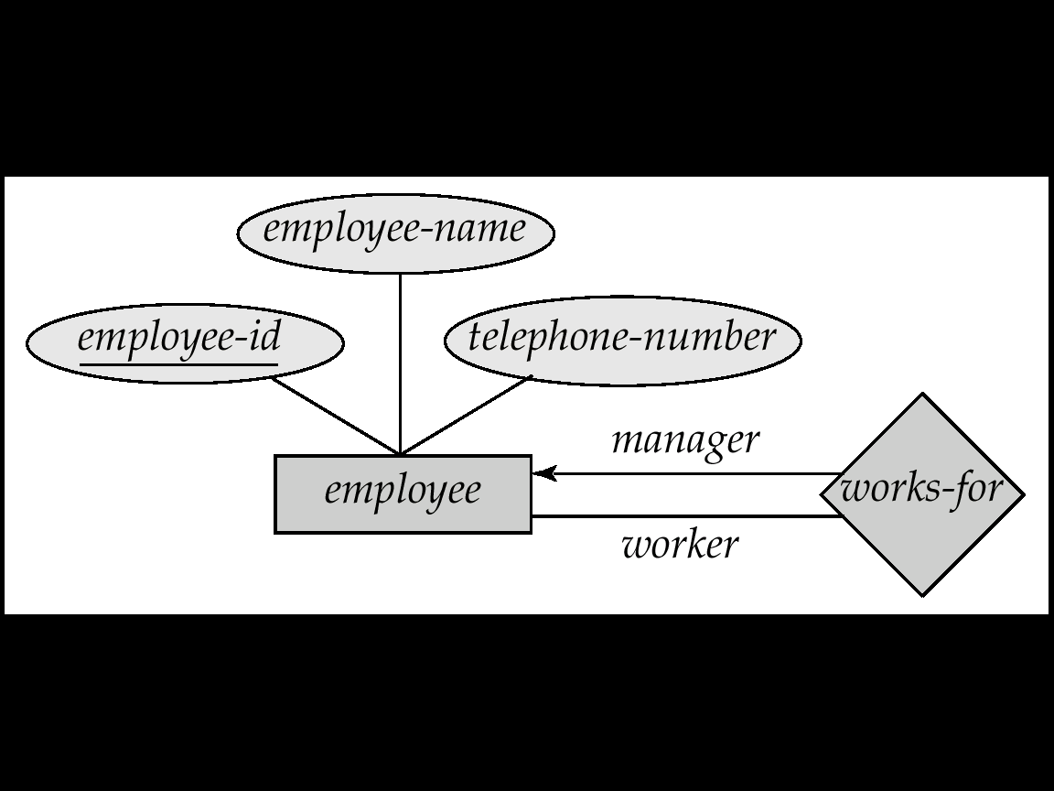
Self Relationship
Sometimes entities in a entity set may relate to other entities in the same set. Thus self relationship
Here employees mange some other employees
The labels “manger” and “worker” are called roles the self relationship

Slide 14
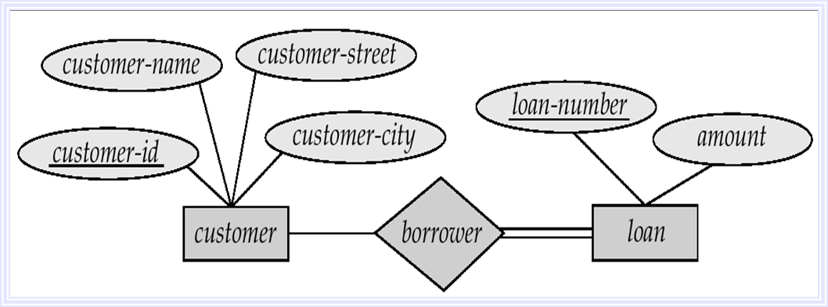
Participation Constraints
Every loan has to have at least one customer
If so, this is a participation constraint: the participation of Loan in Customer is said to be total (vs. partial).
When we require all entities to participate in the relationship (total participation), we use double lines to specify
Notes:
8

Slide 15
Weak Entity Set
Some entity sets in real world naturally depend on some other entity set
They can be uniquely identified only if combined with another entity set
Example:
section1, section2, … become unique only if you put them into a context, e.g. Cs 480 – section 1

Slide 16
Weak Entity Set Notations
Double rectangles for weak entity set
Double diamond for weak entity relationship
Dashed underscore for discriminator

Slide 17
Specialization
A lower-level entity set inherits all the attributes and relationship participation of the higher-level entity set to which it is linked.
A lower-level entity set may have additional attributes and participate in additional relationships

Slide 18
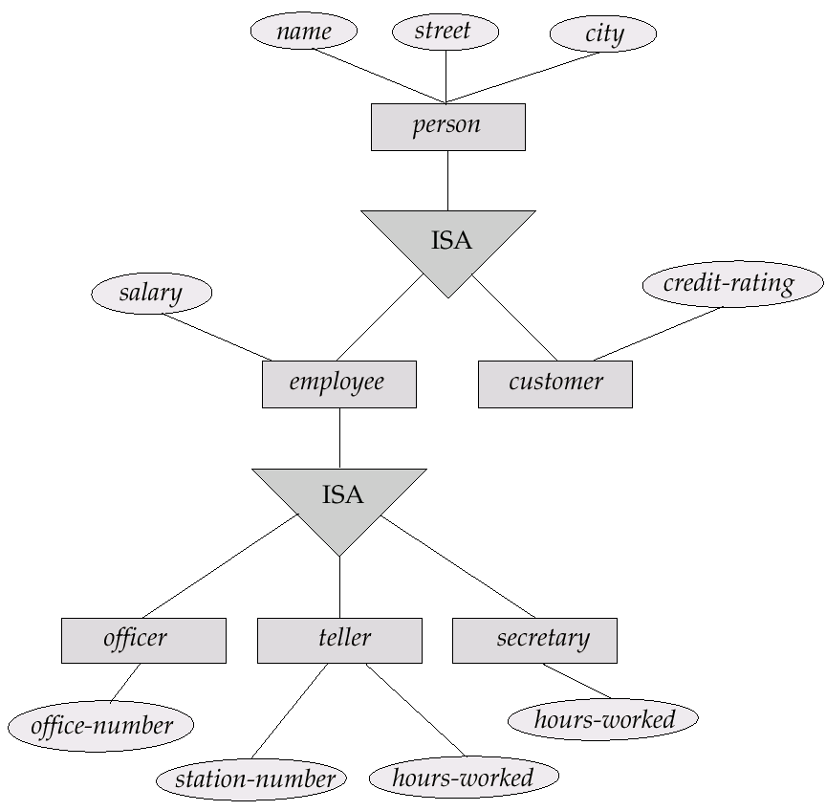
Specialization

Slide 19
Entity vs. Attribute
Should address be an attribute of Employees or an entity (connected to Employees by a relationship)?
Depends upon the use we want to make of address information, and the semantics of the data:
If we have several addresses per employee, address must be an entity (since attributes cannot be set-valued).
If the structure (city, street, etc.) is important, e.g., we want to retrieve employees in a given city, address must be modeled as an entity (since attribute values are atomic).

Slide 20
Summary of Conceptual Design
Conceptual design follows requirements analysis,
Yields a high-level description of data to be stored
ER model popular for conceptual design
Constructs are expressive, close to the way people think about their applications.
Basic constructs: entities, relationships, and attributes (of entities and relationships).
Some additional constructs: weak entities, ISA hierarchies, and aggregation.
Note: There are many variations on ER model.
ER design is subjective. There are often many ways to model a given scenario! Analyzing alternatives can be tricky, especially for a large enterprise.
Ensuring good database design: resulting relational schema should be analyzed and refined further.
Notes:
11

Slide 21
Case Study: ER Modeling
All information related to Dane County Airport is to be organized using a DBMS, and you have been hired to design the database. Your first task is to organize the information about all the airplanes stationed and maintained at the airport, and employees of the airport (technicians, traffic controllers).
Available at http://www.cpp.edu/~ukjayarathna/f16/cs480/case_studies/

Slide 22
How to translate ER Model to Relational Model

Slide 23
Review - Concepts
Relational Model is made up of tables
A row of table = a relational instance/tuple
A column of table = an attribute
A table = a schema/relation
Cardinality = number of rows
Degree = number of columns

Slide 24
Review - Example
Attribute
tuple/relational instance
Cardinality = 2
SID | Name | Major | GPA
1234 | John | CS | 2.8
5678 | Mary | EE | 3.6
4 Degree
A Schema / Relation

Slide 25
Objectives of logical design...
Translate the conceptual design into a logical database design that can be implemented on a chosen DBMS
Input: conceptual model (ERD)
Output: relational schema, normalized relations
Resulting database must meet user needs for:
Data sharing
Ease of access
Flexibility

Slide 26
Some rules...
Every table has a unique name.
Attributes in tables have unique names.
Every attribute value is atomic.
Multi-valued and composite attributes?
Every row is unique.
The order of the columns is irrelevant.
The order of the rows is irrelevant.

Slide 27
The key...
Relational modeling uses primary keys and foreign keys to maintain relationships
Primary keys are typically the unique identifier noted on the conceptual model
Foreign keys are the primary key of another entity to which an entity has a relationship
Composite keys are primary keys that are made of more than one attribute
Weak entities
Associative entities

Slide 28
Constraints
Domain constraints
Allowable values for an attribute as defined in the domain
Temperature (F/C), Salary(Dollar, Pound, Rs…)
Entity integrity constraints
No primary key attribute may be null
Referential integrity constraints
Maintains consistency among rows of two entities
matching of primary and foreign keys
Enforcement options for deleting instances
Restrict
Cascade
Set-to-Null

Slide 29
Transforming E-R diagrams into relations
Mapping regular entities to relations
Composite attributes: use only their simple, component attributes
Multi-valued attributes: become a separate relation with a foreign key taken from the superior entity

Slide 30
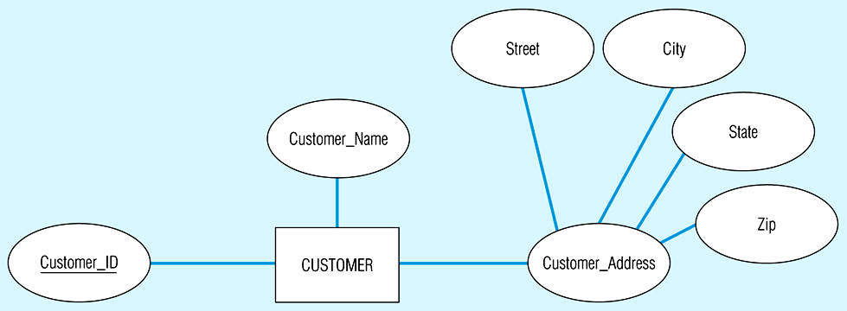
Mapping a composite attribute

Slide 31
Looks like this using relational schema notation

Slide 32
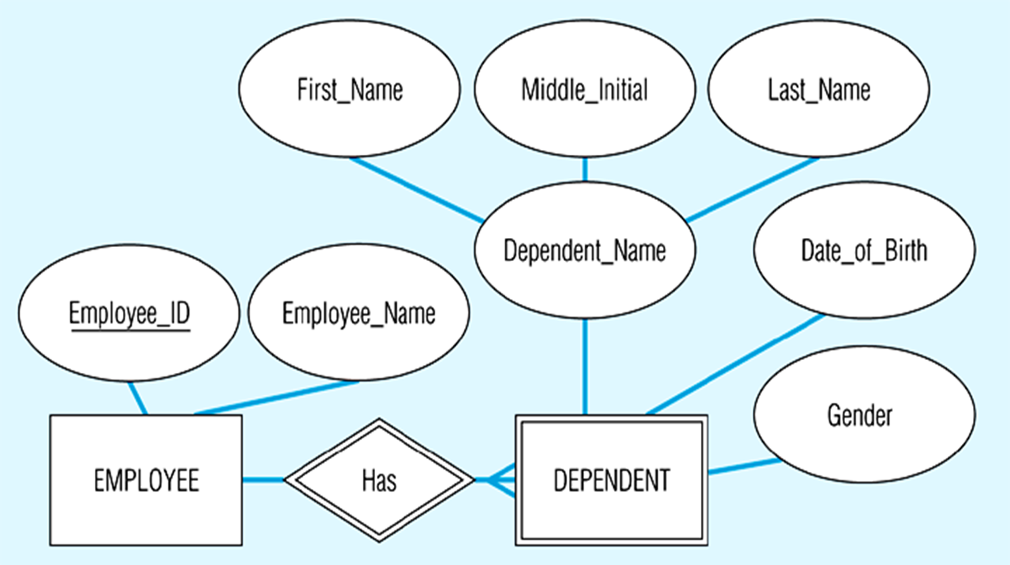
Transforming E-R diagrams into relations
Mapping weak entities
Becomes a separate relation with a foreign key taken from the superior entity

Slide 33
Looks like this using relational schema notation

Slide 34
Transforming E-R diagrams into relations
Mapping binary relationships
One-to-many
primary key on the one side becomes a foreign key on the many side
Many-to-many
create a new relation (associative entity) with the primary keys of the two entities as its primary key
One-to-one
primary key on the mandatory side becomes a foreign key on the optional side

Slide 35
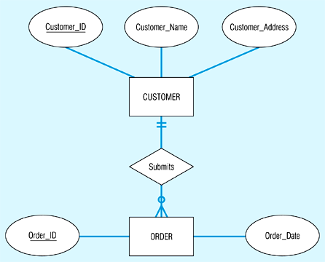
Example of mapping a 1:M relationship

Slide 36
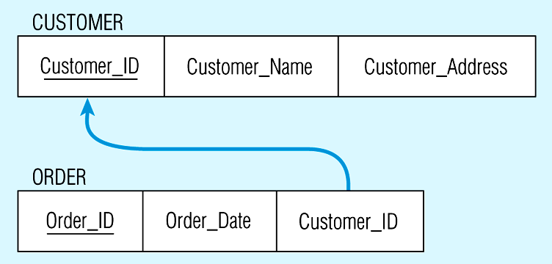
Looks like this using relational schema notation

Slide 37
Example of mapping an M:M relationship

Slide 38
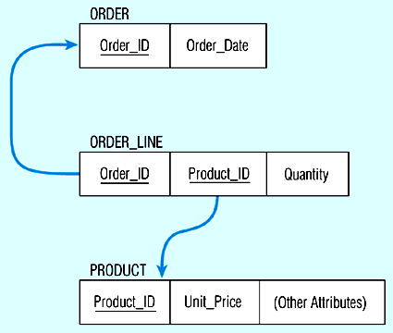
Looks like this using relational schema notation

Slide 39
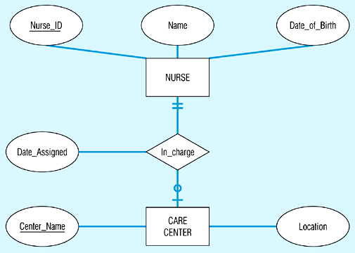
Mapping a binary 1:1 relationship

Slide 40
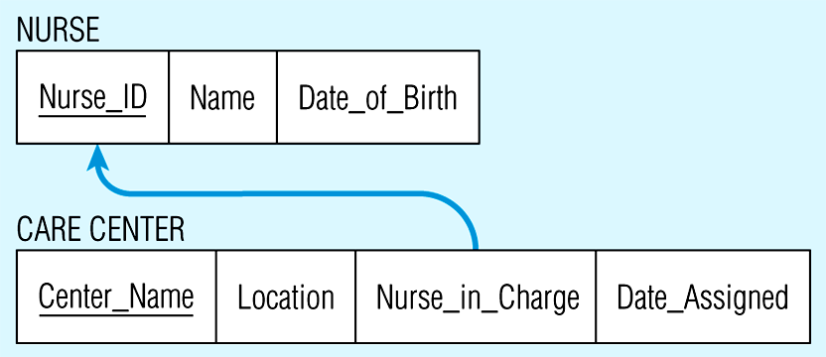
Looks like this using relational schema notation

Slide 41
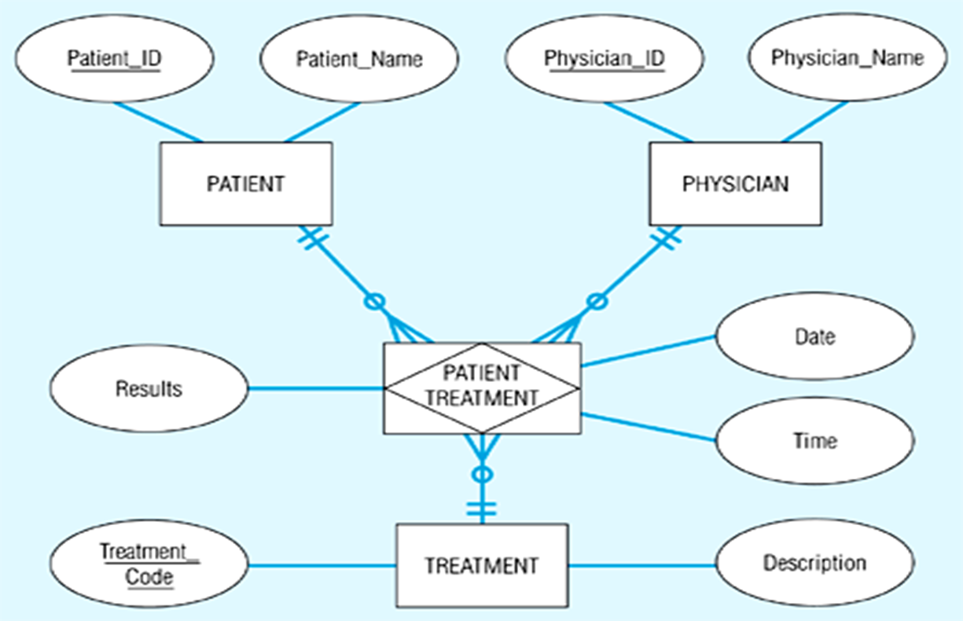
Transforming E-R diagrams into relations
Mapping ternary (and n-ary) relationships
One relation for each entity and one for the associative entity

Slide 42
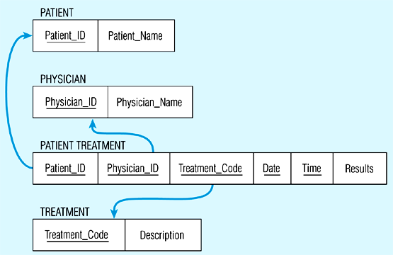
Looks like this using relational schema notation

Slide 43
Transforming E-R diagrams into relations
Mapping Supertype/subtype relationships
Create a separate relation for the supertype and each of the subtypes
Assign common attributes to supertype
Assign primary key and unique attributes to each subtype
Assign an attribute of the supertype to act as subtype discriminator

Slide 44
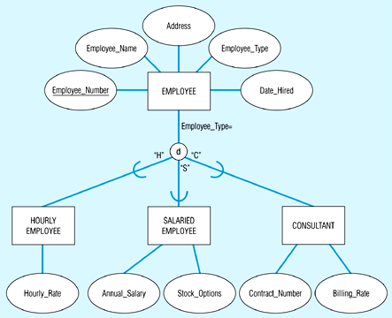
Mapping Supertype/subtype relationships

Slide 45
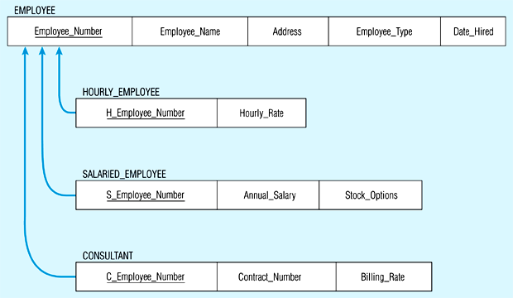
Would look like this...

Slide 46
Case Study: ER Modeling
All information related to Dane County Airport is to be organized using a DBMS, and you have been hired to design the database. Your first task is to organize the information about all the airplanes stationed and maintained at the airport, and employees of the airport (technicians, traffic controllers).
Available at http://www.cpp.edu/~ukjayarathna/f16/cs480/case_studies/

Slide 47
Data normalization
Normalization is a formal process for deciding which attributes should be grouped together in a relation
Objective: to validate and improve a logical design so that it satisfies certain constraints that avoid unnecessary duplication of data
Definition: the process of decomposing relations with anomalies to produce smaller, well-structured relations

Slide 48
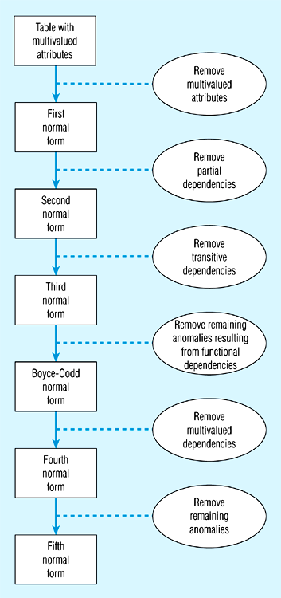
Data normalization

Slide 49
Functional dependencies and keys
Functional dependency: the value of one attribute (the determinant) determines the value of another attribute
A -> B, for every valid instance of A, that value of A uniquely determines the value of B
Candidate key: an attribute or combination of attributes that uniquely identifies an instance
Uniqueness: each non-key field is functionally dependent on every candidate key
Non-redundancy

Slide 50
First normal form
No multi-valued attributes.
Every attribute value is atomic.

Slide 51
Second normal form
1NF and every non-key attribute is fully functionally dependent on the primary key.
Every non-key attribute must be defined by the entire key, not by only part of the key.
No partial functional dependencies.

Slide 52
Third normal form
2NF and no transitive dependencies (functional dependency between non-key attributes.)

Slide 53
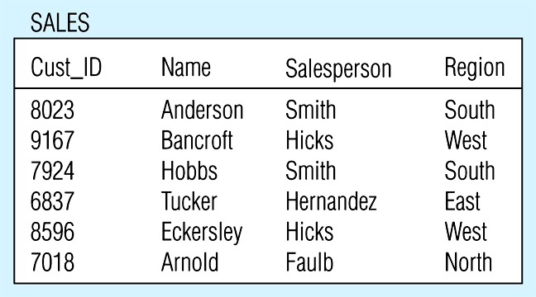
Relation with transitive dependency

Slide 54
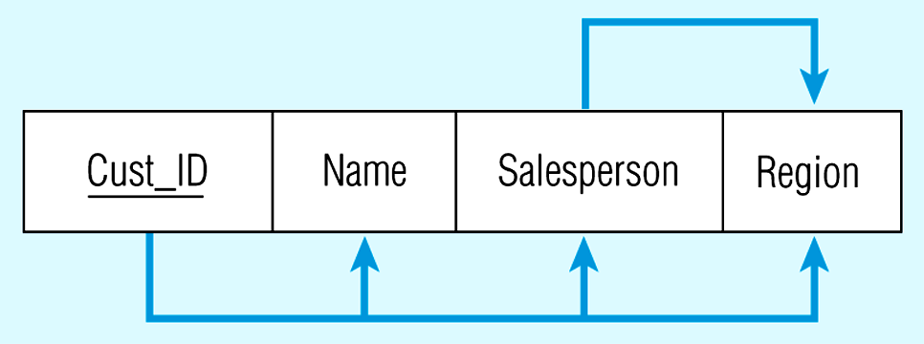
Transitive dependency in SALES relation

Slide 55
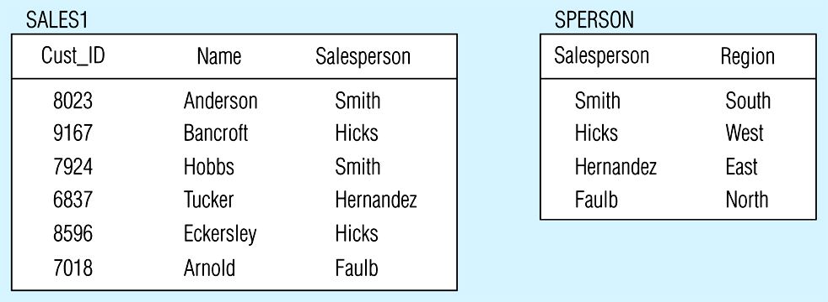
Removing a transitive dependency

Slide 56
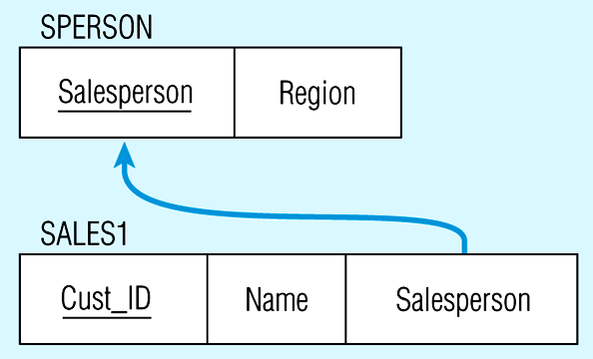
Relations in 3NF

