Slide 1
Lecture 1a- Introduction
CS 140-01
Introduction to Computer Science
Dr. Sampath Jayarathna
Cal Poly Pomona

Slide 2
Today
Who I am
CS 140 educational objectives (and why)
Overview of the course, and logistics
Introduction to Computers
Quick overview of Java and why we study it
First program “Hello World!”

Slide 3
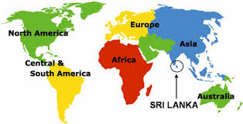
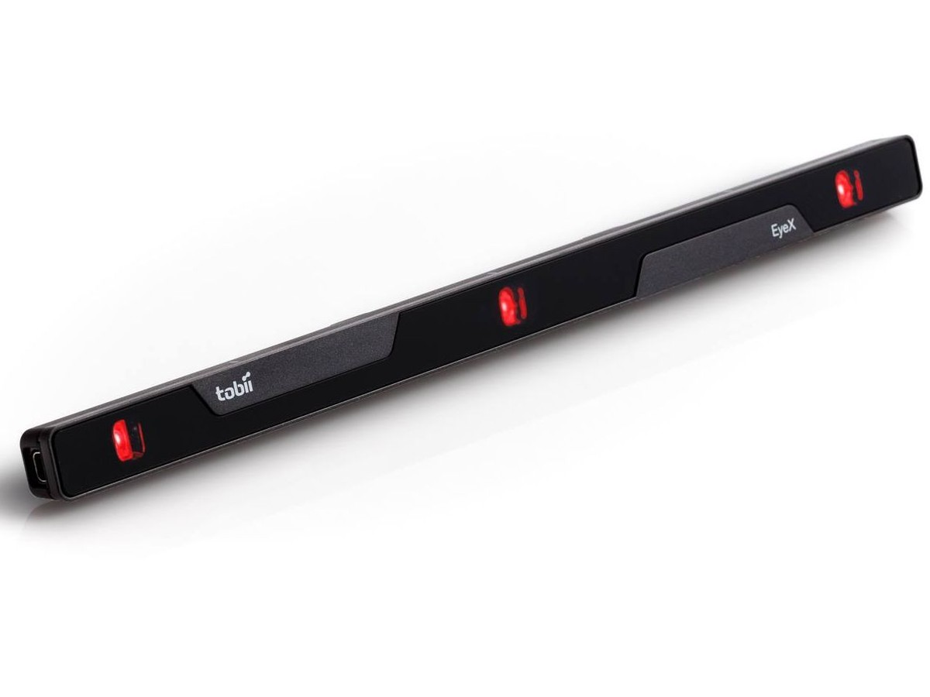
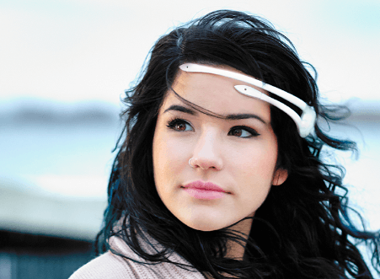
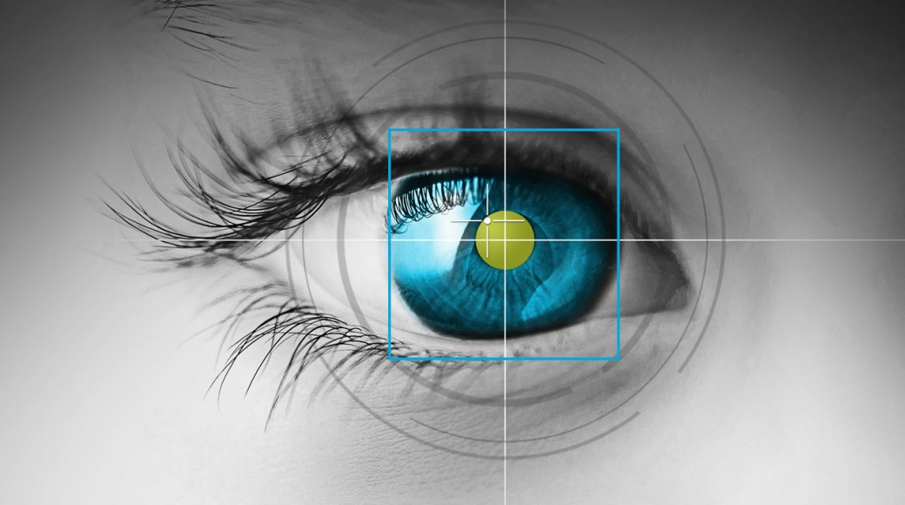
Who am I?
Instructor : Sampath Jayarathna
Joined Cal Poly Pomona Fall 2016 from Texas A&M
Originally from Sri Lanka
Research : Eye tracking, Brain EEG, User modeling, Biometrics
Web : http://www.cpp.edu/~ukjayarathna
Contact : 8-46, ukjayarathna@cpp.edu, (909) 869-3145
Office Hours : MW 3PM – 5PM, or email me for an appointment
[Open Door Policy]

Slide 4
Abstract
Today, I’ll outline the aims for this course and present a rough course plan.
I’ll introduce the basic notion of programming and give examples of areas in which software is critical to our civilization.
Finally, I’ll present the simplest possible Java program and outline how it can be made into running code.

Slide 5
This is a course
About Programming
For beginners
  who want to become professionals
    i.e., people who can produce systems that others will use
  who are assumed to be bright
    Though not (necessarily) geniuses
  who are willing to work hard
    Though do need sleep occasionally, and take a normal course load
Using the Java programming language

Slide 6
Course Information
Schedule : MW, 8-345, 6.00 PM – 7.50 PM http://www.cpp.edu/~ukjayarathna/f17/cs140
www.piazza.com/csupomona/fall2017/cs140/home
Blackboard
Prereqs
  Official: MAT114 or approval of instructor
Format
  Before lecture: do reading slides
  In lecture: put reading in context
  After lecture: assignments, projects for hands-on practice

Slide 7
Student Learning Outcomes
After successfully completing this course, students should be able to:
Comprehend the basic concepts of programming and its use for problem solving
Learn good programming principles and practices using the Java language
Have good knowledge of the syntax and semantics of Java

Slide 8

Communication
Piazza:
  All questions will be fielded through Piazza.
  Many questions everyone can see the answer
  You can also post private messages that can only be seen by the instructor
Blackboard:
  Blackboard will be used primarily for assignments/homework submission, and grade dissemination.
Email:
  Again, email should only be used in rare instances, I will probably point you back to Piazza

Slide 9
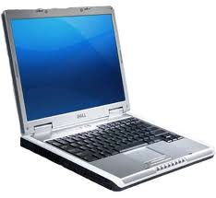
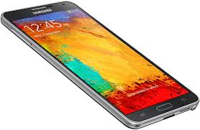
The Rules

Slide 10
Cooperate on Learning
Except for the work you hand in as individual contributions, I strongly encourage you to collaborate and help each other
If in doubt if a collaboration is legitimate: ask!
    Don’t claim to have written code that you copied from others or online
    Don’t give anyone else your code (to hand in for a grade)
    When you rely on the work of others, explicitly list all of your sources – i.e. give credit to those who did the work
Don’t study alone when you don’t have to
    Form study groups
    Do help each other (without plagiarizing)

Slide 11
Course Organization
Grading
Required Materials
  Tony Gaddis, STARTING OUT WITH JAVA – From Control Structures through Objects, 6th edition. Addison-Wesley, 2016. ISBN-13: 978-0133957051
  Bring Your Own Device (BYOD).

Slide 12
Course Organization
Programming Projects: We will have 2 programming projects, worth 15% of your overall grade.
Final Exam: The final exam is comprehensive, closed books and will be held on Monday, Dec. 4th, 6.00pm – 8.00pm.
Midterm Exam: Closed books and will be held on Wednesday, Oct. 25 during class time.
Homework: We will have five homework assignments, each worth 3% of your overall grade.
Quizzes
  Few low-stress quizzes or in-class exercises

Slide 13
Personal devices – Software Setup
Windows/Mac
  Java 8 JRE/JDK
    Download Java 8 JDK
    http://www.oracle.com/technetwork/java/javase/downloads/jdk8-downloads-2133151.html
  Integrated Development Environment (IDE): Eclipse 4.7 (Oxygen)
    Download Eclipse IDE for Java EE Developers
    http://www.eclipse.org/downloads/packages/eclipse-ide-java-ee-developers/oxygenr
If you have other IDEs (NetBeans, IntelliJ Idea etc.), you are welcome to use them.

Slide 14
Why Java?
You can’t learn to program without a programming language
The purpose of a programming language is to allow you to express your ideas in code
Java is one of the language that most directly allows you to express ideas from the largest number of application areas

Slide 15
Why programming?
Our civilization runs on software
  Most engineering activities involve software

Slide 16
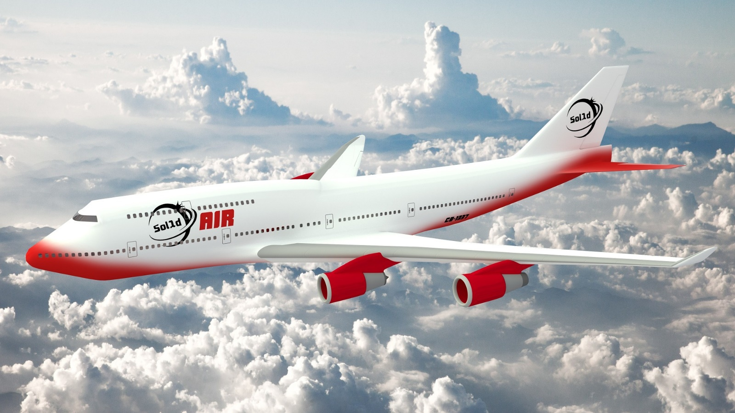

Aircraft
Communication
Control
Display
Signal Processing
Monitoring

Slide 17
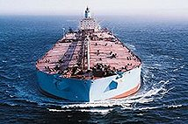
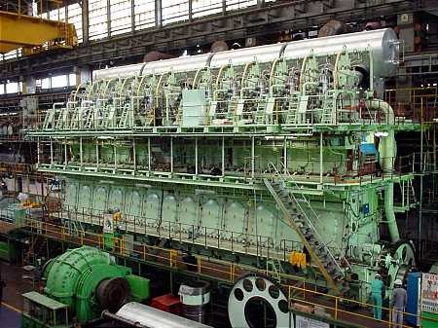
Ships
Design
Construction
Management
Monitoring
Hull Design
Pumps

Slide 18

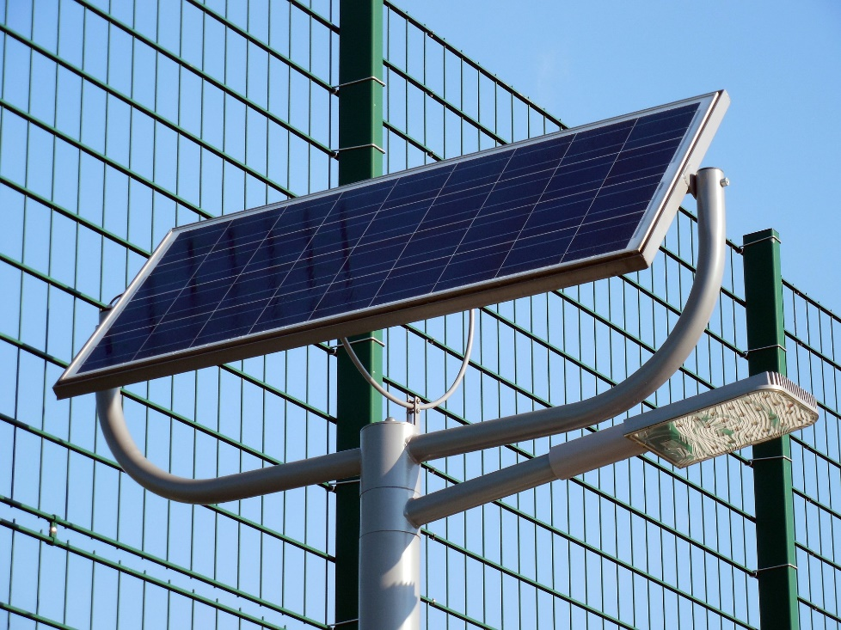
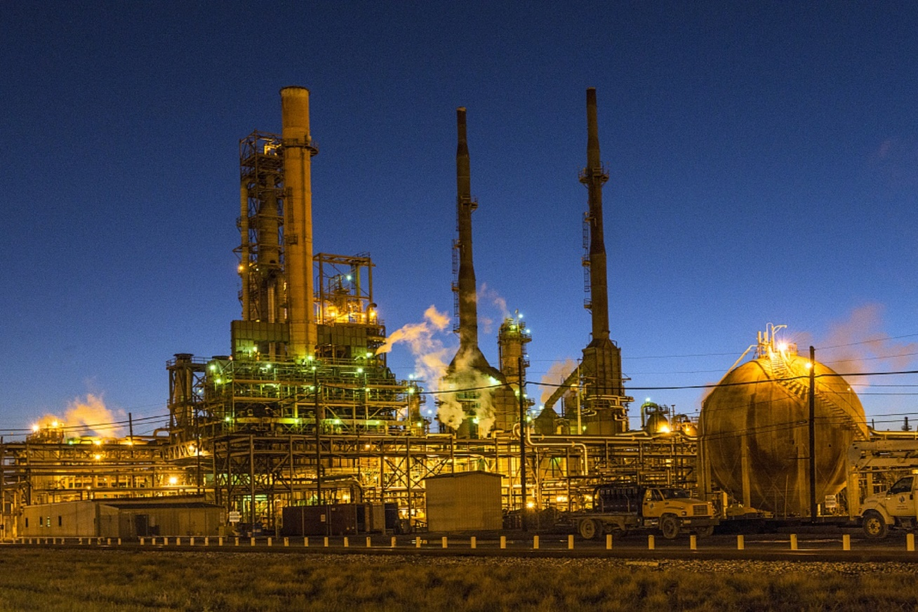
Energy
Control
Monitoring
Analysis
Design
Communications
Manufacturing
Visualization

Slide 19
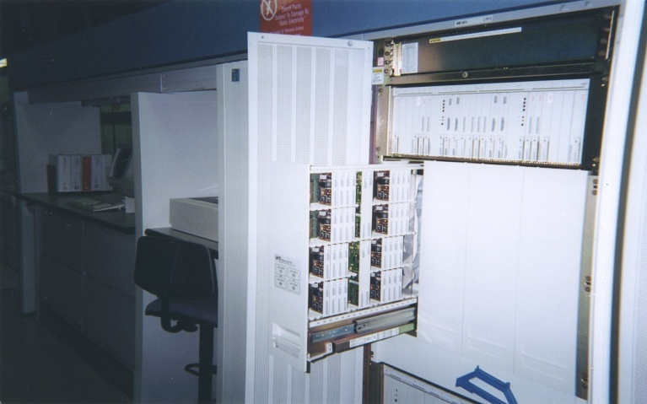
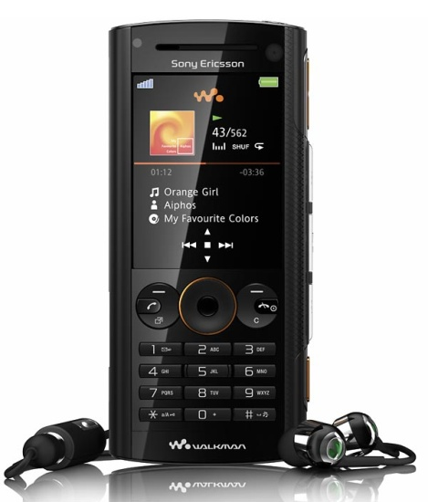
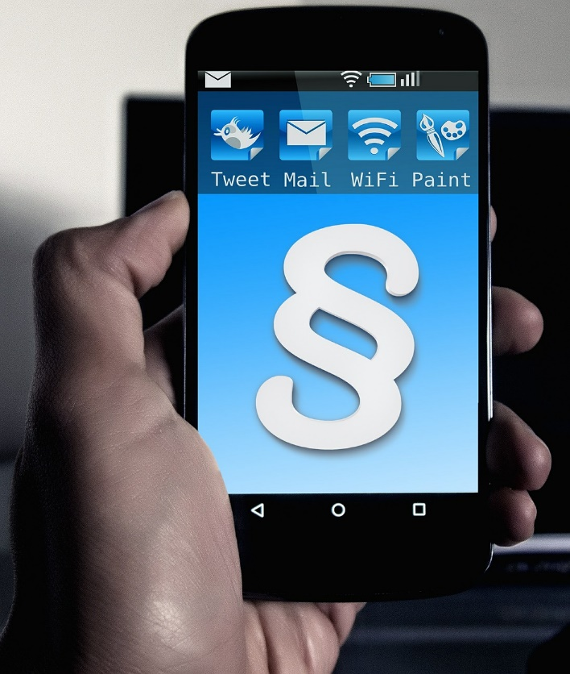
Phones
Voice Quality
User Interfaces
Billing
Mobility
Switching
Reliability
Images

Slide 20
Computer Systems: Hardware
Computer hardware components are the physical pieces of the computer.
The major hardware components of a computer are:
  The central processing unit (CPU)
  Main memory
  Secondary storage devices
  Input and Output devices

Slide 21
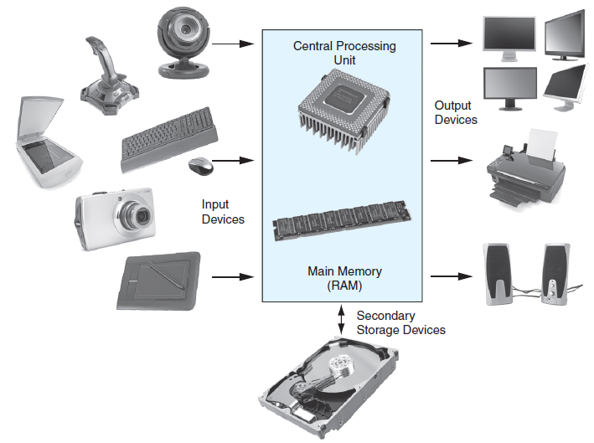
Computer Systems: Hardware

Slide 22
Computer Systems: Hardware
Central Processing Unit
CPU
Arithmetic
Logic
Unit
Instruction (input)
Result (output)
Control
Unit

Slide 23
Computer Systems: Hardware
Central Processing Unit
  The CPU performs the fetch, decode, execute cycle in order to process program information.
The CPU’s control unit fetches, from main memory,
the next instruction in the sequence of program instructions.
Fetch
The instruction is encoded in the form of a number. The control unit decodes the instruction and generates an electronic signal.
Execute
Decode
The signal is routed to the appropriate component of the computer (such as the ALU, a disk drive, or some other device). The signal causes the component to perform an operation.

Slide 24
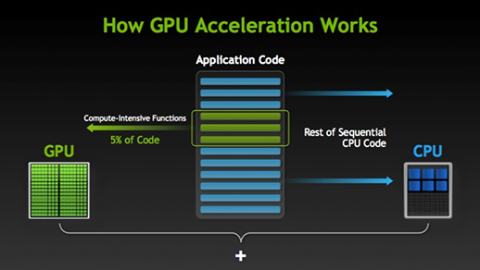
Computer Systems: Modern GPUs
CPUs consist of few cores optimized for serial processing
GPUs consist of thousands of smaller more efficient cores.
Serial portions of the code runs on the CPU while parallel portions run on the GPU.

Slide 25
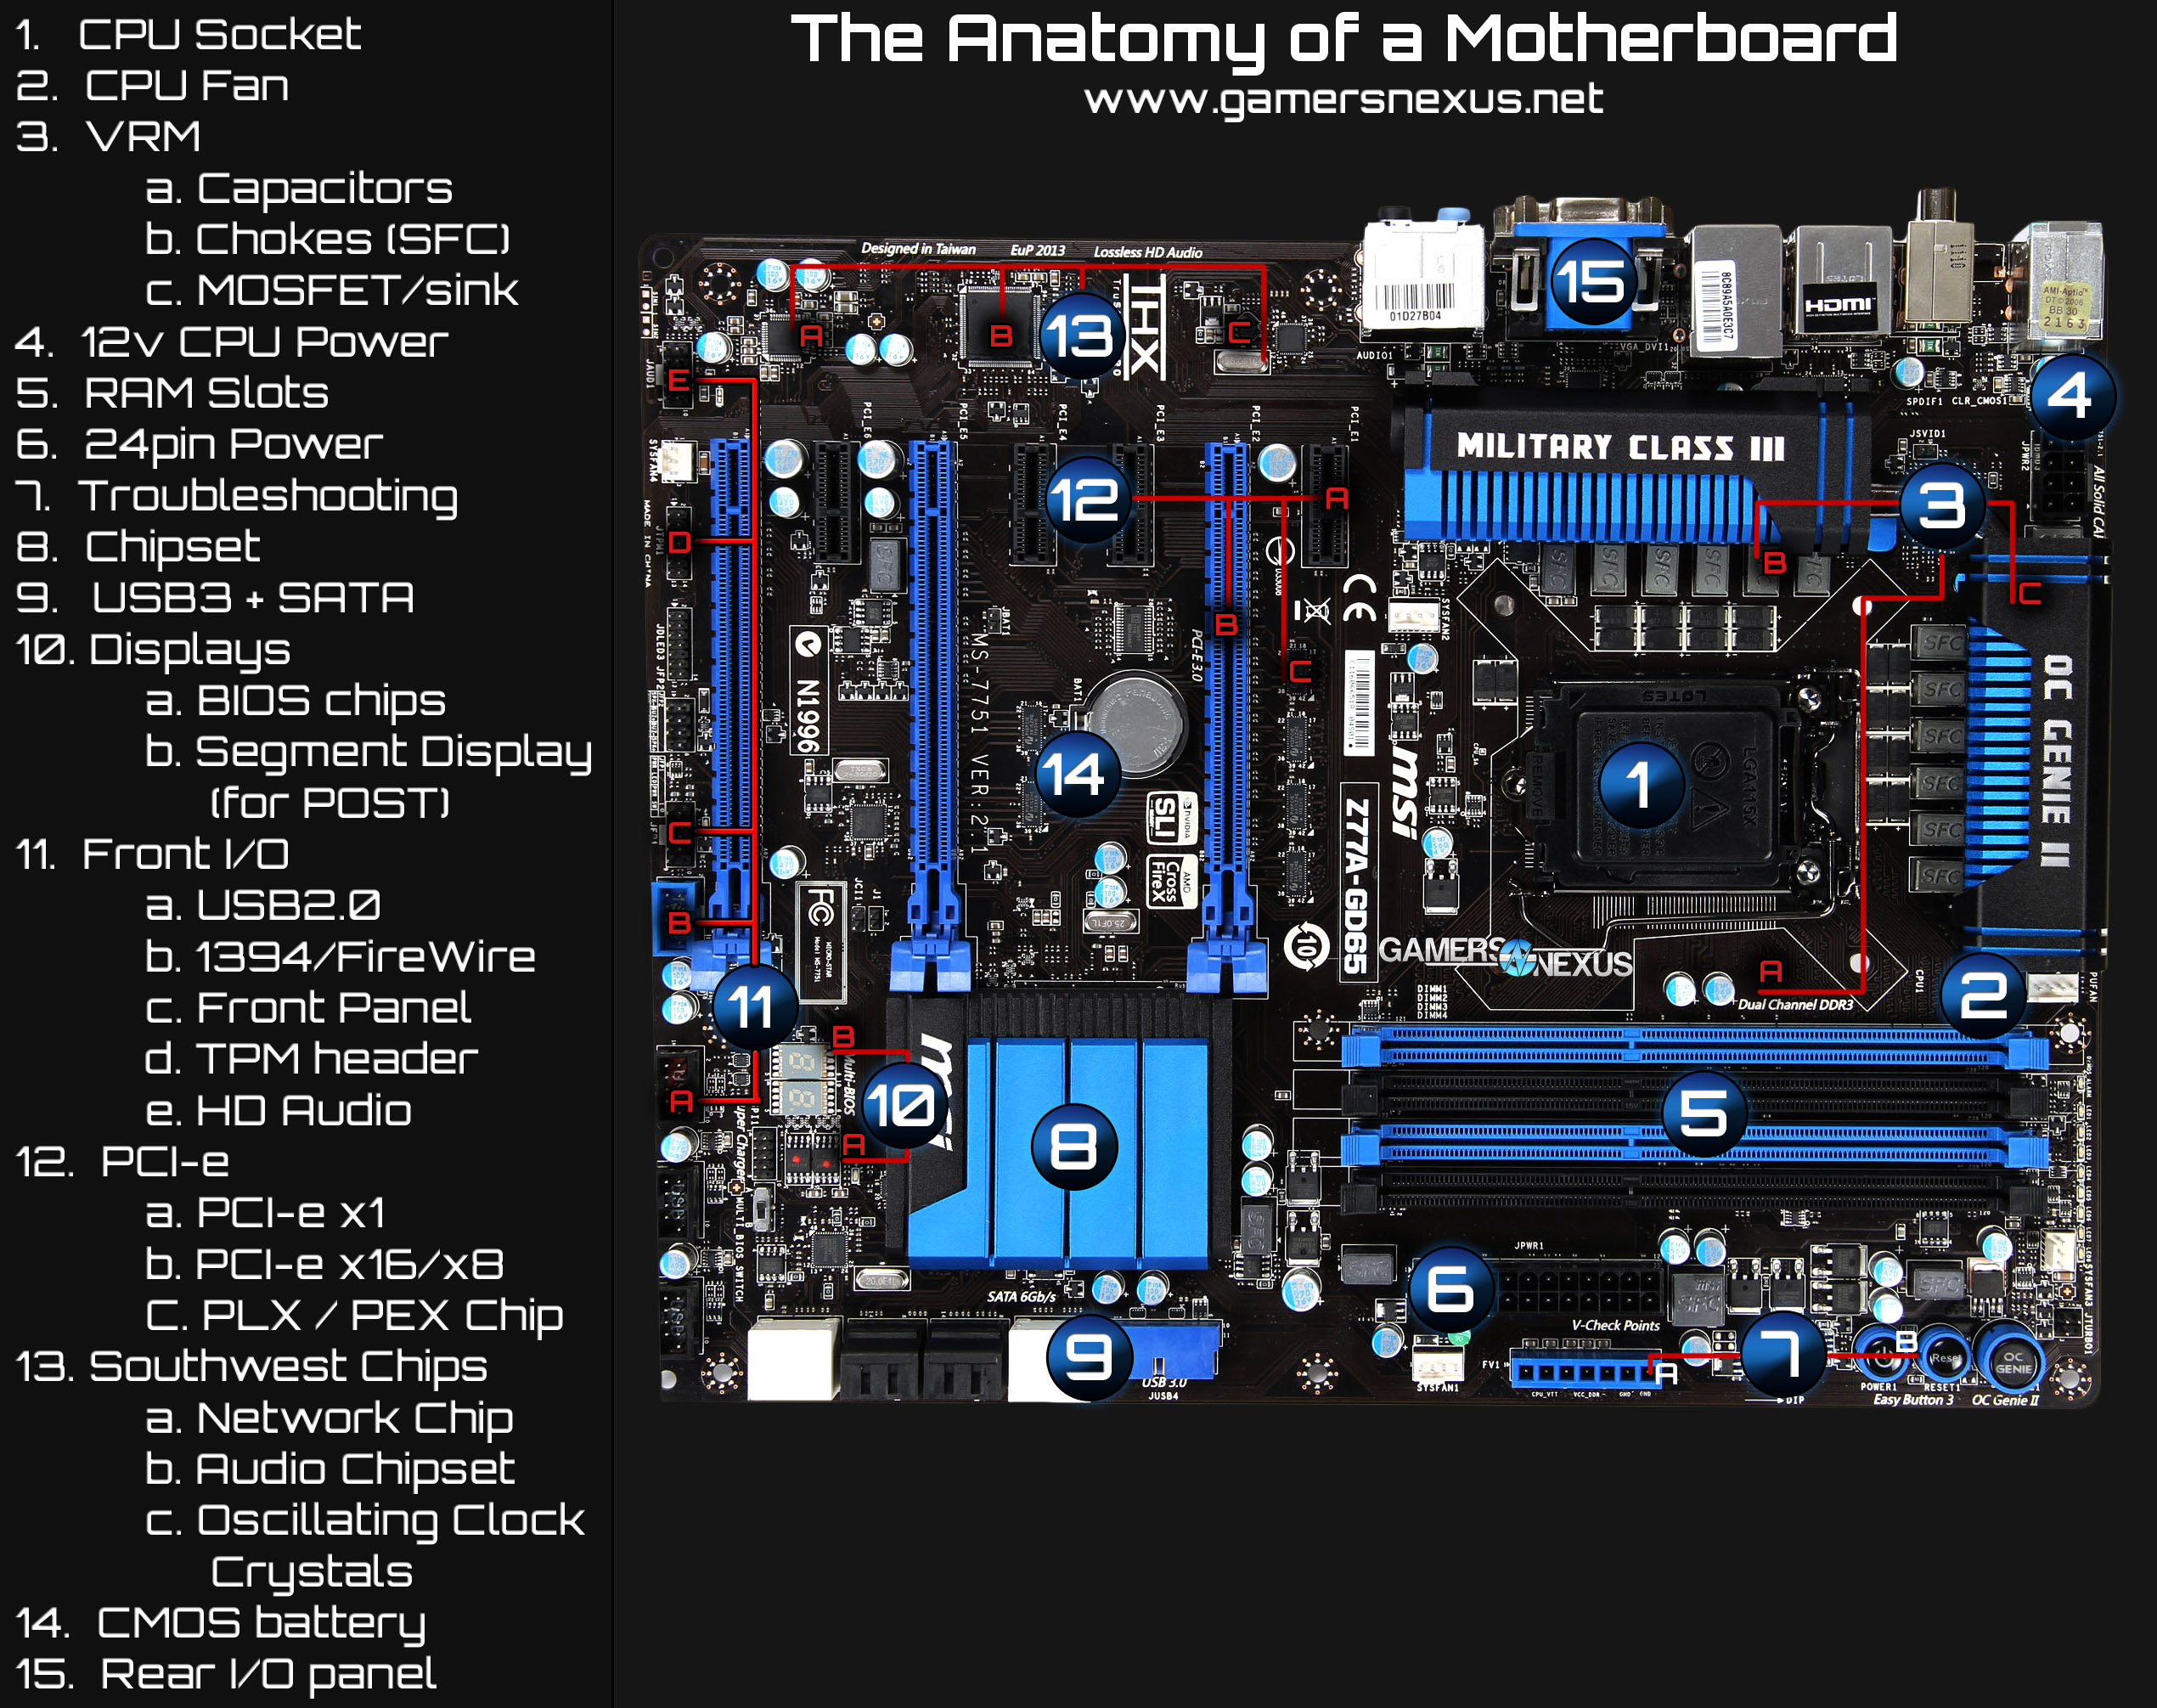
Computer Systems: Anatomy of Motherboard

Slide 26
Computer Systems: Hardware
Main Memory
Commonly known as random-access memory (RAM)
RAM contains:
  currently running programs
  data used by those programs.
RAM is divided into units called bytes.
A byte consists of eight bits that may be either on or off.

Slide 27
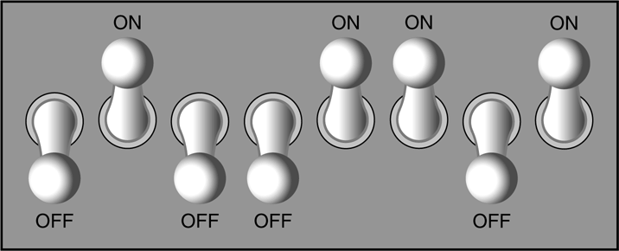
Computer Systems: Hardware
Main Memory
1
1
1
1
A bit is either on or off:
  1 = on
  0 = off
The bits form a pattern that represents a character or a number.
Each byte in memory is assigned a unique number known as an address.
RAM is volatile, which means that when the computer is turned off, the contents of RAM are erased.
0
0
0
0

Slide 28
Computer Systems: Hardware
Main Memory
Main memory can be visualized as a column or row of cells.
0x000
A section of memory is called a byte.
0x001
1
0
1
0
1
0
1
0
A byte is made up of 8 bits.
0x002
0x003
0x004
0x005
A section of two or four bytes is often called a word.
0x006
0x007

Slide 29
Computer Systems: Hardware
Secondary Storage Devices
Secondary storage devices are capable of storing information for longer periods of time (non-volatile).
Common Secondary Storage devices:
  Disk drive
  External drive
  CD drive
  Solid state drive
  USB drive
  DVD drive

Slide 30
Computer Systems: Hardware
Input Devices
Input is any data the computer collects from the outside world.
That data comes from devices known as input devices.
Common input devices:
  Keyboard
  Mouse
  Scanner
  Digital camera

Slide 31
Computer Systems: Hardware
Output Devices
Output is any data the computer sends to the outside world.
That data is displayed on devices known as output devices.
Common output devices:
  Monitors
  Printers
Some devices such as disk drives perform input and output and are called I/O devices (input/output).

Slide 32
Computer Systems: Software
Software refers to the programs that run on a computer.
Categories of software:
  System software: programs that manage the computer hardware and the programs that run on them. Examples: operating systems, utility programs, software development tools
  Application software: programs that provide services to the user. Examples : word processing, games, programs to solve specific problems

Slide 33
Computer Systems: Software
Operating Systems
A multitasking operating system is capable of running multiple programs at once.
  Unix
  Linux
  Mac OS
  Windows
The technique is called time sharing.
A multitasking system divides the allocation of hardware resources and the attention of the CPU among all the executing programs.

Slide 34
Computer Systems: Software
Application Software
Application software refers to programs that make the computer useful to the user.
Application software provides a more specialized type of environment for the user to work in.
Common application software:
  Spreadsheets
  Word processors (MS Word, OpenOffice, Google Docs)
  Accounting software
  Tax software
  Games

