Slide 1
Lecture 1b- Introduction
CS 140
Introduction to Computer Science
Dr. Sampath Jayarathna
Cal Poly Pomona

Slide 2
So what is programming?
Conventional definitions
Telling a very fast moron exactly what to do
A plan for solving a problem on a computer
Specifying the order of a program execution
But modern programs often involve millions of lines of code
And manipulation of data is central
The definition we’ll use
Specifying the structure and behavior of a program, and testing that the program performs its task correctly and with acceptable performance
Never forget to check that “it” works
Software == one or more programs

Slide 3
Programming
Programming is fundamentally simple
Just state what the machine is to do
So why is programming hard?
We want “the machine” to do complex things
And computers are nitpicking, unforgiving, dumb beasts
The world is more complex than we’d like to believe
So we don’t always know the implications of what we want
“Programming is understanding”
When you can program a task, you understand it
When you program, you spend significant time trying to understand the task you want to automate
Programming is part practical, part theory
If you are just practical, you produce non-scalable unmaintainable hacks
If you are just theoretical, you produce toys

Slide 4
Machine Language
Machine language instructions are binary numbers, such as 1011010000000101
Rather than writing programs in machine language, programmers use programming languages.
Why?

Slide 5
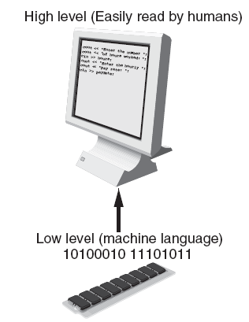
Programs and Programming Languages
Types of languages:
Low-level: used for communication with computer hardware directly. Often written in binary machine code (0’s/1’s) directly.
Ex: Machine Code, Assembly
High-level: closer to human language

Slide 6
Programming Languages
In the distant past, programmers wrote programs in machine language.
Programmers developed higher level programming languages to make things easier.
The first of these was assembler.
Assembler made things easier but was also processor dependent.

Slide 7
Programming Languages
High level programming languages followed that were not processor dependent.
Some common programming languages:
Java
C
Visual Basic
BASIC
C++
Python
COBOL
C#
Ruby
Pascal
PHP
JavaScript

Slide 8
Programming Languages Common Language Elements
There are some concepts that are common to virtually all programming languages.
Common concepts:
Key words
Operators
Punctuation
Programmer-defined identifiers
Strict syntactic rules.

Slide 9
Programming Languages Sample Program
public class HelloWorld
{
public static void main(String[] args)
{
System.out.println("Hello World");
}
}

Slide 10
Programming Languages Sample Program
Key words in the sample program are:
Key words are lower case (Java is a case sensitive language).
Key words cannot be used as a programmer-defined identifier.
public
class
static
void

Slide 11
Programming Languages
Semi-colons are used to end Java statements; however, not all lines of a Java program end a statement.
Part of learning Java is to learn where to properly use the punctuation.
A statement is a complete Java instruction that causes the computer to perform an action.

Slide 12
Programming Languages Variables
Data in a Java program is stored in memory.
Variable names represent a location in memory.
Variables in Java are sometimes called fields.
Variables are created by the programmer who assigns it a programmer-defined identifier.
int hours = 40;
In this example, the variable hours is created as an integer (more on this later) and assigned the value of 40.

Slide 13
Programming Languages Variables
Variables are simply a name given to represent a place in memory.
0x000
0x001
0x002
0x003
0x004
0x005
0x006
0x007

Slide 14
Programming Languages Variables
Assume that the this
variable declaration
has been made.
int length = 72;
0x000
The Java Virtual
Machine (JVM)
actually decides
where the value
will be placed
in memory.
0x001
0x002
0x003
72
0x004
The variable length
is a symbolic name
for the memory
location 0x003.
0x005
0x006
0x007

Slide 15
The Compiler and the Java Virtual Machine
A programmer writes Java programming statements for a program.
These statements are known as source code.
A text editor is used to edit and save a Java source code file.
Source code files have a .java file extension.
A compiler is a program that translates source code into an executable form.

Slide 16
The Compiler and the Java Virtual Machine
A compiler is run using a source code file as input.
Syntax errors that may be in the program will be discovered during compilation.
Syntax errors are mistakes that the programmer has made that violate the rules of the programming language.
The compiler creates another file that holds the translated instructions.

Slide 17
The Compiler and the Java Virtual Machine
Most compilers translate source code into executable files containing machine code.
The Java compiler translates a Java source file into a file that contains byte code instructions.
Byte code instructions are the machine language of the Java Virtual Machine (JVM) and cannot be directly executed directly by the CPU.

Slide 18
The Compiler and the Java Virtual Machine
Byte code files end with the .class file extension.
The JVM is a program that emulates a micro-processor.
The JVM executes instructions as they are read.
JVM is often called an interpreter.
Java is often referred to as an interpreted language.

Slide 19
Program Development Process
Text editor
Saves Java statements
Source code
(.java)
Is read by
Byte code (.class)
Java compiler
Produces
Is interpreted by
Program
Execution
Java
Virtual
Machine
Results in

Slide 20
Portability
Portable means that a program may be written on one type of computer and then run on a wide variety of computers, with little or no modification.
Java byte code runs on the JVM and not on any particular CPU; therefore, compiled Java programs are highly portable.
JVMs exist on many platforms:
Windows
Mac
Linux
Unix
BSD
Etc.

Slide 21
Portability
With most programming languages, portability is achieved by compiling a program for each CPU it will run on.
Java provides an JVM for each platform so that programmers do not have to recompile for different platforms.
Byte code (.class)
Java Virtual
Machine for Windows
Java Virtual
Machine for Unix
Java Virtual
Machine for Linux
Java Virtual
Machine for Mac

Slide 22
Java Versions
The software you use to write Java programs is called the Java Development Kit, or JDK.
There are different editions of the JDK:
Java SE - Java2 Standard Edition.
Java EE - Java2 Enterprise Edition.
Java ME - Java2 Micro Edition.
Available for download at http://java.oracle.com

Slide 23
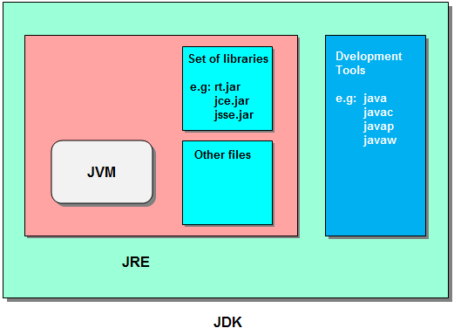
JVM vs. JRE vs. JDK

Slide 24
Compiling and executing a Java Program
The Java compiler is a command line utility.
The command to compile a program is:
javac filename.java
javac is the Java compiler.
The .java file extension must be used.
Example: To compile a java source code file named Payroll.java you would use the command: javac Payroll.java
The command to execute a program is:
java filename
java is the Java interpreter.
You are running the bytecode (.class file), so no need to have .java extension

Slide 25
Software Engineering
Encompasses the whole process of crafting computer software.
Software engineers perform several tasks in the development of complex software projects.
designing,
writing,
testing,
debugging,
documenting,
modifying, and
maintaining.

Slide 26
Software Engineering
Software engineers also use special software designed for testing programs.
Most commercial software applications are large and complex.
Usually a team of programmers, not a single individual, develops them.
Program requirements are thoroughly analyzed and divided into subtasks that are handled by
individual teams
individuals within a team.

