Slide 1
Lecture 2a- Java Fundamentals
CS 140
Introduction to Computer Science
Dr. Sampath Jayarathna
Cal Poly Pomona

Slide 2
Parts of a Java Program
A Java source code file contains one or more Java classes.
If more than one class is in a source code file, only one of them may be public.
The public class and the filename of the source code file must match.
ex: A class named Simple must be in a file named Simple.java
Each Java class can be separated into parts.

Slide 3
Parts of a Java Program
We are going to create a simple java program called Simple.java
To compile the example:
javac Simple.java
Notice the .java file extension is needed.
This will result in a file named Simple.class being created.
To run the example:
java Simple
Notice there is no file extension here.
The java command assumes the extension is .class.

Slide 4
Analyzing The Example
// This is a simple Java program.
This is a Java comment. It is ignored by the compiler.
public class Simple { }
This is the class header for the class Simple
This area is the body of the class Simple.
All of the data and methods for this class will be between these curly braces.

Slide 5
Analyzing The Example
This is the method header
for the main method. The
main method is where a Java
application begins.
// This is a simple Java program.
public class Simple { }
public static void main(String[] args) {
}
This area is the body of the main method.
All of the actions to be completed during
the main method will be between these curly braces.

Slide 6
Analyzing The Example
// This is a simple Java program.
public class Simple { }
public static void main(String [] args) {
System.out.println("Programming is great fun!"); }
This is the Java Statement that is executed when the program runs.

Slide 7
Parts of a Java Program
Comments
The line is ignored by the compiler.
The comment in the example is a single-line comment.
Class Header
The class header tells the compiler things about the class such as what other classes can use it (public) and that it is a Java class (class), and the name of that class (Simple).
Curly Braces
When associated with the class header, they define the scope of the class.
When associated with a method, they define the scope of the method.

Slide 8
Parts of a Java Program
The main Method
This line must be exactly as shown in the example (except the args variable name can be programmer defined).
This is the line of code that the java command will run first.
This method starts the Java program.
Every Java application must have a main method.
Java Statements
When the program runs, the statements within the main method will be executed.

Slide 9
Java Statements
If we look back at the previous example, we can see that there is only one line that ends with a semi-colon.
System.out.println("Programming is great fun!");
This is because it is the only Java statement in the program.
The rest of the code is either a comment or other Java framework code.

Slide 10
Java Statements
Comments are ignored by the Java compiler so they need no semi-colons.
Other Java code elements that do not need semi colons include:
class headers
Terminated by the code within its curly braces.
method headers
Terminated by the code within its curly braces.
curly braces
Part of framework code that needs no semi-colon termination.

Slide 11
Short Review
Java is a case-sensitive language.
All Java programs must be stored in a file with a .java file extension.
Comments are ignored by the compiler.
If a .java file has a public class, the class must have the same name as the file.
Java applications must have a main method.
For every left brace, or opening brace, there must be a corresponding right brace, or closing brace.
Statements are terminated with semicolons.
Comments, class headers, method headers, and braces are not considered Java statements.

Slide 12
Special Characters
// | double slash | Marks the beginning of a single line comment.
( ) | open and close parenthesis | Used in a method header to mark the parameter list.
{ } | open and close curly braces | Encloses a group of statements, such as the contents of a class or a method.
“ ” | quotation marks | Encloses a string of characters, such as a message that is to be printed on the screen
; | semi-colon | Marks the end of a complete programming statement

Slide 13
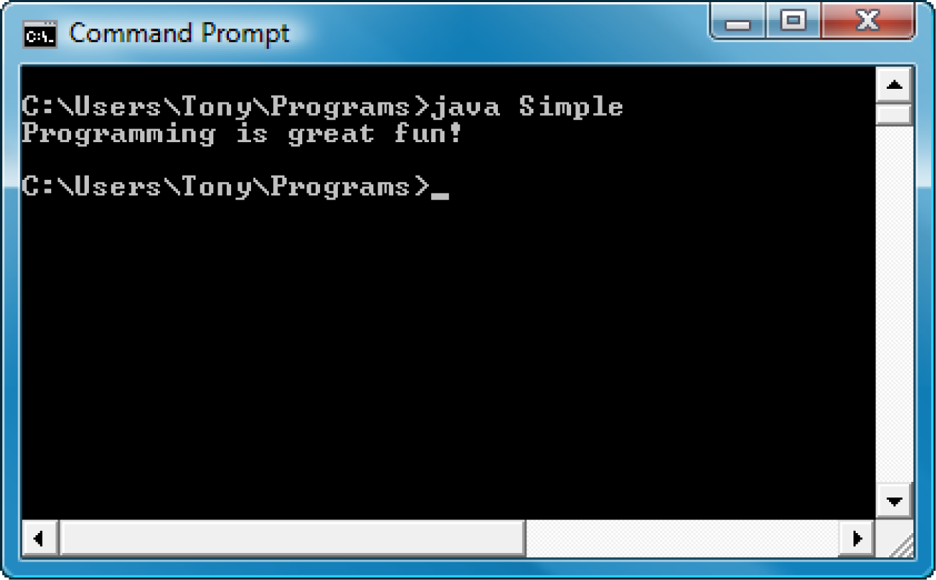
Console Output
Many of the programs that you will write will run in a console window.

Slide 14
Console Output
The console window that starts a Java application is typically known as the standard output device.
The standard input device is typically the keyboard.
Java sends information to the standard output device by using a Java class stored in the standard Java library.
Java classes in the standard Java library are accessed using the Java Applications Programming Interface (API).
The standard Java library is commonly referred to as the Java API.

Slide 15
Console Output
The previous example uses the line:
System.out.println("Programming is great fun!");
This line uses the System class from the standard Java library.
The System class contains methods and objects that perform system level tasks.
The out object, a member of the System class, contains the methods print and println.
The print and println methods actually perform the task of sending characters to the output device.
The line:
System.out.println("Programming is great fun!");
is pronounced: System dot out dot println …
The value inside the parenthesis will be sent to the output device (in this case, a string).

Slide 16
Console Output
The println method places a newline character at the end of whatever is being printed out.
The following lines:
System.out.println("This is being printed out");
System.out.println("on two separate lines.");
Would be printed out on separate lines since the first statement sends a newline command to the screen.

Slide 17
Activity 1 (will be included in quiz grade)
Create a java program to display the following console message.
Your class name is ActivityOne, and the java file name is ActivityOne.java
Your program should display
Hello World!
My name is YourName
I’m from YourCity
I’m YourAge years old!
Submit your ActivityOne.java file to Piazza Activity One thread. Add your partners name and your name to your reply.

Slide 18
Console Output
The print statement works very similarly to the println statement.
However, the print statement does not put a newline character at the end of the output.
The lines:
System.out.print("These lines will be");
System.out.print("printed on");
System.out.println("the same line.");
Will output: These lines will beprinted onthe same line.
Notice the odd spacing? Why are some words run together?

Slide 19
Console Output
For all of the previous examples, we have been printing out strings of characters.
Later, we will see that much more can be printed.
There are some special characters that can be put into the output. System.out.print("This line will have a newline at the end.\n");
The \n in the string is an escape sequence that represents the newline character.
Escape sequences allow the programmer to print characters that otherwise would be unprintable.

Slide 20
Variables and Literals
A variable is a named storage location in the computer’s memory.
A literal is a value that is written into the code of a program.
Programmers determine the number and type of variables a program will need.

Slide 21
The + Operator
The + operator can be used in two ways.
as a concatenation operator
as an addition operator
If either side of the + operator is a string, the result will be a string.
System.out.println("Hello " + "World");
System.out.println("The value is: " + 5);
System.out.println("The value is: " + value);
System.out.println("The value is: " + ‘/n’ + 5);

Slide 22
String Concatenation
Java commands that have string literals must be treated with care.
A string literal value cannot span lines in a Java source code file.
System.out.println("This line is too long and now it has spanned more than one line, which will cause a syntax error to be generated by the compiler. ");

Slide 23
String Concatenation
The String concatenation operator can be used to fix this problem.
System.out.println("These lines are " +
"are now ok and will not " +
"cause the error as before.");
String concatenation can join various data types.
System.out.println("We can join a string to " +
"a number like this: " + 5);

Slide 24
String Concatenation
The Concatenation operator can be used to format complex String objects.
System.out.println("The following will be printed " +
"in a tabbed format: " +
\n\tFirst = " + 5 * 6 + ", " +
"\n\tSecond = " (6 + 4) + "," +
"\n\tThird = " + 16.7 + ".");
Notice that if an addition operation is also needed, it must be put in parenthesis.

Slide 25
Activity 2 (will be included in quiz grade)
Create a java program to display the following console message.
Your class name is ActivityTwo, and the java file name is ActivityTwo.java
Your program should display the following calculation and the result of it after the “:”
Result of “((4+(9*4))/10)-1” is :
Don’t calculate the value above and printed. Your program code should display the value after calculation.
Submit your ActivityTwo.java file to Piazza Activity Two thread. Add your partners name and your name to your reply.

Slide 26
Identifiers
Identifiers are programmer-defined names for:
classes
variables
methods
Identifiers may not be any of the Java reserved keywords.

Slide 27
Java Reserved Keywords
abstract
assert
boolean
break
byte
case
catch
char
class
const
continue
default
do
double
else
enum
extends
false
for
final
finally
float
goto
if
implements
import
instanceof
int
interface
long
native
new
null
package
private
protected
public
return
short
static
strictfp
super
switch
synchronized
this
throw
throws
transient
true
try
void
volatile
while

Slide 28
Identifiers
Identifiers must follow certain rules:
An identifier may only contain:
letters a–z or A–Z,
the digits 0–9,
underscores (_), or
the dollar sign ($)
The first character may not be a digit.
Identifiers are case sensitive.
itemsOrdered is not the same as itemsordered.
Identifiers cannot include spaces.

Slide 29
Variables and Literals
This line is called
a variable declaration.
int value;
The following line is known
as an assignment statement.
value = 5;
0x000
The value 5
is stored in
memory.
0x001
5
0x002
0x003
This is a string literal. It will be printed as is.
System.out.print("The value is ");
System.out.println(value);
The integer 5 will
be printed out here.
Notice no quote marks?

Slide 30
Variable Names
Variable names should be descriptive.
Descriptive names allow the code to be more readable; therefore, the code is more maintainable.
Which of the following is more descriptive?
double tr = 0.0725;
double salesTaxRate = 0.0725;
Java programs should be self-documenting.

Slide 31
Java Naming Conventions
Variable names should begin with a lower case letter and then switch to title case thereafter:
Ex: int caTaxRate
Class names should be all title case.
Ex: public class BigLittle
More Java naming conventions can be found at:
http://java.sun.com/docs/codeconv/html/CodeConventions.doc8.html
A general rule of thumb about naming variables and classes are that, with some exceptions, their names tend to be nouns or noun phrases.

Slide 32
Java Escape Sequences
\n | newline | Advances the cursor to the next line for subsequent printing
\t | tab | Causes the cursor to skip over to the next tab stop
\b | backspace | Causes the cursor to back up, or move left, one position
\r | carriage return | Causes the cursor to go to the beginning of the current line, not the next line
\\ | backslash | Causes a backslash to be printed
\’ | single quote | Causes a single quotation mark to be printed
\” | double quote | Causes a double quotation mark to be printed

Slide 33
Java Escape Sequences
Even though the escape sequences are comprised of two characters, they are treated by the compiler as a single character.
System.out.print("These are our top sellers:\n");
System.out.print("\tComputer games\n\tCoffee\n ");
System.out.println("\tAspirin");
Would result in the following output:
These are our top seller:
Computer games
Coffee
Asprin
With these escape sequences, complex text output can be achieved.

