Slide 1
Lecture 2b- Java Fundamentals
CS 140
Introduction to Computer Science
Dr. Sampath Jayarathna
Cal Poly Pomona

Slide 2
Commenting Code
Java provides three methods for commenting code.
Comment Style | Description
// | Single line comment. Anything after the // on the line will be ignored by the compiler.
/* … */ | Block comment. Everything beginning with /* and ending with the first */ will be ignored by the compiler. This comment type cannot be nested.
/** … */ | Javadoc comment. This is a special version of the previous block comment that allows comments to be documented by the javadoc utility program. Everything beginning with the /** and ending with the first */ will be ignored by the compiler. This comment type cannot be nested.

Slide 3
Scope
Scope refers to the part of a program that has access to a variable’s contents.
Variables declared inside a method (like the main method) are called local variables.
Local variables’ scope begins at the declaration of the variable and ends at the end of the method in which it was declared.

Slide 4
Primitive Data Types
Primitive data types are built into the Java language and are not derived from classes.
There are 8 Java primitive data types.
  byte
  short
  int
  long
  float
  double
  boolean
  char

Slide 5
Numeric Data Types
byte | 1 byte | Integers in the range -128 to +127
short | 2 bytes | Integers in the range of -32,768 to +32,767
int | 4 bytes | Integers in the range of -2,147,483,648 to +2,147,483,647
long | 8 bytes | Integers in the range of -9,223,372,036,854,775,808 to +9,223,372,036,854,775,807
float | 4 bytes | Floating-point numbers in the range of ±3.4x10-38 to ±3.4x1038, with 7 digits accuracy
double | 8 bytes | Floating-point numbers in the range of ±1.7x10-308 to ±1.7x10308 , with 15 digits accuracy
How Gangnam Style broke youtube view count

Slide 6
Variable Declarations
Variable Declarations take the following form:
  DataType VariableName;
  Examples:
    byte inches;
    short month;
    int speed;
    long timeStamp;
    float salesCommission;
    double distance;

Slide 7
Variable Assignment and Initialization
In order to store a value in a variable, an assignment statement must be used.
The assignment operator is the equal (=) sign.
The operand on the left side of the assignment operator must be a variable name.
The operand on the right side must be either a literal or expression that evaluates to a type that is compatible with the type of the variable.

Slide 8
Variable Assignment and Initialization
// This program shows variable assignment.
public class Initialize
{
public static void main(String[] args)
{
int month, days;
month = 2;
days = 28;
System.out.println("Month " + month + " has " +
days + " Days.");
}
}
The variables must be declared before they can be used.

Slide 9
Variable Assignment and Initialization
// This program shows variable assignment.
public class Initialize
{
public static void main(String[] args)
{
int month, days;
month = 2;
days = 28;
System.out.println("Month " + month + " has " +
days + " Days.");
}
}
Once declared, they can then receive a value (initialization);
however the value must be compatible with the variable’s
declared type.

Slide 10
Variable Assignment and Initialization
// This program shows variable assignment.
public class Initialize
{
public static void main(String[] args)
{
int month, days;
month = 2;
days = 28;
System.out.println("Month " + month + " has " +
days + " Days.");
}
}
After receiving a value, the variables can then be used in
output statements or in other calculations.

Slide 11
Variable Assignment and Initialization
// This program shows variable initialization.
public class Initialize
{
public static void main(String[] args)
{
int month = 2, days = 28;
System.out.println("Month " + month + " has " +
days + " Days.");
}
}
Local variables can be declared and initialized on
the same line.

Slide 12
Variable Assignment and Initialization
Variables can only hold one value at a time.
Local variables do not receive a default value.
Local variables must have a valid type in order to be used.
public static void main(String [] args)
{
int month, days; //No value given…
System.out.println("Month " + month + " has " +
days + " Days.");
}
Trying to use uninitialized variables will generate a Syntax Error when the code is compiled.

Slide 13
Activity 3 (will be included in quiz grade)
Your class name is LabActivity, and the java file name is LabActivity.java
Your program should display the following results.
  YourBirthMonth should be a text such as February.
  Each of the date, year and age should be stored in an integer variable and initialized to correct value.
My date of birth is YourBirthMonth YourBirthDate, YourBirthYear
I’m YourAge years old!
Don’t submit to Piazza yet, we are going to do it at the end of the class.

Slide 14
Integer Data Types
byte, short, int, and long are all integer data types.
They can hold whole numbers such as 5, 10, 23, 89, etc.
Integer data types cannot hold numbers that have a decimal point in them.
Integers embedded into Java source code are called integer literals.

Slide 15
Floating Point Data Types
Data types that allow fractional values are called floating-point numbers.
  1.7 and -45.316 are floating-point numbers.
In Java there are two data types that can represent floating-point numbers.
  float - also called single precision (7 decimal points).
  double - also called double precision (15 decimal points).

Slide 16
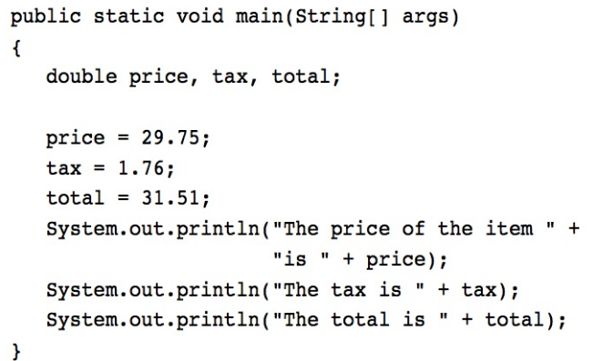
Floating Point Literals
When floating point numbers are embedded into Java source code they are called floating point literals.
Java is a strongly-typed language. Which means it only allows you to store values of compatible data types in variables

Slide 17
Floating Point Literals
The default type for floating point literals is double. It means when you create a floating point literal by default the values type is double
A double value is not compatible with a float variable because of its size and precision.
  float number;
  number = 23.5; // Error because 23.5 type is double!
A double can be forced into a float by appending the letter F or f to the literal.
  float number;
  number = 23.5f; // This will work.

Slide 18
Floating Point Literals
Literals cannot contain embedded currency symbols or commas.
  grossPay = $1,257.00; // ERROR!
  grossPay = 1257.00; // Correct.
Floating-point literals can be represented in scientific notation.
  47,281.97 == 4.728197 x 10⁴.
Java uses E notation to represent values in scientific notation.
  4.728197X10⁴ == 4.728197E4.

Slide 19
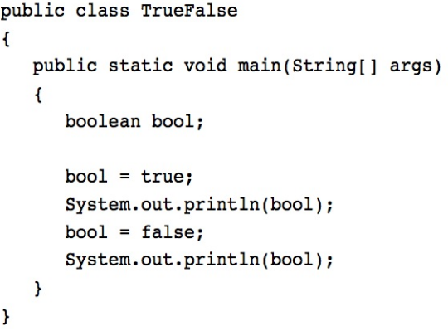
The boolean Data Type
The Java boolean data type can have two possible values.
  true
  false
The value of a boolean variable may only be copied into a boolean variable.

Slide 20
The char Data Type
The Java char data type provides access to single characters.
char literals are enclosed in single quote marks.
  ‘a’, ‘Z’, ‘\n’, ‘1’
Don’t confuse char literals with string literals.
  char literals are enclosed in single quotes.
  String literals are enclosed in double quotes.

Slide 21
Arithmetic Operators
Java has five (5) arithmetic operators.
Operator | Meaning | Type | Example
+ | Addition | Binary | total = cost + tax;
- | Subtraction | Binary | cost = total – tax;
* | Multiplication | Binary | tax = cost * rate;
/ | Division | Binary | salePrice = original / 2;
% | Modulus | Binary | remainder = value % 5;

Slide 22
Arithmetic Operators
The operators are called binary operators because they must have two operands.
Each operator must have a left and right operand.
The arithmetic operators work as one would expect.
It is an error to try to divide any number by zero.
When working with two integer operands, the division operator requires special attention.

Slide 23
Integer Division
Division can be tricky.
  In a Java program, what is the value of 1/2?
You might think the answer is 0.5…
But, that’s wrong.
The answer is simply 0.
Integer division will truncate any decimal remainder.

Slide 24
Operator Precedence
Operator | Associativity | Example | Result
- (unary negation) | Right to left | x = -4 + 3; | -1
* / % | Left to right | x = -4 + 4 % 3 * 13 + 2; | 11
+ - | Left to right | x = 6 + 3 – 4 + 6 * 3; | 23
Higher
Priority
Lower
Priority
Mathematical expressions can be very complex.
There is a set order in which arithmetic operations will be carried out.

Slide 25
Grouping with Parenthesis
When parenthesis are used in an expression, the inner most parenthesis are processed first.
If two sets of parenthesis are at the same level, they are processed left to right.
Red number represents the order of evaluations
x = ((4*5) / (5-2) ) – 25; // result = -19
3
1
2
4

Slide 26
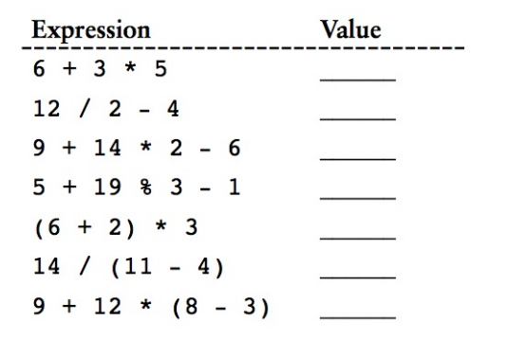
Combined Assignment Operators

Slide 27
Combined Assignment Operators
Java has some combined assignment operators.
These operators allow the programmer to perform an arithmetic operation and assignment with a single operator.
Although not required, these operators are popular since they shorten simple equations.

Slide 28
Combined Assignment Operators
Operator | Example | Equivalent | Value of variable after operation
+= | x += 5; | x = x + 5; | The old value of x plus 5.
-= | y -= 2; | y = y – 2; | The old value of y minus 2
*= | z *= 10; | z = z * 10; | The old value of z times 10
/= | a /= b; | a = a / b; | The old value of a divided by b.
%= | c %= 3; | c = c % 3; | The remainder of the division of the old value of c divided by 3.

Slide 29
Creating Constants
Many programs have data that does not need to be changed.
Littering programs with literal values can make the program hard do read and maintain.
Replacing literal values with constants remedies this problem.
Constants allow the programmer to use a name rather than a value throughout the program.
Constants also give a singular point for changing those values when needed.

Slide 30
Creating Constants
Constants keep the program organized and easier to maintain.
Constants are identifiers that can hold only a single value.
Constants are declared using the keyword final.
Constants need not be initialized when declared; however, they must be initialized before they are used or a compiler error will be generated.

Slide 31
Creating Constants
Once initialized with a value, constants cannot be changed programmatically.
By convention, constants are all upper case and words are separated by the underscore character.
final DataType ConstantName = ConstantValue ;
  final int CAL_SALES_TAX = 0.725;

Slide 32
Activity 4 (will be included in quiz grade)
Use LabActivity.java class,
Calculate the circumference of a circle given the constant value of PI and radius. Circumference = 2*PI*radius
  PI is a constant of value 3.14
  Radius is a double variable called radius
  Circumference is stored in a double variable called circumference
  Your program output is
The radius : 2.6
The circumference of the circle is: 16.328
Don’t submit to piazza yet.

Slide 33
The String Class
Java has no primitive data type that holds a series of characters.
The String class from the Java standard library is used for this purpose.
In order to be useful, the a variable must be created to reference a String object.
  String number;
Notice the S in String is upper case.
By convention, class names should always begin with an upper case character.

Slide 34
Primitive vs. Reference Variables
Primitive variables actually contain the value that they have been assigned.
  number = 25;
The value 25 will be stored in the memory location associated with the variable number.
Objects are not stored in variables, however. Objects are referenced by variables, means the variable contains address of a memory location of the object

Slide 35
Primitive vs. Reference Variables
When a variable references an object, it contains the memory address of the object’s location.
Then it is said that the variable references the object.
  String cityName = "Charleston";
The object that contains the
character string “Charleston”
Charleston
cityName
Address to the object

Slide 36
String Objects
A variable can be assigned a String literal.
  String value = "Hello";
Strings are the only objects that can be created in this way.
A variable can be created using the new keyword.
  String value = new String("Hello");
This is the method that all other objects must use when they are created. More about objects later!!

Slide 37
The String Methods
Since String is a class, objects that are instances of it have methods.
One of those methods is the length method.
  int stringSize = value.length();
This statement runs the length method on the object pointed to by the value variable.

Slide 38
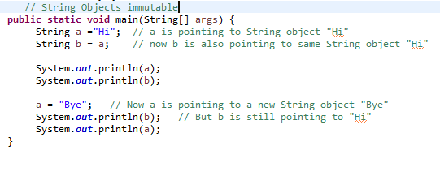

String Methods
The String class contains many methods that help with the manipulation of String objects.
String objects are immutable, meaning that they cannot be changed.
Many of the methods of a String object can create new versions of the object.

Slide 39
The System.out.printf Method
You can use the System.out.printf method to perform formatted console output.
The general format of the method is:
System.out.printf(FormatString, ArgList);

Slide 40
The System.out.printf Method
System.out.printf(FormatString, ArgList);
FormatString is a string that contains text and/or special formatting specifiers.
ArgList is optional. It is a list of additional arguments that will be formatted according to the format specifiers listed in the format string.

Slide 41
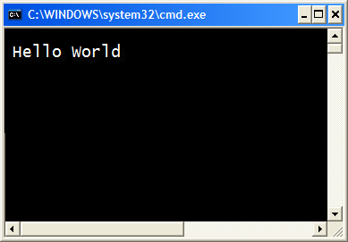
The System.out.printf Method
System.out.printf("Hello World\n");
A simple example:

Slide 42
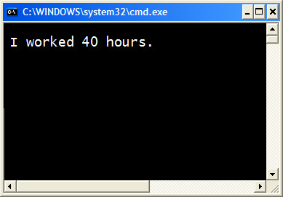
The System.out.printf Method
int hours = 40;
System.out.printf("I worked %d hours.\n", hours);
Another example:

Slide 43
The System.out.printf Method
int hours = 40;
System.out.printf("I worked %d hours.\n", hours);
The %d format specifier indicates that a decimal integer will be printed.
The contents of the hours variable will be printed in the location of the %d format specifier.

Slide 44
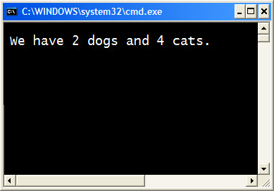
The System.out.printf Method
int dogs = 2, cats = 4;
System.out.printf("We have %d dogs and %d cats.\n",
dogs, cats);
Another example:

Slide 45
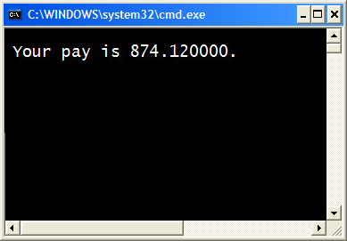
The System.out.printf Method
double grossPay = 874.12;
System.out.printf("Your pay is %f.\n", grossPay);
Another example:

Slide 46
The System.out.printf Method
double grossPay = 874.12;
System.out.printf("Your pay is %f.\n", grossPay);
The %f format specifier indicates that a floating-point value will be printed.
The contents of the grossPay variable will be printed in the location of the %f format specifier.
Another example:

Slide 47
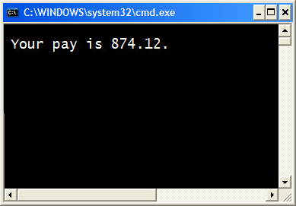
The System.out.printf Method
double grossPay = 874.12;
System.out.printf("Your pay is %.2f.\n", grossPay);
Another example:

Slide 48
The System.out.printf Method
double grossPay = 874.12;
System.out.printf("Your pay is %.2f.\n", grossPay);
The %.2f format specifier indicates that a floating-point value will be printed, rounded to two decimal places.
Another example:

Slide 49
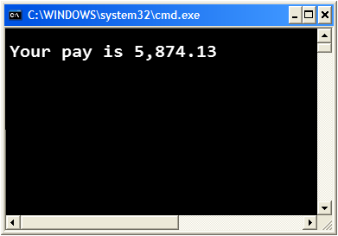
The System.out.printf Method
double grossPay = 5874.127;
System.out.printf("Your pay is %,.2f.\n", grossPay);
The %,.2f format specifier indicates that a floating-point value will be printed with comma separators, rounded to two decimal places.
Another example:

Slide 50

The System.out.printf Method
String name = "Ringo";
System.out.printf("Your name is %s.\n", name);
The %s format specifier indicates that a string will be printed.
Another example:

Slide 51
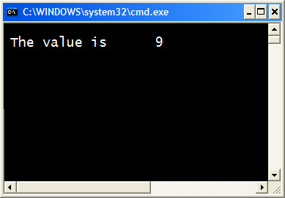
The System.out.printf Method
int number = 9;
System.out.printf("The value is %6d\n", number);
The %6d format specifier indicates the integer will appear in a field that is 6 spaces wide.
Specifying a field width:

Slide 52

The System.out.printf Method
double number = 9.76891;
System.out.printf("The value is %6.2f\n", number);
The %6.2f format specifier indicates the number will appear in a field that is 6 spaces wide, and be rounded to 2 decimal places.
Another example:

Slide 53
The printf Example 1

Slide 54
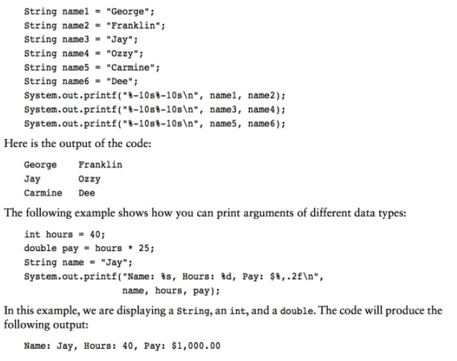
The printf Example 2

Slide 55

The String.format Method
The String.format method works exactly like the System.out.printf method, except that it does not display the formatted string on the screen.
Instead, it returns a reference to the formatted string.
You can assign the reference to a variable, and then use it later.

Slide 56
The String.format Method
The general format of the method is:
String.format(FormatString,ArgumentList);
FormatString is a string that contains text and/or special formatting specifiers.
ArgumentList is optional. It is a list of additional arguments that will be formatted according to the format specifiers listed in the format string.

Slide 57
The Scanner Class
To read input from the keyboard we can use the Scanner class.
The Scanner class is defined in java.util, so we will use the following statement at the top of our programs:
import java.util.Scanner;
Scanner objects work with System.in
To create a Scanner object:
Scanner keyboard = new Scanner (System.in);

Slide 58
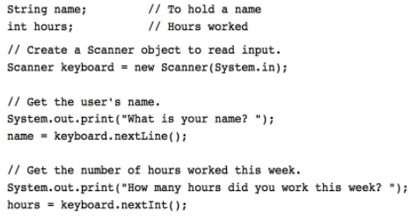
The Scanner Class example

Slide 59
Activity 5 (will be included in quiz grade)
Use the previous activity 4 program.
Change the program to obtain radius as a user input and calculate and display both circumference and area of a circle.
Circumference = 2 * PI * radius
Area = PI * radius²
  PI is a constant of value 3.14
  Radius is a double variable called radius
  Circumference is stored in a double variable called circumference
  Your program output is
Enter value for radius : 2.6
The circumference of the circle is: 16.33
The area of the circle is : 21.23
Submit both activity 4 and 5 in your LabActivity.java to Piazza thread. Format your output using printf method for 2 decimal places.

Slide 60
Type Casting
Java is strongly typed language. Following assignment will be rejected by compiler
int x;
double y = 2.5;
x = y; // error, type mismatch
Following assignment will work with no problems.
int x;
short y = 2;
x = y; // no error

Slide 61
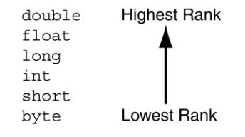
Type Casting
Widening conversions are allowed, means java automatically converts from lower to higher.
Narrowing conversions require manually conversion called type casting
int x;
double y = 2.5;
x = (int)y; // no error, x contains 2

