Slide 1
Lecture 4- Loops and Files
CS 140
Introduction to Computer Science
Dr. Sampath Jayarathna
Cal Poly Pomona

Slide 2
The Increment and Decrement Operators
There are numerous times where a variable must simply be incremented or decremented.
number = number + 1;
number = number – 1;
Java provide shortened ways to increment and decrement a variable’s value.
Using the ++ or -- unary operators, this task can be completed quickly.
number++; or ++number;
number--; or --number;

Slide 3
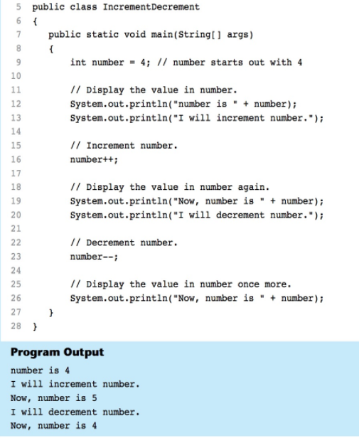
The Increment and Decrement Operators

Slide 4
Differences Between Prefix and Postfix
When an increment or decrement are the only operations in a statement, there is no difference between prefix and postfix notation.
When used in an expression:
prefix notation indicates that the variable will be incremented or decremented prior to the rest of the equation being evaluated.
postfix notation indicates that the variable will be incremented or decremented after the rest of the equation has been evaluated.

Slide 5
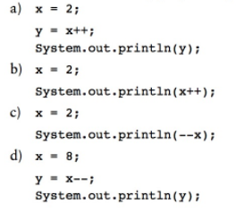
Differences Between Prefix and Postfix

Slide 6
Activity 6 (will be included in quiz grade)
Write a java program and complete the following steps and display the value of x and y.
int x = 3;
x++;
--x;
System.out.println(x); // what is the value of x?
int y = x++;
System.out.println(x); // what is the value of x?
System.out.println(y); // what is the value of y?
y = ++x;
System.out.println(x); // what is the value of x?
System.out.println(y); // what is the value of y?
System.out.println(++x); // what is the value of x?
System.out.println(x++); // what is the value of x?

Slide 7
The while Loop
Java provides three different looping structures.
The while loop has the form:
while(condition)
{
statements;
}
While the condition is true, the statements will execute repeatedly.
The while loop is a pretest loop, which means that it will test the value of the condition prior to executing the loop.

Slide 8
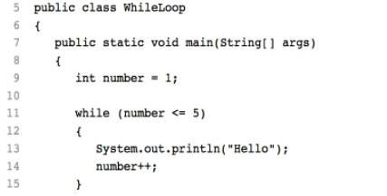
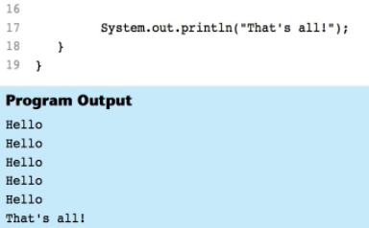
The while Loop
Care must be taken to set the condition to false somewhere in the loop so the loop will end.
Loops that do not end are called infinite loops.
A while loop executes 0 or more times. If the condition is false, the loop will not execute.

Slide 9
Activity 7 (will be included in quiz grade)
Write a while loop to iterate 5 times.
In each iteration, ask from user a number and display the number
You can use the following condition to test the while loop
int test = 0;
while( check test is less than 5 here)
{
// Your scanner code goes here
}

Slide 10
The while loop Flowchart
true
boolean
expression?
statement(s)
false

Slide 11
Infinite Loops
In order for a while loop to end, the condition must become false. The following loop will not end:
int x = 20;
while(x > 0)
{
System.out.println("x is greater than 0");
}
The variable x never gets decremented so it will always be greater than 0.
Adding the x-- above fixes the problem.

Slide 12
Infinite Loops
This version of the loop decrements x during each iteration:
int x = 20;
while(x > 0)
{
System.out.println("x is greater than 0");
x--;
}

Slide 13
Block Statements in Loops
Curly braces are required to enclose block statement while loops. (like block if statements)
while (condition)
{
statement;
statement;
statement;
}

Slide 14
Activity 8 (will be included in quiz grade)
Write a while loop to find the sum of first 500 numbers. Display the result at the end of the loop run.
1+2+3……..+499 + 500
Modify the above code to break from loop when the number is 199.
Modify the code to enter a positive number n and find the sum up to that number.

Slide 15
The while Loop for Input Validation
Input validation is the process of ensuring that user input is valid.
System.out.print("Enter a number in the " +
"range of 1 through 100: ");
number = keyboard.nextInt();
// Validate the input.
while (number < 1 || number > 100)
{
System.out.println("That number is invalid.");
System.out.print("Enter a number in the " +
"range of 1 through 100: ");
number = keyboard.nextInt();
}

Slide 16
Activity 9 (will be included in quiz grade)
Write a while loop to loop through each of the characters of your name.
Use the charAt(index) method to retrieve each character from a String. Index is an int type parameter to retrieve the character in a particular location.
String name = “California”;
Char nameChar = name.charAt(0) // will give ‘C’
nameChar = name.charAt(1); // will give ‘a’
nameChar = name.charAt(name.legnth()-1); will give last character ‘a’;

Slide 17
The do-while Loop
The do-while loop is a post-test loop, which means it will execute the loop prior to testing the condition.
The do-while loop takes the form:
do
{
statement(s);
}while (condition);
Remember the semicolon at the end of while

Slide 18
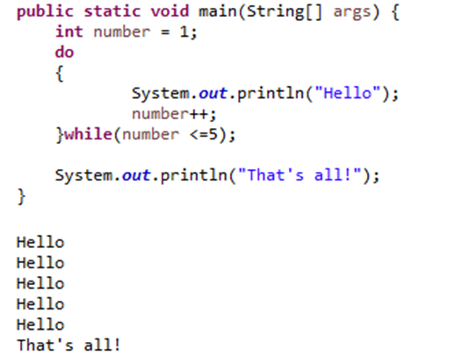
The do-while Loop Flowchart
statement(s)
true
boolean
expression?
false

Slide 19
The for Loop
The for loop is a pre-test loop.
The for loop allows the programmer to initialize a control variable, test a condition, and modify the control variable all in one line of code.
The for loop takes the form:
for(initialization; test; update)
{
statement(s);
}

Slide 20
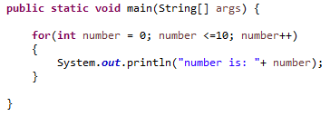
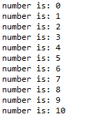
The for Loop Flowchart
boolean
expression?
true
statement(s)
update
false

Slide 21
The Sections of The for Loop
The initialization section of the for loop allows the loop to initialize its own control variable.
for(initialization; test; update)
{
statement(s);
}
The test section of the for statement acts in the same manner as the condition section of a while loop.
The update section of the for loop is the last thing to execute at the end of each loop.

Slide 22
The for Loop Initialization
The initialization section of a for loop is optional; however, it is usually provided.
Typically, for loops initialize a counter variable that will be tested by the test section of the loop and updated by the update section.
The initialization section can initialize multiple variables.
Variables declared in this section have scope only for the for loop.

Slide 23
The Update Expression
The update expression is usually used to increment or decrement the counter variable(s) declared in the initialization section of the for loop.
The update section of the loop executes last in the loop.
The update section may update multiple variables.
Each variable updated is executed as if it were on a line by itself.

Slide 24
Modifying The Control Variable
You should avoid updating the control variable of a for loop within the body of the loop.
The update section should be used to update the control variable.
Updating the control variable in the for loop body leads to hard to maintain code and difficult debugging.

Slide 25
Multiple Initializations and Updates
The for loop may initialize and update multiple variables.
for(int i = 5, int j = 0; i < 10 || j < 20; i++, j+=2)
{
statement(s);
}
Note that the only parts of a for loop that are mandatory are the semicolons.
for(;;)
{
statement(s);
} // infinite loop
If left out, the test section defaults to true.

Slide 26
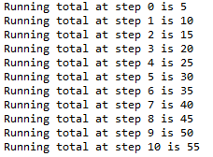
Running Totals
Loops allow the program to keep running totals while evaluating data.
Imagine needing to keep a running total.

Slide 27
The break Statement
The break statement can be used to abnormally terminate a loop.
The use of the break statement in loops bypasses the normal mechanisms and makes the code hard to read and maintain.
It is considered bad form to use the break statement in this manner.

Slide 28
The continue Statement
The continue statement will cause the currently executing iteration of a loop to terminate and the next iteration will begin.
The continue statement will cause the evaluation of the condition in while and for loops.
Like the break statement, the continue statement should be avoided because it makes the code hard to read and debug.

Slide 29
Sentinel Values
Sometimes the end point of input data is not known.
A sentinel value can be used to notify the program to stop acquiring input.
If it is a user input, the user could be prompted to input data that is not normally in the input data range (i.e. –1 where normal input would be positive.)
Programs that get file input typically use the end-of-file marker to stop acquiring input data.

Slide 30
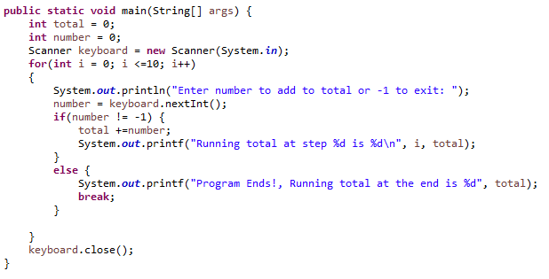
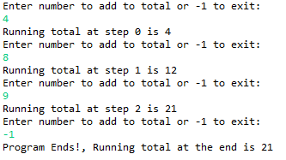
Sentinel Values (-1 is the sentinel here)

Slide 31
Nested Loops
Like if statements, loops can be nested.
If a loop is nested, the inner loop will execute all of its iterations for each time the outer loop executes once.
for(int i = 0; i < 10; i++)
for(int j = 0; j < 10; j++)
loop statements;
The loop statements in this example will execute 100 times.

Slide 32
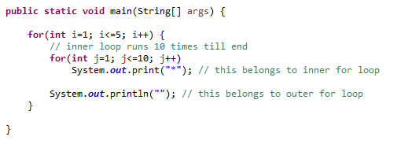
Nested Loops

Slide 33
Deciding Which Loops to Use
The while loop:
Pretest loop
Use it where you do not want the statements to execute if the condition is false in the beginning.
The do-while loop:
Post-test loop
Use it where you want the statements to execute at least one time.
The for loop:
Pretest loop
Use it where there is some type of counting variable that can be evaluated.

Slide 34
File Input and Output
Reentering data all the time could get tedious for the user.
The data can be saved to a file.
Files can be input files or output files.
Files:
Files have to be opened.
Data is then written to the file.
The file must be closed prior to program termination.
In general, there are two types of files:
binary
text

Slide 35
Writing Text To a File
PrintWriter outputFile = new PrintWriter("StudentData.txt");
Pass the name of the file that you wish to open as an argument to the PrintWriter constructor.
Warning: if the file already exists, it will be erased and replaced with a new file.
To open a file for text output you create an instance of the PrintWriter class.

Slide 36
The PrintWriter Class
The PrintWriter class allows you to write data to a file using the print and println methods, as you have been using to display data on the screen.
Just as with the System.out object, the println method of the PrintWriter class will place a newline character after the written data.
The print method writes data without writing the newline character.

Slide 37
The PrintWriter Class
Open the file.
PrintWriter outputFile = new PrintWriter("Names.dat");
outputFile.println("Chris");
outputFile.println("Kathryn");
outputFile.println("Jean");
outputFile.close();
Close the file.
Write data to the file.

Slide 38
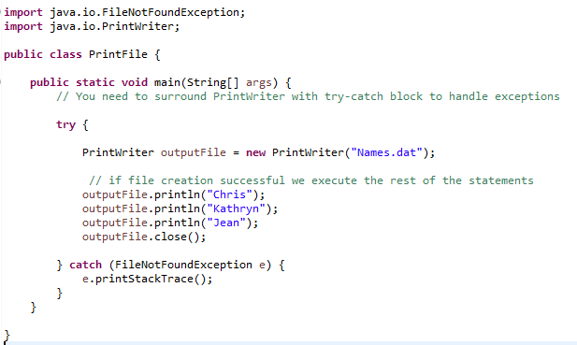
The PrintWriter Class

Slide 39
Exceptions
When something unexpected happens in a Java program, an exception is thrown.
The method that is executing when the exception is thrown must either handle the exception or pass it up the line.
Handling the exception will be discussed later.
To pass it up the line, the method needs a throws clause in the method header or try-catch block to catch the exception.

Slide 40
Exceptions
To insert a throws clause in a method header, simply add the word throws and the name of the expected exception.
PrintWriter objects can throw an IOException, so we write the throws clause like this:
public static void main(String[] args) throws IOException

Slide 41
Appending Text to a File
To avoid erasing a file that already exists, create a FileWriter object in this manner: FileWriter fw = new FileWriter("names.dat", true);
Then, create a PrintWriter object in this manner: PrintWriter fw = new PrintWriter(fw);

Slide 42
Specifying a File Location
On a Windows computer, paths contain backslash (\) characters.
Remember, if the backslash is used in a string literal, it is the escape character so you must use two of them:
PrintWriter outFile =
new PrintWriter("A:\\PriceList.txt");

Slide 43
Specifying a File Location
This is only necessary if the backslash is in a string literal.
If the backslash is in a String object then it will be handled properly.
Fortunately, Java allows Unix style filenames using the forward slash (/) to separate directories:
PrintWriter outFile = new
PrintWriter("/home/rharrison/names.txt");

Slide 44
Reading Data From a File
You use the File class and the Scanner class to read data from a file:
Pass the name of the file as an argument to the File class constructor.
File myFile = new File("Customers.txt");
Scanner inputFile = new Scanner(myFile);
Pass the File object as an argument to the Scanner class constructor.

Slide 45
Reading Data From a File
Scanner keyboard = new Scanner(System.in);
System.out.print("Enter the filename: ");
String filename = keyboard.nextLine();
File file = new File(filename);
Scanner inputFile = new Scanner(file);
The lines above:
Creates an instance of the Scanner class to read from the keyboard
Prompt the user for a filename
Get the filename from the user
Create an instance of the File class to represent the file
Create an instance of the Scanner class that reads from the file

Slide 46
Reading Data From a File
Once an instance of Scanner is created, data can be read using the same methods that you have used to read keyboard input (nextLine, nextInt, nextDouble, etc).
// Open the file.
File file = new File("Names.txt");
Scanner inputFile = new Scanner(file);
// Read a line from the file.
String str = inputFile.nextLine();
// Close the file.
inputFile.close();

Slide 47
Detecting The End of a File
The Scanner class’s hasNext() method will return true if another item can be read from the file.
// Open the file.
File file = new File(filename);
Scanner inputFile = new Scanner(file);
// Read until the end of the file.
while (inputFile.hasNext())
{
String str = inputFile.nextLine();
System.out.println(str);
}
inputFile.close();// close the file when done.

Slide 48
Activity 15 (will be included in quiz grade)
Create an external file called mydat.dat
Create a static method called storeData to add following information through the code (in separate lines)
Your name
Your Age
Your City
Your favorite movie, TV show, singer/song
Create a static method called readData to read data from the file and display the results.

Slide 49
Generating Random Numbers with the Random Class
Some applications, such as games and simulations, require the use of randomly generated numbers.
The Java API has a class, Random, for this purpose. To use the Random class, use the following import statement and create an instance of the class.
import java.util.Random;
Random randomNumbers = new Random();

Slide 50
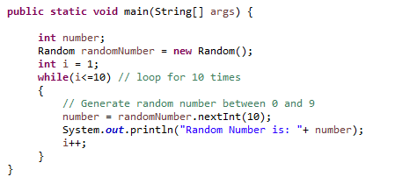
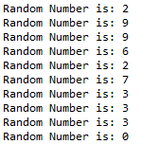
Generating Random Numbers with the Random Class

Slide 51
Some Methods of the Random Class
Method | Description
nextDouble() | Returns the next random number as a double. The number will be within the range of 0.0 and 1.0.
nextFloat() | Returns the next random number as a float. The number will be within the range of 0.0 and 1.0.
nextInt() | Returns the next random number as an int. The number will be within the range of an int, which is –2,147,483,648 to +2,147,483,648.
nextInt(int n) | This method accepts an integer argument, n. It returns a random number as an int. The number will be within the range of 0 to n.

