Slide 1

Lecture 11 – Delivering Results
CS 795/895
Introduction to Data Science
Dr. Sampath Jayarathna
Cal Poly Pomona
Credit for some of the slides in this lecture goes to Joseph Gonzalez at UC Berkeley

Slide 2
Why is visualization a topic in this data science?
Visualization belongs in every stage of the data life cycle
Plots can uncover structure in data that can’t be detected from numerical summaries
Visualization is an important story telling skill

Slide 3
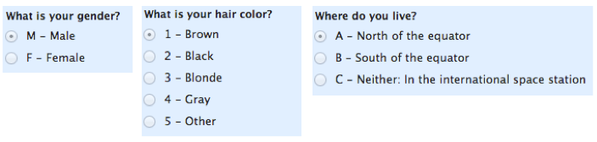
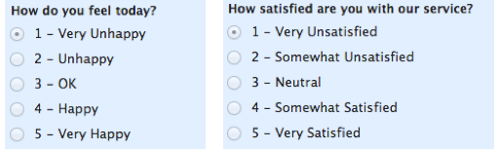
Recap: Good Starting Place – Know your data type
Quantitative (Numeric)
  Continuous (e.g., health care expenditure)
  Discrete (e.g., number of siblings)
Qualitative (Categorical)
  Nominal – or labels (no overlap)
  (e.g., gender, hair color)
  Ordinal – order of the value is important (e.g., Yelp rating, education level)
See table that maps data types to plot types at end of slides

Slide 4
Example Plots

Slide 5
2015 Congressional Hearing: Planned Parenthood
Congressman Chaffetz (R-UT), chair US House Oversight Committee
  Investigation of federal funding of Planned Parenthood
  Chaffetz showed a plot which originally appeared in a report by Americans United for Life (http://www.aul.org/).
Procedures:
  Cancer screenings
  Abortion
Time: 2006 to 2013
How many data points are in this plot?

Slide 6
Voter Registration Trends in California
State of California publishes voter registration summaries
http://www.sos.ca.gov/elections/ror/60day presprim/hist reg stats.pdf
Historical registration counts available for presidential election years
What’s confusing or annoying about this plot?

Slide 7
Earnings
Bureau of Labor Statistics
  Oversees scientific surveys related to economic health of the country
Current Population Survey
  Collects data on the earnings
  www.bls.gov - Web interface to a report generating app
  Which comparisons can be easily made with this plot?

Slide 8
Cherry Blossom Run
10 mile run in Washington DC each April
Race organizers make results available on Web
  Runner name, age, gender, address, hometown, time
  Race results from 1999 to 2016
  In 2012 nearly 17,000 runners ranging in age from 9 to 89 participated
Scatter plot of run time (minutes) by age (years)
70,000 points in this plot.
What’s the relationship between run time and age?

Slide 9
Scale

Slide 10
Planned Parenthood Procedures
All points and lines are on the same scale
How does this plot change the perception of the information?
There has been a dramatic decrease in cancer screenings which dominates this plot
The scales of the two procedures are very different – consider representing as percentages instead
  Procedures in 2006 and 2013 as a percentage
  Abortions increased from 13% to 26% of total procedures

Slide 11
Choosing the Scale
Choose axis limit to fill the plotting region
In necessary,
  Zoom in to focus on region with bulk of data
  Make multiple plots of different regions
  Transform data to improve resolution
Don’t change scale mid-axis
Don’t use two different scales for the same axis

Slide 12
Conditioning

Slide 13
Earnings
Emphasize the important difference –
Lines make it easier to see growth in gap
Placement of one point above the other makes it easier to compare males & females
Juxtapose scatter plots, histograms & keep x and y scales the same across plots to facilitate comparison
Use color and plotting symbols to represent additional variables

Slide 14
Perception - Color

Slide 15
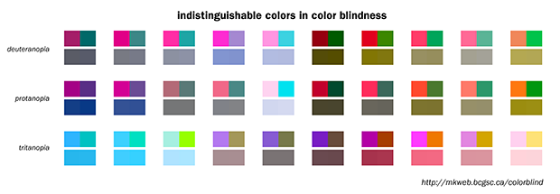
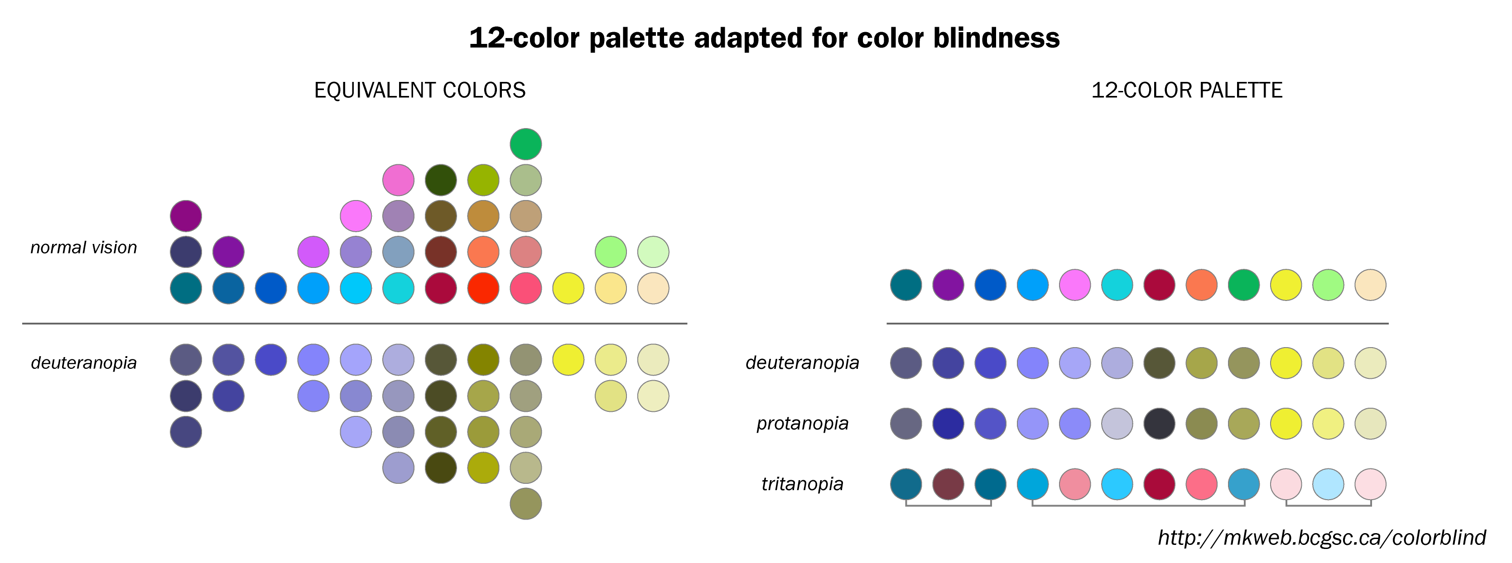
Color Guidelines
Choosing a set of colors which work well together is a challenging task for anyone who does not have an intuitive gift for color
7-10% of males are red-green color blind. Avoid following combinations
  Green & Red.
  Green & Brown.
  Blue & Purple.
  Green & Blue.
  Light Green & Yellow.
  Blue & Grey.
  Green & Grey.
  Green & Black.

Slide 16
Colorfulness
Saturated/colorful colors are hard to look at for a long time.
They tend to produce an after-image eﬀect which can be distracting.

Slide 17
Luminance
Areas should be rendered with colors of similar luminance (brightness).
Lighter colors tend to make areas look larger than darker colors

Slide 18
Data Type and Color
Qualitative – Choose a qualitative scheme that makes it easy to distinguish between categories
Quantitative – Choose a color scheme that implies magnitude.
  Does the data progress from low to high? Use a sequential scheme where light colors are for low values
  Do both low and high value deserve equal emphasis? Use a diverging scheme where light colors represent middle values

Slide 19
Examples of Palettes
Diverging
Qualitative
Sequential

Slide 20
Perception - Length

Slide 21
Bar plot, Pie chart, Dot chart
Experiments found that angle judgments based on pie charts are less accurate than length judgments from bar charts
Length is easier to compare than area or volume
Lengths that fall on a line are easier to compare than lengths on parallel lines, i.e., judgments based on dot charts are easier to make than judgments based on bar plots

Slide 22
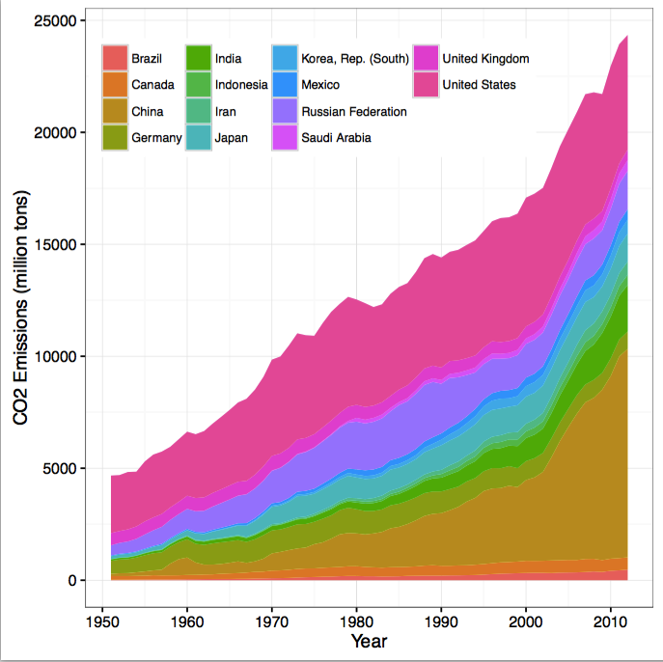
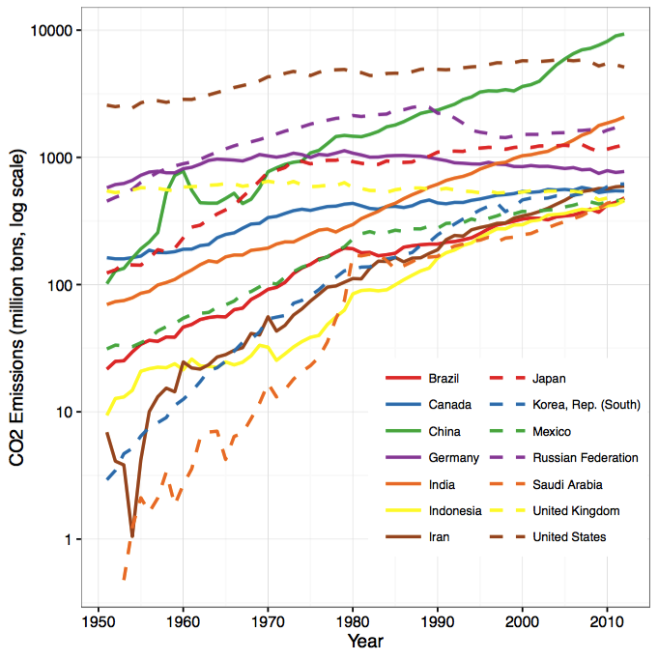
Stacking and Jiggling
Stacked bar plots and histograms are difficult to read because the base line moves from one bar to the next
Line plots where the area between successive lines represent the measurement are very difficult to read because the base line jiggles up and down.
  Data on historical carbon dioxide (CO2) emissions from fuel combustion (http://cait.wri.org)

Slide 23
Large n (records)

Slide 24
Cherry Blossom Run
3-dimensional histogram is needed, but hard to come by
Use heat map or hexbin plot or transparency

Slide 25
Cherry Blossom Run
Local Smoothing helps us see the center
Not Longitudinal – follow same people in time
Slightly transparent points

Slide 26
Philosophy

Slide 27
Reveal the Data
Choose scale appropriately
Avoid having other graph elements interfere with data
Use visually prominent symbols
Eliminate superfluous material, aka chart junk
Avoid over-plotting

Slide 28
Avoid over-plotting
Why are there so few data points?
Shrink the plotting symbol so they don’t plot on top of each other

Slide 29
Facilitate Comparisons
Put Juxtaposed plots on same scale
Make it easy to distinguish elements of superposed plots, e.g. color, line type
Avoid angles, extra dimensions (e.g., areas rather than lines)
Don’t break the visual metaphor

Slide 30
Comparison: area vs length
Broken Visual metaphor – count is represented by height of word, not area

Slide 31
Make a plot information rich
Describe what you see in the Caption
Add context with Reference Markers (lines and points) including text
Use color and plotting symbols to add more information
Plot the same thing more than once in different ways/scales
Reduce clutter
Label axes, including units
Label points and legends for unusual/interesting observations
Captions should:
  Describe what has been graphed
  Draw attention to important features
  Describe conclusions drawn from graph
  Self-contained
  Should be comprehensive

Slide 32
Iterate – Example Voter Registration
Location of tick marks under bars
Color of bars – indicate party
Title confusing
Y-axis label confusing
X-axis label missing

Slide 33
Voter Registration Trends
Check data for understanding of how plot is made
Observation? People vote, not counties
Lurking variable? County size - small counties tend to be rural and conservative

Slide 34
Voter Registration Trends
Collect better/more data
  Decline to state and other parties are missing

Slide 35
Good Plot Making Practice
Put major conclusions in graphical form
Provide reference information
Proof read for clarity and consistency
Graphing is an iterative process
Multiplicity is OK, i.e., two plots of the same variable may provide different messages
Make plots data rich

Slide 36
Univariate (analysis of one variable) Displays
Type | Plot
Quantitative | Histogram, Density curve Box plot, Violin plot Normal quantile plot Few Observations - Rug plot, Dot plot Caution if discrete: density curves and box plots may be misleading
Qualitative | Dot chart Bar chart Pie chart (avoid!) Caution if ordinal –order of bars, dots, etc. should reflect category order

Slide 37
Bivariate (involves multiple variables) Displays
 | Quantitative | Qualitative
Quantitative | Scatter plot Smooth scatter Smooth lines and curves | Multiple histograms, density curves,
Qualitative |  | Side-by-side bar plot Overlaid Lines plot Side-by-side dot chart Mosaic plot

Slide 38
Example libraries/toolkits/APIs
Pandas plotting (Python)
Matplotlib, seaborn
https://python-graph-gallery.com/cheat-sheets/
D3.js (JavaScript)
https://d3js.org
Shiny (R)
https://shiny.rstudio.com
Google Charts (JavaScript)
https://developers.google.com/chart/

Slide 39
Activity 16
Student Opinion Surveys for CS 795/895 Topics in Computer Science
Click Student Opinion Survey https://www.odu.edu/academics/courses-registration/studentopinionsurvey
Complete the opinion survey and confirm it in Piazza activity thread (just write submitted the opinion survey!)

