Slide 1
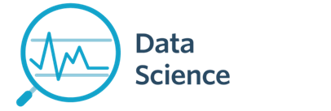
Lecture 1a- Introduction
CS 795/895
Introduction to Data Science
Dr. Sampath Jayarathna
Old Dominion University

Slide 2
Today
Who I am
CS 795/895 educational objectives (and why)
Overview of the course, and logistics

Slide 3
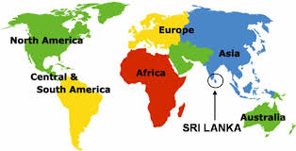
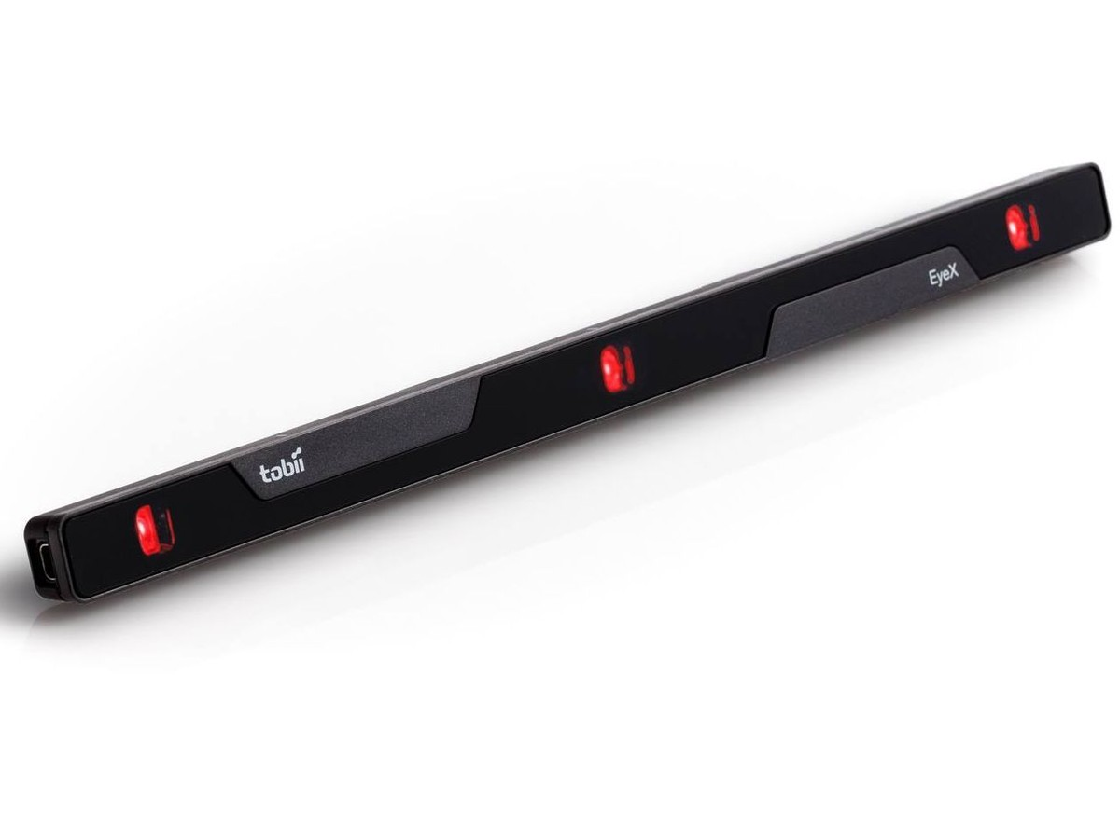
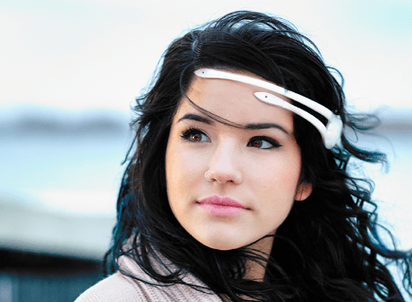
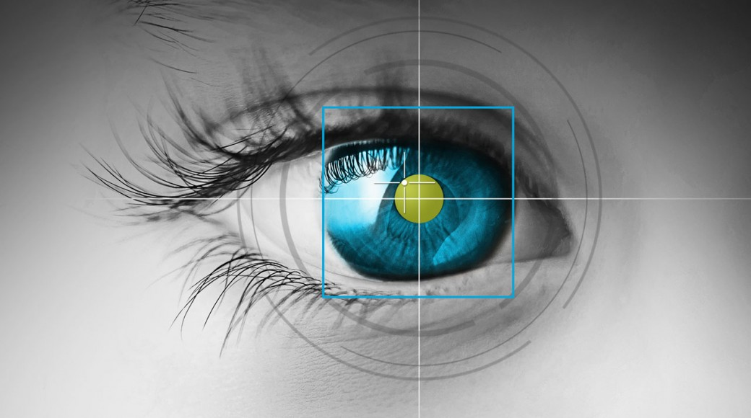
Who am I?
Instructor : Sampath Jayarathna Joined ODU Fall 2018 (Assistant Professor Cal Poly 2016-2018) Originally from Sri Lanka
Research : Eye tracking, Brain EEG, neuro-IR, Machine Learning
Web : http://www.cs.odu.edu/~sampath/
Contact : ECS 3109, sampath@cs.odu.edu, (757) 683-7787
Office Hours : T 3pm – 4pm, or email me for an appointment
[Open Door Policy]

Slide 4
Course Information
Schedule : Tuesday and Thursday, Time: 5.45 PM – 7.00 PM http://www.cs.odu.edu/~sampath/courses/f18/cs795/ https://piazza.com/odu/fall2018/cs795/home
https://www.blackboard.odu.edu/
Prereqs
There are no specific course prerequisites for this course. Knowledge in linear algebra and statistics.
Format
Before lecture: do reading slides
In lecture: put reading in context
After lecture: assignments, projects for hands-on practice

Slide 5
Student Learning Outcomes
After successfully completing this course, students should be able to:
Define and explain the key concepts and models relevant to data science.
Understand the processes of data science: identifying the problem to be solved, data collection, preparation, modeling, evaluation and visualization.
Develop an appreciation of the many techniques for data modeling
Be comfortable using commercial and open source tools such as Python language and associated libraries for data analytics and visualization.

Slide 6
Communication
Piazza:
All questions will be fielded through Piazza.
Many questions everyone can see the answer
You can also post private messages that can only be seen by the instructor
Blackboard:
Blackboard will be used primarily for assignments/homework submission, and grade dissemination.
Email:
Again, email should only be used in rare instances, I will probably point you back to Piazza

Slide 7
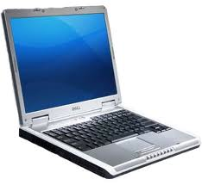
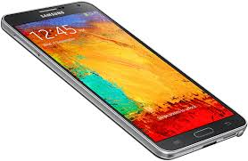
The Rules

Slide 8
Cooperate on Learning
Except for the work you hand in as individual contributions, I strongly encourage you to collaborate and help each other
If in doubt if a collaboration is legitimate: ask!
Don’t claim to have written code that you copied from others or online
Don’t give anyone else your code (to hand in for a grade)
When you rely on the work of others, explicitly list all of your sources – i.e. give credit to those who did the work
Don’t study alone when you don’t have to
Form study groups
Do help each other (without plagiarizing)

Slide 9
Course Organization
Grading
Required Materials
No textbook is required. All the key course content will be documented in slides, which will be available in the course website after each lecture.
Bring Your Own Device (BYOD).

Slide 10
Course Organization
Project: More in the next couple of slides…
Final Exam: The final exam is comprehensive, closed books and will be held on Thursday, December 13 from 4.00 pm to 6.00 PM
Homework: We will have 4 homework assignments, each worth 5% of your overall grade.
Research Paper Presentation
More information in the syllabus
In-class
ungraded in-class activities

Slide 11
Team Project - Evaluation
Form teams of 2 (+ 1?) students
Independent and non-competing
Think of other teams as working for other organizations
Code and document sharing between teams is not permitted
Project grade will have a large impact on course grade (40%)
Project grade will (attempt to) recognize individual contributions
Peer evaluation, Demo evaluation
All artifacts will be considered in the evaluation
Quality matters.

Slide 12
Team Project - Milestones
Project Proposal, Sep. 20
Progress reports, Oct. 18 & Nov. 15
Final Report, Dec. 04 & Dec 05
Demo, Dec. 04 & Dec 05

Slide 13
Team Project - Ideas
Industry projects
Research projects (potential publications in upcoming conferences such as CHIIR, JCDL, CIKM etc.)
Unstructured (or semi-structured)
May be an existing dataset but require some cleaning, inference, model building, analytics and visualizing
Not a structured dataset (not in a some sort of a database)
Work with some equipment such as IoT, wearables, eye trackers, brain trackers, GSR, VR/AR or other sensory data
Talk to me about using some of these equipments available at the lab (can extend this work towards your MS Thesis or PhD)

Slide 14
Personal devices – Software Setup
Windows/Mac/Linux
Anaconda (or any other IDE)
Python 3.6 version
https://www.anaconda.com/download/
Weka 3.8
https://www.cs.waikato.ac.nz/ml/weka/downloading.html
jEdit
http://www.jedit.org/index.php?page=download
mongoDB community server
https://www.mongodb.com/download-center?jmp=nav#community

Slide 15
To-do and Next time
Sign up for the Piazza
Team members 2(+1) and research paper sign-up
HW1 is out!
Due, Sep 11

