Slide 1
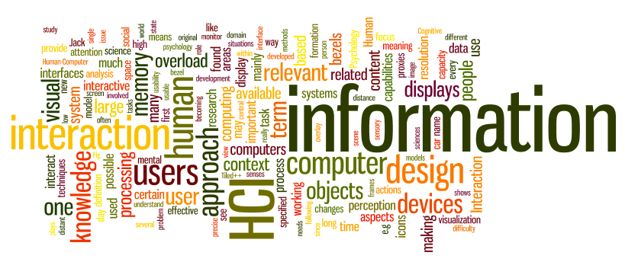
HCI - Introduction
Sampath Jayarathna
Cal Poly Pomona

Slide 2
Today
Who I am
CS 570 educational objectives (and why)
Overview of the course, and logistics
Quick overview of HCI and why we study it
Tech Presentation Tips

Slide 3
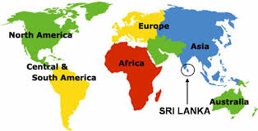
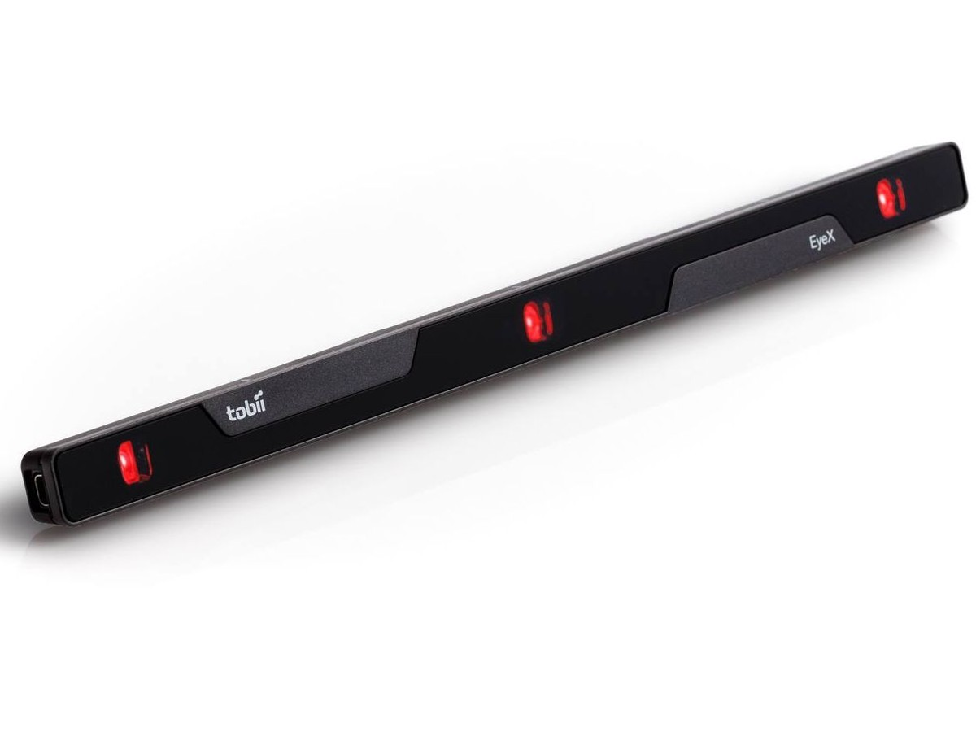
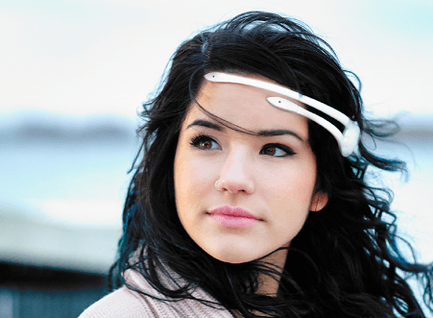
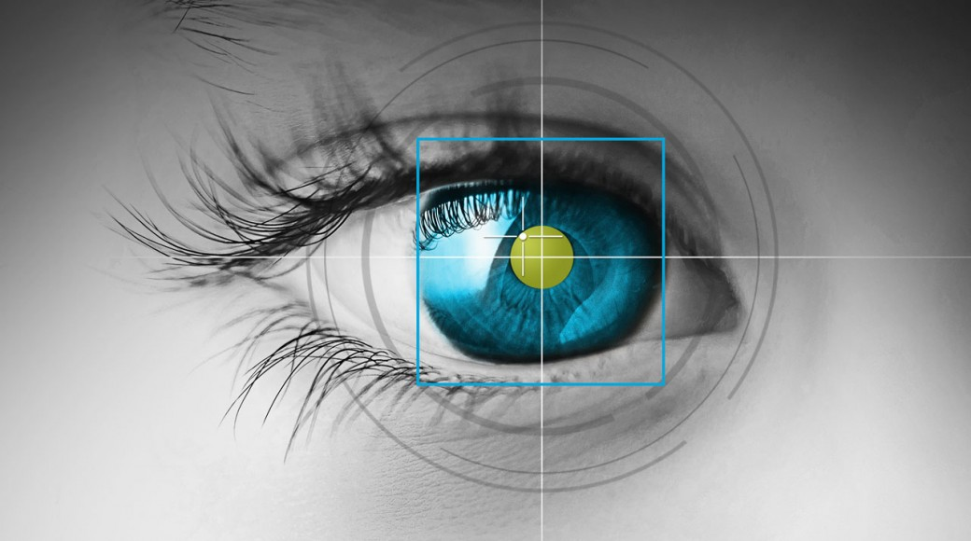
Who am I?
Instructor : Sampath Jayarathna Joined Cal Poly Pomona Fall 2016 from Texas A&M. Originally from Sri Lanka
Research : NeuroIR, Eye tracking, Brain EEG, User modeling
Web : http://www.cpp.edu/~ukjayarathna
Contact : 8-46, ukjayarathna@cpp.edu, (909) 869-3145
Office Hours : MW 3PM – 5PM, or email me for an appointment
[Open Door Policy]

Slide 4
Course Information
Schedule : MW, 8-345, 6.00 PM – 7.50 PM http://www.cpp.edu/~ukjayarathna/courses/s17/cs570
www.piazza.com/csupomona/spring2017/cs570/home
Blackboard
Prereqs
Official: CS331 or approval of instructor
Practical: Know object-oriented programming language
Format
Before lecture: do reading
In lecture: put reading in context
After lecture: assignments, for hands-on practice

Slide 5
Required / Supplementary materials
Required textbook. No textbook is required. All the key course content will be documented in slides, which will be available in the course website after each lecture.
List of optional but recommended materials. You may find some of these optional textbooks helpful, though none are required:
Interaction Design: Beyond Human-Computer Interaction, 4th Edition, Jenny Preece, Helen Sharp, Yvonne Rogers, Wiley, 2015
The Design of Everyday Things, Revised and Expanded Edition, Donald Norman, Perseus, 2013.

Slide 6
Student Learning Outcomes
After successfully completing this course, students should be able to:
Explain characteristics of good and bad interaction design and use them to evaluate human computer interactions
Explain characteristics of users that influence human computer interaction and use them inform interface development
Explain, analyze and develop interaction evaluations including qualitative and quantitative methods.
Explain and develop requirements for interaction design
Constructs interactions using evaluation-based iterative process for directing the design of user interfaces

Slide 7
Communication
Piazza:
All questions will be fielded through Piazza.
Many questions everyone can see the answer
You can also post private messages that can only be seen by the instructor
Blackboard:
Blackboard will be used primarily for assignments/homework, extra credit submission and grade dissemination.
Email:
Again, email should only be used in rare instances, I will probably point you back to Piazza

Slide 8
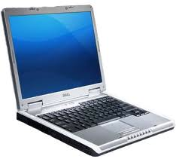
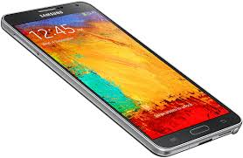
The Rules

Slide 9
Course Organization
Grading
40% | Project: Proposal (5 pts), Progress reports(5), Presentation and Demo (15 pts), Final Report (15 pts)
20% | Final Exam
20% | Homework Assignments (5)
10% | Quizzes (2)
10% | Emerging Software Technology/Tools Presentation (1)
1% | Extra Credit
101% | Your Total Score for the class

Slide 10
Course Organization
Project: More in the next couple of slides…
Final Exam: The final exam is comprehensive, closed books and will be held on Monday, June 05, 6.00pm - 7.45pm.
Homework: We will have five homework assignments, each worth 4% of your overall grade. Homework 1 – April 05, 6pm
Emerging Software Technology/Tools Presentation
More information in the syllabus
Quizzes
2 scheduled
Extra Credit:
Culture reports or User Study evaluation participation

Slide 11
Team Project - Evaluation
Form teams of 5 (+ 1?) students
Independent and non-competing
Think of other teams as working for other organizations
Code and document sharing between teams is not permitted
Project grade will have a large impact on course grade (40%)
Project grade will (attempt to) recognize individual contributions
Peer evaluation, Demo evaluation
All artifacts will be considered in the evaluation
Quality matters.

Slide 12
Team Project - Milestones
Project Proposal, April 12
Progress reports, April 26, May 17
Final Report, May 31
In-class presentation and Demo, May 31

Slide 13
Team Project - Ideas
2 industry projects from Chronaly Inc.
2 industry projects from Sevenlogics Inc.
Possible extension of previous course projects (e.g., from IR course)
Some research topics
Summer Startup opportunities at Student Innovation Lab, Cal Poly Pomona

Slide 14
More on the class
Project (approximately 36 students, about 7-8 teams)
Strict milestones (only 9 weeks)
Progress reports
Not primarily graded on whether your program "works“
Schedule is on the web page

Slide 15
What is human-computer interaction (HCI)?
HCI is the study and the practice of usability.
It is about understanding and creating software and other technology that people will want to use, will be able to use, and will find effective when used.
HCI is the study of how people use computer systems to perform certain tasks
HCI tries to provide us with all understanding of the computer and the person using it, so as to make the interaction between them more effective and more enjoyable.

Slide 16
Humans, Computer and Interaction
The H | Humans good at: Sensing low level stimuli, pattern recognition,inductive reasoning, multiple strategies, adapting “Hard and fuzzy things”.
The C | Computers good at: Counting and measuring, accurate storage and recall, rapid and consistent responses, data processing/calculation, repetitive actions, performance over time, “Simple and sharply defined things”.
The I | The list of skills is somewhat complementary. Let humans do what humans do best and computers do what computers do best.

Slide 17
Motivation: Why Care About People?
Human - computer interaction (HCI)
The study of the ways that people use computers
Practice of making computers easier for people to use
Is that possible?
Yes
It happens when people who design computers and software keep in mind that they are designing for other people

Slide 18
Different design Needs
Three broad categories of computer user:
Expert users with detailed knowledge of that particular system.
Occasional users who know well how to perform the tasks they need to perform frequently.
Novices who have never used the system before.
Users may well be novices at one computer application but experts at another one, so users will belong to different categories for particular computer systems.

Slide 19
To-do and Next time
Sign up for the Piazza
Team members (5+1) and topics for tech talks
HW1 is out!
Due, April 05

