Slide 1
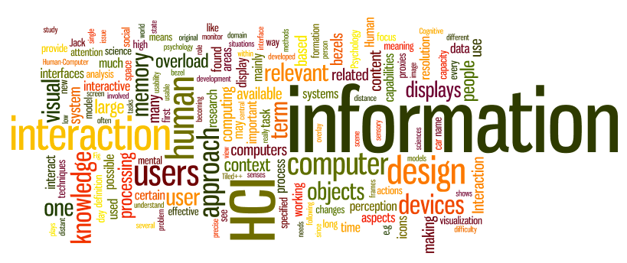
Establishing Requirements
Sampath Jayarathna
Cal Poly Pomona
Credit for some of the slides in this lecture goes to www.id-book.com

Slide 2
Agile methods and requirements
Many agile methods argue that producing detailed system requirements is a waste of time as requirements change so quickly.
The requirements document is therefore always out of date.
Agile methods usually use incremental requirements engineering and may express requirements as ‘user stories’.
This is practical for business systems but problematic for systems that require pre-delivery analysis (e.g. critical systems) or systems developed by several teams.

Slide 3
Functional and non-functional requirements
Functional requirements
  Statements of services the system should provide, how the system should react to particular inputs and how the system should behave in particular situations.
  May state what the system should not do.
Non-functional requirements
  Constraints on the services or functions offered by the system such as timing constraints, constraints on the development process, standards, etc.
  Often apply to the system as a whole rather than individual features or services.
Domain requirements
  Constraints on the system from the domain of operation

Slide 4
functional Vs non-functional requirements
An example of a functional requirement would be:
  A system must send an email whenever a certain condition is met (e.g. an order is placed, a customer signs up, etc).
A related non-functional requirement for the system may be:
  Emails should be sent with a latency of no greater than 12 hours from such an activity.
The functional requirement is describing the behavior of the system as it relates to the system's functionality. The non-functional requirement elaborates a performance characteristic of the system.

Slide 5
System stakeholders
Any person or organization who is affected by the system in some way and so who has a legitimate interest
Stakeholder types
  End users
  System managers
  System owners
  External stakeholders

Slide 6
Case Study : Stakeholders
Suppose that you have to develop software for cash dispenser. You should develop software for both cash dispenser, i.e. the part for communication with the customers (delivering money and report the account state), the software for communication and software needed in banks for communicate with the bank transaction systems. You have a team of 10 people – all of them can play a role of designers, developers, testers and document writers. You have got a contract to implement the first version in 6 months. All hardware and development tools are available. In the project 5 banks are included that use 2 different transaction systems. The customer wants that you incrementally implement the system – first the cash dispenser software, then the interface to the bank account system, finally the communication. The total system should be delivered after 6 months.

Slide 7
Problems of requirements elicitation
Stakeholders don’t know what they really want.
Stakeholders express requirements in their own terms.
Different stakeholders may have conflicting requirements.
Organisational and political factors may influence the system requirements.
The requirements change during the analysis process. New stakeholders may emerge and the business environment may change.

Slide 8
The requirements elicitation and analysis process

Slide 9
Process activities
Requirements discovery
  Interacting with stakeholders to discover their requirements. Domain requirements are also discovered at this stage.
Requirements classification and organisation
  Groups related requirements and organises them into coherent clusters.
Prioritisation and negotiation
  Prioritising requirements and resolving requirements conflicts.
Requirements specification
  Requirements are documented and input into the next round of the spiral.

Slide 10
Requirement Gathering
The importance of requirements
Data gathering for requirements
Data analysis and presentation
Task description: Scenarios
Use Cases
Essential use cases
Task analysis: HTA

Slide 11
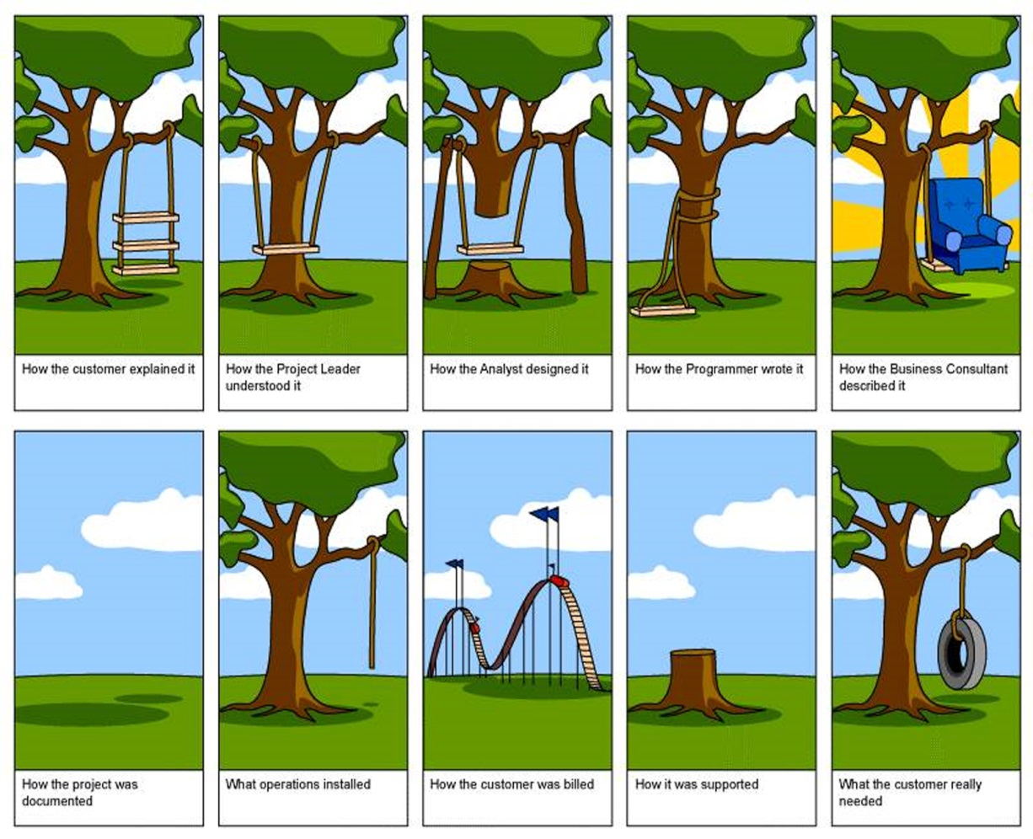
What, how and why?
Why bother?
  Requirements definition is the stage where failure occurs most commonly
Getting requirements right is crucial
11

Slide 12
Establishing requirements
What do users want? What do users ‘need’?
  Requirements need clarification, refinement, completion, re-scoping
  Input: Requirements document (maybe)
  Output: stable requirements
Why ‘establish’?
  Requirements arise from understanding users’ needs
  Requirements can be justified & related to data

Slide 13
Different kinds of requirements
Users: Who are they?
  Characteristics: nationality, educational background, attitude to computers
  System use: novice, expert, casual, frequent
    Novice: prompted, constrained, clear
    Expert: flexibility, access/power
    Frequent: short cuts
    Casual/infrequent: clear menu paths

Slide 14


What are the users’ capabilities?
Humans vary in many dimensions:
  size of hands may affect the size and positioning of input buttons
  motor abilities may affect the suitability of certain input and output devices
  height if designing a physical kiosk
  strength - a child’s toy requires little strength to operate, but greater strength to change batteries
  disabilities (e.g. sight, hearing, dexterity)

Slide 15
Personas
Capture a set of user characteristics (user profile)
Not real people, but synthesised from real users
Bring them to life with a name, characteristics, goals, personal background
Develop a small set of personas with one primary

Slide 16
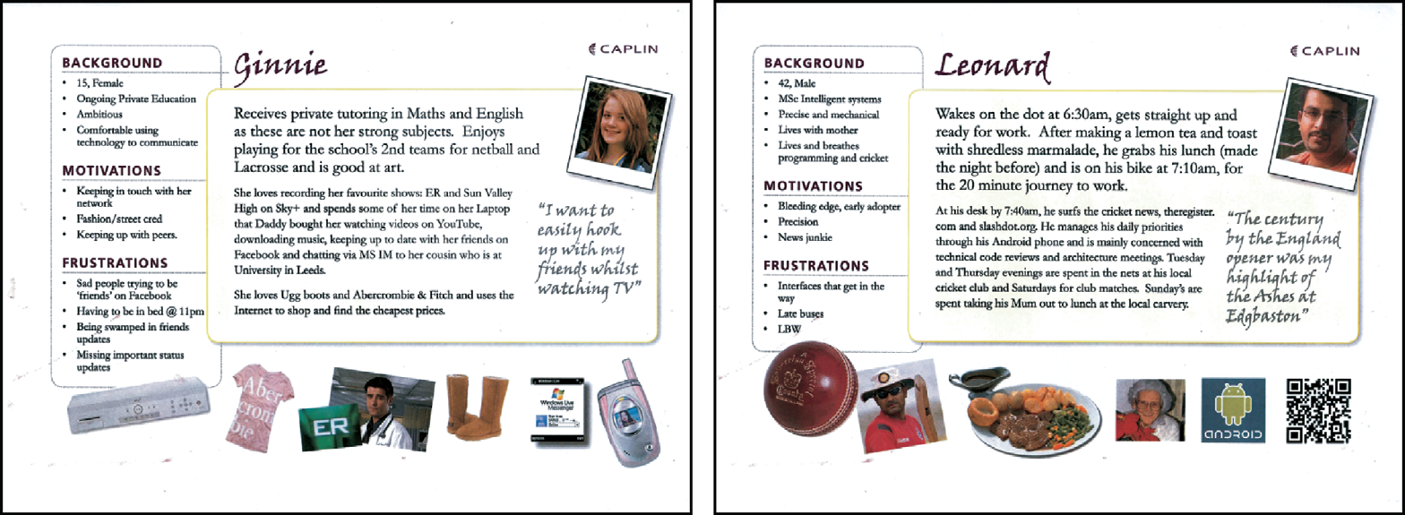
Example Persona

Slide 17
Data gathering for requirements
Interviews:
  Props, e.g. sample scenarios of use,
  prototypes, can be used in interviews
  Good for exploring issues
  Development team members can connect with stakeholders
Focus groups:
  Group interviews
  Good at gaining a consensus view and/or highlighting areas of conflict
  But can be dominated by individuals

Slide 18
Data gathering for requirements
Questionnaires:
  Often used in conjunction with other
  techniques
  Can give quantitative or qualitative data
  Good for answering specific questions from
  a large, dispersed group of people
Researching similar products:
  Good for prompting requirements

Slide 19
Data gathering for requirements
Direct observation:
  Gain insights into stakeholders’ tasks
  Good for understanding the nature and
  context of the tasks
  But, it requires time and commitment
  from a member of the design team, and
  it can result in a huge amount of data
Indirect observation:
  Not often used in requirements activity
  Good for logging current tasks

Slide 20
Data gathering for requirements
Studying documentation:
  Procedures and rules are often written
  down in manuals
  Good source of data about the steps
  involved in an activity, and any
  regulations governing a task
  Not to be used in isolation
  Good for understanding legislation, and
  getting background information
  No stakeholder time, which is a limiting
  factor on the other techniques

Slide 21
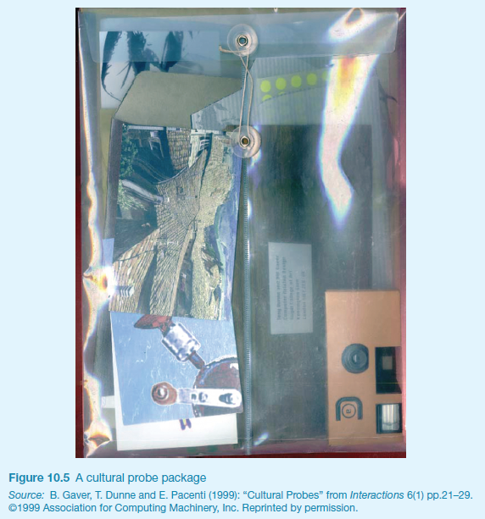
Some examples
Cultural probes

Slide 22
Contextual Inquiry
An approach to ethnographic study where user is expert, designer is apprentice
A form of interview, but
  at users’ workplace (workstation)
  2 to 3 hours long
Four main principles:
  Context: see workplace & what happens
  Partnership: user and developer collaborate
  Interpretation: observations interpreted by user and developer together
  Focus: project focus to understand what to look for

Slide 23
Data interpretation and analysis
Start soon after data gathering session
Initial interpretation before deeper analysis
Different approaches emphasize different elements e.g. class diagrams for object-oriented systems, entity-relationship diagrams for data intensive systems

Slide 24
How to describe the tasks?
Scenarios
  an informal narrative story, simple, ‘natural’, personal, not generalizable
Use cases
  assume interaction with a system
  assume detailed understanding of the interaction
Essential use cases
  abstract away from the details
  does not have the same assumptions as use cases

Slide 25
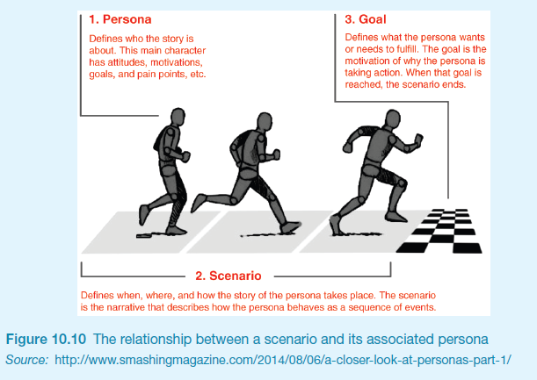
Scenarios and Personas

Slide 26
Case Study: Use case for travel organizer
1. The system displays options for investigating visa and vaccination requirements.
2. The user chooses the option to find out about visa requirements.
3. The system prompts user for the name of the destination country.
4. The user enters the country’s name.
5. The system checks that the country is valid.
6. The system prompts the user for her nationality.
7. The user enters her nationality.
8. The system checks the visa requirements of the entered country for a passport holder of her nationality.
9. The system displays the visa requirements.
10. The system displays the option to print out the visa requirements.
11. The user chooses to print the requirements.

Slide 27
Alternative courses for travel organizer
Some alternative courses:
6. If the country name is invalid:
  6.1 The system displays an error message.
  6.2 The system returns to step 3.
8. If the nationality is invalid:
  8.1 The system displays an error message.
  8.2 The system returns to step 6.
9. If no information about visa requirements is found:
  9.1 The system displays a suitable message.
  9.2 The system returns to step 1.

Slide 28
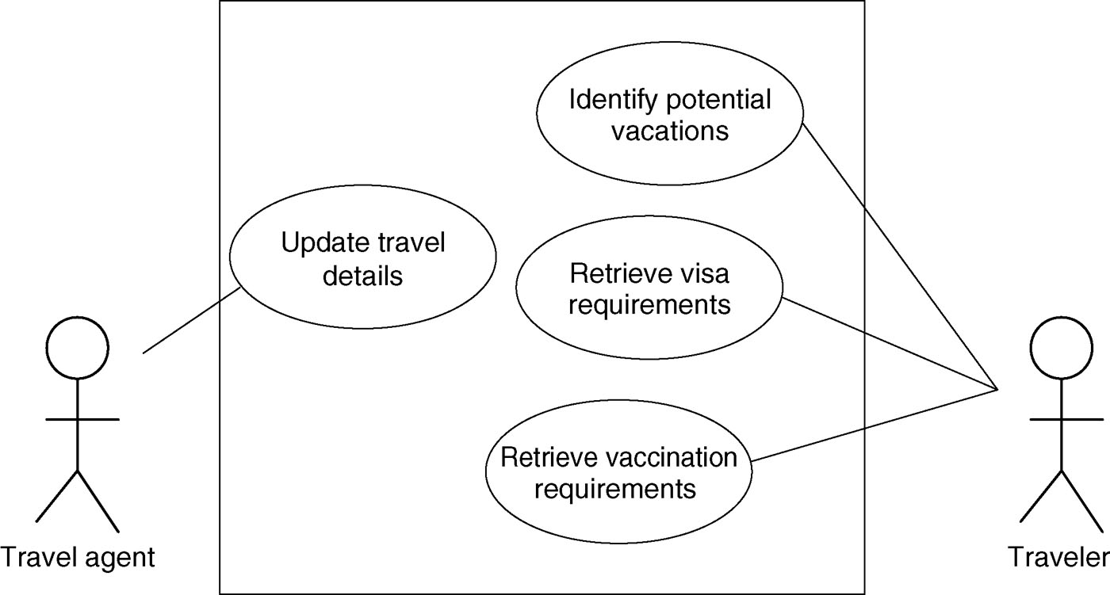
Example use case diagram for travel organizer

Slide 29
Example essential use case (business use case) for travel organizer
retrieve Visa
USER INTENTION SYSTEM RESPONSIBILITY
find visa requirements request destination and nationality
supply required information obtain appropriate visa info
obtain copy of visa info offer info in different formats
choose suitable format provide info in chosen format

Slide 30
Task analysis
Task descriptions are often used to envision new systems or devices
Task analysis is used mainly to investigate an existing situation
It is important not to focus on superficial activities
  What are people trying to achieve?
  Why are they trying to achieve it?
  How are they going about it?
Many techniques, the most popular is Hierarchical Task Analysis (HTA)

Slide 31
Hierarchical Task Analysis
Involves breaking a task down into subtasks, then sub-sub-tasks and so on. These are grouped as plans which specify how the tasks might be performed in practice
HTA focuses on physical and observable actions, and includes looking at actions not related to software or an interaction device
Start with a user goal which is examined and the main tasks for achieving it are identified
Tasks are sub-divided into sub-tasks

Slide 32
Example Hierarchical Task Analysis
0. In order to buy a DVD
1. locate DVD
2. add DVD to shopping basket
3. enter payment details
4. complete address
5. confirm order
plan 0: If regular user do 1-2-5.
If new user do 1-2-3-4-5.

Slide 33
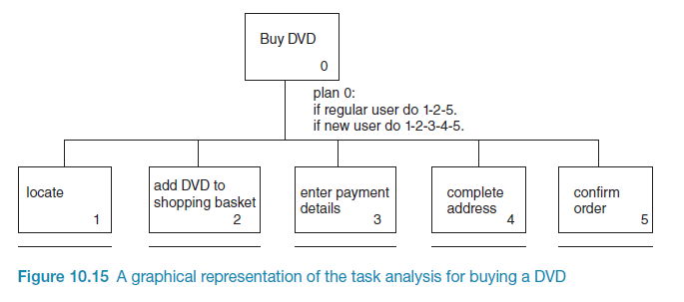
Example Hierarchical Task Analysis

Slide 34
Guidelines for writing requirements
Invent a standard format and use it for all requirements.
Use language in a consistent way. Use shall for mandatory requirements, should for desirable requirements.
Use text highlighting to identify key parts of the requirement.
Avoid the use of computer jargon.
Include an explanation (rationale) of why a requirement is necessary.

Slide 35
Supplement slides: Agile and Scrum

Slide 36
Agile development
Program specification, design and implementation are inter-leaved
The system is developed as a series of versions or increments with stakeholders involved in version specification and evaluation
Frequent delivery of new versions for evaluation
Extensive tool support (e.g. automated testing tools) used to support development.
Minimal documentation – focus on working code

Slide 37
Plan-driven and agile development

Slide 38
Scrum
Scrum is an agile method that focuses on managing iterative development rather than specific agile practices.
There are three phases in Scrum.
  The initial phase is an outline planning phase where you establish the general objectives for the project and design the software architecture.
  This is followed by a series of sprint cycles, where each cycle develops an increment of the system.
  The project closure phase wraps up the project, completes required documentation such as system help frames and user manuals and assesses the lessons learned from the project.

Slide 39
Scrum terminology (a)
Scrum term | Definition
Development team | A self-organizing group of software developers, which should be no more than 7 people. They are responsible for developing the software and other essential project documents.
Potentially shippable product increment | The software increment that is delivered from a sprint. The idea is that this should be ‘potentially shippable’ which means that it is in a finished state and no further work, such as testing, is needed to incorporate it into the final product. In practice, this is not always achievable.
Product backlog | This is a list of ‘to do’ items which the Scrum team must tackle. They may be feature definitions for the software, software requirements, user stories or descriptions of supplementary tasks that are needed, such as architecture definition or user documentation.
Product owner | An individual (or possibly a small group) whose job is to identify product features or requirements, prioritize these for development and continuously review the product backlog to ensure that the project continues to meet critical business needs. The Product Owner can be a customer but might also be a product manager in a software company or other stakeholder representative.

Slide 40
Scrum terminology (b)
Scrum term | Definition
Scrum | A daily meeting of the Scrum team that reviews progress and prioritizes work to be done that day. Ideally, this should be a short face-to-face meeting that includes the whole team.
ScrumMaster | The ScrumMaster is responsible for ensuring that the Scrum process is followed and guides the team in the effective use of Scrum. He or she is responsible for interfacing with the rest of the company and for ensuring that the Scrum team is not diverted by outside interference. The Scrum developers are adamant that the ScrumMaster should not be thought of as a project manager. Others, however, may not always find it easy to see the difference.
Sprint | A development iteration. Sprints are usually 2-4 weeks long.
Velocity | An estimate of how much product backlog effort that a team can cover in a single sprint. Understanding a team’s velocity helps them estimate what can be covered in a sprint and provides a basis for measuring improving performance.

Slide 41
Scrum sprint cycle

Slide 42
The Scrum sprint cycle
Sprints are fixed length, normally 2–4 weeks.
The starting point for planning is the product backlog, which is the list of work to be done on the project.
The selection phase involves all of the project team who work with the customer to select the features and functionality from the product backlog to be developed during the sprint.

Slide 43
The Sprint cycle
Once these are agreed, the team organize themselves to develop the software.
During this stage the team is isolated from the customer and the organization, with all communications channelled through the so-called ‘Scrum master’.
The role of the Scrum master is to protect the development team from external distractions.
At the end of the sprint, the work done is reviewed and presented to stakeholders. The next sprint cycle then begins.

Slide 44
Teamwork in Scrum
The ‘Scrum master’ is a facilitator who arranges daily meetings, tracks the backlog of work to be done, records decisions, measures progress against the backlog and communicates with customers and management outside of the team.
The whole team attends short daily meetings (Scrums) where all team members share information, describe their progress since the last meeting, problems that have arisen and what is planned for the following day.
  This means that everyone on the team knows what is going on and, if problems arise, can re-plan short-term work to cope with them.

Slide 45
Scrum benefits
The product is broken down into a set of manageable and understandable chunks.
Unstable requirements do not hold up progress.
The whole team have visibility of everything and consequently team communication is improved.
Customers see on-time delivery of increments and gain feedback on how the product works.
Trust between customers and developers is established and a positive culture is created in which everyone expects the project to succeed.

Slide 46
Supplement slides: Use Case Modeling

Slide 47
Use case modeling
Use cases were developed originally to support requirements elicitation and now incorporated into the UML.
Each use case represents a discrete task that involves external interaction with a system.
Actors in a use case may be people or other systems.
Represented diagrammatically to provide an overview of the use case and in a more detailed textual form.

Slide 48
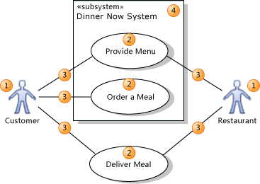
Use case modeling basics
An actor (1) is
  a class of person, organization, device, or external software component that interacts with your system. Example actors are Customer, Restaurant, Temperature Sensor, Credit Card Authorizer.
A use case (2)
  represents the actions that are performed by one or more actors in the pursuit of a particular goal. Example use cases are Order Meal, Update Menu, Process Payment.
On a use case diagram, use cases are associated (3) with the actors that perform them.
Your system (4) is
  whatever you are developing. It might be a small software component, whose actors are just other software components; or it might be a complete application; or it might be a large distributed suite of applications deployed over many computers and devices. Example subsystems are Meal Ordering Website, Meal Delivery Business, Website Version 2.
A use case diagram can show which use cases are supported by your system or its subsystems.

Slide 49
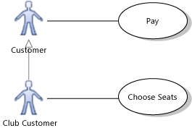
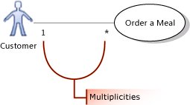
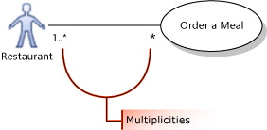
Use case modeling basics
You can draw a Generalization link between Actors.
  The specialized actor, such as Club Customer in the example, inherits the use cases of the generalized actor, such as Customer.
The association between an actor and a use case can show a multiplicity at each end.
  1 to state that exactly one instance of this role participates in each link.
  1..* to state that one or more instance of this role participate in each link.
  0..1 to state that participation is optional.
  * to state that zero or more instances of this role participate in the link.
  In the illustration, one or more restaurants can take part in fulfilling the same meal order.

Slide 50
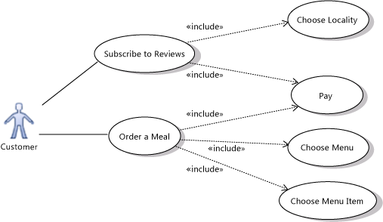
Use case modeling basics
Use an Include relation to show that one use case describes some of the detail of another. In the illustration, Order a Meal includes Pay, Choose Menu, and Choose Menu Item. Each of the included, more detailed use cases is a step that the actor or actors might have to perform to achieve the overall goal of the including use case. The arrow should point at the more detailed, included use case.

Slide 51

Use case modeling basics
Use an Extend link to show that one use case may add functionality to another use case under certain circumstances. The arrow should point at the main, extended use case.
For example, the Login use case of a typical Web site can include Register New User - but only when the user does not already have an account.

Slide 52
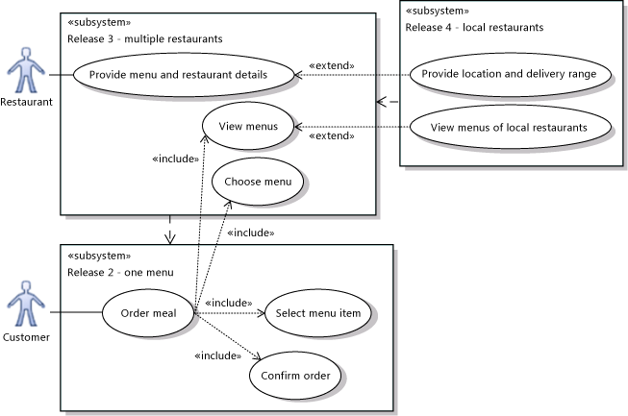
Use case modeling basics
You can use different subsystem boundaries to illustrate different versions of the system.
Use Dependency relations to link subsystems representing different versions or variants.

