Slide 1
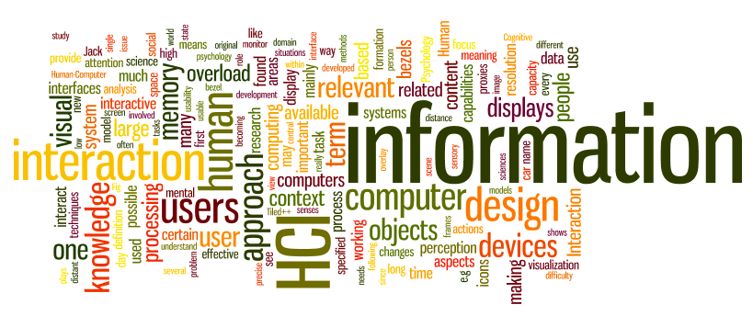
Prototyping
Sampath Jayarathna
Cal Poly Pomona
Credit for some of the slides in this lecture goes to www.id-book.com

Slide 2
Prototyping
What is a prototype?
Different kinds of prototyping
- Low fidelity
- High fidelity
Compromises in prototyping
- Vertical
- Horizontal
Final product needs to be engineered

Slide 3
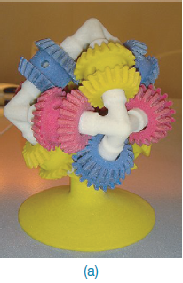
What is a prototype?
In other design fields a prototype is a small-scale model:
a miniature car
a miniature building or town
the examples here come from a 3D printer

Slide 4
What is a prototype?
In interaction design it can be (among other things):
a series of screen sketches
a storyboard, i.e. a cartoon-like series of scenes
a Powerpoint slide show
a video simulating the use of a system
a lump of wood (e.g. PalmPilot)
a cardboard mock-up
a piece of software with limited functionality written in the target language or in another language

Slide 5
Low-fidelity Prototyping
Uses a medium which is unlike the final medium, e.g. paper, cardboard
Is quick, cheap and easily changed
Examples:
sketches of screens, task sequences, etc
‘post-it’ notes
storyboards
‘Wizard-of-Oz’

Slide 6
Storyboards
Often used with scenarios, bringing more detail, and a chance to role play
It is a series of sketches showing how a user might progress through a task using the device
Used early in design

Slide 7
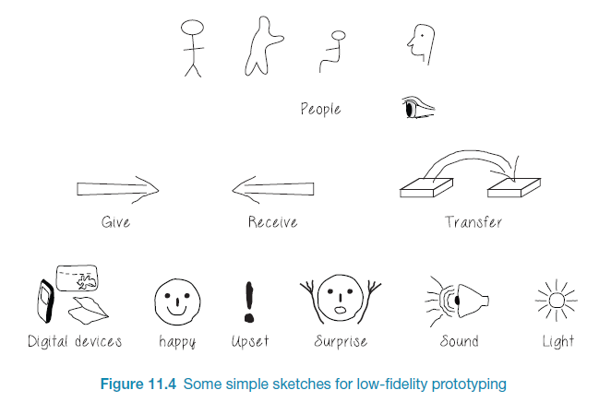
Generate storyboard from scenario

Slide 8
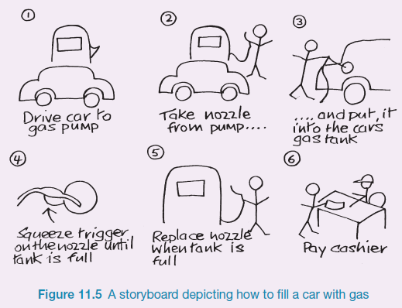
Sketching
Sketching is important to low-fidelity prototyping
Don’t be inhibited about drawing ability. Practice simple symbols

Slide 9
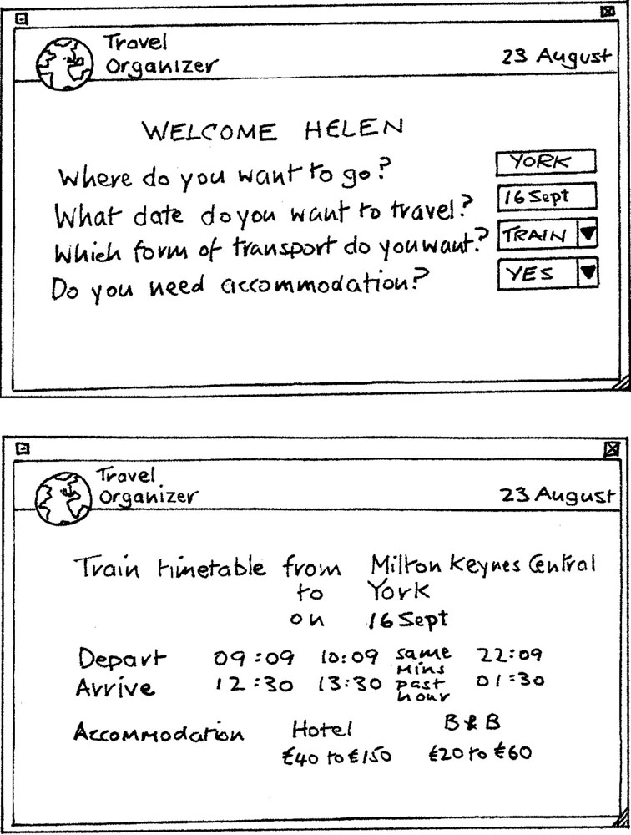
Card-based prototypes
Index cards (3 X 5 inches)
Each card represents one screen or part of screen
Often used in website development

Slide 10
‘Wizard-of-Oz’ prototyping
The user thinks they are interacting with a computer, but a developer is responding to output rather than the system.
Usually done early in design to understand users’ expectations
Ex: Aardvark startup
User
>Blurb blurb
>Do this
>Why?

Slide 11
High-fidelity prototyping
Uses materials that you would expect to be in the final product
Prototype looks more like the final system than a low-fidelity version
High-fidelity prototypes can be developed by integrating existing hardware and software components
Danger that users think they have a complete system…….see compromises

Slide 12
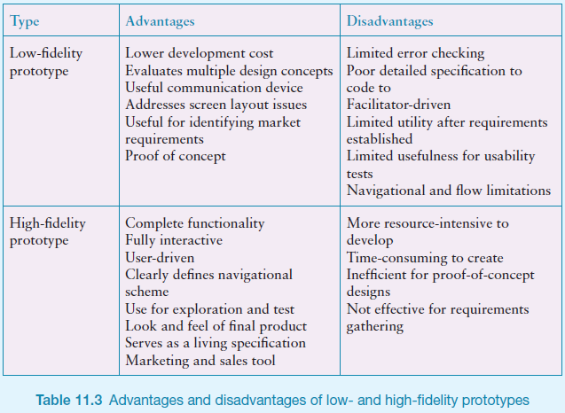
Low Vs High Fidelity prototypes

Slide 13
Compromises in prototyping
All prototypes involve compromises
For software-based prototyping maybe there is a slow response? sketchy icons? limited functionality?
Two common types of compromise
horizontal: provide a wide range of functions, but with little detail
vertical: provide a lot of detail for only a few functions
Compromises in prototypes mustn't be ignored. Product needs engineering

Slide 14
Is there a suitable metaphor?
Interface metaphors combine familiar knowledge with new knowledge in a way that will help the user understand the product.
Conceptualizing what we are doing, e.g. surfing the web
A conceptual model instantiated at the interface, e.g. the desktop metaphor
Visualizing an operation, e.g. an icon of a shopping cart for placing items into

Slide 15
Explore the user’s experience (UX)
Use personas, card-based prototypes or stickies to model the user experience
Visual representation called:
design map
customer/user journey map
experience map
Two common representations
wheel
timeline

Slide 16
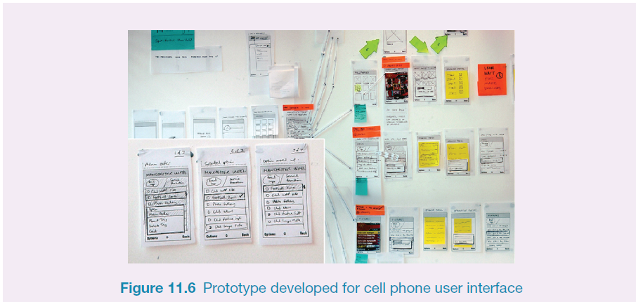
Generate card-based prototype from use case

Slide 17
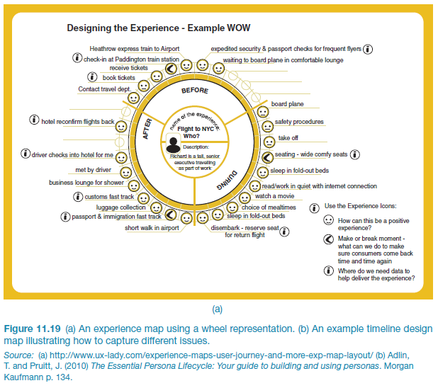
An experience map drawn as a wheel

Slide 18
An experience map drawn as a timeline

Slide 19
GUI Prototyping Tools
Pencil Project :
http://pencil.evolus.vn/
supports Linux, Mac OS X and Windows.
A Firefox add-on is also available
Free
Smartdraw
https://www.smartdraw.com/
$200

Slide 20
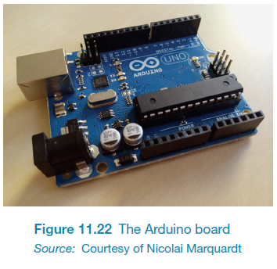
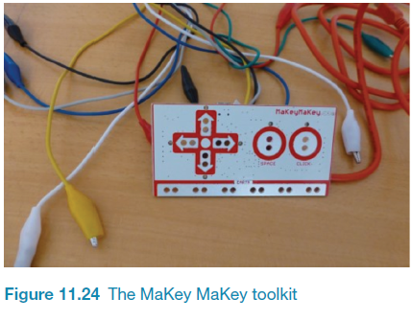
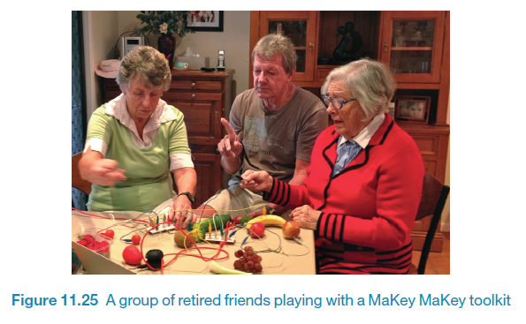
Construction: physical computing
Build and code prototypes using electronics
Toolkits available include
Arduino
Senseboard
MaKey MaKey
Software Development Kits
programming tools and components to develop for a specific platform, e.g. iOS
Includes: IDE, documentation, drivers, sample code, application programming interfaces (APIs)
Makes development much easier
Microsoft’s Kinect SDK has been used in research
Designed for use by wide range of people

