Slide 1
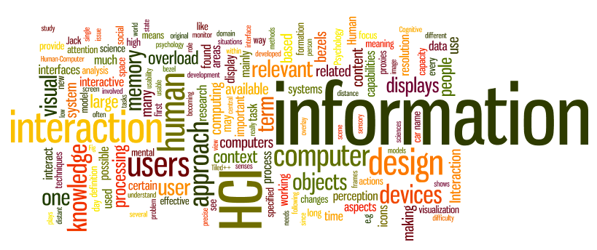
Social and Emotional Interactions
Sampath Jayarathna
Cal Poly Pomona
Credit for some of the slides in this lecture goes to www.id-book.com

Slide 2
Overview
Being social
Face to face conversations
Remote conversations
Tele-presence
Co-presence
Shareable technologies

Slide 3
Conversational mechanisms
Various mechanisms and ‘rules’ are followed when holding a conversation, e.g. mutual greetings
    A: Hi there
    B: Hi!
    C: Hi
    A: All right?
    C: Good, how’s it going?
    A: Fine, how are you?
    C: OK
    B: So-so. How’s life treating you?

Slide 4
Being social
Are F2F conversations being superseded by our social media interactions?
How many friends do you have on Facebook, LinkedIn,etc vs real life?
How much overlap?
How are the ways we live and interact with one another changing?
Are the established rules and etiquette still applicable to online and offline?
Notes:
4

Slide 5
Conversational rules
Turn-taking used to coordinate conversation
  A: Shall we meet at 8?
  B: Um, can we meet a bit later?
  A: Shall we meet at 8?
  B: Wow, look at him?
  A: Yes what a funny hairdo!
  B: Um, can we meet a bit later?
Back channelling to signal to continue and following
  Uh-uh, umm, ahh

Slide 6
More conversational rules
Farewell rituals
  Bye then, see you, yer bye, see you later….
Implicit and explicit cues
  e.g. looking at watch, fidgeting with coat and bags
  explicitly saying “Oh dear, must go, look at the time, I’m late…”

Slide 7
Breakdowns in conversation
When someone says something that is misunderstood:
  Speaker will repeat with emphasis:
    A: “this one?”
    B: “no, I meant that one!”
  Also use tokens:
    Eh? Quoi? Huh? What?

Slide 8
What happens in social media conversations?
Do same conversational rules apply?
Are there more breakdowns?
How do people repair them for:
  Phone?
  email?
  Instant messaging?
  texting?
  Skyping?
Notes:
8

Slide 9
Remote conversations
Much research on how to support conversations when people are ‘at a distance’ from each other
Many applications have been developed
  e.g., email, videoconferencing, videophones, instant messaging, chatrooms
Do they mimic or move beyond existing ways of conversing?

Slide 10
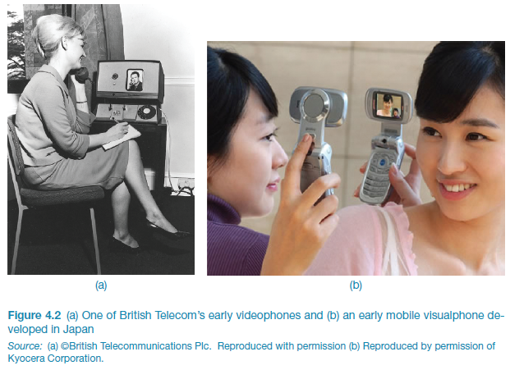
Early videophone and visualphone
Notes:
Figure 4.1

Slide 11
Skype success
Global household name
Seeing others on screen enables more intimacy than audio phone
Enables people to get to know each other better
Notes:
11

Slide 12
Facebook and Twitter
Everyone uses them so what is there to learn?
Used in emergencies, demos, etc.,
  e.g., users spread up-to-the minute info and retweet about how a wildfire or gas plume is moving
  but can also start or fuel rumours, by adding news that is old or incorrect
  more confusing than helpful
Notes:
12

Slide 13
Telepresence
New technologies designed to allow a person to feel as if they were present in the other location
  projecting their body movements, actions, voice and facial expressions to the other location or person
  e.g. superimpose images of the other person on a workspace

Slide 14
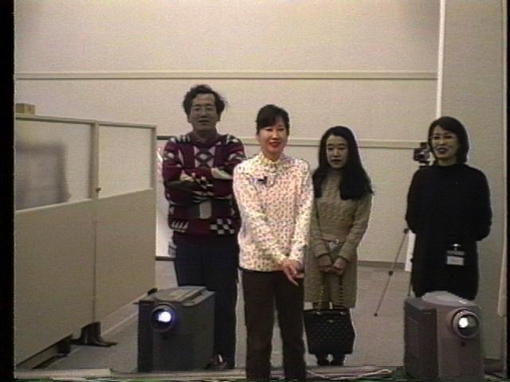
Hypermirror (Morikawa and Maesako, 1998)
  allows people to feel as if they are in the same virtual place even though in physically different spaces
(woman in white sweater is in a different room to the other three)
People in different
places are superimposed
on the same screen
to make them appear as if in same space

Slide 15
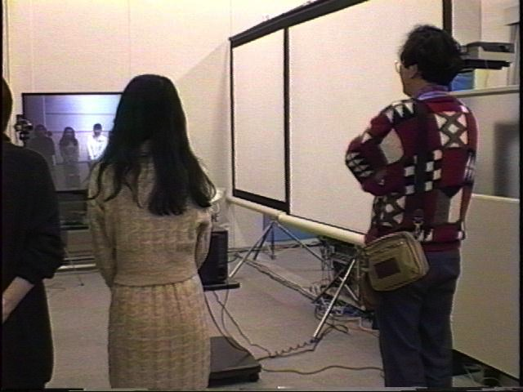
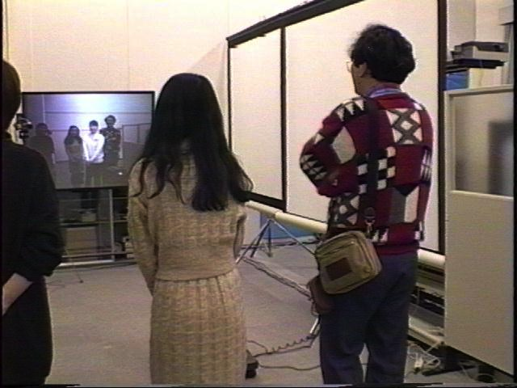
Creating personal space in Hypermirror
2) Two in this room are invading
the ‘virtual’ personal space
of the other person by appearing to be
physically on top of woman in white sweater
3) Two in the room move
apart to allow person
in other space more ‘virtual’
personal space

Slide 16
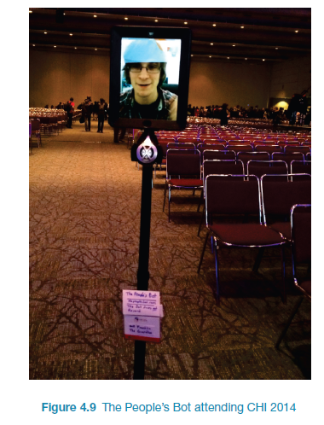
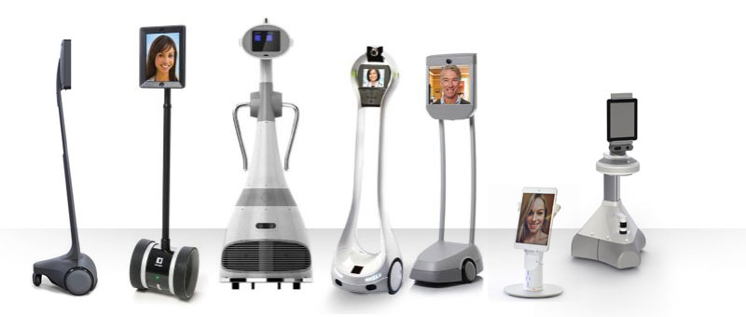
The People’s Bot attending CHI
https://www.youtube.com/watch?v=eRoPcZ8oHA8&list=LLa6-4tUOh2p1giKotWMKCEQ&index=17

Slide 17
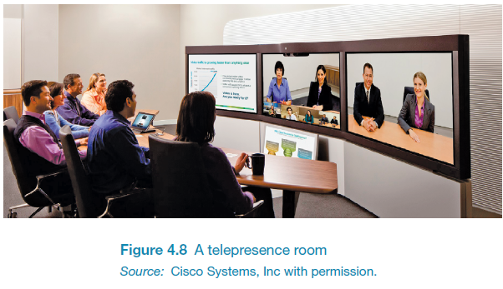
How much realism?
Is needed in telepresence to make it compelling?
Telepresence rooms try make the remote people appear to be life-like by using multiple high def cameras with eye-tracking features and directional microphones
Is Skype just as good?

Slide 18
Coordination mechanisms
When a group of people act or interact together they need to coordinate themselves
  e.g., playing football, navigating a ship
They use:
  verbal and non-verbal communication
  schedules, rules, and conventions
  shared external representations

Slide 19
Co-presence
Technologies that enable co-located groups to collaborate more effectively
  when working, learning and socializing
Examples: Smartboards, Surfaces, Wii and Kinect

Slide 20
F2F coordinating mechanisms
Talk is central
Non-verbal also used to emphasize and as substitute
  e.g. nods, shakes, winks, glances, gestures and hand-raising
Formal meetings
  explicit structures such as agendas, memos, and minutes are employed to coordinate the activity

Slide 21
Awareness mechanisms
Involves knowing who is around, what is happening, and who is talking with whom
Peripheral awareness
  keeping an eye on things happening in the periphery of vision
  Overhearing and overseeing - allows tracking of what others are doing without explicit cues

Slide 22
Lo tech awareness mechanism

Slide 23
Designing technologies to support awareness
Provide awareness of others who are in different locations
Workspace awareness: “the up-to-the-moment understanding of another person’s interaction with the shared workspace” (Gutwin and Greenberg, 2002)
Examples: ReacTable and Reflect Table

Slide 24
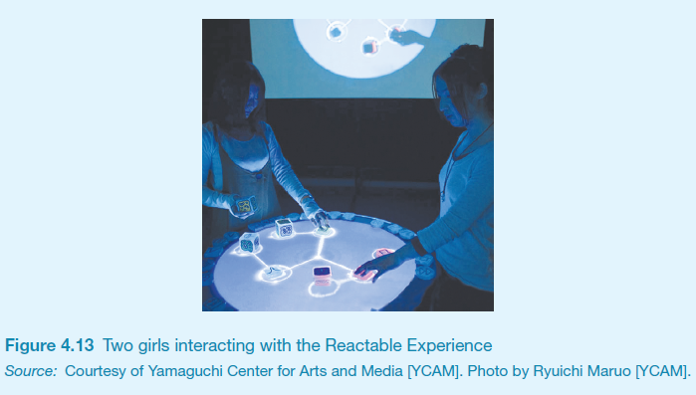
The Reactable experience
http://viewpure.com/Mgy1S8qymx0?start=0&end=0

Slide 25
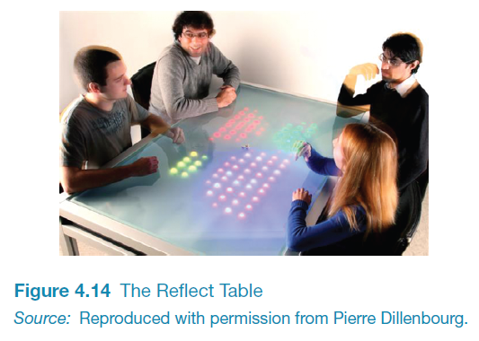
The Reflect Table

Slide 26
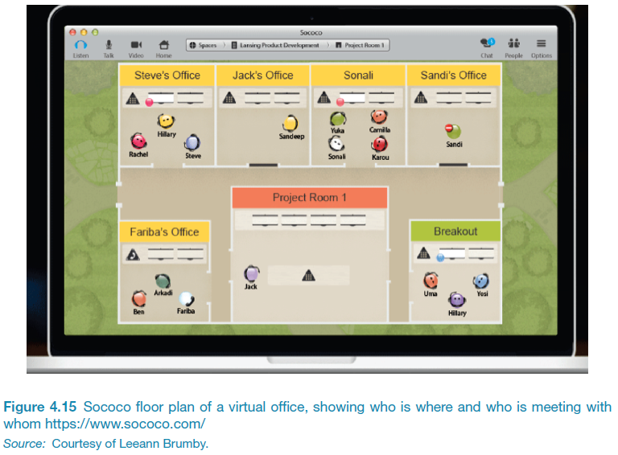
Notification systems
Users notify others as opposed to being constantly monitored
Provide information about shared objects and progress of collaborative tasks
  example: Babble, Sococo

Slide 27
What next?
Besides perpetual sharing and broadcasting of information, knowledge, and personal content?
Lifelogging
  recording everything in one’s life and sharing
Micro-chatting
  beyond twitter and snapchat?

Slide 28
Emotions
Emotions and the user experience
Expressive and annoying interface
  how the ‘appearance’ of an interface can affect users
Models of emotion
  Ortony et al (2005)
Automatic emotion recognition and emotional technologies
Persuasive technologies and behavioural change
  how technologies can be designed to change people’s attitudes and behaviour
Anthropomorphism
  The pros and cons
Notes:
28

Slide 29
Emotions and the user experience
HCI has traditionally been about designing efficient and effective systems
Now more about how to design interactive systems that make people respond in certain ways
  e.g. to be happy, to be trusting, to learn, to be motivated
Emotional interaction is concerned with how we feel and react when interacting with technologies
Notes:
29

Slide 30
Emotional interaction
What makes us happy, sad, annoyed, anxious, frustrated, motivated, delirious and so on
  translating this into different aspects of the user experience
Why people become emotionally attached to certain products (e.g. virtual pets, games)
Can social robots help reduce loneliness and improve wellbeing?
How to change human behaviour through the use of emotive feedback
Notes:
30

Slide 31
Activity
Try to remember the emotions you went through when buying a big ticket item online (e.g. a fridge, a vacation, a computer)
How many different emotions did you go through?
Notes:
Consider the different emotions you experience for a common everyday activity – shopping online for a product, such as a new phone, a washing machine or a vacation. Firstly, there is the realisation of needing or wanting it, and then the desire and anticipation of purchasing it. This is followed by the joy or frustration of finding out more about what products are available and deciding which to choose from potentially hundreds or even thousands (by visiting numerous websites, such as comparison sites, reviews, recommendations, blogs). This entails matching what is available with what you like or need and if you can afford it. The thrill of deciding on a purchase may be quickly followed by the shock of how much it costs and the disappointment that you can’t afford it. The process of having to decide again may be accompanied by annoyance as you cant find one that is as good as your first choice. You think about other options, such as seeking advice from an expert in a shopping mall, but you have an aversion to sales assistants and don’t trust their advice, because you think they have their own interests (making money), rather than yours, at heart. So you carry on looking, getting more tired and frustrated. When you do make a decision you experience a sense of relief. You click merrily though the various options (such as color, size, warranty) and then the dreaded online payment form pops up. You type in all your details and press the final payment button. A window then appears saying that your credit card number is incorrect. So you type it in again very slowly. And you notice you need to type the 3 number security code in again. Finally, when all is done you let out a big sigh. But as you walk away from your computer doubts start to form in your mind – maybe you should have bought the other one...
This rollercoaster set of emotions is what many of us experience when shopping online, especially for expensive products, where there are a myriad of options to choose from and where we want to be sure that we make the right choice.
31

Slide 32
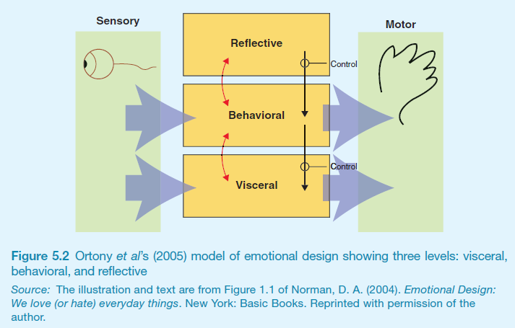
Emotional design model
Norman, Ortony and Revelle (2004) model of emotion
Notes:
32

Slide 33
Claims from model
Our emotional state changes how we think
  when frightened or angry we focus narrowly and body responds by tensing muscles and sweating
    more likely to be less tolerant
  when happy we are less focused and the body relaxes
    more likely to overlook minor problems and be more creative
Notes:
33

Slide 34
Activity
Do you feel more creative when you are in a happy mood? Do you get less work done when you are feeling stressed?

Slide 35


Expressive interfaces
Provide reassuring feedback that can be both informative and fun
But can also be intrusive, causing people to get annoyed and even angry
Color, icons, sounds, graphical elements and animations are used to make the ‘look and feel’ of an interface appealing
  conveys an emotional state
In turn this can affect the usability of an interface
  people are prepared to put up with certain aspects of an interface (e.g. slow download rate) if the end result is appealing and aesthetic
Notes:
35
A good place to start understanding how emotions affect behavior and how behavior affects emotions is to examine how people express themselves and read each other’s expressions. These include understanding the relationship between facial expressions, body language, gestures and tone of voice. For example, when people are happy they typically smile, laugh and open their bodies up. When they are angry they shout, gesticulate and screw up their face. A person’s expressions can trigger emotional responses in others. So when someone smiles it can cause others to feel good and smile back.

Slide 36
Friendly interfaces
Microsoft pioneered friendly interfaces for technophobes - ‘At home with Bob’ software
3D metaphors based on familiar places (e.g. living rooms)
Agents in the guise of pets (e.g. bunny, dog) were included to talk to the user
  Make users feel more at ease and comfortable
Notes:
36

Slide 37
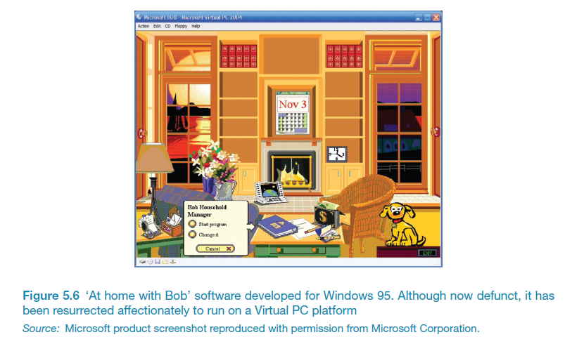
Bob
Notes:
37

Slide 38
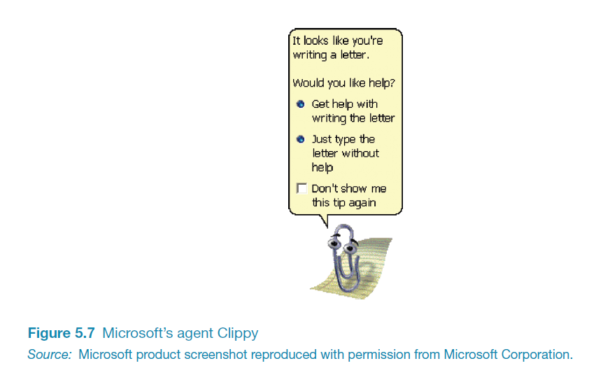
Clippy
Why was Clippy disliked
by so many?
Was it annoying,
distracting,
patronising or other?
Notes:
38

Slide 39
Frustrating interfaces
Many causes:
  When an application doesn’t work properly or crashes
  When a system doesn’t do what the user wants it to do
  When a user’s expectations are not met
  When a system does not provide sufficient information to enable the user to know what to do
  When error messages pop up that are vague, obtuse or condemning
  When the appearance of an interface is garish, noisy, gimmicky or patronizing
  When a system requires users to carry out too many steps to perform a task, only to discover a mistake was made earlier and they need to start all over again
Notes:
39

Slide 40
Gimmicks
Amusing to the designer but not the user, e.g.
  Clicking on a link to a website only to discover that it is still ‘under construction’
Notes:
40

Slide 41
Error messages
“The application Word Wonder has unexpectedly quit due to a type 2 error.”
Why not instead:
“the application has expectedly quit due to poor coding in the operating system”
Shneiderman’s guidelines for error messages include:
    avoid using terms like FATAL, INVALID, BAD
    Audio warnings
    Avoid UPPERCASE and long code numbers
    Messages should be precise rather than vague
    Provide context-sensitive help
Notes:
41

Slide 42
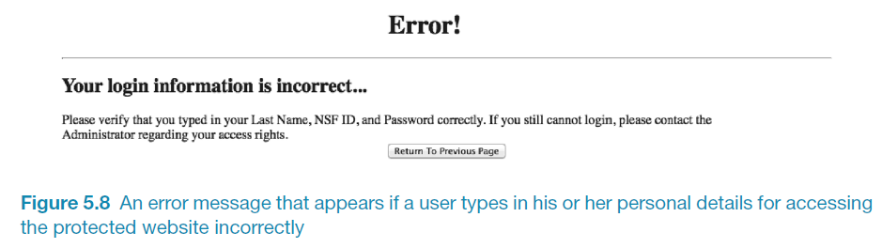
Website error messages
Notes:
42
Can you change to Figure 5.8

Slide 43
More helpful error message
“The requested page /helpme is not available on the web server.
If you followed a link or bookmark to get to this page, please let us know, so that we can fix the problem. Please include the URL of the referring page as well as the URL of the missing page.
Otherwise check that you have typed the address of the web page correctly.
The Web site you seek
Cannot be located, but
Countless more exist.”
Notes:
43

Slide 44
Should computers say they’re sorry?
Reeves and Naas (1996) argue that computers should be made to apologize
Should emulate human etiquette
Would users be as forgiving of computers saying sorry as people are of each other when saying sorry?
How sincere would they think the computer was being? For example, after a system crash:
  “I’m really sorry I crashed. I’ll try not to do it again”
How else should computers communicate with users?
Notes:
44

Slide 45
Detecting emotions and emotional technology
Sensing technologies used to measure GSR, facial expressions, gestures, body movement
Aim is to predict user’s emotions and aspects of their behavior
E.g. what is someone most likely to buy online when feeling sad, bored or happy

Slide 46
Facial Coding
Measures a user’s emotions as they interact with a computer or tablet
Analyses images captured by a webcam of their face
Uses this to gauge how engaged the user is when looking at movies, online shopping sites and ads
6 core expressions - sadness, happiness, disgust, fear, surprise and anger

Slide 47
How to use the emotional data?
If user screws up their face when an ad pops up -> feel disgust
If start smiling -> they are feeling happy
Website can adapt its ad, movie storyline or content to match user’s emotional state
Eye-tracking, finger pulse, speech and words/phrases also analysed when tweeting or posting to Facebook

Slide 48
Indirect emotion detection
Beginning to be used more to infer or predict someone’s behavior
For example, determining a person’s suitability for a job, or how they will vote at an election
Do you think it is creepy that technology can read your emotions from your facial expressions or from your tweets or from your brain signals?

Slide 49
Persuasive technologies and behavioral change
Interactive computing systems deliberately designed to change people’s attitudes and behaviours (Fogg, 2003)
A diversity of techniques now used to change what they do or think
  Pop-up ads, warning messages, reminders, prompts, personalized messages, recommendations, Amazon 1-click
  Commonly referred to as nudging
Notes:
49

Slide 50
Tracking devices
Mobile apps designed to help people monitor and change their behaviour (e.g. fitness, sleeping, weight)
Can compare with online leader boards and charts, to show how they have done in relation to their peers and friends
Also apps that encourage reflection that in turn increase well-being and happiness

Slide 51
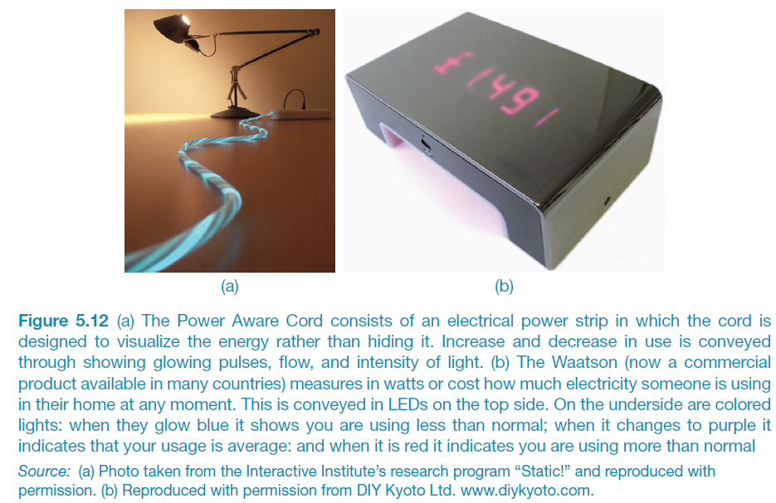
Energy reduction
Notes:
The global concern about climate change has led a number of HCI researchers to design and evaluate various energy sensing devices that display real-time feedback. A goal is to find ways of helping people reduce their energy consumption (and is part of a larger research agenda called sustainable HCI, Mankoff et al, 2008; DiSalvo et al, 2010). A focus is on persuading people to change their everyday habits with respect to environmental concerns, such as reducing their own carbon footprint, their community’s (e.g. school, workplace) or an even larger organization’s (e.g. street, town, country). Two well-known products are the Power Aware Cord and the Waatson. The Power-Aware Cord consists of an electrical power strip in which the cord is designed to visualize the energy rather than hiding it. Increase and decrease in use is conveyed through showing glowing pulses, flow, and intensity of light. The Waatson (now a commercial product available in many countries) measures in watts or cost how much electricity someone is using in their home at any moment. This is conveyed in LEDS on the top-side. On the underside are coloured lights; when they glow blue it shows you are using less than normal; when it changes to purple it indicates that your usage is average, and when it is red it indicates you are using more than usual.
51

Slide 52
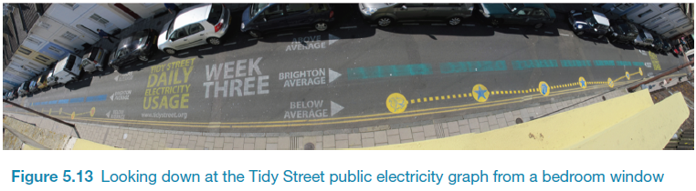
The Tidy Street project
large-scale visualization of the street’s electricity usage
  stenciled display on the road surface using chalk
  provided realtime feedback that all could see change each day
  reduced electricity consumption by 15%

Slide 53
Anthropomorphism
Attributing human-like qualities to inanimate objects (e.g. cars, computers)
Well known phenomenon in advertising
  Dancing butter, drinks, breakfast cereals
Much exploited in human-computer interaction
  Make user experience more enjoyable, more motivating, make people feel at ease, reduce anxiety
Notes:
53

Slide 54
Evidence to support anthropomorphism
Reeves and Naas (1996) found that computers that flatter and praise users in education software programs -> positive impact on them
“Your question makes an important and useful distinction. Great job!”
Students were more willing to continue with exercises with this kind of feedback
Notes:
54

Slide 55
Criticism of anthropomorphism
Deceptive, make people feel anxious, inferior or stupid
People tend not to like screen characters that wave their fingers at the user and say:
  Now Chris, that’s not right. You can do better than that.Try again.”
Many prefer the more impersonal:
  “Incorrect. Try again.”
Notes:
55

Slide 56
Implications
Should we create products that adapt according to people’s different emotional states?
  When people are feeling angry should an interface be more attentive and informative than when they are happy?
Notes:
56

