Slide 1
Lecture 1b- Review
CS 141-02
Introduction to Programming and Problem Solving
Dr. Sampath Jayarathna
Cal Poly Pomona
Copyright © 2016 Pearson Education, Inc., Hoboken NJ

Slide 2
Java Basics
Primitive data types
Read and write to/from console
If-else statements
Loops
Basic String operations
Read and write to/from files

Slide 3
Activity 1
public Class Hello World {
public void main(string[] ts)
{
String message = “Hello World”
system.out.println(Message);}
}
}
Any errors?

Slide 4
The Compiler and the Java Virtual Machine
A programmer writes Java programming statements for a program.
These statements are known as source code.
A text editor is used to edit and save a Java source code file.
Source code files have a .java file extension.
A compiler is a program that translates source code into an executable form.

Slide 5
The Compiler and the Java Virtual Machine
A compiler is run using a source code file as input.
Syntax errors that may be in the program will be discovered during compilation.
Syntax errors are mistakes that the programmer has made that violate the rules of the programming language.
The compiler creates another file that holds the translated instructions.

Slide 6
The Compiler and the Java Virtual Machine
Most compilers translate source code into executable files containing machine code.
The Java compiler translates a Java source file into a file that contains byte code instructions.
Byte code instructions are the machine language of the Java Virtual Machine (JVM) and cannot be directly executed directly by the CPU.

Slide 7
Program Development Process
Text editor
Saves Java statements
Source code
(.java)
Is read by
Byte code
(.class)
Java compiler
Produces
Is interpreted by
Program
Execution
Java
Virtual
Machine
Results in

Slide 8
Portability
Portable means that a program may be written on one type of computer and then run on a wide variety of computers, with little or no modification.
Java byte code runs on the JVM and not on any particular CPU; therefore, compiled Java programs are highly portable.
JVMs exist on many platforms:
Windows
Mac
Linux
Unix
BSD
Etc.

Slide 9
Portability
With most programming languages, portability is achieved by compiling a program for each CPU it will run on.
Java provides an JVM for each platform so that programmers do not have to recompile for different platforms.
Byte code
(.class)
Java Virtual
Machine for Windows
Java Virtual
Machine for Unix
Java Virtual
Machine for Linux
Java Virtual
Machine for Mac

Slide 10
Java Versions
The software you use to write Java programs is called the Java Development Kit, or JDK.
There are different editions of the JDK:
  Java SE - Standard Edition.
  Java EE - Enterprise Edition.
  Java ME - Micro Edition.
Available for download at
http://java.oracle.com

Slide 11
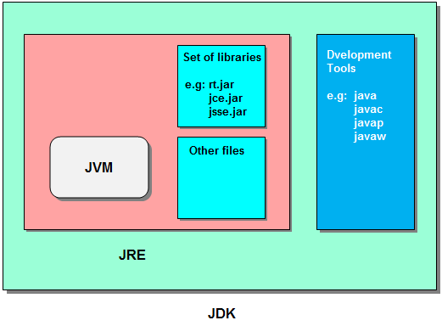
JVM vs. JRE vs. JDK

Slide 12
Compiling a Java Program
The Java compiler is a command line utility.
The command to compile a program is:
    javac filename.java
javac is the Java compiler.
To compile :
  javac Simple.java
    Notice the .java file extension is needed.
    This will result in a file named Simple.class being created.
To run the program:
  java Simple
    Notice there is no file extension here.
    The java command assumes the extension is .class.

Slide 13
Primitive Data Types
Primitive data types are built into the Java language and are not derived from classes.
There are 8 Java primitive data types.
  byte
  short
  int
  long
  float
  double
  boolean
  char

Slide 14
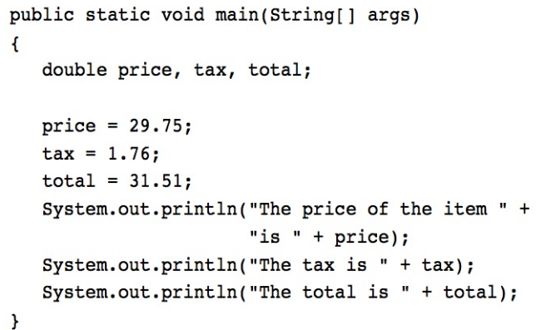
Floating Point Literals
When floating point numbers are embedded into Java source code they are called floating point literals.
Java is a strongly-typed language. Which means it only allows you to store values of compatible data types in variables

Slide 15
Floating Point Literals
The default type for floating point literals is double. It means when you create a floating point literal by default the values type is double
A double value is not compatible with a float variable because of its size and precision.
  float number;
  number = 23.5; // Error because 23.5 type is double!
A double can be forced into a float by appending the letter F or f to the literal.
  float number;
  number = 23.5f; // This will work.

Slide 16
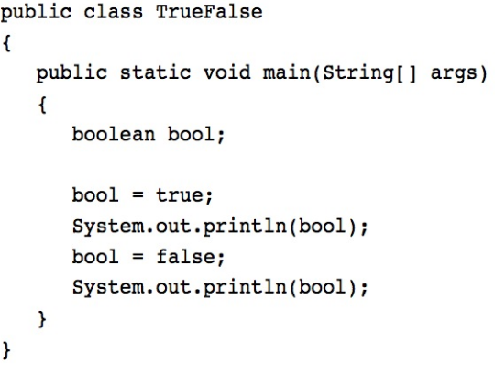
The boolean Data Type
The Java boolean data type can have two possible values.
  true
  false
The value of a boolean variable may only be copied into a boolean variable.

Slide 17
The char Data Type
The Java char data type provides access to single characters.
char literals are enclosed in single quote marks.
  ‘a’, ‘Z’, ‘\n’, ‘1’
Don’t confuse char literals with string literals.
  char literals are enclosed in single quotes.
  String literals are enclosed in double quotes.

Slide 18
Variables
Variables are simply a name given to represent a place in memory.
0x000
0x001
0x002
0x003
0x004
0x005
0x006
0x007

Slide 19
Variables
Assume that the this
variable declaration
has been made.
int length = 72;
0x000
The Java Virtual
Machine (JVM)
actually decides
where the value
will be placed
in memory.
0x001
0x002
0x003
72
0x004
The variable length
is a symbolic name
for the memory
location 0x003.
0x005
0x006
0x007

Slide 20
Variables and Literals
This line is called
a variable declaration.
int value;
The following line is known
as an assignment statement.
value = 5;
0x000
The value 5
is stored in
memory.
0x001
5
0x002
0x003
This is a string literal. It will be printed as is.
System.out.print("The value is ");
System.out.println(value);
The integer 5 will
be printed out here.
Notice no quote marks?

Slide 21
Creating Constants
Once initialized with a value, constants cannot be changed programmatically.
By convention, constants are all upper case and words are separated by the underscore character.
  final double CAL_SALES_TAX = 0.725;

Slide 22
Primitive vs. Reference Variables
Primitive variables actually contain the value that they have been assigned.
  number = 25;
The value 25 will be stored in the memory location associated with the variable number.
Objects are not stored in variables, however. Objects are referenced by variables.

Slide 23
Primitive vs. Reference Variables
When a variable references an object, it contains the memory address of the object’s location.
Then it is said that the variable references the object.
  String cityName = "Charleston";
The object that contains the
character string “Charleston”
Charleston
cityName
Address to the object

Slide 24
Predefined Classes
There are predefined classes in Java
  Ease of programming
  Provides certain useful functionality
    Printing results
    Receiving user input
To use these classes
  Create instances of the classes called objects
  More on this in future lectures

Slide 25
String Objects
A variable can be assigned a String literal.
  String value = "Hello";
Strings are the only objects that can be created in this way.
A variable can be created using the new keyword.
  String value = new String("Hello");
This is the method that all other objects must use when they are created. More about objects later!!

Slide 26
The String Methods
Since String is a class, objects that are instances of it have methods.
One of those methods is the length method.
  int stringSize = value.length();
This statement runs the length method on the object pointed to by the value variable.

Slide 27
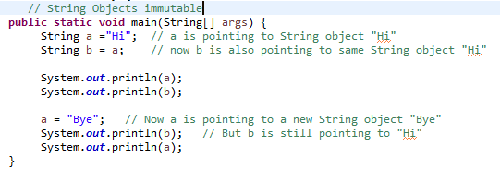

String Methods
The String class contains many methods that help with the manipulation of String objects.
String objects are immutable, meaning that they cannot be changed.
Mutable objects have fields that can be changed, immutable objcts have no fields that can be changed after the object is created.
Many of the methods of a String object can create new versions of the object.

Slide 28
The + Operator
The + operator can be used in two ways.
  as a concatenation operator
  as an addition operator
If either side of the + operator is a string, the result will be a string.
  System.out.println("Hello " + "World");
  System.out.println("The value is: " + 5);
  System.out.println("The value is: " + value);
  System.out.println("The value is: " + ‘/n’ + 5);

Slide 29
String Concatenation
Java commands that have string literals must be treated with care.
A string literal value cannot span lines in a Java source code file.
  System.out.println("This line is too long and now it has spanned more than one line, which will cause a syntax error to be generated by the compiler. ");

Slide 30
String Concatenation
The String concatenation operator can be used to fix this problem.
    System.out.println("These lines are " +
    "are now ok and will not " +
    "cause the error as before.");
String concatenation can join various data types.
    System.out.println("We can join a string to " +
    "a number like this: " + 5);

Slide 31
What does this print?
public class Test{
public static void main(String[] args)
{
System.out.println("Hello: ” + (5+5));
}
}

Slide 32
What about this?
public class Test{
public static void main(String[] args)
{
System.out.println("Hello: ” + 5 + 5);
}
}

Slide 33
Variable Assignment and Initialization
// This program shows variable assignment.
public class Initialize
{
public static void main(String[] args)
{
int month, days;
month = 2;
days = 28;
System.out.println("Month " + month + " has " +
days + " Days.");
}
}
The variables must be declared before they can be used.

Slide 34
Variable Assignment and Initialization
// This program shows variable assignment.
public class Initialize
{
public static void main(String[] args)
{
int month, days;
month = 2;
days = 28;
System.out.println("Month " + month + " has " +
days + " Days.");
}
}
Once declared, they can then receive a value (initialization);
however the value must be compatible with the variable’s
declared type.

Slide 35
Variable Assignment and Initialization
// This program shows variable assignment.
public class Initialize
{
public static void main(String[] args)
{
int month, days;
month = 2;
days = 28;
System.out.println("Month " + month + " has " +
days + " Days.");
}
}
After receiving a value, the variables can then be used in
output statements or in other calculations.

Slide 36
Variable Assignment and Initialization
// This program shows variable initialization.
public class Initialize
{
public static void main(String[] args)
{
int month = 2, days = 28;
System.out.println("Month " + month + " has " +
days + " Days.");
}
}
Local variables can be declared and initialized on
the same line.

Slide 37
Variable Assignment and Initialization
Variables can only hold one value at a time.
Local variables do not receive a default value.
Local variables must have a valid type in order to be used.
public static void main(String [] args)
{
int month, days; //No value given…
System.out.println("Month " + month + " has " +
days + " Days.");
}
Trying to use uninitialized variables will generate a Syntax Error when the code is compiled.

Slide 38
The System.out.printf Method
You can use the System.out.printf method to perform formatted console output.
The general format of the method is:
System.out.printf(FormatString, ArgList);

Slide 39
The System.out.printf Method
System.out.printf(FormatString, ArgList);
FormatString is a string that contains text and/or special formatting specifiers.
ArgList is optional. It is a list of additional arguments that will be formatted according to the format specifiers listed in the format string.

Slide 40
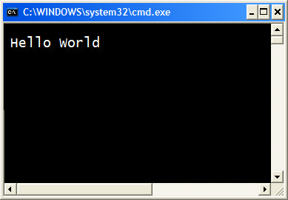
The System.out.printf Method
System.out.printf("Hello World\n");
A simple example:

Slide 41
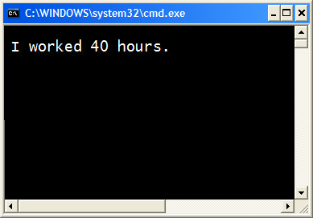
The System.out.printf Method
int hours = 40;
System.out.printf("I worked %d hours.\n", hours);
Another example:

Slide 42
The System.out.printf Method
int hours = 40;
System.out.printf("I worked %d hours.\n", hours);
The %d format specifier indicates that a decimal integer will be printed.
The contents of the hours variable will be printed in the location of the %d format specifier.

Slide 43
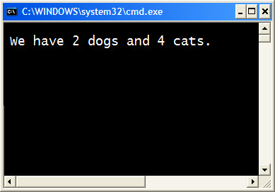
The System.out.printf Method
int dogs = 2, cats = 4;
System.out.printf("We have %d dogs and %d cats.\n",
dogs, cats);
Another example:

Slide 44
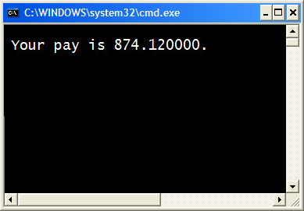
The System.out.printf Method
double grossPay = 874.12;
System.out.printf("Your pay is %f.\n", grossPay);
Another example:

Slide 45
The System.out.printf Method
double grossPay = 874.12;
System.out.printf("Your pay is %f.\n", grossPay);
The %f format specifier indicates that a floating-point value will be printed.
The contents of the grossPay variable will be printed in the location of the %f format specifier.
Another example:

Slide 46
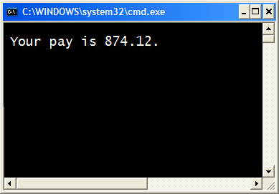
The System.out.printf Method
double grossPay = 874.12;
System.out.printf("Your pay is %.2f.\n", grossPay);
Another example:

Slide 47
The System.out.printf Method
double grossPay = 874.12;
System.out.printf("Your pay is %.2f.\n", grossPay);
The %.2f format specifier indicates that a floating-point value will be printed, rounded to two decimal places.
Another example:

Slide 48
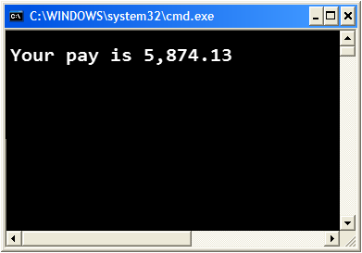
The System.out.printf Method
double grossPay = 5874.127;
System.out.printf("Your pay is %,.2f.\n", grossPay);
The %,.2f format specifier indicates that a floating-point value will be printed with comma separators, rounded to two decimal places.
Another example:

Slide 49

The System.out.printf Method
String name = "Ringo";
System.out.printf("Your name is %s.\n", name);
The %s format specifier indicates that a string will be printed.
Another example:

Slide 50
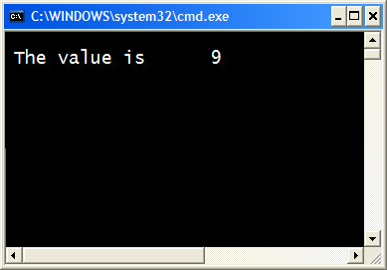
The System.out.printf Method
int number = 9;
System.out.printf("The value is %6d\n", number);
The %6d format specifier indicates the integer will appear in a field that is 6 spaces wide.
Specifying a field width:

Slide 51

The System.out.printf Method
double number = 9.76891;
System.out.printf("The value is %6.2f\n", number);
The %6.2f format specifier indicates the number will appear in a field that is 6 spaces wide, and be rounded to 2 decimal places.
Another example:

Slide 52
The printf Example 1

Slide 53
The String.format Method
The general format of the method is:
String.format(FormatString,ArgumentList);
FormatString is a string that contains text and/or special formatting specifiers.
ArgumentList is optional. It is a list of additional arguments that will be formatted according to the format specifiers listed in the format string.

Slide 54

The String.format Method
The String.format method works exactly like the System.out.printf method, except that it does not display the formatted string on the screen.
Instead, it returns a reference to the formatted string.
You can assign the reference to a variable, and then use it later.

Slide 55
The Scanner Class
To read input from the keyboard we can use the Scanner class.
The Scanner class is defined in java.util, so we will use the following statement at the top of our programs:
import java.util.Scanner;
Scanner objects work with System.in
To create a Scanner object:
Scanner keyboard = new Scanner (System.in);

Slide 56
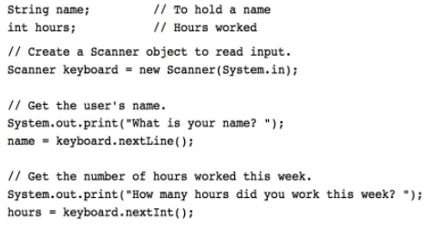
The Scanner Class example

Slide 57
Arithmetic Operators
Java has five arithmetic operators.
Operator | Meaning | Example
+ | Addition | total = cost + tax;
- | Subtraction | cost = total – tax;
* | Multiplication | tax = cost * rate;
/ | Division | salePrice = original / 2;
% | Modulus | remainder = value % 5;

Slide 58
Integer Division
Division can be tricky.
  In a Java program, what is the value of 1/2?
You might think the answer is 0.5…
The answer is simply 0.
Integer division will truncate any decimal remainder.

Slide 59
Scope
Scope refers to the part of a program that has access to a variable’s contents.
Variables declared inside a method (like the main method) are called local variables.
Local variables’ scope begins at the declaration of the variable and ends at the end of the method in which it was declared.

Slide 60
if-else-if Statements
if (expression_1)
{
statement;
statement;
etc.
}
else if (expression_2)
{
statement;
statement;
etc.
}
Insert as many else if clauses as necessary
else
{
statement;
statement;
etc.
}
If expression_1 is true these statements are executed, and the rest of the structure is ignored.
Otherwise, if expression_2 is true these statements are executed, and the rest of the structure is ignored.
These statements are executed if none of the expressions above are true.

Slide 61
The switch Statement
The if-else statement allows you to make true / false branches.
The switch statement allows you to use an ordinal value to determine how a program will branch.
The switch statement can evaluate an integer type or character type variable and make decisions based on the value.

Slide 62
The switch Statement
The switch statement takes the form:
  switch (SwitchExpression)
  {
  case CaseExpression:
  // place one or more statements here
  break;
  case CaseExpression:
  // place one or more statements here
  break;
  // case statements may be repeated
  //as many times as necessary
  default:
  // place one or more statements here
  }

Slide 63
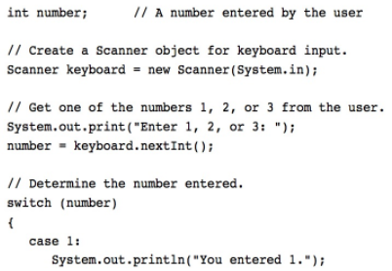
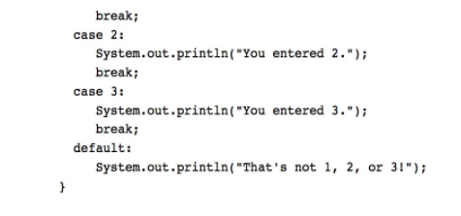
The switch Example

Slide 64
Boolean Expressions
A boolean expression is any variable or calculation that results in a true or false condition.
Expression | Meaning
x > y | Is x greater than y?
x < y | Is x less than y?
x >= y | Is x greater than or equal to y?
x <= y | Is x less than or equal to y.
x == y | Is x equal to y?
x != y | Is x not equal to y?

Slide 65
Logical Operators
Java provides two binary logical operators (&& and ||) that are used to combine boolean expressions.
Java also provides one unary (!) logical operator to reverse the truth of a boolean expression.
Operator | Meaning | Effect
&& | AND | Connects two boolean expressions into one. Both expressions must be true for the overall expression to be true.
|| | OR | Connects two boolean expressions into one. One or both expressions must be true for the overall expression to be true. It is only necessary for one to be true, and it does not matter which one.
! | NOT | The ! operator reverses the truth of a boolean expression. If it is applied to an expression that is true, the operator returns false. If it is applied to an expression that is false, the operator returns true.

Slide 66
The Increment and Decrement Operators
There are numerous times where a variable must simply be incremented or decremented.
  number = number + 1;
  number = number – 1;
Java provide shortened ways to increment and decrement a variable’s value.
Using the ++ or -- unary operators, this task can be completed quickly.
  number++; or ++number;
  number--; or --number;

Slide 67
Differences Between Prefix and Postfix
When an increment or decrement are the only operations in a statement, there is no difference between prefix and postfix notation.
When used in an expression:
  prefix notation indicates that the variable will be incremented or decremented prior to the rest of the equation being evaluated.
  postfix notation indicates that the variable will be incremented or decremented after the rest of the equation has been evaluated.

Slide 68
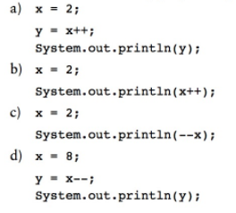
Differences Between Prefix and Postfix

Slide 69
The while Loop
Java provides three different looping structures.
The while loop has the form:
  while(condition)
  {
    statements;
  }
While the condition is true, the statements will execute repeatedly.
The while loop is a pretest loop, which means that it will test the value of the condition prior to executing the loop.

Slide 70
Infinite Loops
In order for a while loop to end, the condition must become false. The following loop will not end:
  int x = 20;
  while(x > 0)
  {
    System.out.println("x is greater than 0");
  }
The variable x never gets decremented so it will always be greater than 0.
Adding the x-- above fixes the problem.

Slide 71
The do-while Loop
The do-while loop is a post-test loop, which means it will execute the loop prior to testing the condition.
The do-while loop (sometimes called called a do loop) takes the form:
  do
  {
  statement(s);
  }while (condition);

Slide 72
The for Loop
The for loop is a pre-test loop.
The for loop allows the programmer to initialize a control variable, test a condition, and modify the control variable all in one line of code.
The for loop takes the form:
  for(initialization; test; update)
  {
    statement(s);
  }

Slide 73
Deciding Which Loops to Use
The while loop:
  Pretest loop
  Use it where you do not want the statements to execute if the condition is false in the beginning.
The do-while loop:
  Post-test loop
  Use it where you want the statements to execute at least one time.
The for loop:
  Pretest loop
  Use it where there is some type of counting variable that can be evaluated.

Slide 74
Activity 2
Bar Chart
Write a program that asks the user to enter today’s sales for five stores. The program should display a bar chart comparing each store’s sales. Create each bar in the bar chart by displaying a row of asterisks. Each asterisk should represent $100 of sales. Here is an example of the program’s output:
Enter today's sales for store 1: 1000 [enter]
Enter today's sales for store 2: 1200 [enter]
Enter today's sales for store 3: 1800 [enter]
Enter today's sales for store 4: 800 [enter]
Enter today's sales for store 5: 1900 [enter]
SALES BAR CHART
Store 1: **********
Store 2: ************
Store 3: ******************
Store 4: ********
Store 5: *******************

Slide 75
File Input and Output
Reentering data all the time could get tedious for the user.
The data can be saved to a file.
  Files can be input files or output files.
Files:
  Files have to be opened.
  Data is then written to the file.
  The file must be closed prior to program termination.
In general, there are two types of files:
  binary
  text

Slide 76
Writing Text To a File
PrintWriter outputFile = new PrintWriter("StudentData.txt");
Pass the name of the file that you wish to open as an argument to the PrintWriter constructor.
Warning: if the file already exists, it will be erased and replaced with a new file.
To open a file for text output you create an instance of the PrintWriter class.

Slide 77
The PrintWriter Class
The PrintWriter class allows you to write data to a file using the print and println methods, as you have been using to display data on the screen.
Just as with the System.out object, the println method of the PrintWriter class will place a newline character after the written data.
The print method writes data without writing the newline character.

Slide 78
The PrintWriter Class
Open the file.
PrintWriter outputFile = new PrintWriter("Names.dat");
outputFile.println("Chris");
outputFile.println("Kathryn");
outputFile.println("Jean");
outputFile.close();
Close the file.
Write data to the file.

Slide 79
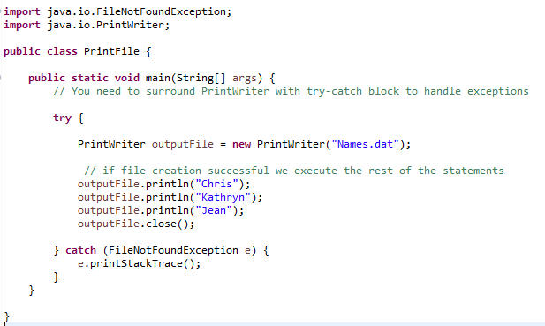
The PrintWriter Class

Slide 80
Exceptions
When something unexpected happens in a Java program, an exception is thrown.
The method that is executing when the exception is thrown must either handle the exception or pass it up the line.
Handling the exception will be discussed later.
To pass it up the line, the method needs a throws clause in the method header or try-catch block to catch the exception.

Slide 81
Exceptions
To insert a throws clause in a method header, simply add the word throws and the name of the expected exception.
PrintWriter objects can throw an IOException, so we write the throws clause like this:
  public static void main(String[] args) throws IOException

Slide 82
Appending Text to a File
To avoid erasing a file that already exists, create a FileWriter object in this manner:
FileWriter fw =
new FileWriter("names.dat", true);
Then, create a PrintWriter object in this manner:
PrintWriter fw = new PrintWriter(fw);

Slide 83
Specifying a File Location
On a Windows computer, paths contain backslash (\) characters.
Remember, if the backslash is used in a string literal, it is the escape character so you must use two of them:
  PrintWriter outFile =
  new PrintWriter("A:\\PriceList.txt");

Slide 84
Specifying a File Location
This is only necessary if the backslash is in a string literal.
If the backslash is in a String object then it will be handled properly.
Fortunately, Java allows Unix style filenames using the forward slash (/) to separate directories:
  PrintWriter outFile = new
  PrintWriter("/home/rharrison/names.txt");

Slide 85
Reading Data From a File
You use the File class and the Scanner class to read data from a file:
Pass the name of the file as an argument to the File class constructor.
File myFile = new File("Customers.txt");
Scanner inputFile = new Scanner(myFile);
Pass the File object as an argument to the Scanner class constructor.

Slide 86
Reading Data From a File
  Scanner keyboard = new Scanner(System.in);
  System.out.print("Enter the filename: ");
  String filename = keyboard.nextLine();
  File file = new File(filename);
  Scanner inputFile = new Scanner(file);
The lines above:
  Creates an instance of the Scanner class to read from the keyboard
  Prompt the user for a filename
  Get the filename from the user
  Create an instance of the File class to represent the file
  Create an instance of the Scanner class that reads from the file

Slide 87
Reading Data From a File
Once an instance of Scanner is created, data can be read using the same methods that you have used to read keyboard input (nextLine, nextInt, nextDouble, etc).
  // Open the file.
  File file = new File("Names.txt");
  Scanner inputFile = new Scanner(file);
  // Read a line from the file.
  String str = inputFile.nextLine();
  // Close the file.
  inputFile.close();

Slide 88
Detecting The End of a File
The Scanner class’s hasNext() method will return true if another item can be read from the file.
  // Open the file.
  File file = new File(filename);
  Scanner inputFile = new Scanner(file);
  // Read until the end of the file.
  while (inputFile.hasNext())
  {
  String str = inputFile.nextLine();
  System.out.println(str);
  }
  inputFile.close();// close the file when done.

Slide 89
Java Naming Conventions
Variable names should begin with a lower case letter and then switch to title case thereafter:
    Ex: int caTaxRate
Class names should be all title case.
    Ex: public class BigLittle
More Java naming conventions can be found at:
  http://java.sun.com/docs/codeconv/html/CodeConventions.doc8.html
A general rule of thumb about naming variables and classes are that, with some exceptions, their names tend to be nouns or noun phrases.

Slide 90
Java Reserved Keywords
abstract
assert
boolean
break
byte
case
catch
char
class
const
continue
default
do
double
else
enum
extends
false
for
final
finally
float
goto
if
implements
import
instanceof
int
interface
long
native
new
null
package
private
protected
public
return
short
static
strictfp
super
switch
synchronized
this
throw
throws
transient
true
try
void
volatile
while

Slide 91
Commenting Code
Java provides three methods for commenting code.
Comment Style | Description
// | Single line comment. Anything after the // on the line will be ignored by the compiler.
/* … */ | Block comment. Everything beginning with /* and ending with the first */ will be ignored by the compiler. This comment type cannot be nested.
/** … */ | Javadoc comment. This is a special version of the previous block comment that allows comments to be documented by the javadoc utility program. Everything beginning with the /** and ending with the first */ will be ignored by the compiler. This comment type cannot be nested.

Slide 92
Programming Style
Although Java has a strict syntax, whitespace characters are ignored by the compiler.

Slide 93
Indentation
Programs should use proper indentation.
Each block of code should be indented a few spaces from its surrounding block.
Two to four spaces are sufficient.
Tab characters should be avoided.
  Tabs can vary in size between applications and devices.

Slide 94
Activity 3
2a) Using nested for loops, print the following to the screen:
******
******
******
******
******
******
******
******
2b) Using nested for loops, print the following to the screen:
*******
******
*****
****
***
**
*

