Slide 1
Lecture 2- Classes, Objects and Methods
CS 141-02
Introduction to Programming and Problem Solving
Dr. Sampath Jayarathna
Cal Poly Pomona
Copyright © 2016 Pearson Education, Inc., Hoboken NJ

Slide 2
Objects and Classes
An object exists in memory, and performs a specific task.
Objects have two general capabilities:
Objects can store data. The pieces of data stored in an object are known as fields.
Objects can perform operations. The operations that an object can perform are known as methods.

Slide 3
Objects and Classes
You have already used the following objects:
Scanner objects, for reading input
String objects, for text variables
PrintWriter objects, for writing data to files
When a program needs the services of a particular type of object, it creates that object in memory, and then calls that object's methods as necessary.

Slide 4
Objects and Classes
Classes: Where Objects Come From
A class is code that describes a particular type of object. It specifies the data that an object can hold (the object's fields), and the actions that an object can perform (the object's methods).
You can think of a class as a code "blueprint" that can be used to create a particular type of object.

Slide 5
Objects and Classes
When a program is running, it can use the class to create, in memory, as many objects of a specific type as needed.
Each object that is created from a class is called an instance of the class.

Slide 6
Objects and Classes
This expression creates a Scanner object in memory.
Example:
Scanner keyboard = new Scanner(System.in);
The object's memory address is assigned to the keyboard variable.
Scanner
object
keyboard
variable

Slide 7
Objects and Classes
This expression creates a Random object in memory.
Example:
Random rand = new Random();
The object's memory address is assigned to the rand variable.
Random
object
rand
variable

Slide 8
Objects and Classes
This expression creates a PrintWriter object in memory.
Example:
PrintWriter outputFile = new PrintWriter("numbers.txt");
The object's memory address is assigned to the outputFile variable.
PrintWriter
object
outputFile
variable

Slide 9
Objects and Classes
The Java API provides many classes
So far, the classes that you have created objects from are provided by the Java API.
Examples:
Scanner
Random
PrintWriter

Slide 10
Writing a Class, Step by Step
public class Rectangle
{
private double length;
private double width;
}
A Rectangle object will have the following fields:
length. The length field will hold the rectangle’s length.
width. The width field will hold the rectangle’s width.

Slide 11
Creating an object
ClassName objectName = new ClassName();
Rectangle box = new Rectangle ();
A Rectangle object
The box variable holds the address of the Rectangle object.
length:
0.0
address
width:
0.0

Slide 12
Writing a Class, Step by Step
The Rectangle class will also have the following methods:
setLength. The setLength method will store a value in an object’s length field.
setWidth. The setWidth method will store a value in an object’s width field.
getLength. The getLength method will return the value in an object’s length field.
getWidth. The getWidth method will return the value in an object’s width field.
getArea. The getArea method will return the area of the rectangle, which is the result of the object’s length multiplied by its width.

Slide 13
Instance Fields and Methods
Instance fields and instance methods require an object to be created in order to be used.
Note that each room represented in this can have different dimensions.
Rectangle kitchen = new Rectangle();
Rectangle bedroom = new Rectangle();
Rectangle den = new Rectangle();

Slide 14
States of Three Different Rectangle Objects
The kitchen variable holds the address of a Rectangle Object.
length:
10.0
address
width:
14.0
The bedroom variable holds the address of a Rectangle Object.
length:
15.0
address
width:
12.0
The den variable holds the address of a Rectangle Object.
length:
20.0
address
width:
30.0

Slide 15
Access Specifiers
An access specifier is a Java keyword that indicates how a field or method can be accessed.
public
When the public access specifier is applied to a class member, the member can be accessed by code inside the class or outside.
private
When the private access specifier is applied to a class member, the member cannot be accessed by code outside the class. The member can be accessed only by methods that are members of the same class.

Slide 16
Writing the Code for the Class Fields
public class Rectangle
{
public double length; // field length
public double width; // field width
public static void main(String[] args)
{
Rectangle box = new Rectangle();
box.length = 4.3; // set values
box.width = 5.2; // set values
}
}
Object.fieldname to access public fields

Slide 17
Private Class Fields
Need public methods to access the fields
public class Rectangle
{
private double length; // field length
private double width; // field width
public static void main(String[] args)
{
Rectangle box = new Rectangle();
box.length = 4.3; // set values
box.width = 5.2; // set values
}
}
Error! Can’t access private fields

Slide 18
Instance Fields and Methods
Fields and methods that are declared as previously shown are called instance fields and instance methods.
Objects created from a class each have their own copy of instance fields.
Instance methods are methods that are not declared with a special keyword, static.

Slide 19
Activity 2
Create a class Vehicle
Create 4 relevant data fields for the class Vehicle.
Write main method and create following objects from the class Vehicle
car
suv
semitruck
schoolBus
Assign relevant data values for the object schoolBus and display the results.

Slide 20
Why Write Methods?
Methods are commonly used to break a problem down into small manageable pieces. This is called divide and conquer.
Methods simplify programs. If a specific task is performed in several places in the program, a method can be written once to perform that task, and then be executed anytime it is needed. This is known as code reuse.

Slide 21
Parts of a Method Header
Method modifiers
public—method is publicly available to code outside the class
static—method belongs to a class, not a specific object.
Return type—void or the data type from a value-returning method
Method name—name that is descriptive of what the method does
Parentheses—contain nothing or a list of one or more variable declarations if the method is capable of receiving arguments.

Slide 22
Header for the setLength Method
Return Type
Notice the word static does not appear in the method header designed to work on an instance of a class (instance method).
Access specifier
Method Name
public void setLength (double len)
{
length = len;
}
Parameter variable declaration

Slide 23
Calling the setLength Method
Rectangle box = new Rectangle ();
box.setLength(10.0);
The box variable holds the address of the Rectangle object.
A Rectangle object
length:
10.0
address
width:
0.0
This is the state of the box object after the setLength method executes.

Slide 24
Writing the Code for the Class Fields
public class Rectangle
{
private double length; // field length
private double width; // field width
/**
The setLength method stores a value in the
length field.
@param len The value to store in length.
*/
public void setLength(double len)
{
length = len;
}
public static void main(String[] args)
{
Rectangle box = new Rectangle();
box.setLength(5.5);
}
}

Slide 25
Accessor and Mutator Methods
Because of the concept of data hiding, fields in a class are private.
The methods that retrieve the data of fields are called accessors.
The methods that modify the data of fields are called mutators.
Each field that the programmer wishes to be viewed by other classes needs an accessor.
Each field that the programmer wishes to be modified by other classes needs a mutator.

Slide 26
Accessors and Mutators
For the Rectangle example, the accessors and mutators are:
setLength : Sets the value of the length field.
public void setLength(double len) …
setWidth : Sets the value of the width field.
public void setLength(double w) …
getLength : Returns the value of the length field.
public double getLength() …
getWidth : Returns the value of the width field.
public double getWidth() …
Other names for these methods are getters and setters.

Slide 27
Getters and Setters for Rectangle Class
public class Rectangle
{
private double width;
private double length;
public void setWidth(double w)
{ width = w;
}
public void setLength(double len)
{ length = len;
}
public double getWidth()
{ return width;
}
public double getLength()
{ return length;
}
public double getArea()
{ return length * width;
}
}

Slide 28
Calling the instance methods
public class Rectangle
{
…
public static void main(String[] args)
{
Rectangle box = new Rectangle();
box.setLength(5.5);
box.setWidth(2.4);
double boxWidth = box.getWidth();
double boxLength = box.getLength();
System.out.println(box.getArea());
}
}

Slide 29
Data Hiding
An object hides its internal, private fields from code that is outside the class that the object is an instance of.
Only the class's methods may directly access and make changes to the object’s internal data.
Code outside the class must use the class's public methods to operate on an object's private fields.

Slide 30
Data Hiding
Data hiding is important because classes are typically used as components in large software systems, involving a team of programmers.
Data hiding helps enforce the integrity of an object's internal data.

Slide 31
Stale Data
Some data is the result of a calculation.
Consider the area of a rectangle.
length × width
It would be impractical to use an area variable here.
Data that requires the calculation of various factors has the potential to become stale.
To avoid stale data, it is best to calculate the value of that data within a method rather than store it in a variable.

Slide 32
Stale Data
Rather than use an area variable in a Rectangle class:
public double getArea()
{
return length * width;
}
This dynamically calculates the value of the rectangle’s area when the method is called.
Now, any change to the length or width variables will not leave the area of the rectangle stale.

Slide 33
Parts of a static Method Header
Method Modifiers
Return Type
Method Name
Parentheses
public static void displayMessage ()
{
System.out.println("Hello");
}

Slide 34
Calling a static Method
A method executes when it is called.
The main method is automatically called when a program starts, but other methods are executed by method call statements.
displayMessage();
Notice that the method modifiers and the void return type are not written in the method call statement. Those are only written in the method header.

Slide 35
Activity 4
Use the class Vehicle created in the Activity 3 (you can copy one from Piazza)
Create a static method in class Vehicle called calculateMpgToKpl which returns double Kilometer per liter (KPL) for parameter of Miles Per Gallon (MPG) value.
Kpl = Mpg x 0.4251
Create a Driver class called VehicleDemo for your Vehicle and copy previous objects, and method calls to the driver class main method.
Now call the static method from the VehicleDemo by passing the MPG value 385.25

Slide 36
Constructors
Classes can have special methods called constructors.
A constructor is a method that is automatically called when an object is created.
Constructors are used to perform operations at the time an object is created.
Constructors typically initialize instance fields and perform other object initialization tasks.

Slide 37
Constructors
Constructors have a few special properties that set them apart from normal methods.
Constructors have the same name as the class.
Constructors have no return type (not even void).
Constructors may not return any values.
Constructors are typically public.

Slide 38
Constructor for Rectangle Class
/**
Constructor
@param len The length of the rectangle.
@param w The width of the rectangle.
*/
public Rectangle(double len, double w)
{
length = len;
width = w;
}

Slide 39
Constructors in UML
Rectangle
Notice there is no
return type listed
for constructors.
width : double
length : double
+Rectangle(double, double)
+ setWidth(double) : void
+ setLength(double): void
+ getWidth() : double
+ getLength() : double
+ getArea() : double
In UML, the most common way constructors are defined is:

Slide 40
Uninitialized Local Reference Variables
Reference variables can be declared without being initialized.
Rectangle box;
This statement does not create a Rectangle object, so it is an uninitialized local reference variable.
A local reference variable must reference an object before it can be used, otherwise a compiler error will occur.
box = new Rectangle(7.0, 14.0);
box will now reference a Rectangle object of length 7.0 and width 14.0.

Slide 41
The Default Constructor
When an object is created, its constructor is always called.
If you do not write a constructor, Java provides one when the class is compiled. The constructor that Java provides is known as the default constructor.
It sets all of the object’s numeric fields to 0.
It sets all of the object’s boolean fields to false.
It sets all of the object’s reference variables to the special value null.

Slide 42
The Default Constructor
The default constructor is a constructor with no parameters, used to initialize an object in a default configuration.
The only time that Java provides a default constructor is when you do not write any constructor for a class.
A default constructor is not provided by Java if a constructor is already written.

Slide 43
Writing Your Own No-Arg Constructor
A constructor that does not accept arguments is known as a no-arg constructor.
The default constructor (provided by Java) is a no-arg constructor.
We can write our own no-arg constructor
public Rectangle()
{
length = 1.0;
width = 1.0;
}

Slide 44
The String Class Constructor
One of the String class constructors accepts a string literal as an argument.
This string literal is used to initialize a String object.
For instance:
String name = new String("Michael Long");

Slide 45
The String Class Constructor
This creates a new reference variable name that points to a String object that represents the name “Michael Long”
Because they are used so often, String objects can be created with a shorthand:
String name = "Michael Long";

Slide 46
Passing Objects as Arguments
When you pass a object as an argument, the thing that is passed into the parameter variable is the object's memory address.
As a result, parameter variable references the object, and the receiving method has access to the object.

Slide 47
Overloading Methods and Constructors
Two or more methods in a class may have the same name as long as their parameter lists are different.
When this occurs, it is called method overloading. This also applies to constructors.
Method overloading is part of Polymorphism, which is important because sometimes you need several different ways to perform the same operation.

Slide 48
Overloaded Method add
public int add(int num1, int num2)
{
int sum = num1 + num2;
return sum;
}
public String add (String str1, String str2)
{
String combined = str1 + str2;
return combined;
}

Slide 49
Method Signature and Binding
Signatures of the add methods of previous slide
A method signature consists of the method’s name and the data types of the method’s parameters, in the order that they appear. The return type is not part of the signature.
add(int, int)
add(String, String)
The process of matching a method call with the correct method is known as binding. The compiler uses the method signature to determine which version of the overloaded method to bind the call to.

Slide 50
Rectangle Class Constructor Overload
If we were to add the no-arg constructor we wrote previously to our Rectangle class in addition to the original constructor we wrote, what would happen when we execute the following calls?
Rectangle box1 = new Rectangle();
Rectangle box2 = new Rectangle(5.0, 10.0);

Slide 51
Rectangle Class Constructor Overload
If we were to add the no-arg constructor we wrote previously to our Rectangle class in addition to the original constructor we wrote, what would happen when we execute the following calls?
Rectangle box1 = new Rectangle();
Rectangle box2 = new Rectangle(5.0, 10.0);
The first call would use the no-arg constructor and box1 would have a length of 1.0 and width of 1.0.
The second call would use the original constructor and box2 would have a length of 5.0 and a width of 10.0.

Slide 52
The BankAccount Example
BankAccount
-balance:double
+BankAccount()
+BankAccount(startBalance:double)
+BankAccount(strString):
+deposit(amount:double):void
+deposit(str:String):void
+withdraw(amount:double):void
+withdraw(str:String):void
+setBalance(b:double):void
+setBalance(str:String):void
+getBalance():double
Overloaded Constructors
Overloaded deposit methods
Overloaded withdraw methods
Overloaded setBalance methods

Slide 53
Activity 4
Use the class Vehicle created in the Activity 3 (you can copy one from Piazza)
Create 2 constructors for your Vehicle, one with no-arguments but initialize the data fields to their defaults and another which takes the default values as parameters
Now call the 2 Constructors via the VehicleDemo and demonstrate the use of Constructor overloading by creating 2 objects called v1 and v2.

Slide 54
Scope of Instance Fields
Variables declared as instance fields in a class can be accessed by any instance method in the same class as the field.
If an instance field is declared with the public access specifier, it can also be accessed by code outside the class, as long as an instance of the class exists.

Slide 55
Shadowing
A parameter variable is, in effect, a local variable.
Within a method, variable names must be unique.
A method may have a local variable with the same name as an instance field.
This is called shadowing.
The local variable will hide the value of the instance field.
Shadowing is discouraged and local variable names should not be the same as instance field names.

Slide 56
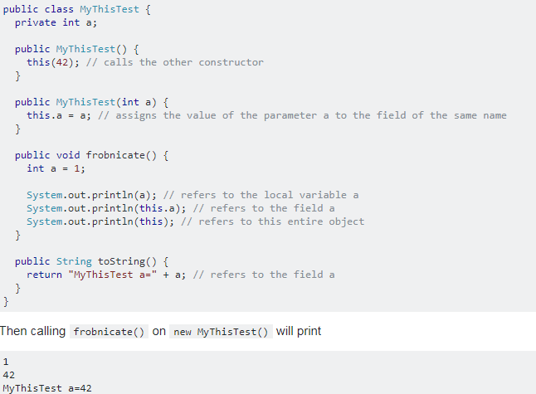
The this Reference
“this” refers to the current object
clarify that you are talking about a field, when there's also something else with the same name as a field
refer to the current object as a whole
invoke other constructors of the current class in your constructor

Slide 57
The this Reference
The this reference can be used to call a constructor from another constructor.
public Stock(String sym)
{
this(sym, 0.0);
}
This constructor would allow an instance of the Stock class to be created using only the symbol name as a parameter.
It calls the constructor that takes the symbol and the price, using sym as the symbol argument and 0 as the price argument.
Elaborate constructor chaining can be created using this technique.
If this is used in a constructor, it must be the first statement in the constructor.

Slide 58
Packages and import Statements
Classes in the Java API are organized into packages.
Explicit and Wildcard import statements
Explicit imports name a specific class
import java.util.Scanner;
Wildcard imports name a package, followed by an *
import java.util.*;
The java.lang package is automatically made available to any Java class.

Slide 59
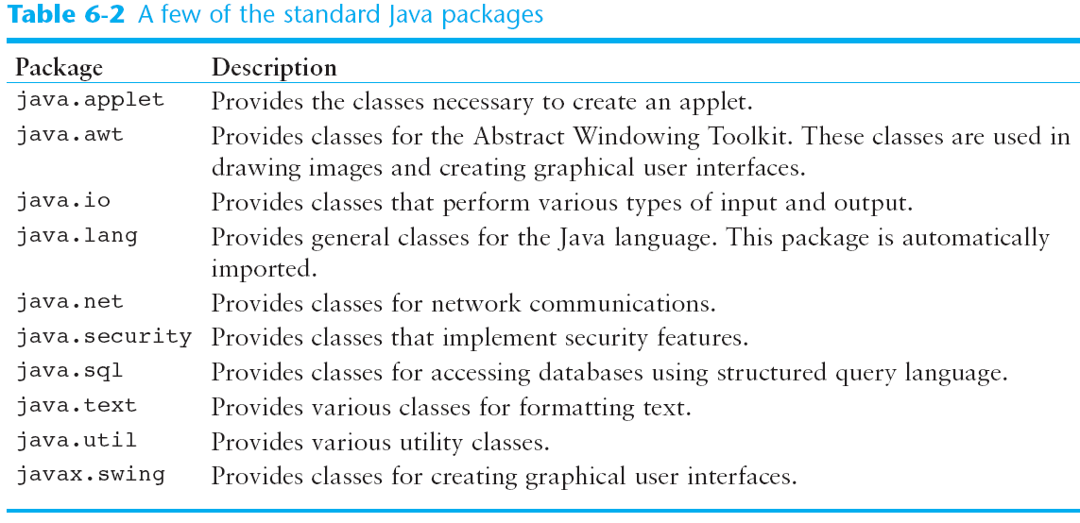
Some Java Standard Packages

Slide 60
Object Oriented Design Finding Classes and Their Responsibilities
Finding the classes
Get written description of the problem domain
Identify all nouns, each is a potential class
Refine list to include only classes relevant to the problem
Identify the responsibilities
Things a class is responsible for knowing
Things a class is responsible for doing
Refine list to include only classes relevant to the problem

