Slide 1
Lecture 3b – Arrays II
CS 141-02
Introduction to Programming and Problem Solving
Dr. Sampath Jayarathna
Cal Poly Pomona
Copyright © 2016 Pearson Education, Inc., Hoboken NJ

Slide 2
Arrays and Files
Saving the contents of an array to a file:
int[] numbers = {10, 20, 30, 40, 50};
PrintWriter outputFile =
new PrintWriter ("Values.txt");
for (int i = 0; i < numbers.length; i++)
outputFile.println(numbers[i]);
outputFile.close();

Slide 3
Arrays and Files
Reading the contents of a file into an array:
final int SIZE = 5; // Assuming we know the size.
int[] numbers = new int[SIZE];
int i = 0;
File file = new File ("Values.txt");
Scanner inputFile = new Scanner(file);
while (inputFile.hasNext() && i < numbers.length)
{
numbers[i] = inputFile.nextInt();
i++;
}
inputFile.close();

Slide 4
Returning an Array Reference
A method can return a reference to an array.
The return type of the method must be declared as an array of the right type.
public static double[] getArray()
{
double[] array = { 1.2, 2.3, 4.5, 6.7, 8.9 };
return array;
}
The getArray method is a public static method that returns an array of doubles.

Slide 5
String Arrays
Arrays are not limited to primitive data.
An array of String objects can be created:
String[] names = { "Bill", "Susan", "Steven", "Jean" };
If an initialization list is not provided, the new keyword must be used to create the array: String[] names = new String[4];
When an array is created in this manner, each element of the array must be initialized.
names[0] = "Bill";
names[1] = "Susan";
names[2] = "Steven";
names[3] = "Jean";

Slide 6
Calling String Methods On Array Elements
String objects have several methods, including:
toUpperCase
compareTo
equals
charAt
Each element of a String array is a String object.
Methods can be used by using the array name and index as before.
System.out.println(names[0].toUpperCase());
char letter = names[3].charAt(0);

Slide 7
The length Field & The length Method
Arrays have a final field named length.
String objects have a method named length.
To display the length of each string held in a String array:
for (int i = 0; i < names.length; i++)
System.out.println(names[i].length());
An array’s length is a field
You do not write a set of parentheses after its name.
A String’s length is a method
You do write the parentheses after the name of the String class’s length method.

Slide 8
Activity 10
Use the RainFall class created in the Activity 9
Create a String array that contains the names of all 12 months
Create a method displayRainfall() that accepts a double array of rainfall values and display the content of the array including the corresponding month using the String months array

Slide 9
Arrays of Objects
Because Strings are objects, we know that arrays can contain objects.
BankAccount[] accounts = new BankAccount[5];
The accounts variable holds the address
of an BankAccount array.
The array is an array of references to BankAccount objects.
Address
accounts[0]
null
accounts[1]
null
accounts[2]
null
accounts[3]
null
accounts[4]
null

Slide 10
Arrays of Objects
Each element needs to be initialized.
for (int i = 0; i < accounts.length; i++)
accounts[i] = new BankAccount();
The accounts variable holds the address
of an BankAccount array.
balance:
0.0
Address
balance:
0.0
accounts[0]
Address
balance:
0.0
accounts[1]
Address
balance:
0.0
accounts[2]
Address
accounts[3]
Address
balance:
0.0
accounts[4]
Address

Slide 11
Activity
Create a class ShapeDemo and use the main method to create an array of Shape.
Use the Shape class created in the Activity 9
Use a loop to create 5 shape objects and store it in the array.
Create a method in ShapeDemo to display the content of the array

Slide 12
The ArrayList Class
Similar to an array, an ArrayList allows object storage
Unlike an array, an ArrayList object:
Automatically expands when a new item is added
Automatically shrinks when items are removed
Requires: import java.util.ArrayList;

Slide 13
Creating an ArrayList
ArrayList<String> nameList = new ArrayList<String>();
Notice the word String written inside angled brackets <>
This specifies that the ArrayList can hold String objects.
If we try to store any other type of object in this ArrayList, an error will occur.

Slide 14
Using an ArrayList
To populate the ArrayList, use the add method:
nameList.add("James");
nameList.add("Catherine");
To get the current size, call the size method
nameList.size(); // returns 2

Slide 15
Using an ArrayList
To access items in an ArrayList, use the get method
nameList.get(1);
In this statement 1 is the index of the item to get.

Slide 16
Using an ArrayList
The ArrayList class's toString method returns a string representing all items in the ArrayList
System.out.println(nameList);
This statement yields :
[ James, Catherine ]
The ArrayList class's remove method removes designated item from the ArrayList
nameList.remove(1);
This statement removes the second item.

Slide 17
Using an ArrayList
The ArrayList class's add method with one argument adds new items to the end of the ArrayList
To insert items at a location of choice, use the add method with two arguments:
nameList.add(1, "Mary");
This statement inserts the String "Mary" at index 1
To replace an existing item, use the set method:
nameList.set(1, "Becky");
This statement replaces “Mary” with “Becky”

Slide 18
Using an ArrayList
An ArrayList has a capacity, which is the number of items it can hold without increasing its size.
The default capacity of an ArrayList is 10 items.
To designate a different capacity, use a parameterized constructor: ArrayList<String> list = new ArrayList<String>(100);

Slide 19
Using an ArrayList
The diamond operator
Beginning in Java 7, you can use the <> operator for simpler ArrayList declarations:
No need to specify the data type here.
ArrayList<String> list = new ArrayList<>();
Java infers the type of the ArrayList object from the variable declaration.

Slide 20
Activity 11
Create an ArrayList of Integer and generate 50 random values in 1-100 to store in the ArrayList
Display the ArrayList
Sort the ArrayList using Collections.sort()
Store the values in an external file called random.dat

Slide 21
Two-Dimensional Arrays
A two-dimensional array is an array of arrays.
It can be thought of as having rows and columns.
column 0
column 1
column 2
column 3
row 0
row 1
row 2
row 3

Slide 22
Two-Dimensional Arrays
two dimensional array
rows
columns
Declaring a two-dimensional array requires two sets of brackets and two size declarators
The first one is for the number of rows
The second one is for the number of columns.
double[][] scores = new double[3][4];
The two sets of brackets in the data type indicate that the scores variable will reference a two-dimensional array.
Notice that each size declarator is enclosed in its own set of brackets.

Slide 23
Accessing Two-Dimensional Array Elements
When processing the data in a two-dimensional array, each element has two subscripts:
one for its row and
another for its column.

Slide 24
Accessing Two-Dimensional Array Elements
The scores variable
holds the address of a
2D array of doubles.
column 0
column 1
column 2
column 3
Address
row 0
scores[0][0]
scores[0][1]
scores[0][2]
scores[0][3]
row 1
scores[1][0]
scores[1][1]
scores[1][2]
scores[1][3]
row 2
scores[2][0]
scores[2][1]
scores[2][2]
scores[2][3]

Slide 25
Accessing Two-Dimensional Array Elements
Accessing one of the elements in a two-dimensional array requires the use of both subscripts.
scores[2][1] = 95;
The scores variable
holds the address of a
2D array of doubles.
column 0
column 1
column 2
column 3
Address
row 0
0
0
0
0
row 1
0
0
0
0
row 2
0
95
0
0

Slide 26
Accessing Two-Dimensional Array Elements
Programs that process two-dimensional arrays can do so with nested loops.
To fill the scores array:
for (int row = 0; row < 3; row++)
{
for (int col = 0; col < 4; col++)
{
System.out.print("Enter a score: ");
scores[row][col] = keyboard.nextDouble();
}
}
Number of rows
Number of columns
keyboard references a Scanner object

Slide 27
Accessing Two-Dimensional Array Elements
To print out the scores array:
for (int row = 0; row < 3; row++)
{
for (int col = 0; col < 4; col++)
{
System.out.println(scores[row][col]);
}
}

Slide 28
Initializing a Two-Dimensional Array
Initializing a two-dimensional array requires enclosing each row’s initialization list in its own set of braces.
int[][] numbers = { {1, 2, 3}, {4, 5, 6}, {7, 8, 9} };
Java automatically creates the array and fills its elements with the initialization values.
row 0 {1, 2, 3}
row 1 {4, 5, 6}
row 2 {7, 8, 9}
Declares an array with three rows and three columns.

Slide 29
Initializing a Two-Dimensional Array
int[][] numbers = {{1, 2, 3},
{4, 5, 6},
{7, 8, 9}};
produces:
The numbers variable
holds the address of a
2D array of int values.
column 0
column 1
column 2
Address
row 0
1
2
3
row 1
4
5
6
row 2
7
8
9

Slide 30
The length Field
Two-dimensional arrays are arrays of one-dimensional arrays.
The length field of the array gives the number of rows in the array.
Each row has a length constant tells how many columns is in that row.
Each row can have a different number of columns.

Slide 31
The length Field
To access the length fields of the array:
int[][] numbers = { { 1, 2, 3, 4 },
{ 5, 6, 7 },
{ 9, 10, 11, 12 } };
for (int row = 0; row < numbers.length; row++)
{
for (int col = 0; col < numbers[row].length; col++)
System.out.println(numbers[row][col]);
}
Number of rows Number of columns in this row.
The array can have variable length rows.

Slide 32
Activity 12
You have the following 2D array,
Create a method to get the sum of all the elements of this 2D array
int[][] numbers = { { 1, 2, 3, 4 },
{5, 6, 7, 8},
{9, 10, 11, 12} };

Slide 33
Summing The Rows of a Two-Dimensional Array
int[][] numbers = {{ 1, 2, 3, 4},
{5, 6, 7, 8},
{9, 10, 11, 12}};
int total;
for (int row = 0; row < numbers.length; row++)
{
total = 0;
for (int col = 0; col < numbers[row].length; col++)
total += numbers[row][col];
System.out.println("Total of row "
+ row + " is " + total);
}

Slide 34
Summing The Columns of a Two-Dimensional Array
int[][] numbers = {{1, 2, 3, 4},
{5, 6, 7, 8},
{9, 10, 11, 12}};
int total;
for (int col = 0; col < numbers[0].length; col++)
{
total = 0;
for (int row = 0; row < numbers.length; row++)
total += numbers[row][col];
System.out.println("Total of column "
+ col + " is " + total);
}

Slide 35
Passing and Returning Two-Dimensional Array References
There is no difference between passing a single or two-dimensional array as an argument to a method.
The method must accept a two-dimensional array as a parameter.

Slide 36
Ragged Arrays
When the rows of a two-dimensional array are of different lengths, the array is known as a ragged array.
You can create a ragged array by creating a two-dimensional array with a specific number of rows, but no columns.
int [][] ragged = new int [4][];
Then create the individual rows.
ragged[0] = new int [3];
ragged[1] = new int [4];
ragged[2] = new int [5];
ragged[3] = new int [6];

Slide 37
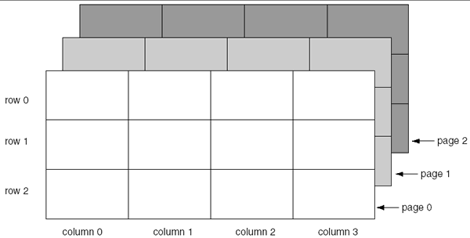
More Than Two Dimensions
Java does not limit the number of dimensions that an array may be.
More than three dimensions is hard to visualize, but can be useful in some programming problems.

Slide 38
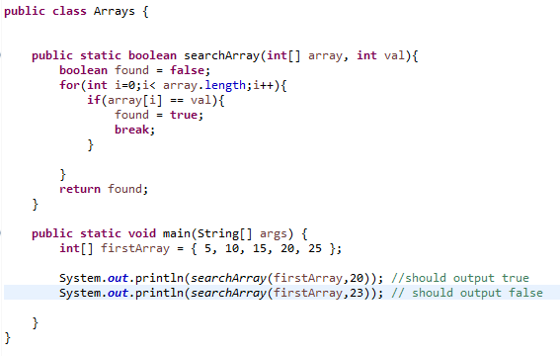
The Sequential Search Algorithm
A search algorithm is a method of locating a specific item in a larger collection of data.
The sequential search algorithm uses a loop to:
sequentially step through an array,
compare each element with the search value, and
stop when
the value is found or
the end of the array is encountered.

Slide 39
Bubble Sort
Sorting takes an unordered collection and makes it an ordered one.
In a bubble sort:
“Bubbling up” the largest element
Traverse a collection of elements
Move from the front to the end
Bubble the largest value to the end using pair-wise comparisons and swapping
1 2 3 4 5 6
77
42
35
12
101
5
1 2 3 4 5 6
5
12
35
42
77
101

Slide 40
Bubble Sort
42
77
77
42
35
12
101
5
35
77
42
77
35
12
101
5
12
77
42
35
77
12
101
5
42
35
12
77
101
5
5
101
42
35
12
77
101
5
42
35
12
77
5
101

Slide 41
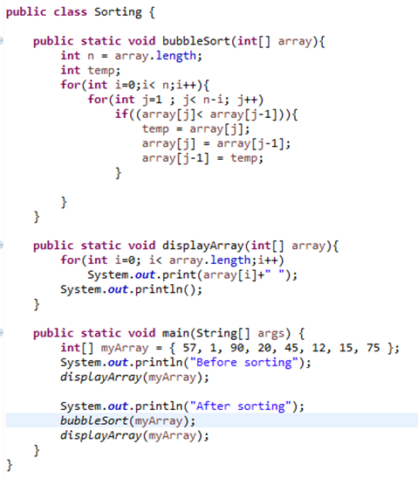
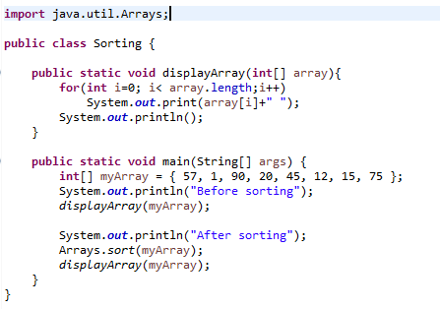
Sorting
Using java Arrays.sort()

