Slide 1
Lecture 7 – Recursions
CS 141-02
Introduction to Programming and Problem Solving
Dr. Sampath Jayarathna
Cal Poly Pomona
Copyright © 2016 Pearson Education, Inc., Hoboken NJ

Slide 2
Topics
Introduction to Recursion
Solving Problems with Recursion
Examples of Recursive Methods
The Towers of Hanoi

Slide 3
Introduction to Recursion
We have been calling other methods from a method.
It’s also possible for a method to call itself.
A method that calls itself is a recursive method.
public class EndlessRecursion
{
public static void message()
{
System.out.println("This is a recursive method.");
message();
}
public static void main(String[] args){
message();
}
}

Slide 4
Introduction to Recursion
This method in the example displays the string “This is a recursive method.”, and then calls itself.
Each time it calls itself, the cycle is repeated endlessly.
Like a loop, a recursive method must have some way to control the number of times it repeats.
The previous example will throw a StackOverflowError when there’s no enough space to create a stack frame for the call (default 512k/1024k for JVM thread stack).

Slide 5
Activity 21
Create a class called Recursion similar to the EndlessRecursion so that the call to messege() method stops at some point.
Hint: think about an int parameter n=5 which you can pass to method that reduce by one each time when recursively call itself. You can call until this parameter is, lets say > 0

Slide 6
Introduction to Recursion
The method is first called from the main method of the class.
First call of the method
n = 5
Second call of the method
n = 4
The second through sixth calls are recursive.
Third call of the method
n = 3
Fourth call of the method
n = 2
Fifth call of the method
n = 1
Sixth call of the method
n = 0

Slide 7
Solving Problems With Recursion
Recursion can be a powerful tool for solving repetitive problems.
Recursion is never absolutely required to solve a problem.
Any problem that can be solved recursively can also be solved iteratively, with a loop.
In many cases, recursive algorithms are less efficient than iterative algorithms.

Slide 8
Solving Problems With Recursion
Recursive solutions repetitively:
allocate memory for parameters and local variables, and
store the address of where control returns after the method terminates.
These actions are called overhead and take place with each method call.
This overhead does not occur with a loop.
Some repetitive problems are more easily solved with recursion than with iteration.
Iterative algorithms might execute faster; however,
a recursive algorithm might be designed faster.

Slide 9
Solving Problems With Recursion
Recursion works like this:
A base case is established.
If matched, the method solves it and returns.
If the base case cannot be solved now:
the method reduces it to a smaller problem (recursive case) and calls itself to solve the smaller problem.
By reducing the problem with each recursive call, the base case will eventually be reached and the recursion will stop.

Slide 10
Solving Problems With Recursion - Factorial
In mathematics, the notation n! represents the factorial of the number n.
The factorial of a nonnegative number can be defined by the following rules:
If n = 0 then n! = 1
If n > 0 then n! = 1 × 2 × 3 × ... × n
Let’s replace the notation n! with factorial(n), which looks a bit more like computer code, and rewrite these rules as:
If n = 0 then factorial(n) = 1
If n > 0 then factorial(n) = 1 × 2 × 3 × ... × n

Slide 11
Solving Problems With Recursion
These rules state that:
when n is 0, its factorial is 1, and
when n is greater than 0, its factorial is the product of all the positive integers from 1 up to n.
Factorial(6) is calculated as
1 × 2 × 3 × 4 × 5 × 6.
The base case is where n is equal to 0:
if n = 0 then factorial(n) = 1
The recursive case, or the part of the problem that we use recursion to solve is:
if n > 0 then factorial(n) = n × factorial(n – 1)

Slide 12
Solving Problems With Recursion
The recursive call works on a reduced version of the problem, n – 1.
The recursive rule for calculating the factorial:
If n = 0 then factorial(n) = 1
If n > 0 then factorial(n) = n × factorial(n – 1)
A Java based solution:
private static int factorial(int n)
{
if (n == 0) return 1; // Base case
else return n * factorial(n - 1);
}

Slide 13
Solving Problems With Recursion
The method is first called from the main method of the FactorialDemo class.
First call of the method
n = 4
Return value: 24
Second call of the method
n = 3
Return value: 6
Third call of the method
n = 2
Return value: 2
Fourth call of the method
n = 1
Return value: 1
Fifth call of the method
n = 0
Return value: 1

Slide 14
Direct and Indirect Recursion
When recursive methods directly call themselves it is known as direct recursion.
Indirect recursion is when method A calls method B, which in turn calls method A.
There can even be several methods involved in the recursion.
Example, method A could call method B, which could call method C, which calls method A.
Care must be used in indirect recursion to ensure that the proper base cases and return values are handled.

Slide 15
The Fibonacci Series
Some mathematical problems are designed to be solved recursively.
One well known example is the calculation of Fibonacci numbers.:
0, 1, 1, 2, 3, 5, 8, 13, 21, 34, 55, 89, 144, 233,…
After the second number, each number in the series is the sum of the two previous numbers.
The Fibonacci series can be defined as:
F0 = 0
F1 = 1
FN = FN–1 + FN–2 for N ≥ 2.

Slide 16
The Fibonacci Series
public static int fib(int n)
{
if (n == 0)
return 0;
else if (n == 1)
return 1;
else
return fib(n - 1) + fib(n - 2);
}
This method has two base cases:
when n is equal to 0, and
when n is equal to 1.
Example: FibNumbers.java

Slide 17
The Towers of Hanoi
The Towers of Hanoi is a mathematical game that uses:
three pegs and
a set of discs with holes through their centers.
The discs are stacked on the leftmost peg, in order of size with the largest disc at the bottom.
The object of the game is to move the pegs from the left peg to the right peg by these rules:
Only one disk may be moved at a time.
A disk cannot be placed on top of a smaller disc.
All discs must be stored on a peg except while being moved.

Slide 18
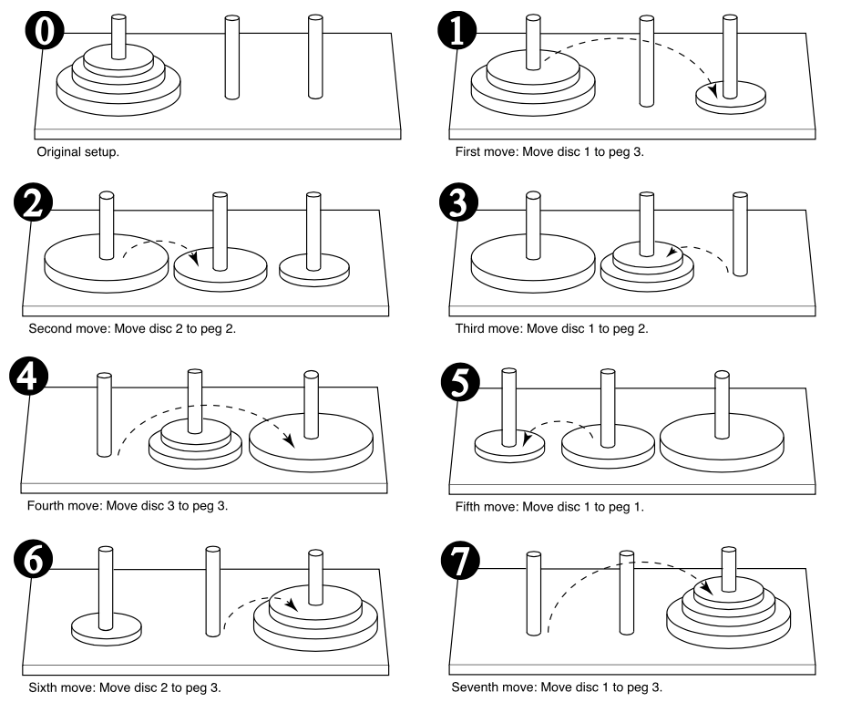
The Towers of Hanoi – Three discs
If three discs:

Slide 19
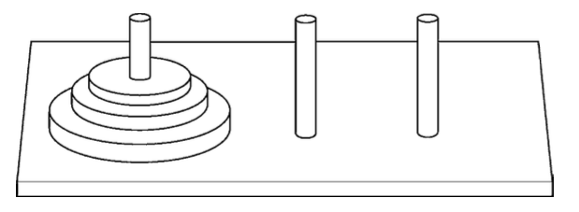
The Towers of Hanoi
If one disc:
Move disc 1 to peg 3.
If two discs:
Move disc 1 to peg 2.
Move disc 2 to peg 3.
Move disc 1 to peg 3.

Slide 20
The Towers of Hanoi
The overall solution to the problem is to move n discs from peg 1 to peg 3 using peg 2 as a temporary peg.
This algorithm solves the game.
If n > 0 Then
Move n – 1 discs from peg A to peg B,
using peg C as a temporary peg.
Move the remaining disc from the peg A to peg C.
Move n – 1 discs from peg B to peg C,
using peg A as a temporary peg.
End If
The base case for the algorithm is reached when there are no more discs to move.
Example: Hanoi.java

