Slide 1
Lecture 1a- Introduction
CS 299
Introduction to Data Science
Dr. Sampath Jayarathna
Cal Poly Pomona

Slide 2
Today
Who I am
CS 299 educational objectives (and why)
Overview of the course, and logistics

Slide 3
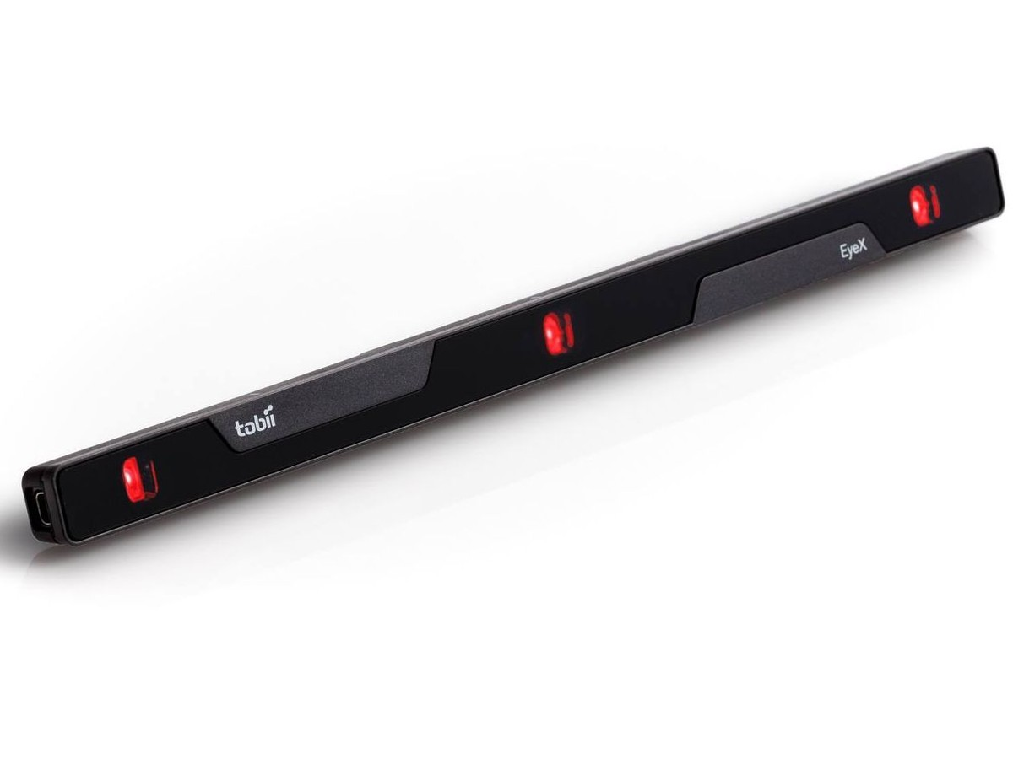
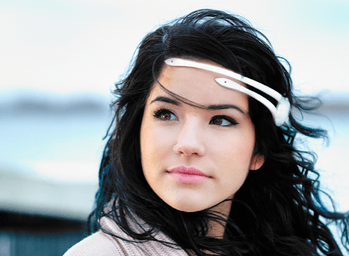
Who am I?
Instructor : Sampath Jayarathna Joined Cal Poly Pomona Fall 2016 from Texas A&M Originally from Sri Lanka
Research : Eye tracking, Brain EEG, User modeling, Biometrics
Web : http://www.cpp.edu/~ukjayarathna
Contact : 8-46, ukjayarathna@cpp.edu, (909) 869-3145
Office Hours : MT 11AM – 1PM, or email me for an appointment
[Open Door Policy]

Slide 4
Course Information
Schedule : MW, 8-302, 2.00 PM – 3.50 PM http://www.cpp.edu/~ukjayarathna/courses/s18/cs299 www.piazza.com/csupomona/spring2018/cs299/home Blackboard
Prereqs
Official: CS 140 grade of C or better, or instructor’s consent. Knowledge in linear algebra and statistics.
Format
Before lecture: do reading slides
In lecture: put reading in context
After lecture: assignments, projects for hands-on practice

Slide 5
Student Learning Outcomes
After successfully completing this course, students should be able to:
Define and explain the key concepts and models relevant to data science.
Understand the processes of data science: identifying the problem to be solved, data collection, preparation, modeling, evaluation and visualization.
Develop an appreciation of the many techniques for data modeling
Be comfortable using commercial and open source tools such as Python, the R language and associated libraries for data analytics and visualization.

Slide 6
Communication
Piazza:
All questions will be fielded through Piazza.
Many questions everyone can see the answer
You can also post private messages that can only be seen by the instructor
Blackboard:
Blackboard will be used primarily for assignments/homework submission, and grade dissemination.
Email:
Again, email should only be used in rare instances, I will probably point you back to Piazza

Slide 7
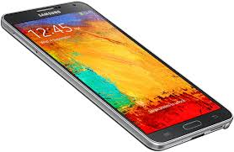
The Rules

Slide 8
Cooperate on Learning
Except for the work you hand in as individual contributions, I strongly encourage you to collaborate and help each other
If in doubt if a collaboration is legitimate: ask!
Don’t claim to have written code that you copied from others or online
Don’t give anyone else your code (to hand in for a grade)
When you rely on the work of others, explicitly list all of your sources – i.e. give credit to those who did the work
Don’t study alone when you don’t have to
Form study groups
Do help each other (without plagiarizing)

Slide 9
Course Organization
Grading
Required Materials
No textbook is required. All the key course content will be documented in slides, which will be available in the course website after each lecture.
Bring Your Own Device (BYOD).

Slide 10
Course Organization
Project: More in the next couple of slides…
Final Exam: The final exam is comprehensive, closed books and will be held on Monday, June. 4th, 1.50pm – 3.50pm.
Midterm Exam: Closed books and will be held on Wednesday, April. 25 during class time.
Homework: We will have five homework assignments, each worth 3% of your overall grade.
Quizzes
2 low-stress quizzes + ungraded in-class activities

Slide 11
Team Project - Evaluation
Form teams of 2 (+ 1?) students
Independent and non-competing
Think of other teams as working for other organizations
Code and document sharing between teams is not permitted
Project grade will have a large impact on course grade (25%)
Project grade will (attempt to) recognize individual contributions
Peer evaluation, Demo evaluation
All artifacts will be considered in the evaluation
Quality matters.

Slide 12
Team Project - Milestones
Project Proposal, April 04
Progress reports, May 02
Final Report, May 30
Demo, May 30

