Slide 1

Lecture 1b- Data Science
CS 299
Introduction to Data Science
Dr. Sampath Jayarathna
Cal Poly Pomona
Credit for some of the slides in this lecture goes to Daisy Wang at UF and Michael Franklin at UC Berkeley

Slide 2
Data Science – A Definition
Data Science is the science which uses computer science, statistics and machine learning, information retrieval, visualization and human-computer interactions to collect, clean, integrate, analyze, visualize, interact with data to create data products.

Slide 3
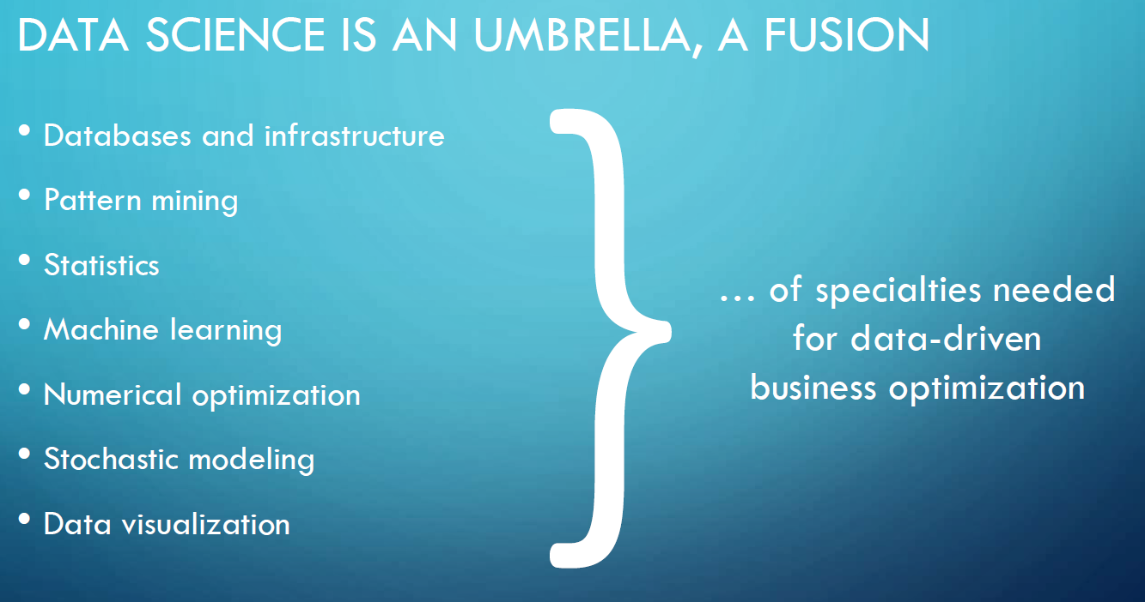
Goal of Data Science
Turn data into data products.

Slide 4
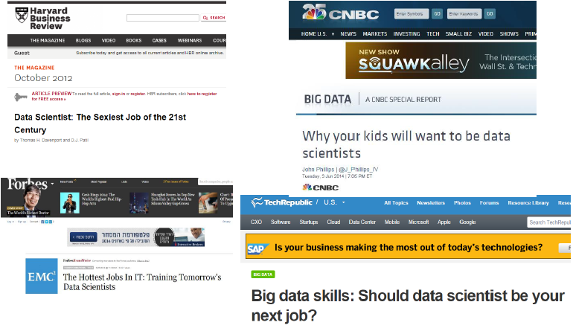
Data Scientists are in high demand

Slide 5
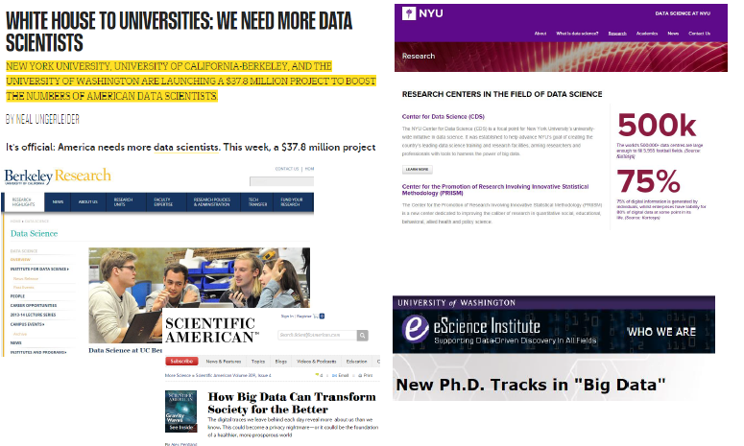
Also in academia

Slide 6
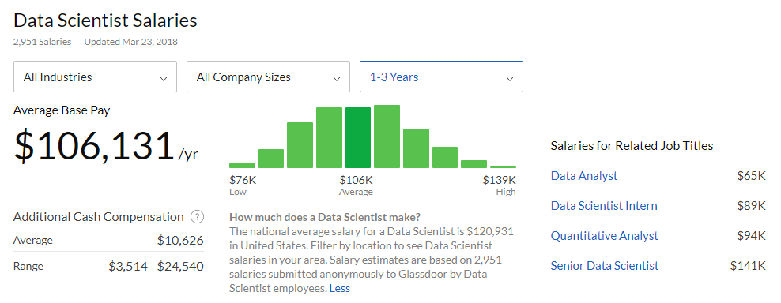
Pays Well

Slide 7
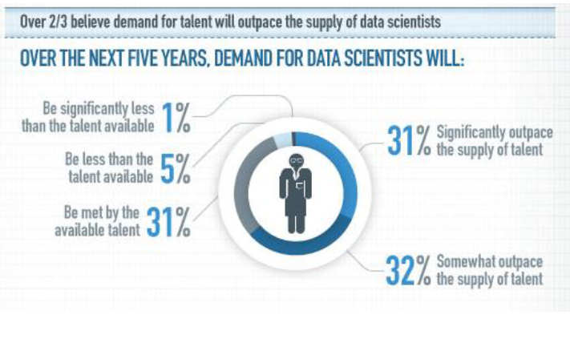
Demand will outpace supply

Slide 8
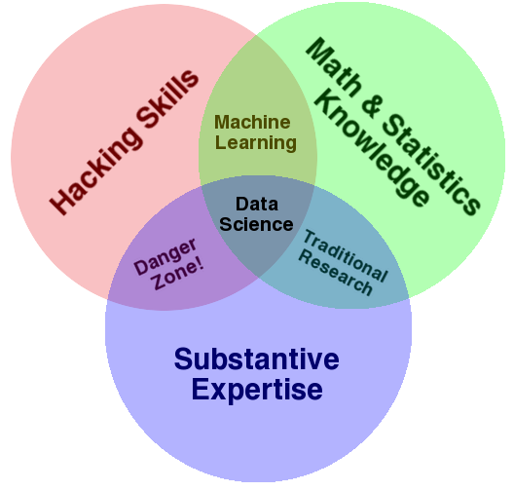
Data Science – A Visual Definition
Notes:
Drew Conway’s definition

Slide 9
Why “Danger Zone?”
Ronny Kohavi (Microsoft) keynote at KDD 2015
People are incredibly clever at explaining “very surprising results”. Unfortunately most very surprising results are caused by data pipeline errors.
Beware “HiPPOs”
Notes:
(Highest Paid-Person’s Opinion)

Slide 10
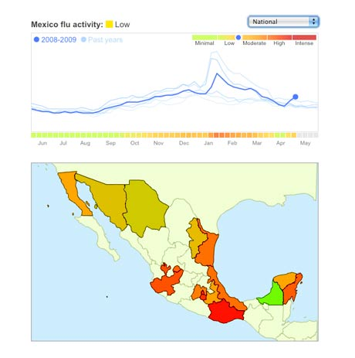
Data Science: Why all the Excitement?
Exciting new effective
applications of data analytics
e.g.,
Google Flu Trends:
Detecting outbreaks
two weeks ahead
of CDC data
New models are estimating
which cities are most at risk
for spread of the Ebola virus.
Prediction model is built on
Various data sources,
types and analysis.

Slide 11
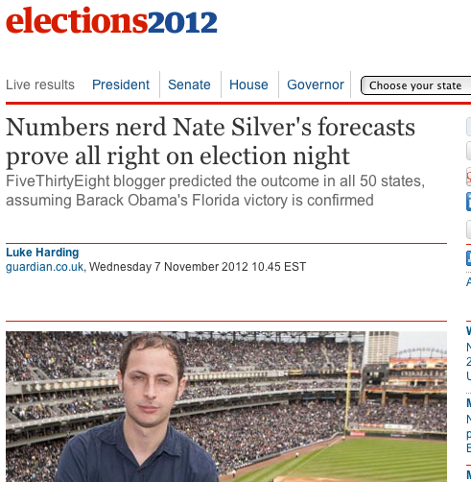
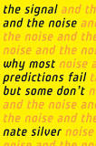
Why the all the Excitement?
Predicting political
champagne and election
Outcome:

Slide 12
Data and Election 2012 (cont.)
…that was just one of several ways that Mr. Obama’s campaign operations, some unnoticed by Mr. Romney’s aides in Boston, helped save the president’s candidacy. In Chicago, the campaign recruited a team of behavioral scientists to build an extraordinarily sophisticated database
…that allowed the Obama campaign not only to alter the very nature of the electorate, making it younger and less white, but also to create a portrait of shifting voter allegiances. The power of this operation stunned Mr. Romney’s aides on election night, as they saw voters they never even knew existed turn out in places like Osceola County, Fla.
-- New York Times, Wed Nov 7, 2012
The White House Names Dr. DJ Patil as the First U.S. Chief Data Scientist, Feb. 18th 2015

Slide 13
Data and Election 2016 (cont.)
Cambridge Analytica has built models that translate the data they harvest into personality profiles for every American adult to have “somewhere close to 4 or 5 thousand data points on every adult in the US.”
Their models are based on the psychometric research of Michal Kosinski. Kosinski and his colleagues (David Stillwell , Alex Kogan) developed a model that linked subjects’ Facebook likes with their OCEAN scores. OCEAN refers to a questionnaire used by psychologists that describes personalities along five dimensions — openness to experience, conscientiousness, extraversion, agreeableness, and neuroticism.

Slide 14
Data and Election 2016 (cont.)
Cambridge Analytica has combined this social psychology with data analytics. They collect data from Facebook and Twitter (which is perfectly legal) and have purchased an array of other data — about television preferences, airline travel, shopping habits, church attendance, what books you buy, what magazines you subscribe to — from third-party organizations and so-called data brokers.
They take all this information and use it for what calls “behavioral microtargeting” — basically individualized advertising.
Instead of tailoring ads according to demographics, they use psychometrics.

Slide 15
Other Data Science Applications
Transaction Databases → Recommender systems (Netflix), Fraud Detection (Security and Privacy)
Wireless Sensor Data → Smart Home, Real-time Monitoring, Internet of Things
Text Data, Social Media Data → Product Review and Consumer Satisfaction (Facebook, Twitter, LinkedIn), E-discovery
Software Log Data → Automatic Trouble Shooting (Splunk)
Genotype and Phenotype Data → Epic, 23andme, Patient-Centered Care, Personalized Medicine

Slide 16
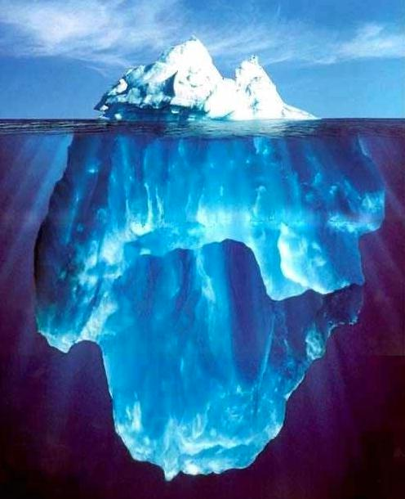





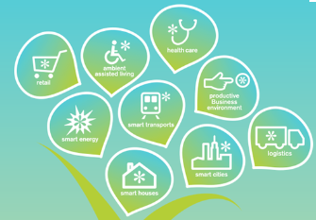
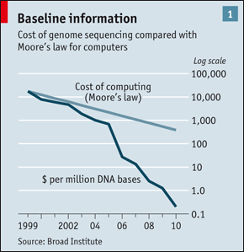
“Big Data” Sources
It’s All Happening On-line
User Generated
Every:
Click
Ad impression
Billing event
Fast Forward, pause,…
Server request
Transaction
Network message
Fault
…
…..
Internet of Things / M2M
Health/Scientific Computing

Slide 17
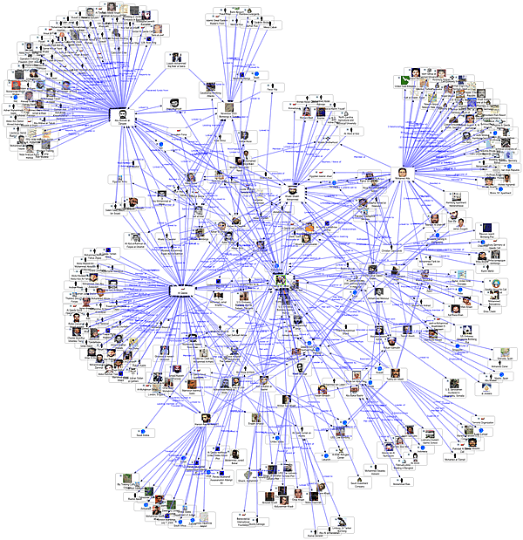
Graph Data
Lots of interesting data
has a graph structure:
Social networks
Communication networks
Computer Networks
Road networks
Citations
Collaborations/Relationships
…
Some of these graphs can get
quite large (e.g., Facebook*
user graph)

Slide 18
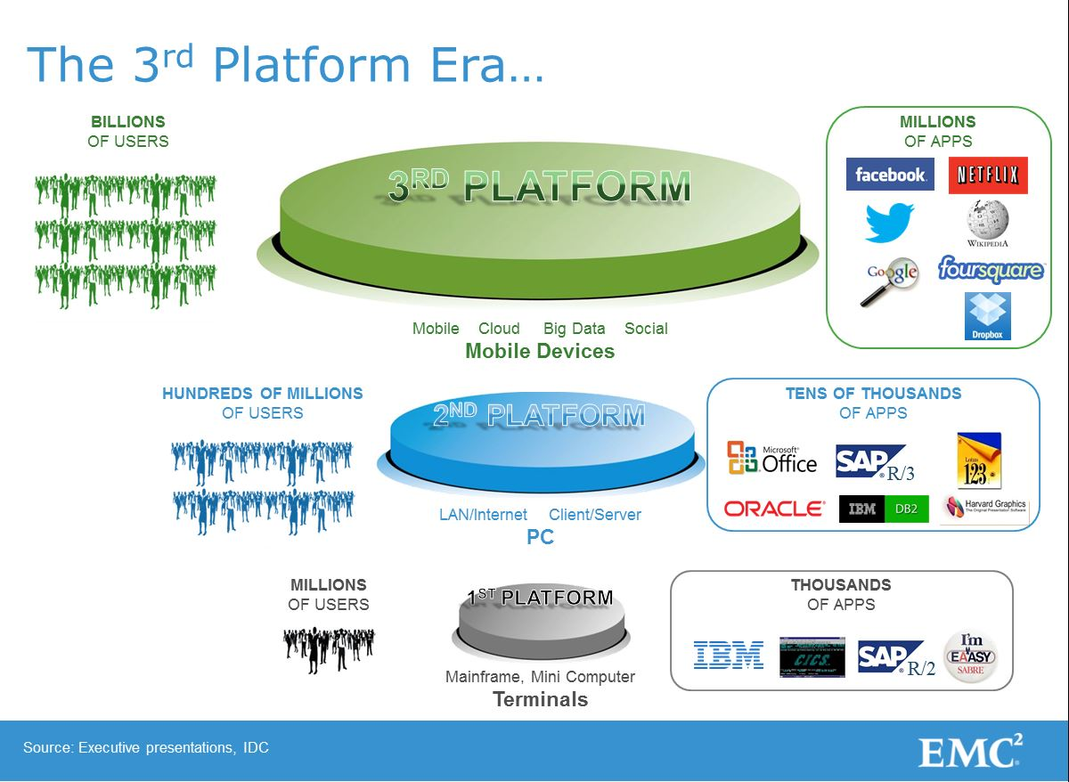
The end of “One size fits all”
A single architecture cannot meet all those demands
3rd platform drives new demands on the databases
  Global high availability
  Data volumes
  Unstructured data
  Transaction rates
  Latency

Slide 19
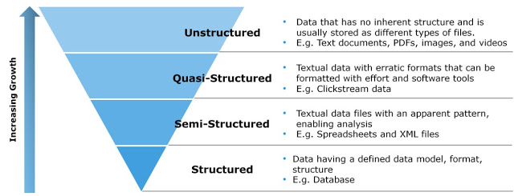
Digital Data: Classification

Slide 20
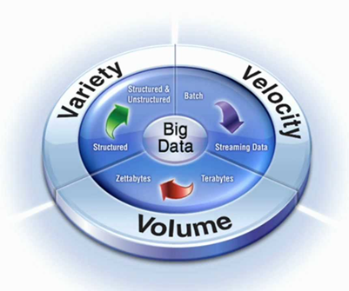
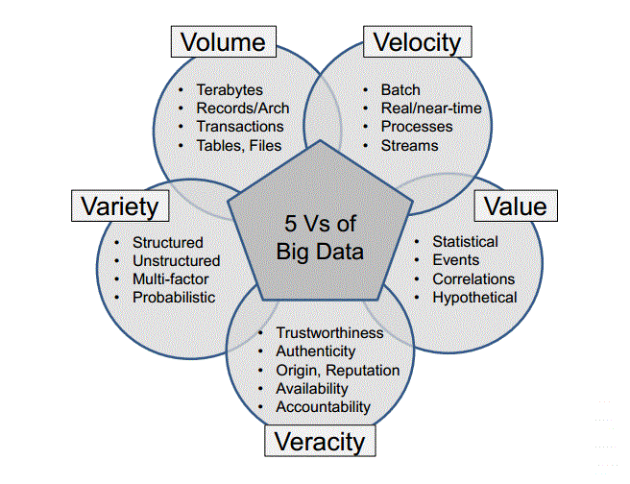
The 3 to 5 “V”s

Slide 21
Information Retrieval
Information Retrieval (IR) is finding material (usually documents) of an unstructured nature (usually text) that satisfies an information need from within large collections (usually stored on computers).
Most prominent example: Web Search Engines

Slide 22
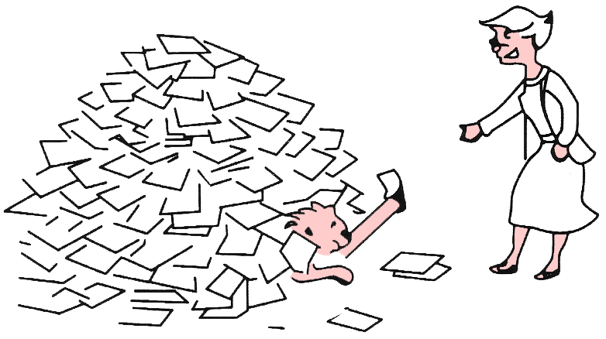

Why information retrieval
Information overload
  “It refers to the difficulty a person can have understanding an issue and making decisions that can be caused by the presence of too much information.” - wiki

Slide 23
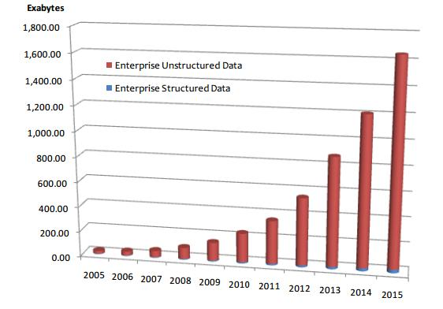
Why information retrieval
Table 1: People in CS Department
Handling unstructured data
  Structured data: database system is a
  good choice
  Unstructured data is more dominant
    Text in Web documents or emails,
    image, audio, video…
    “85 percent of all business
    information exists as unstructured
    data”
    Unknown semantic meaning
ID | Name | Job
1 | Jack | Professor
3 | David | Stuff
5 | Tony | IT support
Total Enterprise Data Growth 2005-2015, IDC 2012

Slide 24
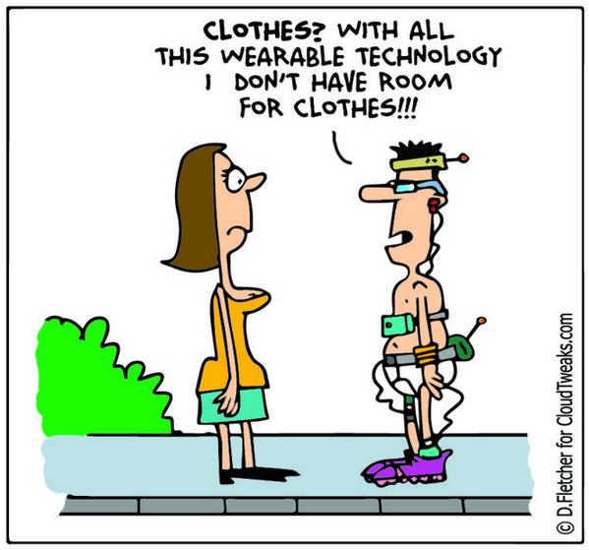
Instrumented Human
Data sets grow rapidly - in part because they are increasingly gathered by cheap and numerous information-sensing Internet of things devices such as mobile devices, wearables, software logs, cameras, microphones

Slide 25
Instrumented World

Slide 26
Big Data Analytics AKA “Data Science”

Slide 27
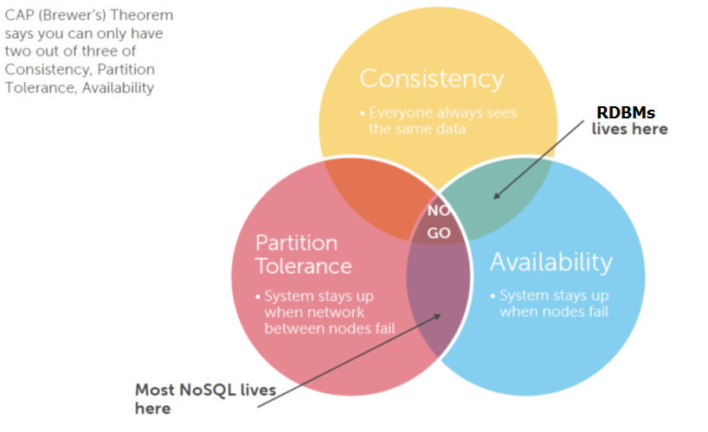
NoSQL

Slide 28
Contrast: Databases
 | Databases | Data Science
Data Value | “Precious” | “Cheap”
Data Volume | Modest | Massive
Examples | Bank records, Personnel records, Census, Medical records | Online clicks, GPS logs, Tweets, Building sensor readings
Priorities | Consistency, Error recovery, Auditability | Speed, Availability, Query richness
Structured | Strongly (Schema) | Weakly or none (Text)
Properties | Transactions, ACID* | CAP* theorem (2/3), eventual consistency
Realizations | SQL | NoSQL: MongoDB, CouchDB, Hbase, Cassandra, Riak, Memcached, Apache River, …
ACID = Atomicity, Consistency, Isolation and Durability
CAP = Consistency, Availability, Partition Tolerance

Slide 29
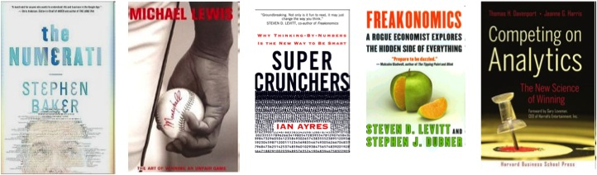
Contrast: Business Intelligence
Business Intelligence | Data Science
Querying the past | Querying the past present and future

Slide 30
Contrast: Machine Learning
Machine Learning
Develop new (individual) models
Prove mathematical properties of models
Improve/validate on a few, relatively clean, small datasets
Publish a paper
Data Science
Explore many models, build and tune hybrids
Understand empirical properties of models
Develop/use tools that can handle massive datasets
Take action!

Slide 31
Myths & Truths about Data Science in Industry
You need big data to do anything interesting
You spend most of time analyzing & building models
You need to be a hard-core programmer to be successful
You can communicate results after analysis is done
Can you guess which one is true?

Slide 32
You need ‘big’ data to do anything interesting
You won’t need big data most of the time

Slide 33


Burdens of Big Data
Big data is costly to collect and store
Big data slows down the iteration
Big data is useful only if:
  You’re trying to build a data product (i.e., search engine)
  You’re dealing with very noisy measurement (i.e., A/B testing)
  You’re interested in identifying the exceptions (outliers)
Even then, start with small data!
Notes:
Would you use a tower crane just to build a cabin?

Slide 34
Determining how much data you need
Exploratory analysis
  Do we have enough coverage for all edge cases? (i.e., outliers)
Statistical Inference
  Is our confidence interval narrow enough?
  Do we have enough statistical power to validate our hypotheses?
Predictive Analysis
  Do we have enough data to train/evaluate our model?

Slide 35
You need to be a hard-core programmer
Basic skills (e.g., SQL) get you pretty far

Slide 36
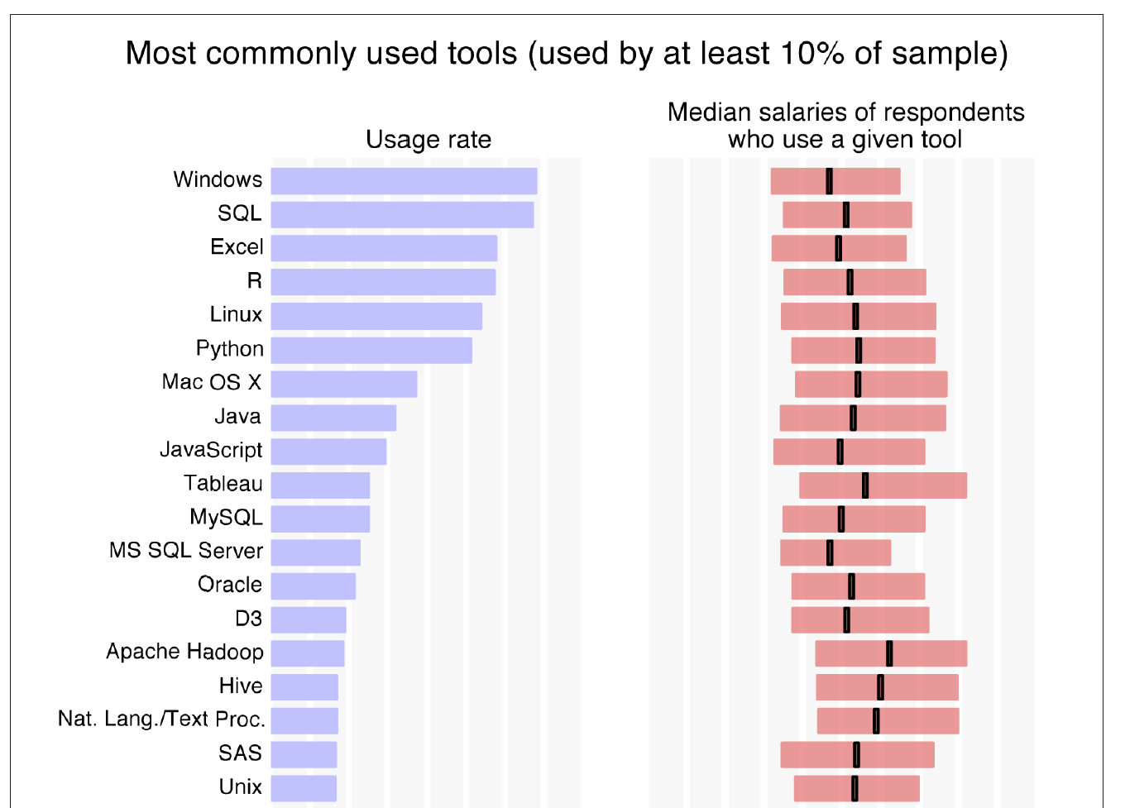
Data Science Tool Usage Survey _{(2014/O’Rielly)}
Still dominated by simple tools…

Slide 37
Choosing Tools for Data Science
End-user
Excel
RDBMS
/ SQL
Small
Data
Big
Data
R
Python
Spark
Developer

Slide 38
Chaining Tools for Data Science
Data Preparation
Exploratory Analysis
Inference / Prediction
Results Communication
Solution Implementation
Use the right toolset in different stages
Spark
Excel
Python
Python
Excel
RDBMS
/ SQL
R
R
Custom
Code

Slide 39
You spend most of time analyzing data
You spend most of time preparing data

Slide 40
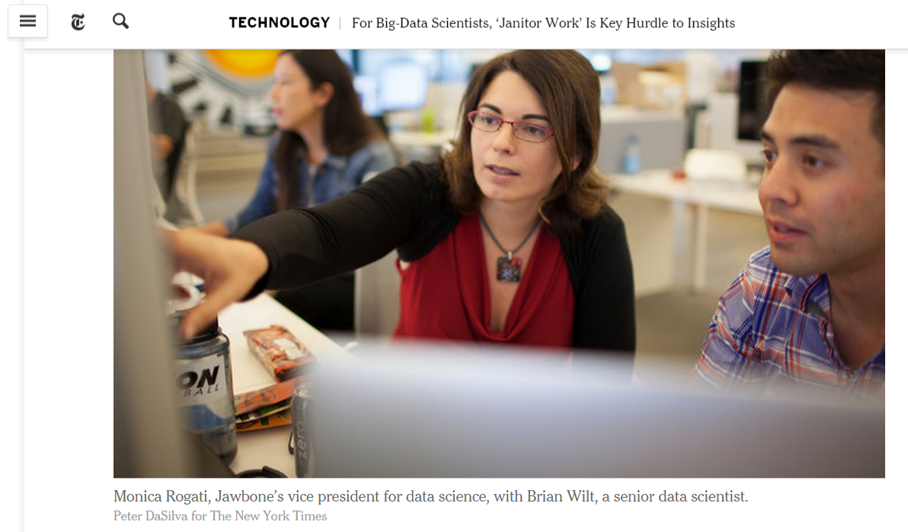
Data scientists, according to interviews and expert estimates, spend from 50 percent to 80 percent of their time mired in this more mundane labor of collecting and preparing unruly digital data, before it can be explored for useful nuggets.

Slide 41
Things can go wrong in many different levels…
Inherent noise / bias in data
The process of collecting the data (instrumentation)
The process of processing the data
Interpretation of processed data
…

Slide 42
Make sure you check for quality issues!
Completeness
Fidelity
Consistency
Is the data representative of the problem space?
Do the measurements capture the reality?
Do different attributes agree with each other?
Any missing observations / attributes?
Any issues of bias or variance?
Are values follow data types specified?

Slide 43
You can communicate results after analysis is done
You need to communicate throughout the process

Slide 44
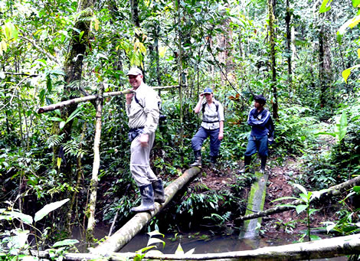

Imagine you’re in jungle with complete strangers

Slide 45
Why communication is so critical for solving a data problem?
You are seldom given a clear-cut problem (hence the data problem)
The team is composed of people with different expertise / style
No one has complete information of the problem / solution space
You often need to change courses multiple times, along the way

Slide 46
Myths & Truths about Data Science in Industry
You need big data to do anything interesting
You spend most of time analyzing & building models
You need to be a hard-core programmer to be successful
You can communicate results after analysis is done
All these are myths!

Slide 47
What’s Hard about Data Science
Overcoming assumptions
Making ad-hoc explanations of data patterns
Overgeneralizing
Communication
Not checking enough (validate models, data pipeline integrity, etc.)
Using statistical tests correctly
Prototype → Production transitions
Data pipeline complexity (who do you ask?)

Slide 48
Anaconda for python3
We’ll be using anaconda which includes python environment and an IDE (spyder) as well as many additional features
  https://www.anaconda.com/download/
Most python modules needed in data science are already installed with the anaconda distribution

Slide 49
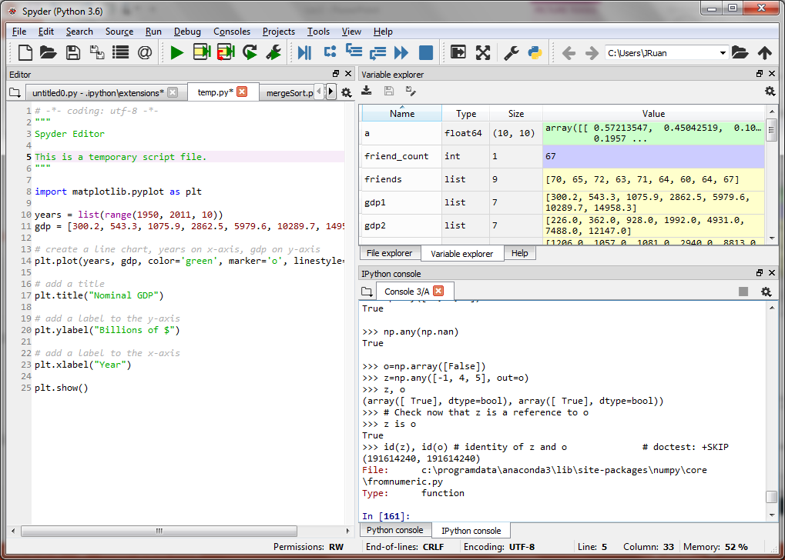

Slide 50
Next Class: Python programming in <2 hours
This is not a comprehensive python language class
Will focus on parts of the language that is worth attention and useful in data science
Two parts:
  Basics
  More advanced – as we go
Comprehensive Python language reference and tutorial available in Anacondo Navigator under “Learning” and on python.org

