Slide 1
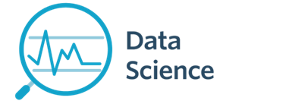
Lecture 3b- Data Wrangling I
CS 299
Introduction to Data Science
Dr. Sampath Jayarathna
Cal Poly Pomona

Slide 2
Exploring Your Data
Working with data is both an art and a science. We’ve mostly been talking about the science part, getting your feet wet with Python tools for Data Science. Lets look at some of the art now.
After you’ve identified the questions you’re trying to answer and have gotten your hands on some data, you might be tempted to dive in and immediately start building models and getting answers. But you should resist this urge. Your first step should be to explore your data.

Slide 3
Exploring Your Data

Slide 4
Data Wrangling
The process of transforming “raw” data into data that can be analyzed to generate valid actionable insights
Data Wrangling : aka
Data preprocessing
Data preparation
Data Cleansing
Data Scrubbing
Data Munging
Data Transformation
Data Fold, Spindle, Mutilate……

Slide 5
Data Wrangling Steps
Iterative process of
Obtain
Understand
Explore
Transform
Augment
Visualize

Slide 6
Data Wrangling Steps

Slide 7
Data Wrangling Steps

Slide 8
Exploring Your Data
The simplest case is when you have a one-dimensional data set, which is just a collection of numbers. For example,
daily average number of minutes each user spends on your site,
the number of times each of a collection of data science tutorial videos was watched,
the number of pages of each of the data science books in your data science library.
An obvious first step is to compute a few summary statistics.
You’d like to know how many data points you have, the smallest, the largest, the mean, and the standard deviation.
But even these don’t necessarily give you a great understanding.

Slide 9
Summary statistics of a single data set
Information (numbers) that give a quick and simple description of the data
Maximum value
Minimum value
Range (dispersion): max – min
Mean
Median
Mode
Quantile
Standard deviation
Etc.
0 quartile = 0 quantile = 0 percentile
1 quartile = 0.25 quantile = 25 percentile
2 quartile = .5 quantile = 50 percentile (median)
3 quartile = .75 quantile = 75 percentile
4 quartile = 1 quantile = 100 percentile

Slide 10
CDC BRFSS Dataset
The Behavioral Risk Factor Surveillance System (BRFSS) is the nation's premier system of health-related telephone surveys that collect state data about U.S. residents regarding their health-related risk behaviors, chronic health conditions, and use of preventive services.
http://www.cpp.edu/~ukjayarathna/courses/s18/cs299/files/data/

Slide 11
Activity 10
Download the brfss.csv file and load it to your python module.
http://www.cpp.edu/~ukjayarathna/courses/s18/cs299/files/data/
Display the content and observe the data
Create a function cleanBRFSSFrame() to clean the dataset
Drop the sex from the dataframe
Drop the rows of NaN values (every single NaN)
Use describe() method to display the count, mean, std, min, and quantile data for column weight2 and the mode.
Notes:
Obj = pd.read_csv(‘values.csv’)

Slide 12
Mean vs average vs median vs mode
(Arithmetic) Mean: the “average” value of the data
Average: can be ambiguous
The average household income in this community is $60,000
The average (mean) income for households in this community is $60,000
The income for an average household in this community is $60,000
What if most households are earning below $30,000 but one household is earning $1M
Median: the “middlest” value, or mean of the two middle values
Can be obtained by sorting the data first
Does not depend on all values in the data.
More robust to outliers
Mode: the most-common value in the data
def mean(a): return sum(a) / float(len(a))
def mean(a): return reduce(lambda x, y: x+y, a) / float(len(a))
Quantile: a generalization of median. E.g. 75 percentile is the value which 75% of values are less than or equal to

Slide 13
Variance and standard deviation
Describes the spread of the data from the mean
Is the mean squared of the deviation
Standard deviation (square root of the variance): σ
Easier to understand than variance
Has the same unit as the measurement
Say the data measures height of people in inch, the unit of σ is also inch. The unit for σ² is square inch …

Slide 14
Population vs sample
Population: all members of a group in a study
The average height of men
The average height of living male ≥ 18yr in USA between 2001 and 2010
The average height of all male students ≥ 18yr registered in Fall’17
Sample: a subset of the members in the population
Most studies choose to sample the population due to cost/time or other factors
Each sample is only one of many possible subsets of the population
May or may not be representative of the whole population
Sample size and sampling procedure is important
df = pd.read_csv('brfss.csv', index_col=0)
print(df.sample(100))

Slide 15
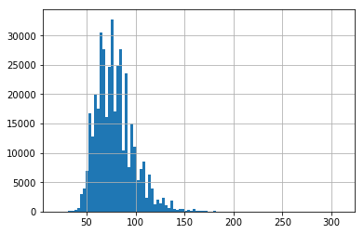
Exploring Your Data
Good next step is to create a histogram, in which you group your data into discrete buckets and count how many points fall into each bucket:
df = pd.read_csv('brfss.csv', index_col=0)
df['weight2'].hist(bins=100)
A histogram is a plot that lets you discover, and show, the underlying frequency distribution (shape) of a set of continuous data. This allows the inspection of the data for its underlying distribution (e.g., normal distribution), outliers, skewness, etc.
Notes:
The major difference is that a histogram is only used to plot the frequency of score occurrences in a continuous data set that has been divided into classes, called bins. Bar charts, on the other hand, can be used for a great deal of other types of variables including ordinal and nominal data sets.

Slide 16
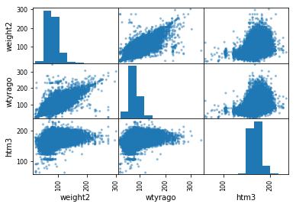
Feature Matrix
We can review the relationships between attributes by looking at the distribution of the interactions of each pair of attributes.
scatter_matrix(df[['weight2', 'wtyrago', 'htm3' ]])
This is a powerful plot from which a lot of inspiration about the data can be drawn. For example, we can see a possible correlation between weight and weight year ago

Slide 17
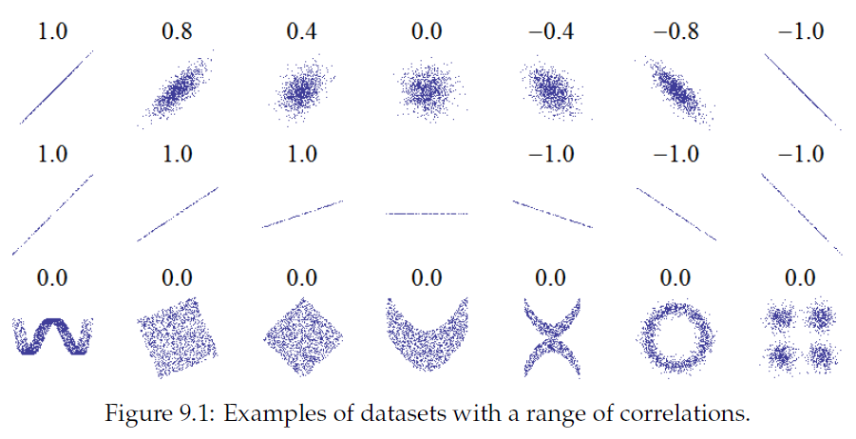
Correlation only measures linear relationship

Slide 18
Types of data
There are two basic types of data: numerical and categorical data.
Numerical data: data to which a number is assigned as a quantitative value.
Categorical data: data defined by the classes or categories into which an individual member falls.

Slide 19
Continuous or Non-continuous data
A continuous variable is one in which it can theoretically assume any value between the lowest and highest point on the scale on which it is being measured
(e.g. weight, speed, price, time, height)
Non-continuous variables, also known as discrete variables, that can only take on a finite number of values
Discrete data can be numeric -- like numbers of apples -- but it can also be categorical -- like red or blue, or male or female, or good or bad.

Slide 20
Qualitative vs. Quantitative Data
A qualitative data is one in which the “true” or naturally occurring levels or categories taken by that variable are not described as numbers but rather by verbal groupings
Open ended answers
Quantitative data on the other hand are those in which the natural levels take on certain quantities (e.g. price, travel time)
That is, quantitative variables are measurable in some numerical unit (e.g. pesos, minutes, inches, etc.)
Likert scales, semantic scales, yes/no, check box

Slide 21
Data transformation and normalization
Transform data to obtain a certain distribution
Normalize data so different columns became comparable / compatible
Typical normalization approach:
Z-score transformation
Scale to between 0 and 1
mean normalization

Slide 22
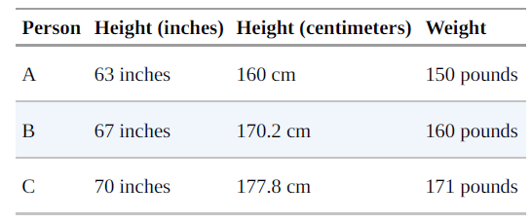
Rescaling
Many techniques are sensitive to the scale of your data. For example, imagine that you have a data set consisting of the heights and weights of hundreds of data scientists, and that you are trying to identify clusters of body sizes.
data = {"height_inch":{'A':63, 'B':67, 'C':70},
"height_cm":{'A':160, 'B':170.2, 'C':177.8},
"weight":{'A':150, 'B':160, 'C':171}}
df2 = DataFrame(data)
print(df2)

Slide 23
Why normalization (re-scaling)
height_inch height_cm weight
A 63 160.0 150
B 67 170.2 160
C 70 177.8 171
from scipy.spatial import distance
a = df2.iloc[0, [0,2]]
b = df2.iloc[1, [0,2]]
c = df2.iloc[2, [0,2]]
print("%.2f" % distance.euclidean(a,b)) #10.77
print("%.2f" % distance.euclidean(a,c)) # 22.14
print("%.2f" % distance.euclidean(b,c)) #11.40

Slide 24
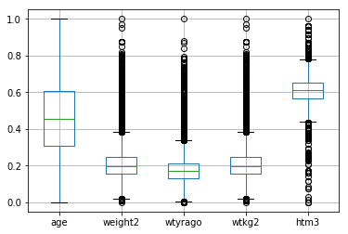
Activity 11
Use the brfss.csv file and load it to your python module.
http://www.cpp.edu/~ukjayarathna/courses/s18/cs299/files/data/
Use the min-max algorithm to re-scale the data. Remember to drop the column ‘sex’ from the dataframe before the rescaling. (Activity 10)
(series – series.min())/(series.max() – series.min())
Create a boxplot of the dataset.
Notes:
Obj = pd.read_csv(‘values.csv’)

Slide 25
Z-score transformation
Z scores, or standard scores, indicate how many standard deviations an observation is above or below the mean. These scores are a useful way of putting data from different sources onto the same scale.
The Z score reflects a standard normal deviate - the variation of across the standard normal distribution, which is a normal distribution with mean equal to zero and standard deviation equal to one.
Z score: Z = (x - sample mean)/sample standard deviation.

Slide 26
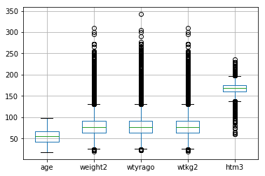
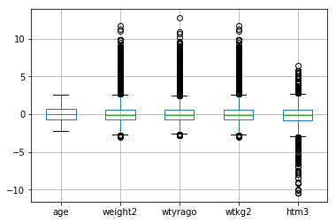
Z-score transformation
def zscore(series):
return (series - series.mean(skipna=True)) / series.std(skipna=True);
df3 = df2.apply(zscore)
df3.boxplot()
df4.boxplot()

Slide 27
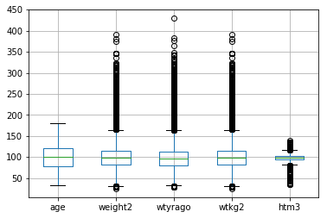
Mean-based scaling
def meanScaling(series):
return series / series.mean()
df8 = df4.apply(meanScaling) * 100
df8.boxplot()

