Slide 1
Lecture 7 – Delivering Results with R
CS 299
Introduction to Data Science
Dr. Sampath Jayarathna
Cal Poly Pomona

Slide 2
What is R?
R is
A software package for statistical computing and graphics
A collection of 6,700+ packages
A (not ideal) programming language
A work environment
Widely used in research and academia
Powerful
Free
Notes:
R is an interpreted language, but with much of it compiled in C.

Slide 3
Some history
S was developed at Bell Labs, starting in the 1970s
R was created in the 1990s by Ross Ihaka and Robert Gentleman
R was based on S, with code written in C
S largely was used to make good graphs – not an easy thing in 1975. R, like S, is quite good for graphing.

Slide 4
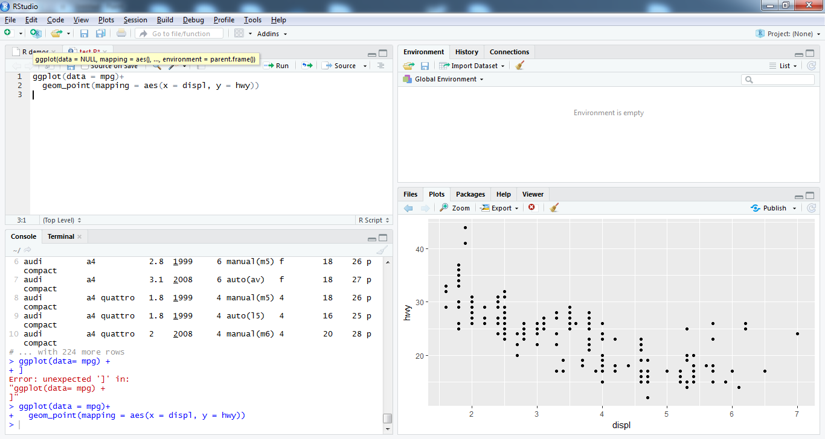
RStudio
An Integrated Development Environment (IDE) for R
An easy way to use R

Slide 5
Prerequisites : tidyverse
R packages for data science
The tidyverse is an opinionated collection of R packages designed for data science. All packages share an underlying design philosophy, grammar, and data structures.
To access the datasets, help pages, and functions, install the tidyverse package by running the code in Rstudio console,
install.packages("tidyverse")
You only need to install the package once, but you need to reload it every time you start a new session
library(tidyverse)

Slide 6
Normal Variables
We can use <- as the assignment operator in R (shortcut alt + - in Rstudio)
x <- 4 (set x to 4)
For printing the value of x
x [1] 4
OR, print(x) [1] 4
Notes:
X <- y <-5 works but not x <- y = 5

Slide 7
A Numeric Vector
Simplest data structure
Numeric vector
> v <- c(1,2,3)
<- is the assignment operator
c is the list concatenation operator
To print the value, v
Type : > v
Output: [1] 1 2 3

Slide 8
A vector is a full fledged variable
Let us do the following:
> 1/v [1] 1.0000000 0.5000000 0.3333333
> v + 2 [1] 3 4 5
We can treat a vector as a regular variable
For example, we can have:
> v1 <- v / 2 > v1 [1] 0.5 1.0 1.5

Slide 9
Functions on Vectors
If v is a vector
Here, are a few of the functions that take vectors as inputs: mean(v), max(v), sqrt(v), length(v), sum(v), prod(v), sort (v) (in ascending order)
> sqrt(v)
[1] 1.000000 1.414214 1.732051

Slide 10
Generating Vectors
Suppose we want a vector of the form: (1,2,3,... 100)
We do not have to generate it manually.
We can use the following commands: > v <- 1:100 OR > v <- seq(1,100)
seq takes an additional argument, which is the difference between consecutive numbers:
seq (1,100,10) gives (1,11,21,31 ... , 91)
rep (2,5) generates a vector (2, 2, 2, 2, 2)

Slide 11
Lists and Data Frames
A list is a heterogeneous data structure
It can contain data belonging to all kinds of types
Example:
> lst <- list (“one”, 1, TRUE)
Elements can be lists, arrays, factors, and normal variables
The components are always numbered
They are accessed as follows: lst[[1]], lst[[2]], lst[[3]]
[[ ... ]] is the operator for accessing an element in a list
index from 1, Not 0

Slide 12
Named Components
Lists can also have named components
lst <- list(name=“Sofia”, age=29, marks=33.7)
The three components are: lst$name, lst$age, lst$marks
We can also use
lst [[“name”]], lst[[“age”]], lst [[“marks”]]

Slide 13
Data Frames
columns
Data Frame
rows
It is a table in R similar to Pandas DataFrame
> entries <- c(“cars”, “trucks”, “bikes”)
> price <- c (8, 10, 5)
> num <- c (1, 2, 3) > df <- data.frame(entries, price, num)
> df
entries price num
1 cars 8 1
2 trucks 10 2
3 bikes 5 3

Slide 14
Accessing an Element
Can be accessed as a regular array, or as a list
> df[1,2]
[1] 8
> df[2,]
entries price num
2 trucks 10 2
> df$price
[1] 8 10 5
Summary shows a summary of each variable in the data frame
> summary(df)
entries price num
bikes :1 Min. : 5.000 Min. :1.0
cars :1 1st Qu.: 6.500 1st Qu.:1.5
trucks:1 Median : 8.000 Median :2.0
Mean : 7.667 Mean :2.0
3rd Qu.: 9.000 3rd Qu.:2.5
Max. :10.000 Max. :3.0
Row names, i.e. character values

Slide 15
Reading Data from Files
Reads in a data frame from a file
Steps:
Store the data frame in a file
Read it in
> df <- read.table (“<filename>”)
Access the data frame

Slide 16
Grouping, Loops, Conditional Execution
R does have support for regular if statements, while loops, and other conditionals
if statement
if (condition) statement 1 else statement 2. Use {} for creating grouped statements
The condition should evaluate to a single variable (not a vector)
Example:
x <- 3
if (x > 0)
x <- x+ 3
else
x <- x + 6
Print(x)
[1] 6

Slide 17
For loop
for (var in expr1) {
....
....
}
for (v in 1:10)
print (v)
[1] 1
[1] 2
[1] 3
[1] 4
[1] 5
[1] 6
[1] 7
[1] 8
[1] 9
[1] 10
Example:

Slide 18
While loop
i <- 1
while(i < 10)
{
print(i)
i <- i+1
}
[1] 1
[1] 2
[1] 3
[1] 4
[1] 5
[1] 6
[1] 7
[1] 8
[1] 9

Slide 19
Writing one’s own functions
cube <- function(x){
x*x*x
}
print(cube(4))
[1] 64
A function takes a list of arguments within ( ... )
To return a value, just print the expression (without assignment statements) or use return()

Slide 20
Applying a Function
lapply (1:2,cube)
[[1]]
[1] 1
[[2]]
[1] 8
Apply the cube function to a vector
Applies the function to each and every argument
sapply returns a list
sapply (1:3, cube)
[1] 1 8 27

Slide 21
Plotting a Function
A basic 2D plot:
vec1 <-seq(1,100,10)
vec2 <-seq(1,100,5)
plot(vec1, type="o", col="blue“, main=“plot of lines”)
To add a line to the same plot:
lines(vec2, type=“b", col=“red“)

Slide 22
Plotting Example 2
library("MASS")
data(cats) # load data
plot(cats$Bwt, cats$Hwt) # scatter plot of cats body weight vs heart rate
plot(cats$Bwt, cats$Hwt, col = "blue", main = "Heart rate plotted against body weight of cats", xlab = "Body weight", ylab = "Heart rate") # scatter plot

Slide 23
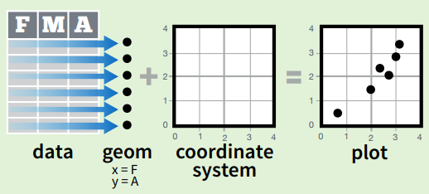
What is ggplot2?
R has several systems for making graphics, but ggplot2 is one of the most elegant and most versatile.
ggplot2 is based on the grammar of graphics, the idea that you can build every graph from the same few components: a data set, a set of geoms—visual marks that represent data points, and a coordinate system.

Slide 24
What is ggplot2?
An implementation of the Grammar of Graphics by Leland Wilkinson
Grammar of graphics represents and abstraction of graphics ideas/objects
Think “verb”, “noun”, “adjective” for graphics
Allows for a “theory” of graphics on which to build new graphics and graphics objects

Slide 25
Basic Components of a ggplot2 Plot
A data frame
aesthetic mappings: how data are mapped to color, size
geoms: geometric objects like points, lines, shapes.
facets: for conditional plots.
stats: statistical transformations like binning, quantiles, smoothing.
scales: what scale an aesthetic map uses (example: male = red, female = blue).
coordinate system

Slide 26
Building Plots with ggplot2
When building plots in ggplot2 the “artist’s palette” model may be the closest analogy
Plots are built up in layers
Plot the data
Overlay a summary
Metadata and annotation

Slide 27
ggplot2 “Hello World”
Let’s use our first graph to answer a question: do cars with big engines use more fuel than cars with small engines?
What does the relationship between engine size and fuel efficiency look like? Positive? Negative? non-linear?
Lets load mpg data frame found in ggplot2 library(tidyverse) print(mpg)
Car engine size in liters

Slide 28
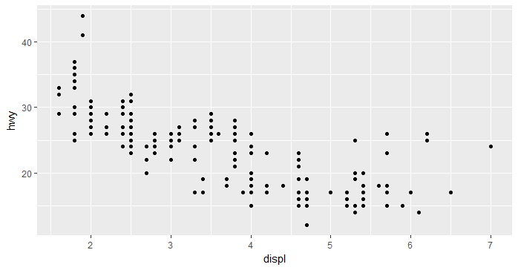
ggplot2 “Hello World”
ggplot(data = mpg) +
geom_point(mapping = aes(x = displ, y=hwy))
The plot shows negative relationship between engine size (displ) and fuel efficiency (hwy).

Slide 29
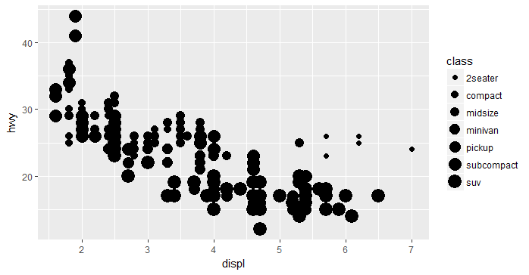
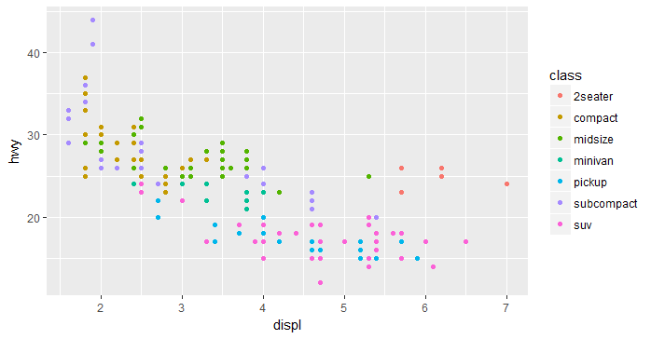
Building Plots with ggplot2
ggplot() : creates a coordinate system that you can add layers to with first argument of ggplot() is the dataset to use in graph
Complete your graph by adding layers.
Function geom_point() adds a layer of geometric points to your plot which creates a scatterplot.
ggplot2 takes a mapping argument to define how variables in your dataset are mapped to visual properties called aesthetics or aes()
x, y, color, size, shape, stroke, alpha etc.
ggplot(data = mpg) +
geom_point(mapping = aes(x = displ, y=hwy, color = class))

