Slide 1
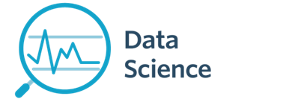
Revisions
CS 299
Introduction to Data Science
Dr. Sampath Jayarathna
Cal Poly Pomona

Slide 2
Final Exam
June 04, Monday
1.50 pm - 3.50 pm
Room 8-302
Closed books and you may bring one standard 8.5" by 11" piece of paper with any notes you deem appropriate or significant (front and back).
For finals, no iPads, iPhones, Blackberries, Android phones/tablets, laptops are allowed. Standard calculators are allowed (optional)

Slide 3
Structure
Multiple Choice questions
~4-5 questions from each series such as Evaluation, Classification etc.
Similar to the quizzes and midterm.

Slide 4
Study Guide
Only from lectures since midterm! Yay!
Lecture 4 – Text Retrieval Models
Lecture 5 – Evaluations
Lecture 6a, 6b – Text Classification and SVM
Lecture 7a - Visualizations

Slide 5
Extended Study Guide
Lecture 4 – Text Retrieval Models
Common preprocessing steps (no coding examples)
tf, df, tfidf, vector space, cosine (should be able to calculate)
Lecture 5 – Evaluations
Precision, recall, confusion matrix, accuracy, F measure, MAP (should be able to calculate)
Lecture 6a, 6b – Text Classification and SVM
Classification vs clustering
Knn, Roccio, svm: decision boundary, support vectors, (you don’t need to know how to do any specific calculations of the decision boundary etc. )
Roccio vs KNN, (specially what is prototype and what is neighbor based)
Generalization vs overfitting
Cross validation

Slide 6
Practice Questions
You are working as an assistant-biologist to the Charles Darwin on the Beagle voyage. You are at the Galapagos Island and you have just discovered a new animal that has not yet been classified. Mr. Darwin has asked you to classify the animal using a K-nearest-neighbor approach and he has supplied you with a case-base of already classified animals and their distance measure to the mystery animal.
What is the class of mystery animal if you use
1-NN:
3-NN:
7-NN:
Species | Class | Distance
Cat | Mammal | 6
Frog | Amphibian | 1
Squirrel | Mammal | 5.5
Duck | Bird | 2
Salamander | Amphibian | 1.3
Bat | Mammal | 5
Butterfly | Arthropods | 8

Slide 7
Practice Questions
For a given query there are 16 relevant documents in the collection. The precision for the query is 0.40, and the recall for the query is 0.25. How many documents are in the result set (retrieved) including both relevant and non-relevant?
What is the F measure?
If the total non relevant documents in the collection are 20, then what is the accuracy of this search system?
 | Relevant | Non-relevant
Retrieved | tp | fp
Not Retrieved | fn | tn

Slide 8
Practice Questions
Here is a simplified example of the vector space retrieval model. Consider a very small collection that contains 64 documents and assume you index the terms “times”, “york” and “angeles”. df of the terms in the collections are 8, 4 and 16 respectively. For document d1,
d1: “new york times is better than the los angeles times”
Find cosine similarity for following query q= “ new york times is the best”
angles log2(64/16)=log2(4) =2
times log2(64/8)=log2(8) = 3
york log2(64/4)=log2(16) =4
With max normalization of tf, and without normalizing the query,
times york angeles times york angeles
d1 2/2 1/2 ½ tfidf d1 1*3=3 ½*4=2 ½*2=1
q 1 1 0 tfidf q 1*3=3 1*4=4 ½*0=0
Cosine = (9+8+0) /sqrt((9+4+1)x(9+16+0)) = 17/18.71 = 0.91

Slide 9
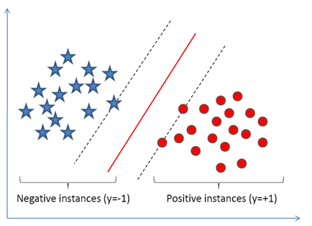
Practice Questions
Consider the following classification problem with positive and negative instances.
Mark the support vectors, the decision boundary $w^{T}x+b=0$ and $w^{T}x+b=1$ and${ w}^{T}x+b=−1$.
For an SVM, if we remove one of the support vectors from the training set, what happens to the decision boundary?

Slide 10
General Advice
Don’t leave answers empty. Partial credit will be given. Do things to make your thinking and process visible
Suggestion: Read the entire exam before you begin work on any problem. Budget your time wisely, according to point distribution
Grading will be based on correctness, clarity, and neatness
Do not confer with any other person. Don’t cheat. All the involved parties will get F for the course.
Use time wisely, you have 2 hrs. Re-read after you are done
Start time is 1.50pm, not 2pm. So, arrive early. We have another class starts at 4pm, so the papers will be collected by 3.50pm
I will be on a conference, so my TA will be there to proctor the exam, I’ll try to arrange someway that you can ask questions from me. But expect delays.

