Slide 1
Lecture 1- Introduction
CS 128
Introduction to C++
Sampath Jayarathna
Cal Poly Pomona
Based on slides created by Bjarne Stroustrup & Tony Gaddis

Slide 2
Today
Who I am
CS 128 educational objectives (and why)
Overview of the course, and logistics
Quick overview of C++ and why we study it
First program “Hello World!”

Slide 3
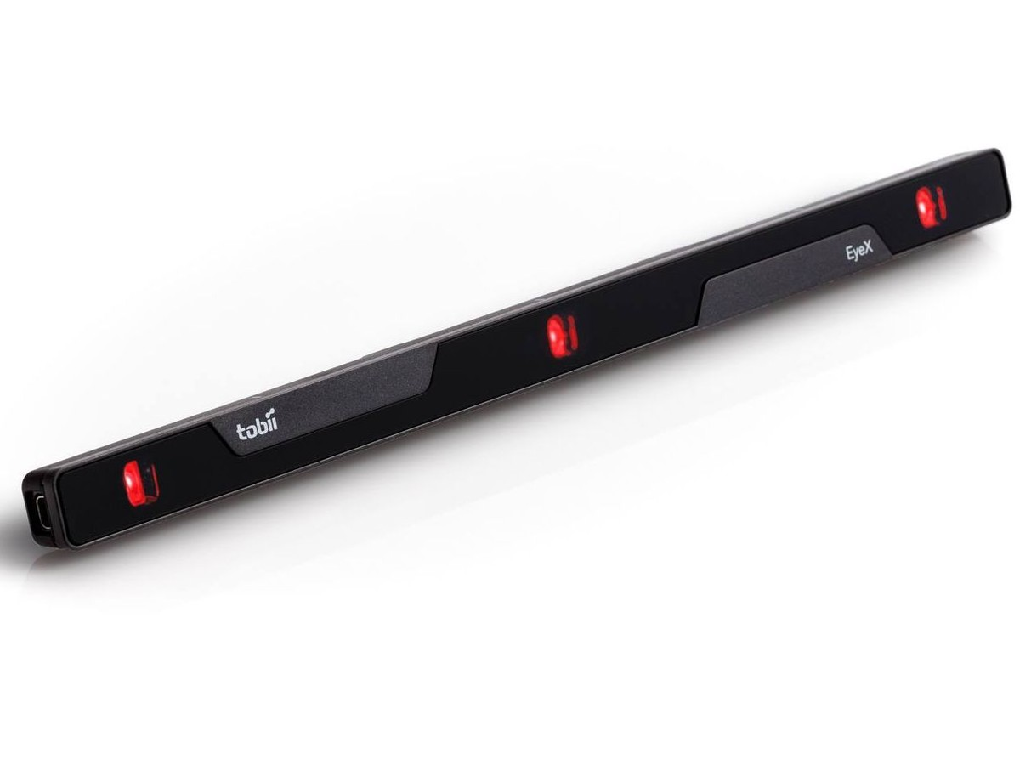
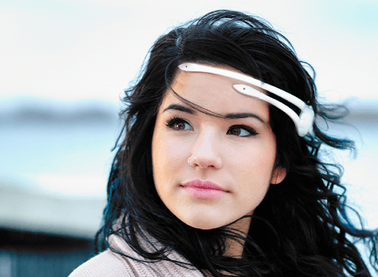
Instructor : Sampath Jayarathna Joined Cal Poly Pomona Fall 2016 from Texas A&M. Originally from Sri Lanka
Research : NeuroIR, Eye tracking, Brain EEG, User modeling
Web : http://www.cpp.edu/~ukjayarathna
Lab : http://www.cpp.edu/~ukjayarathna/nirds-lab
Contact : 8-46, ukjayarathna@cpp.edu, (909) 869-3145
Office Hours : W, Th (online) 10am – 12pm, or email me for an appointment
[Open Door Policy]

Slide 4
Abstract
Today, I’ll outline the aims for this course and present a rough course plan.
I’ll introduce the basic notion of programming and give examples of areas in which software is critical to our civilization.
Finally, I’ll present the simplest possible C++ program and outline how it can be made into running code.

Slide 5
This is a course
About Programming
For beginners
who want to become professionals
i.e., people who can produce systems that others will use
who are assumed to be bright
Though not (necessarily) geniuses
who are willing to work hard
Though do need sleep occasionally, and take a normal course load
Using the C++ programming language

Slide 6
Course Information
Schedule : T/Th, Room: 8-52, Time: 1.00 PM – 4.50 PM http://www.cpp.edu/~ukjayarathna/courses/su18/cs128
www.piazza.com/csupomona/summer2018/cs128/home
Blackboard
Prereqs
Official: MAT105 and 106 or approval of instructor
Format
Before lecture: do reading slides
In lecture: put reading in context
After lecture: assignments, for hands-on practice

Slide 7
Student Learning Outcomes
After successfully completing this course, students should be able to:
Comprehend the basic concepts of programming and its use for problem solving
Learn good programming principles and practices using the C++ language
Have good knowledge of the syntax and semantics of C++ and its compilation and execution

Slide 8
Communication
Piazza:
All questions will be fielded through Piazza.
Many questions everyone can see the answer
You should post at least one substantive, interesting post to the discussion forum.
You must also respond to at least four posts made by others.
You can also post private messages that can only be seen by the instructor
Blackboard:
Blackboard will be used primarily for assignments/homework, extra credit submission and grade dissemination.
Email:
Again, email should only be used in rare instances, I will probably point you back to Piazza

Slide 9
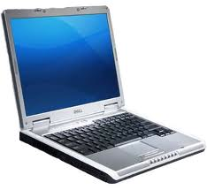
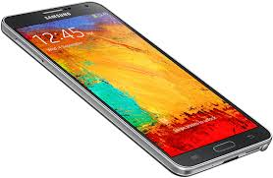
The Rules

Slide 10
Cooperate on Learning
Except for the work you hand in as individual contributions, I strongly encourage you to collaborate and help each other
If in doubt if a collaboration is legitimate: ask!
Don’t claim to have written code that you copied from others
Don’t give anyone else your code (to hand in for a grade)
When you rely on the work of others, explicitly list all of your sources – i.e. give credit to those who did the work
Don’t study alone when you don’t have to
Form study groups
Do help each other (without plagiarizing)

Slide 11
Required / Supplementary materials
Required textbook. No textbook is required. All the key course content will be documented in slides, which will be available in the course website after each lecture.
List of optional but recommended materials. You may find some of these optional textbooks helpful, though none are required:
Starting out with C++: From Control Structures through Objects by Gaddis, 7th Edition, 2011.
Bring Your Own Device (BYOD).

Slide 12
Course Organization
Grading
30% | Final Exam
30% | In-Class Assignments (3)
30% | Mini-midterm (2)
10% | In-Class Activities
100% | Your Total Score for the class

Slide 13
Course Organization
Final Exam:
Mini-midterm:
In Class Assignments: We will have 3 in-class assignments, each worth 10% of your overall grade.
In Class Activities:

Slide 14
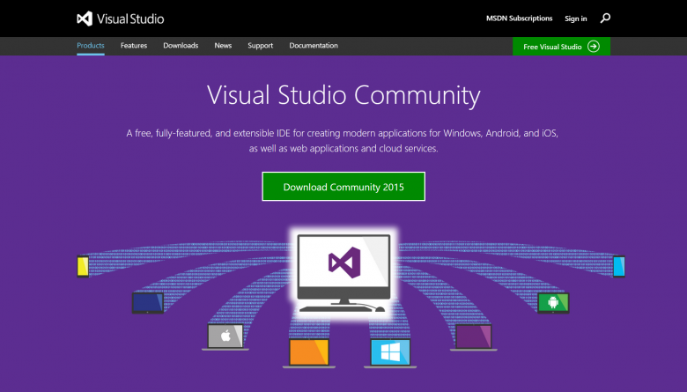
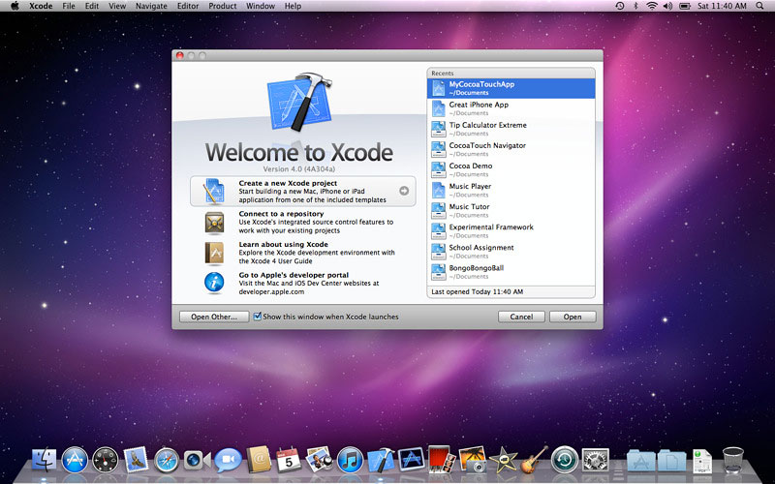
Personal devices – Software Setup
Windows – Visual Studio Community
https://www.visualstudio.com/vs/community/
MacOS – Xcode
From Apple App Store, search for “Xcode”
Apple developer web site: https://developer.apple.com/xcode/

Slide 15
Why C++ ?
You can’t learn to program without a programming language
The purpose of a programming language is to allow you to express your ideas in code
C++ is the language that most directly allows you to express ideas from the largest number of application areas
C++ is the most widely used language in engineering areas

Slide 16
Why C++ ?
C++ allows direct expression of ideas from many application areas
C++ is most widely used language in engineering areas
C++ is precisely and completely defined by an ISO standard
C++ is widely available
Concepts you learn with C++ are directly applicable to many other languages

Slide 17
Why programming?
Our civilization runs on software
Most engineering activities involve software

Slide 18
Aircraft
Communication
Control
Display
Signal Processing
Monitoring

Slide 19
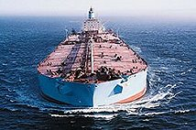
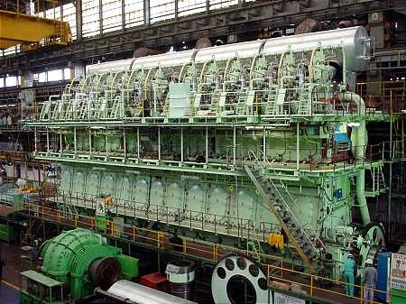
Ships
Design
Construction
Management
Monitoring
Hull Design
Pumps

Slide 20
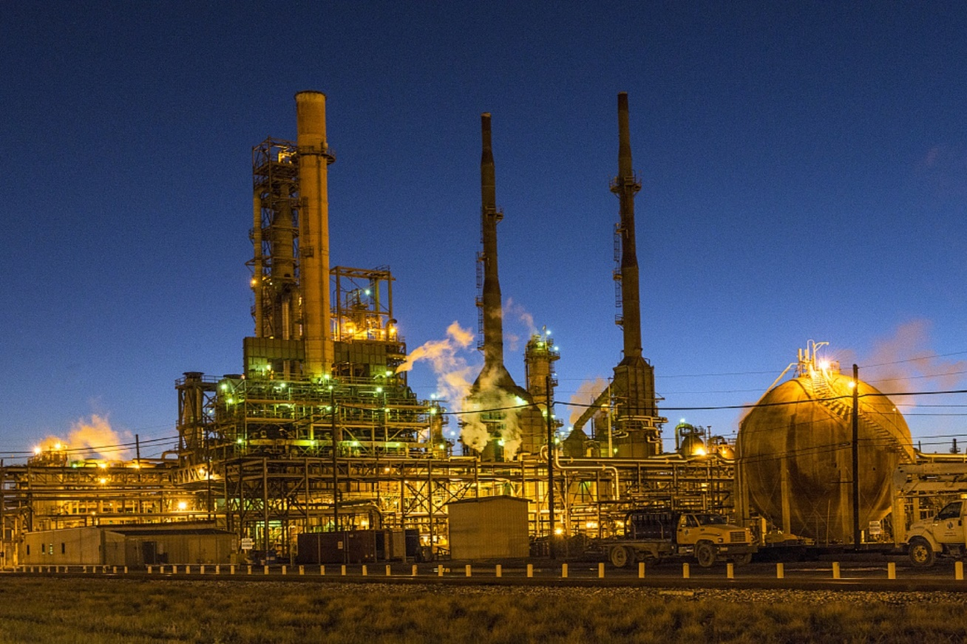
Energy
Control
Monitoring
Analysis
Design
Communications
Manufacturing
Visualization

Slide 21
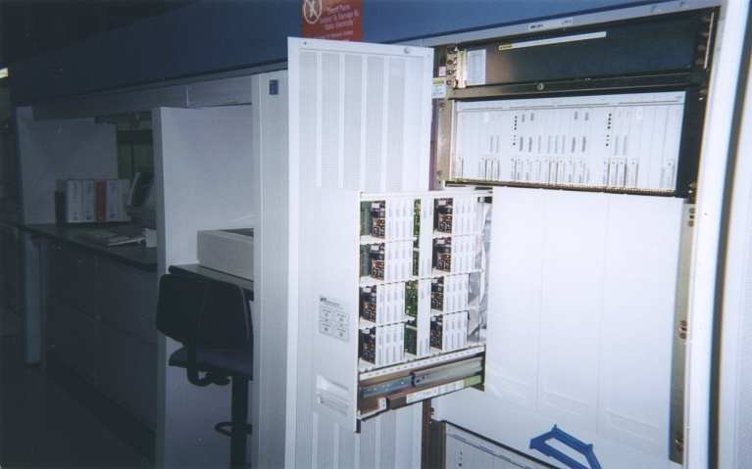
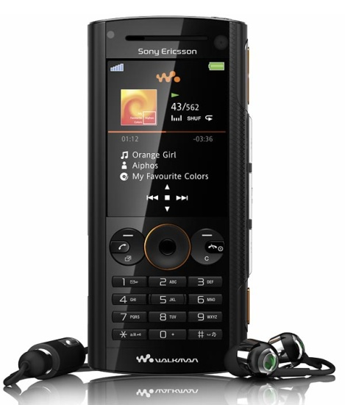
Phones
Voice Quality
User Interfaces
Billing
Mobility
Switching
Reliability
Images

Slide 22
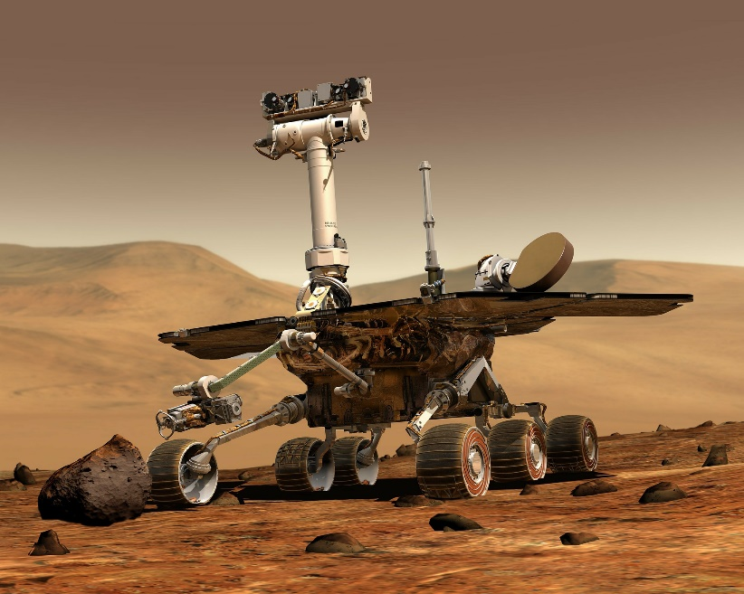
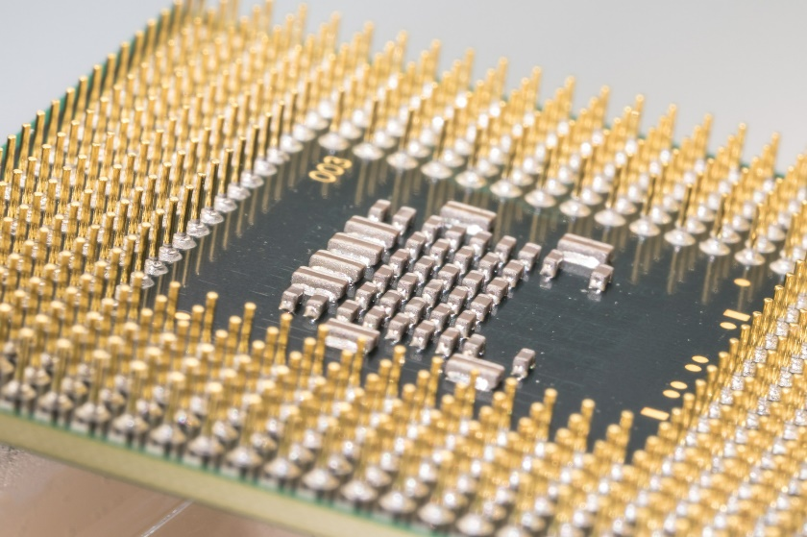
Where is C++ Used
Mars Rovers,
Animation,
Graphics,
Photoshop,
GUIs,
Embedded Systems,
OS’s, Compilers, Slides, Chip Design, Chip Manufacturing, Semiconductor Tools,…

Slide 23
Main Hardware Component Categories

Slide 24
Central Processing Unit (CPU)
Comprised of:
Control Unit
Retrieves and decodes program instructions
Coordinates activities of all other parts of computer
Arithmetic & Logic Unit
Hardware optimized for high-speed numeric calculation
Hardware designed for true/false, yes/no decisions

Slide 25
CPU Organization

Slide 26
Main Memory
It is volatile. Main memory is erased when program terminates or computer is turned off
Also called Random Access Memory (RAM)
Organized as follows:
bit: smallest piece of memory. Has values 0 (off, false) or 1 (on, true)
byte: 8 consecutive bits. Bytes have addresses.

Slide 27
Main Memory
Addresses – Each byte in memory is identified by a unique number known as an address.
In Figure, the number 149 is stored in the byte with the address 16, and the number 72 is stored at address 23.

Slide 28
Secondary Storage & Input Devices
Non-volatile: data retained when program is not running or computer is turned off
Comes in a variety of media:
magnetic: floppy disk, hard drive
optical: CD-ROM, DVD
Flash drives, connected to the USB port
Input Devices: Devices that send information to the computer from outside
Many devices can provide input:
Keyboard, mouse, scanner, digital camera, microphone
Disk drives, CD drives, and DVD drives

Slide 29
Software-Programs That Run on a Computer
Categories of software:
System software: programs that manage the computer hardware and the programs that run on them. Examples: operating systems, utility programs, software development tools
Application software: programs that provide services to the user. Examples : word processing, games, programs to solve specific problems

Slide 30
Machine Language
Machine language instructions are binary numbers, such as 1011010000000101
Rather than writing programs in machine language, programmers use programming languages.

Slide 31
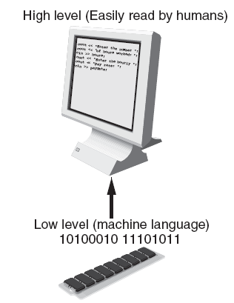
Programs and Programming Languages
Types of languages:
Low-level: used for communication with computer hardware directly. Often written in binary machine code (0’s/1’s) directly.
High-level: closer to human language

Slide 32
Programs and Programming Languages
Types of languages:
Low-level: used for communication with computer hardware directly. Often written in binary machine code (0’s/1’s) directly.
High-level: closer to human language

Slide 33
Some Well-Known Programming Languages
C++
BASIC
Ruby
Java
FORTRAN
Visual Basic
C#
COBOL
JavaScript
C
Python

Slide 34
Simplified Model
Input
Processor
Output
Memory
Abstraction

Slide 35
Memory
Usually stored in RAM
Composed of ones and zeroes
Address for each byte (group of 8 bits)
Physical Address
Logical Address
Starts at zero

Slide 36
Memory Layout
Memory
Code
Static Data
Heap / Free Store
Stack and heap grow toward each other.
Heap / Free Store
Stack
Stack

Slide 37
Memory
Stack : special region of your computer's memory that stores temporary variables created by each function (including the main() function)
Every time a function declares a new variable, it is "pushed" onto the stack. Then every time a function exits, all of the variables pushed onto the stack by that function, are freed
Heap: a region of your computer's memory that is not managed automatically for you, and is not as tightly managed by the CPU.
Memory Leaks

Slide 38
Hello, world!
“Hello world” is a very important program
Its purpose is to help you get used to your tools
Compiler
Program development environment
Program execution environment

Slide 39
Steps to create your first C++ program
New > Project > Empty Project
Give a name to your project “CppProject”
In the solution explorer panel, right click on Source Files
Add > new item > C++ file (.cpp)

Slide 40
A first program – just the guts…
// …
void main() // main() is where a C++ program starts
{
cout << "Hello, world!"; // output the 13 characters Hello, world!
}
// quotes delimit a string literal
// NOTE: “smart” quotes “ ” will cause compiler problems.
// so make sure your quotes are of the style " "

Slide 41
A first program – complete
#include <iostream> // get the library facilities needed for now
using namespace std; // use standard namespace std in place of std::cout
void main() // main() is where a C++ program starts
{
cout << "Hello, world!"; // output the 13 characters Hello, world! system(“pause”);
}
// note the semicolons; they terminate statements
// braces { … } group statements into a block
// without system(“pause”) the output window will be closed immediately
// before you have a chance to read the output in Windows environment

Slide 42
Activity 1
Create a c++ program to display the following console message.
Your c++ file name is activityone.cpp
Your program should display
Hello World!
My name is YourName
I’m from YourCity
I’m YourAge years old!
Submit your ActivityOne.cpp file to Piazza Activity One thread. Add your partners name (if works with another) and your name to your reply.

Slide 43
Hello, world!
Type in the program carefully
After you get it to work, please make a few mistakes to see how the tools respond; for example
Forget the header
Forget to terminate the string
Misspell return (e.g., retrun)
Forget a semicolon
Forget { or }
…

Slide 44
Compilation Process
Starting with source code (e.g. C++) and converting it into machine code that the computer can run.
When using our IDE, the process appears like this:
Source Code
Compile
Executable File

Slide 45
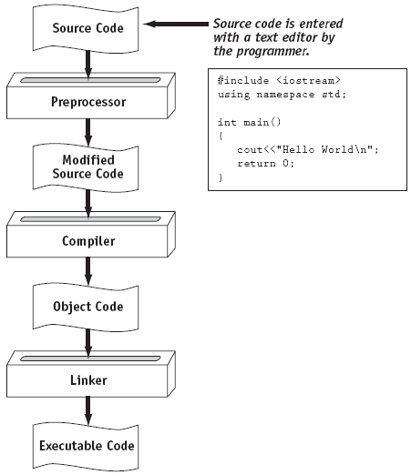
From a High-Level Program to an Executable File

Slide 46
Actual Process
Source Code
Assembler
Assembler File
Compiler
Object Code File
Linker
Executable File
Expanded Source Code
C++ Preprocessor
#included header files
Object Code for Library Functions
http://faculty.cs.niu.edu/~mcmahon/CS241/Notes/compile.html

Slide 47
Hello world
It’s almost all “boiler plate”
Only cout << "Hello, world! " directly does anything
That’s normal
Most of our code, and most of the systems we use simply exist to make some other code elegant and/or efficient
“Boiler plate,” that is, notation, libraries, and other support is what makes our code simple, comprehensible, trustworthy, and efficient.
Would you rather write 1,000,000 lines of machine code?
This implies that we should not just “get things done”; we should take great care that things are done elegantly, correctly, and in ways that ease the creation of more/other software:
Style Matters!

Slide 48
Compilation and linking
C++ source code
C++ compiler
Object code
Executable program
linker
Library Object code
You write C++ source code
Source code is (in principle) human readable
The compiler translates what you wrote into object code (sometimes called machine code)
Object code is simple enough for a computer to “understand”
The linker links your code to system code needed to execute
E.g., input/output libraries, operating system code, and windowing code
The result is an executable program
E.g., a .exe file on windows or an a.out file on Unix

Slide 49
Input, Processing, and Output
Three steps that a program typically performs:
Gather input data:
from keyboard
from files on disk drives
Process the input data
Display the results as output:
send it to the screen
write to a file

Slide 50
So what is programming?
Conventional definitions
Telling a very fast moron exactly what to do
A plan for solving a problem on a computer
Specifying the order of a program execution
But modern programs often involve millions of lines of code
And manipulation of data is central
Definition from another domain (academia)
A … program is an organized and directed accumulation of resources to accomplish specific … objectives …
Good, but no mention of actually doing anything
The definition we’ll use
Specifying the structure and behavior of a program, and testing that the program performs its task correctly and with acceptable performance
Never forget to check that “it” works
Software == one or more programs

Slide 51
Programming
Programming is fundamentally simple
Just state what the machine is to do
So why is programming hard?
We want “the machine” to do complex things
And computers are nitpicking, unforgiving, dumb beasts
The world is more complex than we’d like to believe
So we don’t always know the implications of what we want
“Programming is understanding”
When you can program a task, you understand it
When you program, you spend significant time trying to understand the task you want to automate
Programming is part practical, part theory
If you are just practical, you produce non-scalable unmaintainable hacks
If you are just theoretical, you produce toys

Slide 52
Software Engineering
Encompasses the whole process of crafting computer software.
Software engineers perform several tasks in the development of complex software projects.
designing,
writing,
testing,
debugging,
documenting,
modifying, and
maintaining.

Slide 53
Software Engineering
Software engineers also use special software designed for testing programs.
Most commercial software applications are large and complex.
Usually a team of programmers, not a single individual, develops them.
Program requirements are thoroughly analyzed and divided into subtasks that are handled by
individual teams
individuals within a team.

Slide 54
The next lecture
Will talk more about types, values, variables, declarations, simple input and output, very simple computations, and type safety.

