Slide 1
Lecture 2 Variables, Types, Operators
CS 128
Introduction to C++
Sampath Jayarathna
Cal Poly Pomona
Based on slides created by Bjarne Stroustrup & Tony Gaddis

Slide 2
The Parts of a C++ Program
comment
// sample C++ program
#include <iostream>
using namespace std;
int main()
{
cout << "Hello, there!";
return 0;
}
preprocessor directive
which namespace to use
beginning of function named main
beginning of block for main
output statement
string literal
Send 0 to operating system
end of block for main

Slide 3
Special Characters
Character | Name | Meaning
// | Double slash | Beginning of a comment
# | Pound sign | Beginning of preprocessor directive
< > | Open/close brackets | Enclose filename in #include
( ) | Open/close parentheses | Used when naming a function
{ } | Open/close brace | Encloses a group of statements
" " | Open/close quotation marks | Encloses string of characters
; | Semicolon | End of a programming statement

Slide 4
The cout Object
Displays output on the computer screen. You use the stream insertion operator << to send output to cout: cout << "Programming is fun!";
Can be used to send more than one item to cout: cout << "Hello " << "there!";
Or:
cout << "Hello ";
cout << "there!";
This produces one line of output: cout << "Programming is "; cout << "fun!";

Slide 5
The endl Manipulator
You can use the endl manipulator to start a new line of output. This will produce two lines of output: cout << "Programming is" << endl; cout << "fun!";

Slide 6
The \n Escape Sequence
You can also use the \n escape sequence to start a new line of output. This will produce two lines of output: cout << "Programming is\n"; cout << "fun!";
Notice that the \n is INSIDE
the string.

Slide 7
The #include Directive
Inserts the contents of another file into the program
This is a preprocessor directive, not part of C++ language
#include lines not seen by compiler
Do not place a semicolon at end of #include line

Slide 8
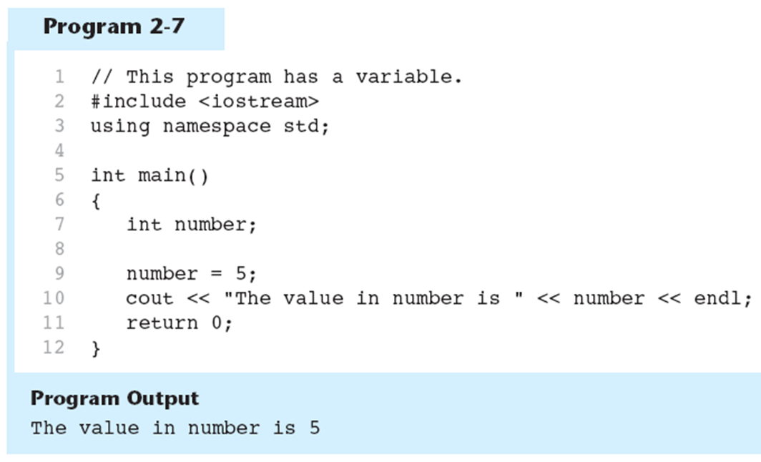
Variables and Literals
Variable: a storage location in memory
Has a name and a type of data it can hold
Must be defined before it can be used:
int item;

Slide 9
Literals
Literal: a value that is written into a program’s code.
"hello, there" (string literal)
12 (integer literal)

Slide 10
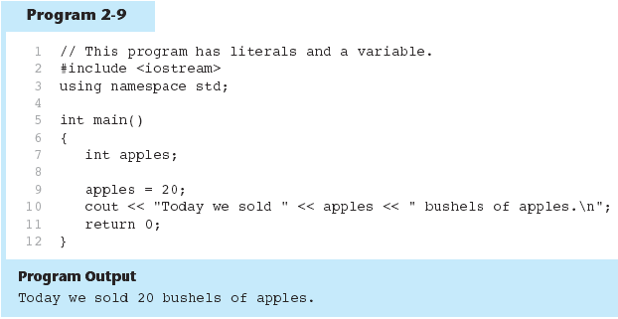
Integer Literal in Program
20 is an integer literal

Slide 11
String Literals
These are string literals

Slide 12
Types
C++ provides a set of types
E.g. bool, char, int, double
Called “built-in types”
C++ programmers can define new types
Called “user-defined types”
We'll get to that eventually
The C++ standard library provides a set of types
E.g. string, vector, complex
Technically, these are user-defined types
they are built using only facilities available to every user

Slide 13
Identifiers
An identifier is a programmer-defined name for some part of a program: variables, functions, etc.
A variable name should represent the purpose of the variable. For example: itemsOrdered The purpose of this variable is to hold the number of items ordered.

Slide 14
Variable Names
A name in a C++ program
Starts with a letter, contains letters, digits, and underscores (only)
x, number_of_elements, Fourier_transform, z2
Not names:
12x
time$to$market
main line
Do not start names with underscores: _foo
those are reserved for implementation and systems entities
Users can't define names that are taken as keywords
E.g.:
int
if
while
double

Slide 15
Names
Choose meaningful names
Abbreviations and acronyms can confuse people
mtbf, TLA, myw, nbv
Short names can be meaningful
(only) when used conventionally:
x is a local variable
i is a loop index
Don't use overly long names
Ok:
partial_sum element_count staple_partition
Too long:
the_number_of_elements remaining_free_slots_in_the_symbol_table

Slide 16
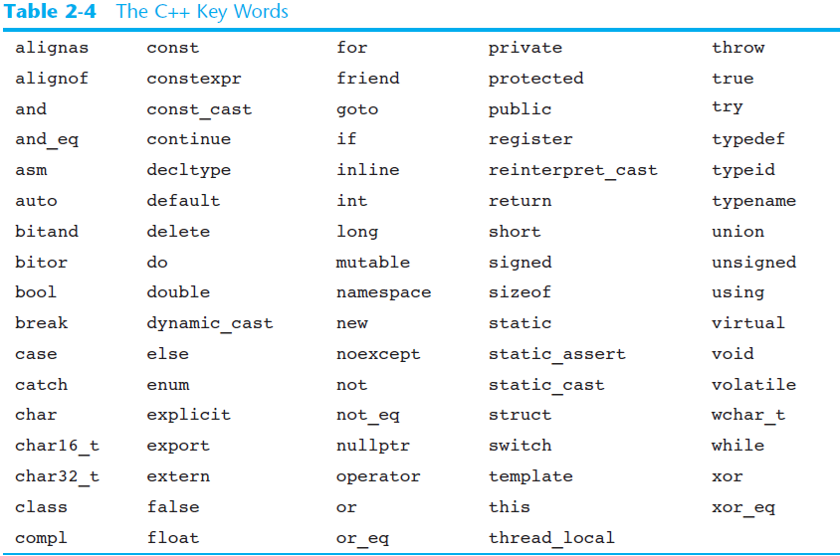
C++ Key Words
You cannot use any of the C++ key words as an identifier. These words have reserved meaning.

Slide 17
Variable Assignments and Initialization
An assignment statement uses the = operator to store a value in a variable. item = 12;
This statement assigns the value 12 to the item variable.
The variable receiving the value must appear on the left side of the = operator.
This will NOT work: // ERROR! 12 = item;

Slide 18
Variable Initialization
To initialize a variable means to assign it a value when it is defined:
int length = 12;
Can initialize some or all variables:
int length = 12, width = 5, area;

Slide 19
Declaration and initialization
int a = 7;
int b = 9;
char c = 'a';
double x = 1.2;
string s1 = "Hello, world";
string s2 = "1.2";
7
a:
b:
9
c:
'a'
x:
1.2
s1:
12 | "Hello, world"
s2:
3 | "1.2"

Slide 20
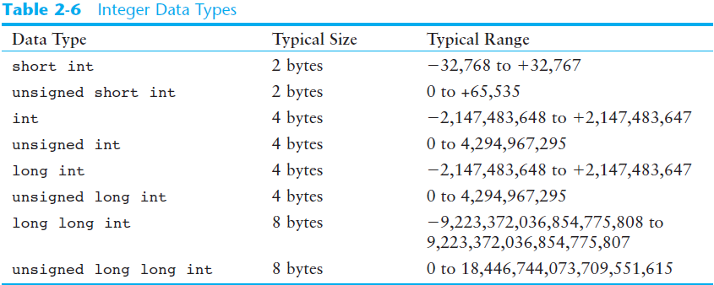
Integer Data Types
Integer variables can hold whole numbers such as 12, 7, and -99.

Slide 21
Defining Variables
Variables of the same type can be defined
- On separate lines:
int length;
int width;
unsigned int area;
- On the same line:
int length, width;
unsigned int area;
Variables of different types must be in different definitions

Slide 22
The char Data Type
Used to hold characters or very small integer values
Usually 1 byte of memory
Numeric value of character from the character set is stored in memory:
Character literals must be enclosed in single quote marks. Example: 'A'
MEMORY:
letter
CODE:
char letter;
letter = 'C';
67

Slide 23
The C++ string Class
Special data type supports working with strings
#include <string>
Can define string variables in programs:
string firstName, lastName;
Can receive values with assignment operator:
firstName = "George";
lastName = "Washington";
Can be displayed via cout
cout << firstName << " " << lastName;

Slide 24
Activity 2
Modify your activity 1 program to include variables for name, city and age which are respectively string, string and int data types.
Your program should display
Hello World!
My name is YourName
I’m from YourCity
I’m YourAge years old!
Submit your ActivityOne.cpp file to Activity 2. Add your partners name (if works with another) .

Slide 25
Input and type
We read into a variable
Here, first_name
A variable has a type
Here, string
The type of a variable determines what operations we can do on it
Here, cin>>first_name; reads characters until a whitespace character is seen (“a word”)
White space: space, tab, newline, …

Slide 26
Input and output
// read first name:
#include <iostream> // header for standard input output
#include <string> // header for string
using namespace std;
int main()
{
cout << "Please enter your first name (followed " << "by 'enter'):\n";
string first_name;
cin >> first_name;
cout << "Hello, " << first_name << '\n';
}
// note how several values can be output by a single statement
// a statement that introduces a variable is called a declaration
// a variable holds a value of a specified type
// the final return 0; is optional in main()
// but you may need to include it to pacify your compiler

Slide 27
String input
// read first and second name:
int main()
{
cout << "please enter your first and second names\n";
string first;
string second;
cin >> first >> second; // read two strings
string name = first + ' ' + second; // concatenate strings
// separated by a space
cout << "Hello, "<< name << '\n';
}
// I left out the #include ….to save space and
// reduce distraction
// Don’t forget it in real code
// Similarly, I left out the Windows-specific system(“pause”);

Slide 28
Integers
// read name and age:
int main()
{
cout << "please enter your first name and age\n";
string first_name; // string variable
int age; // integer variable
cin >> first_name >> age; // read
cout << "Hello, " << first_name << " age " << age << '\n';
}

Slide 29
Activity 3
Modify your activity 2 program to input the values for name, city and age from user.
Your program should display after all the data inputs, at the very end
Hello userName
Great to see that you are from userCity
You are userAge years old!
Submit your ActivityOne.cpp file to Activity 3. Add your partners name (if works with another) .

Slide 30
Floating-Point Data Types
The floating-point data types are: float double long double
They can hold real numbers such as:
12.45 -3.8
Stored in a form similar to scientific notation
All floating-point numbers are signed

Slide 31
Floating-Point Data Types

Slide 32
The bool Data Type
Represents values that are true or false
bool variables are stored as small integers
false is represented by 0, true by 1:
bool allDone = true;
bool finished = false;
allDone
finished
1
0

Slide 33
A technical detail
In memory, everything is just bits; type is what gives meaning to the bits
(bits/binary) 01100001 is the int 97 is the char 'a'
(bits/binary) 01000001 is the int 65 is the char 'A'
(bits/binary) 00110000 is the int 48 is the char '0'
char c = 'a';
cout << c; // print the value of character c, which is a
int i = c;
cout << i; // print the integer value of the character c, which is 97
This is just as in “the real world”:
What does “42” mean?
You don’t know until you know the unit used
Meters? Feet? Degrees Celsius? $s? a street number? Height in inches? …

Slide 34
Declaring Variables With the auto Key Word
C++ 11 introduces an alternative way to define variables, using the auto key word and an initialization value. Here is an example:
auto amount = 100;
The auto key word tells the compiler to determine the variable’s data type from the initialization value.
auto interestRate= 12.0;
auto stockCode = 'D';
auto customerNum = 459L;
int
double
char
long

Slide 35
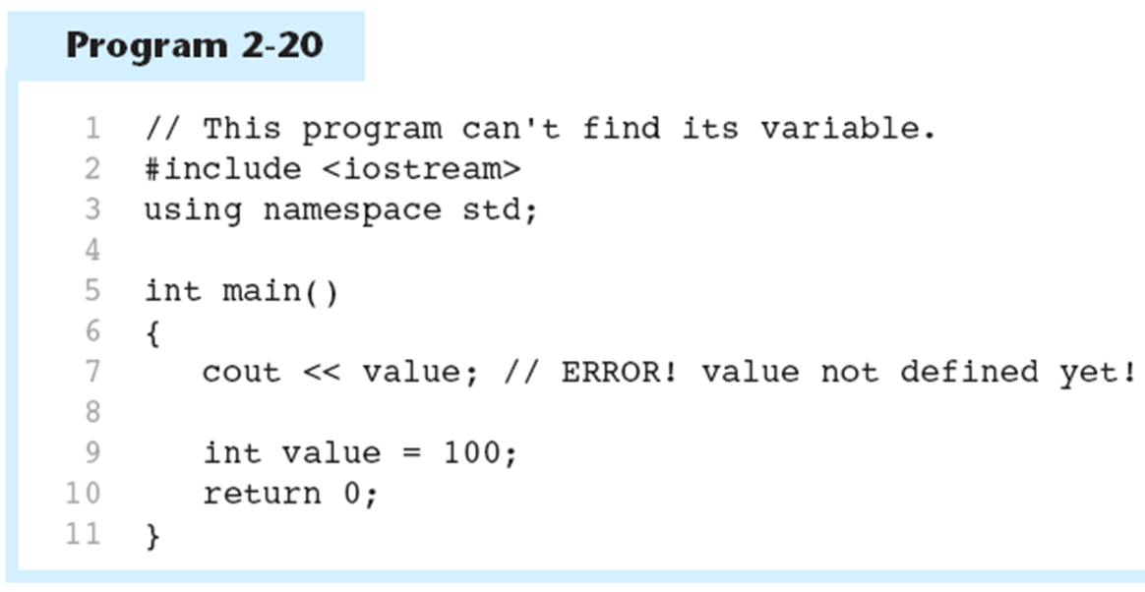
Scope
The scope of a variable: the part of the program in which the variable can be accessed
A variable cannot be used before it is defined

Slide 36
Arithmetic Operators
Used for performing numeric calculations
C++ has unary, binary, and ternary operators:
unary (1 operand) -5
binary (2 operands) 13 - 7
ternary (3 operands) exp1 ? exp2 : exp3 (condition) ? (if true) : (if false)
auto grade = 85;
auto result = (grade> 75)? “pass” : “fail”;

Slide 37
Binary Arithmetic Operators
SYMBOL | OPERATION | EXAMPLE | VALUE OF ans
+ | addition | ans = 7 + 3; | 10
- | subtraction | ans = 7 - 3; | 4
* | multiplication | ans = 7 * 3; | 21
/ | division | ans = 7 / 3; | 2
% | modulus | ans = 7 % 3; | 1

Slide 38
Simple arithmetic
// do a bit of very simple arithmetic:
int main()
{
cout << "please enter a floating-point number: "; // prompt for a number
double n; // floating-point variable
cin >> n;
cout << "n == " << n
<< "\nn+1 == " << n+1 // '\n' means “a newline”
<< "\nthree times n == " << 3*n
<< "\ntwice n == " << n+n
<< "\nn squared == " << n*n
<< "\nhalf of n == " << n/2
<< "\nsquare root of n == " << sqrt(n) // need #include <math.h>
<< '\n';
}

Slide 39
Activity 4
Create a program calculator.cpp to take 2 int values from user input and display the results for simple arithmetic operations on the int values
Your program should display addition, subtraction, multiplication, division and module in each line
Ex: if the 2 numbers are 5 and 8, your output should be
Enter 2 numbers : 5 8 Addition 5+8 = 13
Subtraction 5-8 = -3
Multiplication 5x8 = 40
Division 5/8 = 0
Modulo 5%8 = 5
Submit your calculator.cpp file to Activity 4. Add your partners name (if works with another) .

Slide 40
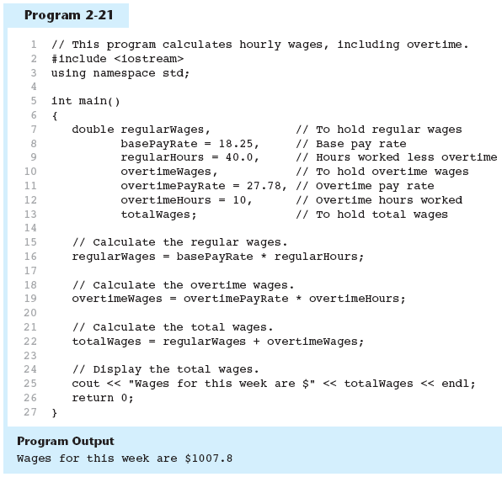
Arithmetic Operators

Slide 41
A Closer Look at the / Operator
/ (division) operator performs integer division if both operands are integers
cout << 13 / 5; // displays 2
cout << 91 / 7; // displays 13
If either operand is floating point, the result is floating point
cout << 13 / 5.0; // displays 2.6
cout << 91.0 / 7; // displays 13.0

Slide 42
A Closer Look at the % Operator
% (modulus) operator computes the remainder resulting from integer division
cout << 13 % 5; // displays 3
% requires integers for both operands
cout << 13 % 5.0; // error

Slide 43
Comments
Used to document parts of the program
Intended for persons reading the source code of the program:
Indicate the purpose of the program
Describe the use of variables
Explain complex sections of code
Are ignored by the compiler

Slide 44
Single-Line Comments
Begin with // through to the end of line:
int length = 12; // length in inches
int width = 15; // width in inches
int area; // calculated area
// calculate rectangle area
area = length * width;

Slide 45
Multi-Line Comments
Begin with /*, end with */
Can span multiple lines:
/* this is a multi-line
comment
*/
Can begin and end on the same line:
int area; /* calculated area */

Slide 46
Named Constants
Named constant (constant variable): variable whose content cannot be changed during program execution
Used for representing constant values with descriptive names:
const double TAX_RATE = 0.0675;
const int NUM_STATES = 50;
Often named in uppercase letters

Slide 47
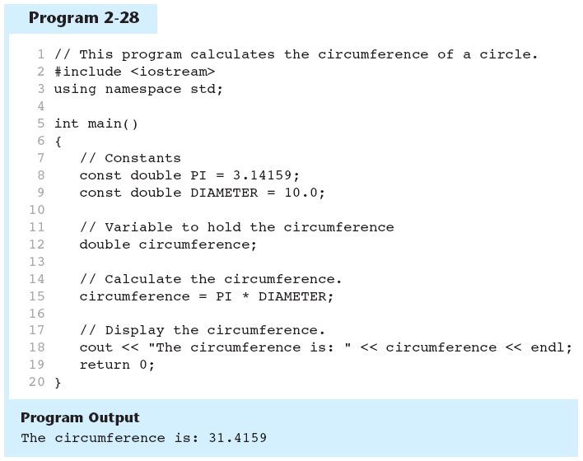
Named Constants in Program 2-28

Slide 48
Programming Style
The visual organization of the source code
Includes the use of spaces, tabs, and blank lines
Does not affect the syntax of the program
Affects the readability of the source code

Slide 49
The next lecture
Will talk about expressions, statements, debugging, simple error handling, and simple rules for program construction

