Slide 1
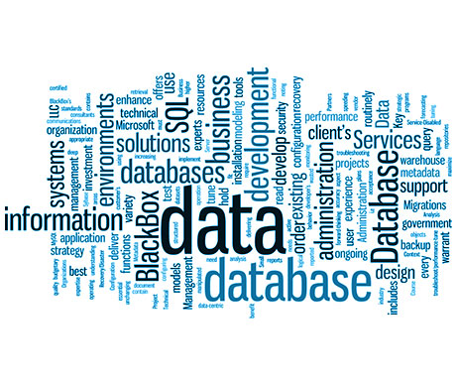
Introduction to DBMS
Sampath Jayarathna
Cal Poly Pomona

Slide 2
What is a Database?
?

Slide 3
Files, Databases and Mini-world
File: A collection of records or documents dealing with one organization, person, area or subject.
Manual (paper) files
Computer files
Database: A collection of related data.
Data: Known facts that can be recorded and have an implicit meaning.
bibliographic, statistical, business data, images, etc.
Mini-world:
Some part of the real world about which data is stored in a database. For example, student grades and transcripts at a university.

Slide 4
Types of Databases and Database Applications
Traditional Applications:
Numeric and Textual Databases
More Recent Applications:
Multimedia Databases
Geographic Information Systems (GIS)
Biological and Genome Databases
Data Warehouses
Mobile databases
Real-time and Active Databases

Slide 5
Recent Developments
Social Networks started capturing a lot of information about people and about communications among people-posts, tweets, photos, videos in systems such as:
- Facebook
- Twitter
- Linked-In
All of the above constitutes data
Search Engines- Google, Bing, Yahoo : collect their own repository of web pages for searching purposes

Slide 6
Recent Developments (2)
New Technologies are emerging to manage vast amounts of data generated:
- AirBnB
- Uber
- Tesla
Big Data storage systems involving large clusters of distributed computers
NOSQL (Not Only SQL) systems
A large amount of data now resides on the “cloud” which means it is in huge data centers using thousands of machines.

Slide 7
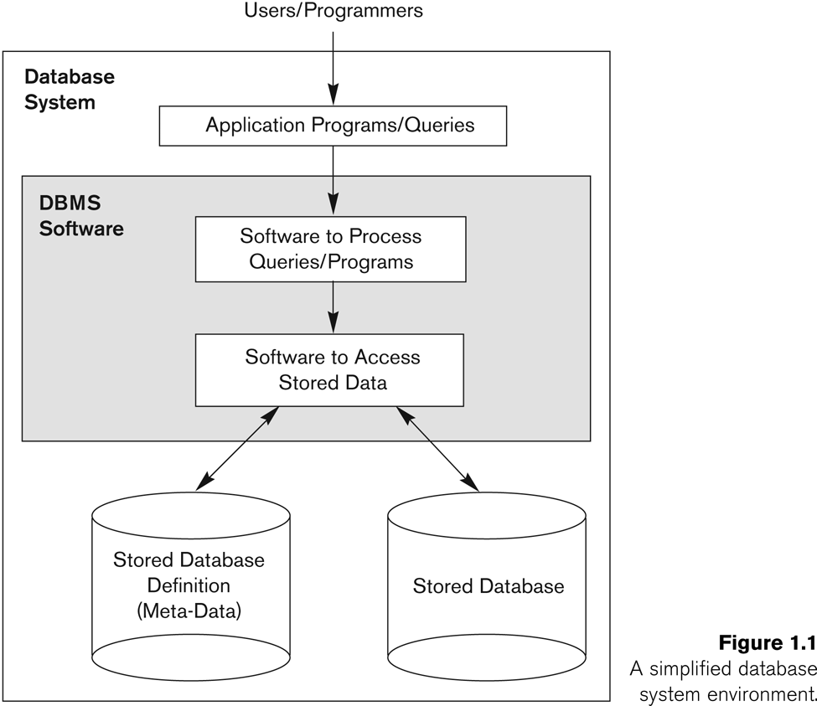
Terms and Concepts
Database Management System -- DBMS
Software system used to define, create, maintain and provide controlled access to the database and its metadata

Slide 8
Terms and Concepts
Metadata
Data about data. In DBMS this means all of the characteristics describing the attributes of an entity
name of attribute
data type of attribute
size of the attribute
format or special characteristics
Characteristics of files or relations
name, content, notes, etc.
Data Dictionary
AKA Repository (old usage)
The place where all metadata for a particular database is stored
may also include information on relationships between files or tables in a particular database

Slide 9
Historical Development of Database Technology
Early Database Applications:
The Hierarchical and Network Models were introduced in mid 1960s and dominated during the seventies.
A bulk of the worldwide database processing still occurs using these models, particularly, the hierarchical model using IBM’s IMS system.
Relational Model based Systems:
Relational model was originally introduced in 1970, was heavily researched and experimented within IBM Research and several universities.
Relational DBMS Products emerged in the early 1980s.

Slide 10
Historical Development of Database Technology (continued)
Object-oriented and emerging applications:
Object-Oriented Database Management Systems (OODBMSs) were introduced in late 1980s and early 1990s to cater to the need of complex data processing in CAD and other applications.
Their use has not taken off much.
Many relational DBMSs have incorporated object database concepts, leading to a new category called object-relational DBMSs (ORDBMSs)
Extended relational systems add further capabilities (e.g. for multimedia data, text, XML, and other data types)

Slide 11
Historical Development of Database Technology (continued)
Data on the Web and E-commerce Applications:
Web contains data in HTML (Hypertext markup language) with links among pages.
This has given rise to a new set of applications and E-commerce is using new standards like XML (eXtended Markup Language).
Script programming languages such as PHP and JavaScript allow generation of dynamic Web pages that are partially generated from a database
Also allow database updates through Web pages

Slide 12
Extending Database Capabilities (1)
New functionality is being added to DBMSs in the following areas:
Scientific Applications – Physics, Chemistry, Biology - Genetics
Earth and Atmospheric Sciences and Astronomy
XML (eXtensible Markup Language)
Image Storage and Management
Audio and Video Data Management
Data Warehousing and Data Mining – a very major area for future development using new technologies
Spatial Data Management and Location Based Services
Time Series and Historical Data Management
The above gives rise to new research and development in incorporating new data types, complex data structures, new operations and storage and indexing schemes in database systems.

Slide 13
Extending Database Capabilities (2)
Background since the advent of the 21st Century:
First decade of the 21st century has seen tremendous growth in user generated data and automatically collected data from applications and search engines.
Social Media platforms such as Facebook and Twitter are generating millions of transactions a day and businesses are interested to tap into this data to “understand” the users
Cloud Storage and Backup is making unlimited amount of storage available to users and applications

Slide 14
Extending Database Capabilities (3)
Emergence of Big Data Technologies and NOSQL databases
New data storage, management and analysis technology was necessary to deal with the onslaught of data in petabytes a day (10**15 bytes or 1000 terabytes) in some applications – this started being commonly called as “Big Data”.
Hadoop (which originated from Yahoo) and Mapreduce Programming approach to distributed data processing (which originated from Google) as well as the Google file system have given rise to Big Data technologies.
NOSQL (Not Only SQL- where SQL is the de facto standard language for relational DBMSs) systems have been designed for rapid search and retrieval from documents, processing of huge graphs occurring on social networks, and other forms of unstructured data with flexible models of transaction processing.

Slide 15
When not to use a DBMS
Main inhibitors (costs) of using a DBMS:
High initial investment and possible need for additional hardware.
Overhead for providing generality, security, concurrency control, recovery, and integrity functions.
When a DBMS may be unnecessary:
If the database and applications are simple, well defined, and not expected to change.
If access to data by multiple users is not required.
When a DBMS may be infeasible:
In embedded systems where a general purpose DBMS may not fit in available storage

Slide 16
When not to use a DBMS
When no DBMS may suffice:
If there are stringent real-time requirements that may not be met because of DBMS overhead (e.g., telephone switching systems)
If the database system is not able to handle the complexity of data because of modeling limitations (e.g., in complex genome and protein databases)
If the database users need special operations not supported by the DBMS (e.g., GIS and location based services).

Slide 17
From File Systems to DBMS
Problems with File Processing systems
Inconsistent Data
Inflexibility
Limited Data Sharing
Poor enforcement of standards
Excessive program maintenance

Slide 18
DBMS Benefits
Minimal Data Redundancy
Consistency of Data
Integration of Data
Sharing of Data
Ease of Application Development
Uniform Security, Privacy, and Integrity Controls
Data Accessibility and Responsiveness
Data Independence
Reduced Program Maintenance

Slide 19
Data Models
Data Model:
A set of concepts to describe the structure of a database, the operations for manipulating these structures, and certain constraints that the database should obey.
Data Model Operations:
These operations are used for specifying database retrievals and updates by referring to the constructs of the data model.
Operations on the data model may include basic model operations (e.g. generic insert, delete, update) and user-defined operations (e.g. compute_student_gpa, update_inventory)
Data Model Structure and Constraints:
Constructs are used to define the database structure
Constructs typically include elements (and their data types) as well as groups of elements (e.g. entity, record, table), and relationships among such groups
Constraints specify some restrictions on valid data; these constraints must be enforced at all times

Slide 20
Categories of Data Models
Conceptual (high-level, semantic) data models:
Provide concepts that are close to the way many users perceive data.
(Also called entity-based or object-based data models.)
Physical (low-level, internal) data models:
Provide concepts that describe details of how data is stored in the computer. These are usually specified in an ad-hoc manner through DBMS design and administration manuals
Implementation (representational) data models:
Provide concepts that fall between the above two, used by many commercial DBMS implementations (e.g. relational data models used in many commercial systems).
Self-Describing Data Models:
Combine the description of data with the data values. Examples include XML, key-value stores and some NOSQL systems.

Slide 21
Schemas vs. Instances
Database Schema:
The description of a database.
Includes descriptions of the database structure, data types, and the constraints on the database.
Schema Diagram:
An illustrative display of (most aspects of) a database schema.
Schema Construct:
A component of the schema or an object within the schema, e.g., STUDENT, COURSE.

Slide 22
Database Schema vs. Database State
Database State:
Refers to the content of a database at a moment in time.
Initial Database State:
Refers to the database state when it is initially loaded into the system.
Valid State:
A state that satisfies the structure and constraints of the database.
Distinction
The database schema changes very infrequently.
The database state changes every time the database is updated.
Schema is also called intension.
State is also called extension.

Slide 23
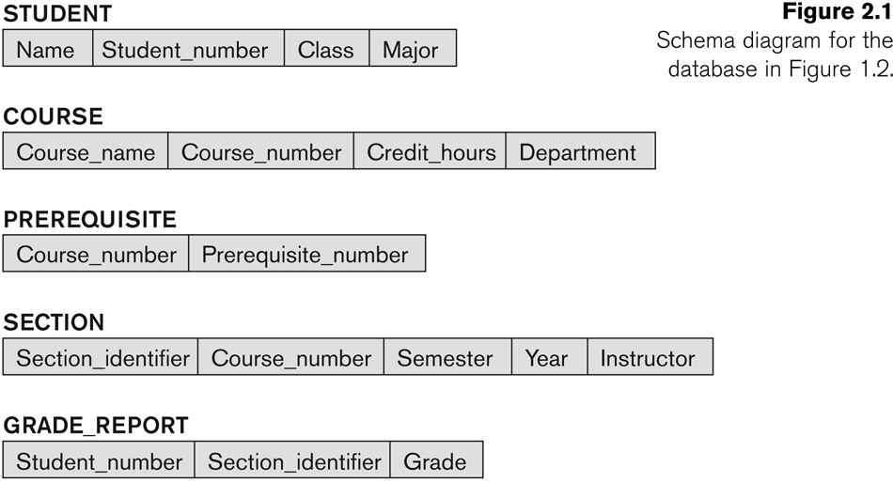
Example of a Database Schema

Slide 24
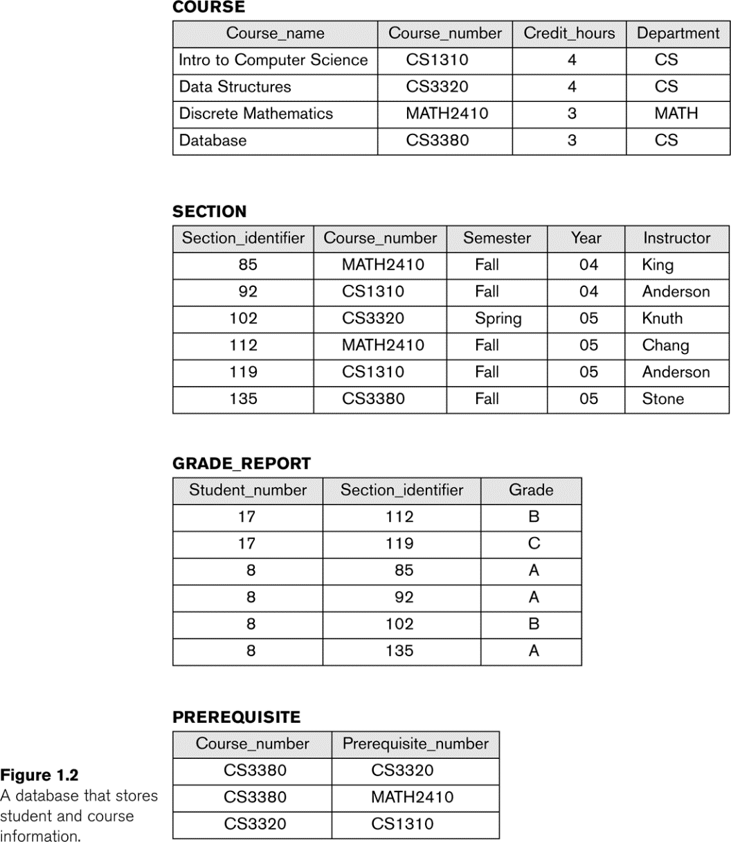
Example of a database state

Slide 25
Three-Schema Architecture
Defines DBMS schemas at three levels:
Internal schema at the internal level to describe physical storage structures and access paths (e.g indexes).
Typically uses a physical data model.
Conceptual schema at the conceptual level to describe the structure and constraints for the whole database for a community of users.
Uses a conceptual or an implementation data model.
External schemas at the external level to describe the various user views.
Usually uses the same data model as the conceptual schema.

Slide 26
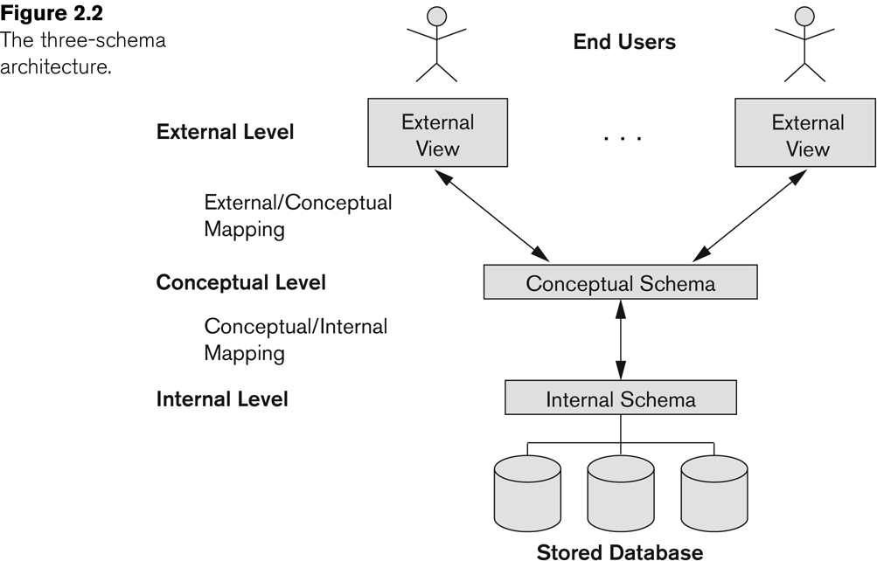
The three-schema architecture
Proposed to support DBMS characteristics of:
Program-data independence.
Support of multiple views of the data.
Not explicitly used in commercial DBMS products, but has been useful in explaining database system organization

Slide 27
Three-Schema Architecture
Mappings among schema levels are needed to transform requests and data.
Programs refer to an external schema, and are mapped by the DBMS to the internal schema for execution.
Data extracted from the internal DBMS level is reformatted to match the user’s external view (e.g. formatting the results of an SQL query for display in a Web page)

Slide 28
Data Independence
Logical Data Independence:
The capacity to change the conceptual schema without having to change the external schemas and their associated application programs.
Physical Data Independence:
The capacity to change the internal schema without having to change the conceptual schema.
For example, the internal schema may be changed when certain file structures are reorganized or new indexes are created to improve database performance

Slide 29
Data Independence (continued)
When a schema at a lower level is changed, only the mappings between this schema and higher-level schemas need to be changed in a DBMS that fully supports data independence.
The higher-level schemas themselves are unchanged.
Hence, the application programs need not be changed since they refer to the external schemas.

Slide 30
Class Activity 1
Work in groups (2 or more).
Based on the difference between logical data independence and physical data independence, which one is harder to achieve? Why?
Submit your answer to class activity piazza thread.

Slide 31
DBMS Languages
Data Definition Language (DDL)
Data Manipulation Language (DML)
High-Level or Non-procedural Languages: These include the relational language SQL
May be used in a standalone way or may be embedded in a programming language
Low Level or Procedural Languages:
These must be embedded in a programming language

Slide 32
DBMS Languages
Data Definition Language (DDL):
DDL statements are used to build and modify the structure of your tables and other objects in the database.
Used by the DBA and database designers to specify the conceptual schema of a database.
In many DBMSs, the DDL is also used to define internal and external schemas (views).
CREATE TABLE <table name> ( <attribute name 1> <data type 1>, ... <attribute name n> <data type n>);

Slide 33
DBMS Languages
Data Manipulation Language (DML):
DML statements are used to work with the data in tables.
Used to specify database retrievals and updates
DML commands (data sublanguage) can be embedded in a general-purpose programming language (host language), such as COBOL, C, C++, or Java.
Alternatively, stand-alone DML commands can be applied directly (called a query language).
INSERT INTO <table name> VALUES (<value 1>, ... <value n>);

Slide 34
Types of DML
High Level or Non-procedural Language:
The user only specifies what data is needed
For example, the SQL relational language
Are “set”-oriented and specify what data to retrieve rather than how to retrieve it.
Low Level or Procedural Language:
The user specifies what data is needed and how to get it
Retrieve data one record-at-a-time;
Constructs such as looping are needed to retrieve multiple records, along with positioning pointers.

Slide 35
DBMS Interfaces
Stand-alone query language interfaces
Example: Entering SQL queries at the DBMS interactive SQL interface (e.g. SQL*Plus in ORACLE)
Programmer interfaces for embedding DML in programming languages
User-friendly interfaces
Menu-based, forms-based, graphics-based, etc.
Mobile Interfaces:interfaces allowing users to perform transactions using mobile apps

Slide 36
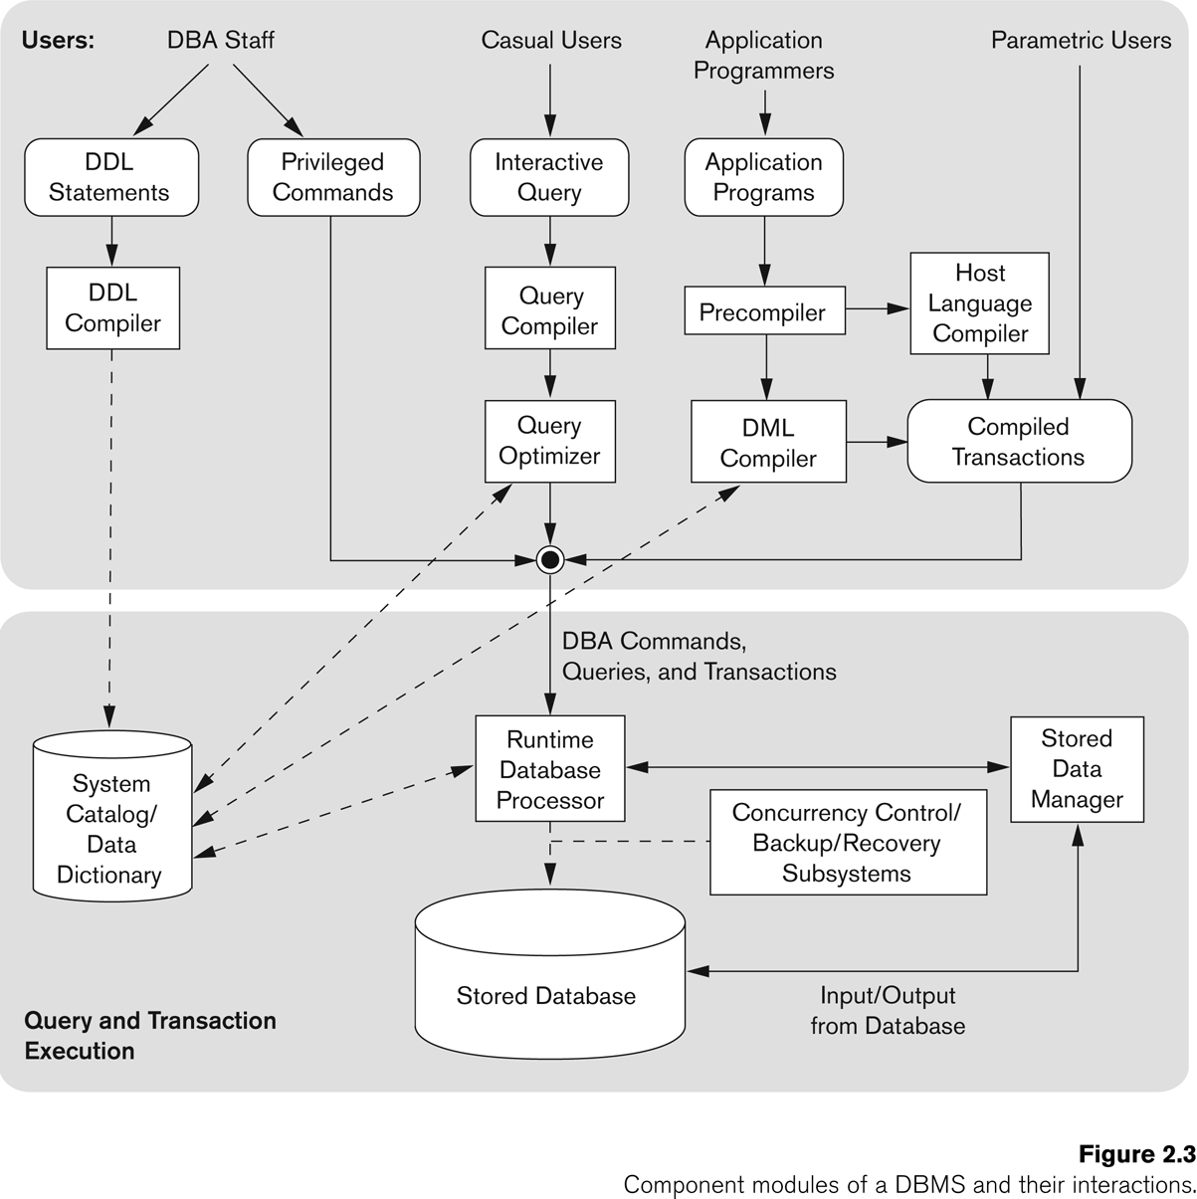
Typical DBMS Component Modules

Slide 37
Database System Utilities
To perform certain functions such as:
Loading data stored in files into a database. Includes data conversion tools.
Backing up the database periodically on tape.
Reorganizing database file structures.
Performance monitoring utilities.
Report generation utilities.
Other functions, such as sorting, user monitoring, data compression, etc.

Slide 38
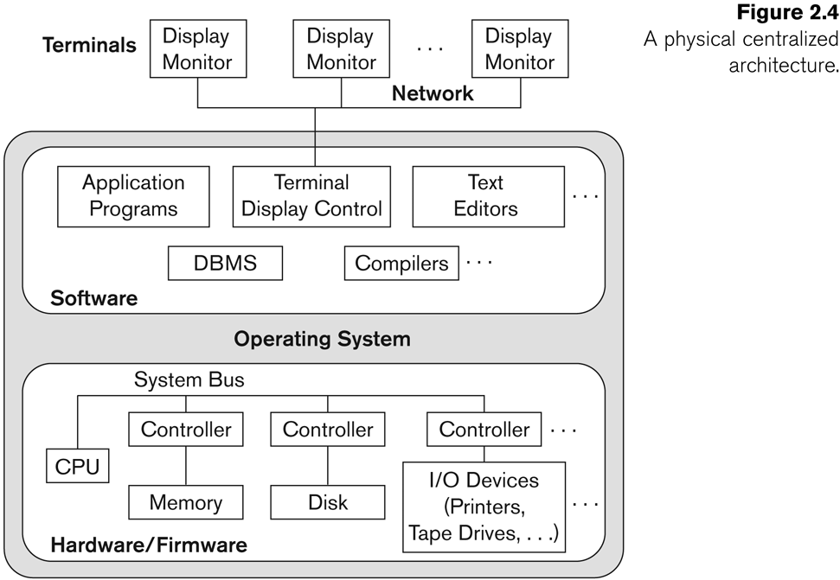
Centralized and Client-Server DBMS Architectures
Centralized DBMS:
Combines everything into single system including- DBMS software, hardware, application programs, and user interface processing software.
User can still connect through a remote terminal – however, all processing is done at centralized site.

Slide 39
Basic 2-tier Client-Server Architectures
Specialized Servers with Specialized functions
Print server
File server
DBMS server
Web server
Email server
Clients can access the specialized servers as needed

Slide 40
Clients
Provide appropriate interfaces through a client software module to access and utilize the various server resources.
Clients may be diskless machines or PCs or Workstations with disks with only the client software installed.
Connected to the servers via some form of a network.
(LAN: local area network, wireless network, etc.)

Slide 41
DBMS Server
Provides database query and transaction services to the clients
Relational DBMS servers are often called SQL servers, query servers, or transaction servers
Applications running on clients utilize an Application Program Interface (API) to access server databases via standard interface such as:
ODBC: Open Database Connectivity standard
JDBC: for Java programming access

Slide 42
Two Tier Client-Server Architecture
Client and server must install appropriate client module and server module software for ODBC or JDBC
A client program may connect to several DBMSs, sometimes called the data sources.
In general, data sources can be files or other non-DBMS software that manages data.

Slide 43
Three Tier Client-Server Architecture
Common for Web applications
Intermediate Layer called Application Server or Web Server:
Stores the web connectivity software and the business logic part of the application used to access the corresponding data from the database server
Acts like a conduit for sending partially processed data between the database server and the client.
Three-tier Architecture Can Enhance Security:
Database server only accessible via middle tier
Clients cannot directly access database server
Clients contain user interfaces and Web browsers
The client is typically a PC or a mobile device connected to the Web

Slide 44
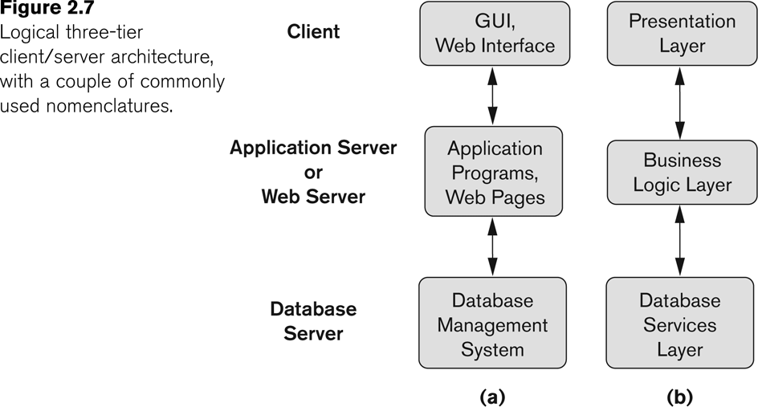
Three-tier client-server architecture

