Slide 1
Basic SQL
Sampath Jayarathna
Cal Poly Pomona

Slide 2
Introduction to SQL
SQL functions fit into two broad categories:
Data definition language
SQL includes commands to:
Create database objects, such as tables, indexes, and views
Define access rights to those database objects
Data manipulation language
Includes commands to insert, update, delete, and retrieve data within database tables

Slide 3
Introduction to SQL (continued)
SQL is relatively easy to learn
Basic command set has vocabulary of less than 100 words
Nonprocedural language
American National Standards Institute (ANSI) prescribes a standard SQL
Several SQL dialects exist

Slide 4
Introduction to SQL (continued)

Slide 5
SQL(Built-in) Data Types
SQL
Data Types
Predefined
Types
Ref Types
Arrays
User-Defined
Types
ROW
Data Struct
Numeric
String
DateTime
Interval
Boolean
Date
Bit
Character
Blob
Exact
Approximate
Time
Fixed
Fixed
Varying
Timestamp
Varying
CLOB

Slide 6
Specifying Constraints in SQL
Basic constraints:
Relational Model has 3 basic constraint types that are supported in SQL:
Key constraint: A primary key value cannot be duplicated
Entity Integrity Constraint: A primary key value cannot be null
Referential integrity constraints : The “foreign key “ must have a value that is already present as a primary key, or may be null.

Slide 7
Common SQL Constrains
The following constraints are commonly used in SQL:
NOT NULL - Ensures that a column cannot have a NULL value
UNIQUE - Ensures that all values in a column are different
PRIMARY KEY - A combination of a NOT NULL and UNIQUE. Uniquely identifies each row in a table
FOREIGN KEY - Uniquely identifies a row/record in another table
CHECK - Ensures that all values in a column satisfies a specific condition
DEFAULT - Sets a default value for a column when no value is specified
INDEX - Used to create and retrieve data from the database very quickly

Slide 8
Specifying Key and Referential Integrity Constraints
PRIMARY KEY clause
Specifies one or more attributes that make up the primary key of a relation
PRIMARY KEY (Dnumber);
UNIQUE clause
Specifies alternate (secondary) keys (called CANDIDATE keys in the relational model).
UNIQUE (Dname);

Slide 9
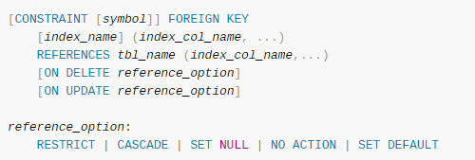
Specifying Key and Referential Integrity Constraints
FOREIGN KEY clause
Default operation: reject update on violation
Attach referential triggered action clause
Options include SET NULL, CASCADE, and SET DEFAULT
Action taken by the DBMS for SET NULL or SET DEFAULT is the same for both ON DELETE and ON UPDATE
CASCADE option suitable for “relationship” relations
MySQL referential integrity constrain options:

Slide 10
Connecting to MySQL
MySQL provides an interactive shell for creating tables, inserting data, etc.
On Windows, just go to c:\mysql\bin, and type:
mysql
Or, click on the Windows icon

Slide 11
Mysql Script File
you can execute a script with the SOURCE command. For example, suppose we have the following script file.
If you’re at the MySQL command line mysql> you have to declare the SQL file as source.
mysql> source \home\user\Desktop\Company.sql;
CREATE Company;
USE company;
DROP TABLE IF EXISTS employees;
CREATE TABLE employees (id INT, first_name VARCHAR(20), last_name VARCHAR(30));
INSERT INTO employees (id, first_name, last_name) VALUES (1, 'John', 'Doe');
INSERT INTO employees (id, first_name, last_name) VALUES (2, 'Bob', 'Smith');
INSERT INTO employees (id, first_name, last_name) VALUES (3, 'Jane', 'Doe');
SELECT * FROM employees;
As you can see, the script switches to the ‘Company' database, drops the 'employees' table if it exists, creates the table, inserts three rows, and then displays the contents of the table.

Slide 12
Sample Session
For example:
Enter password: *****
Welcome to the MySQL monitor. Commands end with ; or \g.
Your MySQL connection id is 241 to server version: 3.23.49
Type 'help;' or '\h' for help. Type '\c' to clear the buffer.
mysql>
To exit the MySQL Shell, just type QUIT or EXIT:
mysql> QUIT
mysql> exit

Slide 13
Canceling a Command
If you decide you don't want to execute a command that you are in the process of entering, cancel it by typing \c
mysql> SELECT
-> USER()
-> \c
mysql>

Slide 14
Using a Database
To get started on your own database, first check which databases currently exist.
Use the SHOW statement to find out which databases currently exist on the server:
mysql> SHOW DATABASES;
+----------+
| Database |
+----------+
| mysql |
| test |
+----------+
2 rows in set (0.01 sec)

Slide 15
Using a Database
To create a new database, issue the “create database” command:
mysql> CREATE DATABASE Company;
To the select a database, issue the “use” command:
mysql> USE Company;
Use the Drop command to delete if the database already exist:
mysql> DROP DATABASE IF EXISTS Company;

Slide 16
Creating a Table
Once you have selected a database, you can view all database tables:
mysql> show tables;
Empty set (0.02 sec)
An empty set indicates that I have not created any tables yet.

Slide 17
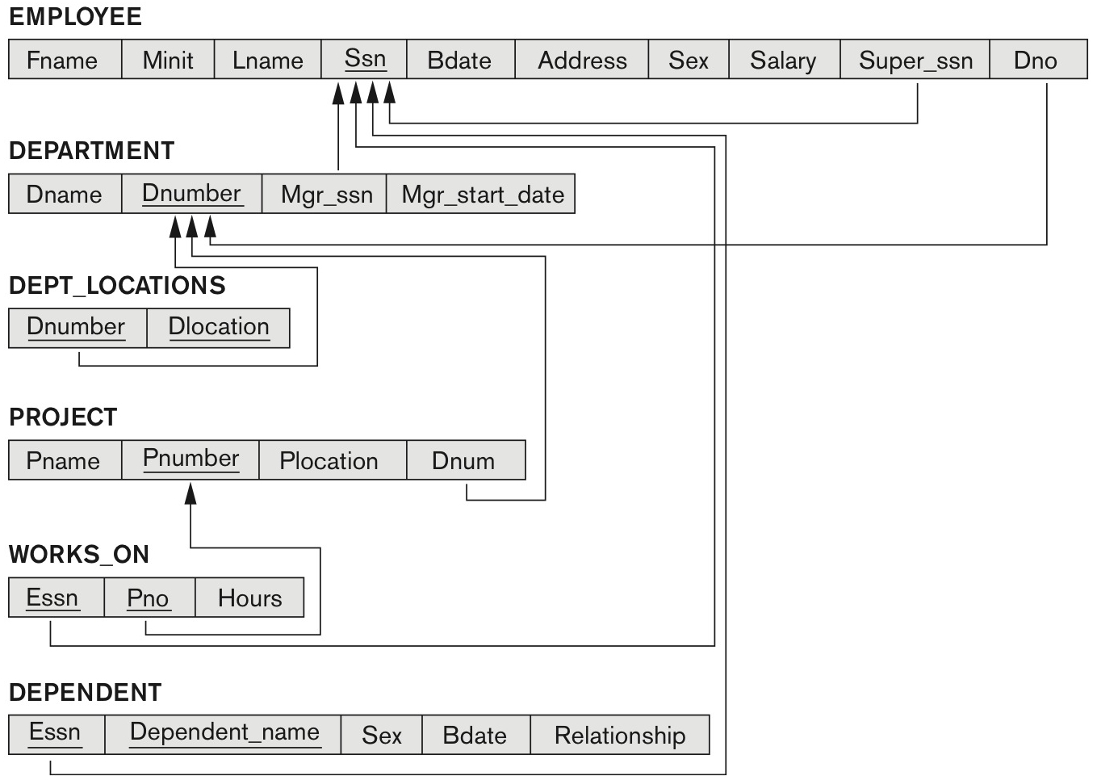
COMPANY relational database schema

Slide 18
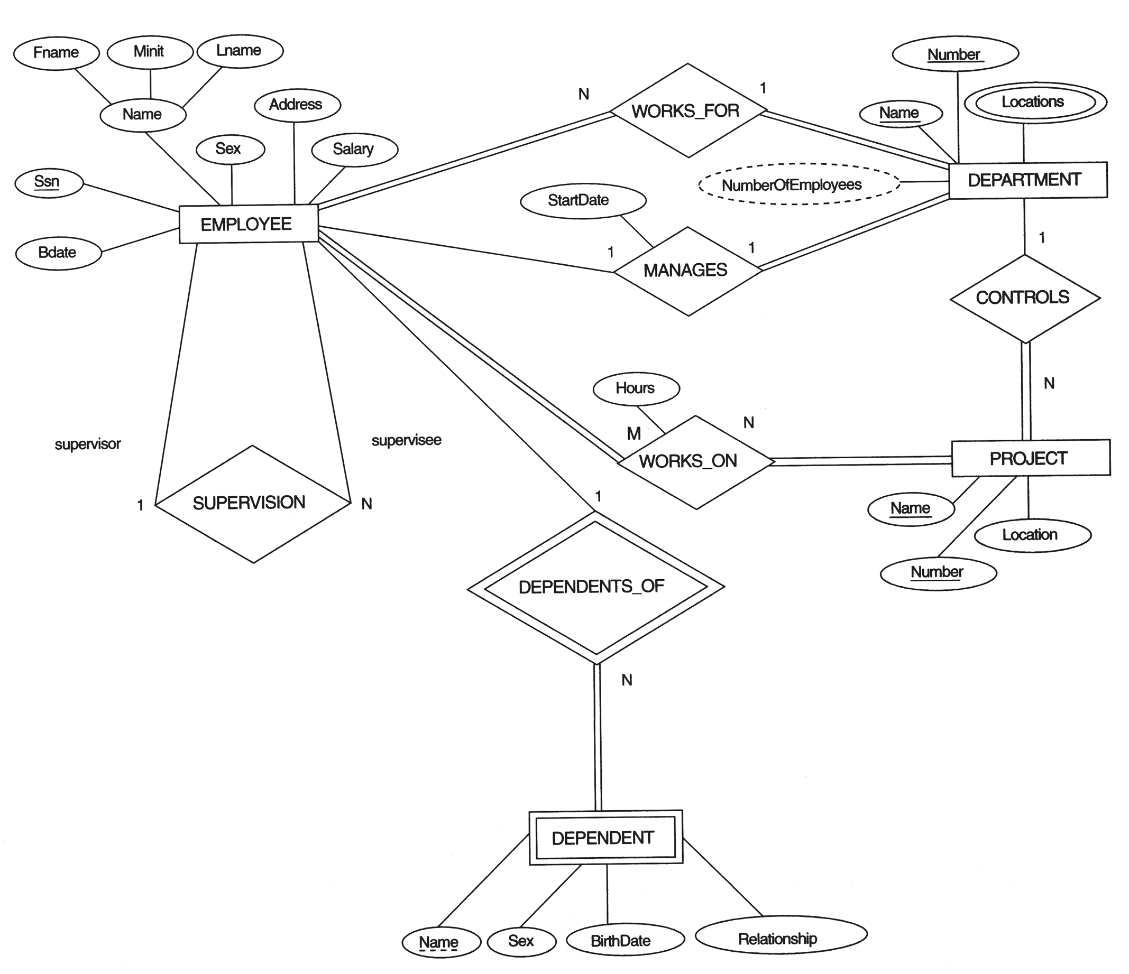
The ERD for the COMPANY database

Slide 19
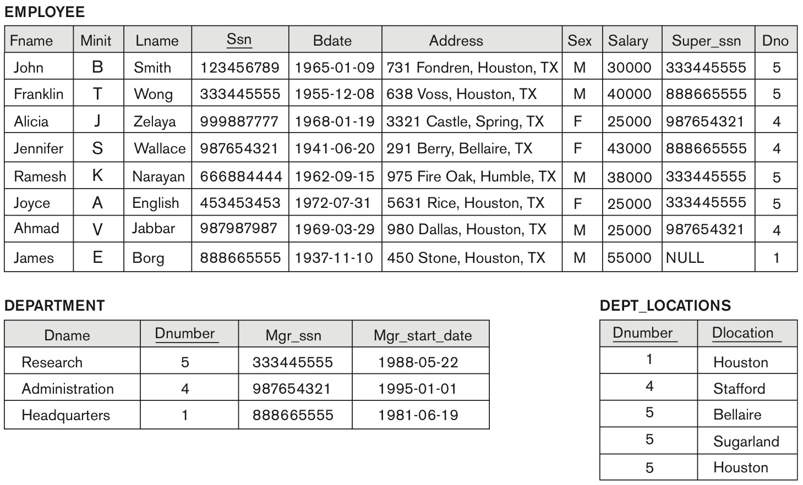
One possible database state for the COMPANY relational database schema

Slide 20
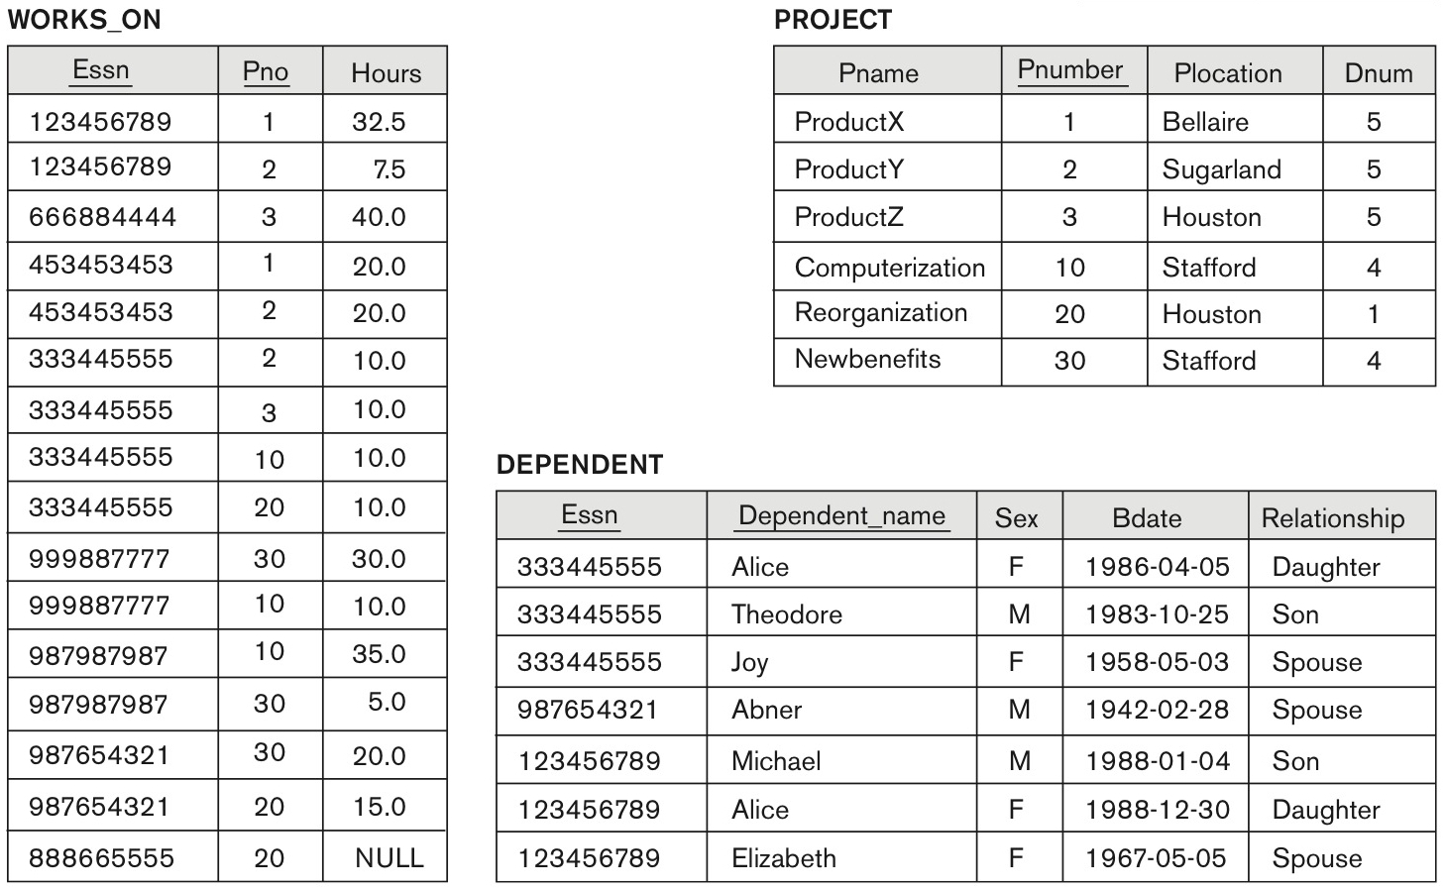
One possible database state for the COMPANY relational database schema – continued

Slide 21
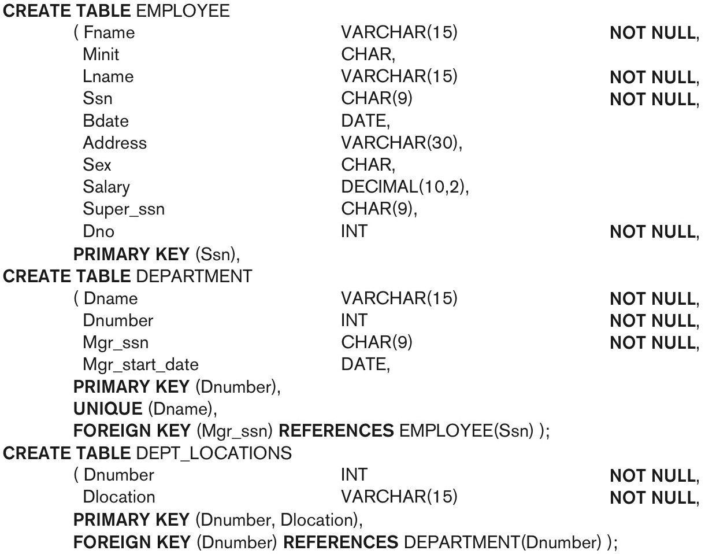
SQL CREATE TABLE data definition statements for defining the COMPANY schema
continued on next slide

Slide 22
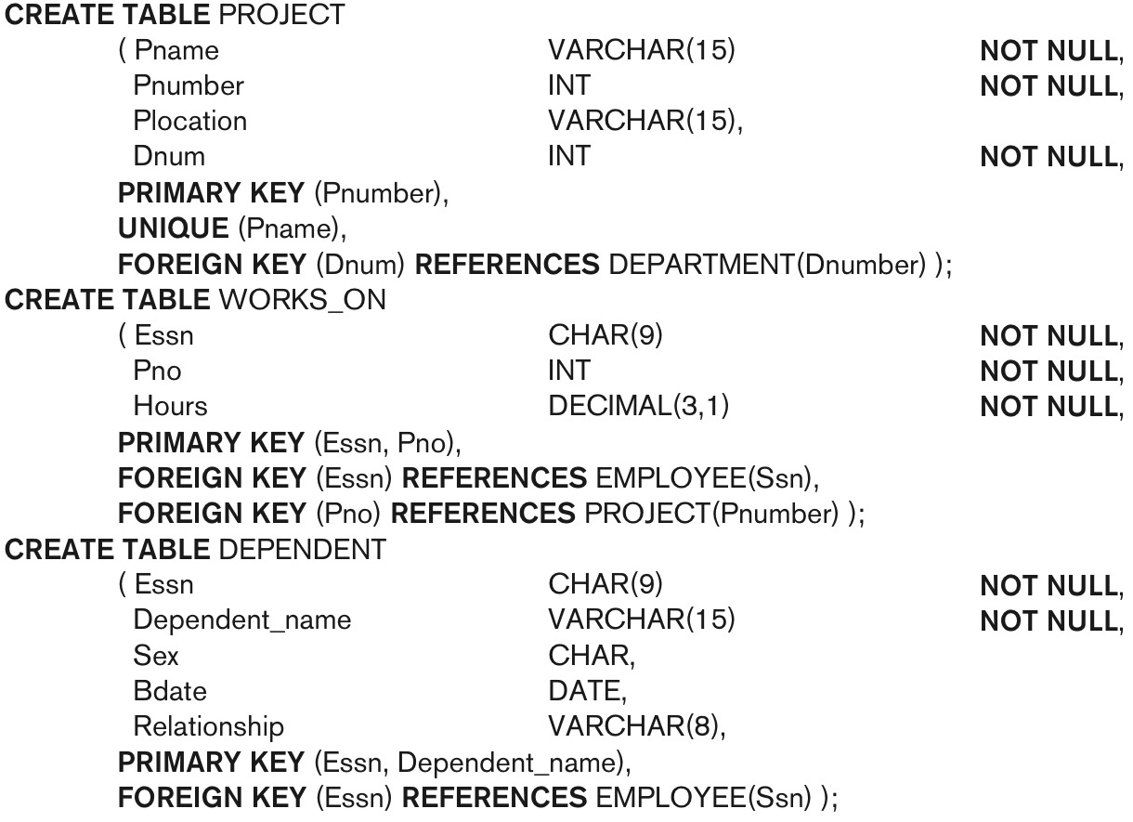
SQL CREATE TABLE data definition statements for defining the COMPANY schema -continued

Slide 23
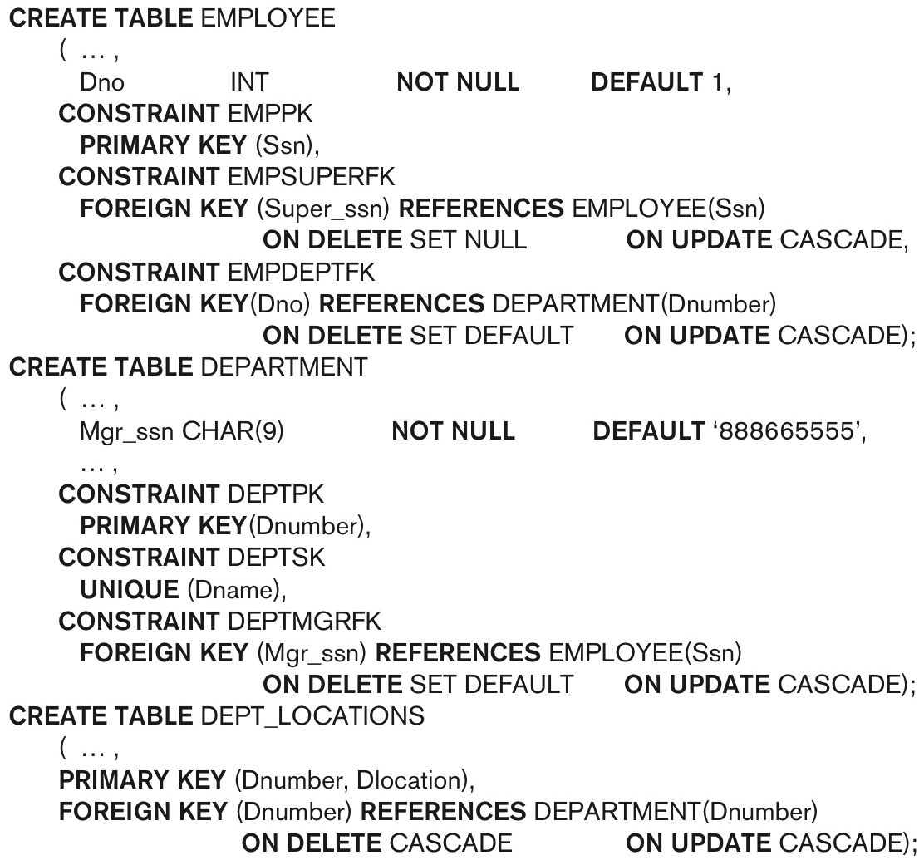
Giving Names to Constraints
Using the Keyword CONSTRAINT
Name a constraint
Useful for later altering
SQL will generate error message with the constraint name. With clear and descriptive names, its easier to understand the error.

Slide 24
Class Activity 9
Consider the following relations for a database that keeps track of student enrollment in courses and the books adopted for each course:
STUDENT(SSN, Name, Major, Bdate)
COURSE(Course#, Cname, Dept)
ENROLL(SSN, Course#, Quarter, Grade)
BOOK_ADOPTION(Course#, Quarter, Book_ISBN)
TEXT(Book_ISBN, Book_Title, Publisher, Author)
TERM(Quarter, Name, Year)
Create a sql script Bookstore.sql to generate the database and relevant tables in MySQL.
Create relevant constraints for PRIMARY key, FOREIGN key including referential integrity constraints

Slide 25
Introduction to SQL (continued)

Slide 26
Introduction to SQL (continued)

Slide 27
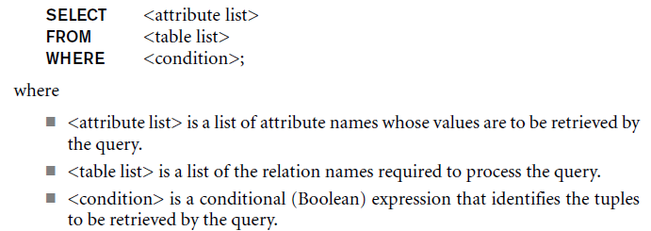
Basic Retrieval Queries in SQL
SELECT statement
One basic statement for retrieving information from a database
SQL allows a table to have two or more tuples that are identical in all their attribute values

Slide 28
The Structure of Basic SQL Queries
Logical comparison operators
=, <, <=, >, >=, and <>
Projection attributes
Attributes whose values are to be retrieved
Selection condition
Boolean condition that must be true for any retrieved tuple. Selection conditions include join conditions when multiple relations are involved.

Slide 29
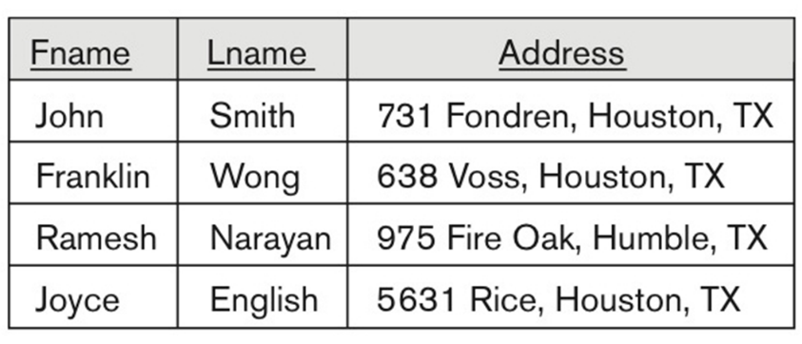
Basic Retrieval Queries
Join between Employee and Department

Slide 30
Joining Database Tables
Ability to combine (join) tables on common attributes is most important distinction between relational database and other databases
Join is performed when data are retrieved from more than one table at a time
Join is generally composed of an equality comparison between foreign key and primary key of related tables

Slide 31
Joining Database Tables
Ability to combine (join) tables on common attributes is most important distinction between relational database and other databases
Join is performed when data are retrieved from more than one table at a time
Join is generally composed of an equality comparison between foreign key and primary key of related tables

Slide 32
Joins
Product (pname, price, category, manufacturer)
Company (cname, stockPrice, country)
Find all products under $200 manufactured in Japan; return their names and prices.
Join between Product and Company
SELECT PName, Price FROM Product, Company WHERE Manufacturer=CName AND Country=‘Japan’ AND Price <= 200

Slide 33
Joins
Product
Company
PName | Price | Category | Manufacturer
Gizmo | $19.99 | Gadgets | GizmoWorks
Powergizmo | $29.99 | Gadgets | GizmoWorks
SingleTouch | $149.99 | Photography | Canon
MultiTouch | $203.99 | Household | Hitachi
Cname | StockPrice | Country
GizmoWorks | 25 | USA
Canon | 65 | Japan
Hitachi | 15 | Japan
SELECT PName, Price FROM Product, Company WHERE Manufacturer=CName AND Country=‘Japan’ AND Price <= 200
PName | Price
SingleTouch | $149.99

Slide 34
Basic Retrieval Queries (Contd.)

Slide 35
Ambiguous Attribute Names
Same name can be used for two (or more) attributes in different relations
As long as the attributes are in different relations
Must qualify the attribute name with the relation name to prevent ambiguity

Slide 36
Aliasing, and Renaming
Aliases or tuple variables
Declare alternative relation names E and S to refer to the EMPLOYEE relation twice in a query:
Query 8. For each employee, retrieve the employee’s first and last name and the first and last name of his or her immediate supervisor.
SELECT E.Fname, E.Lname, S.Fname, S.Lname
FROM EMPLOYEE AS E, EMPLOYEE AS S
WHERE E.Super_ssn=S.Ssn;
Recommended practice to abbreviate names and to prefix same or similar attribute from multiple
The attribute names can also be renamed
EMPLOYEE AS E(Fn, Mi, Ln, Ssn, Bd, Addr, Sex, Sal, Sssn, Dno)
Note that the relation EMPLOYEE now has a variable name E which corresponds to a tuple variable
The “AS” may be dropped in most SQL implementations

Slide 37
Unspecified WHERE Clause
Missing WHERE clause
Indicates no condition on tuple selection
Effect is a CROSS PRODUCT
Result is all possible tuple combinations result

Slide 38
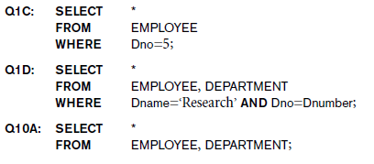
Use of the Asterisk
Specify an asterisk (*)
Retrieve all the attribute values of the selected tuples

Slide 39
Arithmetic Operations
Standard arithmetic operators:
Addition (+), subtraction (–), multiplication (*), and division (/) may be included as a part of SELECT
Show the resulting salaries if every employee working on the ‘ProductX’ project is given a 10 percent raise.
SELECT E.Fname, E.Lname, 1.1 * E.Salary AS Increased_sal
FROM EMPLOYEE AS E, WORKS_ON AS W, PROJECT AS P
WHERE E.Ssn=W.Essn AND W.Pno=P.Pnumber AND P.Pname=‘ProductX’;

Slide 40
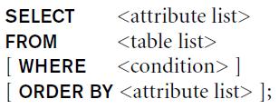
Ordering of Query Results
Use ORDER BY clause
Keyword DESC to see result in a descending order of values
Keyword ASC to specify ascending order explicitly
Typically placed at the end of the query
ORDER BY D.Dname DESC, E.Lname ASC, E.Fname ASC

Slide 41
Aggregation
SELECT avg(price)
FROM Product
WHERE maker=“Toyota”
SELECT count(*)
FROM Product
WHERE year > 1995
SQL supports several aggregation operations:
sum, count, min, max, avg
Except count, all aggregations apply to a single attribute

Slide 42
Aggregation: Count
COUNT applies to duplicates, unless otherwise stated:
SELECT Count(category)
FROM Product
WHERE year > 1995
same as Count(*)
We probably want:
SELECT Count(DISTINCT category)
FROM Product
WHERE year > 1995

Slide 43
More Examples
Purchase(product, date, price, quantity)
SELECT Sum(price * quantity)
FROM Purchase
What do
they mean ?
SELECT Sum(price * quantity)
FROM Purchase
WHERE product = ‘bagel’

Slide 44
Simple Aggregations
Product | Date | Price | Quantity
Bagel | 10/21 | 1 | 20
Banana | 10/3 | 0.5 | 10
Banana | 10/10 | 1 | 10
Bagel | 10/25 | 1.50 | 20
SELECT Sum(price * quantity)
FROM Purchase
WHERE product = ‘bagel’
50 (= 20+30)

Slide 45
Grouping of Query Results
Use Group BY clause
GROUP BY will aggregate records by the specified columns which allows you to perform aggregation functions on non-grouped columns (such as SUM, COUNT, AVG, etc).
SELECT Count(*), Dno
FROM EMPLOYEE
GROUP BY Dno

Slide 46
Tables as Sets in SQL
SQL does not automatically eliminate duplicate tuples in query results
For aggregate operations duplicates must be accounted for
Use the keyword DISTINCT in the SELECT clause
Only distinct tuples should remain in the result

Slide 47
Virtual Tables: Creating a View
View is virtual table based on SELECT query
Can contain columns, computed columns, aliases, and aggregate functions from one or more tables
Base tables are tables on which view is based
Create view by using CREATE VIEW command

Slide 48
Virtual Tables: Creating a View (continued)

Slide 49
INSERT, DELETE, and UPDATE Statements
Three commands used to modify the database:
INSERT, DELETE, and UPDATE
INSERT typically inserts a tuple (row) in a relation (table)
UPDATE may update a number of tuples (rows) in a relation (table) that satisfy the condition
DELETE may also update a number of tuples (rows) in a relation (table) that satisfy the condition

Slide 50
INSERT
In its simplest form, it is used to add one or more tuples to a relation
Attribute values should be listed in the same order as the attributes were specified in the CREATE TABLE command
Constraints on data types are observed automatically
Any integrity constraints as a part of the DDL specification are enforced

Slide 51
The INSERT Command
Specify the relation name and a list of values for the tuple. All values including nulls are supplied.
The variation below inserts multiple tuples where a new table is loaded values from the result of a query.

Slide 52
DELETE
Removes tuples from a relation
Includes a WHERE-clause to select the tuples to be deleted
Referential integrity should be enforced
Tuples are deleted from only one table at a time (unless CASCADE is specified on a referential integrity constraint)
A missing WHERE-clause specifies that all tuples in the relation are to be deleted; the table then becomes an empty table
The number of tuples deleted depends on the number of tuples in the relation that satisfy the WHERE-clause

Slide 53
The DELETE Command
Removes tuples from a relation
Includes a WHERE clause to select the tuples to be deleted. The number of tuples deleted will vary.

Slide 54
UPDATE
Used to modify attribute values of one or more selected tuples
A WHERE-clause selects the tuples to be modified
An additional SET-clause specifies the attributes to be modified and their new values
Each command modifies tuples in the same relation
Referential integrity specified as part of DDL specification is enforced

Slide 55
UPDATE
Example: Change the location and controlling department number of project number 10 to 'Bellaire' and 5, respectively
U5: UPDATE PROJECT SET PLOCATION = 'Bellaire', DNUM = 5 WHERE PNUMBER=10

Slide 56
Backup Database
mysqldump
Writes the contents of database tables into text files
Example
mysqldump -u [uname] -p[pass] db_name > db_backup.sql
Select … INTO OUTFILE ‘/path/outputfilename’;
Example
>SELECT * FROM student INTO OUTFILE ‘/dump/student.txt’;
mysql –u username –p password –h host database > /path/to/file
mysql –u bcb –p tuckseed0 bcb > test

Slide 57
Summary
SQL
A Comprehensive language for relational database management
Data definition, queries, updates, constraint specification, and view definition
Covered :
Data definition commands for creating tables
Commands for constraint specification
Simple retrieval queries
Database update commands

