Slide 1
Indexing
Sampath Jayarathna
Cal Poly Pomona
Credit for some of the slides in this lecture goes to www.db-book.com

Slide 2
Basic Concepts
Indexing mechanisms used to speed up access to desired data.
E.g., author catalog in library
Search Key - attribute to set of attributes used to look up records in a file.
An index file consists of records (called index entries) of the form
Index files are typically much smaller than the original file
Two basic kinds of indices:
Ordered indices: search keys are stored in sorted order
Hash indices: search keys are distributed uniformly across “buckets” using a “hash function”.
search-key
pointer

Slide 3
Basic Concepts
The best way to improve the performance of SELECT operations is to create indexes on one or more of the columns that are tested in the query.
The index entries act like pointers to the table rows, allowing the query to quickly determine which rows match a condition in the WHERE clause, and retrieve the other column values for those rows.
Although it can be tempting to create an indexes for every possible column used in a query, unnecessary indexes waste space and waste time for DBMS to determine which indexes to use.
Indexes also add to the cost of inserts, updates, and deletes because each index must be updated. You must find the right balance to achieve fast queries using the optimal set of indexes.

Slide 4
SQL Syntax
To create an index for a table
There may be other options based on the DBMS CREATE INDEX Index_Name ON Table_Name (index_column_name, ….., ….)
To see if the indexes exist on the table SHOW INDEXES FROM Table_Name

Slide 5
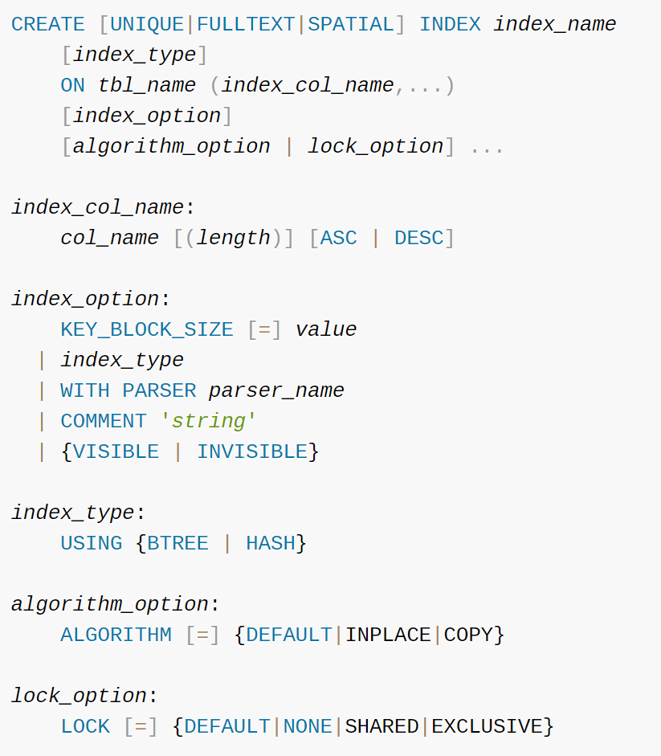
MySQL Indexing
Index Type
BTree (lecture 4a)
Hash (lecture 4b)

Slide 6
Ordered Indices
In an ordered index, index entries are stored sorted on the search key value. E.g., author catalog in library.
Primary index: in a sequentially ordered file, the index whose search key specifies the sequential order of the file.
The search key of a primary index is usually but not necessarily the primary key.
Index-sequential file: ordered sequential file with a primary index.
Indexed Sequential Access Method (ISAM)
Secondary index: an index whose search key specifies an order different from the sequential order of the file.

Slide 7
Ordered Indices
Primary index
5
13
14
16
18
30
35
43
Data
Page
Data
Page
Data
Page
Data
Page
Data
Page
Data
Page
Secondary index
5
13
14
16
18
30
35
43
Data
Page
Data
Page
Data
Page
Data
Page
Data
Page
Data
Page

Slide 8
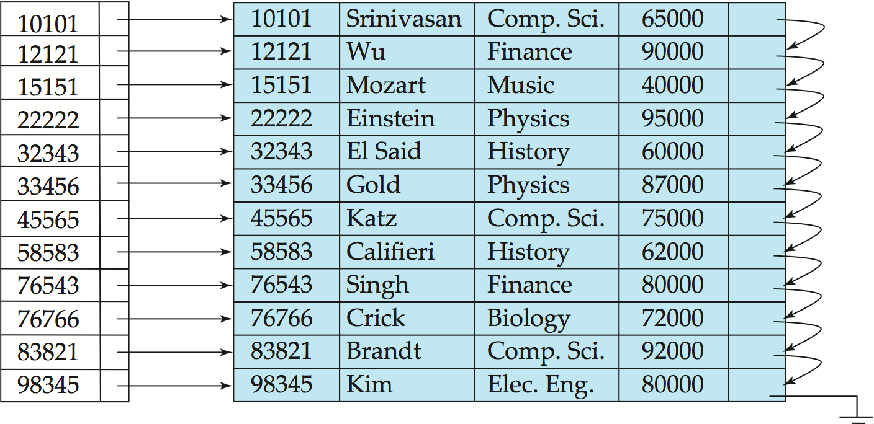
Dense Index Files
Dense index — Index record appears for every search-key value in the file.
E.g. index on ID attribute of instructor relation

Slide 9
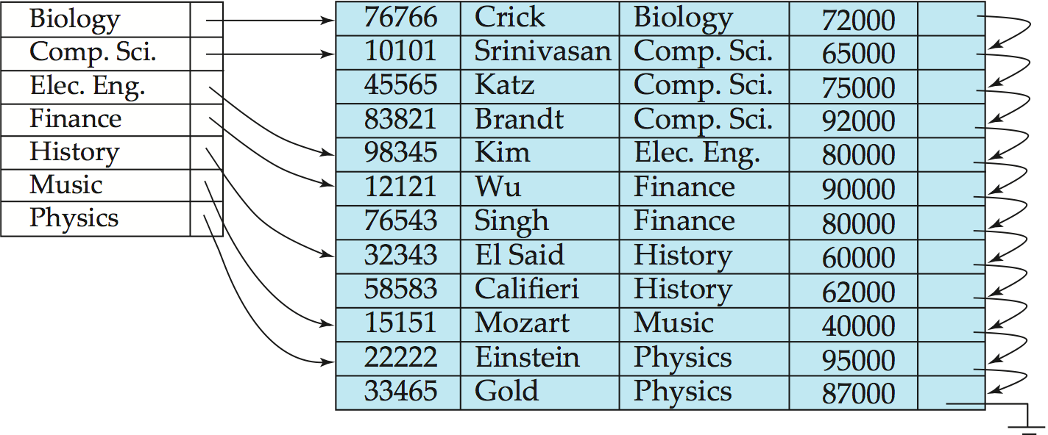
Dense Index Files (Cont.)
Dense index on dept_name, with instructor file sorted on dept_name

Slide 10
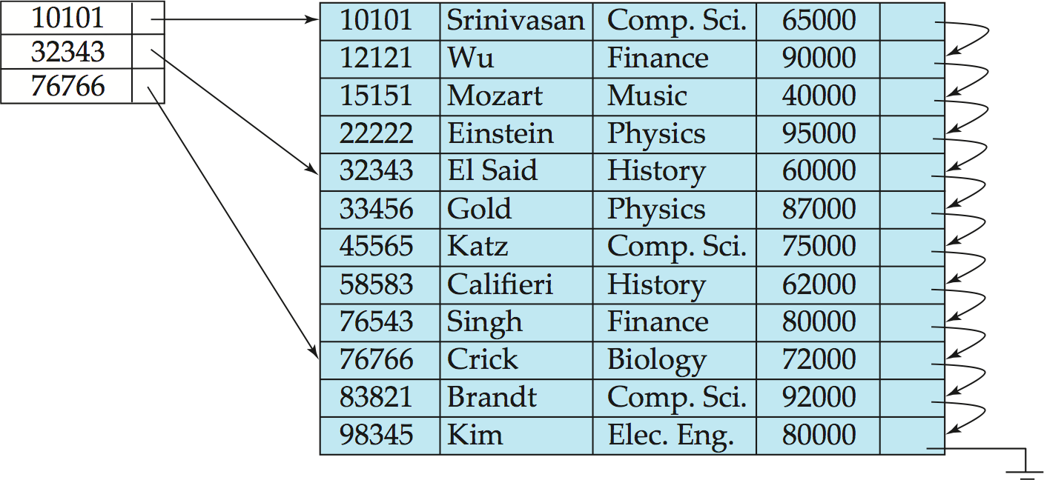
Sparse Index Files
Sparse Index: contains index records for only some search-key values.
Applicable when records are sequentially ordered on search-key
To locate a record with search-key value K we:
Find index record with largest search-key value < K
Search file sequentially starting at the record to which the index record points
Compared to dense indices:
Less space and less maintenance overhead for insertions and deletions.
Generally slower than dense index for locating records.

Slide 11
Multilevel Index
If primary index does not fit in memory, access becomes expensive.
Solution: treat primary index kept on disk as a sequential file and construct a sparse index on it.
outer index – a sparse index of primary index
inner index – the primary index file
If even outer index is too large to fit in main memory, yet another level of index can be created, and so on.
Indices at all levels must be updated on insertion or deletion from the file.

Slide 12
Multilevel Index
Single level Index
5
13
14
16
18
30
35
43
Data
Page
Data
Page
Data
Page
Data
Page
Data
Page
Data
Page
17
upper index
Multilevel Index
5
13
14
16
18
30
35
43
lower index
Data
Page
Data
Page
Data
Page
Data
Page
Data
Page
Data
Page

Slide 13
Index Update: Deletion
If deleted record was the only record in the file with its particular search-key value, the search-key is deleted from the index also.
Single-level index entry deletion:
Dense indices – deletion of search-key is similar to file record deletion.
Sparse indices –
if an entry for the search key exists in the index, it is deleted by replacing the entry in the index with the next search-key value in the file (in search-key order).
If the next search-key value already has an index entry, the entry is deleted instead of being replaced.

Slide 14
Index Update: Insertion
Single-level index insertion:
Perform a lookup using the search-key value appearing in the record to be inserted.
if the search-key value does not appear in the index, insert it.
Multilevel insertion and deletion: algorithms are simple extensions of the single-level algorithms

Slide 15
ISAM Limitations
Problems with ISAM:
What if the index itself is too large to fit entirely in RAM at the same time?
performance degrades as file grows
Periodic reorganization of entire file is required.
Insertion and deletion could be very expensive if all records after the inserted or deleted one have to shift up or down.

Slide 16
B Trees
B-tree indices are an alternative to indexed-sequential files
B-tree is one of the most important data structures in computer science.
What does B stand for?
Several versions of B-trees have been proposed, including B+ trees.
B-tree is a self-balancing tree data structure that keeps data sorted and allows searches, sequential access, insertions, and deletions in logarithmic time.
automatically reorganizes itself with small, local, changes, in the face of insertions and deletions.
Reorganization of entire file is not required to maintain performance.
(Minor) disadvantage of B-trees:
extra insertion and deletion overhead, space overhead.
Advantages of B-trees outweigh disadvantages
B-trees are used extensively

Slide 17
B-Tree Order
The literature on B-trees is not uniform in its terminology.
We’ll follow the following definition of a B-tree of order b : is a tree which satisfies the following properties:
Key order
Every node has at most b children and b-1 keys.
Every non-leaf node (except root) has at least ⌈b/2⌉ children.
The root has at least two children if it is not a leaf node.
All leaves appear in the same level

Slide 18
B-Tree Order
The order, or branching factor, b of a B tree measures the capacity of nodes (i.e., the number of children nodes) for internal nodes in the tree
Node Type | Children Type | Min Number of Children | Max Number of Children (or records) | Example b=7 | Example b=100
Root Node (when it is the only node in the tree) | Records | 1 | b-1 | 1–6 | 1–99
Root Node | Internal Nodes or Leaf Nodes | 2 | b | 2–7 | 2–100
Internal Node | Internal Nodes or Leaf Nodes | Ceil(b/2) | b | 4–7 | 50–100
Leaf Node | Records | Ceil(b/2) -1 | b-1 | 3–6 | 49–99

Slide 19
Constructing a B-tree
Suppose we start with an empty B-tree and keys arrive in the following order:1 12 8 2 25 5 14 28 17 7 52 16 48 68 3 26 29 53 55 45
We want to construct a B-tree of order 5 (5-1 keys in each node)
The first four items go into the root:
To put the fifth item in the root would violate the size of node
Therefore, when 25 arrives, pick the middle key to make a new root
1
2
8
12
25

Slide 20
Constructing a B-tree (contd.)
8
1
2
12
25
6, 14, 28, 17 get added to the leaf nodes:
8
1
2
6
12
14
25
28
17

Slide 21
Constructing a B-tree (contd.)
Adding 17 to the right leaf node would over-fill it, so we take the middle key, push it (to the root) and split the leaf
8
17
1
2
6
12
14
25
28
7, 52, 16, 48, 68 get added to the leaf nodes
8
17
1
2
6
7
12
14
16
25
28
48
52
68

Slide 22
Constructing a B-tree (contd.)
Adding 68 causes us to split the right most leaf, pushing 48 to the root, and adding 3 causes us to split the left most leaf, pushing 3 to the root; 26, 29, 53, 55 then go into the leaves
3
8
17
48
1
2
6
7
12
14
16
25
26
28
29
52
53
55
68
Adding 45 causes a split of
25
26
28
29
45
and pushing 28 to the root then causes the root to split

Slide 23
Constructing a B-tree (contd.)
17
3
8
28
48
1
2
6
7
12
14
16
25
26
29
45
52
53
55
68

Slide 24
Inserting into a B-Tree
Attempt to insert the new key into a leaf
If this would result in that leaf becoming too big (overflow), split the leaf into two, pushing the middle key to the leaf’s parent
If this would result in the parent becoming too big, split the parent into two, pushing the middle key
This strategy might have to be repeated all the way to the top
If necessary, the root is split in two and the middle key is pushed to a new root, making the tree one level higher

Slide 25
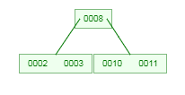
Split based on order b
⌊(b-1)/2⌋ to left node and ⌈(b-1)/2⌉ to right node.
Ex: if order b=5, out of (2,3,8,10,11) keys, 2 keys to left (2,3) and 2 keys to right (10, 11) and middle key (8) to separator
Ex: if order b=4, out of (2,3,8,10) keys, 1 key to left (2) and 2 keys to right (8, 10) and middle key (3) to separator

Slide 26
Class Activity 10
Insert the following keys to a order 5 B-tree:
3, 7, 9, 23, 45, 1, 5, 14, 25, 24, 13, 11, 8, 19, 4, 31, 35, 56

Slide 27
Deletion in B-Tree
Overflow (during insertion ) = more than the maximum capacity b-1 of keys in the node
Underflow (during deletion) = less than the minimum capacity ⌊(b-1)/2⌋
of keys in the node.

Slide 28
Deleting a B-Tree keys – leaf key
Delete key: on underflow, may need to merge
Delete a key at a leaf – no underflow (easy)
Just delete the key
Delete a leaf-key, underflow, and rich sibling (left sibling or right sibling )
Rich can give a key, without underflow.
But, borrowing a key: only THROUGH the parent (parent key to delete node, and highest key of left sibling or lowest key of right sibling to parent)
Delete a leaf-key, underflow and poor sibling
Merge by pulling a key from the parent (exact reversal from insertion, ‘split and push up’ vs ‘merge and pull down’)
Merge with left sibling or right sibling (if left does not exist) and pull the parent down to merged node
If parent underflow because of delete: repeat recursively

Slide 29
Deleting a B-Tree keys – Non leaf key
Each element in a non-leaf (internal node) acts as a separation value for two subtrees, therefore we need to find a replacement for separation.
Delete a key at a non leaf
Just delete the key and replace highest from left sub-tree leaf or lowest from right sub-tree, if underflow, repeat recursively
Deleting a non-leaf eventually deletes a leaf key

Slide 30
Insert 10
12
2
3
8
10
13
27
We find the location for 10 by following a path from the root using the stored key values to guide the search.
The search falls out the tree at the 4th child of the 1st child of the root.
The 1st child of the root has room for the new element, so we store it there.

Slide 31
Insert 11
and
and
12
2
3
8
10
11
13
27
We fall out of the tree at the child to the right of key 10.
But there is no more room in the left child of the root to hold 11.
Therefore, we must split this node...

Slide 32
Insert 11 (Continued)
8
12
2
3
10
11
13
27
The parent gets one new child. (If the parent become overflow, then it, too, will have to be split).

Slide 33
Remove 8
8
12
2
3
10
11
13
27
Removing 8 underflow the node (minimum required 2 keys)
Removing 8 might force us to move another key up from one of the children. It could either be the 3 from the 1st child or the 10 from the second child.
However, neither child has more than the minimum number of children (2), so the two nodes will have to be merged. Nothing moves up.

Slide 34
Remove 8 (Continued)
12
2
3
10
11
13
27

Slide 35
Remove 13
12
2
3
10
11
13
27
Removing 13 would cause the node containing it to become underflow.
To fix this, we try to reassign one key from a sibling that has spares.

Slide 36
Remove 13 (Cont)
11
2
3
10
12
27
The 13 is replaced by the parent’s key 12.
The parent’s key 12 is replaced by the spare key 11 from the left sibling.
The sibling has one fewer element.

Slide 37
Remove 11
11
2
3
10
12
27
11 is in a non-leaf, so replace it by the value immediately preceding: 10.
10 is at leaf, and this node has spares, so just delete it there.

Slide 38
Remove 11 (Cont)
10
2
3
12
27

Slide 39
Remove 2
10
2
3
12
27
Although 2 is at leaf level, removing it leads to an underflow node.
The node has no left sibling. It does have a right sibling, but that node is at its minimum occupancy already.
Therefore, the node must be merged with its right sibling.

Slide 40
Remove 2 (Cont)
3
10
12
27
The result is illegal, because the root does not have at least 2 children.
Therefore, we must remove the root, making its child the new root.

Slide 41
Remove 2 (Cont)
3
10
12
27
The new B-tree has only one node, the root.

Slide 42
Insert 49
3
10
12
27
Let’s put an element into this B-tree.

Slide 43
Insert 49 (Cont)
3
10
12
27
49
Adding this key make the node overfull, so it must be split into two.
But this node was the root.
So we must construct a new root, and make these its children.

Slide 44
Insert 49 (Cont)
12
3
10
27
49
The middle key (12) is moved up into the root.
The result is a B-tree with one more level.

Slide 45
Class Activity 11
Given order 5 B-tree created by these data (last exercise):
3, 7, 9, 23, 45, 1, 5, 14, 25, 24, 13, 11, 8, 19, 4, 31, 35, 56
Add these further keys: 2, 6,12
Delete these keys: 4, 5, 7, 3, 14

Slide 46
B Trees vs B+ tree

Slide 47
B-Tree Index File Example
B-tree (above) and B+-tree (below) on same data

Slide 48
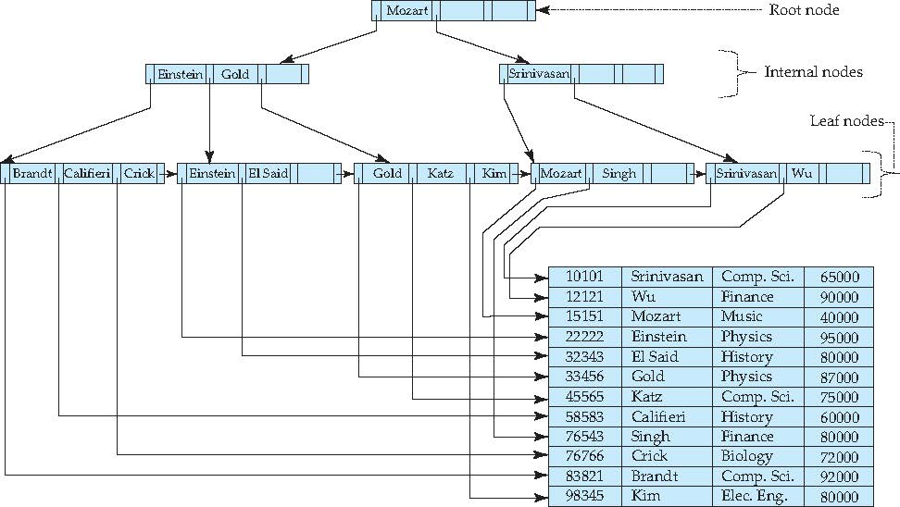
Example of B⁺-Tree

Slide 49
B⁺-Tree Insertion
B⁺-Tree before and after insertion of “Adams”

Slide 50
B-Tree Index Files (Cont.)
Advantages of B-Tree indices:
May use less tree nodes than a corresponding B⁺-Tree.
Sometimes possible to find search-key value before reaching leaf node.
Advantages of B+ tree
Because B+ trees don't have data associated with interior nodes, more keys can fit on a page of memory.
The leaf nodes of B+ trees are linked, so doing a full scan of all objects in a tree requires just one linear pass through all the leaf nodes. A B tree, on the other hand, would require a traversal of every level in the tree.
Disadvantages of B-Tree indices:
Only small fraction of all search-key values are found early

