Slide 1
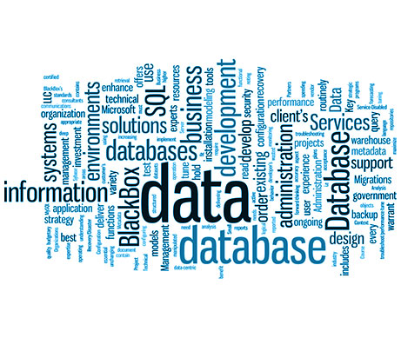
Information Retrieval
Sampath Jayarathna
Cal Poly Pomona
Credit for some of the slides in this lecture goes to Prof. Ray Mooney at UT Austin

Slide 2
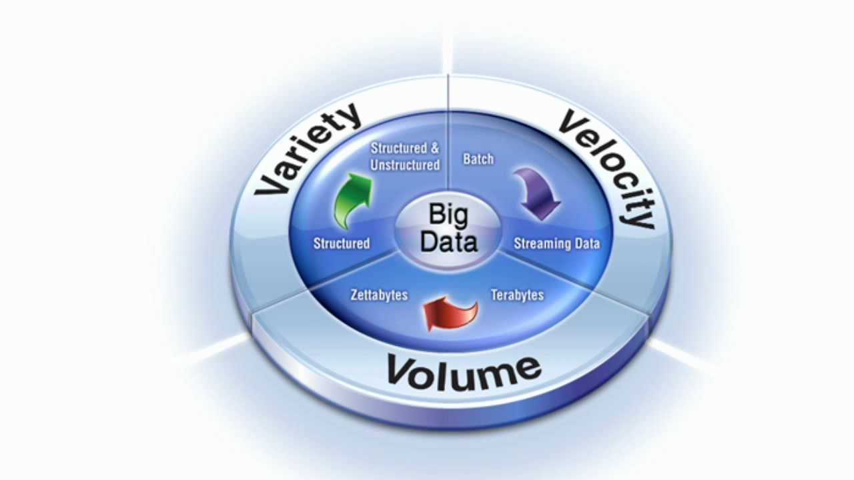
Big Data Aspect of User Behavior
Lately, the term "big data" tends to refer to the use of predictive analytics, user behavior analytics, or certain other advanced data analytics methods that extract value from data, and seldom to a particular size of data set.

Slide 3
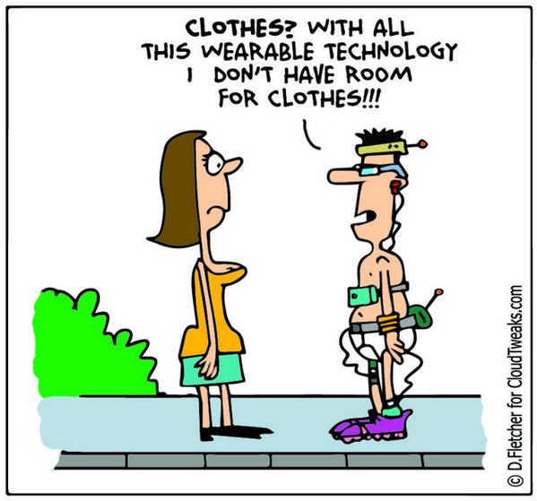
Big Data Aspect of User Behavior
Data sets grow rapidly - in part because they are increasingly gathered by cheap and numerous information-sensing Internet of things devices such as mobile devices, wearables, software logs, cameras, microphones

Slide 4
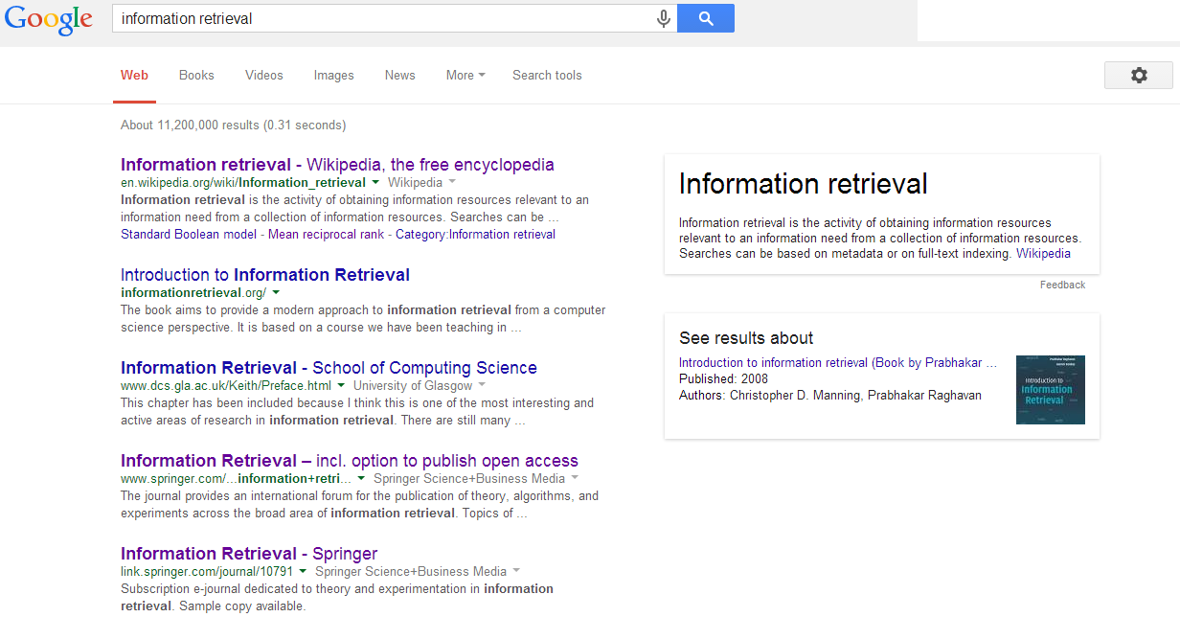
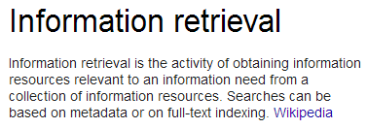
What is information retrieval?

Slide 5
Information Retrieval
Information Retrieval (IR) is finding material (usually documents) of an unstructured nature (usually text) that satisfies an information need from within large collections (usually stored on computers).
Most prominent example: Web Search Engines

Slide 6
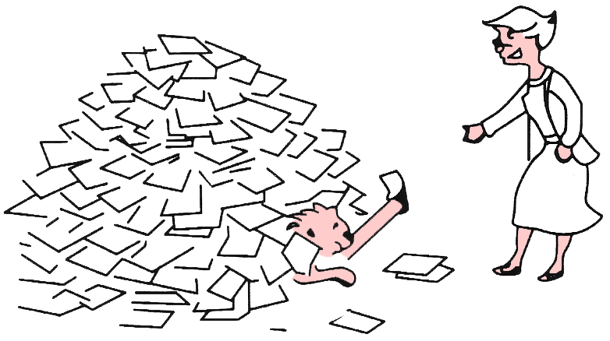
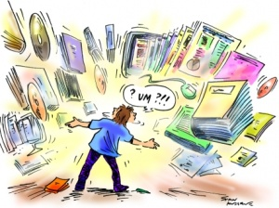
Why information retrieval
Information overload
  “It refers to the difficulty a person can have understanding an issue and making decisions that can be caused by the presence of too much information.” - wiki

Slide 7
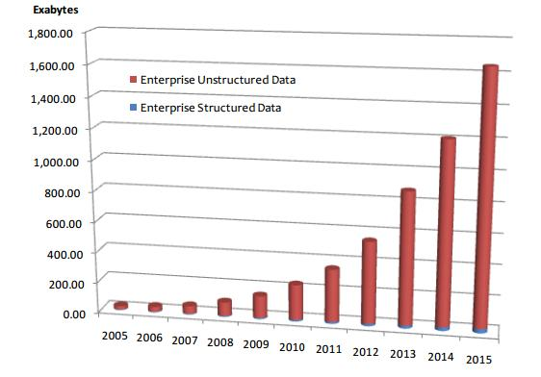
Why information retrieval
Handling unstructured data
  Structured data: database system is a good choice
  Unstructured data is more dominant
    Text in Web documents or emails, image, audio, video…
    “85 percent of all business information exists as unstructured data” - Merrill Lynch
    Unknown semantic meaning
Table 1: People in CS Department
ID | Name | Job
1 | Jack | Professor
3 | David | Staff
5 | Tony | IT support
Total Enterprise Data Growth 2005-2015, IDC 2012

Slide 8
IR v.s. DBs
Information Retrieval:
  Unstructured data
  Semantics of object are subjective
  Simple keyword queries
  Relevance-drive retrieval
  Effectiveness is primary issue, though efficiency is also important
    Effective – doing the right thing
    Efficient – doing things right
Database Systems:
  Structured data
  Semantics of each object are well defined
  Structured query languages (e.g., SQL)
  Exact retrieval
  Emphasis on efficiency

Slide 9
IR and DBs are getting closer
DBs => IR
  Use information extraction to convert unstructured data to structured data
  Semi-structured representation: XML data; queries with structured information
IR => DBs
  Approximate search is available in DBs
  Eg. in mySQL
mysql> SELECT * FROM articles
-> WHERE MATCH (title,body)
AGAINST ('database');

Slide 10
Exploring Your Data

Slide 11
Data Wrangling (from Data Science)
The process of transforming “raw” data into data that can be analyzed to generate valid actionable insights
Data Wrangling : aka
  Data preprocessing
  Data preparation
  Data Cleansing
  Data Scrubbing
  Data Munging
  Data Transformation
  Data Fold, Spindle, Mutilate……

Slide 12
Data Wrangling Steps
Iterative process of
  Obtain
  Understand
  Explore
  Transform
  Augment
  Visualize

Slide 13
Data Wrangling Steps

Slide 14
Data Wrangling Steps

Slide 15
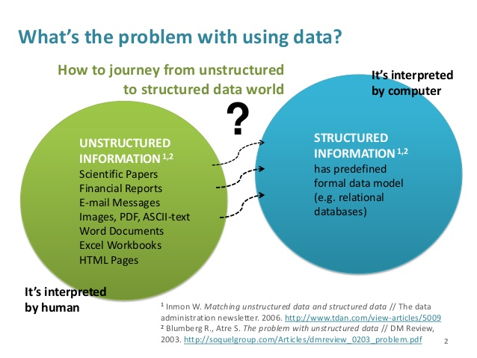
Unstructured to Structured

Slide 16
Preprocessing (Cleaning) Text
Cleaning text is really hard, problem specific, and full of tradeoffs.
Remember, simple is better.
Simpler text data, simpler models, smaller vocabularies. You can always make things more complex later to see if it results in better model.
Hopefully, you can see that getting truly clean text is impossible, that we are really doing the best we can based on the time, resources, and knowledge we have.

Slide 17
Common Preprocessing Steps
Break into tokens (keywords) on whitespace.
Strip unwanted characters/markup (e.g. HTML tags, punctuation, numbers, etc.).
Remove common stopwords (e.g. a, the, it, etc.).
Stem tokens to “root” words
Detect common word/phrases (possibly using a domain specific dictionary).
  WordNet
Build inverted index (keyword → list of docs containing it).

Slide 18
Python NLTK
The Natural Language Toolkit, or NLTK for short, is a Python library written for working and modeling text.
It provides good tools for loading and cleaning text that we can use to get our data ready for working with machine learning and deep learning algorithms.
There are few ways to do this, such as from within a script:
import nltk
nltk.download()
from the command line (anaconda prompt)
python -m nltk.downloader all

Slide 19
Tokenize
NLTK provides a function called word_tokenize() for splitting strings into tokens.
It splits tokens based on white space and punctuation. For example, commas and periods are taken as separate tokens. Contractions are split apart (e.g. “What’s” becomes “What” “‘s“). Quotes are kept, and so on.
from nltk.tokenize import word_tokenize
sample_text = """Success? I don’t know what that word means. I’m happy. But success, that goes back to what in somebody’s eyes success means. For me, success is inner peace. That’s a good day for me.
"""
tokens = word_tokenize(sample_text)
print(tokens)

Slide 20
Normalizing Case
It is common to convert all words to one case.
  This means that the vocabulary will shrink in size, but some distinctions are lost (e.g. “Apple” the company vs “apple” the fruit is a commonly used example).
We can convert all words to lowercase by calling the lower() function on each word.
tokens = [word.lower() for word in tokens]
print(tokens)
['success', 'i', 'don', 't', 'know', 'what', 'that', 'word', 'means', 'i', 'm', 'happy', 'but', 'success', 'that', 'goes', 'back', 'to', 'what', 'in', 'somebody', 's', 'eyes', 'success', 'means', 'for', 'me', 'success', 'is', 'inner', 'peace', 'that', 's', 'a', 'good', 'day', 'for', 'me']

Slide 21
Filter out Punctuations
Running the previous code, we can see that punctuation are now tokens that we could then decide to specifically filter out.
This can be done by iterating over all tokens and only keeping those tokens that are all alphabetic. Python has the function isalpha() that can be used.
tokens = [word for word in tokens if word.isalpha()]
print(tokens)
['Success', 'I', 'don', 't', 'know', 'what', 'that', 'word', 'means', 'I', 'm', 'happy', 'But', 'success', 'that', 'goes', 'back', 'to', 'what', 'in', 'somebody', 's', 'eyes', 'success', 'means', 'For', 'me', 'success', 'is', 'inner', 'peace', 'That', 's', 'a', 'good', 'day', 'for', 'me']

Slide 22
Filter out Stopwords
Stop words are those words that do not contribute to the deeper meaning of the phrase.
  They are the most common words such as: “the“, “a“, and “is“.
NLTK provides a list of commonly agreed upon stop words for a variety of languages, such as English.
from nltk.corpus import stopwords
stop_words = stopwords.words('english')
words = [w for w in tokens if not w in stop_words]
print(words)
['Success', 'I', 'know', 'word', 'means', 'I', 'happy', 'But', 'success', 'goes', 'back', 'somebody', 'eyes', 'success', 'means', 'For', 'success', 'inner', 'peace', 'That', 'good', 'day']

Slide 23
Stemming
Stemming refers to the process of reducing each word to its root or base.
  For example “fishing,” “fished,” “fisher” all reduce to the stem “fish.”
There are many stemming algorithms, although a popular and long-standing method is the Porter Stemming algorithm.
from nltk.stem.porter import PorterStemmer
porter = PorterStemmer()
stemmed = [porter.stem(word) for word in words]
print(stemmed)

Slide 24
N-grams and Stemming
N-gram: given a string, n-grams for that string are fixed length consecutive overlapping) substrings of length n
Example: “statistics”
  bigrams: st, ta, at, ti, is, st, ti, ic, cs
  trigrams: sta, tat, ati, tis, ist, sti, tic, ics
N-grams can be used for conflation (stemming)
  measure association between pairs of terms based on unique n-grams
  the terms are then clustered to create “equivalence classes” of terms.
N-grams can also be used for indexing
  index all possible n-grams of the text (e.g., using inverted lists)
  larger n gives better results, but increases storage requirements
  no semantic meaning, so tokens not suitable for representing concepts
  can get false hits, e.g., searching for “retail” using trigrams, may get matches with “retain detail” since it includes all trigrams for “retail”

Slide 25
N-grams and Stemming (Example)
“statistics”
    bigrams: st, ta, at, ti, is, st, ti, ic, cs
    7 unique bigrams: at, cs, ic, is, st, ta, ti
“statistical”
    bigrams: st, ta, at, ti, is, st, ti, ic, ca, al
    8 unique bigrams: al, at, ca, ic, is, st, ta, ti
Now use Dice’s coefficient to compute “similarity” for pairs of words”
where A is no. of unique bigrams in first word, B is no. of unique bigrams in second word, and C is no. of unique shared bigrams. In this case,
(2*6)/(7+8) = .80
Now we can form a word-word similarity matrix (with word similarities as entries). This matrix is s used to cluster similar terms.
2C
S =
A + B

Slide 26
Activity 17
Calculate the similarity between following 2 strings using Dice Coefficient and Bigrams
“Cal Poly Pomona”
“California State Polytechnic University Pomona”

Slide 27
N-gram indexes
Sec. 3.2.2
Enumerate all n-grams occurring in any term
e.g., from text “April is the cruelest month” we get bigrams:
  $ is a special word boundary symbol
Maintain a second inverted index from bigrams to dictionary terms that match each bigram.
$a, ap, pr, ri, il, l$, $i, is, s$, $t, th, he, e$, $c, cr, ru, ue, el, le, es, st, t$, $m, mo, on, nt, th, h$

Slide 28
Bigram index example
Sec. 3.2.2
The n-gram index finds terms based on a query consisting of n-grams (here n=2).
$m
mace
madden
mo
among
amortize
on
along
among

Slide 29
Using N-gram Indexes
Sec. 3.2.2
Wild-Card Queries
  Query mon* can now be run as
    $m AND mo AND on
  Gets terms that match AND version of wildcard query
  Must post-filter terms against query
  Surviving enumerated terms are then looked up in the term-document inverted index.
Spell Correction
  Enumerate all the n-grams in the query
  Use the n-gram index (wild-card search) to retrieve all lexicon terms matching any of the query n-grams
  Threshold based on matching n-grams and present to user as alternatives
    Can use Dice or Jaccard coefficients

