Slide 1
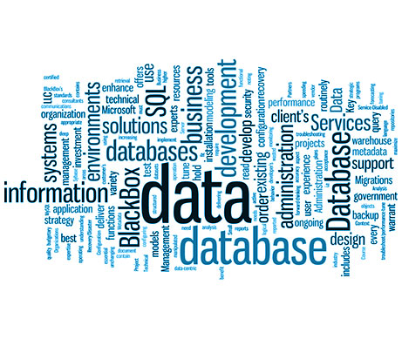
Database Trends
Sampath Jayarathna
Cal Poly Pomona
Slides adopted from Dell Software Group, Guy Harrisons Top 5 Trends in Databases

Slide 2
The end of “One size fits all”

Slide 3
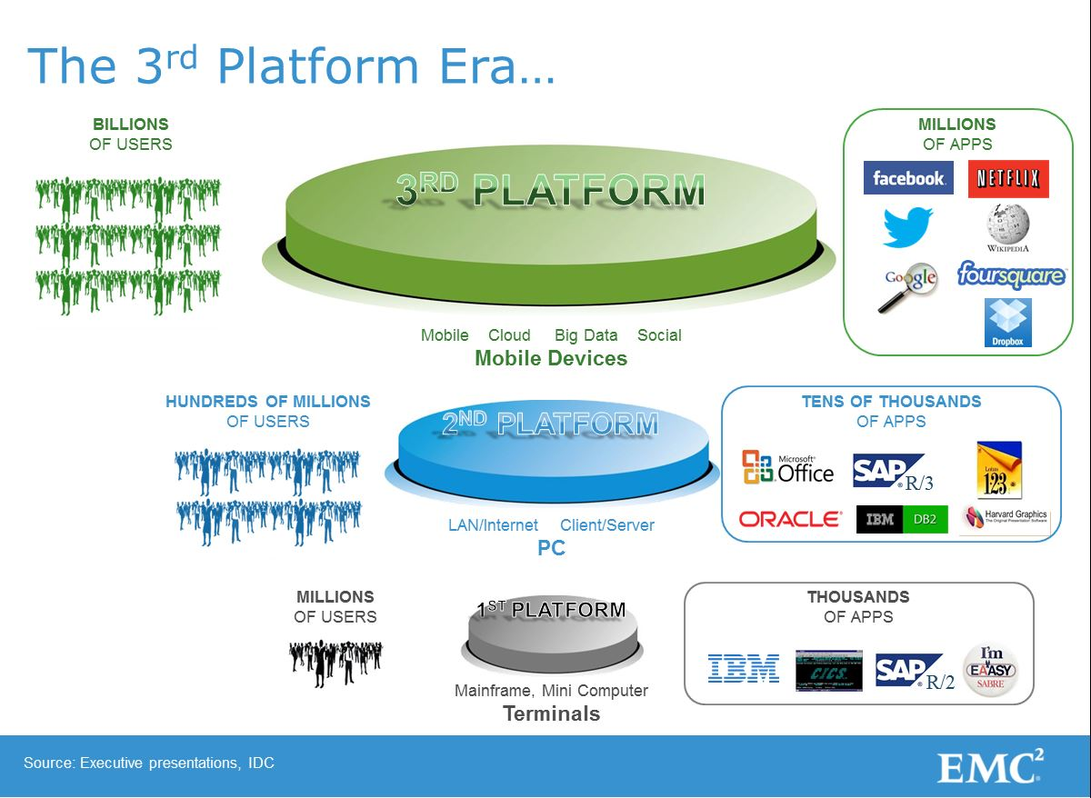
The end of “One size fits all”
A single architecture cannot meet all those demands
3rd platform drives new demands on the databases
  Global high availability
  Data volumes
  Unstructured data
  Transaction rates
  Latency

Slide 4
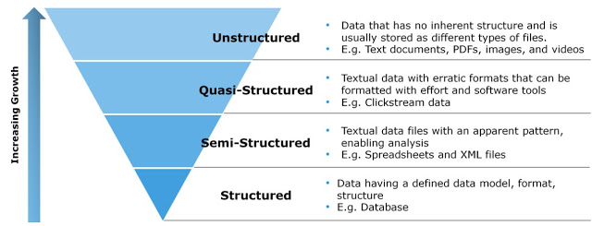
Digital Data: Classification

Slide 5
The 3 to 4 “V”s

Slide 6
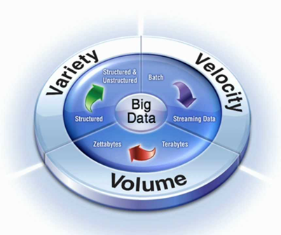
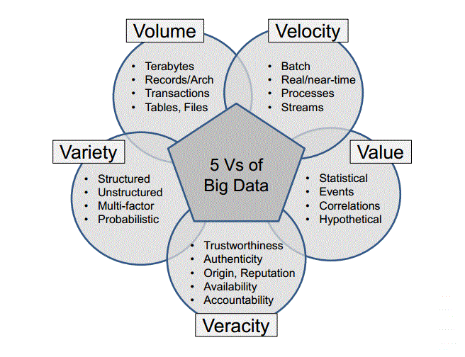
The 3 to 5 “V”s

Slide 7
Big Data Analytics AKA “Data Science”

Slide 8
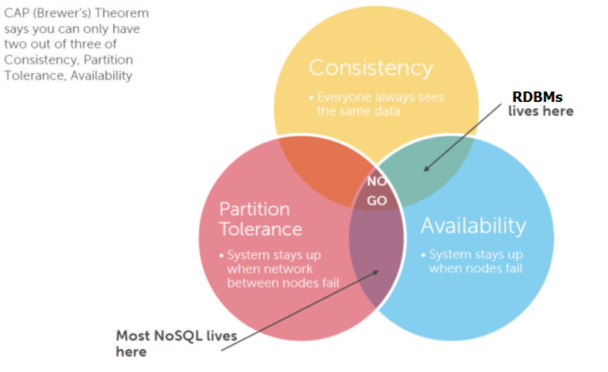
NoSQL

Slide 9
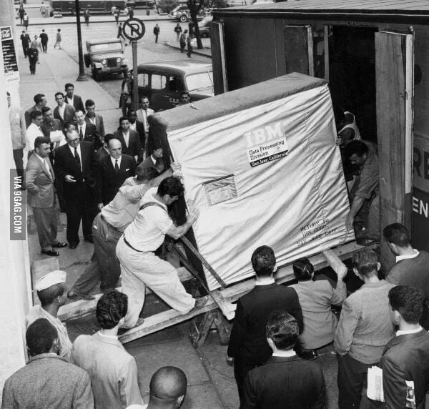
The End of Disk?
5MB IBM HDD

Slide 10
In Memory Databases

Slide 11
Instrumented Human
Data sets grow rapidly - in part because they are increasingly gathered by cheap and numerous information-sensing Internet of things devices such as mobile devices, wearables, software logs, cameras, microphones

Slide 12
Instrumented World

Slide 13
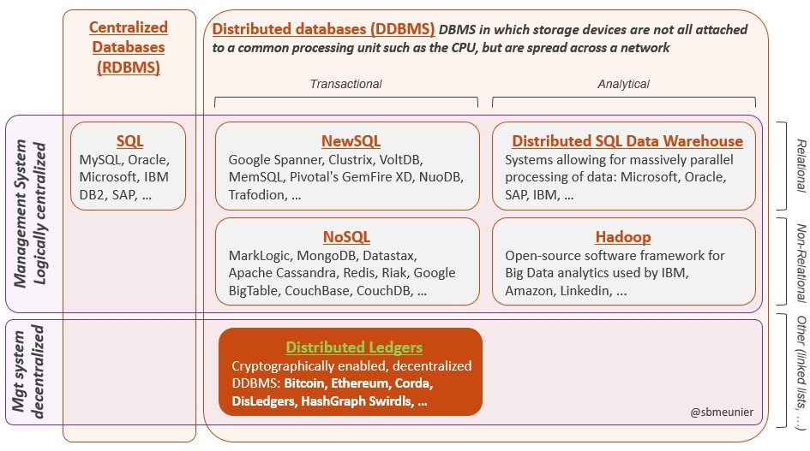
Blockchain – Special kind of Distributed Database
Relational databases (RDBMS) organize data in tables and use the SQL query language. They became the norm in the 80s.
Databases are distributed (DDBMS) when the storage devices are not all attached to a common processing unit such as the CPU, but are spread across a network.
  NoSQL, NewSQL, Distributed Ledgers

Slide 14
Blockchain – How it works?
On the internet, anyone can publish information and then others can access it anywhere in the world. A blockchain allows anyone to send value anywhere in the world where the blockchain file can be accessed. But you must have a private, cryptographically created key to access only the blocks you “own.”
By giving a private key which you own to someone else, you effectively transfer the value of whatever is stored in that section of the blockchain.
So, to use the bitcoin example, keys are used to access addresses, which contain units of currency that have financial value.
  This fills the role of recording the transfer, which is traditionally carried out by banks.
  It also fills a second role, establishing trust and identity, because no one can edit a blockchain without having the corresponding keys.

Slide 15
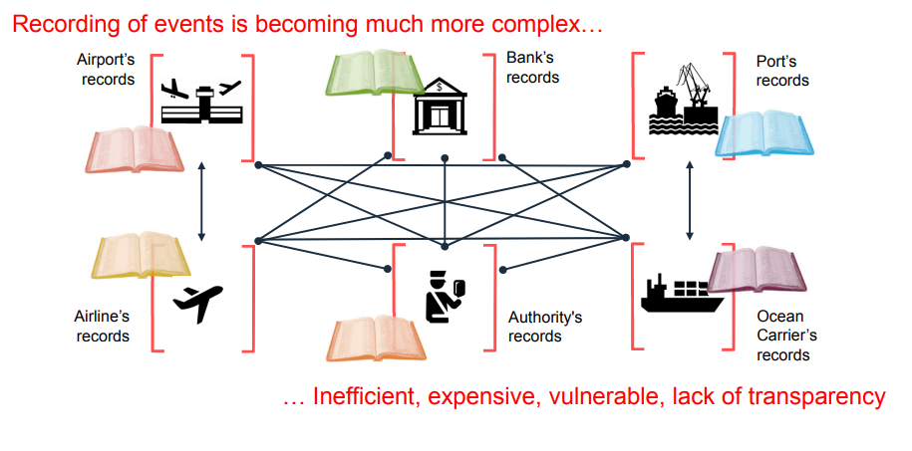
Traditional – How it works?

Slide 16
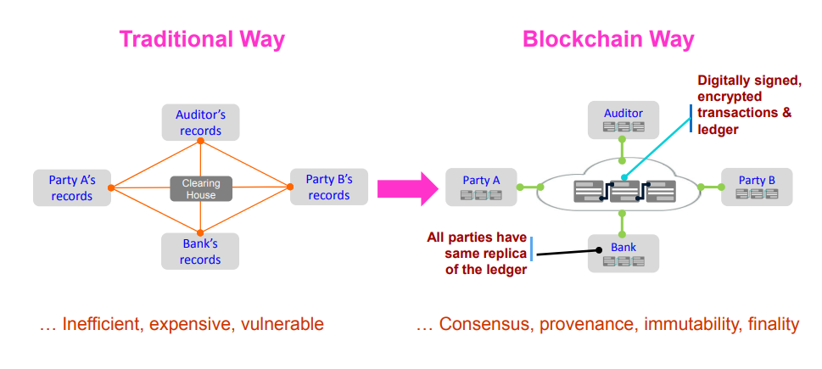
Blockchain – How it works?

Slide 17
Blockchain – How it works?
Blockchain technology offers the intriguing possibility of eliminating this “middle man”. It does this by filling three important roles – recording transactions, establishing identity and establishing contracts – traditionally carried out by the financial services sector.
But it is the third role, establishing contracts, that extends its usefulness outside the financial services sector. Apart from a unit of value (like a bitcoin), blockchain can be used to store any kind of digital information.
  These are known as “smart contracts,” and the possibilities for their use are practically endless.
  For example, your smart thermostat might communicate energy usage to a smart grid; when a certain number of wattage hours has been reached, another blockchain automatically transfers value from your account to the electric company, effectively automating the meter reader and the billing process.
  if a doctor or patient issues a private key to a medical device, say a blood glucose monitor, the device could automatically and securely record a patient’s blood glucose levels, and then, potentially, communicate with an insulin delivery device to maintain blood glucose at a healthy level.

Slide 18
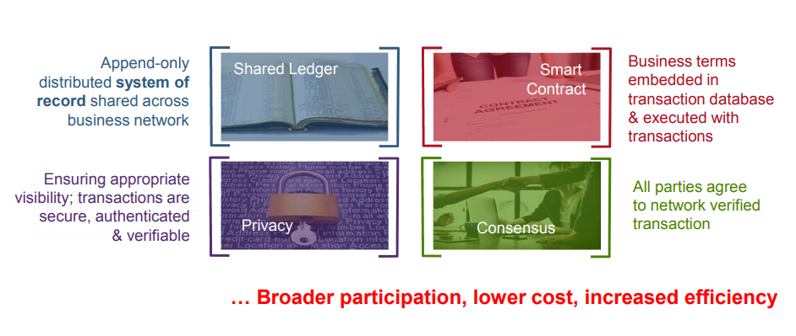
Blockchain – For Bussiness

Slide 19
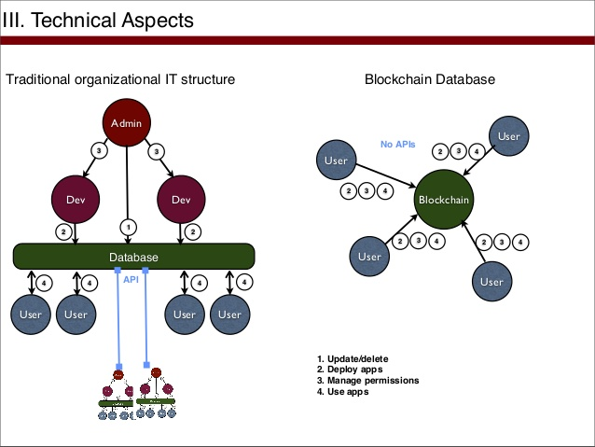
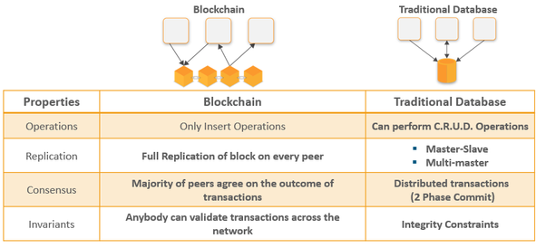
Blockchain Vs Databases

