Slide 1
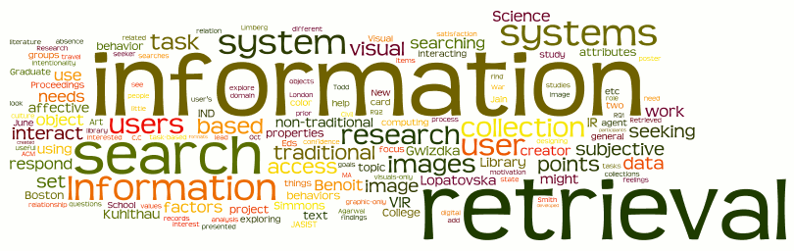
Evaluation in IR
Sampath Jayarathna
Cal Poly Pomona
Credit for some of the slides in this lecture goes to Prof. Ray Mooney at UT Austin & Prof. Rong Jin at MSU

Slide 2
Evaluation
Evaluation is key to building effective and efficient IR systems
  usually carried out in controlled experiments
  online testing can also be done
Effectiveness and efficiency are related
  High efficiency may be obtained at the price of effectiveness

Slide 3
Why System Evaluation?
There are many retrieval models/ algorithms/ systems, which one is the best?
What is the best component for:
  Ranking function (dot-product, cosine, …)
  Term selection (stopword removal, stemming…)
  Term weighting (TF, TF-IDF,…)
How far down the ranked list will a user need to look to find some/all relevant documents?

Slide 4
Difficulties in Evaluating IR Systems
Effectiveness is related to the relevancy of retrieved items.
Relevancy is not typically binary but continuous.
Even if relevancy is binary, it can be a difficult judgment to make.
Relevancy, from a human standpoint, is:
  Subjective: Depends upon a specific user’s judgment.
  Situational: Relates to user’s current needs.
  Cognitive: Depends on human perception and behavior.
  Dynamic: Changes over time.

Slide 5
Human Labeled Corpora : (Gold Standard)
Start with a corpus of documents.
Collect a set of queries for this corpus.
Have one or more human experts exhaustively label the relevant documents for each query.
Typically assumes binary relevance judgments.
Requires considerable human effort for large document/query corpora.

Slide 6
Precision and Recall
Space of all documents
Relevant +
Retrieved
Relevant
Retrieved
Not Relevant + Not Retrieved

Slide 7
Precision and Recall
Precision
  The ability to retrieve top-ranked documents that are mostly relevant.
  Precision P = tp/(tp + fp)
Recall
  The ability of the search to find all of the relevant items in the corpus.
  Recall R = tp/(tp + fn)
 | Relevant | Nonrelevant
Retrieved | tp | fp
Not Retrieved | fn | tn

Slide 8
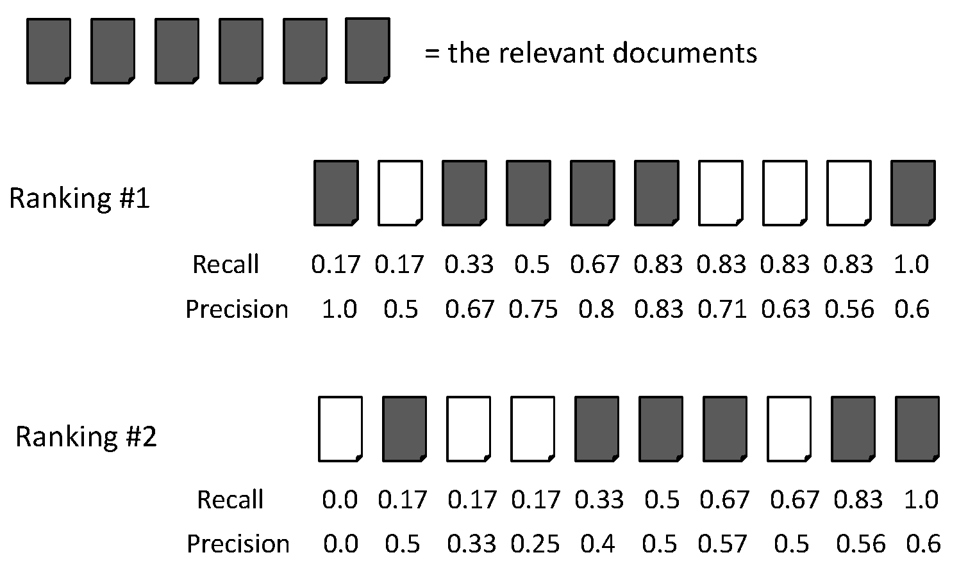
Precision/Recall : Example
Recall = 2/6 = 0.33
Precision = 2/3 = 0.67

Slide 9
Precision/Recall : Example
Recall = 5/6 = 0.83
Precision = 5/6 = 0.83

Slide 10
Accuracy : Example
Accuracy = tp + tn/(tp+tn+fp+fn)
 | Relevant | Nonrelevant
Retrieved | tp = ? | fp = ?
Not Retrieved | fn = ? | tn = ?

Slide 11
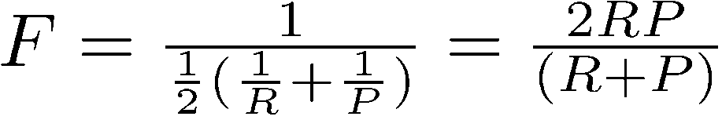
F Measure (F1/Harmonic Mean)
One measure of performance that takes into account both recall and precision.
Harmonic mean of recall and precision:
  Why harmonic mean?
  harmonic mean emphasizes the importance of small values, whereas the arithmetic mean is affected more by outliers that are unusually large
  Data are extremely skewed; over 99% documents are non-relevant. This is why accuracy is not an appropriate measure
  Compared to arithmetic mean, both need to be high for harmonic mean to be high.

Slide 12
F Measure (F1/Harmonic Mean) : example
Recall = 2/6 = 0.33
Precision = 2/3 = 0.67
F = 2*Recall*Precision/(Recall + Precision)
= 2*0.33*0.67/(0.33 + 0.67) = 0.44

Slide 13
F Measure (F1/Harmonic Mean) : example
Recall = 5/6 = 0.83
Precision = 5/6 = 0.83
F = 2*Recall*Precision/(Recall + Precision)
= 2*0.83*0.83/(0.83 + 0.83) = 0.83

Slide 14
E Measure (parameterized F Measure)
A variant of F measure that allows weighting emphasis on precision over recall:
Value of β controls trade-off:
  β = 1: Equally weight precision and recall (E=F).
  β > 1: Weight recall more.
  β < 1: Weight precision more.

Slide 15
Computing Recall/Precision Points
For a given query, produce the ranked list of retrievals.
Adjusting a threshold on this ranked list produces different sets of retrieved documents, and therefore different recall/precision measures.
Mark each document in the ranked list that is relevant according to the gold standard.
Compute a recall/precision pair for each position in the ranked list that contains a relevant document.

Slide 16
Computing Recall/Precision Points: Example 1
Let total # of relevant docs = 6
Check each new recall point:
R=1/6=0.167; P=1/1=1
R=2/6=0.333; P=2/2=1
R=3/6=0.5; P=3/4=0.75
R=4/6=0.667; P=4/6=0.667
Missing one
relevant document.
Never reach
100% recall
R=5/6=0.833; p=5/13=0.38

Slide 17
Computing Recall/Precision Points: Example 2
Let total # of relevant docs = 6
Check each new recall point:
R=1/6=0.167; P=1/1=1
R=2/6=0.333; P=2/3=0.667
R=3/6=0.5; P=3/5=0.6
R=4/6=0.667; P=4/8=0.5
R=5/6=0.833; P=5/9=0.556
R=6/6=1.0; p=6/14=0.429

Slide 18
Mean Average Precision (MAP)
Average Precision: Average of the precision values at the points at which each relevant document is retrieved.
  Ex1: (1 + 1 + 0.75 + 0.667 + 0.38 + 0)/6 = 0.633
  Ex2: (1 + 0.667 + 0.6 + 0.5 + 0.556 + 0.429)/6 = 0.625
  Averaging the precision values from the rank positions where a relevant document was retrieved
  Set precision values to be zero for the not retrieved documents

Slide 19
Average Precision: Example

Slide 20
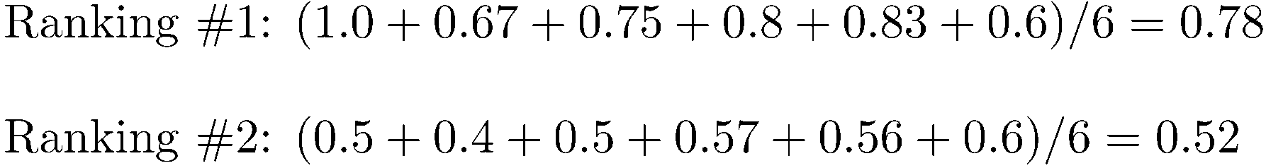
Average Precision: Example

Slide 21
Average Precision: Example

Slide 22
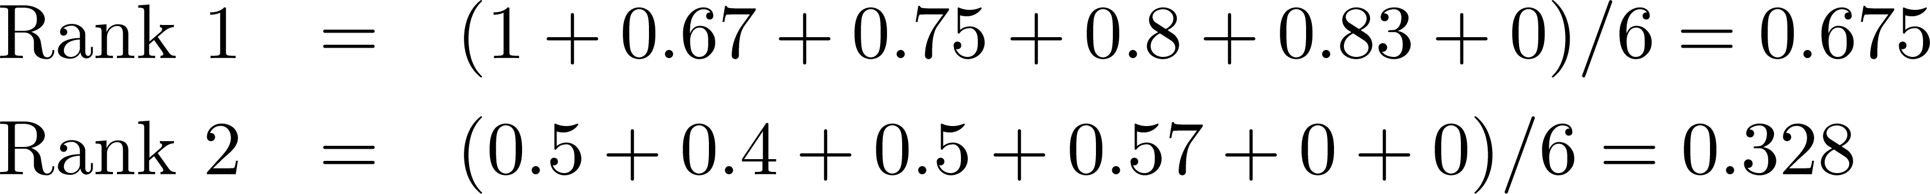
Average Precision: Example
Miss one relevant document

Slide 23
Average Precision: Example
Miss two relevant documents

Slide 24
Mean Average Precision (MAP)
Summarize rankings from multiple queries by averaging average precision
Most commonly used measure in research papers
Assumes user is interested in finding many relevant documents for each query
Requires many relevance judgments in text collection

Slide 25
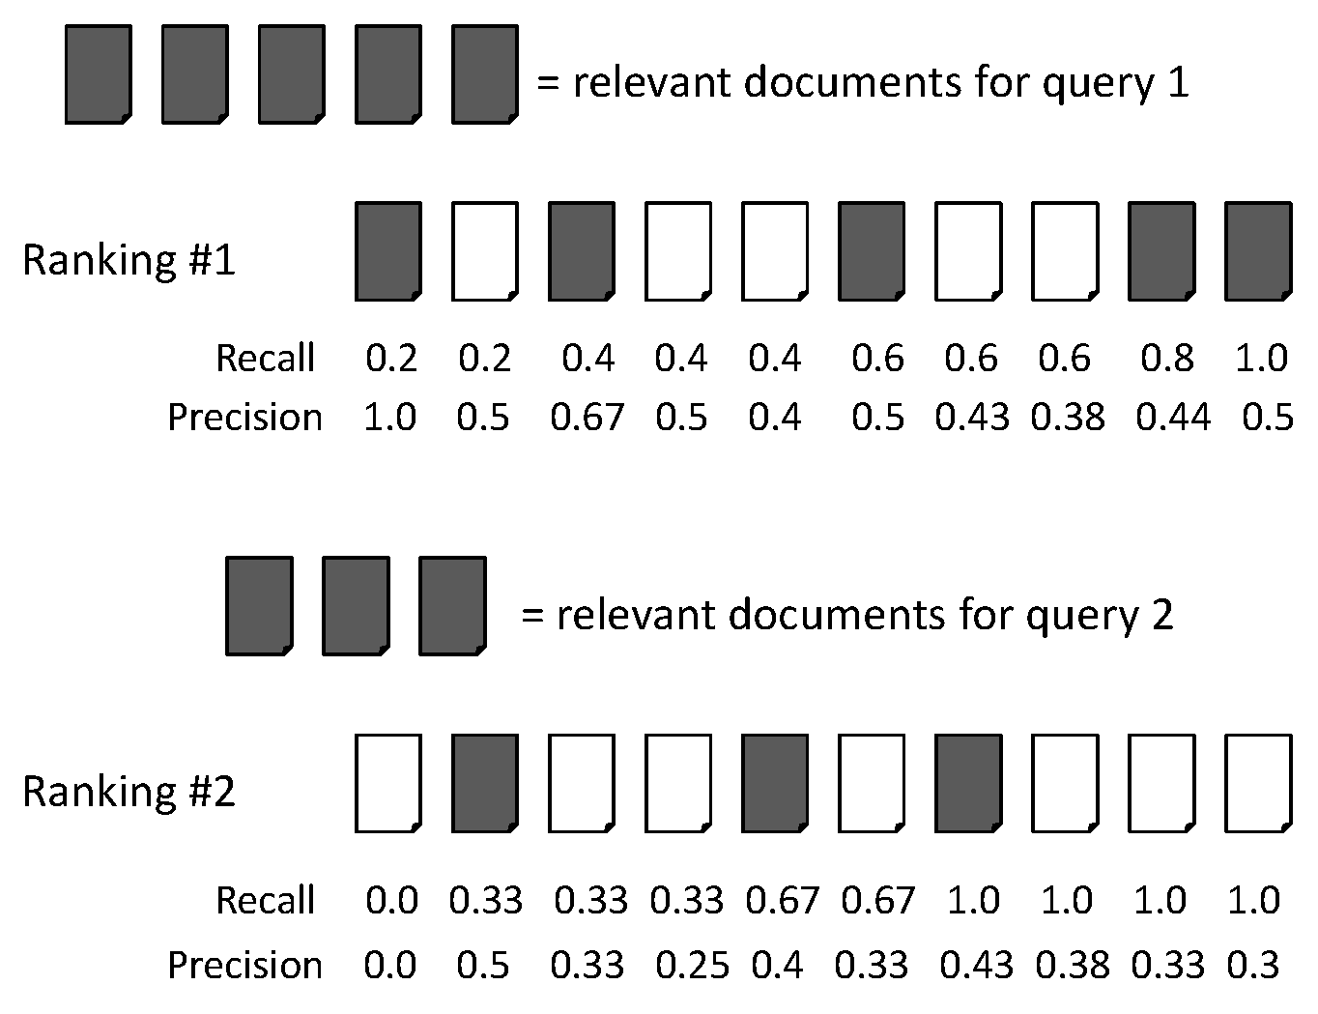
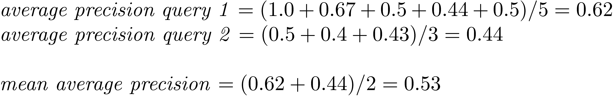
Mean Average Precision (MAP)

Slide 26
Non-Binary Relevance
Documents are rarely entirely relevant or non-relevant to a query
Many sources of graded relevance judgments
  Relevance judgments on a 5-point scale
  Multiple judges

Slide 27
Cumulative Gain
With graded relevance judgments, we can compute the gain at each rank.
Cumulative Gain at rank n:
  (Where rel_{i} is the graded relevance of the document at position i)

Slide 28
Discounted Cumulative Gain (DCG)
Popular measure for evaluating web search and related tasks
  Use graded relevance
Two assumptions:
  Highly relevant documents are more useful than marginally relevant document
  the lower the ranked position of a relevant document, the less useful it is for the user, since it is less likely to be examined

Slide 29
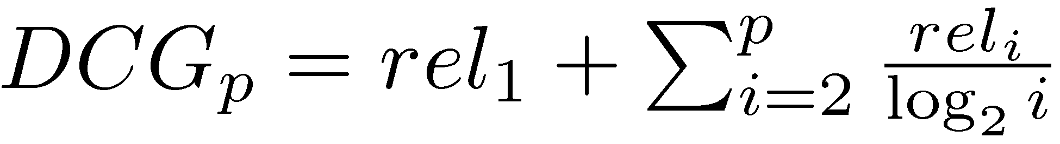
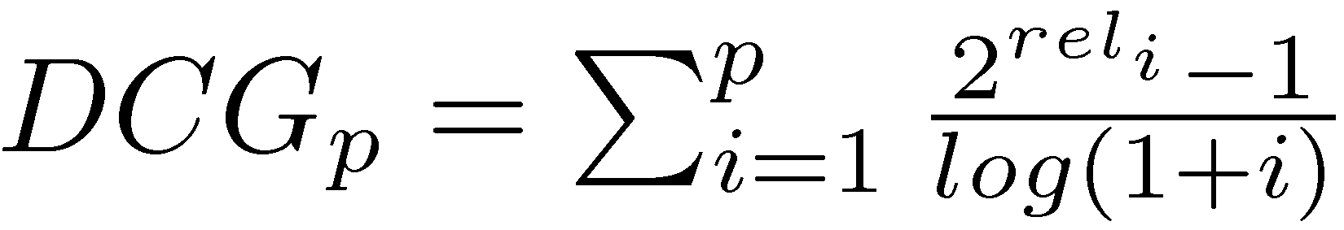
Discounted Cumulative Gain
Gain is accumulated starting at the top of the ranking and is discounted at lower ranks
  Typical discount is 1/log (rank)
  With base 2, the discount at rank 4 is 1/2, and at rank 8 it is 1/3

Slide 30
Discounting Based on Position
Users care more about high-ranked documents, so we discount results by 1/log₂(rank)
Discounted Cumulative Gain:

Slide 31
Normalized Discounted Cumulative Gain (NDCG)
To compare DCGs, normalize values so that a ideal ranking would have a Normalized DCG of 1.0
Ideal ranking:

Slide 32
Normalized Discounted Cumulative Gain (NDCG)
Normalize by DCG of the ideal ranking:
NDCG ≤ 1 at all ranks
NDCG is comparable across different queries

Slide 33

NDCG Example
Documents ordered by ranking algorithm
  D1, D2, D3, D4, D5, D6
The user provides following relevance score
  3,2,3,0,1,2
    \
    Changing the order of any two documents does not affect the CG measure. If D3 and D4 are switched, the CG remains the same, 11.

Slide 34
NDCG Example
DCG is used to emphasize highly relevant documents appearing early in the result list. Using the logarithmic scale for reduction, the DCG for each result
Now D3 and D4 are switched, results in a reduced DCG because a less relevant document is placed higher in the ranking; that is, a more relevant document is discounted more by being placed in a lower rank.
    To normalize DCG values, an ideal ordering for the given query is needed. For this example, that ordering would be the monotonically decreasing sort of the relevance judgments provided by the experiment participant
      3,3,2,2,1,0

Slide 35
Focusing on Top Documents
Users tend to look at only the top part of the ranked result list to find relevant documents
Some search tasks have only one relevant document
  e.g., navigational search, question answering
Recall not appropriate
  instead need to measure how well the search engine does at retrieving relevant documents at very high ranks

Slide 36
Focusing on Top Documents
Precision at Rank R
  R typically 5, 10, 20
  easy to compute, average, understand
  not sensitive to rank positions less than R
Reciprocal Rank
  reciprocal of the rank at which the first relevant document is retrieved
  Mean Reciprocal Rank (MRR) is the average of the reciprocal ranks over a set of queries
  very sensitive to rank position

Slide 37
R- Precision
Precision at the R-th position in the ranking of results for a query that has R relevant documents.
R = # of relevant docs = 6
R-Precision = 4/6 = 0.67

Slide 38
Mean Reciprocal Rank (MRR)
RR = 1/1 = 1
RR = 1/2 = 0.5
MRR = (1+0.5)/2 = 0.75

Slide 39
Significance Tests
Given the results from a number of queries, how can we conclude that ranking algorithm B is better than algorithm A?
A significance test
  null hypothesis: no difference between A and B
  alternative hypothesis: B is better than A
  the power of a test is the probability that the test will reject the null hypothesis correctly
  increasing the number of queries in the experiment also increases power of test

Slide 40
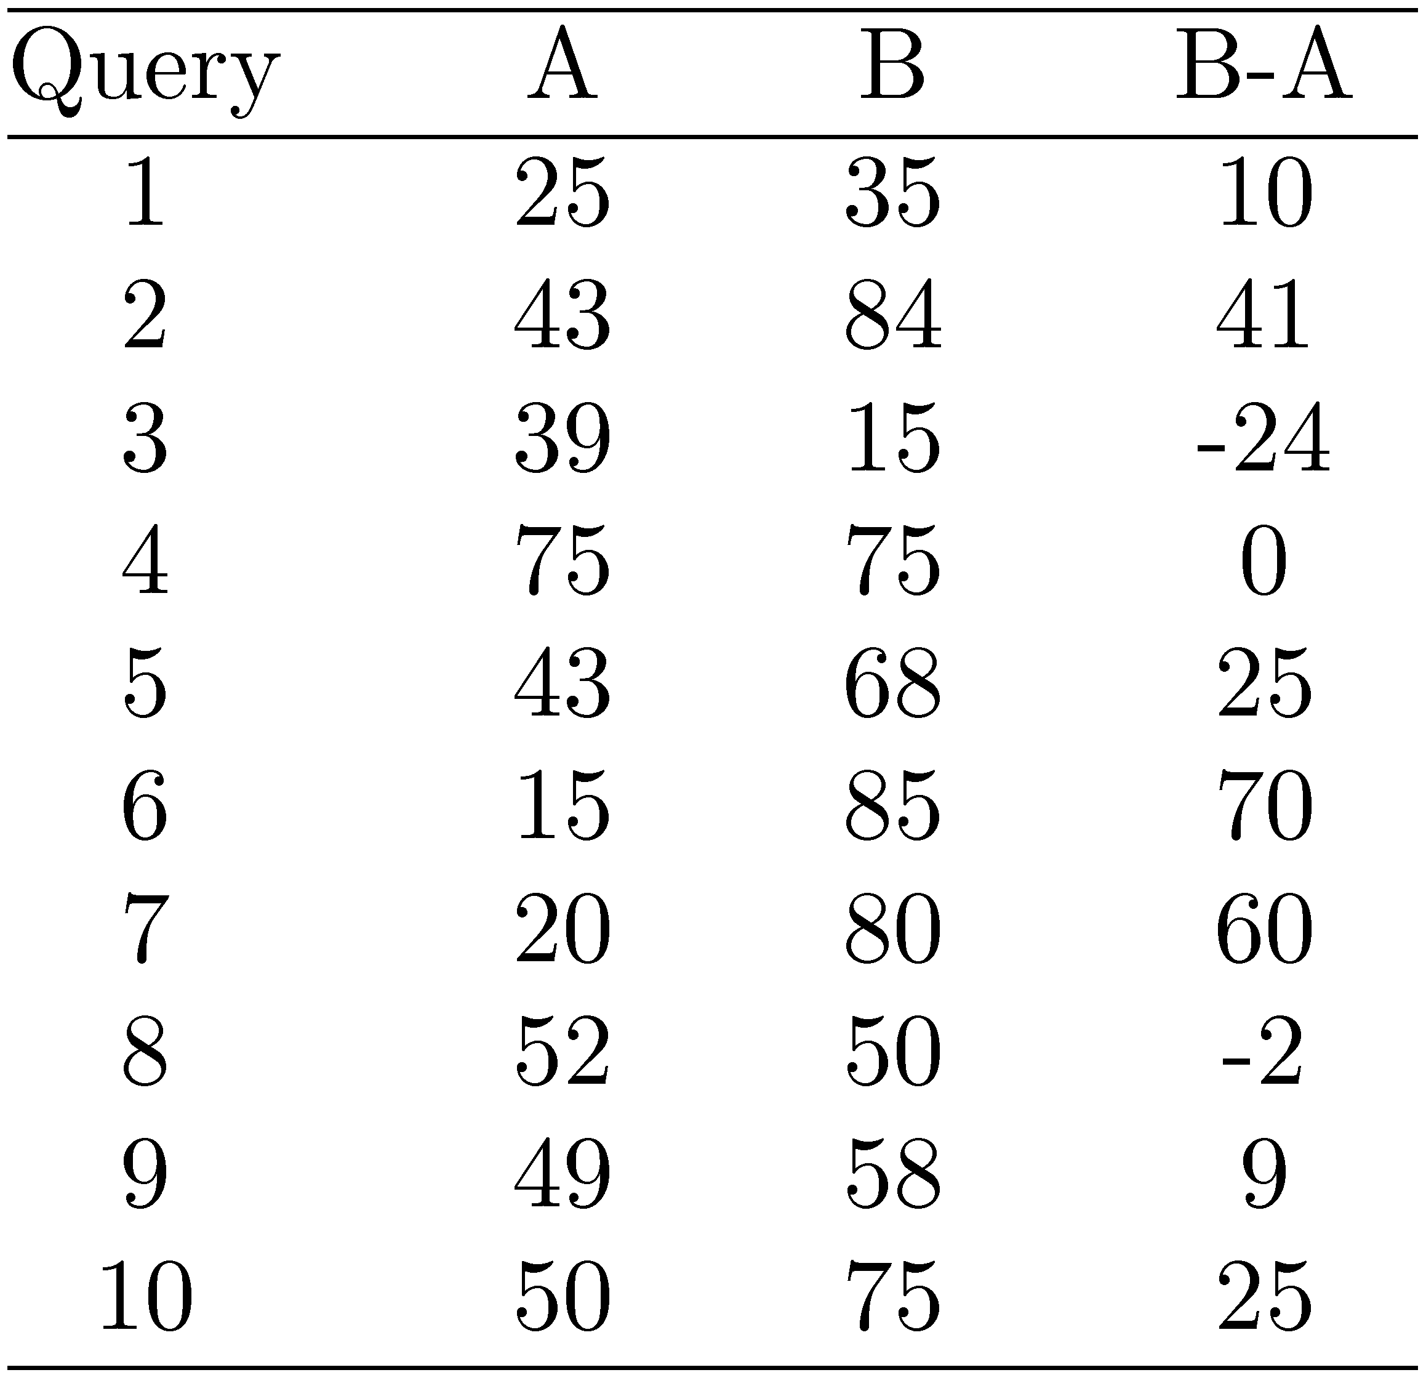
Example Experimental Results
Significance level: α = 0.05
Probability for B=A

Slide 41
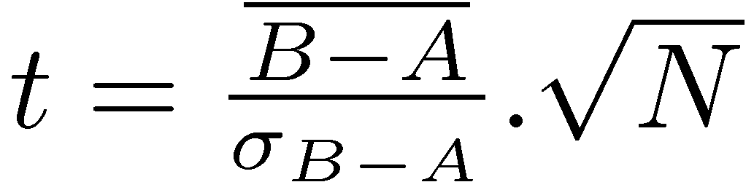
Example Experimental Results
t-test
t = 2.33 p-value = 0.02 < 0.05
Probability for B=A is 0.02
Reject null hypothesis
→ B is better than A
Avg 41.1 62.5
Significance level: α = 0.05
Probability for B=A

Slide 42
Online Testing
Test (or even train) using live traffic on a search engine
Benefits:
  real users, less biased, large amounts of test data
Drawbacks:
  noisy data, can degrade user experience
Often done on small proportion (1-5%) of live traffic

Slide 43
Summary
No single measure is the correct one for any application
  choose measures appropriate for task
  use a combination
  shows different aspects of the system effectiveness
Use significance tests (t-test)
Analyze performance of individual queries

