Slide 1
Text Categorization
Sampath Jayarathna
Cal Poly Pomona
Credit for some of the slides in this lecture goes to Prof. Ray Mooney at UT Austin

Slide 2
Shopping on the Web
Suppose you want to buy a cappuccino maker as a gift
try Google for “cappuccino maker”
What do you expect to see?
Search List….
Anything else?

Slide 3
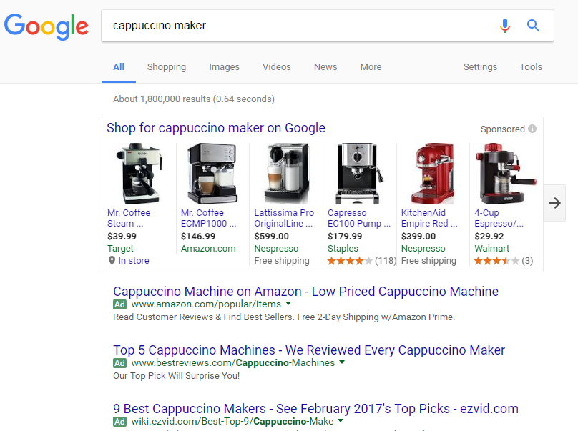
Notes:
You can get to a Google hierarchy indirectly if you note the
“Shopping > Home and Garden ...” link.

Slide 4
Observations
Broad indexing & speedy search alone are not enough.
Organizational view of data is critical for effective retrieval.
Categorized data are easy for user to browse.
Category taxonomies become most central in well-known web sites.

Slide 5
Text Categorization Applications
Web pages organized into category hierarchies
Journal articles indexed by subject categories (e.g., the Library of Congress, MEDLINE, etc.)
Responses to Census Bureau occupations
Patents archived using International Patent Classification
Patient records coded using international insurance categories
E-mail message filtering
News events tracked and filtered by topics

Slide 6
Cost of Manual Text Categorization
MEDLINE (National Library of Medicine)
$2 million/year for manual indexing of journal articles
using MEdical Subject Headings (18,000 categories)
Mayo Clinic
$1.4 million annually for coding patient-record events
using the International Classification of Diseases (ICD) for billing insurance companies
US Census Bureau decennial census (1990: 22 million responses)
232 industry categories and 504 occupation categories
$15 million if fully done by hand
Notes:
Why not simply categorize by hand? Too time and resource intensive.

Slide 7
What does it take to compete?
Suppose you were starting a web search company, what would it take to compete with established engines?
You need to be able to establish a competing hierarchy fast.
You will need a relatively cheap solution. (Unless you have investors that want to pay millions of dollars just to get off the ground.)

Slide 8
Why not a semi-automatic text categorization tool?
Humans can encode knowledge of what constitutes membership in a category.
This encoding can then be automatically applied by a machine to categorize new examples.
For example...
Open Directory Project?
DMOZ is the largest, most comprehensive human-edited directory of the Web. It is constructed and maintained by a passionate, global community of volunteer editors. It was historically known as the Open Directory Project (ODP).
http://www.dmoz.org/

Slide 9
Rule-based Approach to TC
Text in a Web Page “Saeco revolutionized espresso brewing a decade ago by introducing Saeco Super Automatic machines, which go from bean to coffee at the touch of a button. The all-new Saeco Vienna Super-Automatic home coffee and cappuccino machine combines top quality with low price!”
Rule (espresso or coffee or cappuccino ) and machine* Coffee Maker

Slide 10
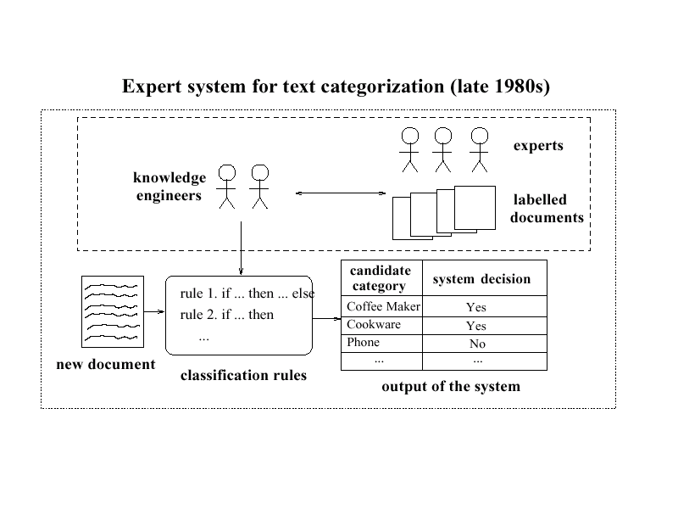
Expert System for TC (late 1980s)
Experience has shown
too time consuming, too difficult, inconsistency issues (as the rule set gets large)

Slide 11
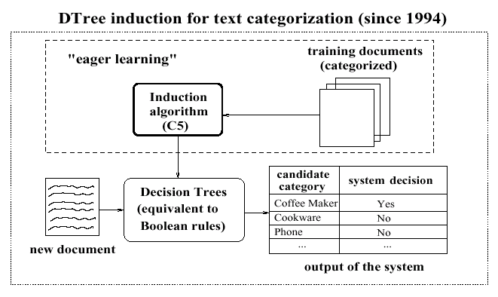
Replace Knowledge Engineering with a Statistical Learner
Notes:
A decision tree learner is a statistical learner that learns rules based on statistical patterns in the data.

Slide 12
Predicting Topics of News Stories
Given: Collection of example news stories already labeled with a category (topic).
Task: Predict category for news stories not yet labeled.
For our example, we’ll only get to see the headline of the news story.
We’ll represent categories using colors. (All examples with the same color belong to the same category.)

Slide 13
Our Labeled Examples
Amatil Proposes Two-for-Five Bonus Share Issue
Citibank Norway Unit Loses Six Mln Crowns in 1986
Japan Ministry Says Open Farm Trade Would Hit U.S.
Vieille Montagne Says 1986 Conditions Unfavourable
Jardine Matheson Said It Sets Two-for-Five Bonus Issue Replacing “B” Shares
Anheuser-Busch Joins Bid for San Miguel
Italy’s La Fondiaria to Report Higher 1986 Profits
Isuzu Plans No Interim Dividend
Senator Defends U.S. Mandatory Farm Control Bill
Bowater Industries Profit Exceed Expectations

Slide 14
What to predict before seeing the document?
?
Amatil Proposes Two-for-Five Bonus Share Issue
Citibank Norway Unit Loses Six Mln Crowns in 1986
Japan Ministry Says Open Farm Trade Would Hit U.S.
Vieille Montagne Says 1986 Conditions Unfavourable
Jardine Matheson Said It Sets Two-for-Five Bonus Issue Replacing “B” Shares
Anheuser-Busch Joins Bid for San Miguel
Italy’s La Fondiaria to Report Higher 1986 Profits
Isuzu Plans No Interim Dividend
Senator Defends U.S. Mandatory Farm Control Bill
Bowater Industries Profit Exceed Expectations
Notes:
If we have no other information, our best guess is probably the gray-green category (since it is the most common).

Slide 15
Predict with Evidence
Senate Panel Studies Loan Rate, Set Aside Plans
Amatil Proposes Two-for-Five Bonus Share Issue
Citibank Norway Unit Loses Six Mln Crowns in 1986
Japan Ministry Says Open Farm Trade Would Hit U.S.
Vieille Montagne Says 1986 Conditions Unfavourable
Jardine Matheson Said It Sets Two-for-Five Bonus Issue Replacing “B” Shares
Anheuser-Busch Joins Bid for San Miguel
Italy’s La Fondiaria to Report Higher 1986 Profits
Isuzu Plans No Interim Dividend
Senator Defends U.S. Mandatory Farm Control Bill
Bowater Industries Profit Exceed Expectations
Notes:
Why do we think this belongs to the yellow-orange category?
“Senate” and “Senator” seem related.
All discuss government related issues as well. If we have a “related word list” (a.k.a. query expansion) we might find the related words have a high overlap.
(All actually discuss “farms” as well, but we don’t know that the “loan rate” is actually a “farm” loan.)

Slide 16
The Actual Topic
Senate Panel Studies Loan Rate, Set Aside Plans
Amatil Proposes Two-for-Five Bonus Share Issue
Citibank Norway Unit Loses Six Mln Crowns in 1986
Japan Ministry Says Open Farm Trade Would Hit U.S.
Vieille Montagne Says 1986 Conditions Unfavourable
Jardine Matheson Said It Sets Two-for-Five Bonus Issue Replacing “B” Shares
Anheuser-Busch Joins Bid for San Miguel
Italy’s La Fondiaria to Report Higher 1986 Profits
Isuzu Plans No Interim Dividend
Senator Defends U.S. Mandatory Farm Control Bill
Bowater Industries Profit Exceed Expectations

Slide 17
Representing Documents
Usually, an example is represented as a series of feature-value pairs. The features can be arbitrarily abstract (as long as they are easily computable) or very simple.
For example, the features could be the set of all words and the values, their number of occurrences in a particular document.
Japan Firm Plans to Sell U.S. Farmland to Japanese
Farmland:1
Firm:1
Japan:1
Japanese:1
Plans:1
Sell:1
To:2
U.S.:1
Representation
Notes:
Note that high frequency words like “to” do not give information, because they occur about the same number of times in all categories. We can either discard these words or rely on the method we choose to recognize that this word is not associated with category membership.

Slide 18
1-Nearest Neighbor
Looking back at our example
Did anyone try to find the most similar labeled item and then just guess the same color?
This is 1-Nearest Neighbor
Senate Panel Studies Loan Rate, Set Aside Plans
Amatil Proposes Two-for-Five Bonus Share Issue
Citibank Norway Unit Loses Six Mln Crowns in 1986
Japan Ministry Says Open Farm Trade Would Hit U.S.
Vieille Montagne Says 1986 Conditions Unfavourable
Jardine Matheson Said It Sets Two-for-Five Bonus Issue Replacing “B” Shares
Anheuser-Busch Joins Bid for San Miguel
Italy’s La Fondiaria to Report Higher 1986 Profits
Isuzu Plans No Interim Dividend
Senator Defends U.S. Mandatory Farm Control Bill
Bowater Industries Profit Exceed Expectations

Slide 19
Classification Task
Given:
A description of an instance, x ∈ X, where X is the instance language or instance or feature space.
Typically, x is a row in a table with the instance/feature space described in terms of features or attributes.
A fixed set of class or category labels: C={c₁, c₂,…c_{n}}
Classification task is to determine:
The class/category of x: c(x) ∈ C, where c(x) is a function whose domain is X and whose range is C.

Slide 20
Example of Classification Learning
Instance language: <size, color, shape>
size ∈ {small, medium, large}
color ∈ {red, blue, green}
shape ∈ {square, circle, triangle}
C = {positive, negative}
D:
Hypotheses?
Small, red, circle → positive?
Large, blue, circle → negative?
Example | Size | Color | Shape | Category
1 | small | red | circle | positive
2 | large | red | circle | positive
3 | small | red | triangle | negative
4 | large | blue | circle | negative

Slide 21
General Learning Issues
Many hypotheses are usually consistent with the training data.
Classification accuracy (% of instances classified correctly).
Measured on independent test data.
Training time (efficiency of training algorithm).
Testing time (efficiency of subsequent classification).

Slide 22
Generalization
Hypotheses must generalize to correctly classify instances not in the training data.
Simply memorizing training examples is a consistent hypothesis that does not generalize.
Occam’s razor:
Finding a simple hypothesis helps ensure generalization.

Slide 23
Text Categorization
Assigning documents to a fixed set of categories.
Applications:
Web pages
Recommending
Yahoo-like classification
Newsgroup Messages
Recommending
spam filtering
News articles
Personalized newspaper
Email messages
Routing
Folderizing
Spam filtering

Slide 24
Learning for Text Categorization
Manual development of text categorization functions is difficult.
Learning Algorithms:
Neural network
Relevance Feedback (Rocchio)
Rule based (Ripper)
Nearest Neighbor (case based)
Support Vector Machines (SVM)
Bayesian (naïve)

Slide 25
Using Relevance Feedback (Rocchio)
Relevance feedback methods can be adapted for text categorization.
Use standard TF/IDF weighted vectors to represent text documents (normalized by maximum term frequency).
For each category, compute a prototype vector by summing the vectors of the training documents in the category.
Assign test documents to the category with the closest prototype vector based on cosine similarity.

Slide 26
Illustration of Rocchio Text Categorization

Slide 27
Rocchio Text Categorization Algorithm(Training)
Assume the set of categories is {c₁, c₂,…c_{n}}
For i from 1 to n let p_{i} = <0, 0,…,0> (init. prototype vectors)
For each training example <x, c(x)> ∈ D
Let d be the normalized TF/IDF term vector for doc x
Let i = j: (c_{j} = c(x))
(sum all the document vectors in c_{i} to get p_{i})
Let p_{i} = p_{i} + d

Slide 28
Rocchio Text Categorization Algorithm(Test)
Given test document x
Let d be the TF/IDF weighted term vector for x
Let m = –2 (init. maximum cosSim)
For i from 1 to n:
(compute similarity to prototype vector)
Let s = cosSim(d, p_{i})
if s > m
let m = s
let r = c_{i} (update most similar class prototype)
Return class r

Slide 29
Rocchio Properties
Does not guarantee a consistent hypothesis.
Forms a simple generalization of the examples in each class (a prototype).
Prototype vector does not need to be averaged or otherwise normalized for length since cosine similarity is insensitive to vector length.
Classification is based on similarity to class prototypes.

Slide 30
Nearest Neighbor Classification
Also known as, Instance-Based, Lazy Learning, Memory-based, Case-based learning
well-known approach to pattern recognition
initially by Fix and Hodges (1951)
applied to text categorization in early 90’s
strong baseline in benchmark evaluations
among top-performing methods in TC evaluations
scalable to large TC applications

Slide 31
Nearest-Neighbor Learning Algorithm
Learning is just storing the representations of the training examples in D.
Testing instance x:
Compute similarity between x and all examples in D.
Assign x the category of the most similar example in D.
Does not explicitly compute a generalization or category prototypes.

Slide 32
Key Components of Nearest Neighbor
“Similar” item: We need a functional definition of “similarity” if we want to apply this automatically.
How many neighbors do we consider?
Does each neighbor get the same weight?
All categories in neighborhood? Most frequent only? How do we make the final decision?

Slide 33
K Nearest-Neighbor
Using only the closest example to determine categorization is subject to errors due to:
A single atypical example.
Noise (i.e. error) in the category label of a single training example.
More robust alternative is to find the k most-similar examples and return the majority category of these k examples.
Value of k is typically odd to avoid ties, 3 and 5 are most common.

Slide 34
Similarity Metrics
Nearest neighbor method depends on a similarity (or distance) metric.
Simplest for continuous m-dimensional instance space is Euclidian distance.
For text, cosine similarity of TF-IDF weighted vectors is typically most effective.

Slide 35
3 Nearest Neighbor Illustration (Euclidian Distance)
.
.
.
.
.
.
.
.
.
.
.

Slide 36
Illustration of 3 Nearest Neighbor for Text

Slide 37
K Nearest Neighbor for Text
Training:
For each each training example <x, c(x)> ∈ D
Compute the corresponding TF-IDF vector, d_{x}, for document x
Test instance y:
Compute TF-IDF vector d for document y
For each <x, c(x)> ∈ D
Let s_{x} = cosSim(d, d_{x})
Sort examples, x, in D by decreasing value of s_{x}
Let N be the first k examples in D. (get most similar neighbors)
Return the majority class of examples in N

Slide 38
Rocchio Anomoly
Prototype models have problems with polymorphic (disjunctive) categories.
In this example, the category of the new document will be red based on cosine similarity between document and prototypes (big red arrow and big black arrow)

Slide 39
3 Nearest Neighbor Comparison
Nearest Neighbor tends to handle polymorphic categories better.
This will assign black to the document category because 2 closest neighbors among 3 Nearest Neighbors are in black category.

Slide 40
Nearest Neighbor with Inverted Index
Determining k nearest neighbors is the same as determining the k best retrievals using the test document as a query to a database of training documents.
Use standard VSR inverted index methods to find the k nearest neighbors.

Slide 41
Evaluating Categorization
Evaluation must be done on test data that are independent of the training data (usually a disjoint set of instances).
Classification accuracy: c/n where n is the total number of test instances and c is the number of test instances correctly classified by the system.
Results can vary based on sampling error due to different training and test sets.
Average results over multiple training and test sets (splits of the overall data) for the best results.

Slide 42
N-Fold Cross-Validation
Ideally, test and training sets are independent on each trial.
But this would require too much labeled data.
Partition data into N equal-sized disjoint segments.
Run N trials, each time using a different segment of the data for testing, and training on the remaining N−1 segments.
This way, at least test-sets are independent.
Report average classification accuracy over the N trials.
Typically, N = 10.

Slide 43
Learning Curves
In practice, labeled data is usually rare and expensive.
Would like to know how performance varies with the number of training instances.
Learning curves plot classification accuracy on independent test data (Y axis) versus number of training examples (X axis).

Slide 44
N-Fold Learning Curves
Want learning curves averaged over multiple trials.
Use N-fold cross validation to generate N full training and test sets.
For each trial, train on increasing fractions of the training set, measuring accuracy on the test data for each point on the desired learning curve.

Slide 45
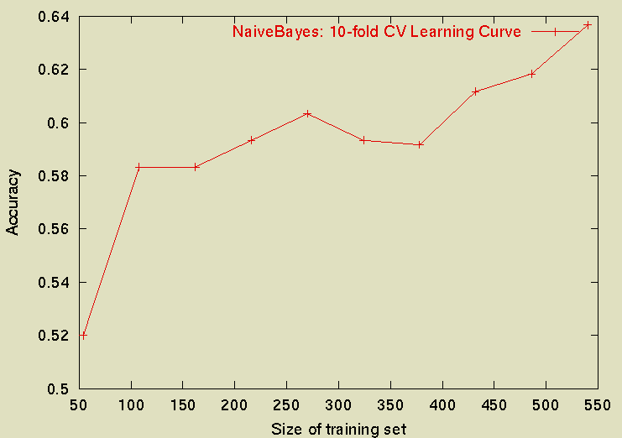
Sample Learning Curve (Yahoo Science Data)

