Slide 1
Introduction to Weka
Sampath Jayarathna
Cal Poly Pomona

Slide 2
Todays Workshop!
What is WEKA?
The Explorer:
Preprocess data
Classification
Clustering (later)
Attribute Selection
Data Visualization
KnowledgeFlow
Generate multiple ROC curves

Slide 3
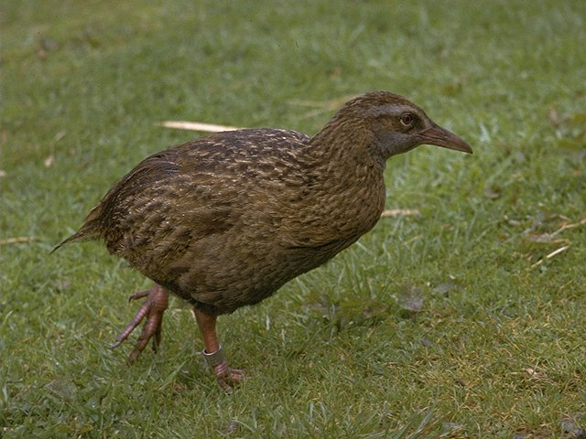
What is WEKA?
Waikato Environment for Knowledge Analysis
It’s a data mining/machine learning tool developed by Department of Computer Science, University of Waikato, New Zealand.
Weka is also a bird found only on the islands of New Zealand.
Website: http://www.cs.waikato.ac.nz/ml/weka/
Support multiple platforms (written in java):
Windows, Mac OS X and Linux

Slide 4
Main Features
49 data preprocessing tools
76 classification/regression algorithms
8 clustering algorithms
3 algorithms for finding association rules
15 attribute/subset evaluators + 10 search algorithms for feature selection

Slide 5
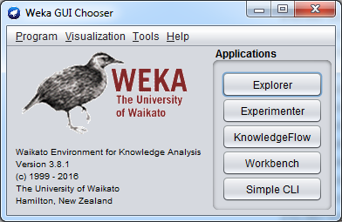
WEKA GUI
Main components
“The Explorer” (exploratory data analysis)
“The Experimenter” (experimental environment)
“The KnowledgeFlow” (process model inspired interface)
“Simple CLI” (Command Line interface)

Slide 6
Todays Workshop!
What is WEKA?
The Explorer:
Preprocess data
Classification
Clustering (later)
Attribute Selection
Data Visualization
KnowledgeFlow
Generate multiple ROC curves

Slide 7
Explorer: pre-processing the data
Data can be imported from a file in various formats: ARFF, CSV, C4.5, binary
Data can also be read from a URL or from an SQL database (using JDBC)
Pre-processing tools in WEKA are called “filters”
WEKA contains filters for:
Discretization, normalization, resampling, attribute selection, transforming and combining attributes, …

Slide 8
WEKA only deals with “flat” files called “arff”
@relation heart-disease-simplified
@attribute age numeric
@attribute sex { female, male}
@attribute chest_pain_type { typ_angina, asympt, non_anginal, atyp_angina}
@attribute cholesterol real
@attribute exercise_induced_angina { yes, no}
@attribute class { present, not_present}
@data
63,male,typ_angina,233,no,not_present
67,male,asympt,286,yes,present
67,male,asympt,229,yes,present
38,female,non_anginal,?,no,not_present
...
Numeric attribute
Nominal attribute
Missing value represented by ?

Slide 9
Exercise 1
Lets create an arff file from our weather data
Create CSV file from the weather excel file
Now add the header for the file and rename it as wether.arff
Next, load the weather.arff file to Weka Explorer

Slide 10
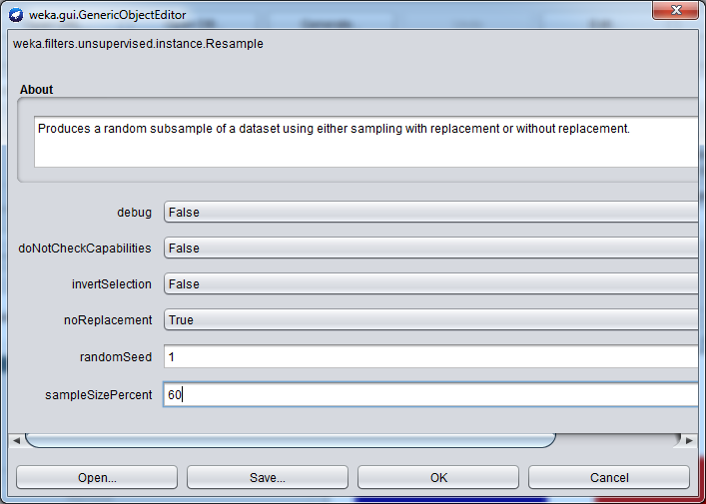
Subsampling
Keep the invertSelection to false when creating your train sample (Example 60% train and 40% test)
Undo the subsampling and then click filter again
Change the invertSelection to true when creating your test sample.

Slide 11
Exercise 2
Load iris.arff dataset from Weka 3.8.1\data
Create train.arff and test.arff with 60/40 split using subsampling filters unsupervised.instance.Resample

Slide 12
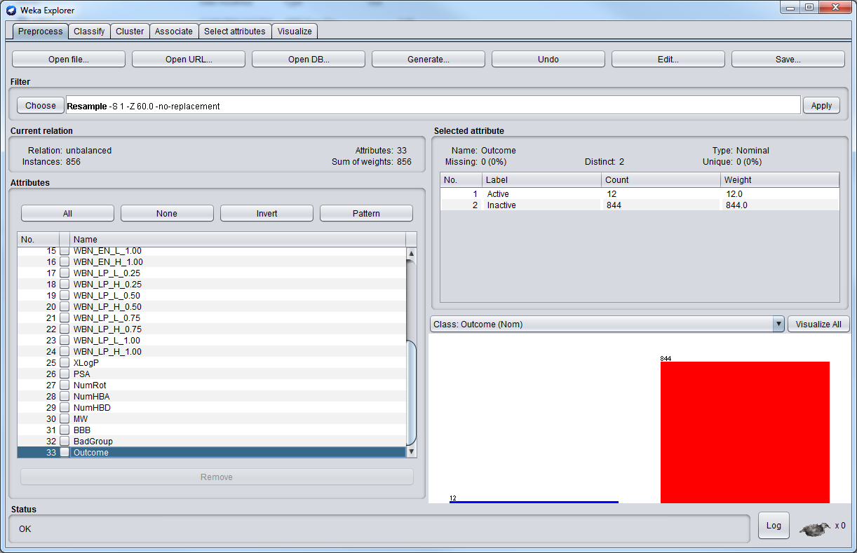
Data Imbalance
Consider random under-sampling or over-sampling to overcome overfitting.

Slide 13
Exercise 3
Load unbalanced.arff dataset from Weka 3.8.1\data
Balance the dataset using ClassBalancer filter in the Supervised/instance

Slide 14
Explorer: building “classifiers”
Classifiers in WEKA are models for predicting nominal or numeric quantities
Implemented learning schemes include:
Decision trees and lists, instance-based classifiers, support vector machines, multi-layer perceptrons, logistic regression, Bayes’ nets, …
“Meta”-classifiers include:
Bagging, boosting, stacking, error-correcting output codes, locally weighted learning, …

Slide 15
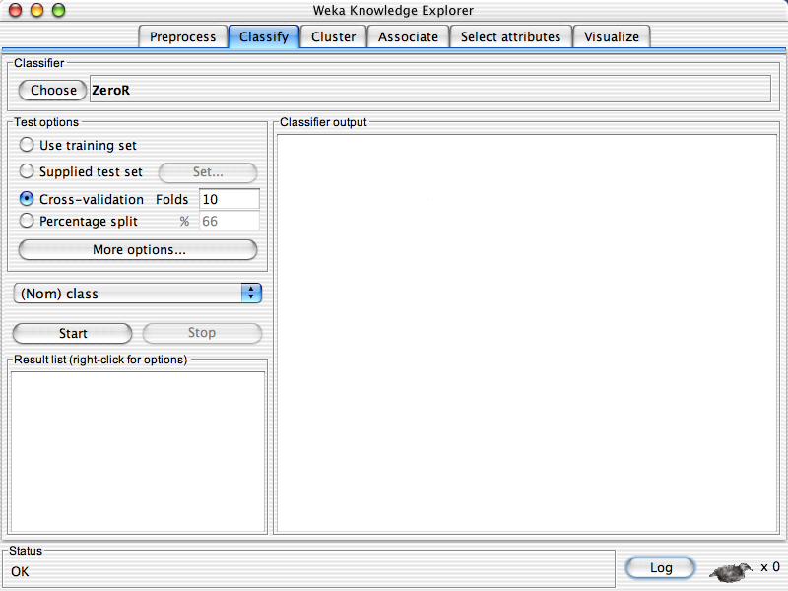

Slide 17
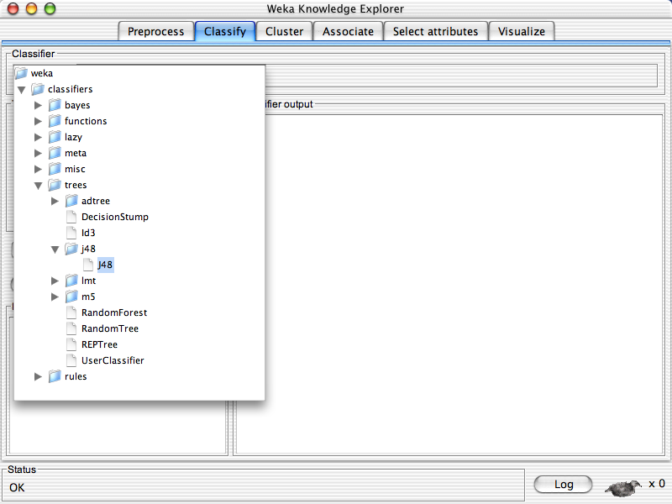

Slide 18
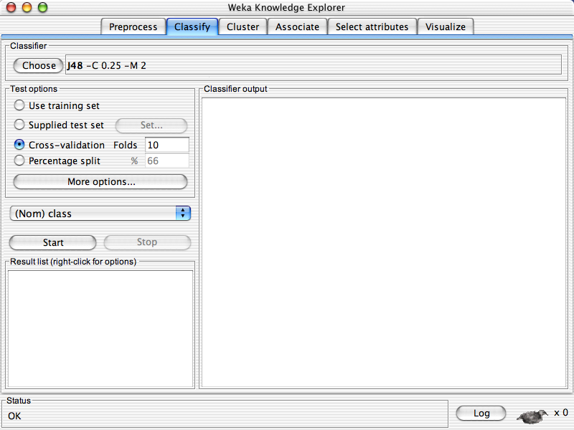

Slide 20
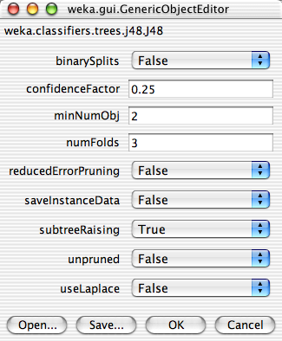

Slide 24
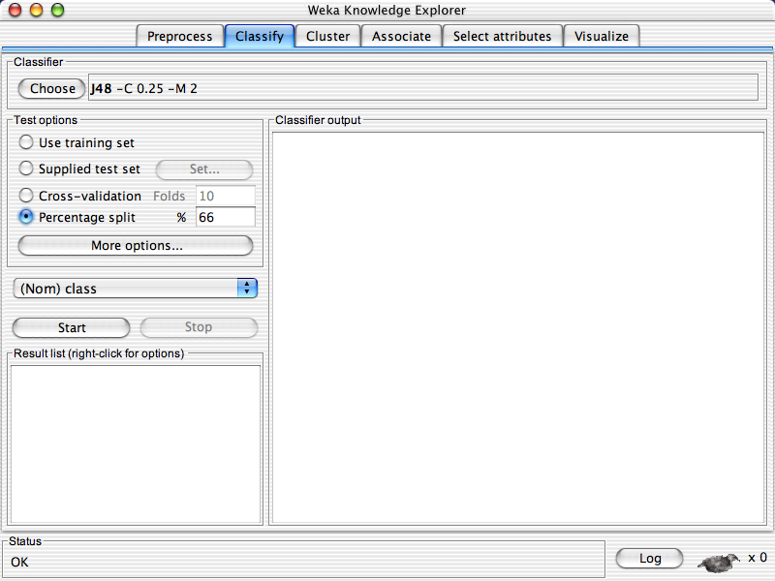

Slide 26
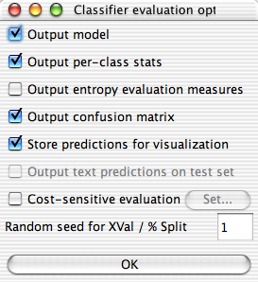

Slide 29
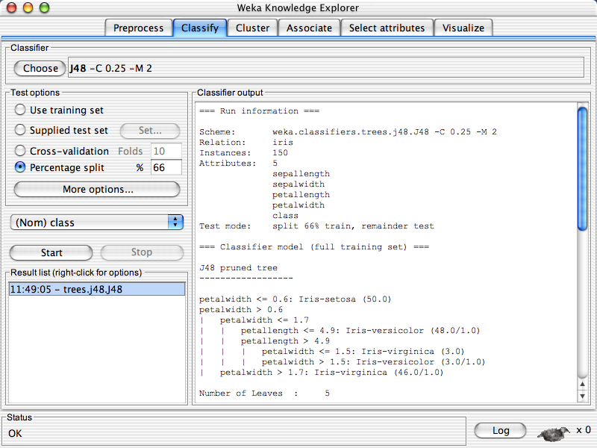

Slide 30
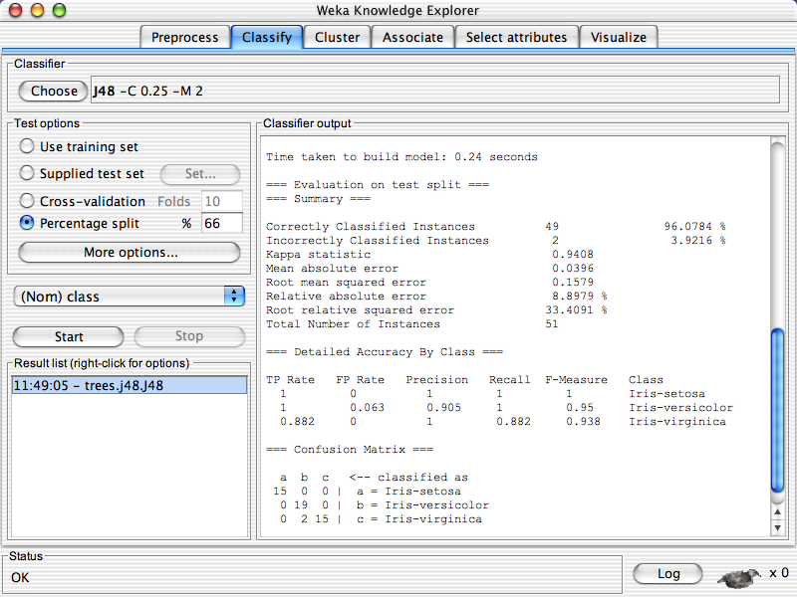

Slide 31
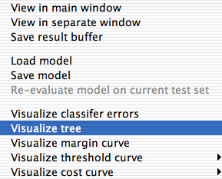

Slide 32
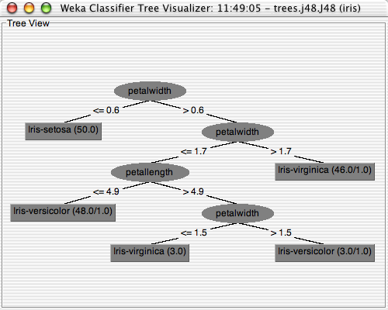

Slide 33
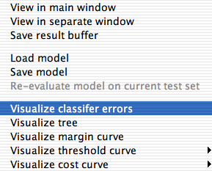

Slide 34
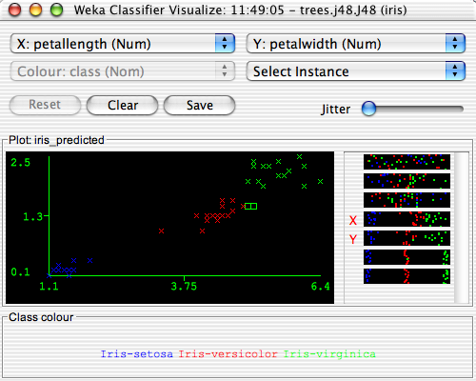

Slide 37
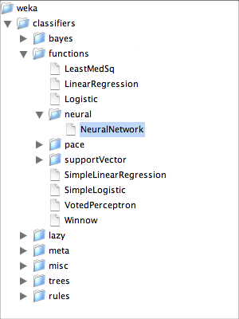

Slide 38
Exercise 4
Load iris.arff dataset from Weka 3.8.1\data
Use KNN classifier and modify the value of K=1, K=3, K=5 and report the accuracy

Slide 39
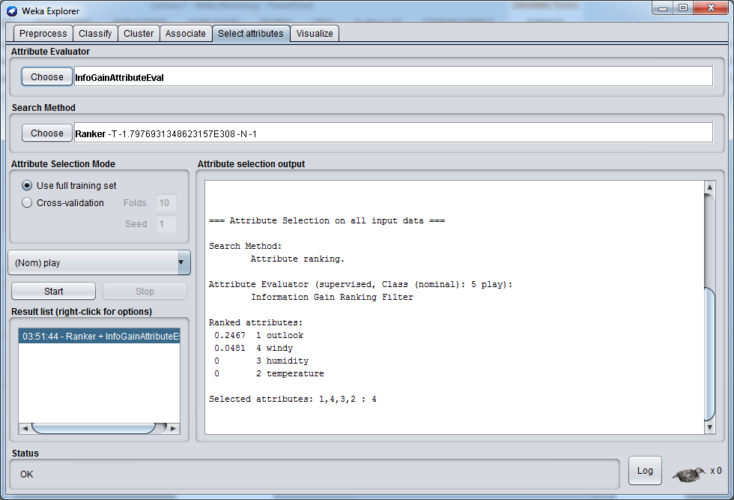
Feature Selection (filter method)

Slide 40
Exercise 5
Using iris.arff dataset from Weka 3.8.1\data
Remove last 5 features one by one from the ranker and report the accuracy each time.

Slide 41
Todays Workshop!
What is WEKA?
The Explorer:
Preprocess data
Classification
Clustering (later)
Attribute Selection
Data Visualization
KnowledgeFlow
Generate multiple ROC curves

Slide 42
Knowledge Flow Interface
“Visual: drag-and-drop” user interface for WEKA - intuitive
Java-Beans-based
Can do everything that Explorer does (plus a bit more), but not as comprehensively as Experimenter
Data sources, classifiers, etc. are beans and can be connected graphically
Data “flows” through modules: e.g.,
“data source” ->“filter” ->“classifier”-> “evaluator”
KF layouts can be saved and re-used later

Slide 43
Knowledge Flow: An Example
What we want to do:
Take a dataset
Do some attribute selection
Perform some classification on the reduced data using 10 fold CV
Examine the subsets selected for each CV fold
Visualize the results in text format and ROC

Slide 44
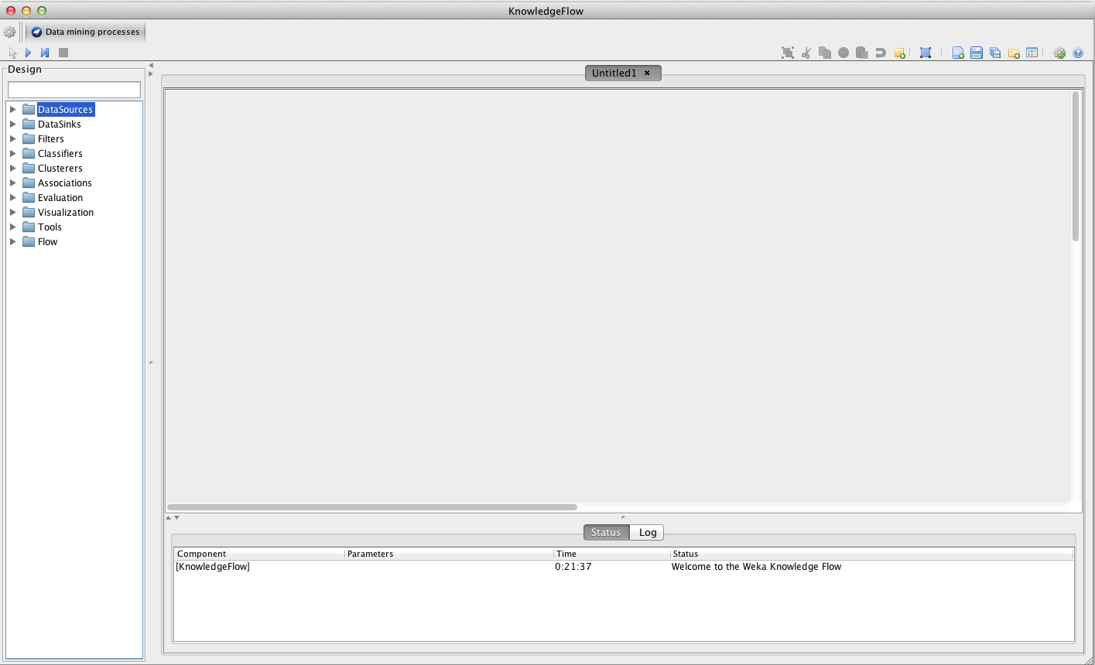
Getting Started

Slide 45
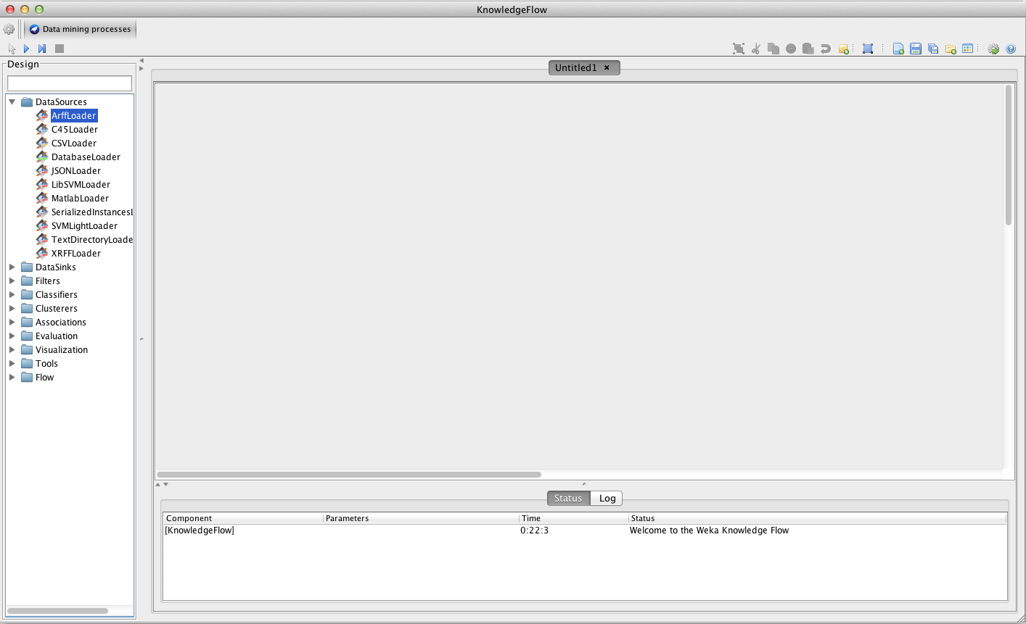

Slide 46
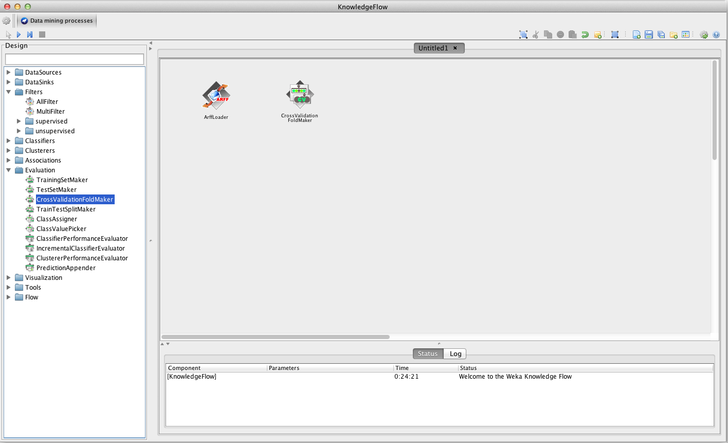
A few ‘hidden’ steps…

Slide 47
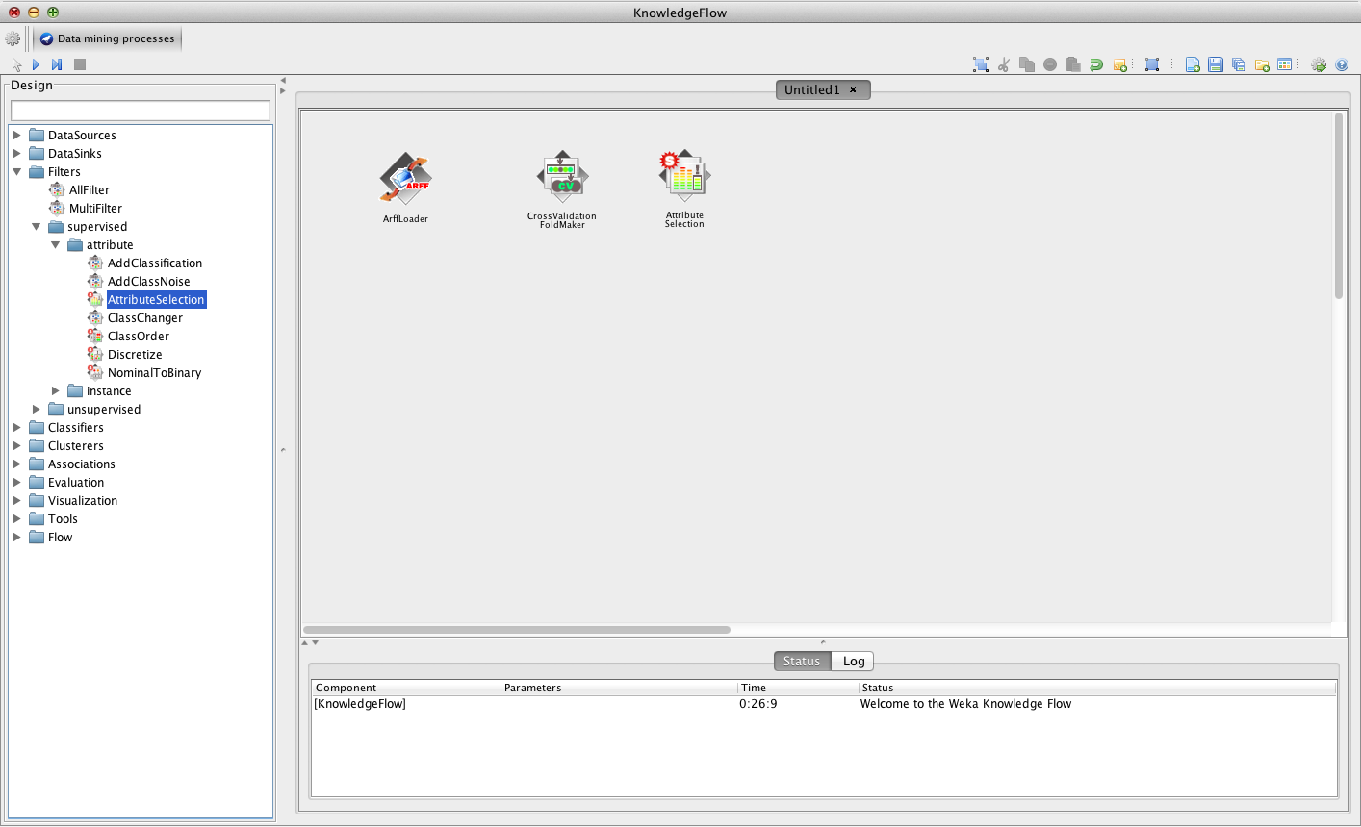

Slide 48
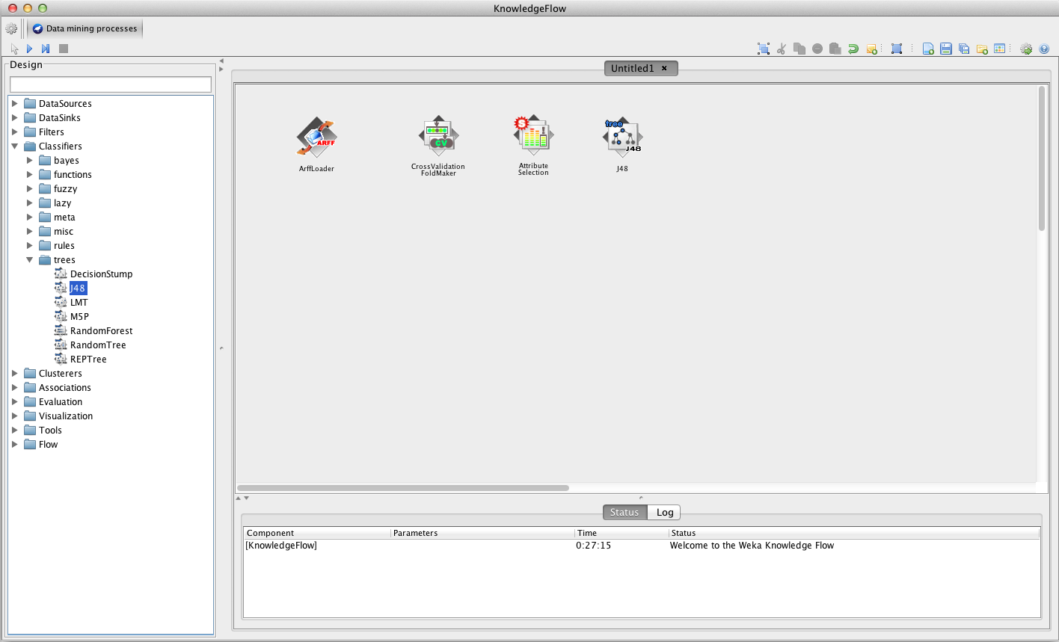
Add the Classifier learner

Slide 49
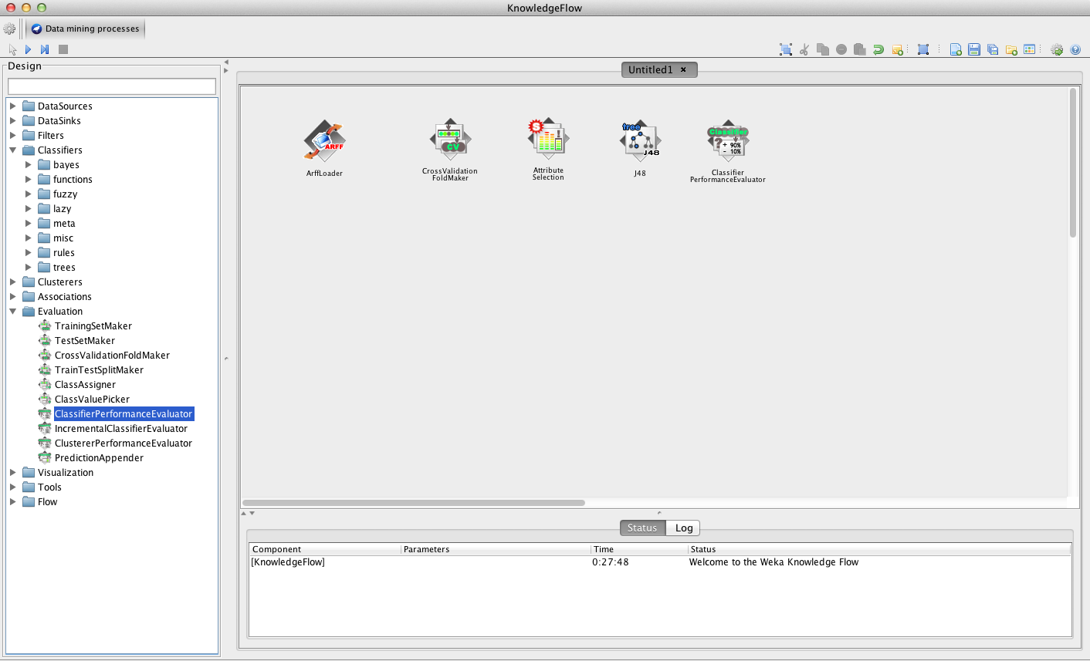
…and the performance evaluator

Slide 50
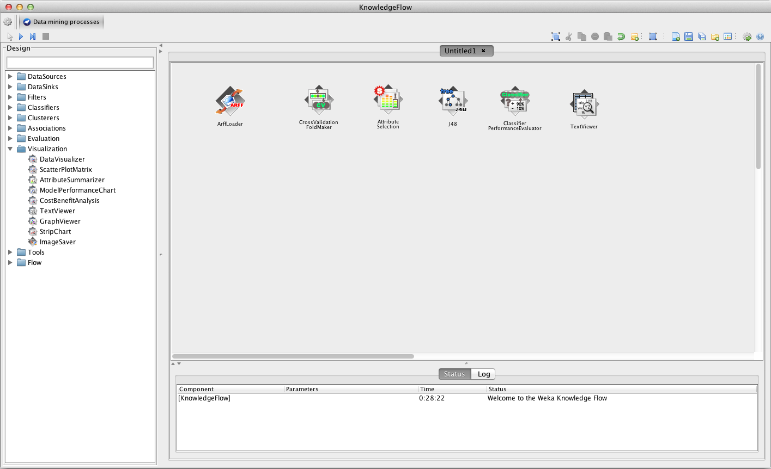
TextViewers can be used for visualisation of results as well as examining the processes – more later…

Slide 51
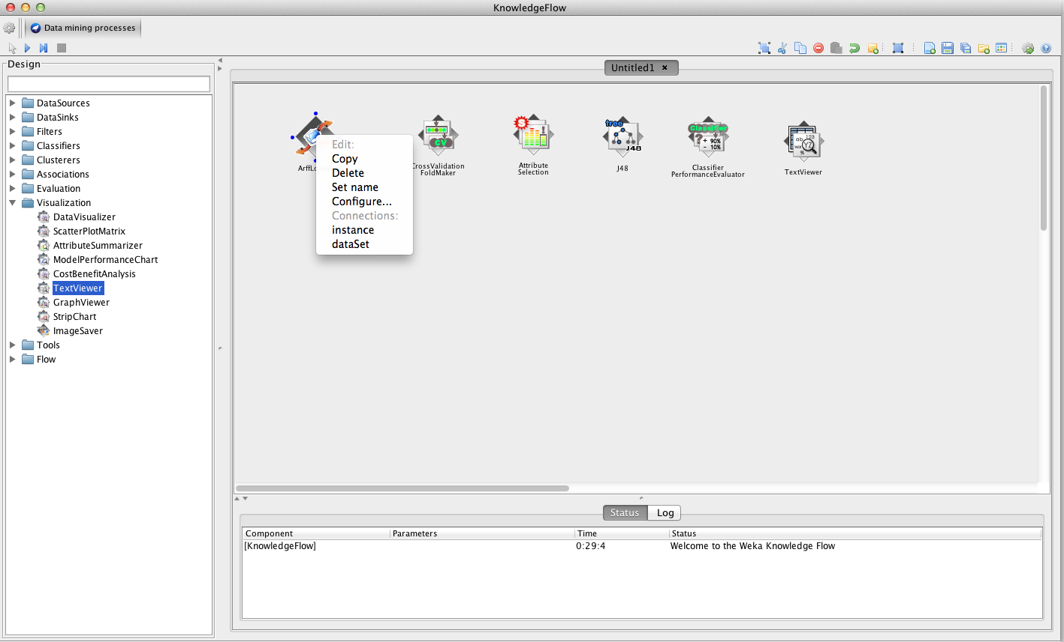
‘Right-clicking’ on each ‘block’ allows you to configure it as well as ‘wire-up’ to others…

Slide 52
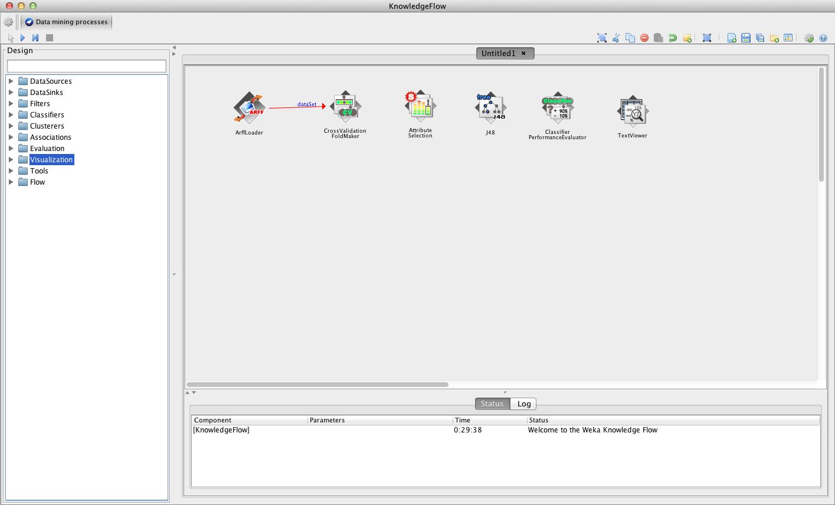
Connect: dataSet to CrossValidationFoldMaker

Slide 53
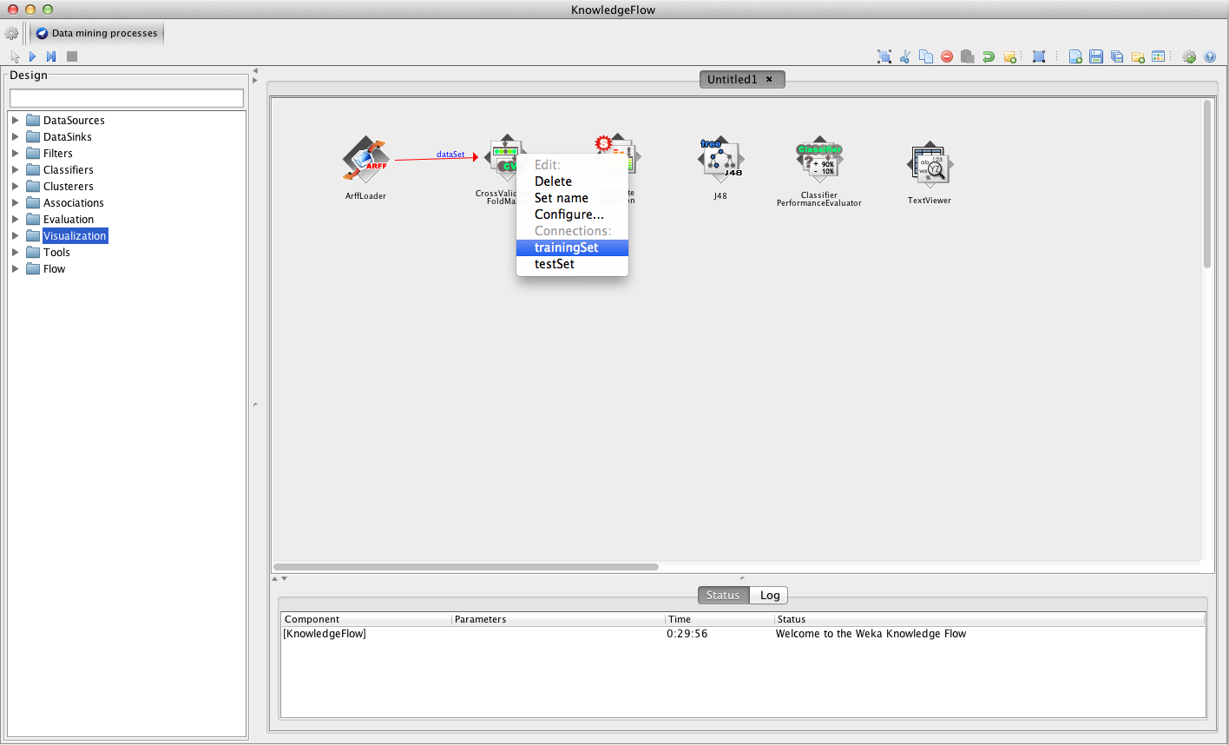
Continue to ‘wire-up’ each ‘block’…

Slide 54
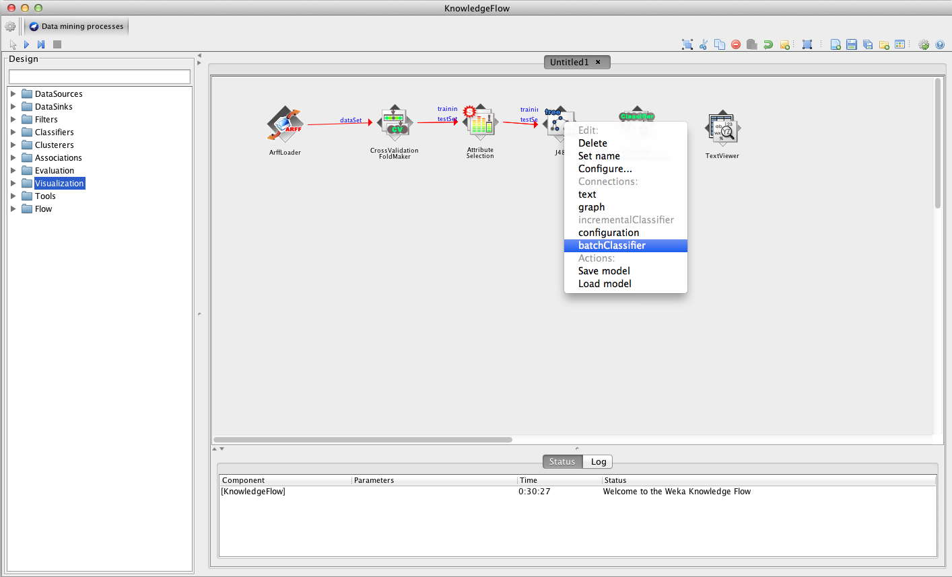
…and so on

Slide 55
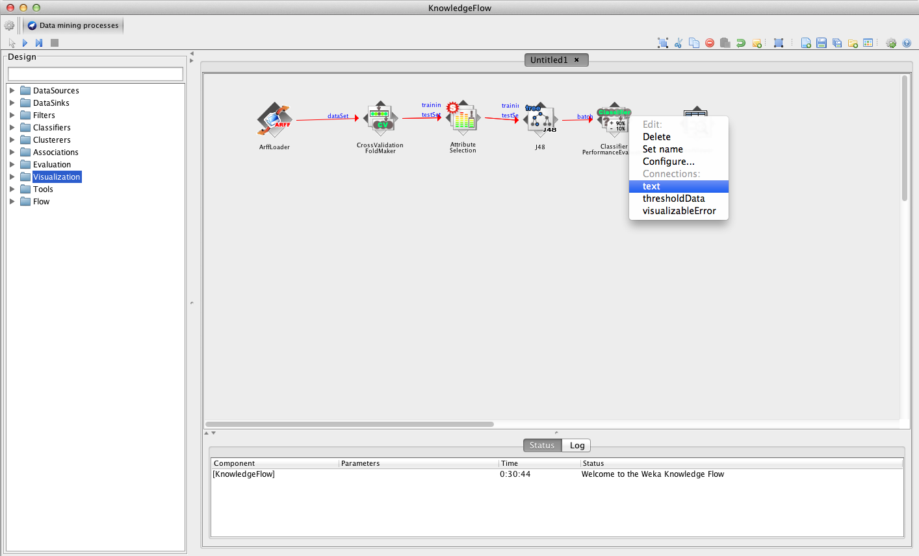
To see the results output: ‘dump’ the text to TextViewer…

Slide 56
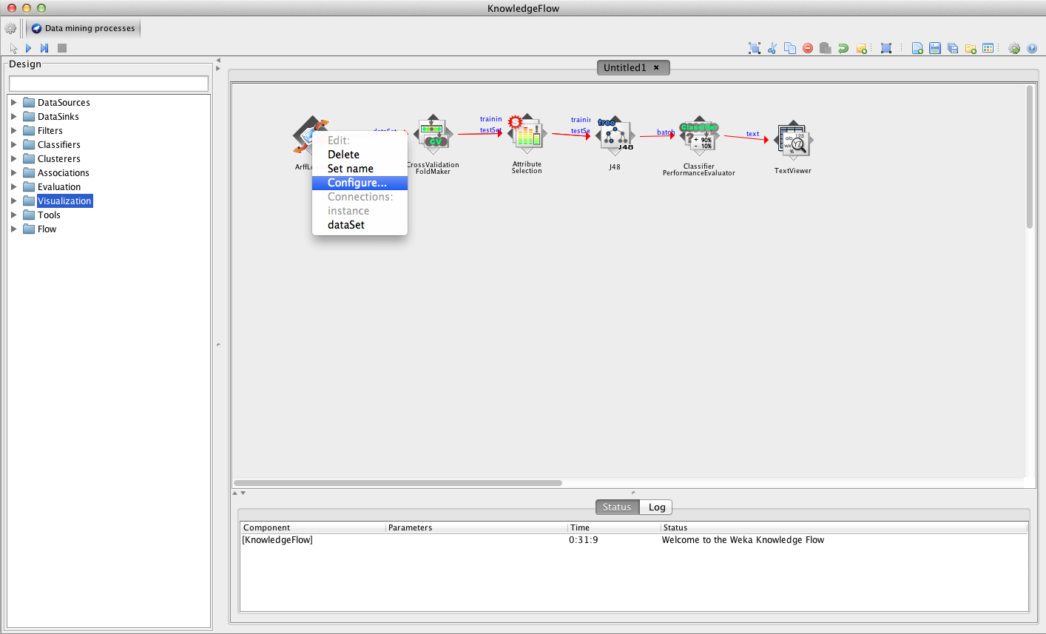
When you have finished ‘wiring-up’, it’s time to configure each of the components/blocks…

Slide 57
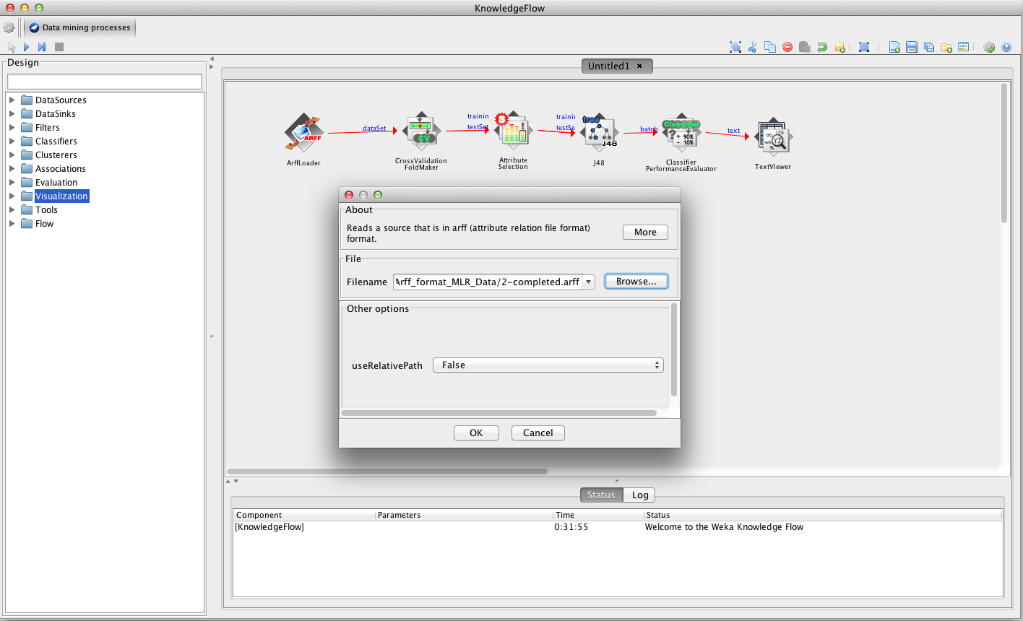
Set the path/filename(s) of the datasets you would like to load…

Slide 58
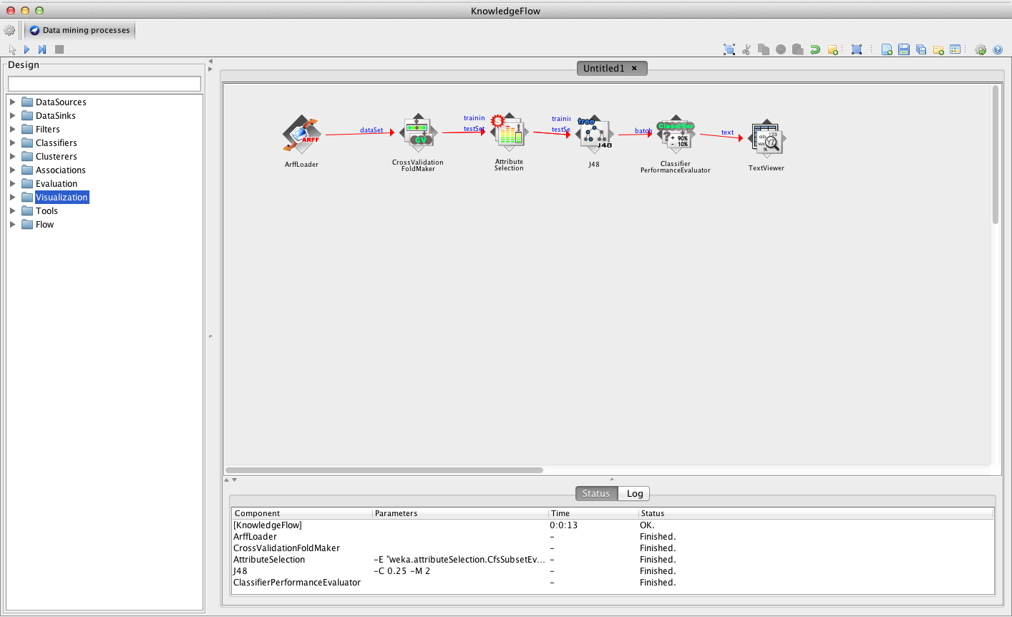
Once all is configured, you are ready to start…

Slide 59
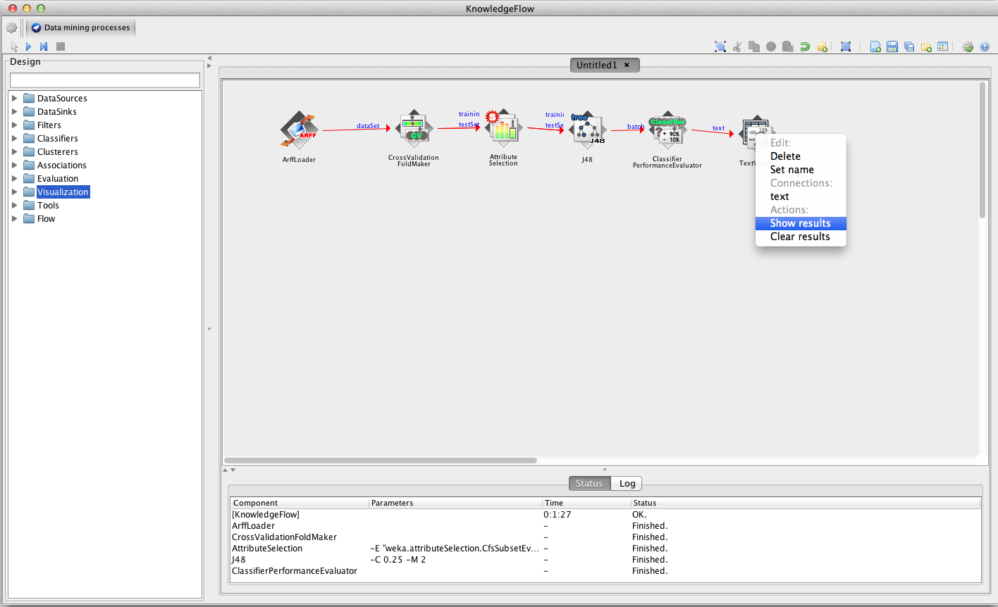
Once all experiments have finished, we can visualize the results…

Slide 60
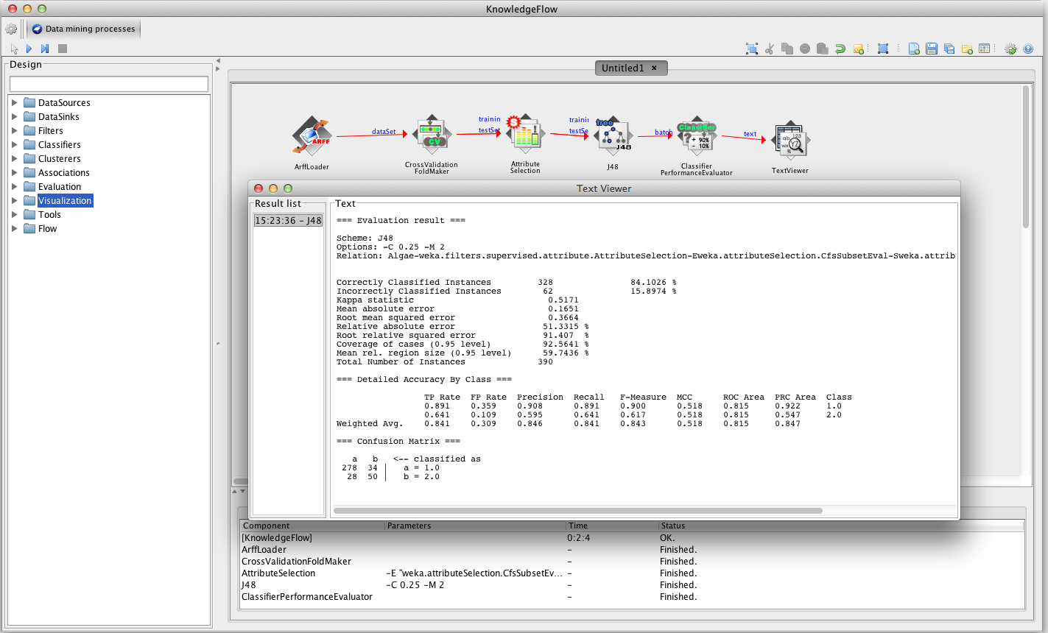
Output is similar to that of console window of Explorer

Slide 61
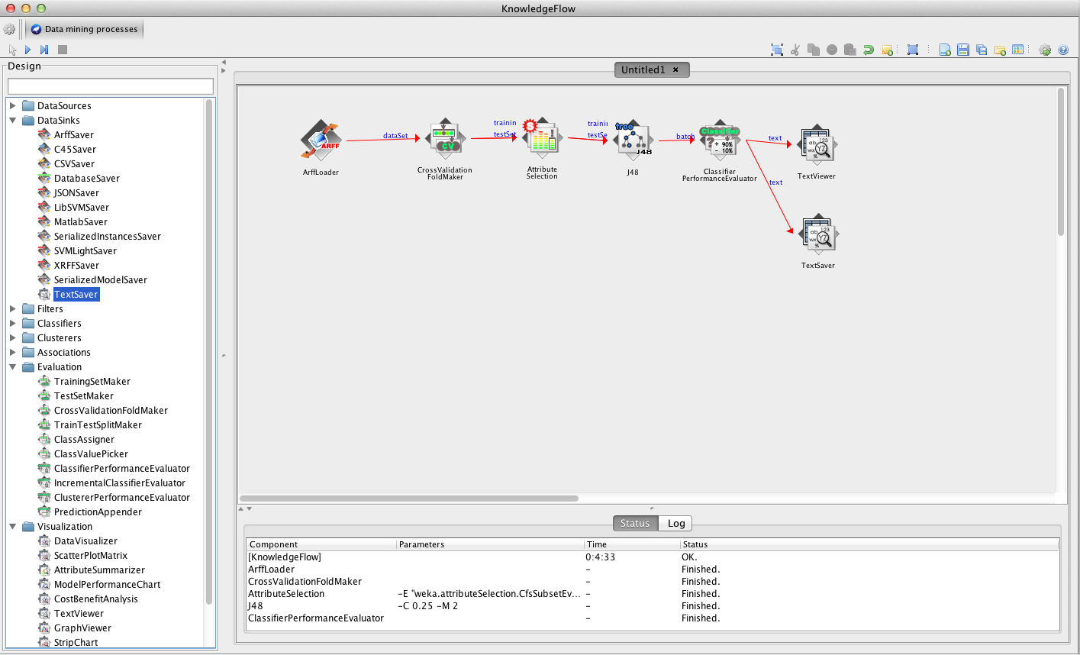
But there are also ways save these results if we want to keep them for later…

Slide 62
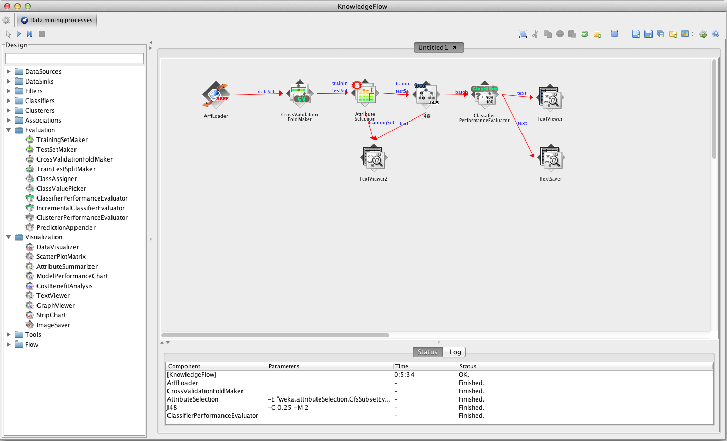
TextViewer components are also useful for ‘looking-inside’ processes…

Slide 63
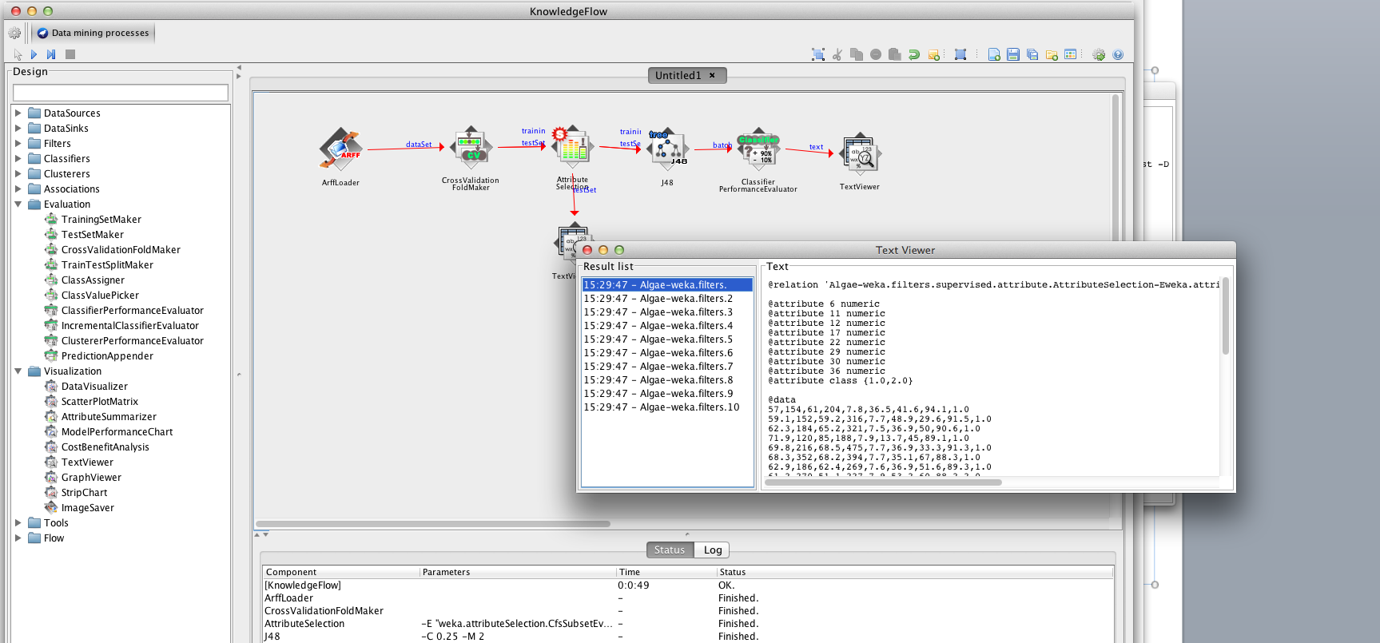
For example: attribute selection….

Slide 64
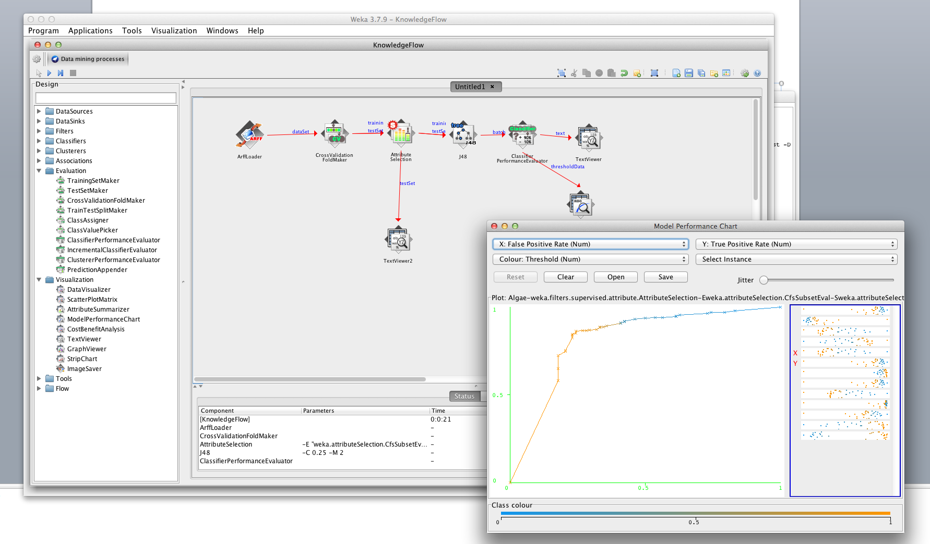
It is also possible to visualize data in a similar way to Explorer…e.g. ROC/threshold curves

Slide 65
Area under the ROC Curve
True positive rate = tp/(tp+fn) = recall = sensitivity
False positive rate = fp/(tn+fp).
An ROC curve demonstrates several things:
The closer the curve follows the left-hand border and then the top border of the ROC space, the more accurate the test.
The closer the curve comes to the 45-degree diagonal of the ROC space, the less accurate the test.

Slide 66
Q: Lets generate a ROC Curve
Use the weather data arff file and generate ROC curve. Follow the following KnowledgeFlow

Slide 67
Exercise: How to generate multiple ROC curves?
Use the weather data arff file and generate multiple ROC curves in a single chart (pick 3 classifiers)
Remember to add following into your KnowledgeFlow
ClassValuePicker between ClassAssigner and CrossValidationFoldMaker
Add ModelPerformanceChart from Visualization
To save your ROC curve
Shift + Alt + Left Click

Slide 68
Write your own algorithms…
WEKA is Open Source!
Much of the work is already done for you
Take advantage of the WEKA framework
Writing code and contributing to the WEKA project now easier than before see:
http://weka.wikispaces.com/How+can+I+contribute+to+WEKA%3F

Slide 69
Conclusion
Explorer and Knowledge Flow:
Offer useful and flexible ways to perform a range of batches of experiments
Beware of the way in which results are generated!
KF is particularly useful for visualization
Just a snapshot of capabilities of WEKA!

